Slide 1

IBM Applied Data Science Capstone Project
Evaluating Restaurant Locations in Toronto
By Using Major Crime Indicators (MCI)
Richard Xue, MBA, MS
April 2, 2020

Slide 2
Introduction/Business Problem
This project uses Toronto Major Crime Indicators (MCI) data to identify neighborhoods in Toronto that may be good locations to build new restaurants.
Demand for new restaurants with more menu options is growing in Toronto. Healthy restaurants are emerging to attempt to meet the demand for meatless cuisine, vegetarian or vegan tasting menus.1
Selecting new venue locations is always a challenge for restaurants owners and investors. Few factors such as health-conscious and safe neighborhoods need to be carefully considered before making the final decision of new venue locations.
This project explores data insights specifically to identify restaurant locations in safe neighborhoods in Toronto that may be under-served by current venues. Detail data analysis is performed to explain the factors that lead to such data insights on selecting of new restaurant locations.

Slide 3
Audience & Stakeholders
The audience for this project is restaurants owners, investors and anyone servicing the fast-food and sit-in food segments. These stakeholders have a vested interest in responding to market demand by making investment and operations decisions based on data insights. This project explores some of those data insights and provides guidance specific to venue location.

Slide 4
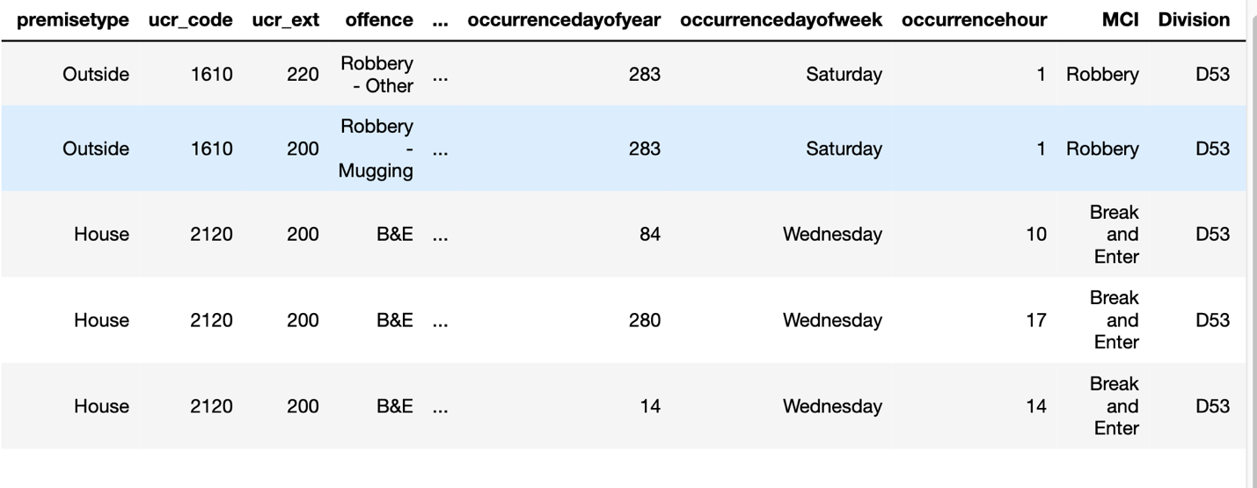
Data
Data Sources
1. Major Crime Indicators (MCI)
Toronto Policy Service website
Download MCI data as CSV file

Slide 5
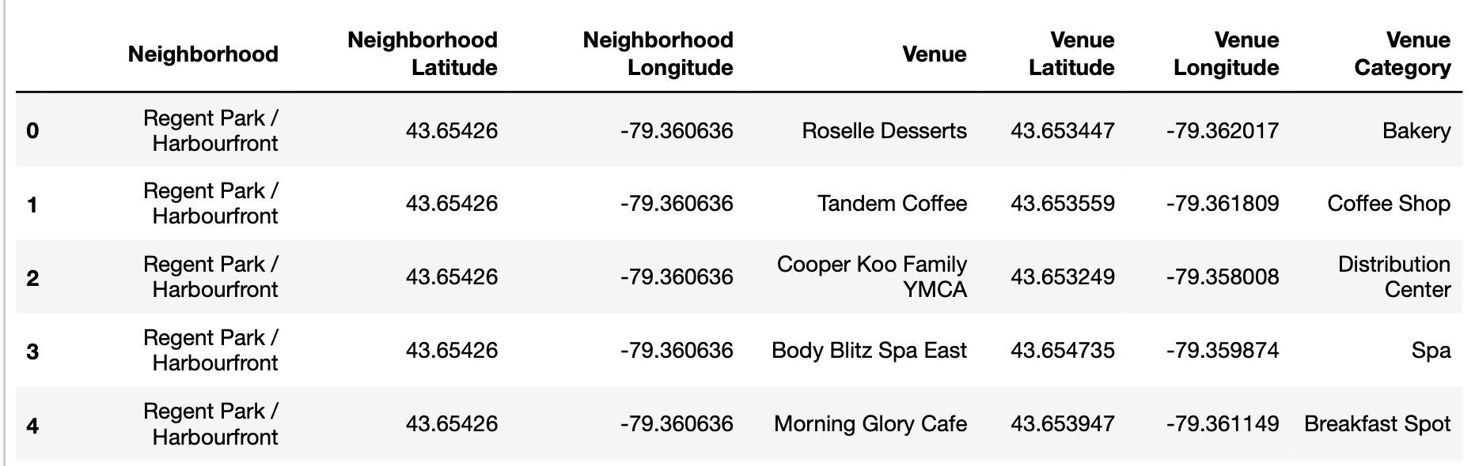
Data
Data Sources
2. Foursquare Venue Data
Foursquare provides useful venues data.
Get Venues via Foursquare REST GET API

Slide 6
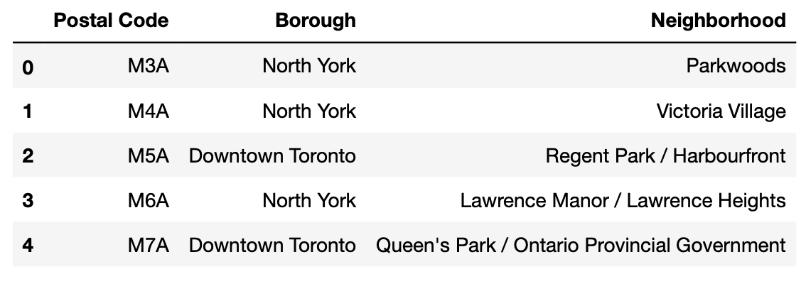
Data
Data Sources
3. Neighborhood Geocodes Data
Wiki webpage contains Neighborhood Geocodes data
Use Python BeautifulSoup package to get Postal Code, Borough, and Neighborhood information.

Slide 7

Data Gathering & Cleansing
Load Toronto MCI data from Toronto Policy Service
Retrieve Foursquare Food Venues Data
Load Neighborhood Geocodes

Slide 8
Data Feature Selections
1. MCI Data
Neighborhood Name
MCI indicator
2. Foursquare Venues Data
Neighborhood Name
Category

Slide 9
Methodology
Data Preparation
Data Exploration
Data Categorization
Clustering of Neighborhoods
Choropleth Crime Neighborhood Map
Choropleth Venue Neighborhood Map
Data Comparison
Examine the Clusters

Slide 10
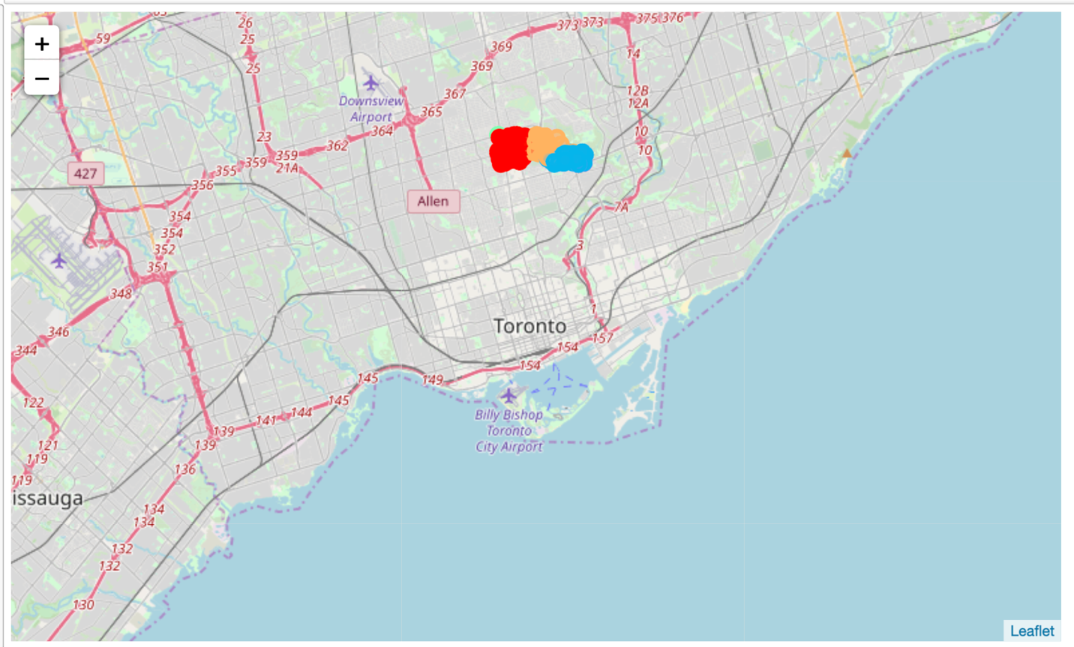
Results
Choropleth Crime Neighborhood Map
Three top clusters highlighted in red, orange and blue are located outside of the downtown area of Toronto.
The downtown area of Toronto are relative safer comparing to these three clusters.

Slide 11
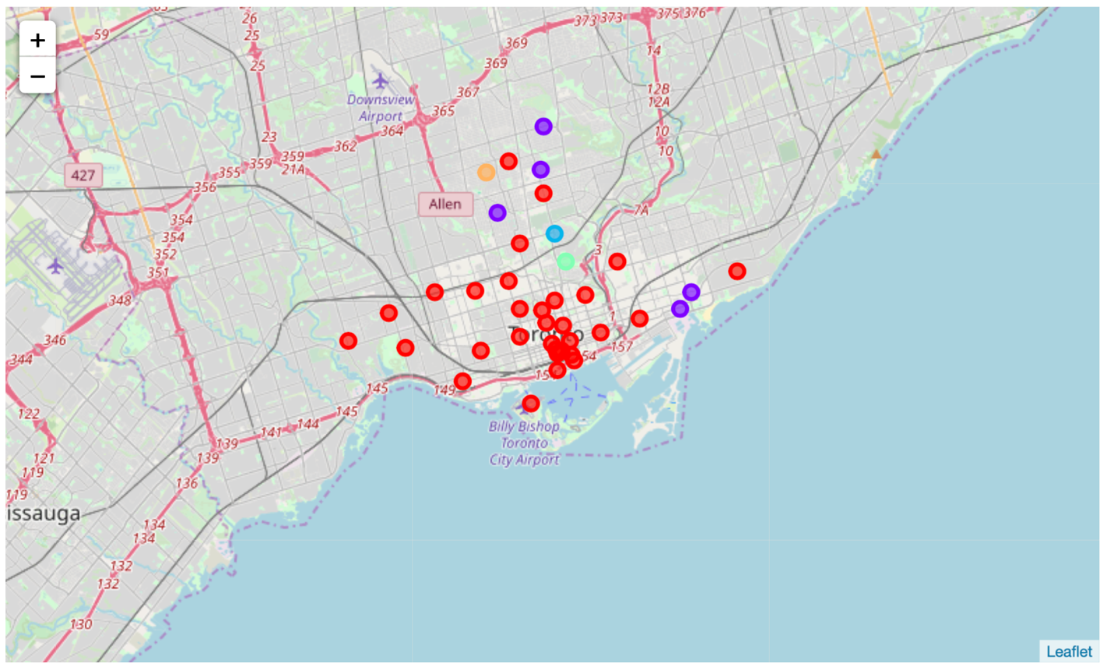
Results
Choropleth Venue Neighborhood Map
Top venue cluster is highlighted in red which is the downtown area of Toronto.
Many restaurants locate in the downtown area of Toronto.

Slide 12
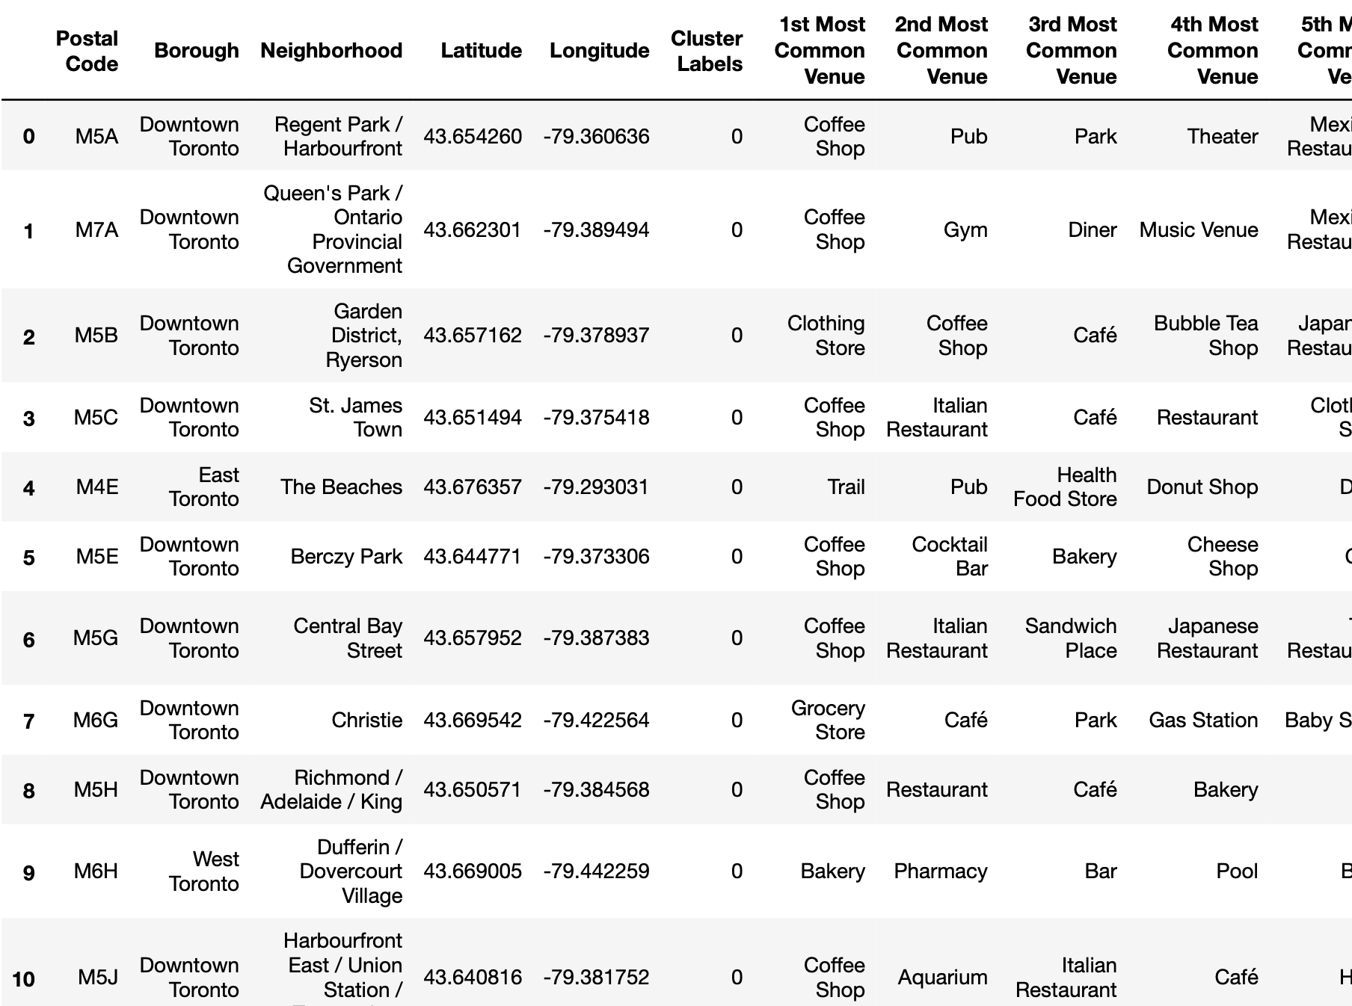
Results
Common Venues of Top Venue Cluster
Most common venues in top venue cluster include: Coffee Shop, Pub, Italian Restaurant, Mexico Restaurant, Japanese Restaurant, etc..

Slide 13
Results
Comparison of Choropleth Crime and Venue Neighborhood Maps
Downtown Neighborhoods:
Have higher business density
Have many existing restaurant venues
Attract many consumers to dine in or have a drink
Have much lower crimes reported in the past five years (2014 – 2019)
MCI indicator is another key factor to seek venue locations for new businesses

Slide 14
Discussion
Although, number of venues and safety are among the key reasons for restaurant owner and investors to consider when they select a location to open a restaurant. There are other factors we may want to consider in our data analytic and model methodology.
For example, should we consider Neighborhood Venue Average Health Ratings (VAHR) when selecting a location beside the safety reason?
Should we consider the existing competitors with the same food type?
Population to Venue Ration, Population Density and Population Growth Rate may also be good indicators for restaurant owners or investors to look at details on the restaurant, fast-food, or dine-in food market opportunities.

Slide 15
Recommendations
The in-depth data analysis and machine learning of this project provide several decision factors and the insights gained by the data analysis, visualizations and machine learning.
These factors and insights together highlight a framework in considering locations for restaurant owners, investors and stakeholders seeking to open new venues in neighborhoods of Toronto.
The data analyses, visualizations, and machine learning in this project suggest how the MCI data and venue data can be considered as part of a decision framework for locating new venues.
One key contribution is the data comparison of Toronto crime data with venue data.

Slide 16
Conclusion
This project explores data from various data sources, composites data, and create Choropleth maps for neighborhood venues and crime data.
The data analysis, visualization of choropleth maps along with insights contribute to the identification of restaurant locations in safe neighborhoods in Toronto.
These data analysis and insights may be useful for restaurant owners, investor and stakeholders as considering factors for new restaurant locations.
These data analysis, insights and factors could also be applied for evaluating existing venues to rebrand or renovate their venues with respect to neighborhood food category.

Slide 17
Q & A
Questions?

