Slide 1
Android Audio System Introduction

Slide 2
Outline
Background
Android Audio System
Audio Framework
Audio HAL

Slide 3
Background

Slide 4

Background
Information about this slide
  Software
    Android 4.0/4.2
Notes:
以前 Mint 有報告過
只講有改到的地方
不講 code，只分享概念

Slide 5
Android Audio System

Slide 6

Architecture Audio System
The complexity of android audio system
  Soft real-time requirement
  Large number of usage scenarios
    Software
      phone/media player/…
      different volume setting/…
    Hardware
      earpiece/speaker/hdmi/…
      mic/bluetooth/…
  Flexibility design
    good design pattern
    performance (Java/JNI/binder/…)
Notes:
有些能關有些不能關
有新裝置時聲音要轉移
同一個東西在不同地方有不同名稱
裝置有 FM
7.1 聲道

Slide 7
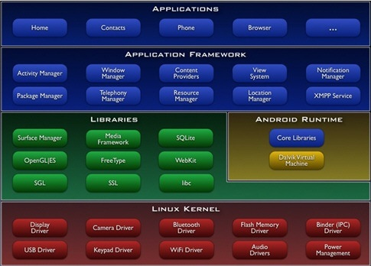
Architecture Audio System
Java App
Android Framework
Audio HAL
Linux Driver

Slide 8

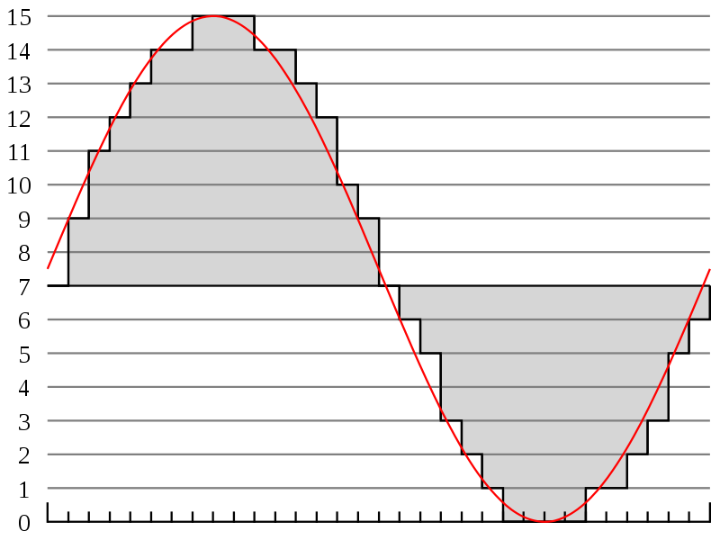
Android Audio System
app
pcm data
data flow
Audio Policy
Audio Flinger
AudioTrack/AudioRecord/…
(AudioPolicy/AudioFlinger/…)
control flow
Audio HAL
(open/read/write/…)
Audio Driver

Slide 9
Audio Framework

Slide 10
Audio Framework
Network Packet Routing
sender 1
router
receiver 1
sender 2
Routing path
receiver 2
sender 3
receiver 3
sender 4

Slide 11
Audio Framework
Audio Routing (play audio)
AudioTrack 1
Audio Policy
Hardware 1
AudioTrack 2
Audio Flinger
Hardware 2
AudioTrack 3
Hardware 3
AudioTrack 4
Java App
Audio Framework
Audio HAL
Notes:
只講 play 部份，record 反之亦然
有其他諸如 Audio System 之類的裝置管理沒講

Slide 12
Audio Policy
Decide which thread in AudioFlinger should sound be attached.
  stream → strategy → output
    stream : VOICE_CALL, TTS, MUSIC, …
    strategy : PHONE, MUSIC, …
    output : a thread in AudioFlinger
  strategy : bridge between software data stream and hardware

Slide 13
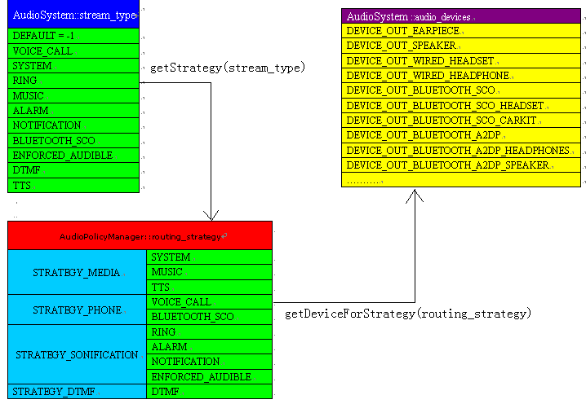
Audio Policy

Slide 14
Audio Policy
IOProfile (audio_policy.conf)
  Content
    Define all the possible I/O devices
    Define default I/O device
  Hierarchical structure
    hardware module
    profile
      sampling_rates/channels/formats/devices/flags
  With IOProfile, audio policy gets better OO structure.

Slide 15
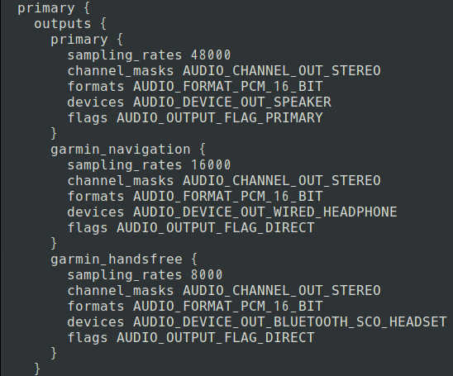
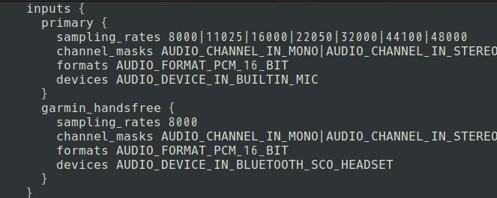
Audio Policy

Slide 16

Audio Flinger
Several thread to read/write data
  Create thread by AudioPolicy
    mixer thread
    duplicating thread
    direct output thread
  Resampler
  Non-blocking audio I/O
  AudioWatchdog
Notes:
4.0 -> 4.2 自 7xxx ~ 9xxx (Leo 3926)
相關的自 14xxx ~ 20xxx
TODO : 5 ~ 9
FIXME : 4 ~ 28

Slide 17
Audio HAL

Slide 18
Audio HAL
app
AudioTrack/AudioRecord/…
(AudioPolicy/AudioFlinger/…)
Audio HAL
(open/read/write/…)
Audio Driver
Platform Group
Notes:
1. The original version is provided from
SoC vendor.
2. Dynamic library linked by
AudioFlinger.

Slide 19
Audio HAL
ALSA (Advanced Linux Sound Architecture)
  unified interface/SMP/thread-safe/…
  usespace library
    alsa-lib
    tinyalsa
  tinyplay/tinycap/ tinymix
Audio HAL interface
  volume setting
  I/O function
  …
Notes:
Why use Tinyalsa
We can use ALSA-lib substitute for Tinyalsacompletely, but we can’t use Tinyalsa substitute for ALSA-lib completely. But,in some times, Tinyalsa can substitute for ALSA-lib to work for some basicfunction.
The only reason is that it is smaller and simpler than ALSA-lib.
Google Android supplies the Tinyalsa.
Audio HAL interface forms changed in Android 4.0.

