Slide 1

Linux Sound Drivers Framework
Barry Song(宋宝华)
June 19, 2009

Slide 2
Contents
OSS Framework and Dataflow
ALSA Framework and Dataflow
ASoC (ALSA on SoC) Framework and SoC Core
AD1938 ASoC Drivers

Slide 3
OSS Framework
Two char devices: dsp and mixer
OSS
dsp
mixer
file_operations
file_operations
write
read
ioctl
ioctl
Start-up
Wake-up
SOUND_MIXER_VOLUME
DMA transmit
SOUND_MIXER_MIC
…
DMA interrupt

Slide 4
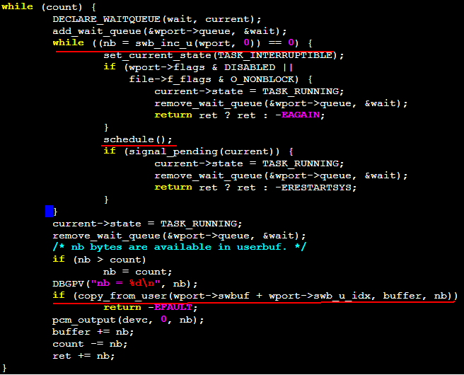
Typical OSS Read/Write Flow
Wake-up
Audio interrupt

Slide 5
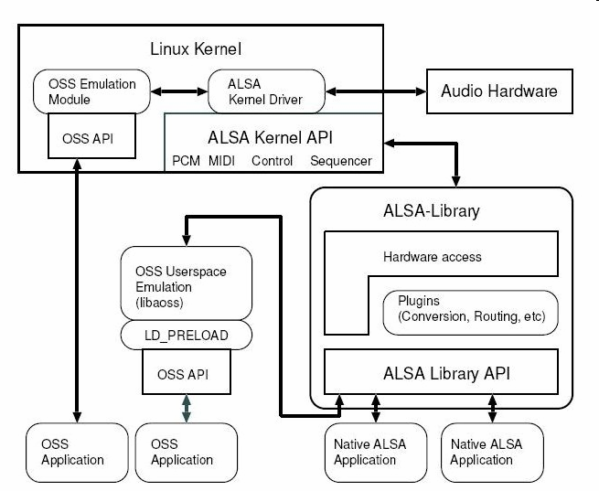
ALSA Framework

Slide 6
ALSA Dataflow
snd_pcm_ops functions
static struct snd_pcm_ops snd_ad1938_playback_ops = {
.open = snd_ad1938_playback_open,
.close = snd_ad1938_playback_close,
.ioctl = snd_pcm_lib_ioctl,
.hw_params = snd_ad1938_hw_params,
.hw_free = snd_ad1938_hw_free,
.prepare = snd_ad1938_playback_prepare,
.trigger = snd_ad1938_playback_trigger,
.pointer = snd_ad1938_playback_pointer,
.copy = snd_ad1938_playback_copy,
.silence = snd_ad1938_playback_silence,
};
Not like OSS, ALSA sound core will manage flow control with the help of low level driver callbacks.
sound core
return frames
START/STOP..
trigger
pointer
snd_pcm_period_elapsed
DMA transmit
DMA interrupt

Slide 7
ASoC: ALSA on SoC
ASoC splits an embedded audio system into 3 components :-
* Codec driver: The codec driver is platform independent and contains audio
controls, audio interface capabilities, codec DAPM definition and codec IO
functions.
* Platform driver: The platform driver contains the audio DMA engine and audio interface drivers (e.g. I2S, AC97, PCM) for that platform.
* Machine driver: The machine driver handles any machine specific controls and audio events (e.g. turning on an amp at start of playback).
SoC Core:
Traditional ALSA Driver
machine
platform
Codec

Slide 8
Typical SoC Core Methods
Call corresponding functions of every spitted component
  static int soc_pcm_prepare(struct snd_pcm_substream *substream)
  {
  if (machine->ops && machine->ops->prepare) {
  ret = machine->ops->prepare(substream);
  }
  if (platform->pcm_ops->prepare) {
  ret = platform->pcm_ops->prepare(substream);
  }
  if (codec_dai->ops->prepare) {
  ret = codec_dai->ops->prepare(substream, codec_dai);
  }
  if (cpu_dai->ops->prepare) {
  ret = cpu_dai->ops->prepare(substream, cpu_dai);
  }
  ...
  }
Except that, maintain issues like dynamic power management , pops elimination and so on with the help of low level driver callbacks.

Slide 9
AD1938 with ASoC
AD1938 codec driver:
sound/soc/codecs/ad1938.h
sound/soc/codecs/ad1938.c
TDM DAI driver:
sound/soc/blackfin/bf5xx-tdm.h
sound/soc/blackfin/bf5xx-tdm.c
TDM PCM (DMA) driver:
sound/soc/blackfin/bf5xx-tdm-pcm.h
sound/soc/blackfin/bf5xx-tdm-pcm.c
SPORT interface driver:
sound/soc/blackfin/bf5xx-sport.h
sound/soc/blackfin/bf5xx-sport.c
Machine (Board) driver:
sound/soc/blackfin/bf5xx-ad1938.c
SPI board info:
Add related information to arch/blackfin/mach-xxx/boards/xxx.c
Codec
Platform
Board

Slide 10
Thank You!

