Slide 1
Chapter 1
Computer Abstractions and Technology
Notes:
Morgan Kaufmann Publishers
Chapter 1 — Computer Abstractions and Technology

Slide 2
Computer Organization
Instructor: Dr. Vasil Y. Hnatyshin
Contact Info: Department of Computer Science,
3rd floor, Robinson Building
Email: hnatyshin@rowan.edu
Phone: (856) 256-4758
Office Hours: By appointment
Meeting Time: Mon/Wed 2:00 pm – 3:15 pm
Location: Robinson 121
Required Book: “Computer Organization and Design: the Hardware/Software Interface”
by D.A. Patterson and J.L. Hennessy
Chapter 1 — Computer Abstractions and Technology — <number>

Slide 3
Computer Organization
What will we cover in this class:
  Machine language, compilers and architecture
  Computer Performance
  Memory System
  I/O system
What will you learn in other classes:
  Algorithm Efficiency in DSA and DAA
  Processor and Circuit Design in Digital Design
Component | Affects on performance | Where do we learn about it
Algorithm | Determines the efficiency of the program | Other classes
Programming language, compiler, architecture | Determines the number of instructions used to implement the program | Chapters 2 – 3
Processor and memory | Determines how fast instructions are executed | Chapter 4,5, and 7 and other classes
I/O systems | Determines how fast I/O instructions are executed | Chapter 6
Chapter 1 — Computer Abstractions and Technology — <number>

Slide 4
The Computer Revolution
§1.1 Introduction
Progress in computer technology
  Underpinned by Moore’s Law (more of an observation)
  Processor speeds, or overall processing power for computers will double every two years
Makes novel applications feasible
  Computers in automobiles
  Cell phones
  Human genome project
  World Wide Web
  Search Engines
Computers are pervasive
Chapter 1 — Computer Abstractions and Technology — <number>
Notes:
Morgan Kaufmann Publishers
Chapter 1 — Computer Abstractions and Technology

Slide 5
Classes of Computers
Personal computers
  General purpose, variety of software
  Subject to cost/performance tradeoff
Server computers
  Network based
  High capacity, performance, reliability
  Range from small servers to building sized
Chapter 1 — Computer Abstractions and Technology — <number>
Notes:
Morgan Kaufmann Publishers
Chapter 1 — Computer Abstractions and Technology

Slide 6
Classes of Computers
Supercomputers
  High-end scientific and engineering calculations
  Highest capability but represent a small fraction of the overall computer market
Embedded computers
  Hidden as components of systems
  Stringent power/performance/cost constraints
Chapter 1 — Computer Abstractions and Technology — <number>

Slide 7
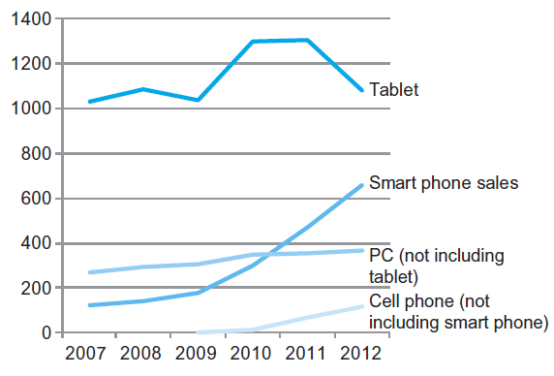
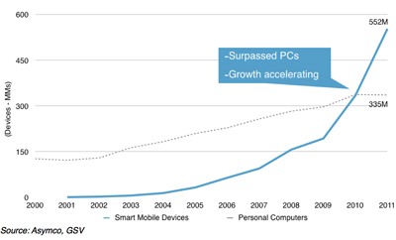
The PostPC Era
The number manufactured per year of tablets and smart phones, which reflect the PostPC era, versus personal computers and traditional cell phones
http://gsvcap.com/social-media/social-darwinism/
Smart phones represent the recent growth in the cell phone industry, and they passed PCs in 2011. Tablets are the fastest growing category, nearly doubling between 2011 and 2012. Recent PCs and traditional cell phone categories are relatively flat or declining.
Chapter 1 — Computer Abstractions and Technology — <number>
Notes:
Morgan Kaufmann Publishers
Chapter 1 — Computer Abstractions and Technology

Slide 8
The PostPC Era
Personal Mobile Device (PMD)
  Battery operated
  Connects to the Internet
  Hundreds of dollars
  Smart phones, tablets, electronic glasses
Cloud computing
  Warehouse Scale Computers (WSC)
  Software as a Service (SaaS)
  Portion of software run on a PMD and a portion run in the Cloud
  Amazon and Google
Chapter 1 — Computer Abstractions and Technology — <number>

Slide 9
What You Will Learn
How programs are translated into the machine language
  And how the hardware executes them
The hardware/software interface
What determines program performance
  And how it can be improved
How hardware designers improve performance
What is parallel processing
Chapter 1 — Computer Abstractions and Technology — <number>
Notes:
Morgan Kaufmann Publishers
Chapter 1 — Computer Abstractions and Technology

Slide 10
Understanding Performance
Algorithm
  Determines number of operations executed
Programming language, compiler, architecture
  Determine number of machine instructions executed per operation
Processor and memory system
  Determine how fast instructions are executed
I/O system (including OS)
  Determines how fast I/O operations are executed
Chapter 1 — Computer Abstractions and Technology — <number>
Notes:
Morgan Kaufmann Publishers
Chapter 1 — Computer Abstractions and Technology

Slide 11








Eight Great Ideas
Design for Moore’s Law
Use abstraction to simplify design
Make the common case fast
Performance via parallelism
Performance via pipelining
Performance via prediction
Hierarchy of memories
Dependability via redundancy
§1.2 Eight Great Ideas in Computer Architecture
Chapter 1 — Computer Abstractions and Technology — <number>

Slide 12

Below Your Program
All computer systems consist of hardware & software (programs)
Computers use programs which are set of instructions
Software is a collection of programs that tell the hardware what to do
§1.3 Below Your Program
Application software
  Written in high-level language
System software
  Compiler: translates HLL code into machine code
  Operating System: service code
    Handling input/output
    Managing memory and storage
    Scheduling tasks & sharing resources
Hardware
  Processor, memory, I/O controllers
Chapter 1 — Computer Abstractions and Technology — <number>
Notes:
Morgan Kaufmann Publishers
Chapter 1 — Computer Abstractions and Technology

Slide 13
Application Software
Application software is the software that has made using computers indispensable and popular
Common application software
  Word processors
  Desktop publishing programs
  Spreadsheets
  Presentation managers
  Drawing programs
  Games

Slide 14
Operating System
Controls and manages the computing resources
Important services that an operating system provides
  File system
  Commands that allow for manipulation of the file system
  Ability to perform input and output on a variety of devices
  Management of the running systems
Examples
  MSDOS ®, Windows ®, Unix ®, Mac OS, Linux

Slide 15
Programming Languages
Machine Language
  “Native tongue” of the computer
  Binary 0s and 1s that specify what to do
      0010 0000 0000 0100
      1000 0000 0000 0101
      0011 0000 0000 0110
High - Level Languages
  Resemble human language (VB, C++, Java, VB.NET)
    cost = price + tax;
  Advantages of the high-level programming language
    More natural for programmers
    Can be designed for intended use (e.g. Fortran – scientific operation, List – symbol manipulation, Cobol – business, Java – web, C – system management, VB/C# – windows, Objective C – mobile platform)
    Increases Productivity
    Independent of computer

Slide 16

Levels of Program Code
High-level language
  Level of abstraction closer to problem domain
  Provides for productivity and portability
Assembly language
  Textual representation of instructions
Hardware representation
  Binary digits (bits)
  Encoded instructions and data
Chapter 1 — Computer Abstractions and Technology — <number>
Notes:
Morgan Kaufmann Publishers
Chapter 1 — Computer Abstractions and Technology

Slide 17
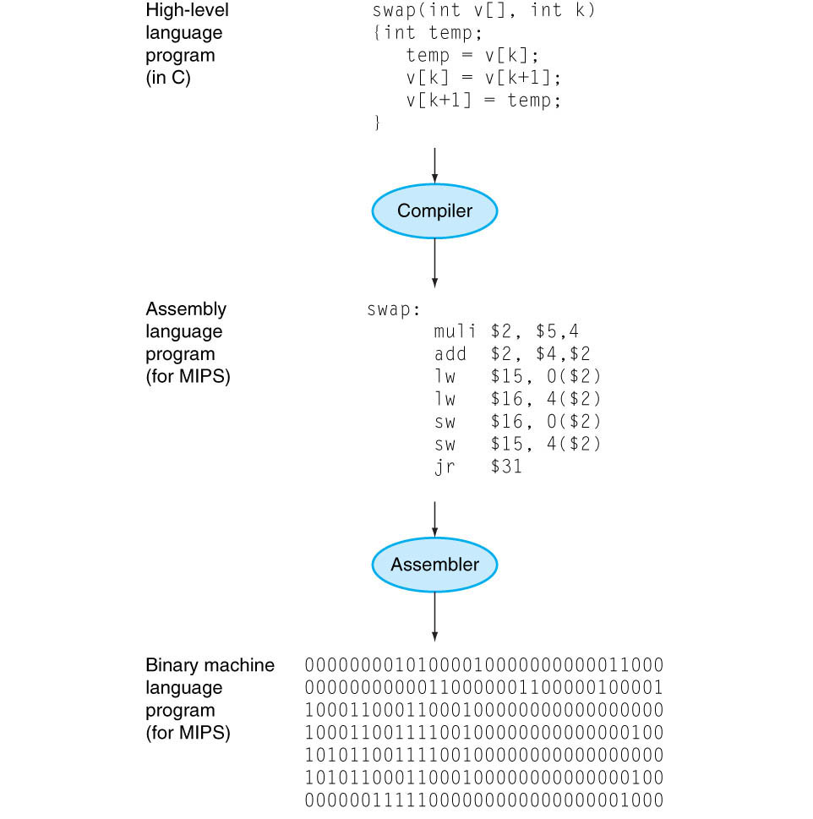
Program Compilation
C program compiled into assembly language and then assembled into binary machine language.
The translation from high-level language to binary machine language is shown in two steps.
Some compilers cut out the middleman and produce binary machine language directly.
These languages and this program are examined in more detail in Chapter 2.
Other questions
What does the linker do?
What is binary digit or bit?
Identify instructions in the picture?
What is the difference between assembly and machine languages?

Slide 18

Components of a Computer
Same components for
all kinds of computer
  Desktop, server,
  embedded
Input/output includes
  User-interface devices
    Display, keyboard, mouse
  Storage devices
    Hard disk, CD/DVD, flash
  Network adapters
    For communicating with other computers
§1.4 Under the Covers
The BIG Picture
Chapter 1 — Computer Abstractions and Technology — <number>
Notes:
Morgan Kaufmann Publishers
Chapter 1 — Computer Abstractions and Technology

Slide 19
Components of a Computer
The organization of a computer:
The processor gets instructions and data from memory.
Output writes data to memory, and Input reads data from memory.
Datapath is processor component that performs arithmetic operations.
Control sends the signals that determine the operations of the datapath, memory, input, and output.
The BIG Picture
Notes:
Morgan Kaufmann Publishers
Chapter 1 — Computer Abstractions and Technology

Slide 20

Touchscreen
PostPC device
Supersedes keyboard and mouse
Resistive and Capacitive types
  Resistive touchscreen work well with stylus or gloved finger and provide better accuracy
  Today, most tablets, smart phones use capacitive touchscreen
  Capacitive allows multiple touches simultaneously
Chapter 1 — Computer Abstractions and Technology — <number>
Notes:
Morgan Kaufmann Publishers
Chapter 1 — Computer Abstractions and Technology

Slide 21
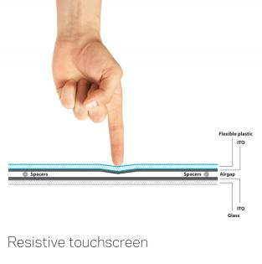
Touchscreen
Resistive touchscreen
  Displays are composed of multiple layers that are separated by thin spaces.
  Pressure applied to the surface of the display by a finger or stylus causes the layers to touch, which completes electrical circuits and tells the device where the user is touching.
Chapter 1 — Computer Abstractions and Technology — <number>
Notes:
Morgan Kaufmann Publishers
Chapter 1 — Computer Abstractions and Technology

Slide 22
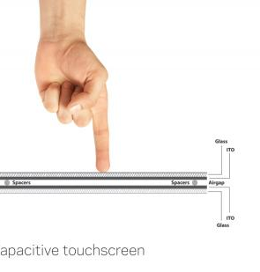
Touchscreen
Capacitive touchscreen
  Capacitive touchscreens distinguish and sense specific touch location based on the electrical impulses in a human body, typically the fingertip.
  This enables capacitive touchscreens to not require any actual force to be applied to the screen’s surface;
  At the same time, capacitive screens typically don't respond to styluses or gloved hands due to the lack of electrical impulses generated.
http://www.alphr.com/realworld/357325/capacitive-or-resistive-whats-the-best-type-of-touchscreen
Chapter 1 — Computer Abstractions and Technology — <number>
Notes:
Morgan Kaufmann Publishers
Chapter 1 — Computer Abstractions and Technology

Slide 23
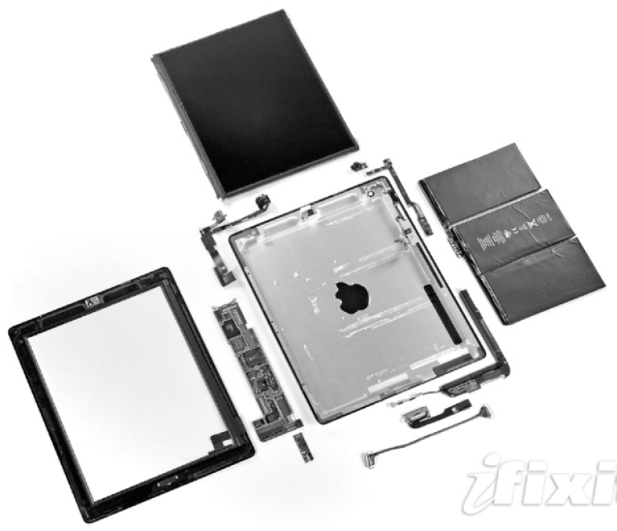
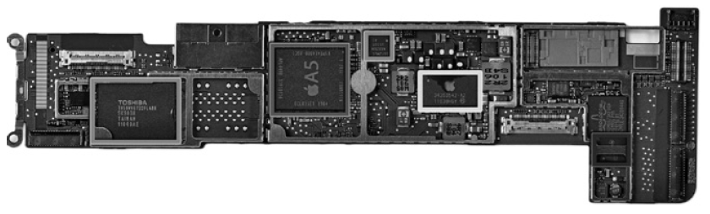
Opening the Box
Capacitive multitouch LCD screen
3.8 V, 25 Watt-hour battery
Computer board
Chapter 1 — Computer Abstractions and Technology — <number>
Notes:
Morgan Kaufmann Publishers
Chapter 1 — Computer Abstractions and Technology

Slide 24
Inside the Processor (CPU)
Datapath: performs operations on data
Control: sequences datapath, memory, ...
Cache memory
  Small fast SRAM memory for immediate access to data
Chapter 1 — Computer Abstractions and Technology — <number>
Notes:
Morgan Kaufmann Publishers
Chapter 1 — Computer Abstractions and Technology

Slide 25
Basic Computer Components
  Main Memory – is a storage area for instructions and data during program execution.
  Central Processor Unit (CPU) – is an active part of the computer that perform operations such as addition of numbers, testing of numbers, signaling different devices to activate, etc.
  CPU consists of datapath and control.
  Datapath – is CPU component that performs arithmetic operations
  Control – is CPU component that commands the datapath, memory, and I/O devices according to the program’s instructions.

Slide 26
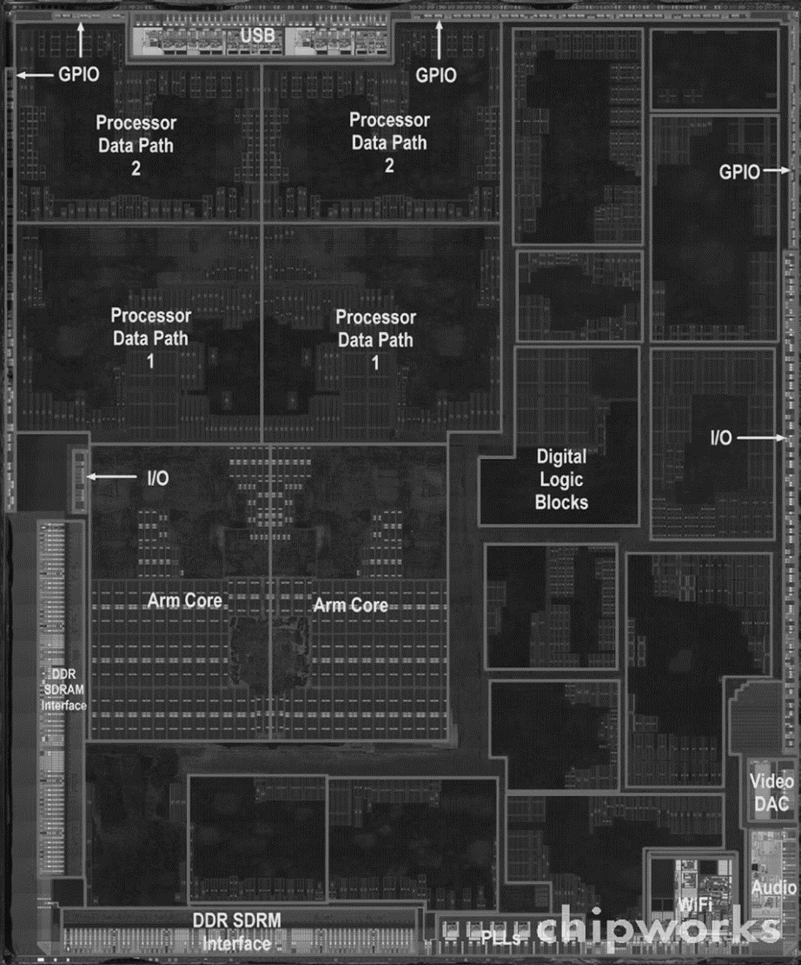
Inside the Processor
Apple A5
Chapter 1 — Computer Abstractions and Technology — <number>
Notes:
Morgan Kaufmann Publishers
Chapter 1 — Computer Abstractions and Technology

Slide 27
Abstractions
The BIG Picture
Abstraction helps us deal with complexity
  Hide lower-level detail
Instruction set architecture (ISA)
  The hardware/software interface
Application binary interface
  The ISA plus system software interface
Implementation
  The details underlying and interface
Chapter 1 — Computer Abstractions and Technology — <number>
Notes:
Morgan Kaufmann Publishers
Chapter 1 — Computer Abstractions and Technology

Slide 28
Instruction Set Architecture
Abstraction is a technique that temporarily hides some of the lower-level details to facilitate design of complex computer systems.
Instruction set architecture or simply architecture is an abstraction that represents the interface between the hardware and the lowest-level software.
The instruction set architecture includes all information the required to write machine language programs correctly:
  Instructions
  Registers
  Memory Access
  I/O, etc.

Slide 29
Instruction Set Architecture
Operating system usually include information about I/O, allocating memory and other low-level functions.
The combination of the basic instruction set and the operating systems interface provided for application programmers is called the application binary interface.
An instruction set, or instruction set architecture (ISA), is the part of the computer architecture related to programming, including
  the native data types,
  instructions,
  registers,
  addressing modes,
  memory architecture,
  interrupt and exception handling,
  and external I/O.
An ISA includes a specification of the set of opcodes, the native commands implemented by a particular processor.

Slide 30
Instruction Set Architecture
Often we need to distinguish between the architecture and implementation:
  Architecture is an abstract interface between the hardware and lowest-level software of the computer.
  Implementation is the hardware that obeys the architecture abstraction.
Both hardware and software consists of hierarchical levels, where each lower level hides details from the higher level.
This approach enables computer designers to deal with the complexities of computer system.
Instruction set architecture (e.g. an interface between hardware and low-level software) enables different implementations of the same architecture of varying cost and performance but sometimes may prevent using new innovations.

Slide 31




A Safe Place for Data
Volatile main memory
  Loses instructions and data when power off
Non-volatile secondary memory
  Magnetic disk
  Flash memory
  Optical disk (CDROM, DVD)
  Floppy and Zip drives
Chapter 1 — Computer Abstractions and Technology — <number>
Notes:
Morgan Kaufmann Publishers
Chapter 1 — Computer Abstractions and Technology

Slide 32
Cache vs. RAM vs. Hard disk
A CPU cache is a cache used by the central processing unit of a computer to reduce the average time to access memory.
The cache is a smaller, faster memory which stores copies of the data from the most frequently used main memory locations.
As long as most memory accesses are to cached memory locations, the average latency of memory accesses will be closer to the cache latency than to the latency of main memory.
Random access memory – usually takes the form of integrated circuits that allow the stored data to be accessed in any order, i.e. at random. Slower, larger, and cheaper memory than cache.

Slide 33
Cache vs. RAM vs. Hard disk
Secondary storage mechanisms such as tapes, magnetic discs and optical discs rely on the physical movement of the recording medium or a reading head. In these devices, the movement takes longer than the data transfer, and the retrieval time varies depending on the physical location of the next item. Much slower, larger, and cheaper than main memory.
Data Access comparison
  Registers - work at clock speed of CPU
  L1 cache - a few nanoseconds
  L2 cache - a few more nanoseconds
  RAM - 10s to 100s of nanoseconds
  Disk controller memory - midway between disk and PC
  Hard disk - 10s of milliseconds
  Offline storage, e.g. tape or network storage - seconds to m

Slide 34


Networks
Communication, resource sharing, nonlocal access
Local area network (LAN): Ethernet
Wide area network (WAN): the Internet
Wireless network: WiFi, Bluetooth, ZigBee
Chapter 1 — Computer Abstractions and Technology — <number>
Notes:
Morgan Kaufmann Publishers
Chapter 1 — Computer Abstractions and Technology

Slide 35

Technology Trends
Electronics technology continues to evolve
  Increased capacity and performance
  Reduced cost
§1.5 Technologies for Building Processors and Memory
DRAM capacity
Year | Technology | Relative performance/cost
1951 | Vacuum tube | 1
1965 | Transistor | 35
1975 | Integrated circuit (IC) | 900
1995 | Very large scale IC (VLSI) | 2,400,000
2013 | Ultra large scale IC | 250,000,000,000
Chapter 1 — Computer Abstractions and Technology — <number>
Notes:
Morgan Kaufmann Publishers
Chapter 1 — Computer Abstractions and Technology

Slide 36




Defining Performance
§1.6 Performance
Which airplane has the best performance?
Chapter 1 — Computer Abstractions and Technology — <number>
Notes:
Morgan Kaufmann Publishers
Chapter 1 — Computer Abstractions and Technology

Slide 37
Computer Performance
What does it mean that one computer is better than another?
Airplane Name | Passenger Capacity | Cruising Range (miles) | Cruising Speed (mph) | Passenger throughput (passengers x mph)
Boeing 777 | 375 | 4630 | 610 | 228,750
Boeing 747 | 470 | 4150 | 610 | 286,700
Concorde | 132 | 4000 | 1350 | 178,200
Douglas DC-8-50 | 146 | 8720 | 544 | 79,424
Which of the following airplanes is the best?
  Fastest – Concorde
  Largest Passenger Capacity – Boeing 747
  Longest Range – Douglas Dc-8-50
  Best throughput – Boeing 747

Slide 38
Computer Performance
The computer is fastest if
  It completes a single task first
  It completes the largest number of tasks per period of time
These correspond to the following performance metrics:
  The computer response time or execution time is the total amount of time the computer needs to perform a task. This metric is more appropriate for individual computers.
  Throughput – the total amount of work done in a given time. This metric is more appropriate for servers.
When discussing performance of different computer types (e.g. desktop, server, embedded, etc) we may want to use different set of performance metrics and benchmark applications.

Slide 39
Response Time and Throughput
Response time
  How long it takes to do a task
Throughput
  Total work done per unit time
    e.g., tasks/transactions/… per hour
How are response time and throughput affected by
  Replacing the processor with a faster version?
  Adding more processors?
We’ll focus on response time for now…
Chapter 1 — Computer Abstractions and Technology — <number>
Notes:
Morgan Kaufmann Publishers
Chapter 1 — Computer Abstractions and Technology

Slide 40
Computer Response Time
To maximize computer performance we need to minimize computer response time or execution time for a certain task.
Performance (A) = 1 / Execution Time (A)
Computer A performs better than computer B is execution time of computer A is shorter than execution time of computer B.
Performance (A) > Performance (B)
1 / Execution Time (A) > 1 /Execution Time (B)
Execution Time (A) < Execution Time (B)
Computer A is n times faster than computer B:
Execution Time (B) / Execution Time (A) =
Performance (A) / Performance (B) = n

Slide 41
Response Time Example
Problem:
  Initially computer runs a program in 20 seconds, after we replaced CPU computer runs the same program in 15 seconds.
Questions:
  How much faster the computer become?
  Does this change improve response time, throughput or both?
Solution:
  Performance (new) / Performance (old) =
  Execution Time (old) / Execution Time (new) = 20/15 = 1.33(3)
New computer became 1.33(3) times faster than the old one.
  Since execution time decreased, change of CPU improved response time.
  Since throughput is the measure of number of tasks executed per unit of time, decreasing response time will cause more tasks executed per unit of time, thus changing CPU will also increase throughput.

Slide 42
Measuring Performance
If time is the measure of computer performance than the computer that performs the same task in the least time is the fastest
Execution time (wall-clock time, response time, elapsed time) is measured in seconds and means the total time to complete a task.
Computer may work on several tasks simultaneously and the execution time of the program may differ from one run to another.
We are concerned with CPU execution time is the actual time the CPU spends computing a specific task
CPU time does not include the time spent waiting on I/O or running other programs
CPU execution time can be divided into
  User CPU time is the time it takes to run a program
  System CPU time is the time CPU spends in operating system to perform tasks on behalf of the user program.

Slide 43
Measuring Execution Time
Elapsed time
  Total response time, including all aspects
    Processing, I/O, OS overhead, idle time
  Determines system performance
CPU time
  Time spent processing a given job
    Discounts I/O time, other jobs’ shares
  Comprises user CPU time and system CPU time
  Different programs are affected differently by CPU and system performance
Chapter 1 — Computer Abstractions and Technology — <number>
Notes:
Morgan Kaufmann Publishers
Chapter 1 — Computer Abstractions and Technology

Slide 44
Measuring Performance
Computing System CPU times are difficult because
  It is hard to identify for which program the operating system performs a task
  Operating systems are often have somewhat different functionality
It is easier to think about computer performance in terms of how fast the hardware can perform basic functions.
Almost all computers are constructed using a clock that runs at a constant rate and determines when an event takes place in the hardware.
These discrete time intervals are called clock cycles.
The length of the clock cycle is often referred to as clock period (e.g. 0.25 ns, 3.4 ps, etc) or as clock rate (e.g. 4.0 GHz), which is the inverse of clock period.

Slide 45
CPU Clocking
Operation of digital hardware governed by a constant-rate clock
Clock period
Clock (cycles)
Data transfer
and computation
Update state
Clock period: duration of a clock cycle
  e.g., 250ps = 0.25ns = 250×10^{–12}s
Clock frequency (rate): cycles per second
  e.g., 4.0GHz = 4000MHz = 4.0×10⁹Hz
Chapter 1 — Computer Abstractions and Technology — <number>
Notes:
Morgan Kaufmann Publishers
Chapter 1 — Computer Abstractions and Technology

Slide 46
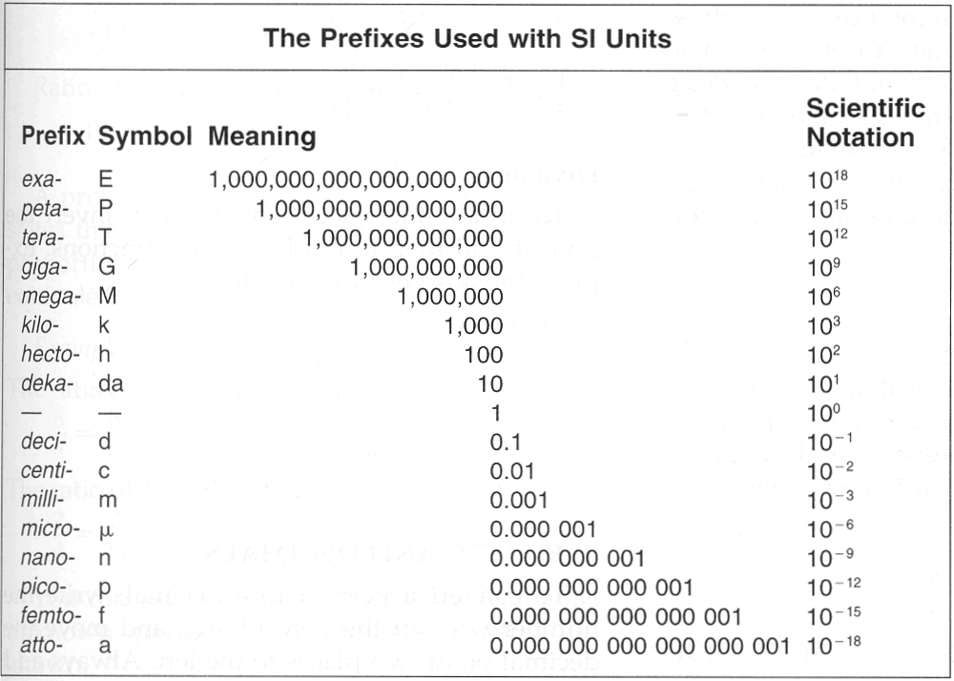
System of Units Prefixes

Slide 47
CPU execution time
CPU execution time for program =
  = CPU clock cycles for program * Clock cycle time
  = CPU clock cycles for program / Clock rate
CPU cycle time = 1 / CPU clock rate
To improve the computer performance we need to decrease CPU execution time, which requires:
  Reduction of the number of clock cycles per program
  Reduction of the length of the clock cycle (e.g. increasing clock rate
  Hardware designer must often trade off clock rate against cycle count

Slide 48

CPU Time Example
Computer A has clock cycle 4 GHz and runs program X in 10 seconds. Any increase in CPU clock rate will require increase in the number of clock cycles by 1.2.
What should be the clock rate of the new computer if we want the program to run in 6 seconds?
Chapter 1 — Computer Abstractions and Technology — <number>
Notes:
Morgan Kaufmann Publishers
Chapter 1 — Computer Abstractions and Technology

Slide 49
CPU Time Example
Current computer (Compute the number of clock cycles in a program):
10 seconds = CPU clock cycles / 4 GHz
CPU clock cycles = 10 sec * 4 GHz = 40 * 10⁹ cycles
New computer:
CPU time (new) = CPU clock cycles (new) / CPU rate (new)
CPU time (new) = 6 seconds
Compute the number of clock cycles in a new program:
CPU clock cycles (new) = 1.2 * CPU clock cycles (current)
CPU clock cycles (new) = 1.2 * 40 * 10⁹ cycles = 48 * 10⁹ cycles
CPU rate (new) = CPU clock cycles (new) / CPU time (new)
CPU rate (new) = 48 * 10⁹ cycles / 6 seconds = 8 GHz

Slide 50

CPU Time Example
Computer A: 2.0 GHz clock rate, 10 s CPU time
Designing Computer B
  Want to achieve for 6s CPU time
  Faster clock causes 1.2 × clock cycles
How fast must Computer B clock be?
Chapter 1 — Computer Abstractions and Technology — <number>
Notes:
Morgan Kaufmann Publishers
Chapter 1 — Computer Abstractions and Technology

Slide 51

Instruction Count and CPI
Instruction Count for a program
  Determined by program, ISA and compiler
Average cycles per instruction
  Determined by CPU hardware
  If different instructions have different CPI
    Average CPI affected by instruction mix
Chapter 1 — Computer Abstractions and Technology — <number>
Notes:
Morgan Kaufmann Publishers
Chapter 1 — Computer Abstractions and Technology

Slide 52

CPI Example
Computer A: Cycle Time = 250ps, CPI = 2.0
Computer B: Cycle Time = 500ps, CPI = 1.2
Same ISA, both computers execute same number of instructions
Which is faster, and by how much?
A is faster…
…by this much
Chapter 1 — Computer Abstractions and Technology — <number>
Notes:
Morgan Kaufmann Publishers
Chapter 1 — Computer Abstractions and Technology

Slide 53
CPI Summary
Program performance (number of CPU clock cycles/program) depends on
  the number of instructions in the program and
  the number of clock cycles required for executing each instruction
      CPU clock cycles =
      Number of instructions for a program x
      Average clock cycles per instruction
Instruction Count for a program
  Determined by program, instruction set architecture (ISA), and compiler

Slide 54
CPI Summary
Number of cycles per instruction
  Determined by CPU hardware
  If instructions have different CPI then average CPI is used
The term clock cycles per instruction (CPI) is computed as the average number of clock cycles needed to execute 1 instruction in the program.

Slide 55
CPI Example
Consider two computers with the following characteristics for a given program:
Computer A: Clock cycle time = 25 ns,
CPI = 2.0
Computer B: Clock rate = 400 MHz,
CPI = 1.2
Which computer is faster for this program and by how much?

Slide 56
CPI Example
Consider two computers with the following characteristics for a given program:
Computer A: Clock cycle time = 25 ns, CPI = 2.0
Computer B: Clock rate = 400 MHz, CPI = 1.2
Which computer is faster for this program and by how much?
Solution:
Both computers running the same program with the total number of instruction called I.
CPU time (A) = Clock cycle time (A) * I * CPI (A)
= 25*10⁻⁹ * 2.0 * I = 50*10⁻⁹ * I seconds
CPU time (B) = I * CPI(B) / Clock rate (B)
= 1.2 * I / (400*10⁶) = 30 * 10⁻⁹* I seconds
Computer B is faster because it takes it less time to complete program execution.
CPU performance (B)/ CPU performance (A) =
= CPU time(A)/CPU time (B)
= 50*10⁻⁹ * I seconds / (30 * 10⁻⁹* I seconds) =1.666(6)
Thus, computer B is 1.666(6) times faster than computer B.

Slide 57
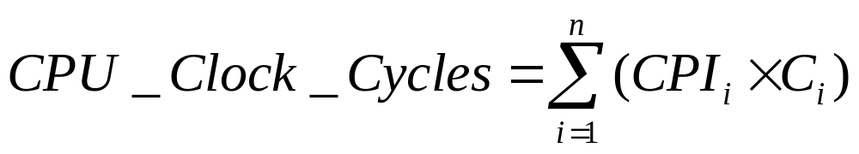
CPI in More Detail
CPU execution time can be measured by running the program
CPU’s clock rate is usually advertised for each computer.
The CPI and instruction count is much more difficult to obtain.
The number of instruction in a program and CPI can be measured by using special software tools.
The total number of the clock cycles in the program is measured as the sum of the products of the CPI for a certain type of instruction and the number of instructions of that type:
Where C_{i} is the number of instructions of class i and CPI_{i} is the average number of cycles for instructions of that class.

Slide 58
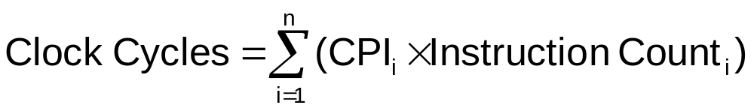

CPI in More Detail
If different instruction classes take different numbers of cycles
Weighted average CPI
Relative frequency
Chapter 1 — Computer Abstractions and Technology — <number>
Notes:
Morgan Kaufmann Publishers
Chapter 1 — Computer Abstractions and Technology

Slide 59
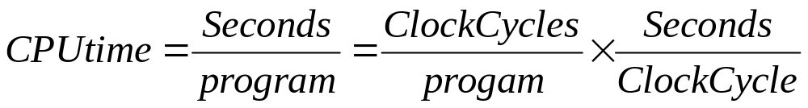
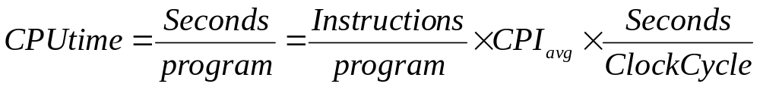
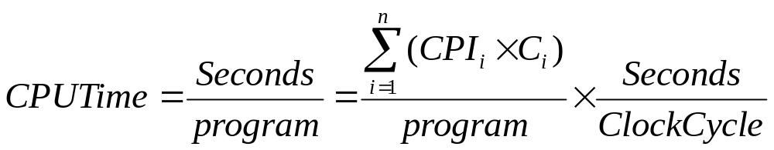
CPU time Summary
Time is the overall measure of performance

Slide 60
Overall Performance: Example
Consider the following instructions:
Type A: CPI = 5
Type B: CPI = 1
Type C: CPI = 4
Program code sequences
Sequence 1: A = 2, B = 2, C = 4
Sequence 2: A = 2, B = 6, C = 2
What is the instruction count for each sequence?
Which sequence is faster?
What is average CPI for each sequence?

Slide 61
Overall Performance: Example
Consider the following instructions:
Type A: CPI = 5
Type B: CPI = 1
Type C: CPI = 4
Program code sequences
Sequence 1: A = 2, B = 2, C = 4
Sequence 2: A = 2, B = 6, C = 2
What is the instruction count for each sequence?
Which sequence is faster?
What is average CPI for each sequence?
Solution:
Sequence 1: Instruction count = 2 + 2 + 4 = 8
Sequence 2: Instruction count = 2 + 6 + 2 = 10
The total number of CPU cycles (ignore clock rate because programs will be run on the same machine)
Sequence 1: CPU clock cycles = 2 * 5 + 2 * 1 + 4 * 4 = 28
Sequence 2: CPU clock cycles = 2 * 5 + 6 * 1 + 2 * 4 = 24
Code sequence 2 requires more instructions but it will be executed faster because it needs fewer clock cycles to complete.
To compute average CPI divide CPU clock cycles by the number of instructions:
Sequence 1: CPU clock cycles / I = 28 / 8 = 3.5
Sequence 2: CPU clock cycles/ I = 24 / 10 = 2.4

Slide 62
CPI Example
Alternative compiled code sequences using instructions in classes A, B, C
Class | A | B | C
CPI for class | 1 | 2 | 3
IC in sequence 1 | 2 | 1 | 2
IC in sequence 2 | 4 | 1 | 1
Sequence 1: IC = 5
  Clock Cycles
  = 2×1 + 1×2 + 2×3
  = 10
  Avg. CPI = 10/5 = 2.0
Sequence 2: IC = 6
  Clock Cycles
  = 4×1 + 1×2 + 1×3
  = 9
  Avg. CPI = 9/6 = 1.5
Chapter 1 — Computer Abstractions and Technology — <number>
Notes:
Morgan Kaufmann Publishers
Chapter 1 — Computer Abstractions and Technology

Slide 63

Performance Summary
The BIG Picture
Performance depends on
  Algorithm: affects IC, possibly CPI
  Programming language: affects IC, CPI
  Compiler: affects IC, CPI
  Instruction set architecture: affects IC, CPI, T_{c}
Chapter 1 — Computer Abstractions and Technology — <number>
Notes:
Morgan Kaufmann Publishers
Chapter 1 — Computer Abstractions and Technology

Slide 64
Computer Performance
Algorithm – influences instruction count and possibly CPI. Algorithm determines the number and possibly type of instructions in the program, thus influencing CPI (e.g. int vs. float arithmetic)
Programming Language – influences instruction count and CPI. Programming languages differ in the types of instructions supported, which in turn influences instruction count. Languages with heavy support for data abstraction require indirect calls and thus will need instructions with higher CPI.
Compiler – influences instruction count and CPI because compilers determine how the program is translated into machine code.
Instruction set architecture – influences instruction count, CPI and clock rate, because it is responsible for the instructions used for each command, the cost in cycles of each instruction, and average clock rate.

Slide 65
Computer Performance
Components of Performance | Units of Measure
CPU execution time for a program | Seconds for the program
Instruction count | Instructions executed for the program
Clock cycles per instruction (CPI) | Average number of clock cycles per instruction
Clock cycle time | Seconds per clock cycle

Slide 66

Power Trends
§1.7 The Power Wall
In CMOS IC technology
×30
5V → 1V
×1000
Chapter 1 — Computer Abstractions and Technology — <number>
Notes:
Morgan Kaufmann Publishers
Chapter 1 — Computer Abstractions and Technology

Slide 67

Reducing Power
Suppose a new CPU has
  85% of capacitive load of old CPU
  15% voltage and 15% frequency reduction
The power wall
  We can’t reduce voltage further
  We can’t remove more heat
How else can we improve performance?
Chapter 1 — Computer Abstractions and Technology — <number>
Notes:
Morgan Kaufmann Publishers
Chapter 1 — Computer Abstractions and Technology

Slide 68

Uniprocessor Performance
§1.8 The Sea Change: The Switch to Multiprocessors
Constrained by power, instruction-level parallelism, memory latency
Chapter 1 — Computer Abstractions and Technology — <number>
Notes:
Morgan Kaufmann Publishers
Chapter 1 — Computer Abstractions and Technology

Slide 69
Multiprocessors
Multicore microprocessors
  More than one processor per chip
Requires explicitly parallel programming
  Compare with instruction level parallelism
    Hardware executes multiple instructions at once
    Hidden from the programmer
  Hard to do
    Programming for performance
    Load balancing
    Optimizing communication and synchronization
Chapter 1 — Computer Abstractions and Technology — <number>
Notes:
Morgan Kaufmann Publishers
Chapter 1 — Computer Abstractions and Technology

Slide 70
Computer Performance
How do we evaluate performance of different computers?
Usually, to evaluate computer performance a set of benchmarks is that approximate the actual computer workload is executed on the computer and then their performance is compared.
  Benchmark is a program specially chosen to evaluate computer performance.
  Workload is a set of programs (applications) that are usually run on a computer or programs that approximate such mix. Usually workload consists of the programs and the frequencies with which they are executed.

Slide 71
Computer Performance
The use of benchmarks whose performance depends on very small code segment encourages optimizations in either the architecture or compiler that targets such code segments.
Such optimizations may mislead the consumer about actual computer performance or may even cause incorrect code to be generated.
Small benchmarks
  Attractive when starting architectural or compiler design, since they small enough to compile and can be easily simulated by hand.
  Very useful when designing new computer for which compilers are not yet available.
  Should not be used for evaluation of working computers.

Slide 72
Computer Performance
What kinds of applications are used as benchmarks?
Depends on the type and the use of the computer.
  Desktop computers will usually measure CPU performance, or a specific task such as DVD playback or graphics performance.
  Servers benchmarks depend on the type of server:
    CPU performance for scientific applications
    Web serving
    File serving
    Databases
  Embedded computers usually use specific embedded applications

Slide 73
Computer Performance
A detailed performance report is written after the benchmark is selected and performance measurements are obtained
Reproducibility – the report should provide all the necessary information for someone to re-run the benchmark measurements and re-produce the same results.
Performance report must include detailed information about:
  Operating system
  Compilers
  Inputs – different inputs may take different paths in the program and yield different results.
  Computer Configuration

Slide 74
Computer Performance
Comparing computer performance may not be a straightforward task since the computers often perform well with one set of benchmark programs and poorly with another.
Consider the following example:
Computer A:
Executes benchmark program 1 in 5 second
Executes benchmark program 2 in 500 seconds
Computer B:
Executes benchmark program 1 in 10 second
Executes benchmark program 2 in 100 seconds
Question is which computer is better?

Slide 75
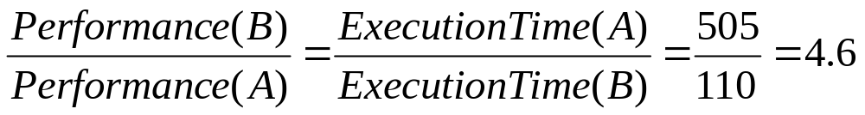
Computer Performance
If we consider individual programs then
Computer A is faster than computer B for benchmark program 1
Computer B is faster than computer A for benchmark program 2
It is difficult to identify which computer is better collectively.
The simplest approach to summarize the computer performance is to sum up execution times for the all the benchmark and then compare them. In such a case
Thus, computer B is 4.6 times faster than computer A.

Slide 76
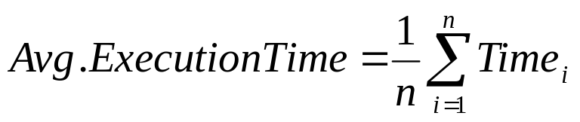
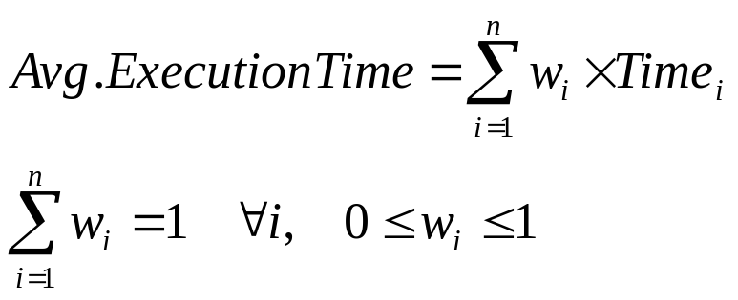
Computer Performance
If all the programs in the benchmark run with the same frequency then the average execution time is computed as arithmetic mean:
Time_{i} is the execution time for the i^{th} program in the benchmark that consists of n different programs.
If the programs in the benchmark run with the different frequency then the weighted arithmetic mean is used to compute the average execution time:
Where, w_{i} is the weight of the frequency of program execution.

Slide 77
Computer Performance
Two computers X and Y are compared using the benchmark that consists of three programs, A, B, and C.
The frequencies of program execution for A, B, and C are 0.4, 0.2, & 0.4.
Computer X has clock rate 400 MHz, and programs A, B and C have the following characteristics:
 | Type 1 | Type 2 | Type 3 | Type 4
CPI | 10 | 20 | 5 | 1
I(A) | 20 | 4 | 20 | 20
I(B) | 7 | 5 | 0 | 30
I(C) | 2 | 4 | 20 | 50
Computer Y has clock cycle length of 5 nanoseconds and the following characteristics:
 | Type 1 | Type 2 | Type 3 | Type 4
CPI | 15 | 10 | 2 | 20
I(A) | 0 | 4 | 10 | 2
I(B) | 4 | 20 | 15 | 0
I(C) | 0 | 1 | 10 | 1
Which of the computers executes the benchmark faster and by how much?

Slide 78
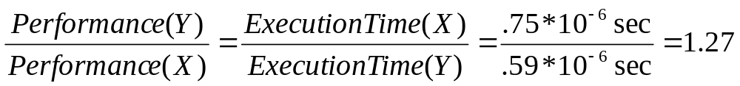
Computer Performance
Compute execution times for each of the programs on computers X and Y
Computer X:
  Execution Time = Total Clock Cycles/ Clock rate = Sum(CPI*I)/ Clock rate
  Execution time (A) = (10*20+20*4+5*20+1*20) clock cycles /400 MHz = 10⁻⁶ s
  Execution time (B) = (10*7+20*5+5*0+1*30) clock cycles /400 MHz = .5* 10⁻⁶ s
  Execution time (C) = (10*2+20*4+5*20+1*50) clock cycles /400 MHz = .625* 10⁻⁶ s
Computer Y:
  Execution Time = Total Clock Cycles * Clock Cycle Length
  Execution time (A) = (15*0+10*4+2*10+20*2) clock cycles * 5 ps = .5*10⁻⁶ s
  Execution time (B) = (15*4+10*20+2*15+20*0) clock cycles * 5 ps = 1.45*10⁻⁶ s
  Execution time (C) = (15*0+10*1+2*10+20*1) clock cycles /400 MHz = .250* 10⁻⁶ s
Compute execution times for benchmark on computers X and Y
  Execution time (X) = (0.4 * 1 + 0.2 * .5+ 0.4*.625)* 10⁻⁶ s = .75 * 10⁻⁶ s
  Execution time (Y) = (0.4 * .5 + 0.2 * 1.45+ 0.4*.250)* 10⁻⁶ s = .59 * 10⁻⁶
Thus, computer Y is 1.27 times faster than computer X.

Slide 79

SPEC CPU Benchmark
Programs used to measure performance
  Supposedly typical of actual workload
Standard Performance Evaluation Corp (SPEC)
  Develops benchmarks for CPU, I/O, Web, …
SPEC CPU2006
  Elapsed time to execute a selection of programs
    Negligible I/O, so focuses on CPU performance
  Normalize relative to reference machine
  Summarize as geometric mean of performance ratios
    CINT2006 (integer) and CFP2006 (floating-point)
Chapter 1 — Computer Abstractions and Technology — <number>
Notes:
Morgan Kaufmann Publishers
Chapter 1 — Computer Abstractions and Technology

Slide 80

CINT2006 for Intel Core i7 920
Chapter 1 — Computer Abstractions and Technology — <number>
Notes:
Morgan Kaufmann Publishers
Chapter 1 — Computer Abstractions and Technology

Slide 81

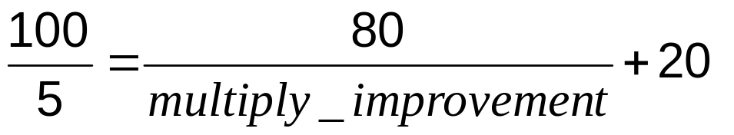
Pitfall: Amdahl’s Law
Improving an aspect of a computer and expecting a proportional improvement in overall performance
Example: multiply instructions account for 80 second out of 100 seconds of the program execution time
  How much improvement in multiply operation is needed to achieve a 5 times better overall performance?
  Can’t be done!
Corollary: make the common case fast
Notes:
Morgan Kaufmann Publishers
Chapter 1 — Computer Abstractions and Technology

Slide 82

Pitfall: MIPS as a Performance Metric
MIPS: Millions of Instructions Per Second
  Doesn’t account for
    Differences in ISAs between computers
    Differences in complexity between instructions
  CPI varies between programs on a given CPU
Chapter 1 — Computer Abstractions and Technology — <number>
Notes:
Morgan Kaufmann Publishers
Chapter 1 — Computer Abstractions and Technology

Slide 83
Concluding Remarks
Cost/performance is improving
  Due to underlying technology development
Hierarchical layers of abstraction
  In both hardware and software
Instruction set architecture
  The hardware/software interface
Execution time: the best performance measure
Power is a limiting factor
  Use parallelism to improve performance
§1.9 Concluding Remarks
Chapter 1 — Computer Abstractions and Technology — <number>
Notes:
Morgan Kaufmann Publishers
Chapter 1 — Computer Abstractions and Technology

