Slide 1
Chapter 4
The Processor
Notes:
Morgan Kaufmann Publishers
Chapter 4 — The Processor

Slide 2
Introduction
§4.1 Introduction
CPU performance factors
  Instruction count
    Determined by ISA and compiler
  CPI and Cycle time
    Determined by CPU hardware
We will examine two MIPS implementations
  A simplified version
  A more realistic pipelined version
Simple subset, shows most aspects
  Memory reference: lw, sw
  Arithmetic/logical: add, sub, and, or, slt
  Control transfer: beq, j
Chapter 4 — The Processor — <number>
Notes:
Morgan Kaufmann Publishers
Chapter 4 — The Processor

Slide 3
Instruction Execution
PC → instruction memory, fetch instruction
Register numbers → register file, read registers
Depending on instruction class
  Use ALU to calculate
    Arithmetic result
    Memory address for load/store
    Branch target address
  Access data memory for load/store
  PC ← target address or PC + 4
Chapter 4 — The Processor — <number>
Notes:
Morgan Kaufmann Publishers
Chapter 4 — The Processor

Slide 4
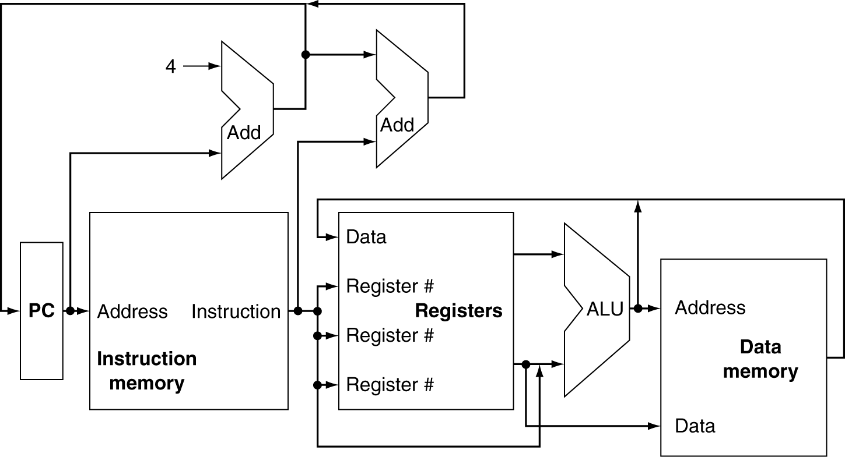
CPU Overview
Chapter 4 — The Processor — <number>
Notes:
Morgan Kaufmann Publishers
Chapter 4 — The Processor

Slide 5
Multiplexers
Can’t just join wires together
  Use multiplexers
Chapter 4 — The Processor — <number>
Notes:
Morgan Kaufmann Publishers
Chapter 4 — The Processor

Slide 6
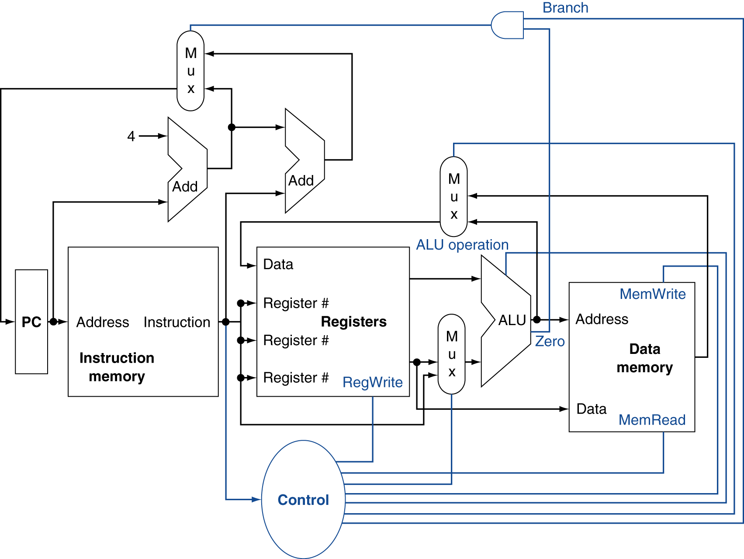
Control
Chapter 4 — The Processor — <number>
Notes:
Morgan Kaufmann Publishers
Chapter 4 — The Processor

Slide 7
Logic Design Basics
Information encoded in binary
  Low voltage = 0, High voltage = 1
  One wire per bit
  Multi-bit data encoded on multi-wire buses
Combinational element
  Operate on data
  Output is a function of input
State (sequential) elements
  Store information
§4.2 Logic Design Conventions
Chapter 4 — The Processor — <number>
Notes:
Morgan Kaufmann Publishers
Chapter 4 — The Processor

Slide 8
Combinational Elements
AND-gate
  Y = A & B
Adder
  Y = A + B
A
+
Y
B
A
Y
B
Arithmetic/Logic Unit
  Y = F(A, B)
Multiplexer
  Y = S ? I1 : I0
A
I0
M
u
x
Y
Y
ALU
I1
B
S
F
Chapter 4 — The Processor — <number>
Notes:
Morgan Kaufmann Publishers
Chapter 4 — The Processor

Slide 9
Building a Datapath
Datapath
  Elements that process data and addresses
  in the CPU
    Registers, ALUs, mux’s, memories, …
We will build a MIPS datapath incrementally
  Refining the overview design
§4.3 Building a Datapath
Chapter 4 — The Processor — <number>
Notes:
Morgan Kaufmann Publishers
Chapter 4 — The Processor

Slide 10
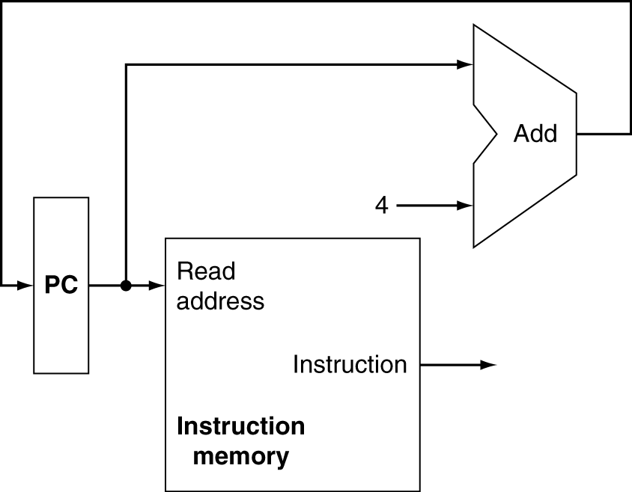
Instruction Fetch
Increment by 4 for next instruction
32-bit register
Chapter 4 — The Processor — <number>
Notes:
Morgan Kaufmann Publishers
Chapter 4 — The Processor

Slide 11
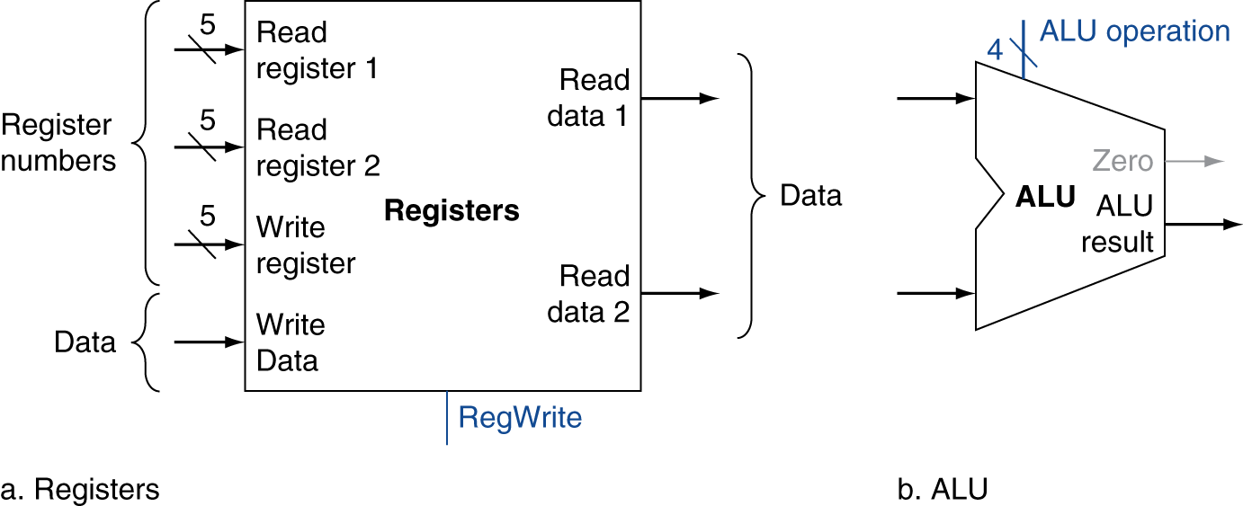
R-Format Instructions
Read two register operands
Perform arithmetic/logical operation
Write register result
Chapter 4 — The Processor — <number>
Notes:
Morgan Kaufmann Publishers
Chapter 4 — The Processor

Slide 12
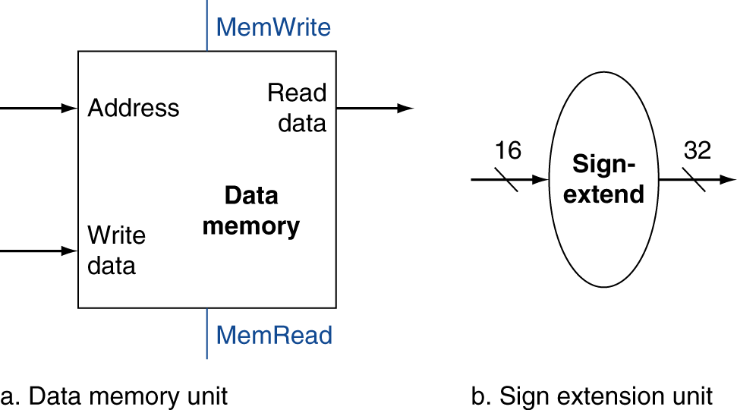
Load/Store Instructions
Read register operands
Calculate address using 16-bit offset
  Use ALU, but sign-extend offset
Load: Read memory and update register
Store: Write register value to memory
Chapter 4 — The Processor — <number>
Notes:
Morgan Kaufmann Publishers
Chapter 4 — The Processor

Slide 13
Load/Store Instructions
Ex. lw $t0, offset($t1)
Chapter 4 — The Processor — <number>
Notes:
Morgan Kaufmann Publishers
Chapter 4 — The Processor

Slide 14
Branch Instructions
Read register operands
Compare operands
  Use ALU, subtract and check Zero output
Calculate target address
  Sign-extend displacement
  Shift left 2 places (word displacement)
  Add to PC + 4
    Already calculated by instruction fetch
Chapter 4 — The Processor — <number>
Notes:
Morgan Kaufmann Publishers
Chapter 4 — The Processor

Slide 15
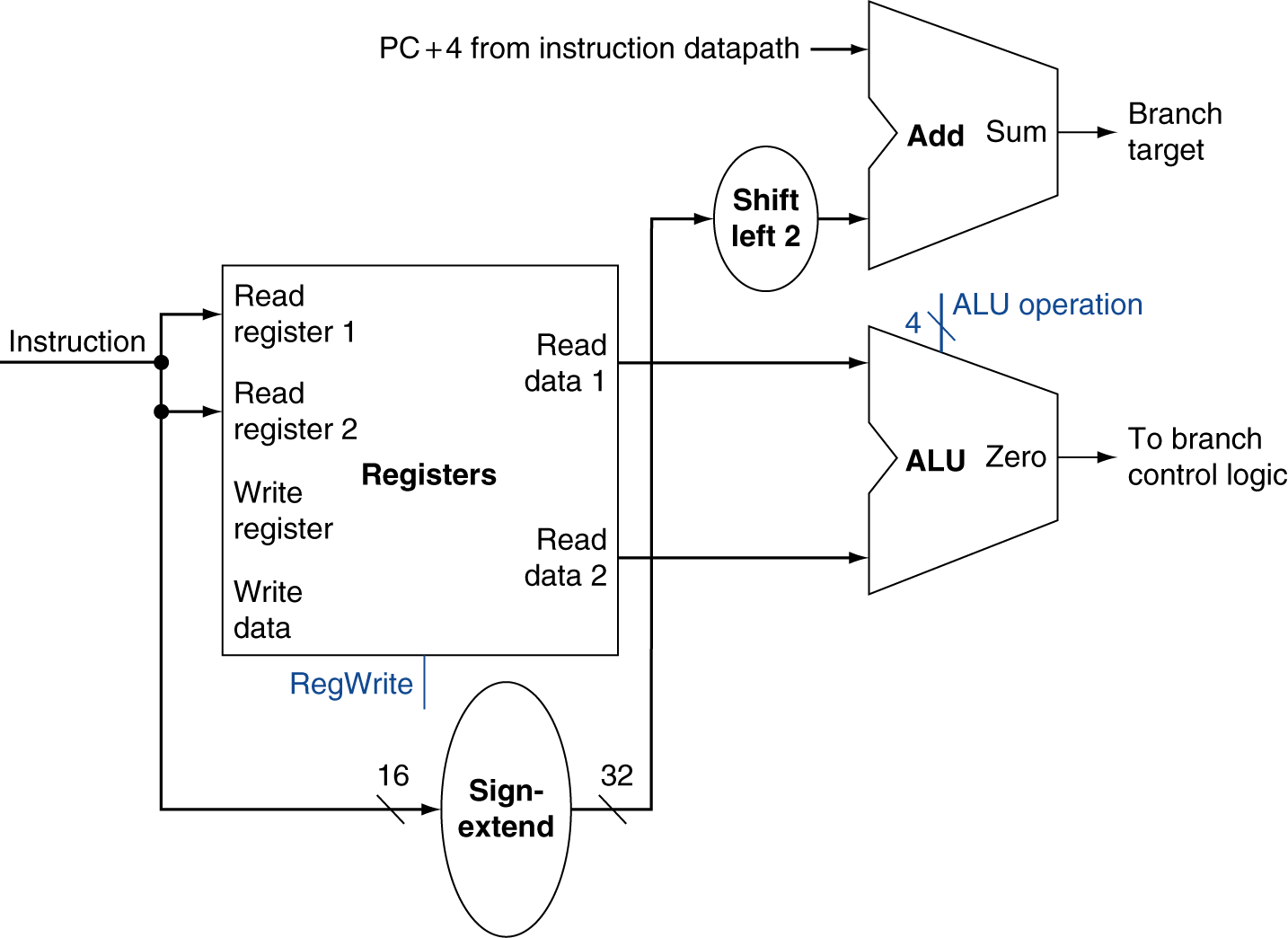
Branch Instructions
Just
re-routes wires
Sign-bit wire replicated
Chapter 4 — The Processor — <number>
Notes:
Morgan Kaufmann Publishers
Chapter 4 — The Processor

Slide 16
Composing the Elements
First-cut data path does an instruction in one clock cycle
  Each datapath element can only do one function at a time
  Hence, we need separate instruction and data memories
Use multiplexers where alternate data sources are used for different instructions
Chapter 4 — The Processor — <number>
Notes:
Morgan Kaufmann Publishers
Chapter 4 — The Processor

Slide 17
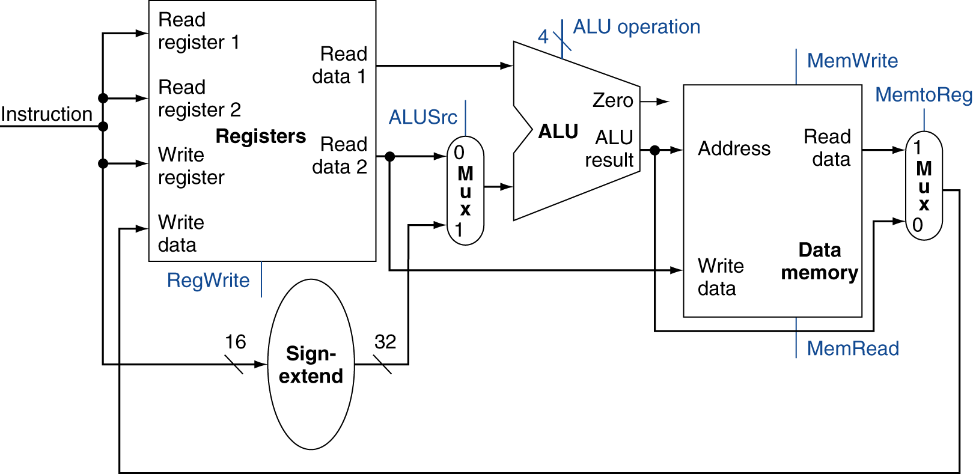
R-Type/Load/Store Datapath
Chapter 4 — The Processor — <number>
Notes:
Morgan Kaufmann Publishers
Chapter 4 — The Processor

Slide 18
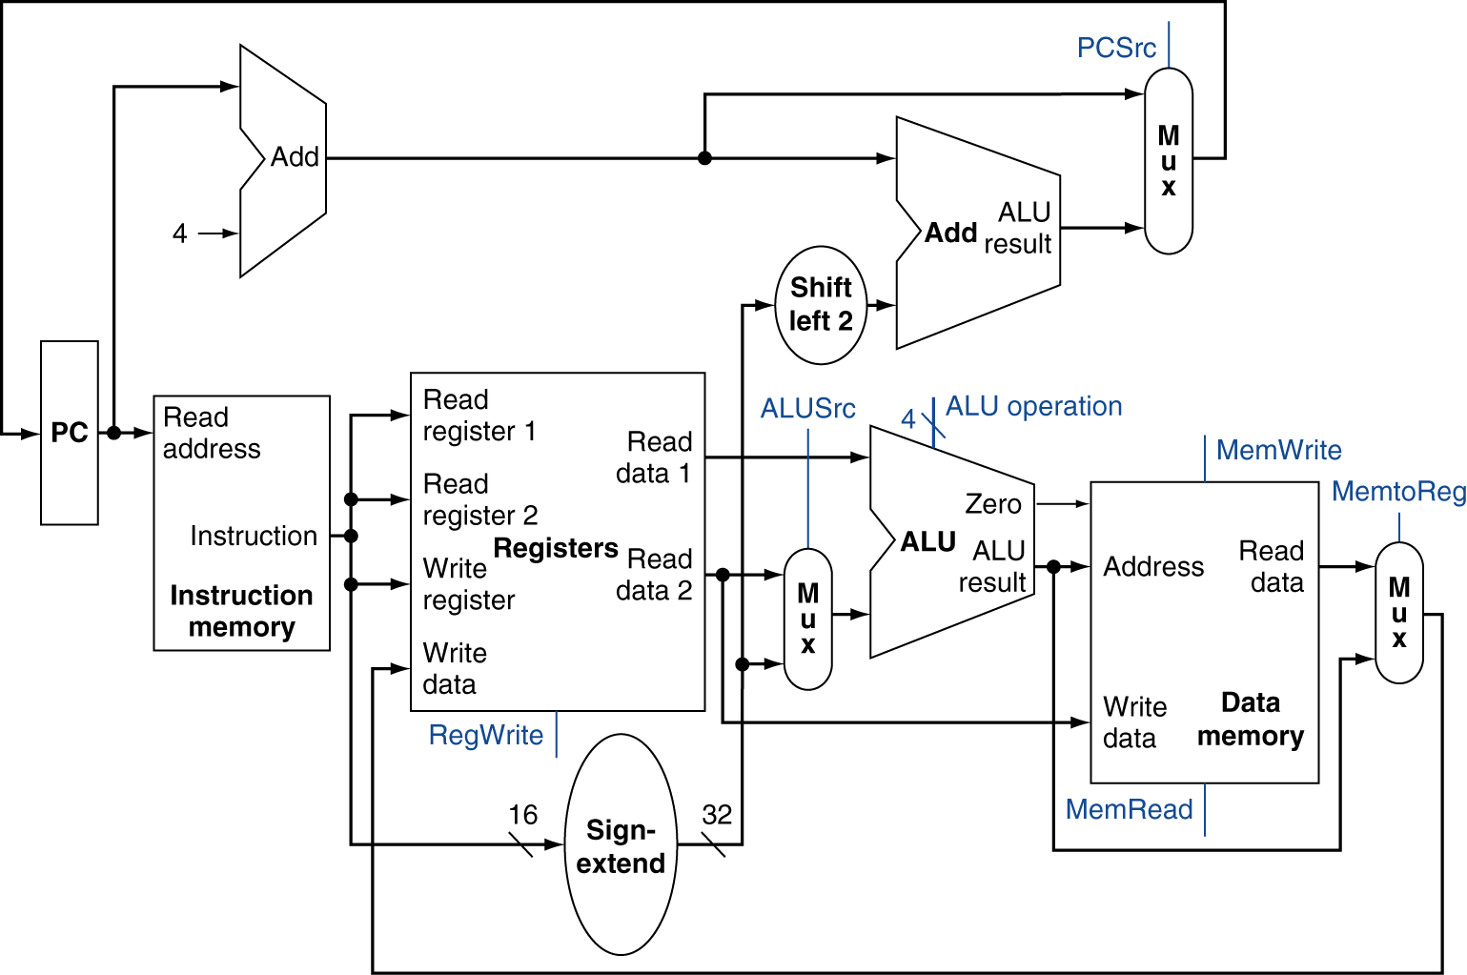
Full Datapath
Chapter 4 — The Processor — <number>
Notes:
Morgan Kaufmann Publishers
Chapter 4 — The Processor

Slide 19
ALU Control
ALU used for
  Load/Store: F = add
  Branch: F = subtract
  R-type: F depends on funct field
§4.4 A Simple Implementation Scheme
ALU control | Function
0000 | AND
0001 | OR
0010 | add
0110 | subtract
0111 | set-on-less-than
1100 | NOR
Chapter 4 — The Processor — <number>
Notes:
Morgan Kaufmann Publishers
Chapter 4 — The Processor

Slide 20
ALU Control
Assume 2-bit ALUOp derived from opcode
  Combinational logic derives ALU control
opcode | ALUOp | Operation | funct | ALU function | ALU control
lw | 00 | load word | XXXXXX | add | 0010
sw | 00 | store word | XXXXXX | add | 0010
beq | 01 | branch equal | XXXXXX | subtract | 0110
R-type | 10 | add | 100000 | add | 0010
 |  | subtract | 100010 | subtract | 0110
 |  | AND | 100100 | AND | 0000
 |  | OR | 100101 | OR | 0001
 |  | set-on-less-than | 101010 | set-on-less-than | 0111
Chapter 4 — The Processor — <number>
Notes:
Morgan Kaufmann Publishers
Chapter 4 — The Processor

Slide 21
The Main Control Unit
Control signals derived from instruction
R-type
0
rs
rt
rd
shamt
funct
31:26
25:21
20:16
15:11
10:6
5:0
Load/
Store
35 or 43
rs
rt
address
31:26
25:21
20:16
15:0
Branch
4
rs
rt
address
31:26
25:21
20:16
15:0
opcode
always read
read, except for load
write for R-type and load
sign-extend and add
Chapter 4 — The Processor — <number>
Notes:
Morgan Kaufmann Publishers
Chapter 4 — The Processor

Slide 22
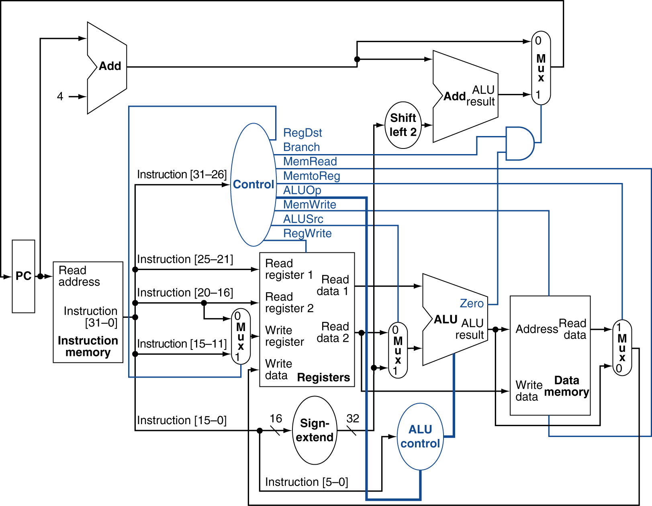
Datapath With Control
Chapter 4 — The Processor — <number>
Notes:
Morgan Kaufmann Publishers
Chapter 4 — The Processor

Slide 23
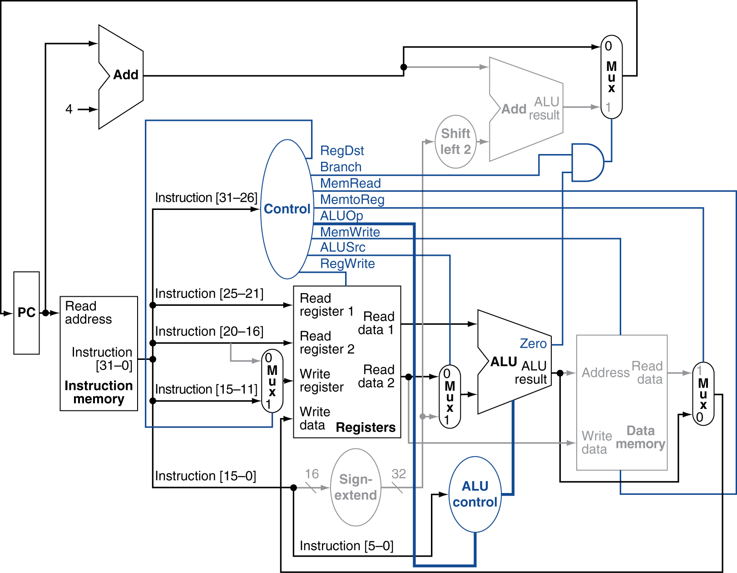
R-Type Instruction
Chapter 4 — The Processor — <number>
Notes:
Morgan Kaufmann Publishers
Chapter 4 — The Processor

Slide 24
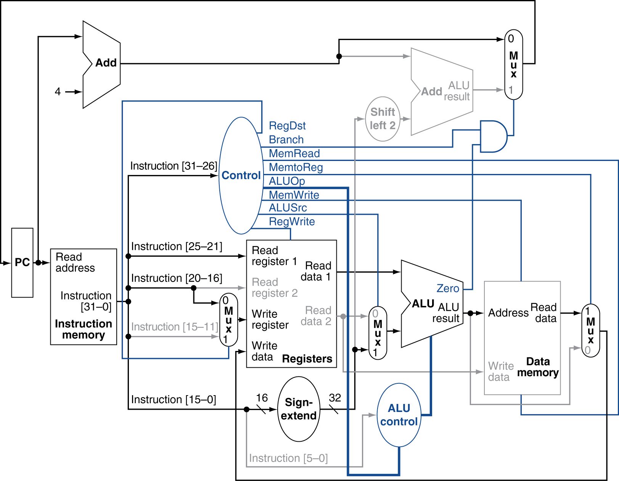
Load Instruction
Chapter 4 — The Processor — <number>
Notes:
Morgan Kaufmann Publishers
Chapter 4 — The Processor

Slide 25
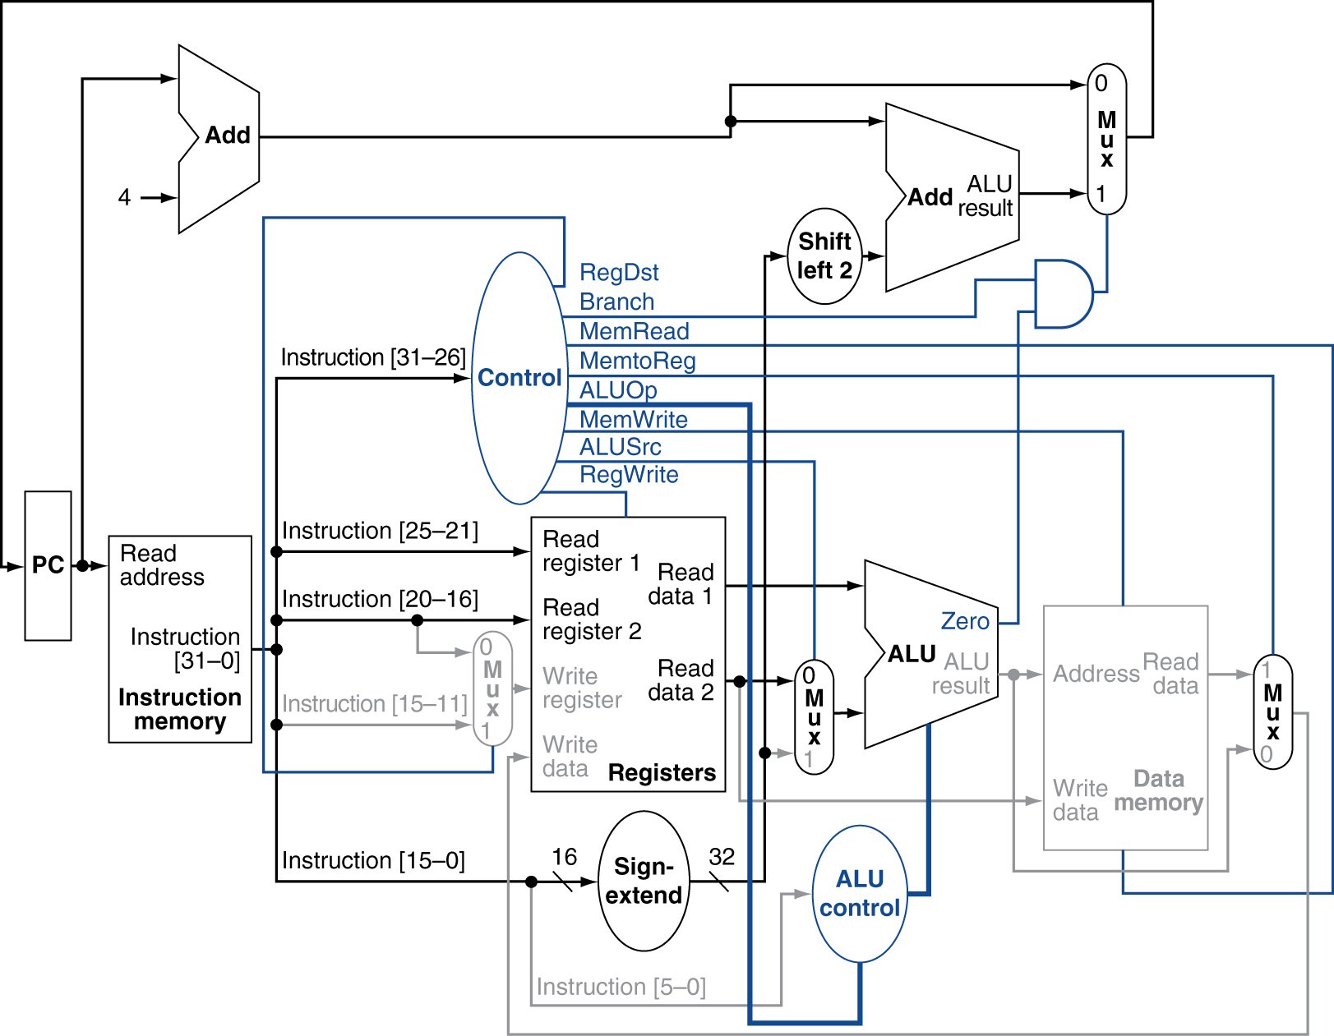
Branch-on-Equal Instruction
Chapter 4 — The Processor — <number>
Notes:
Morgan Kaufmann Publishers
Chapter 4 — The Processor

Slide 26
Implementing Jumps
Jump
2
address
31:26
25:0
Jump uses word address
Update PC with concatenation of
  Top 4 bits of old PC
  26-bit jump address
  00
Need an extra control signal decoded from opcode
Chapter 4 — The Processor — <number>
Notes:
Morgan Kaufmann Publishers
Chapter 4 — The Processor

Slide 27
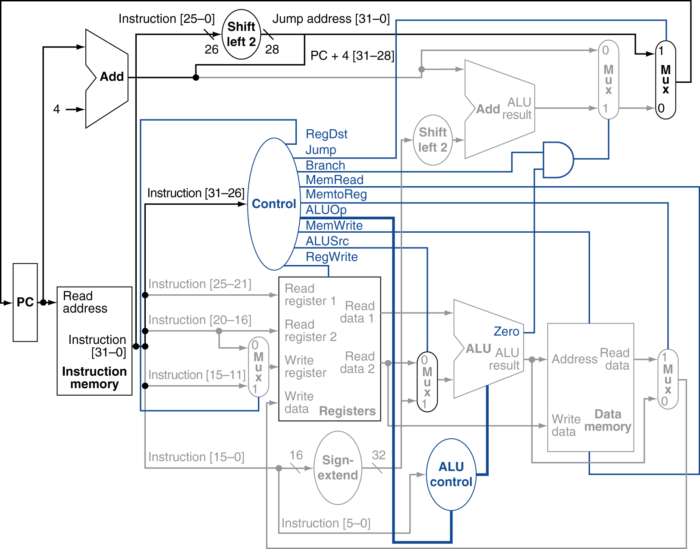
Datapath With Jumps Added
Chapter 4 — The Processor — <number>
Notes:
Morgan Kaufmann Publishers
Chapter 4 — The Processor

Slide 28
Performance Issues
Longest delay determines clock period
  Critical path: load instruction
  Instruction memory → register file → ALU → data memory → register file
Not feasible to vary period for different instructions
Violates design principle
  Making the common case fast
We will improve performance by pipelining
Chapter 4 — The Processor — <number>
Notes:
Morgan Kaufmann Publishers
Chapter 4 — The Processor

Slide 29
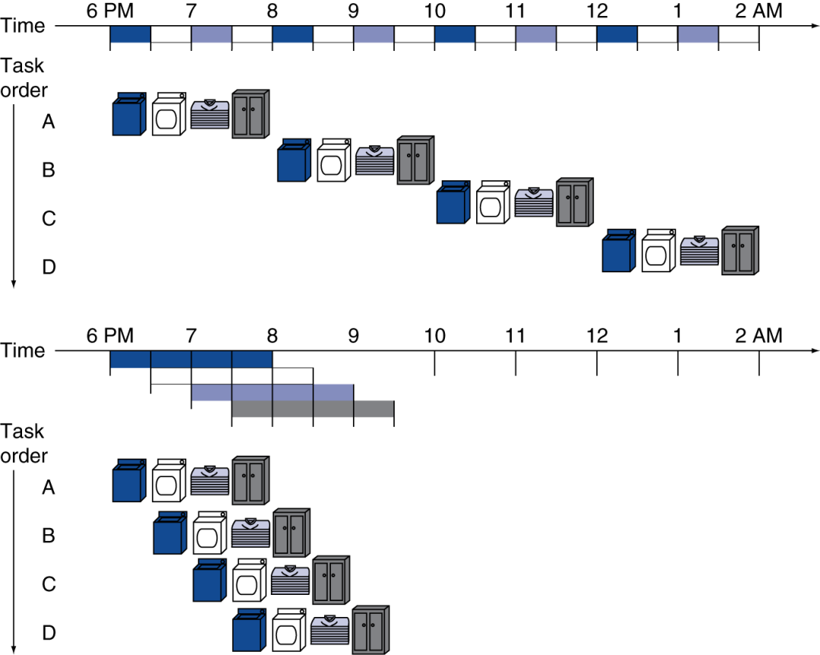
Pipelining Analogy
Pipelined laundry: overlapping execution
  Parallelism improves performance
§4.5 An Overview of Pipelining
Four loads:
  Speedup
  = 16/7 = 2.3
Non-stop:
  Speedup
  = 4n/(n + 3.0) ≈ 4
  = number of stages
Chapter 4 — The Processor — <number>
Notes:
Morgan Kaufmann Publishers
Chapter 4 — The Processor

Slide 30
MIPS Pipeline
Five stages, one step per stage
  IF: Instruction fetch from memory
  ID: Instruction decode & register read
  EX: Execute operation or calculate address
  MEM: Access memory operand
  WB: Write result back to register
Chapter 4 — The Processor — <number>
Notes:
Morgan Kaufmann Publishers
Chapter 4 — The Processor

Slide 31
Pipeline Performance
Assume time for stages is
  100ps for register read or write
  200ps for other stages
Compare pipelined datapath with single-cycle datapath
Instr | Instr fetch | Register read | ALU op | Memory access | Register write | Total time
lw | 200ps | 100 ps | 200ps | 200ps | 100 ps | 800ps
sw | 200ps | 100 ps | 200ps | 200ps |  | 700ps
R-format | 200ps | 100 ps | 200ps |  | 100 ps | 600ps
beq | 200ps | 100 ps | 200ps |  |  | 500ps
Chapter 4 — The Processor — <number>
Notes:
Morgan Kaufmann Publishers
Chapter 4 — The Processor

Slide 32
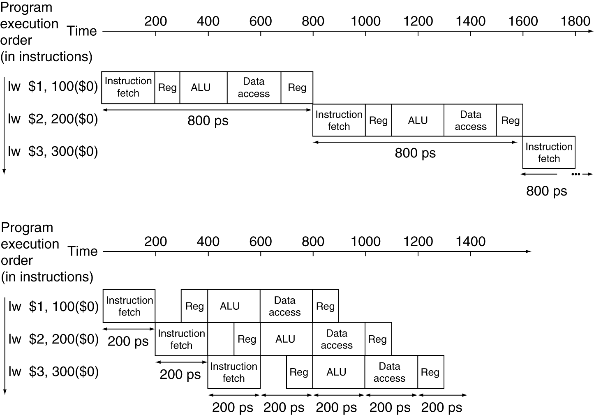
Pipeline Performance
Single-cycle (T_{c}= 800ps)
Pipelined (T_{c}= 200ps)
Chapter 4 — The Processor — <number>
Notes:
Morgan Kaufmann Publishers
Chapter 4 — The Processor

Slide 33
Pipeline Speedup
If all stages are balanced
  i.e., all take the same time
  Time stage_{pipelined} = Time instr._{nonpipelined} / Num. stages
If not balanced, speedup is less
Speedup due to increased throughput
  Latency (time for each instruction) does not decrease
Chapter 4 — The Processor — <number>
Notes:
Morgan Kaufmann Publishers
Chapter 4 — The Processor

Slide 34
Pipelining and ISA Design
MIPS ISA designed for pipelining
  All instructions are 32-bits
    Easier to fetch and decode in one cycle
    c.f. x86: 1- to 17-byte instructions
  Few and regular instruction formats
    Can decode and read registers in one step
  Load/store addressing
    Can calculate address in 3rd stage, access memory in 4th stage
  Alignment of memory operands
    Memory access takes only one cycle
Chapter 4 — The Processor — <number>
Notes:
Morgan Kaufmann Publishers
Chapter 4 — The Processor

Slide 35
Hazards
Situations that prevent starting the next instruction in the next cycle
Structure hazards
  A required resource is busy
Data hazard
  Need to wait for previous instruction to complete its data read/write
Control hazard
  Deciding on control action depends on previous instruction
Chapter 4 — The Processor — <number>
Notes:
Morgan Kaufmann Publishers
Chapter 4 — The Processor

Slide 36
Structure Hazards
Conflict for use of a resource
In MIPS pipeline with a single memory
  Load/store requires data access
  Instruction fetch would have to stall for that cycle
    Would cause a pipeline “bubble”
Hence, pipelined datapaths require separate instruction/data memories
  Or separate instruction/data caches
Chapter 4 — The Processor — <number>
Notes:
Morgan Kaufmann Publishers
Chapter 4 — The Processor

Slide 37
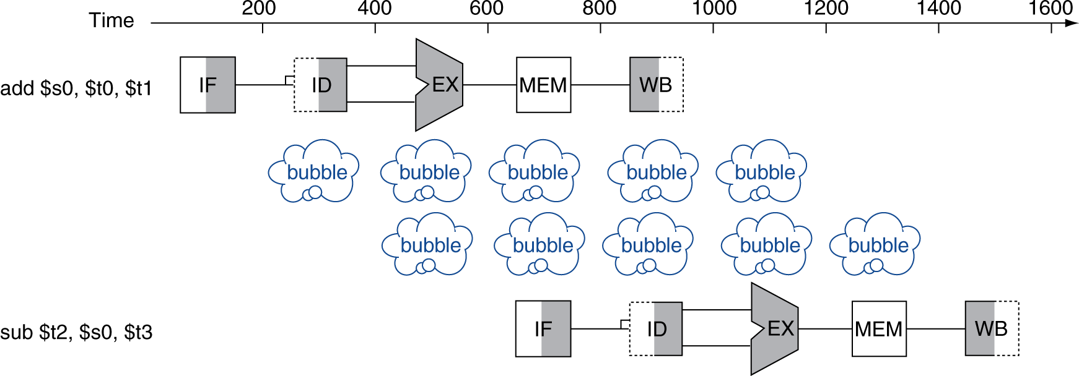
Stage representation
IF: Instruction fetch from memory
ID: Instruction decode & register read
EX: Execute operation or calculate address
MEM: Access memory operand
WB: Write result back to register
Read
Not used
Write
Used
Chapter 4 — The Processor — <number>
Notes:
Morgan Kaufmann Publishers
Chapter 4 — The Processor

Slide 38
Data Hazards
An instruction depends on completion of data access by a previous instruction
  add $s0, $t0, $t1
  sub $t2, $s0, $t3
Chapter 4 — The Processor — <number>
Notes:
Morgan Kaufmann Publishers
Chapter 4 — The Processor

Slide 39
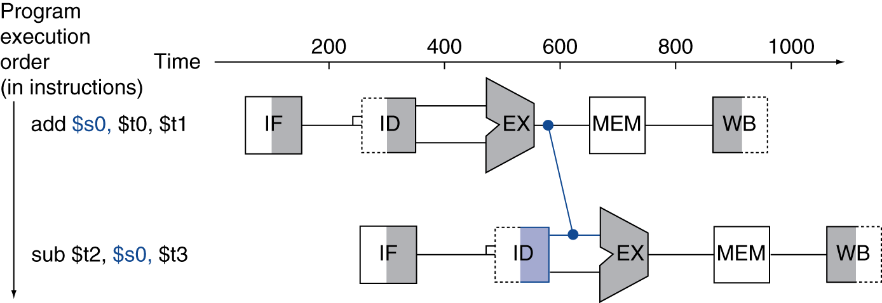
Forwarding (aka Bypassing)
Use result as soon as the register value is computed
  Don’t wait for it to be stored in a register
  Requires extra connections in the datapath
Chapter 4 — The Processor — <number>
Notes:
Morgan Kaufmann Publishers
Chapter 4 — The Processor

Slide 40
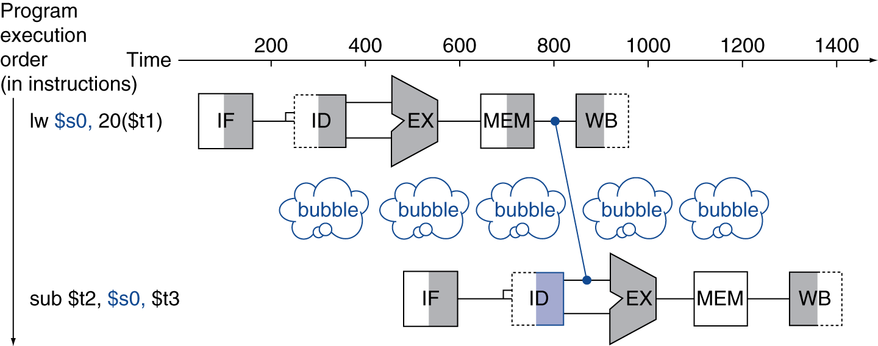
Load-Use Data Hazard
Can’t always avoid stalls by forwarding
  If value not computed when needed
  Can’t forward backward in time!
Chapter 4 — The Processor — <number>
Notes:
Morgan Kaufmann Publishers
Chapter 4 — The Processor

Slide 41
Code Scheduling to Avoid Stalls
Reorder code to avoid use of load result in the next instruction
C code for A = B + E; C = B + F;
lw $t1, 0($t0)
lw $t2, 4($t0)
add $t3, $t1, $t2
sw $t3, 12($t0)
lw $t4, 8($t0)
add $t5, $t1, $t4
sw $t5, 16($t0)
lw $t1, 0($t0)
lw $t2, 4($t0)
lw $t4, 8($t0)
add $t3, $t1, $t2
sw $t3, 12($t0)
add $t5, $t1, $t4
sw $t5, 16($t0)
stall
stall
13 cycles
11 cycles
Chapter 4 — The Processor — <number>
Notes:
Morgan Kaufmann Publishers
Chapter 4 — The Processor

Slide 42
Example (ex. 4.13)
lw $1, 40($6)
add $6, $2, $2
sw $6, 50($1)
Instr. | Pipeline stages
lw | IF | ID | EX | MEM | WB | WB $1 need for EX in sw
add |  | IF | ID | EX | MEM | WB | WB $6 needed for MEM in sw
sw |  |  | IF | ID | EX | MEM | WB
Chapter 4 — The Processor — <number>
Notes:
Morgan Kaufmann Publishers
Chapter 4 — The Processor

Slide 43
Example (ex. 4.13)
lw $1, 40($6)
add $6, $2, $2
nop
sw $6, 50($1)
Instr. | Pipeline stages
lw | IF | ID | EX | MEM | WB
add |  | IF | ID | EX | MEM | WB
nop |  |  | * | * | * | * | *
sw |  |  |  | IF | ID | EX | MEM | WB
Chapter 4 — The Processor — <number>
Notes:
Morgan Kaufmann Publishers
Chapter 4 — The Processor

Slide 44
Example (ex. 4.13)
lw $5, -16($5)
sw $5, -16($5)
add $5, $5, $5
Instr. | Pipeline stages
lw | IF | ID | EX | MEM | WB
sw |  | IF | ID | EX | MEM | WB | $5 is needed for EX-WB in sw
add |  |  | IF | ID | EX | MEM | WB | $5 is needed for EX-WB in add
Chapter 4 — The Processor — <number>
Notes:
Morgan Kaufmann Publishers
Chapter 4 — The Processor

Slide 45
Example (ex. 4.13)
lw $5, -16($5)
nop
nop
sw $5, -16($5)
add $5, $5, $5
Instr. | Pipeline stages
lw | IF | ID | EX | MEM | WB
nop |  | * | * | * | * | *
nop |  |  | * | * | * | * | *
sw |  |  |  | IF | ID | EX | MEM | WB
add |  |  |  |  | IF | ID | EX | MEM | WB
Chapter 4 — The Processor — <number>
Notes:
Morgan Kaufmann Publishers
Chapter 4 — The Processor

Slide 46
Control Hazards
Branch determines flow of control
  Fetching next instruction depends on branch outcome
  Pipeline can’t always fetch correct instruction
    Still working on ID stage of branch
In MIPS pipeline
  Need to compare registers and compute target early in the pipeline
  Add hardware to do it in ID stage
Chapter 4 — The Processor — <number>
Notes:
Morgan Kaufmann Publishers
Chapter 4 — The Processor

Slide 47
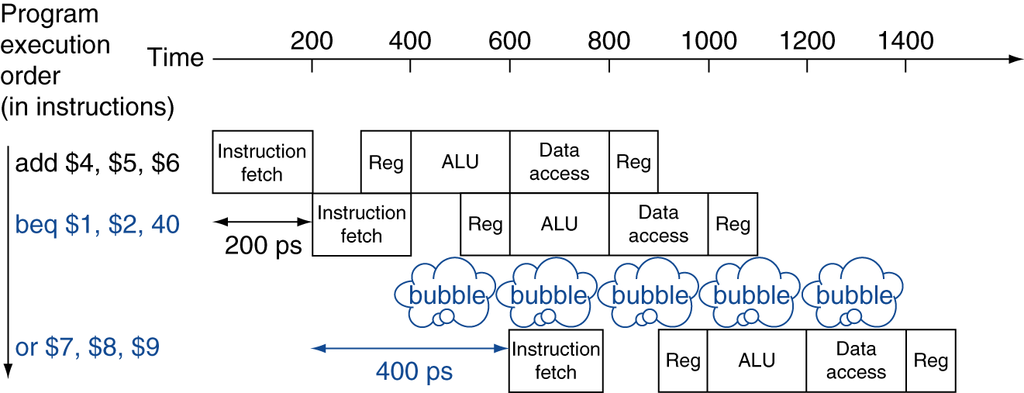
Stall on Branch
Wait until branch outcome determined before fetching next instruction
Chapter 4 — The Processor — <number>
Notes:
Morgan Kaufmann Publishers
Chapter 4 — The Processor

Slide 48
Branch Prediction
Longer pipelines can’t readily determine branch outcome early
  Stall penalty becomes unacceptable
Predict outcome of branch
  Only stall if prediction is wrong
In MIPS pipeline
  Can predict branches not taken
  Fetch instruction after branch, with no delay
Chapter 4 — The Processor — <number>
Notes:
Morgan Kaufmann Publishers
Chapter 4 — The Processor

Slide 49
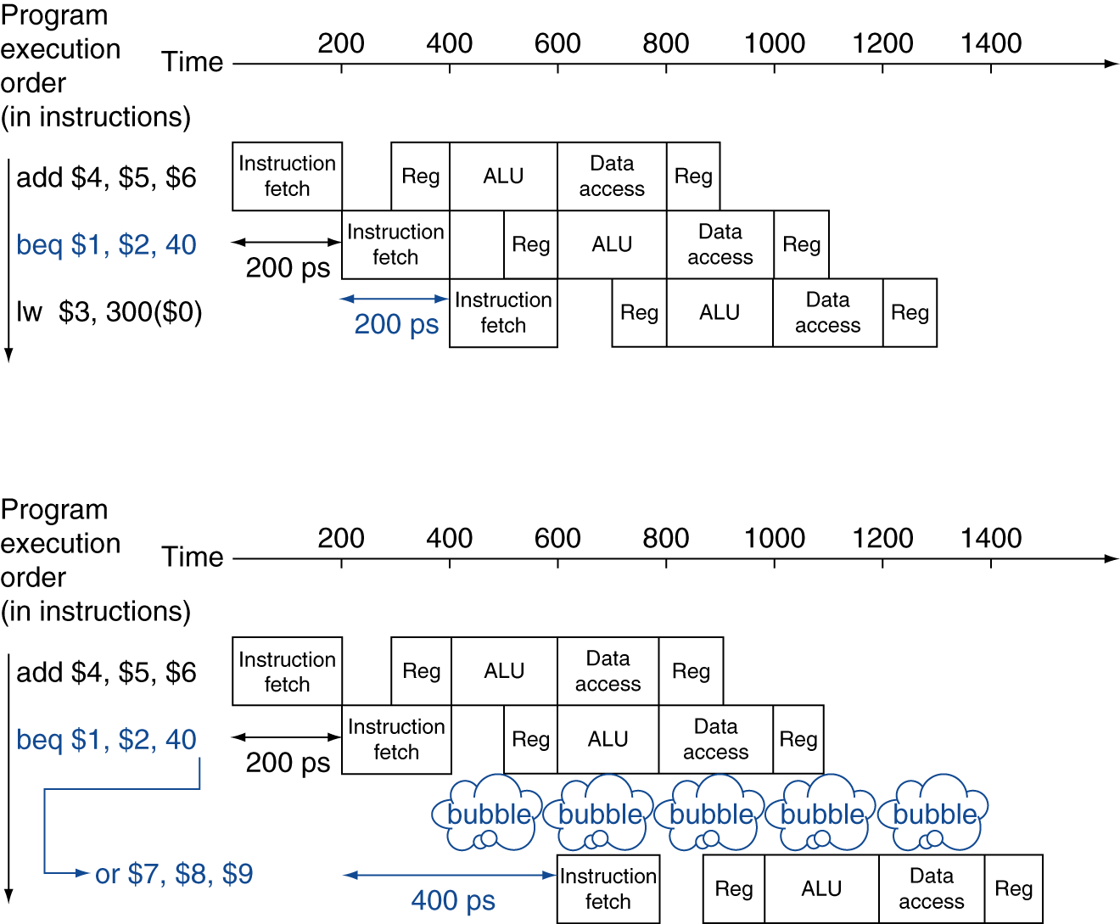
MIPS with Predict Not Taken
Prediction correct
Prediction incorrect
Chapter 4 — The Processor — <number>
Notes:
Morgan Kaufmann Publishers
Chapter 4 — The Processor

Slide 50
More-Realistic Branch Prediction
Static branch prediction
  Based on typical branch behavior
  Example: loop and if-statement branches
    Predict backward branches taken
    Predict forward branches not taken
Dynamic branch prediction
  Hardware measures actual branch behavior
    e.g., record recent history of each branch
  Assume future behavior will continue the trend
    When wrong, stall while re-fetching, and update history
Chapter 4 — The Processor — <number>
Notes:
Morgan Kaufmann Publishers
Chapter 4 — The Processor

Slide 51
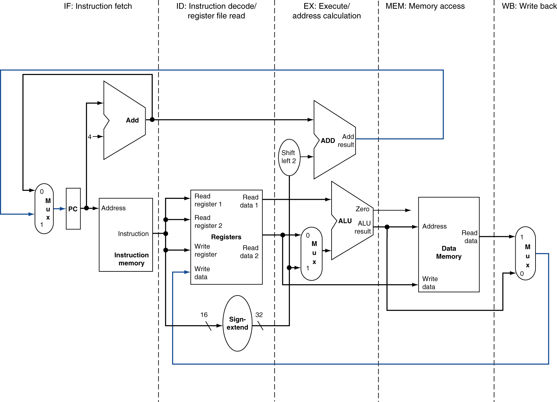
MIPS Pipelined Datapath
§4.6 Pipelined Datapath and Control
MEM
Right-to-left flow leads to hazards
WB
Chapter 4 — The Processor — <number>
Notes:
Morgan Kaufmann Publishers
Chapter 4 — The Processor

Slide 52
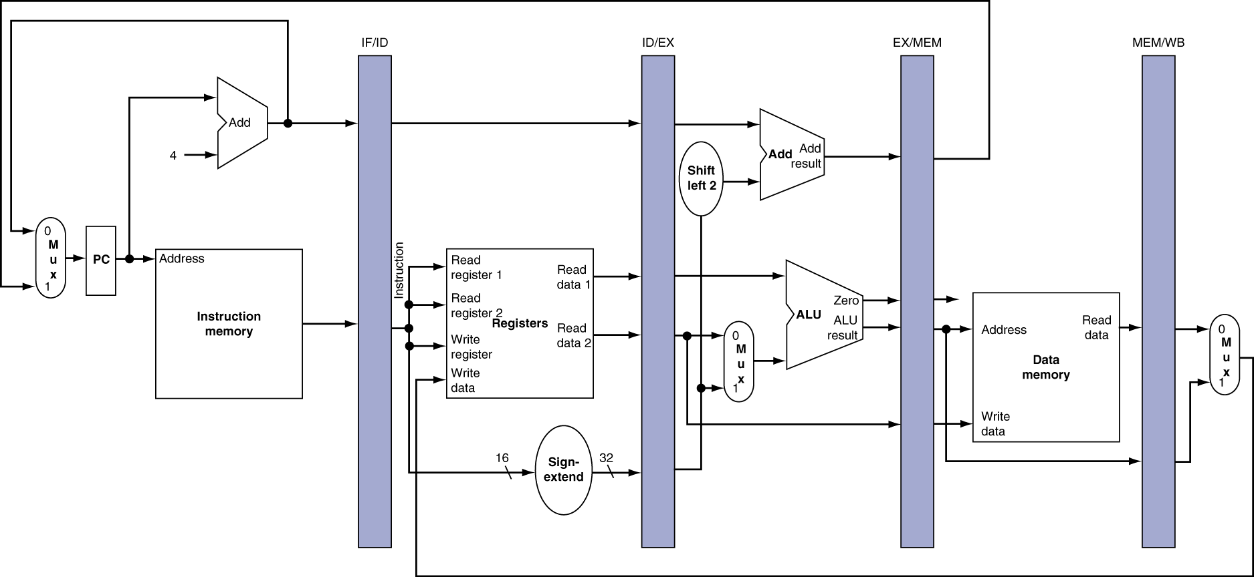
Pipeline registers
Need registers between stages
  To hold information produced in previous cycle
Chapter 4 — The Processor — <number>
Notes:
Morgan Kaufmann Publishers
Chapter 4 — The Processor

Slide 53
Pipeline Summary
The BIG Picture
Pipelining improves performance by increasing instruction throughput
  Executes multiple instructions in parallel
  Each instruction has the same latency
Subject to hazards
  Structure, data, control
Instruction set design affects complexity of pipeline implementation
Chapter 4 — The Processor — <number>
Notes:
Morgan Kaufmann Publishers
Chapter 4 — The Processor

