Slide 1
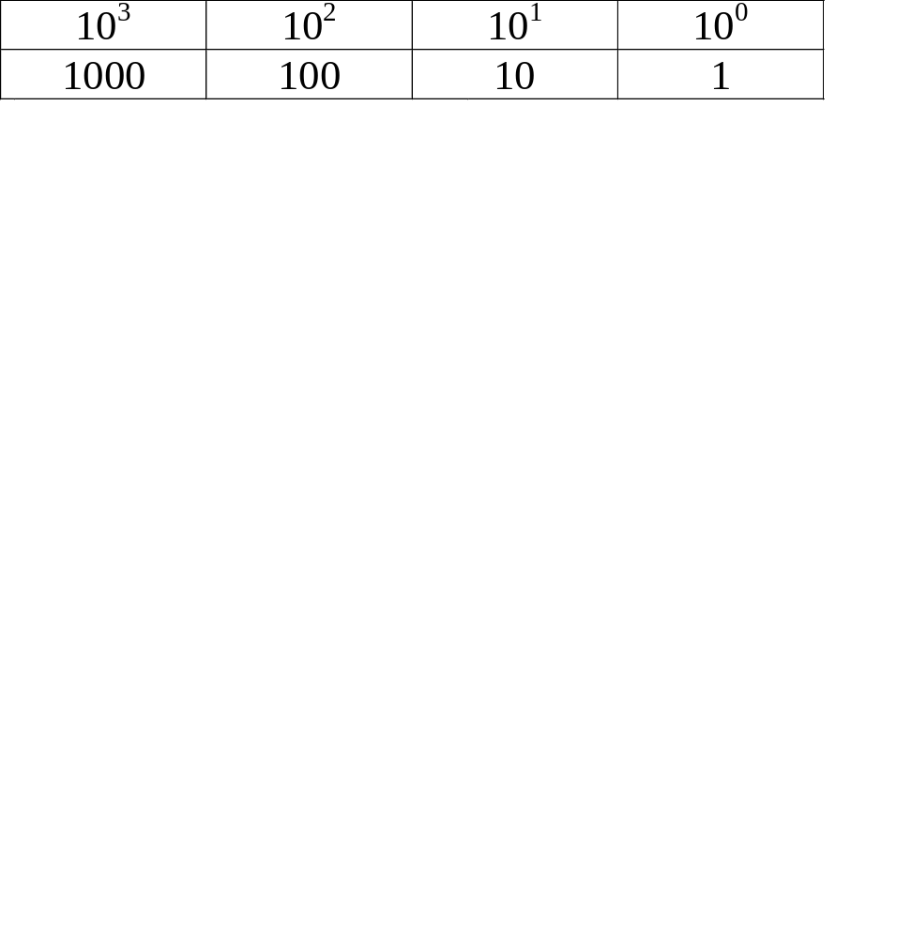
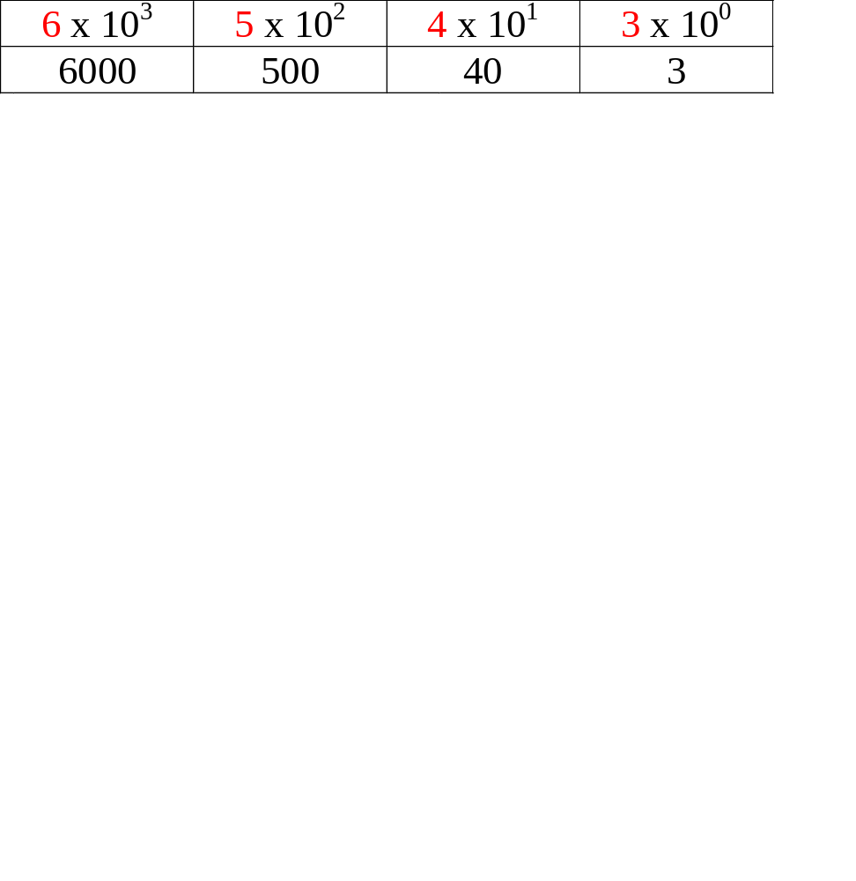
Base-10
10 digits: 0 - 9 (decimal)
place values: 10^{x}
i.e. 6543
6000 + 500 + 40 + 3 = 6543

Slide 2

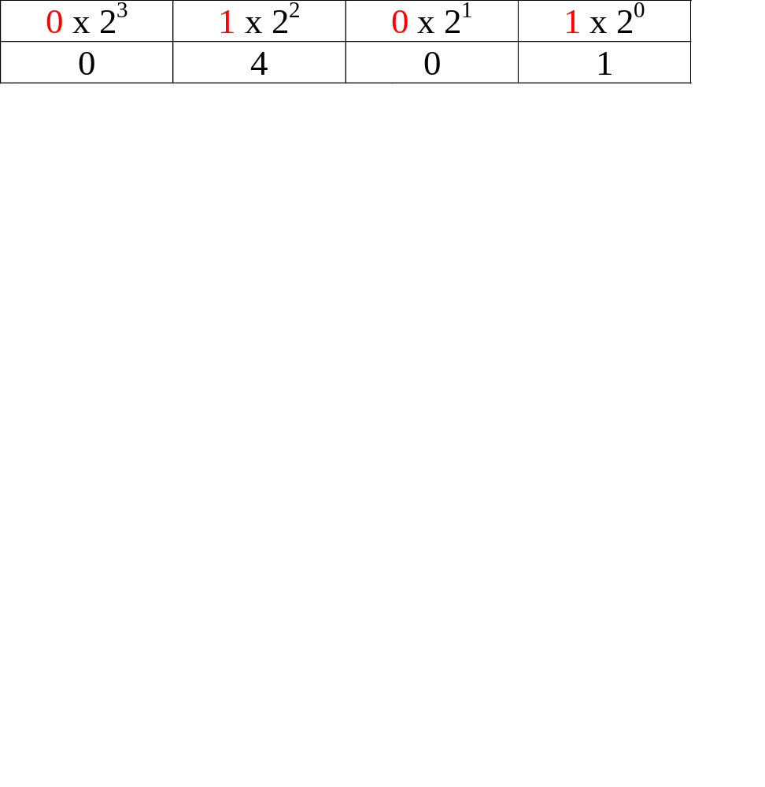
Base-2
2 digits: 0 - 1 (binary)
place values: 2^{x}
i.e. 0101 (binary)
0 + 4 + 0 + 1 = 5 (decimal)

Slide 3
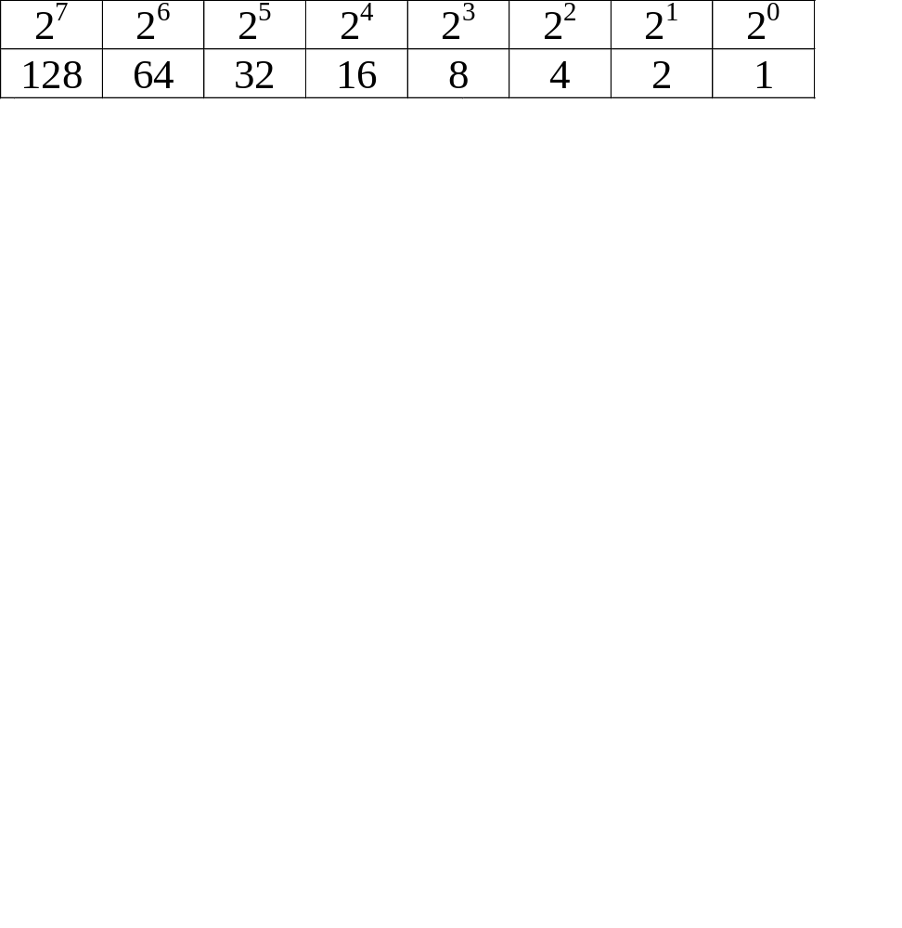
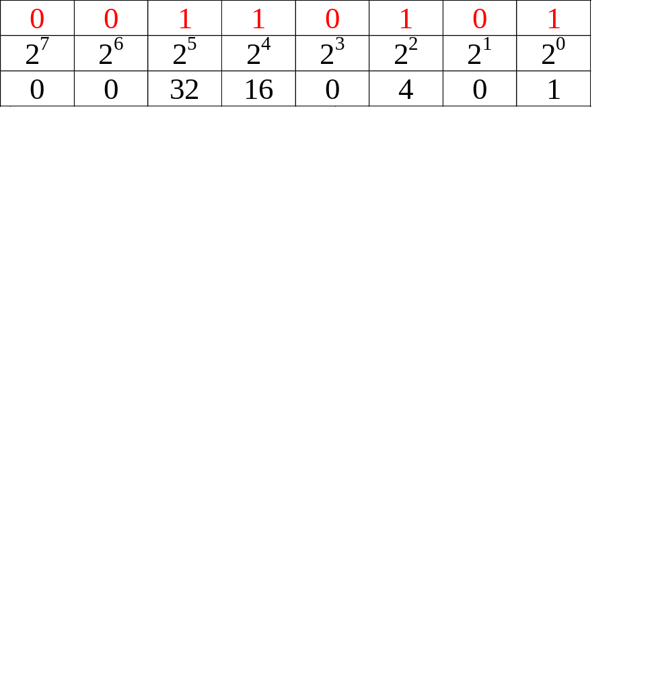
Bits & Bytes
bit = binary digit (0-1)
byte = 8 bits
i.e. 00110101 (binary)
0 + 0 + 32 + 16 + 0 + 4 + 0 + 1 = 53 (decimal)

Slide 4
32-bit vs. 64-bit Machines
system architecture
instruction set
machine language
x86 = 32-bit
x64 = 64-bit

