Slide 1
Objects First with Java A Practical Introduction using BlueJ
David J. Barnes
Michael Kölling
6.0
Notes:
Replace this with your course title and your name/contact details.

Slide 2
Course Contents
Introduction to object-oriented programming (OOP) …
… with a strong software engineering foundation …
… aimed at producing and maintaining large, high-quality software systems.

Slide 3
Buzzwords
responsibility-driven design
inheritance
encapsulation
iterators
overriding
coupling
cohesion
javadoc
interface
collection classes
mutator methods
polymorphic method calls

Slide 4
Goals
Sound knowledge of programming principles
Sound knowledge of object-orientation
Able to critically assess the quality of a (small) software system
Able to implement a small software system in Java

Slide 5
Book
David J. Barnes & Michael Kölling Objects First with Java A Practical Introduction using BlueJ 6th edition,
Pearson Education, 2017

Slide 6
IOOP - Course Overview
Objects and classes
Understanding class definitions
Object interaction
Grouping objects
More sophisticated behavior - libraries
Designing classes
Well-behaved objects - testing, maintaining, debugging

Slide 7
OOPDA - Course Overview
Inheritance
Polymorphism
Extendable, flexible class structures
Building graphical user interfaces
Handling errors
Designing applications

Slide 8
Advanced material
There is advanced material on:
Streams
Lambdas
2D arrays
This may be skipped on first reading ... or read, according to preference!

Slide 9
Classes and objects
Fundamental to much of the early parts of this course
Class: category or type of ‘thing’ (Like a template or blueprint)
Object: belongs to a particular class and has individual characteristics
Explore through BlueJ …

Slide 10
Fundamental concepts
It is vital to understand these concepts as soon as possible.
object
class
method
parameter
data type

Slide 11
Classes and Objects
Classes (noun)
Represents ALL generic objects of a similar kind or type
e.g. Car
Objects (proper noun)
Represents ONE specific thing from the real world or some problem domain
e.g. THAT red car in the garage or YOUR green car in the parking lot

Slide 12
Methods and Parameters
Methods (verbs)
Objects have operations which can be invoked on a specific object
e.g. drive the red car
Parameters (adverbs)
Additional necessary information may be passed to the method to help with its execution
e.g. drive the red car for 10 miles

Slide 13
Other observations
Many distinct instances can be created from a single class
An object has attributes that are values stored in fields
The CLASS defines what FIELDS an object has
But each OBJECT stores its own set of VALUES (the state of the object)

Slide 14
Demo of figures project
Notes:
Here, I start discussing objects and classes. I talk to the students
about it for a while, then I do an extensive demo of the shapes example in
BlueJ. All important points of this lecture are encountered and pointed
out during this demo.
All following slides serve only as summary, or reminder. No new material
is introduced after the demo.

Slide 15
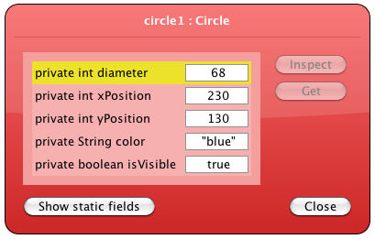
State

Slide 16
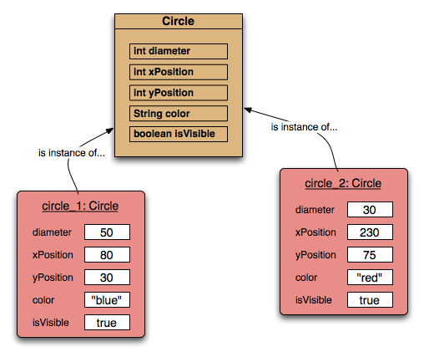
Two circle objects

Slide 17
Source code
Each class has its own JAVA source code associated with it that defines its details (attributes and methods)
The source code is written to obey the rules of a particular programming language (i.e. JAVA)
We will explore this in detail in the next chapter

Slide 18
Return values
All the methods in the figures project have void return types
But methods may return a result via a return value that is not void
Such methods will have a specific non-void return data type
More on this in the next chapter

Slide 19
Review
Classes model concepts
Source code realises those concepts
Source code defines:
What objects can do (methods)
What data they store (attributes)
Objects come into existence with pre-defined attribute values
The methods determine what objects do with their data

Slide 20
Review
When a method is called an object:
Alters its state, and/or
Uses its data to decide what to do
Some methods take parameters that affect their actions
Methods without parameters typically use their state to decide what to do
Some methods return a value

Slide 21
Review
Most programs contain multiple classes
At runtime, objects interact with each other to realize the overall effect of the program

