Slide 1
Understanding class definitions
Exploring source code
6.0

Slide 2
Main concepts to be covered
fields
constructors
methods
parameters
assignment statements

Slide 3
Ticket machines – an external view
Exploring the behavior of a typical ticket machine using naive-ticket-machine project that supplies tickets of a fixed price
How is that price determined?
How does a machine keep track of the money that is entered so far?
How does a machine keep track of the total amount of money collected?
How is ‘money’ entered into a machine?
How does the machine issue the ticket?

Slide 4
Ticket machines
Demo of
naïve-ticket-machine

Slide 5
Ticket machines – an internal view
Interacting with an object gives us clues about its behavior
Looking inside allows us to determine how that behavior is provided or implemented
All Java classes have a similar-looking internal view

Slide 6
Basic class structure
The outer wrapper of TicketMachine
public class TicketMachine
{
Inner part omitted
}
public class ClassName
{
Fields
Constructors
Methods
}
The inner contents of a class

Slide 7
Keywords
Words with a special meaning in the language:
public
class
private
int
Also known as reserved words
Always entirely lower-case

Slide 8
Fields
Fields store values for an object
They are also known as instance variables
Fields define the state of an object
Use Inspect in BlueJ to view the state
Some values change often
Some change rarely (or not at all)
public class TicketMachine
{
private int price;
private int balance;
private int total;
Further details omitted.
}
type
visibility modifier
variable name
private int price;

Slide 9
Constructors
public TicketMachine(int cost)
{
price = cost;
balance = 0;
total = 0;
}
Initialize an object
Have the same name as their class
Close association with the fields:
Initial values stored into the fields
Parameter values often used for these

Slide 10
Passing data via parameters
Parameters are another sort of variable

Slide 11
Assignment
Values may be stored into fields and other variables via assignment statements:
variable = expression;
balance = balance + amount;
A variable can store just one value, so any previous value is lost
pattern
example

Slide 12
Choosing variable names
There is a lot of freedom over choice of names … so use it wisely!
Choose expressive names to make code easier to understand:
price, amount, name, age, etc.
Avoid single-letter or cryptic names:
w, t5, xyz123

Slide 13
Next concepts to be covered
String concatenation
Methods
accessors and mutators
Conditional statements
Local variables
Scope and lifetime

Slide 14

String concatenation
4 + 5
9
"wind" + "ow"
"window"
"Result: " + 6
"Result: 6"
"# " + price + " cents"
"# 500 cents"
4 + 5 + “window“ + 4 + 5
“9window45"
overloading
Notes:
try out in codepad

Slide 15
Quiz
System.out.println(5 + 6 + "hello");
System.out.println("hello" + 5 + 6);
11hello
hello56

Slide 16
Methods
Methods implement the behavior of objects
Methods have a consistent structure comprised of a header and a body
Accessor methods provide information about an object
Mutator methods alter the state of an object
Other sorts of methods accomplish a variety of tasks (e.g. Print methods)

Slide 17
Method structure
The header provides the method’s signature:
public int getPrice()
The header tells us:
the visibility to objects of other classes (e.g. public, private or protected)
whether the method returns a result
the name of the method
whether the method takes parameters
The body encloses the method’s statements within curly braces { }

Slide 18
Method summary
Methods implement all object behavior
A method has a name and a return type
The return-type may be void
A non-void return type means the method will return a value to its caller
A method might take parameters
Parameters bring values in from outside for the method to use

Slide 19
Accessor (get) methods
return type
visibility modifier
method name
parameter list (empty)
public int getPrice()
{
return price;
}
return statement
start and end of method body (block)

Slide 20
Accessor methods
An accessor method always has a return type that is not void
An accessor method returns a value (result) of the type given in the header
The method will contain a return statement to return the value
NOTE: Returning is not printing!

Slide 21
Test
public class CokeMachine
{
private price;
public CokeMachine()
{
300 = price
}
public int getPrice
{
return Price;
}
What is wrong here?
(there are six errors!)

Slide 22
Test
public class CokeMachine
{
private price;
public CokeMachine()
{
price = 300
}
public int getPrice
{
return Price;
}
int
What is wrong here?
;
(there are six errors!)
()
-
}

Slide 23
Mutator methods
Have a similar method structure: header and body
Used to mutate (i.e. change) an object’s state
Achieved through changing the value of one or more fields
Typically contain one or more assignment statements
Often receive parameters

Slide 24
Mutator methods
visibility modifier
return type
method name
formal parameter
public void insertMoney(int amount)
{
balance = balance + amount;
}
field being mutated
assignment statement
Compound assignment operators (e.g. +=, -=, *=, /=)
balance += amount;

Slide 25
set mutator methods
Fields often have dedicated set mutator methods
These have a simple, distinctive form:
void return type
method name related to the field name
single formal parameter with the same type as the type of the field
a single assignment statement

Slide 26
A typical set method
public void setDiscount(int amount)
{
discount = amount;
}
We can easily infer that discount is a field of type int:
private int discount;

Slide 27
Protective mutators
A set method does not have to always assign unconditionally to the field
The parameter may be checked for validity and rejected if inappropriate
Mutators thereby protect fields
Mutators support encapsulation

Slide 28
Printing from methods
public void printTicket()
{
// Simulate the printing of a ticket.
System.out.println("##################");
System.out.println("# The BlueJ Line");
System.out.println("# Ticket");
System.out.println("# " + price + " cents.");
System.out.println("##################");
System.out.println();
// Update the total collected with the balance.
total = total + balance;
// Clear the balance.
balance = 0;
}

Slide 29
Reflecting on the ticket machines
Their behavior is inadequate in several ways:
No checks on the amounts entered
No refunds
No checks for a sensible initialization
How can we do better?
We need the ability to choose between different courses of action

Slide 30
Making choices in everyday life
If I have enough money left, then I will go out for a meal
Otherwise, I will stay home and watch a movie

Slide 31
Making a choice in everyday life
if(I have enough money left)
{
I will go out for a meal;
}
else
{
I will stay home and watch a movie;
}

Slide 32
Making choices in Java
‘if’ keyword
boolean condition to be tested
actions if condition is true
if(perform some test)
{
Do these statements if the test gave a true result
}
else
{
Do these statements if the test gave a false result
}
‘else’ keyword
actions if condition is false

Slide 33
Making a choice in the ticket machine
public void insertMoney(int amount)
{
if(amount > 0)
{
balance = balance + amount;
}
else
{
System.out.println( "Use a positive amount: "
+ amount);
}
}
conditional statement avoids an inappropriate action

Slide 34
How do we write a method to ‘refund’ an excess balance?
Notes:
write method in BlueJ;
first: do it wrong

Slide 35
Unsuccessful attempt
public int refundBalance()
{
// Return the amount left
return balance;
// Clear the balance
balance = 0;
}
It looks logical, but the language does not allow it.

Slide 36
Variables – a recap
Fields are one sort of variable
They store values through the life of an object
They are accessible throughout the class
Parameters are another sort of variable:
They receive values from outside the method
They help a method complete its task
Each call to the method receives a fresh set of values
Parameter values are short lived

Slide 37
Local variables
Methods can define their own local variables:
Short lived just like parameters
But MUST be declared within the method first
Unlike parameters which receives external values, the method MUST set their values
Used for temporary calculation and storage
Exist only as long as method is being executed
ONLY accessible from within declared code block
ONLY defined within a particular scope
Storage and values will DISAPPEAR after the method call is completed
May NOT be accessed outside of the method

Slide 38
Local variables
A local variable
public int refundBalance()
{
int amountToRefund;
amountToRefund = balance;
balance = 0;
return amountToRefund;
}
No visibility
modifier
Replace declaration & assignment with:
int amountToRefund = balance;

Slide 39
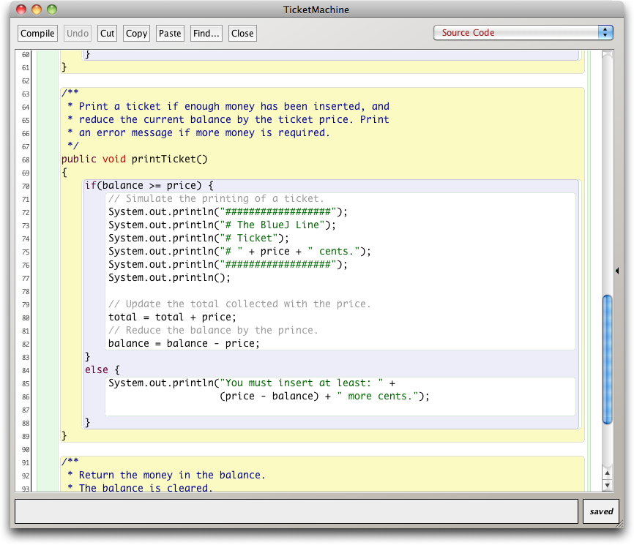
Scope highlighting

Slide 40
Scope and lifetime
Each block defines a new scope
Class, method and statement
Scopes may be nested:
statement block inside another block inside a method body inside a class body
Scope is static (textual)
Lifetime is dynamic (runtime)

Slide 41
Scope and lifetime of variables
Fields
Scope: the entire class in which it was defined
Lifetime: existence time of its containing object
Parameters
Scope: method/constructor which it is declared
Lifetime: execution time of method/constructor in which it was declared/passed into
Local variables
Scope: the code block in which it was declared
Lifetime: the execution time of the code block in which it was declared and initialized in

Slide 42
Review (1)
Class bodies contain fields, constructors and methods
Fields store values that determine an object’s state
Constructors initialize objects – particularly their fields
Methods implement the behavior of objects

Slide 43
Review (2)
Fields, parameters and local variables are all variables
Fields persist for the lifetime of an object
Local variables are used for short-lived temporary storage.
Parameters are used to receive values into a constructor or method

Slide 44
Review (3)
Methods have a return type
void methods do not return anything
non-void methods always return a value
non-void methods must have a return statement

Slide 45
Review (4)
Correct behavior often requires objects to make decisions
Objects can make decisions via conditional if statements
A true-or-false test allows one of two alternative courses of actions to be taken

