Slide 1
Object interaction
Creating cooperating objects
6.0

Slide 2
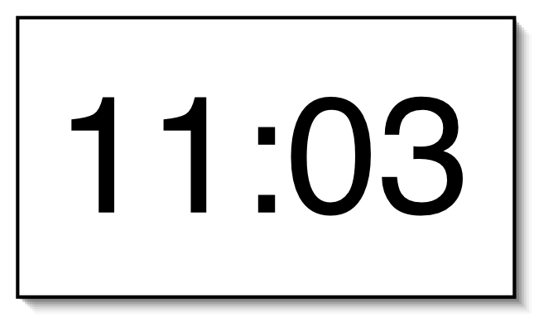
A digital clock

Slide 3
Abstraction and modularization
Abstraction is the ability to ignore details of parts to focus attention on a higher level of a problem
Modularization is the process of dividing a whole into well-defined parts, which can be built and examined separately, and which interact in well-defined ways

Slide 4



Modularizing the clock display
One four-digit display?
Or two two-digit displays?

Slide 5
Modeling a two-digit display
We call the class NumberDisplay
Two integer fields:
The current value
The limit for the value
The current value is incremented until it reaches its limit
It rolls over to zero at this point

Slide 6
Implementation - NumberDisplay
public class NumberDisplay
{
private int limit;
private int value;
public NumberDisplay(int limit)
{
this.limit = limit;
value = 0;
}
...
}

Slide 7
Implementation - ClockDisplay
public class ClockDisplay
{
private NumberDisplay hours;
private NumberDisplay minutes;
Constructor and
methods omitted.
}

Slide 8
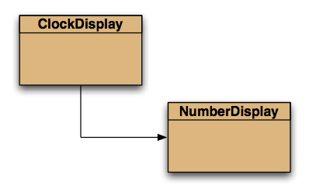
Class diagram (static view)

Slide 9
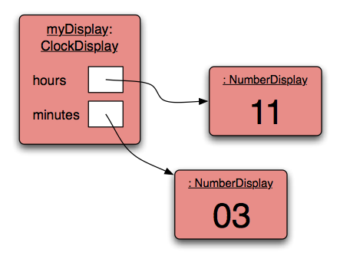
Object diagram (dynamic view)

Slide 10
Primitive types vs. Object types
SomeObject obj;
object type
int i;
primitive type
32

Slide 11
Quiz: What is the output?
int a; int b; a = 32; b = a; a = a + 1; System.out.println(b);
Person a; Person b; a = new Person("Everett"); b = a; a.changeName("Delmar"); System.out.println(b.getName());

Slide 12
Primitive types vs. object types
ObjectType a;
ObjectType b;
b = a;
int a;
int b;
32
32

Slide 13
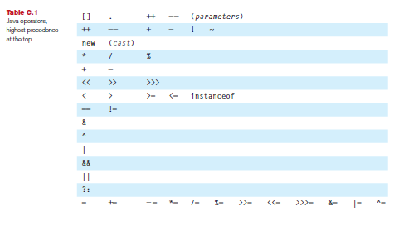
Java operators

Slide 14

Java relational operators
boolean result
Tests equality …. not identity!!

Slide 15
Java logical operators
BINARY
&& and
|| or
^ exclusive or
UNARY
! not

Slide 16
Logic operators for boolean values
Operands && || ^
T T T T F
T F F T T
F T F T T
F F F F F
Which are examples of short-circuit operators?

Slide 17
Logic operators for boolean values
Operands && || ^
T T T T F
T F F T T
F T F T T
F F F F F

Slide 18
The modulo operator
The division operator (/), when applied to int operands, returns the result of an integer division
The modulo operator (%) returns the remainder of an integer division
For example, generally: 17 / 5 gives result 3, remainder 2
In Java: 17 / 5 == 3 17 % 5 == 2

Slide 19

The modulo operation as an expression
Dividend / Divisor = Quotient RRemainder
21 / 5 = 4 R1
Thus, the modulo operation(%) is expressed as:
a % b == a – ((a / b) * b)
21 % 5 == 21 – ((21 / 5) * 5)
== 21 – ((4) * 5)
== 21 – 20
== 1

Slide 20
Quiz
What is the result of the expression 8 % 3
For integer n >= 0, what are all possible results of: n % 5
Can n be negative? ………… YES!! What are all the possible results of: -n % 5
Is this possible? n % 0

Slide 21
Quiz
What is the result of the expression 8 % 3 == 2
For integer n >= 0, what are all possible results of: n % 5 0, 1, 2, 3, 4
Can n be negative? ………… YES!! What are all the possible results of: -n % 5 -4, -3, -2, -1, -0
Is this possible? ………… NO!! n % 0 since n/0 is undefined

Slide 22
increment method
public void increment()
{
value = value + 1;
if(value == limit) { // Keep the value within the limit. value = 0; }
}

Slide 23
Alternative increment method
public void increment()
{
value = (value + 1) % limit;
}
Check that you understand how the rollover works in this version.

Slide 24
Source code: NumberDisplay
public NumberDisplay(int rollOverLimit)
{
limit = rollOverLimit;
value = 0;
}
public void increment()
{
value = (value + 1) % limit;
}
* value is between 0 --> (limit - 1)

Slide 25
Source code: NumberDisplay
public String getDisplayValue()
{
if(value < 10) {
return "0" + value;
}
else {
return "" + value;
}
}

Slide 26
Source code: setValue()
public void setValue(int replacementValue)
{
if((replacementValue >= 0) &&
(replacementValue < limit))
{
value = replacementValue;
}
}

Slide 27
Classes as types
Data can be classified under many different types; e.g. integer, boolean, floating-point.
In addition, every class is a unique data type; e.g. String, TicketMachine, NumberDisplay.
Data types, therefore, can be composites and not simply values.

Slide 28
Concepts
abstraction
modularization
classes define types
class diagram
object diagram
object references
object types
primitive types

Slide 29
Objects creating objects
public class ClockDisplay
{
private NumberDisplay hours;
private NumberDisplay minutes;
private String displayString;
public ClockDisplay()
{
hours = new NumberDisplay(24);
minutes = new NumberDisplay(60);
…
}
}

Slide 30
Objects creating objects
in class ClockDisplay:
hours = new NumberDisplay(24);
actual parameter
in class NumberDisplay:
public NumberDisplay(int rollOverLimit)
formal parameter

Slide 31
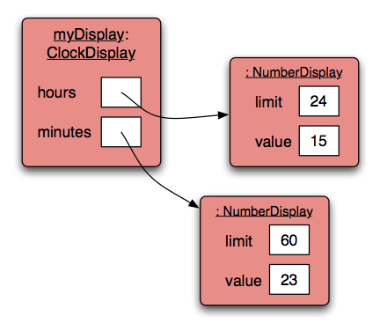
ClockDisplay object diagram

Slide 32
Object interaction
Two objects interact when one object calls a method on another
The interaction is usually all in one direction (client, server)
The client object can ask the server object to do something
The client object can ask for data from the server object

Slide 33
Object interaction
Two NumberDisplay objects store data on behalf of a ClockDisplay object
The ClockDisplay is the client object
The NumberDisplay objects are the server objects
The client calls methods in the server objects

Slide 34
Method calling
‘client’ method
public void timeTick()
{
minutes.increment();
if(minutes.getValue() == 0) {
// it just rolled over!
hours.increment();
}
updateDisplay();
}
‘server’ methods
internal/self method call

Slide 35
External method calls
General form of external method call: object . methodName ( params )
Examples: hours.increment() minutes.getValue()

Slide 36
Internal method calls
No variable name is required for internal method calls: updateDisplay();
Internal methods often have private visibility to prevent them from being called from outside their defining class
Method is found in this same invoking class/object where the call is made

Slide 37
Internal method
/**
* Update the internal string that
* represents the display.
*/
private void updateDisplay()
{
displayString =
hours.getDisplayValue() + ":" +
minutes.getDisplayValue();
}

Slide 38
Method calls
Internal means this object
External means any other object, regardless of its type
NOTE: A method call on another object of the same type would also be an external call

Slide 39
The this keyword
Used to distinguish parameters and fields of the same name
this could also be used as a reference to the invoking object instead of method calls public ClockDisplay(int limit) { this.limit = limit; value = 0; }

Slide 40
null
null is a special value in Java
Object fields are initialized to null by default
You can test for and assign null
private NumberDisplay hours; if(hours != null) { ... } hours = null;

Slide 41
null vs. void
null
Means undefined or no memory address is being pointed to
Used in code to represent no object reference exists
void
Means empty or no data type
Used in place of the return type for a method when no value is being returned

Slide 42
The debugger
Useful for gaining insights into program behavior …
… whether or not there is a program error
Set breakpoints
Examine variables
Step through code

Slide 43
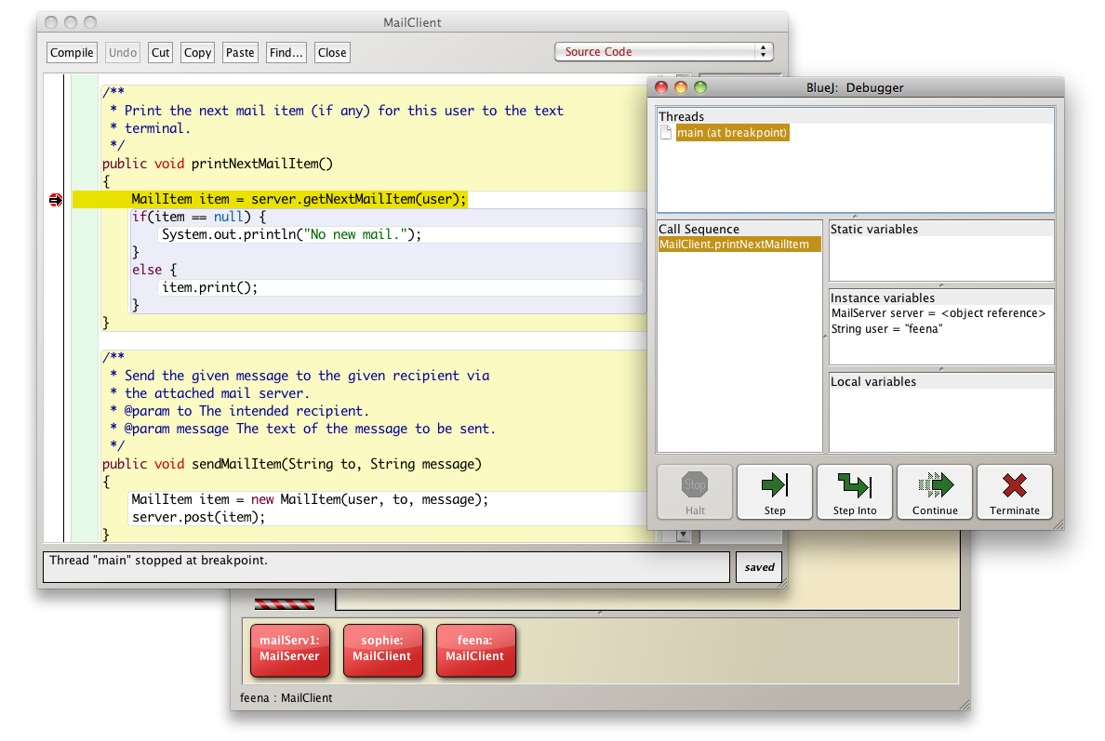
The debugger

Slide 44
Errors
Syntax
* Errors in the code text itself
* Found when compiling with unrecognizable text
* Fix by editing code
Logic
* Errors in the behavior of the program
* Found when running with unexpected results
* Fix by debugging and observing states
Runtime
* Errors which prohibit program from completing
* Found when executing the program
* Fix by tracing, debugging, observing and editing

Slide 45
Concept summary
object creation
overloading
internal/external method calls
debugger

