Slide 1
Grouping objects
Introduction to collections
6.0

Slide 2
Main concepts to be covered
Collections to group objects (e.g. ArrayList)
Builds on the abstraction theme to simplify a problem into components
Start making use of existing Java library classes to save time coding

Slide 3
The requirement to group objects
Many applications involve collections of objects:
Personal organizers
Library catalogs
Student record systems
Music organizer
Number of items to be stored is dynamic
Items added
Items deleted
Items retrieved

Slide 4
An organizer for music files
COLLECTION
Contains a group of songs
ITEMS
Songs are stored as its filename only
No pre-defined limit on the number of songs
OPERATIONS
Song files may be added
Song files may be deleted
How many song files are stored (i.e. size)
Get a song filename from the group
Explore the music-organizer-v1 project

Slide 5
Music collection example MusicOrganizer
CLASS
* MusicOrganizer containing various song files
FIELDS
* Dynamic ArrayList storage for a varying number of song String filenames
METHODS
* addFile
* removeFile
* getNumberOfFiles
* listFile

Slide 6
Class libraries
Provides many useful classes (e.g. String)
Don’t have to write class from scratch
Java calls its libraries packages
Use library classes the same way as classes that you write (i.e constructor/methods)
But do not appear in BlueJ class diagram
Grouping objects is a recurring requirement that is handled in the java.util package (e.g. ArrayList)
ArrayList library class will:
group the unsorted but ordered items
store item details
handle general access to the items

Slide 7
import java.util.ArrayList; // import statement
// first line of file
/** // before class definition
* ...
*/
public class MusicOrganizer
{
// Storage for an arbitrary number of file names.
private ArrayList<String> files;
/**
* Perform any initialization required for the
* organizer.
*/
public MusicOrganizer()
{
files = new ArrayList<String>();
}
...
}

Slide 8
Collections
We specify ...
collection type: ArrayList
containing objects of type: <String>
We say ... “ArrayList of String”
private ArrayList<String> files;
myMusic:
MusicOrganizer
files
null
* Only 1 field named files is defined for the entire class

Slide 9
Generic classes for items of any type
ArrayList<parameter-type>
These collections are known and defined as parameterized or generic types
parameter type between the angle brackets is the object type of the items in the list
ArrayList<Person>
ArrayList<TicketMachine>
An ArrayList may store any object type, but ALL objects in the list will be the same type

Slide 10
Creating an ArrayList object in the constructor
In Java versions prior to version 7
files = new ArrayList<String>( );
Java 7 introduced ‘diamond notation’
files = new ArrayList< >( );
where the type parameter can be inferred from the variable it is being assigned to
myMusic:
MusicOrganizer
:ArrayList<String>
new
files
•

Slide 11
Key methods of class ArrayList
The ArrayList class implements list functionality with methods for the following operations:
add(item)
add(index, item)
remove(item)
remove(index)
get(index)
size()
isEmpty()

Slide 12
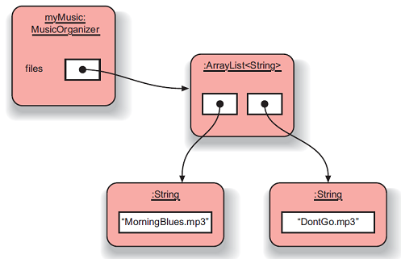
Object structures with ArrayList collections
Only a single field that stores an object of type ArrayList<String>
All work to access and manage the data is done in ArrayList object
Benefits of abstraction by not knowing details of how work is done
Helps us avoid duplication of information and behavior

Slide 13
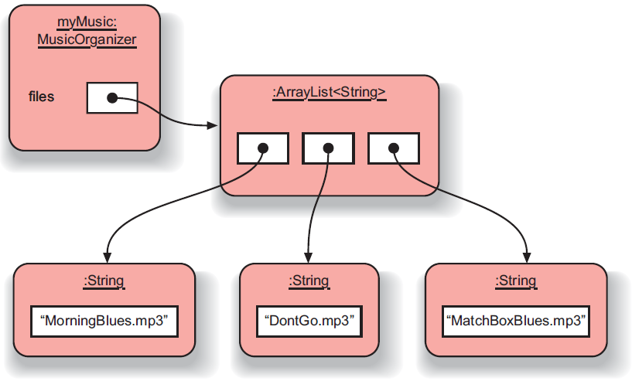
Adding a third file
Dynamic capacity with ability to increase and/or decrease as needed with its add( ) and remove( ) methods
Keeps an internal count of the number of items with size( ) method returning that count
Maintains the items in the order inserted with each new item added to the end of the list
As an item is removed, all items following after the removed item are shifted up and forward in order to fill the removed item’s space

Slide 14
Features of the collection
It increases its capacity as necessary
It keeps a private count of the number of items in the list
size() accessor
It keeps the objects in order of adding, but is otherwise unsorted
Details of how this is done are hidden
Does that matter?
Does not knowing prevent us from using it?

Slide 15
Generic classes
We can use ArrayList with any class type: ArrayList<TicketMachine> ArrayList<ClockDisplay> ArrayList<Track> ArrayList<Person>
Each will store multiple objects of the specific type

Slide 16
Using the collection
public class MusicOrganizer
{
private ArrayList<String> files;
...
public void addFile(String filename)
{
files.add(filename);
}
public int getNumberOfFiles()
{
return files.size();
}
...
}
Adding a new file
Returning the number of files
(delegation)

Slide 17
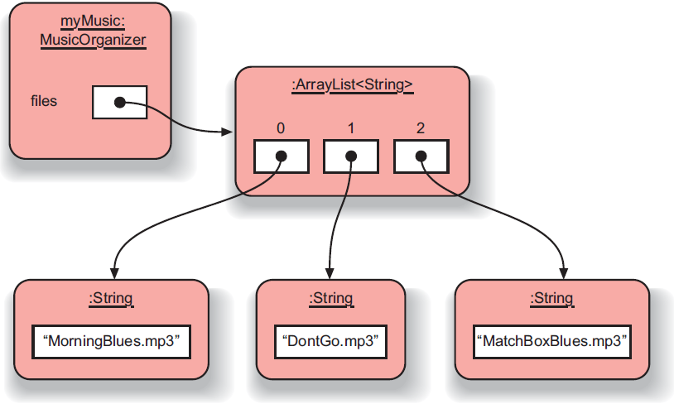
ArrayList Index numbering
Implicit numbering which starts with index 0 (same as String class)
Last item in the collection has the index size-1
Thus, valid index values would be between [0 . . . size( )-1]

Slide 18
Retrieving an object from the collection
Index validity checks
between [0 … size-1]
public void listFile(int index)
{
if(index >= 0 && index < files.size()) { String filename = files.get(index);
System.out.println(filename);
}
else {
// This is not a valid index.
}
}
Retrieve and print the file name
Needed? (Error message?)

Slide 19
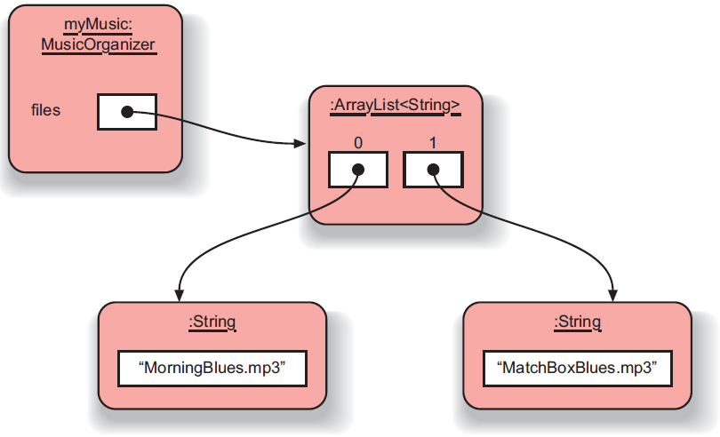
Removal may affect numbering
Removal process may change index values of other objects in the list
Collection moves all subsequent items up by 1 position to fill the gap
Indices of items in front of (preceding) the removed item are UNCHANGED
Indices of items after (following) the removed item are decreased by 1
Same “shifting” of items may also occur if adding new items into positions other than the end
files.remove(1);

Slide 20
The general utility of indices
Index values:
start at 0
are numbered sequentially
have no gaps in consecutive objects
Using integers to index collections has a general utility:
next: index + 1
previous: index – 1
last: list.size( ) – 1
the first three: items at indices 0, 1, 2
We could use loops and iteration to access items in sequence: 0, 1, 2, …

Slide 21
Review
Collections allow an arbitrary number of objects to be stored
Class libraries usually contain tried-and-tested collection classes
Java’s class libraries are called packages
We have used the ArrayList class from the java.util package

Slide 22
Review
Items may be added and removed
Each item has an index
Index values may change if items are removed (or further items added)
The main ArrayList methods are add, get, remove and size
ArrayList is a parameterized or generic type

Slide 23
Interlude: Some popular errors...

Slide 24
/** * Print out info (number of entries). */ public void showStatus() { if(files.size() == 0); { System.out.println("Organizer is empty"); } else { System.out.print("Organizer holds "); System.out.println(files.size() + " files"); } }
What’s wrong here?

Slide 25
/** * Print out info (number of entries). */ public void showStatus() { if(files.size() == 0); { System.out.println("Organizer is empty"); } else { System.out.print("Organizer holds "); System.out.println(files.size() + "files"); } }
This is the same as before!

Slide 26
/** * Print out info (number of entries). */ public void showStatus() { if(files.size() == 0) ; { System.out.println("Organizer is empty"); } else { System.out.print("Organizer holds "); System.out.println(files.size() + "files"); } }
This is the same again

Slide 27
/** * Print out info (number of entries). */ public void showStatus() { if(files.size() == 0) { ; } { System.out.println("Organizer is empty"); } else { System.out.print("Organizer holds "); System.out.println(files.size() + "files"); } }
and the same again…

Slide 28
/** * Print out info (number of entries). */ public void showStatus() { if(isEmpty = true) { System.out.println("Organizer is empty"); } else { System.out.print("Organizer holds "); System.out.println(files.size() + "files"); } }
This time I have a boolean field called ‘isEmpty’...
What’s wrong here?

Slide 29
/** * Print out info (number of entries). */ public void showStatus() { if(isEmpty == true) { System.out.println("Organizer is empty"); } else { System.out.print("Organizer holds "); System.out.println(files.size() + "files"); } }
This time I have a boolean field called ‘isEmpty’...
The correct version

Slide 30
/** * Store a new file in the organizer. If the * organizer is full, save it and start a new one. */ public void addFile(String filename) { if(files.size() == 100) files.save(); // starting new list files = new ArrayList<String>(); files.add(filename); }
What’s wrong here?

Slide 31
/** * Store a new file in the organizer. If the * organizer is full, save it and start a new one. */ public void addFile(String filename) { if(files.size() == 100) files.save(); // starting new list files = new ArrayList<String>(); files.add(filename); }
This is the same.

Slide 32
/** * Store a new file in the organizer. If the * organizer is full, save it and start a new one. */ public void addFile(String filename) { if(files.size() == 100) { files.save(); // starting new list files = new ArrayList<String>(); } files.add(filename); }
The correct version

Slide 33
Grouping objects
Collections and the for-each loop

Slide 34
Main concepts to be covered
Collections
Iteration
Loops: the for-each loop

Slide 35
Iteration
We often want to perform some actions an arbitrary number of times
e.g. print ALL the file names in the organizer
How many are there?
Most programming languages include loop statements or iterative control structures to make this possible
Java has several sorts of loop statement
We will start with its for-each loop

Slide 36
Iteration fundamentals
The process of repeating some actions over and over
Loops provide us with a way to control how many times we repeat those actions
With a collection, we often want to repeat the actions: exactly once for every object in the collection

Slide 37
For-each loop pseudo code
General form of the for-each loop
for keyword
loop header
for(ElementType element : collection) {
loop body
}
Statement(s) to be repeated
Pseudo-code expression of the actions of a for-each loop
For each element in collection, do the things in the loop body.
** where element is indeed a variable declaration of type ElementType and the variable is known as the loop variable

Slide 38
A Java example
/**
* List all file names in the organizer.
*/
public void listAllFiles()
{
for(String filename : files) {
System.out.println(filename);
}
}
for each filename in files, print out filename
for keyword introduces loop with details between ( )
loop variable filename is declared of type String
loop body repeated for each element in files ArrayList
each time, variable filename holds one of the elements
allows access to the object for that particular element

Slide 39
Review
Loop statements allow a block of statements to be repeated
The for-each loop allows iteration over a whole collection
With a for-each loop every object in the collection is made available exactly once to the loop’s body
But the for-each loop does NOT provide the index position of the current element

Slide 40
Selective processing
Statements may be nested, giving greater selectivity to the actions:
public void findFiles(String searchString)
{
for(String filename : files) {
if(filename.contains(searchString)) { System.out.println(filename); }
}
}
contains gives a partial match of the filename; use equals for an exact match
** using if statement to only print filenames matching the searchString

Slide 41
Critique of for-each
Only use for any type of collection
Accesses each element in sequence
Same action for each element but may use selective filter using if statements
Easy to write
Termination happens naturally
But, the collection cannot be changed
There is no index provided during access
Not all collections are index-based
Can NOT stop part way through loop
e.g. Find-the-first-that-matches
Provides definite iteration of ENTIRE list
a.k.a. bounded iteration

Slide 42
for-each
PROS
easy to use
access to ALL items one-by-one
ability to change the state of the item
terminates automatically
selective filter using if-else statements
actions in body may be complicated with multiple lines
use on ANY type of collection
abstraction from details of how handling occurs
CONS
no index provided
can NOT stop during looping
definite iteration of ALL items
can NOT remove or add elements during loop
use for collections only
access must be to ALL items in sequence [0 to size-1]

