Slide 1
Grouping objects
Iterator objects
Notes:
also explain: how to pass an ArrayList for testing

Slide 2
Iterator type
Third variation to iterate over a collection
Uses a while loop and Iterator object
But NO integer index variable
Takes advantage of abstraction with use of library class (like for-each)
import java.util.Iterator;
Iterator class vs. iterator( ) method

Slide 3
Iterator and iterator()
Collections (e.g. ArrayList) have an iterator() method
This returns an Iterator object
Iterator<E> has three methods:
boolean hasNext()
E next()
void remove()

Slide 4
Using an Iterator object
java.util.Iterator
returns an Iterator object
Iterator<ElementType> it = myCollection.iterator();
while(it.hasNext()) {
call it.next() to get the next object
do something with that object
}
Declare variable it as type Iterator of ElementType
Use iterator() method of collection (e.g. ArrayList) and assign the returned Iterator object to variable it
it object *indexes* to the first element in the collection
it.hasNext() checks to see if there is an object at the index
it.next() will get the actual object and advance the index
Objects First with Java - A Practical Introduction using BlueJ, © David J. Barnes, Michael Kölling
Notes:
Objects First with Java
© David J. Barnes and Michael Kölling
4
java.util.Iterator use = (1) create it object using .iterator method, (2) it.hasNext in loop condition, (3) it.next to get the next object, (4) it.remove (if necessary)

Slide 5
Iterator object example
java.util.Iterator
returns an Iterator object
public void listAllFiles()
{
Iterator<Track> it = tracks.iterator();
while(it.hasNext()) { Track tk = it.next();
System.out.println(tk.getDetails());
}
}
Prints ALL tracks in the collection (like while & for-each)
Still use while … BUT do not need an index variable
Iterator keeps track of current location, if there are any more items (hasNext) and which one to return (next)
Iterator.next returns next item AND moves past that item (can NOT go back)
Notes:
Objects First with Java
© David J. Barnes and Michael Kölling
5
Use ArrayList<Track> tracks (i.e. first row of students) to demo it.next -> (1) retrieve current object, (2) increment it to next, (3) return the retrieved object from #1

Slide 6
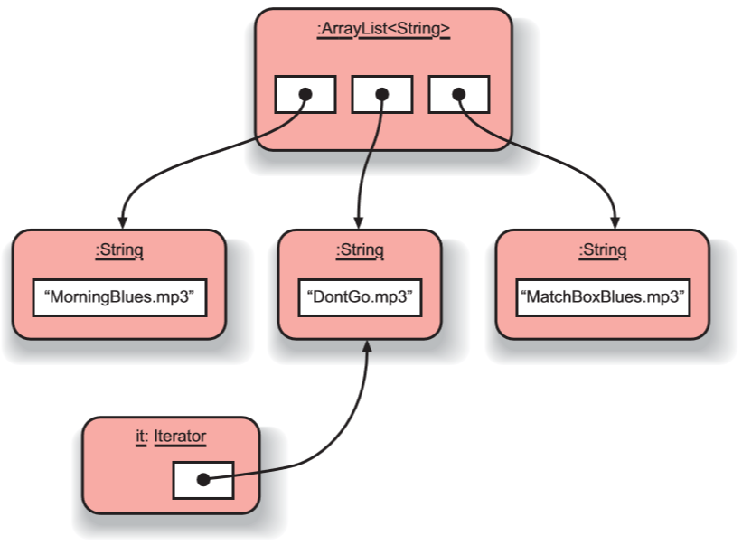
Iterator object
An iterator, after one iteration, pointing to the next item to be processed.
Objects First with Java - A Practical Introduction using BlueJ, © David J. Barnes, Michael Kölling

Slide 7
Iterator mechanics

Slide 8
myList:List
myList.iterator()
:Element
:Element
:Element
:Element
:Iterator

Slide 9
myList:List
:Element
:Element
:Element
:Element
:Iterator
:Iterator
hasNext()?
✔
next()
Element e = iterator.next();

Slide 10
myList:List
:Element
:Element
:Element
:Element
:Iterator
:Iterator
hasNext()?
✔
next()

Slide 11
myList:List
:Element
:Element
:Element
:Element
:Iterator
:Iterator
hasNext()?
✔
next()

Slide 12
myList:List
:Element
:Element
:Element
:Element
:Iterator
:Iterator
hasNext()?
✔
next()

Slide 13
myList:List
:Element
:Element
:Element
:Element
:Iterator
✗
hasNext()?

Slide 14
Track example
private ArrayList<Track> tracks;
tracks:
ArrayList<Track>
:Track
:Track
:Track
:Track
tracks:
ArrayList<Track>
Each Track has:
String artist
String title
String filename
0 1 2 3
:Track
:Track
:Track
:Track
Objects First with Java - A Practical Introduction using BlueJ, © David J. Barnes, Michael Kölling

Slide 15
Track example
tracks:
ArrayList<Track>
0 1 2 3
:Track
:Track
:Track
:Track
public void listAllFiles()
{
Iterator<Track> it = tracks.iterator();
while(it.hasNext())
{ Track t = it.next();
System.out.println(t.getDetails());
}
}
Objects First with Java - A Practical Introduction using BlueJ, © David J. Barnes, Michael Kölling

Slide 16
Track example
Iterator<Track> it = tracks.iterator();
tracks:
ArrayList<Track>
0 1 2 3
:Track
:Track
:Track
:Track
Use the iterator method of the ArrayList class to get an Iterator object for tracks
Assigns the Iterator object to the local variable named it
it
:Iterator
Objects First with Java - A Practical Introduction using BlueJ, © David J. Barnes, Michael Kölling

Slide 17
Track example
while(it.hasNext())
tracks:
ArrayList<Track>
0 1 2 3
:Track
:Track
:Track
:Track
it
:Iterator
it.hasNext()?
true
Objects First with Java - A Practical Introduction using BlueJ, © David J. Barnes, Michael Kölling

Slide 18
Track example
Track t = it.next();
tracks:
ArrayList<Track>
0 1 2 3
:Track
:Track
:Track
:Track
it.next( ) will:
Grab the current element
Move to the next element
Return last grabbed element
=
it
:Iterator
it
:Iterator
t

Slide 19
Track example
System.out.println(t.getDetails());
tracks:
ArrayList<Track>
0 1 2 3
:Track
:Track
:Track
:Track
it
:Iterator
t.getDetails( ) makes an external method call to the Track class with the t object to print out the String artist, title and filename fields.
t

Slide 20
Track example
Exit 1st iteration of while body
and repeat loop
tracks:
ArrayList<Track>
0 1 2 3
:Track
:Track
:Track
:Track
while(it.hasNext())
{
Track t = it.next();
System.out.println
(t.getDetails());
}
it
:Iterator
X
t

Slide 21
Track example
2nd iteration
tracks:
ArrayList<Track>
0 1 2 3
:Track
:Track
:Track
:Track
next
hasNext
true
=
it
:Iterator
while(it.hasNext())
{
Track t = it.next();
System.out.println
(t.getDetails());
}
t

Slide 22
Track example
Exit 2nd iteration
tracks:
ArrayList<Track>
0 1 2 3
:Track
:Track
:Track
:Track
it
:Iterator
while(it.hasNext())
{
Track t = it.next();
System.out.println
(t.getDetails());
}
X
t

Slide 23
Track example
3rd iteration
tracks:
ArrayList<Track>
0 1 2 3
:Track
:Track
:Track
:Track
=
while(it.hasNext())
{
Track t = it.next();
System.out.println
(t.getDetails());
}
it
:Iterator
t

Slide 24
Track example
Exit 3rd iteration
tracks:
ArrayList<Track>
0 1 2 3
:Track
:Track
:Track
:Track
it
:Iterator
while(it.hasNext())
{
Track t = it.next();
System.out.println
(t.getDetails());
}
X
t

Slide 25
Track example
4th iteration
tracks:
ArrayList<Track>
0 1 2 3
:Track
:Track
:Track
:Track
while(it.hasNext())
{
Track t = it.next();
System.out.println
(t.getDetails());
}
=
it
:Iterator
t

Slide 26
Track example
Exit 4th iteration
tracks:
ArrayList<Track>
0 1 2 3
:Track
:Track
:Track
:Track
while(it.hasNext())
{
Track t = it.next();
System.out.println
(t.getDetails());
}
it
:Iterator
X
t

Slide 27
Track example
5th iteration
tracks:
ArrayList<Track>
0 1 2 3
:Track
:Track
:Track
:Track
false
hasNext
while(it.hasNext())
{
Track t = it.next();
System.out.println
(t.getDetails());
}
it
:Iterator
NO more elements,
so the while loop STOPS!!

Slide 28
Index versus Iterator
Ways to iterate over a collection:
for-each loop (definite iteration)
Process every element w/o removing an element
while loop (indefinite iteration)
Use if we might want to stop part way through
Use for repetition that doesn't involve a collection
Iterator object (indefinite iteration)
Use if we might want to stop part way through
Often used with collections where indexed access is not very efficient, or impossible
Available for all collections in the Java class library
Use to remove from a collection
Iteration is important programming pattern

Slide 29
Removing elements
for each track in the collection
{
if track.getArtist( ) is the out-of-favor artist:
collection.remove(track)
}
Impossible with a for-each loop
Trying to remove( ) during an iteration causes ConcurrentModificationException
while loop possible, but NOT recommended
Easy to get indices wrong when removing
Proper solution is use of Iterator with while

Slide 30
Removing from a collection
Iterator<Track> it = tracks.iterator();
while(it.hasNext()) {
Track t = it.next();
String artist = t.getArtist();
if(artist.equals(artistToRemove)) {
it.remove();
}
}
Use the Iterator’s remove method.
Does NOT use tracks collection variable in the loop body
Must use Iterator’s remove( ) and NOT the ArrayList’s
Iterator’s can only remove the last retrieved using next
But it ALLOWS the element to be removed during loop
Iterator abstracts removal and keeps iteration in sync
Notes:
Use ArrayList<Track> tracks to demo it.remove -> (1) removes pointer of LAST object from tracks, (2) shifts ALL objects from current-to-last up one, (3) it still points to the correct element

Slide 31
Removing from a collection
tracks:
ArrayList<Track>
0 1 2 3
:Track
:Track
:Track
:Track
=
it
:Iterator
while(it.hasNext())
{
Track t = it.next();
String artist = t.getArtist();
if(artist.equals(artistToRemove))
{
it.remove();
}
}
t

Slide 32
Removing from a collection
tracks:
ArrayList<Track>
0 1 2 3
X
:Track
:Track
:Track
:Track
remove
Iterator remove method will:
remove the LAST element that returned by Iterator
handle indices of remaining elements (abstraction)
keeps iteration properly in sync
BUT limited to removing only last element
=
it
:Iterator
t

Slide 33
Removing from a collection without using an Iterator?
int index = 0;
while(index < tracks.size()) {
Track t = tracks.get(index);
String artist = t.getArtist();
if(artist.equals(artistToRemove)) {
tracks.remove(index);
}
index++;
}
Can you spot what is wrong?
Notes:
HINT: What if the 2nd to last element is removed? Will the last element get searched?

Slide 34
Review
Use an ArrayList to store an arbitrary number of object in a collection
Loop statements allow a block of statements to be repeated
for-each iterates over a whole collection
while loop allows the repetition to be controlled by a boolean expression
All collection classes provide Iterator objects that provide sequential access and modification to a whole collection

Slide 35
New COPY of an existing ArrayList
ArrayList<Track> copiedList = new ArrayList<Track>(tracks);
Declare a variable with the same ArrayList of <Element> type as the original ArrayList
Create a new ArrayList object (with the same element type as original) to store the copy in
Pass the original ArrayList as the parameter
Point the variable to the new COPY of the original list with exact same contents
NOTE:
Only ONE instance of each object element – but TWO ArrayList objects which point to the same objects in exactly the same order!!
Objects First with Java - A Practical Introduction using BlueJ, © David J. Barnes, Michael Kölling
Notes:
Objects First with Java
© David J. Barnes and Michael Kölling
35
java.util.ArrayList constructors – (1) no params, (2) one int param, (3) one list param

Slide 36
Random library class
import java.util.Random;
Random rand = new Random();
int index = rand.nextInt(size);
Generates a pseudo-random number by:
Using the Random library class imported from the java.util package
Creating an instance of class Random and assigning it to a local variable
With that instance, call the method nextInt to get a number
Optional parameter – upper limit size passed
Notes:
Objects First with Java
© David J. Barnes and Michael Kölling
36
java.util.Random constructors – (1) no params, (2) one long param for seed
Random.nextInt methods – (1) no params, (2) one int param … other Random methods?

Slide 37
Collections library class
import java.util.Collections;
ArrayList<String> files = new ArrayList< >();
Collections.shuffle(files);
Shuffles the items in a collection by:
Using the Collections library class imported from the java.util package
Calls the method shuffle to randomly change the order of existing items in the collection without removing/adding items
Parameter – pass the entire collection
Objects First with Java - A Practical Introduction using BlueJ, © David J. Barnes, Michael Kölling
Notes:
Objects First with Java
© David J. Barnes and Michael Kölling
37
** Ways to return a copied list of only Track elements containing “an” – (1) COPY & REMOVE, (2) NEW & ADD
** Ways to play a random Track order every time starting – (1) Collections.shuffle (if orig changed), (2) Random w/ seed index, (3) COPY & shuffle

Slide 38
auction project example
Online Auction system with:
Set of items (called lots) offered for sale
Each Lot assigned a unique lot number
A Person can try to buy the lot by bidding
At close of auction, highest Bid wins lot
Any lots with no bids remain sold at close
Unsold lots may be offered in later auction
Classes: Auction, Bid, Lot, Person
Objects First with Java - A Practical Introduction using BlueJ, © David J. Barnes, Michael Kölling

Slide 39
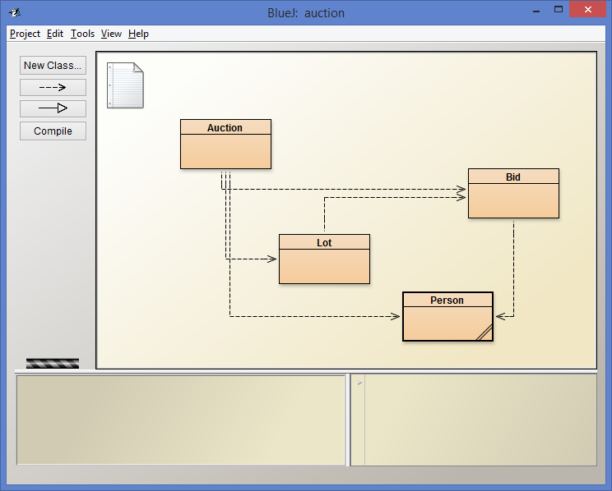
auction project

Slide 40
The auction project
The auction project provides further illustration of collections and iteration
Examples of using null
Anonymous objects
Chaining method calls

Slide 41
auction project
Online Auction system:
Sell items via enterLot with String description
Auction object creates Lot object for entered lot
lot number and description is assigned with no bidders
Bidder Person can register with only their name
Place bid with bidFor method of Auction object with lot number and how much to bid
Lot number passed so Lot objects internal to Auction
Auction object transforms bid amount to object
Lot records the highest bid object
Objects First with Java - A Practical Introduction using BlueJ, © David J. Barnes, Michael Kölling

Slide 42
null
Used with object types
Used to indicate … 'no object'
Used to indicate ‘no bid yet’ at the intialization of highestBid in the auction
highestBid = null;
We can test if an object variable holds the null value: if(highestBid == null) …
Attempt to de-reference null pointer:
NullPointerException

Slide 43
Anonymous objects
Objects are often created and handed on elsewhere immediately: Lot furtherLot = new Lot(…); lots.add(furtherLot);
We don’t really need furtherLot: lots.add(new Lot(…));

Slide 44
Chaining method calls
Methods often return objects
We often immediately call a method on the returned object:
Bid bid = lot.getHighestBid(); Person bidder = bid.getBidder();
We can use the anonymous object concept and chain method calls:
Person bidder = lot.getHighestBid().getBidder();

Slide 45
Chaining method calls
Each method in the chain is called on the object returned from the previous method call in the chain.
String name = lot.getHighestBid().getBidder().getName();
Returns a Bid object from the Lot
Returns a Person object from the Bid
Returns a String object from the Person

Slide 46
while versus do-while
Iterator<ElementType> it = myCollection.iterator();
while(it.hasNext()) {
call it.next() to get the next object
do something with that object
possibly it.remove()
}
How is a do-while loop different?
if collection has at least 1 element
{
Iterator<ElementType> it = myCollection.iterator();
do {
call it.next() to get the next object
do something with that object
possibly it.remove()
} while(it.hasNext());
}
Notes:
ArrayList.isEmpty()

Slide 47
Review
Collections are used widely in many different applications
The Java library provides many different ready made collection classes
Collections are often manipulated using iterative control structures
The while loop is the most important control structure to master

Slide 48
Review
Some collections lend themselves to index-based access
e.g. ArrayList
Iterator provides a versatile means to iterate over different types of collection
Removal using an Iterator is less error-prone in most circumstance

