Slide 1
More-Sophisticated Behavior
Using library classes to implement some more advanced functionality
6.0

Slide 2
Main concepts to be covered
Using library classes
Reading documentation

Slide 3
The Java class library
Thousands of classes
Tens of thousands of methods
Many useful classes that make life much easier
Library classes are often inter-related
Arranged into packages

Slide 4
Working with the library
A competent Java programmer must be able to work with the libraries
You should:
know some important classes by name;
know how to find out about other classes
Remember:
we only need to know the interface, not the implementation

Slide 5
Reading class documentation
Documentation of the Java libraries in HTML format
Readable in a web browser
Class API: Application Programmers Interface
Interface description for all library classes

Slide 6
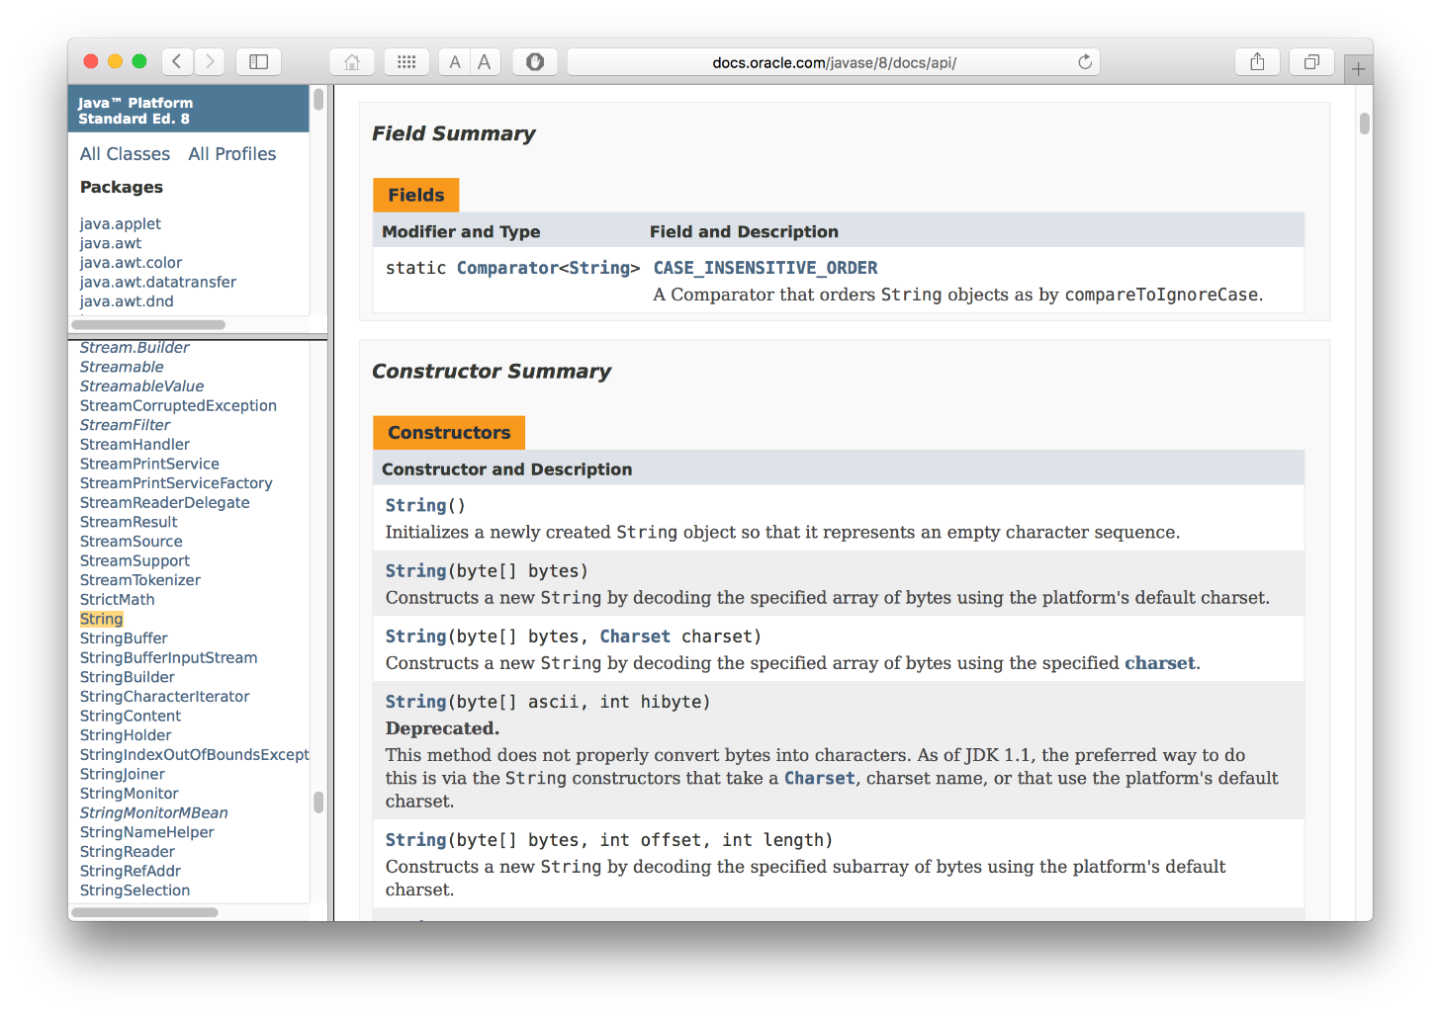
API Reference

Slide 7
Interface vs implementation
The documentation includes (the WHAT):
the name of the class
a general description of the class
a list of constructors and methods
return values and parameters for constructors and methods
a description of the purpose of each constructor and method
the interface of the class

Slide 8
Interface vs implementation
The documentation does not include (HOW):
private fields (most fields are private)
private methods
the bodies (source code) of methods
the implementation of the class

Slide 9
Debug with Logging
Print statements require removal before production
Logging provides a more effective alternative
Import classes/interfaces with core logging facilitate
import java.util.logging.Logger;
import java.util.logging.Level;
Declare and initialize the logger object for a class
Logger logger =
Logger.getLogger(ClassName.class.getName());
Instead of System.out.println statements, now use:
void log(Level level, String msg)
logger.log(Level.WARNING, "Name is INVALID");
Static Level constants in descending order:
SEVERE (highest value)
WARNING
INFO
CONFIG
FINE
FINER
FINEST (lowest value)

Slide 10
A Technical Support System
A interactive text dialog system providing technical support for online customers
Idea based on Eliza (AI program) developed by Joseph Weizenbaum (MIT, 1960s)
tech-support project requirements:
Technical support system text interface
User inputs a technical support question
Program generates a response

Slide 11
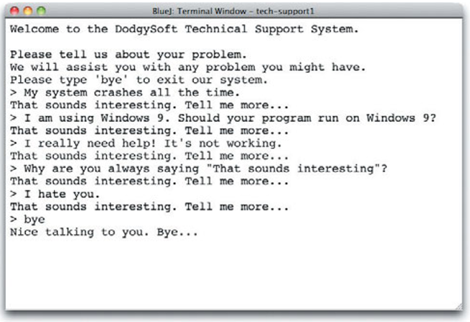
Interactive text dialog system tech-support

Slide 12
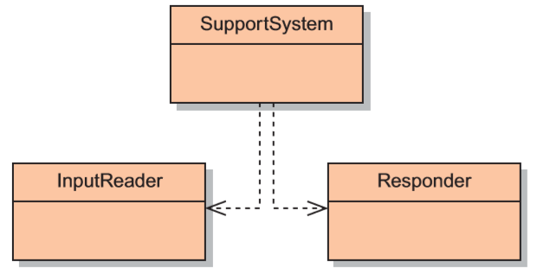
Modularization

Slide 13
tech-support project
public class SupportSystem
{
private InputReader reader;
private Responder responder;
/**
* Creates a technical support system.
*/
public SupportSystem()
{
reader = new InputReader();
responder = new Responder();
}
...

Slide 14
Basic structure
tech-support project requirements:
Technical support system text interface
User inputs a technical support question
Program generates a response
String input = reader.getInput();
...
String response = responder.generateResponse();
System.out.println(response);

Slide 15
Main loop structure
boolean finished = false;
while(!finished) {
do something
if(exit condition) {
finished = true;
}
else {
do something more
}
}
A common iteration pattern.

Slide 16
SupportSystem class
public void start()
{
boolean finished = false;
printWelcome();
while(!finished) {
String input = reader.getInput();
if(input.startsWith("bye")) {
finished = true;
}
else {
String response = responder.generateResponse();
System.out.println(response);
}
}
printGoodbye();
}
** input is ignored by Responder in this version

Slide 17
The exit condition
String input = reader.getInput();
if(input.startsWith("bye")) {
finished = true;
}
Where does ‘startsWith’ come from?
What is it?
What does it do?
How can we find out?

Slide 18
Documentation for startsWith
startsWith
public boolean startsWith(String prefix)
Tests if this string starts with the specified prefix
Parameters:
prefix - the prefix
Returns:
true - if the String startsWith the prefix
false – otherwise the String does not

Slide 19
Methods from String
boolean contains(char c)
boolean endsWith(String s)
int indexOf(String s)
int indexOf(String s, int i)
String substring(int b)
String substring(int b, int e)
String toUpperCase( )
String trim( )
Beware: strings are immutable!
(when invoking its methods, but may be mutated with the assignment operator)

Slide 20
Immutable String
String method
String toUpperCase()
Incorrect use
input.toUpperCase();
Correct use
input = input.toUpperCase();
if(input.toUpperCase().contains())

Slide 21
Using library classes
Classes organized into packages
Classes from the library must be imported using an import statement (except classes from java.lang)
They can then be used like classes from the current project

Slide 22
Packages and import
Single classes may be imported: import java.util.ArrayList;
Whole packages can be imported: import java.util.*;
Importation does NOT involve source code insertion

Slide 23
Using Random
The library class Random can be used to generate random numbers
import java.util.Random;
...
Random rand = new Random();
...
int num = rand.nextInt();
int value = 1 + rand.nextInt(100);
int index = rand.nextInt(list.size());

Slide 24
Selecting a random response
private Random randomGenerator;
private ArrayList<String> responses;
public Responder()
{
randomGenerator = new Random();
responses = new ArrayList<String>();
fillResponses();
}
private void fillResponses()
{
…fill ArrayList responses with a selection of response strings…
}
public String generateResponse()
{
int index = randomGenerator.nextInt(responses.size());
return responses.get(index);
}

Slide 25
Fill ArrayList of responses
private ArrayList<String> responses;
public Responder()
{
randomGenerator = new Random();
responses = new ArrayList<String>();
fillResponses();
}
public void fillResponses()
{
responses.add("That sounds odd. Could you describe \n" + "that problem in more detail?");
responses.add("No other customer has ever \n" + "complained about this before. \n" +
"What is your system configuration?");
responses.add("That’s a known problem with Vista." + "Windows 7 is much better.");
responses.add("I need a bit more information on that.");
responses.add("Have you checked that you do not \n" + "have a dll conflict?");
responses.add("That is explained in the manual. \n" + "Have you read the manual?");
responses.add("Your description is a bit \n" + "wishy-washy. Have you got an expert \n" +
"there with you who could describe \n" + "this more precisely?");
responses.add("That’s not a bug, it’s a feature!");
responses.add("Could you elaborate on that?");
}

Slide 26
Parameterized (Generic) classes
The documentation includes provision for a type parameter:
ArrayList<E>
These type names reappear in the parameters and return types:
E get(int index)
boolean add(E e)

Slide 27
Parameterized classes
The types in the documentation are placeholders for the types we use in practice
An ArrayList<TicketMachine> actually has methods:
TicketMachine get(int index)
boolean add(TicketMachine e)

Slide 28
Review
Java has an extensive class library
A good programmer must be familiar with the library
The documentation tells us what we need to know to use a class (its interface)
Some classes are parameterized with additional types
Parameterized classes are also known as generic classes or generic types

Slide 29
Further library classes
Using library classes to implement some more advanced functionality

Slide 30
Main concepts to be covered
Further library classes:
Set – avoiding duplicates
Map – creating associations
Writing documentation:
javadoc

Slide 31
Using sets
import java.util.HashSet;
...
HashSet<String> mySet = new HashSet<String>();
mySet.add("one");
mySet.add("two");
mySet.add("three");
for(String element : mySet) {
do something with element
}
Compare with code for an ArrayList!

Slide 32
ArrayList vs. HashSet
Similarities
Contain a collection of objects
Add objects (.add method)
Remove objects (.remove method)
Number of elements (.size method)
Iterator ability (.iterator method)
Differences
HashSet objects are unique, while an ArrayList can have duplicate objects
HashSet objects are not ordered, while ArrayList objects are ordered

Slide 33
Maps
Maps are flexible-sized collections that contain:
value pairs each with its own object type
each pair consists of a key and a value
Uses the key to easily lookup the value
instead of using an integer index
For example, a telephone book:
name and phone number pair
Reverse-lookup of key using value
not so easy

Slide 34
Using maps
A map with strings as keys and values
:HashMap
"Charles Nguyen"
"(531) 9392 4587"
"Lisa Jones"
"(402) 4536 4674"
"William H. Smith"
"(998) 5488 0123"

Slide 35
Using maps .put and .get
Declaration and creation of contacts HashMap:
HashMap<String, String> contacts = new HashMap<String, String>();
HashMap .put method inserts an entry:
contacts.put("Charles Nguyen", "(531) 9392 4587");
contacts.put("Lisa Jones", "(402) 4536 4674");
contacts.put("William H. Smith", "(998) 5488 0123");
HashMap .get method retrieves the value :
String number = contacts.get("Lisa Jones");
System.out.println(number);
Does HashMap have an iterator method?
Notes:
.put return values? .get return values? How do you iterate thru a HashMap? (.keySet, .values, .entrySet)

Slide 36
Using maps in TechSupport
private HashMap<String, String> responseMap;
:
responseMap = new HashMap<String, String>();
:
responseMap.put("slow",
"I think this has to do with your hardware. \n" + "Upgrading your processor should solve all " + "performance problems. \n" + "Have you got a problem with our software?");
responseMap.put("bug",
"Well, you know, all software has some bugs. \n" + "But our software engineers are working very " + "hard to fix them. \n" + "Can you describe the problem a bit further?");
responseMap.put("expensive",
"The cost of our product is quite competitive. \n" + "Have you looked around and " + "really compared our features?");

Slide 37
TechSupport response map
Responses in an ArrayList of String:
public String generateResponse()
{
int index = randomGenerator.nextInt(responses.size());
return responses.get(index);
}
Using a HashMap:
public String generateResponse(String word)
{
String response = responseMap.get(word);
if(response != null) {
return response;
}
else {
return pickDefaultResponse();
}
}

Slide 38
Dividing Strings
public HashSet<String> getInput()
{
System.out.print("> ");
String inputLine =
reader.nextLine().trim().toLowerCase();
String[ ] wordArray = inputLine.split(" ");
HashSet<String> words = new HashSet<String>();
for(String word : wordArray) {
words.add(word);
}
return words;
}
Objects First with Java - A Practical Introduction using BlueJ, © David J. Barnes, Michael Kölling

Slide 39
String .split
String[ ] split(String regex)
Splits this string around matches of the given regular expression
String[] wordArray = inputLine.split(" ");
Splits inputLine around the regular expression of “ ”
Regular Expressions
“ ” – space
“\t” - tab
“\\s” - any white space
“[ \t]” – space or tab(grouping)
“[ \t]+” – space or tab(one or more)
Objects First with Java - A Practical Introduction using BlueJ, © David J. Barnes, Michael Kölling

Slide 40
Using regex
String.split( )
String[] wordArray =
originalString.split(“[ \t]+”);
Splits original String around (one or more) spaces or tabs
String[] wordArray = originalString.split(“\\s+”);
Splits original String around (one or more) of ANY white space
String.trim( ).replaceAll( )
String newString =
oldString.trim( ).replaceAll(“\\s+”, “ ”);
Removes ALL occurrences of leading and trailing spaces with .trim AND
Replaces ALL (one or more) white spaces with just a SINGLE space
Notes:
Objects First with Java
© David J. Barnes and Michael Kölling
40

Slide 41
TechSupport input set
Input using an String:
String input = reader.getInput();
:
String response = responder.generateResponse();
Split input words into a HashSet of String:
HashSet<String> input = reader.getInput();
:
String response = responder.generateResponse(input);
:
public String generateResponse(HashSet<String> words)
{
for(String word : words) {
String response = responseMap.get(word);
if(response != null) {
return response;
}
}
return pickDefaultResponse();
}

Slide 42
List, Map and Set
Alternative ways to group objects
Varying implementations available:
List: ArrayList, LinkedList
Set: HashSet, TreeSet
HashMap is unrelated to HashSet, & HashSet is closer to ArrayList
Name consist of 2 parts “Array” “List”
2nd word – collection type (List, Map, Set)
1st word – how it is implemented

Slide 43
Collections and primitive types
Generic collection classes can be used with all class/object types
But what about primitive types such as int, boolean, etc…
Suppose we want an ArrayList of int?

Slide 44
Wrapper classes
Primitive types are not objects types
Primitive-type values must be wrapped in objects to be stored in a collection!
Wrapper classes exist for all primitive types:
Primitive type Wrapper class
int Integer
float Float
char Character
... ...
Notes:
Note that there is no simple mapping rule from primitive name to wrapper name!

Slide 45
Wrapper classes
wrap the value
int i = 18;
Integer iwrap = new Integer(i);
…
int value = iwrap.intValue();
unwrap it
In practice, autoboxing and unboxing mean we don't often have to do this explicitly
int i = 18;
Integer iwrap = i;
…
int value = iwrap;

Slide 46
Autoboxing and unboxing
private ArrayList<Integer> markList;
...
public void storeMark(int mark)
{
markList.add(mark);
}
autoboxing
int firstMark = markList.remove(0);
unboxing

Slide 47
Class variables and Constants

Slide 48
Class variables
A class variable is shared between ALL instances/objects of the class
It is a field stored in the class and exists independent of any instances
Designated by the static keyword
Public static variables are accessed via the class name (NOT object name)
Thermometer.boilingPoint

Slide 49
Constants
A variable, once set, can have its value fixed
Designated by the final keyword
final int SIZE = 10;
Final fields must be set in their declaration or the constructor
Combining static and final is common

Slide 50
Class constants
static - class variable
final - constant
private static final int GRAVITY = 3;
Public visibility is less of an issue with final fields
Upper-case names often used for class constants:
public static final int BOILING_POINT = 100;

Slide 51
Class constants
private static final int GRAVITY = 3;
private int xPosition;
private int yPosition;

Slide 52
HashMap diagrams
private static final int MAX = 3;
Organizer
MAX
3
private HashMap<String, String> phonebook;
myOrganizer:
Organizer
:HashMap<String, String>
phonebook
:Map
:String
:Map
:String
“John Doe”
“Jane Smith”
K
V
K
V
:String
:String
“856-111-1111”
“856-222-2222”

Slide 53
Class Methods
So far, only used instance methods
invoked on an instance(object) of a class
However, class methods are different
may be invoked WITHOUT a class object
Similar to class variables in that the class methods BELONG to the class
having the class is enough to invoke it
Objects First with Java - A Practical Introduction using BlueJ, © David J. Barnes, Michael Kölling

Slide 54
Class methods
A static method belongs to its class rather than the instances:
public static int getDaysThisMonth()
Static methods are invoked via their class name:
int days = Calendar.getDaysThisMonth();
There is NO object so the name of class is used before the dot!

Slide 55
Limitations of class methods
A static method exists independent of any instances.
Therefore:
They cannot access instance fields within their class
They cannot call instance methods within their class

Slide 56
Review
Class variables belong to their class rather than its instances
Class methods belong to their class rather than its instances
Class variables are used to share data among instances
Class methods are prohibited from accessing instance variables and methods

Slide 57
Review
The values of final variables are fixed
They must be assigned at declaration or in the constructor (for fields)
final and static are unrelated concepts, but they are often used together

Slide 58
Further Advanced Material

Slide 59
Polymorphic collection types
Different collection classes offer similar interfaces:
ArrayList and LinkedList
HashSet and TreeSet
Types exist which capture those similarities:
List
Set

Slide 60
Polymorphic collection types
Polymorphism allows us to ignore the more specific type in most cases
Create objects of the specific type
BUT declare variables of the more general type:
List<Track> tracks = new LinkedList<>();
Map<String, String> responseMap = new HashMap<>();

Slide 61
The Stream collect method
Used to create a new collection object at the end of a pipeline
The collect method takes a Collector parameter that accumulates elements of the stream
We often use the polymorphic collection types for the result

Slide 62
Collecting a filtered stream
public List<Sighting> getSightingsOf(String animal)
{
return sightings
.stream()
.filter(record -> animal.equals(
record.getAnimal()))
.collect(Collectors.toList());
}
java.util.stream.Collectors
static toList method returns a generic Collector object

Slide 63
Writing class documentation
User classes should be documented the same way library classes are
Others should be able to use your class without reading the implementation
Make your class a potential library class

Slide 64
Elements of documentation
Documentation for a class should include:
the class name
a comment describing the overall purpose and characteristics of the class
a version number (@version)
the authors’ names (@author)
documentation for each constructor and each method

Slide 65
Elements of documentation
The documentation for each constructor and method should include:
the name of the method
the return type (@return)
the parameter names and types (@param)
a description of the purpose and function of the method
a description of each parameter
a description of the value returned

Slide 66
javadoc
Class comment:
/**
* The Responder class represents a response
* generator object. It is used to generate an
* automatic response.
*
* @author Michael Kölling and David J. Barnes
* @version 1.0 (2011.07.31)
*/

Slide 67
javadoc
Method/Constructor comment:
/**
* Read a line of text from standard input (the text
* terminal), and return it as a set of words.
*
* @param prompt A prompt to print to screen.
* @return A set of Strings, where each
* String is of the words typed
* by the user
*/
public HashSet<String> getInput(String prompt)
{
...
}

Slide 68
Public vs private
Public elements are accessible to objects of other classes
Fields, constructors and methods
Fields should NOT be public
Keeps the integrity of the field
Private elements are accessible only to objects of the same class
Only methods that are intended for other classes should be public

Slide 69
Information hiding
Data belonging to one object is hidden from other objects (abstraction)
Know what an object can do, but NOT necessarily how it does it
Information hiding increases the level of independence (modularization)
Independence of modules is important for large systems and maintenance (loose coupling)

Slide 70
Code completion
The BlueJ editor supports lookup of methods
Use Ctrl-space after a method-call dot to bring up a list of available methods
Use Return to select a highlighted method

Slide 71
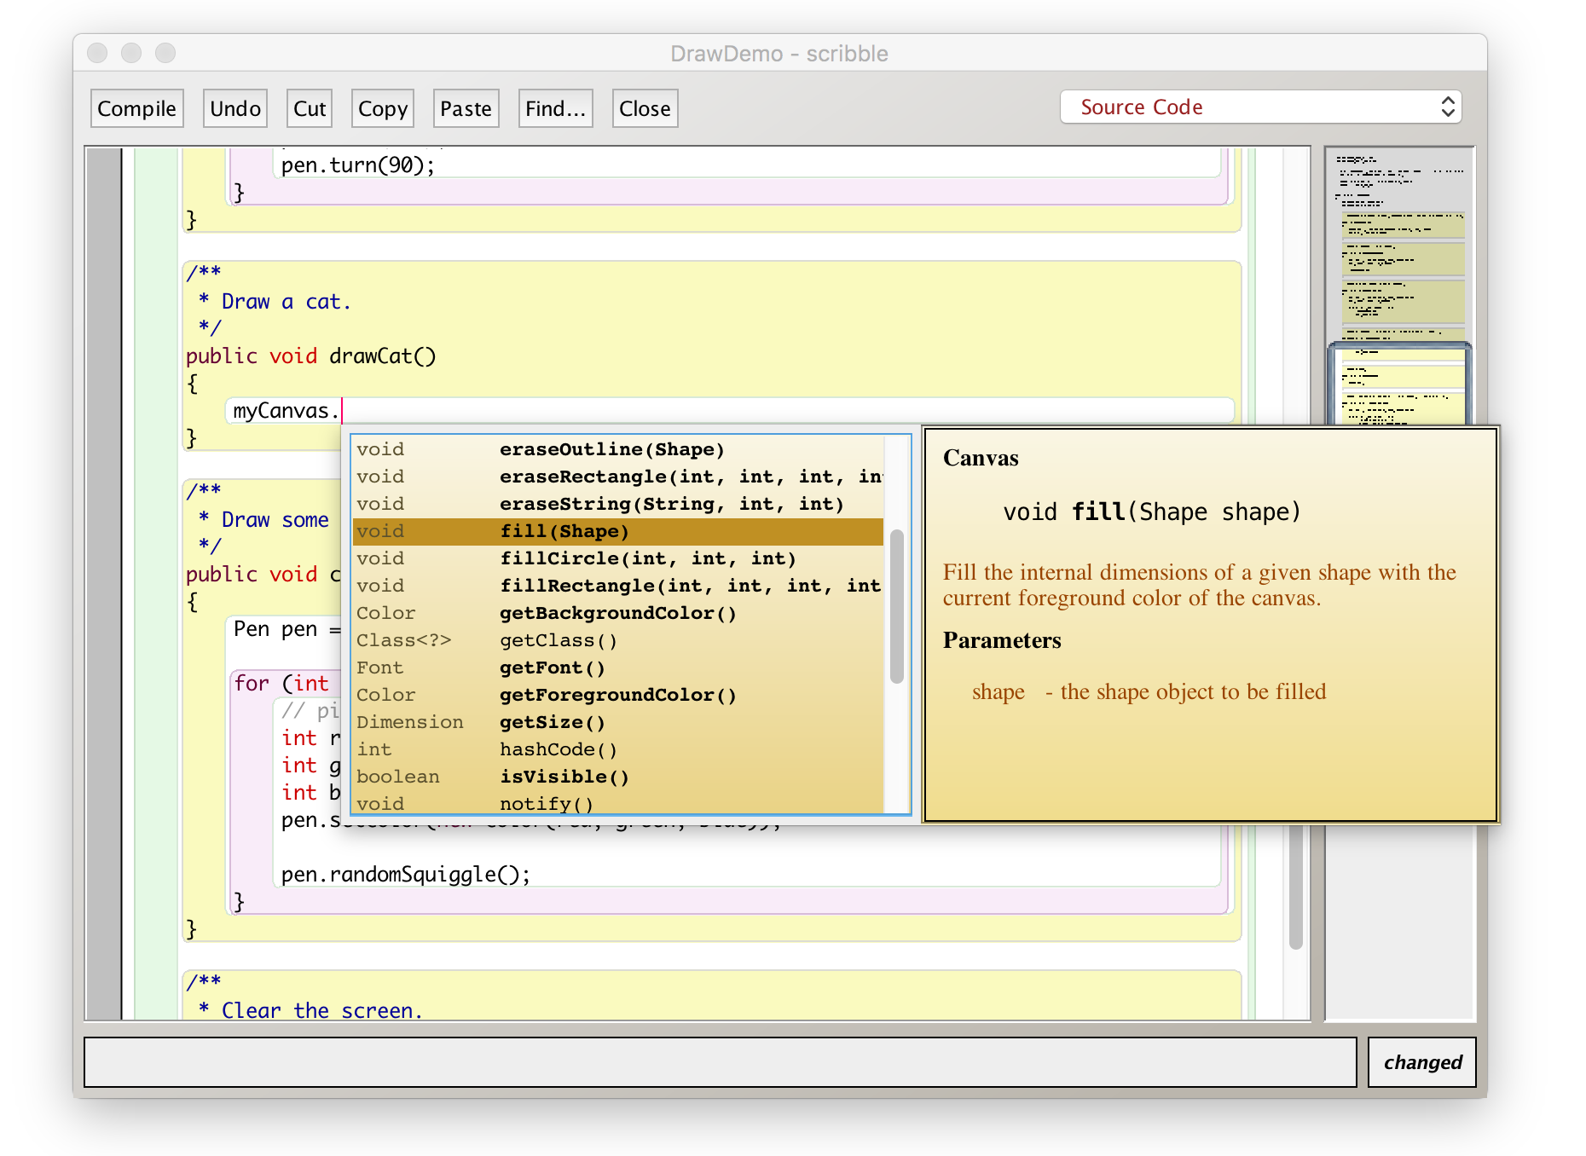
Code completion in BlueJ

Slide 72
Review
Java has an extensive class library
A good programmer must be familiar with the library
The documentation tells us what we need to know to use a class (interface)
The implementation is hidden (information hiding)
Classes are documented so that the interface can be read on its own (class comment, method comments)

