Slide 1
Well-behaved objects
6.0

Slide 2
Main concepts to be covered
Testing
Debugging
Test automation
Writing for maintainability

Slide 3
Code snippet of the day
public void test()
{
int sum = 1;
for(int i = 0; i <= 4; i++);
{
sum = sum + 1;
}
System.out.println("The result is: " + sum);
System.out.println("Double result: " + sum+sum);
}
What is the output?
Notes:
The result is: 2
Double result: 22

Slide 4
Possible results
The result is: 5
Which is printed?
The result is: 6
The result is: 11
The result is: 2
Double result: 22
The result is: 2
Double result: 12
Double result: 4
Double result: 22
Double result: 66

Slide 5
Code snippet of the day
public void test()
{
int sum = 1;
for(int i = 0; i <= 4; i++);
{
sum = sum + 1;
}
System.out.println("The result is: " + sum);
System.out.println("Double result: " + sum+sum);
}
Notes:
The result is: 2
Double result: 22

Slide 6
We have to deal with errors
Early errors are usually syntax errors
The compiler will spot these
Later errors are usually logic errors
The compiler cannot help with these
Also known as bugs
Some logical errors have no immediately obvious manifestation
Commercial software is rarely error free

Slide 7
Prevention vs Detection (Developer vs Maintainer)
We can lessen the likelihood of errors:
Use software engineering techniques, like encapsulation
Pay attention to cohesion and coupling
We can improve the chances of detection:
Use software engineering practices, like modularization and good documentation
We can develop detection skills

Slide 8
Testing and debugging
These are crucial skills
Testing searches for the presence of errors
Debugging searches for the source of errors
The manifestation of an error may well occur some distance from its source

Slide 9
Testing and debugging techniques
Unit testing (within BlueJ)
Test automation
Manual walkthroughs
Print statements
Debuggers

Slide 10
Unit testing
Application testing can only be done after entire application is completed
Unit testing of any single unit can be done once written and compiled
Each unit of an application may be tested
Method, class, module (package in Java)
Can (should) be done during development
Finding and fixing early lowers development costs (e.g. programmer time)
A test suite is built up

Slide 11
Testing fundamentals
Understand what the unit should do – its contract (requirements)
You will be looking for violations
Use positive tests and negative tests (include null and empty conditions)
Test boundaries
Zero, One, Full
Search an empty collection
Add to a full collection
Search for/remove the only element

Slide 12
Well-behaved objects
Test automation

Slide 13
Main concepts to be covered
Unit testing
JUnit
Regression testing
Test cases
Test classes
Assertions
Fixtures

Slide 14
Unit testing within BlueJ
Objects of individual classes can be created
Individual methods can be invoked
Inspectors provide an up-to-date view of an object’s state
Explore through the online-shop project

Slide 15
Test automation
Good testing is a creative process, but ...
... thorough testing is time consuming and repetitive
Regression testing involves re-running tests that have previously passed
Use of a test rig or test harness can relieve some of the burden
Program to automate testing conditions

Slide 16
Test harness
Additional test classes are written to automate the testing
Objects of the harness classes replace human interactivity
Creativity and imagination required to create these test classes
Test classes must be kept up to date as functionality is added

Slide 17
Test automation
Test frameworks exist to support automation
Explore fuller automation through the online-shop-junit project
Intervention only required if a failure is reported

Slide 18
JUnit
JUnit is a Java test framework
Test cases are methods that contain tests
Test classes contain test methods
Assertions are used to assert expected method results
Fixtures are used to support multiple tests

Slide 19
online-shop-junit project
Show unit testing tools in BlueJ
Tools -> Preferences -> Interface
Create test class and methods
Create Test Class for a class
Create Test Method for the test class
Naming begins with test (e.g. testTwoComments)
Record test of SalesItem object & 2 comments
Ensure assertions are the expected results
End button to stop recording of test
Run Tests, Test All or each method indiv.
Create initial objects with setup method
Use Object Bench to Test Fixture

Slide 20
Demo of online-shop-junit

Slide 21
Well-behaved objects
Debugging

Slide 22
Prevention vs Detection (Developer vs Maintainer)
We can lessen the likelihood of errors
Use software engineering techniques, like encapsulation
Pay attention to cohesion and coupling
We can improve the chances of detection
Use software engineering practices, like modularization and good documentation
We can develop detection skills

Slide 23
Modularization and interfaces
Applications often consist of different modules
e.g. so different teams can work on them
The interface between modules must be clearly specified
Supports independent concurrent development
Increases the likelihood of successful integration

Slide 24
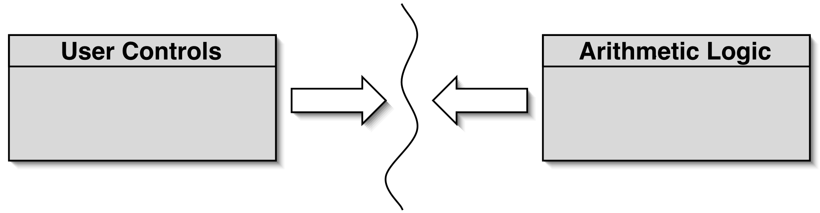
Modularization in a calculator
Each module does not need to know implementation details of the other
User controls could be a GUI or a hardware device
Logic could be hardware or software

Slide 25
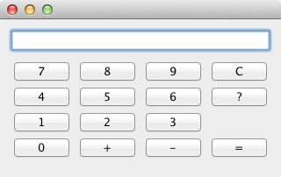
Method headers as a (class) interface
// Return the value to be displayed.
public int getDisplayValue();
// Call when a digit button is pressed.
public void numberPressed(int number);
// Plus operator is pressed.
public void plus();
// Minus operator is pressed.
public void minus();
// Call to complete a calculation.
public void equals();
// Call to reset the calculator.
public void clear();
* Interface is shown in the javadoc documentation!!

Slide 26
Debugging techniques
Manual walkthroughs
Print statements
Debuggers

Slide 27
Debugging
It is important to develop code-reading skills
Debugging will often be performed on others code
Techniques and tools exist to support the debugging process
Explore through the calculator-engine project

Slide 28
Manual walkthroughs
Review of printed (hard) copies
Relatively under-used
A low-tech approach
More powerful than appreciated
Get away from the computer!
Run a program by hand
High-level (Step) or low-level (Step into) views

Slide 29
Tabulating object state
An object’s behavior is largely determined by its state …
… so incorrect behavior is often the result of incorrect state
Tabulate the values of key fields
Document state changes after each method call
Tracing of object state changes

Slide 30
Verbal walkthroughs
Explain to someone else what the code is doing:
They might spot the error
You might spot the error, through the process of explaining
Group-based processes exist for conducting formal walkthroughs or inspections
☺ Rubber Duck Debugging ☺

Slide 31
Print statements
The most popular technique
No special tools required
All programming languages support them
Only effective if the right methods are documented
Output may be voluminous!
Turning off and on requires forethought
Possibly use logging in lieu of print statements

Slide 32
Debug with Logging
Print statements require removal before production
Logging provides a more effective alternative
Import classes/interfaces with core logging facilitie
import java.util.logging.Logger;
import java.util.logging.Level;
Declare and initialize the logger object for a class
Logger logger =
Logger.getLogger(ClassName.class.getName());
Instead of System.out.println statements, now use:
void log(Level level, String msg)
logger.log(Level.WARNING, "Name is INVALID");
Static Level constants in descending order:
SEVERE (highest value)
WARNING
INFO
CONFIG
FINE
FINER
FINEST (lowest value)

Slide 33
Choosing a test strategy
Be aware of the available strategies
Choose strategies appropriate to the point of development
Automate whenever possible
Reduces tedium
Reduces human error
Makes (re)testing more likely

Slide 34
Debuggers
Debuggers are both language- and environment-specific
BlueJ has an integrated debugger
Support breakpoints
Step and Step-into controlled execution
Call sequence (stack)
Object state

Slide 35
Debugging streams (advanced)
A pipeline of multiple operations might be hard to debug
The peek operation can provide insights
Consumer that passes on its input unchanged: peek(s -> System.out.println(s))

Slide 36
Review
Errors are a fact of life in programs
Good software development techniques can reduce their occurrence
Testing and debugging skills are essential
Make testing a habit
Automate testing where possible
Continually repeat tests
Practice a range of debugging skills

