Slide 1
Improving structure with inheritance
6.0

Slide 2
Main concepts to be covered
Inheritance
Subtyping
Substitution
Polymorphic variables

Slide 3
The Network example
A small, prototype social network
Supports a news feed with posts
Stores text posts and photo posts
MessagePost: multi-line text message
PhotoPost: photo and caption
Allows operations on the posts:
e.g. search, display and remove

Slide 4
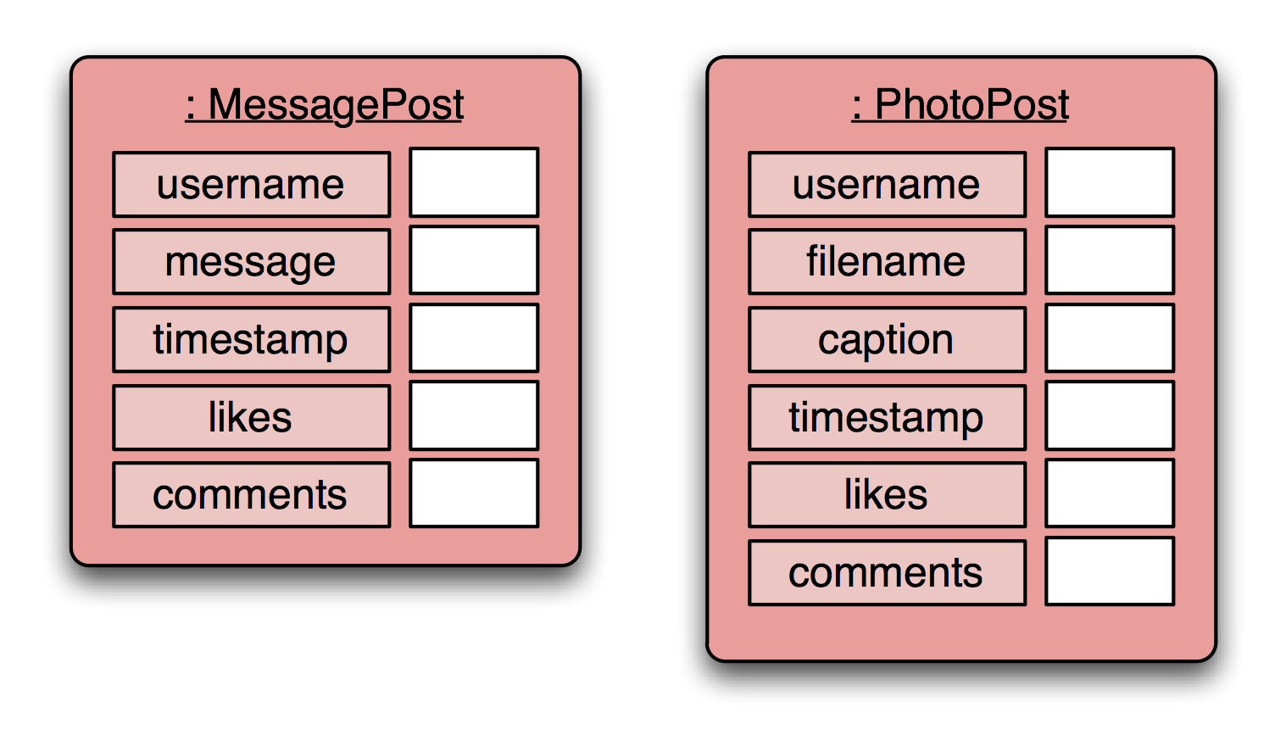
Network objects
Notes:
one object per post; each object stores details for one particular post.

Slide 5
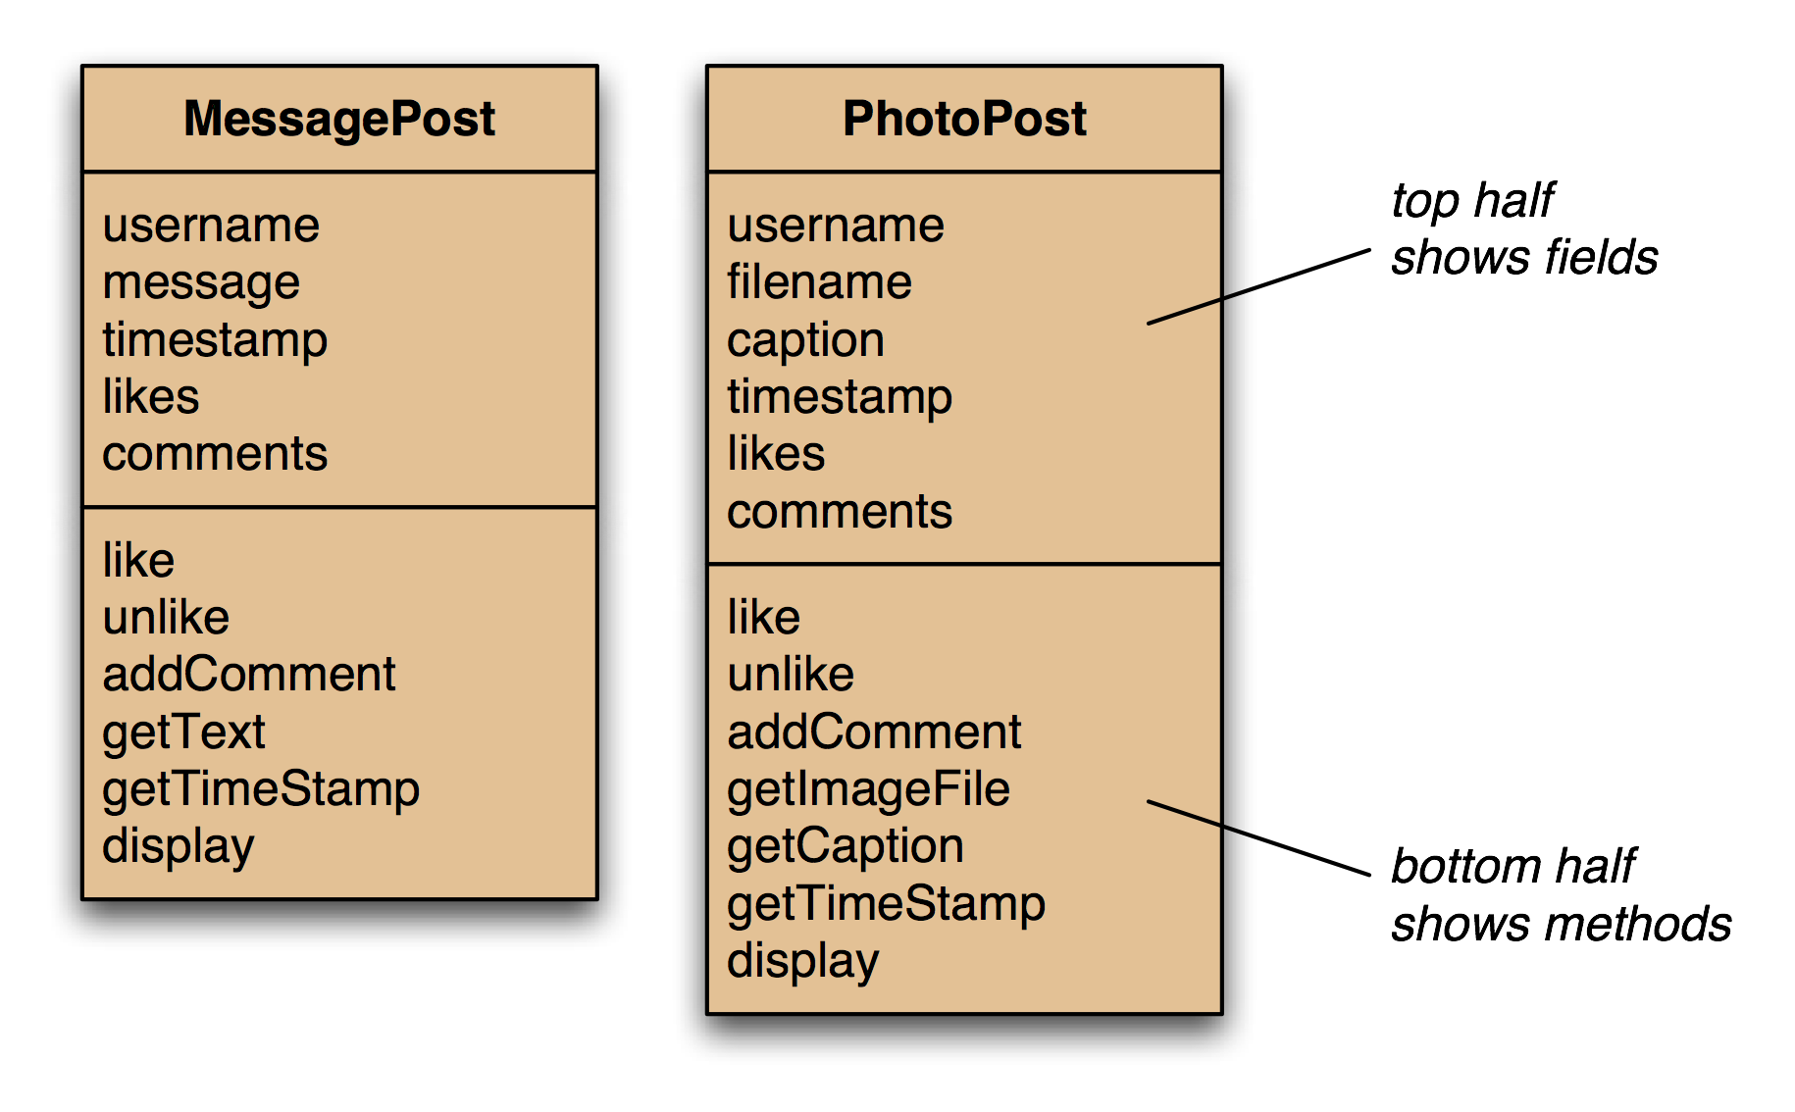
Network classes
Notes:
add the obvious methods (getters and setters); not complete here - just examples

Slide 6
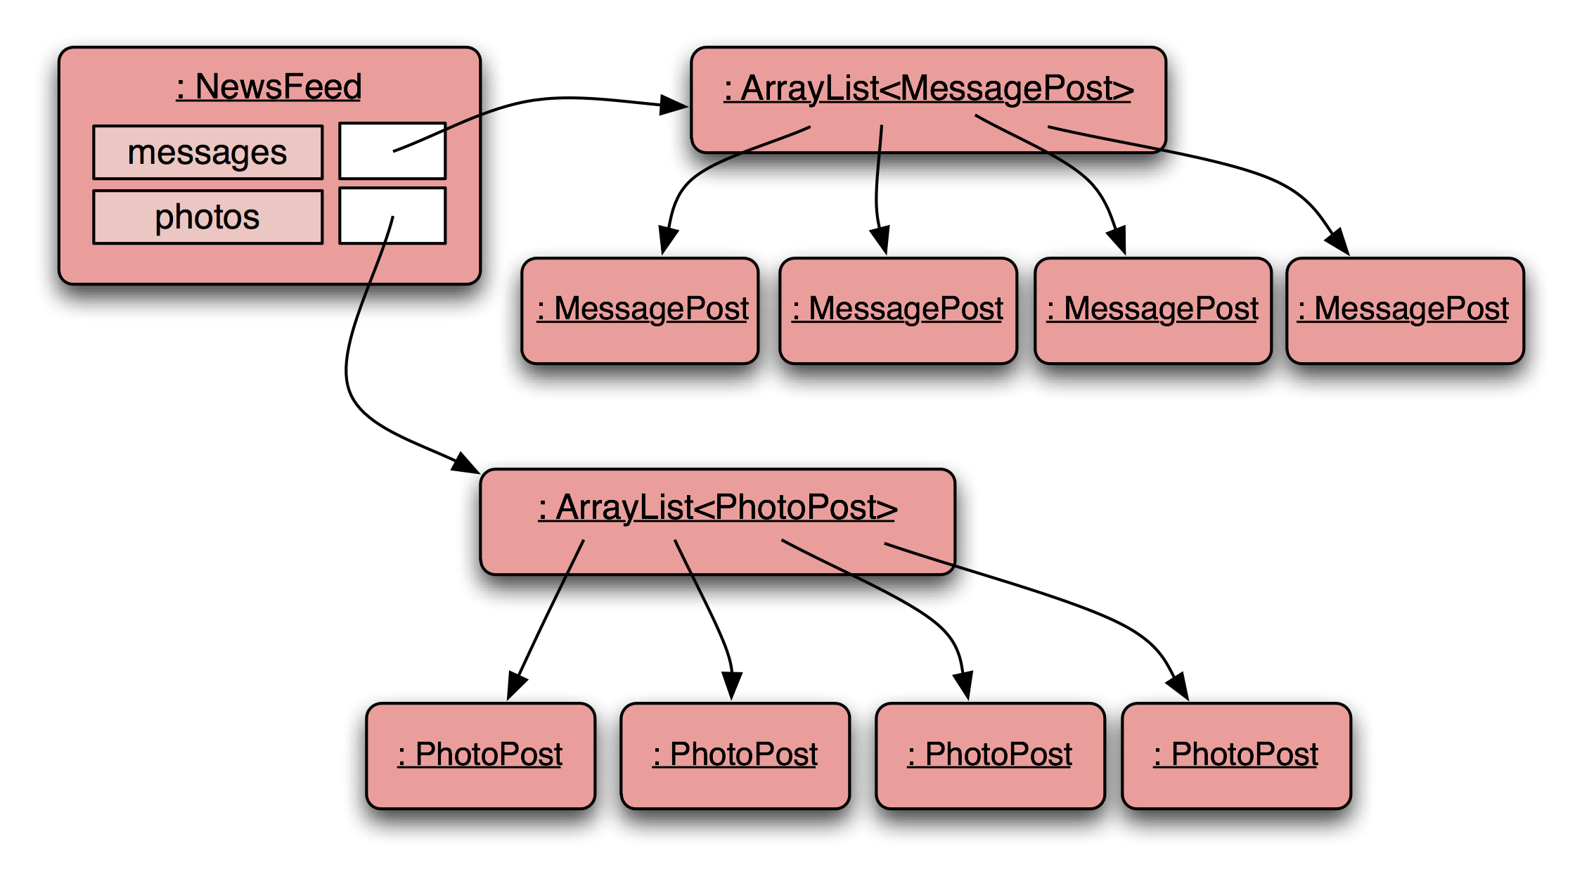
Network object model
Notes:
database object will hold two collections: one for MessagePosts, one for PhotoPosts

Slide 7
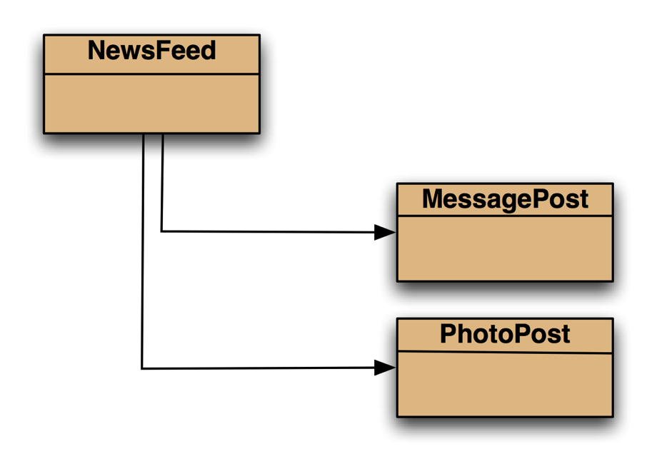
Class diagram
Notes:
class diagram is simple (ArrayList not shown in BlueJ)

Slide 8
Message-Post source code
public class MessagePost
{
private String username;
private String message;
private long timestamp;
private int likes;
private ArrayList<String> comments;
public MessagePost(String author, String text)
{
username = author;
message = text;
timestamp = System.currentTimeMillis();
likes = 0;
comments = new ArrayList<>();
}
public void addComment(String text) ...
public void like() ...
public void display() ...
...
}
Just an outline
Notes:
extract from MessagePost code - nothing unusual, just an ordinary class

Slide 9
Photo-Post source code
public class PhotoPost
{
private String username;
private String filename;
private String caption;
private long timestamp;
private int likes;
private ArrayList<String> comments;
public PhotoPost(String author, String filename,
String caption)
{
username = author;
this.filename = filename;
this.caption = caption;
timestamp = System.currentTimeMillis();
likes = 0;
comments = new ArrayList<>();
}
public void addComment(String text) ...
public void like() …
public void display() …
...
}
Just an outline
Notes:
extract from PhotoPost code (how does it differ from MessagePost code?)

Slide 10
NewsFeed
public class NewsFeed
{
private ArrayList<MessagePost> messages;
private ArrayList<PhotoPost> photos;
...
public void show()
{
for(MessagePost message : messages) {
message.display();
System.out.println(); // empty line between posts
}
for(PhotoPost photo : photos) {
photo.display();
System.out.println(); // empty line between posts
}
}
}
Notes:
extract from NewsFeed code.

Slide 11
Critique of Network
Code duplication:
MessagePost and PhotoPost classes very similar (large parts are identical)
makes maintenance difficult/more work
introduces danger of bugs through incorrect maintenance
Code duplication in NewsFeed class as well
Notes:
we note a lot of code duplication.
this is one problem with this solution (there are others)

Slide 12
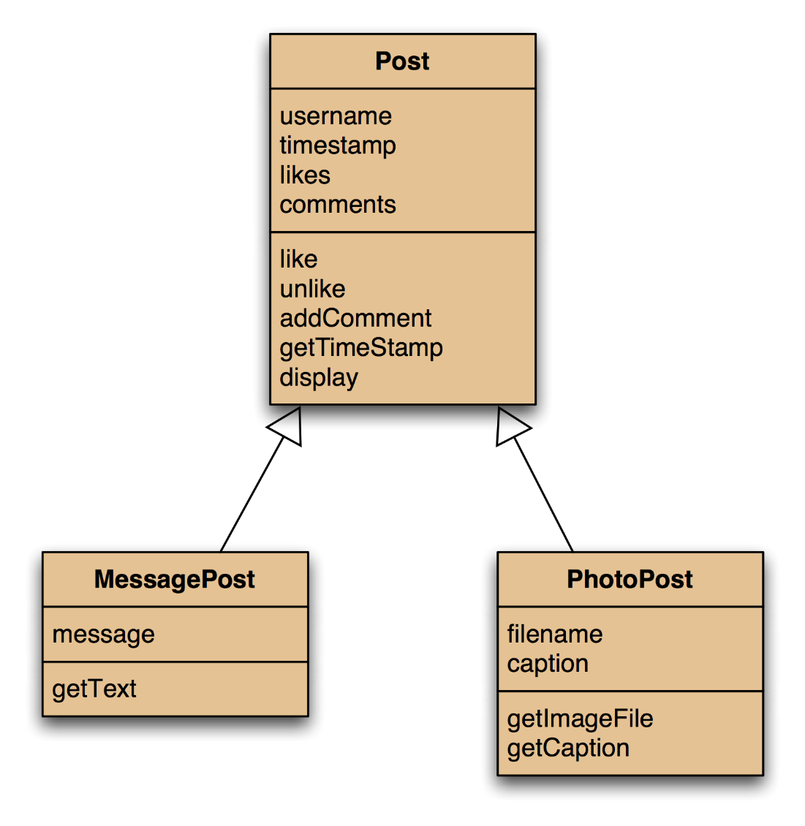
Using inheritance
Notes:
solution: inheritance. make superclass with common attributes, make subclasses

Slide 13
Using inheritance
define one superclass : Post
define subclasses for MessagePost and PhotoPost
the superclass defines common attributes (via fields)
the subclasses inherit the superclass characteristics
the subclasses add other characteristics

Slide 14
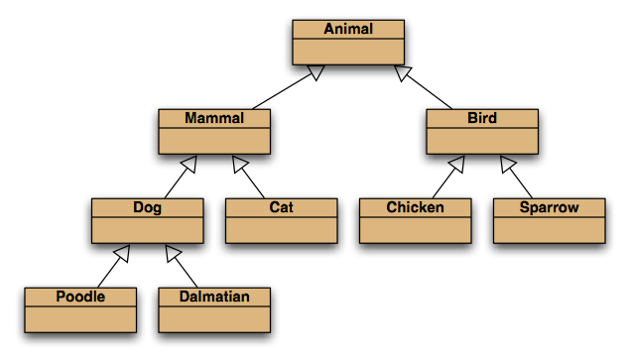
Inheritance hierarchies
Notes:
inheritance hierarchies are nothing unusual. we see them all the time.
(a masters student is a students is a person...)

Slide 15
Inheritance in Java
no change here
public class Post
{
...
}
public class PhotoPost extends Post
{
...
}
public class MessagePost extends Post
{
...
}
change here

Slide 16
Superclass
public class Post
{
private String username;
private long timestamp;
private int likes;
private ArrayList<String> comments;
// constructor and methods omitted.
}
Notes:
we define common fields in superclass

Slide 17
Subclasses
public class MessagePost extends Post
{
private String message;
// constructor and methods omitted.
}
public class PhotoPost extends Post
{
private String filename;
private String caption;
// constructor and methods omitted.
}
Notes:
we add subclass fields; inherit superclass fields
subclass objects will have all fields.

Slide 18
Inheritance and constructors
public class Post
{
private String username;
private long timestamp;
private int likes;
private ArrayList<String> comments;
/**
* Initialise the fields of the post.
*/
public Post(String author)
{
username = author;
timestamp = System.currentTimeMillis();
likes = 0;
comments = new ArrayList<String>();
}
// methods omitted
}
Notes:
how do we initialise the fields? superclass: nothing unusual.

Slide 19
Inheritance and constructors
public class MessagePost extends Post
{
private String message;
/**
* Constructor for objects of class MessagePost
*/
public MessagePost(String author, String text)
{
super(author); // MUST be first statement
message = text;
}
// methods omitted
}
Subclass must call superclass constructor!
Must take values for all fields that we want to initialize!
Notes:
subclass: must call superclass constructor!
Must take values for all fields that we want to initialise.

Slide 20
Superclass constructor call
Subclass constructors must always contain a super call
If none is written, the compiler inserts one (without parameters)
only compiles if the superclass has a constructor without parameters
Must be the first statement in the subclass constructor

Slide 21
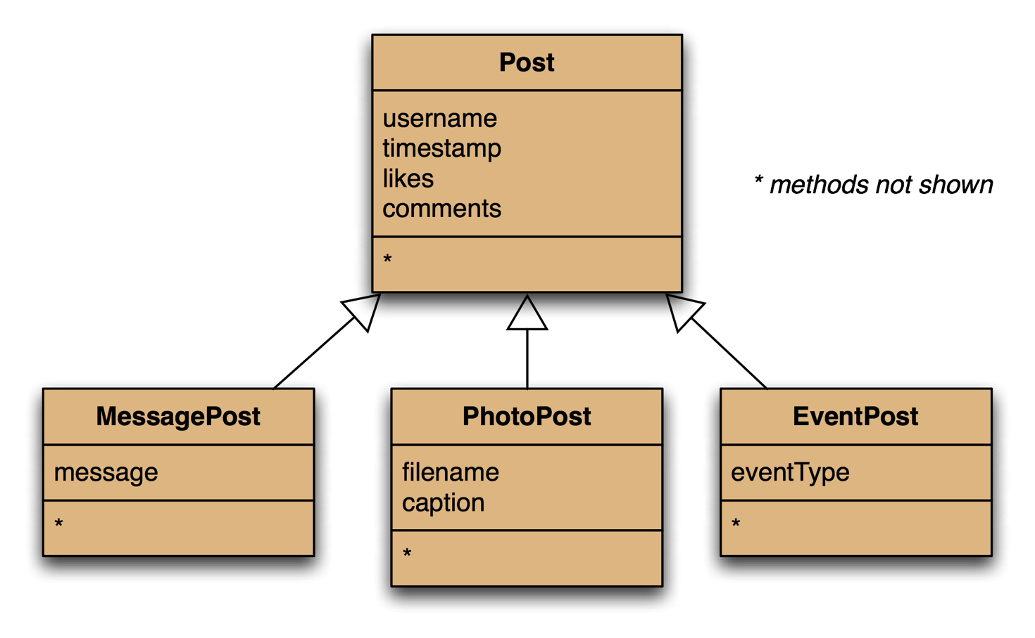
Adding more item types
Notes:
it is now much easier to add new types.
common attributes do not need to be rewritten.

Slide 22
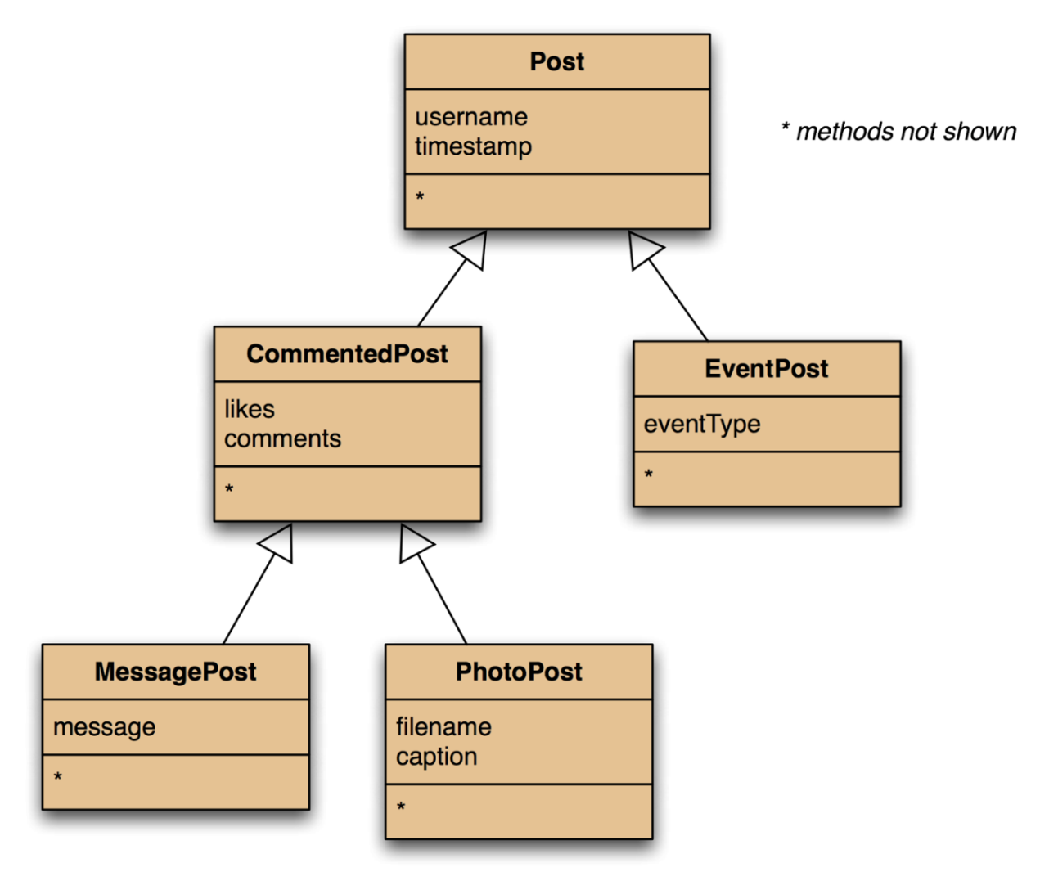
Deeper hierarchies
Abstract classes serve solely as a superclass and are not intended to be used to create instances.
Objects First with Java - A Practical Introduction using BlueJ, © David J. Barnes, Michael Kölling
Notes:
when adding new types, the hierarchy may be extended

Slide 23
Review (so far)
Inheritance (so far) helps with:
Avoiding code duplication
Code reuse
Easier maintenance
Extendibility

Slide 24
Revised NewsFeed source code
public class NewsFeed
{
private ArrayList<Post> posts;
/**
* Construct an empty news feed.
*/
public NewsFeed()
{
posts = new ArrayList<Post>();
}
/**
* Add a post to the news feed.
*/
public void addPost(Post post)
{
posts.add(post);
}
...
}
avoids code duplication in the client class!
No longer a messages AND
photos
ArrayLists!!
Notes:
note: code duplication in class NewsFeed removed as well!
only on field, one ArrayList creation, on add method

Slide 25
New NewsFeed source code
/**
* Show the news feed. Currently: print the
* news feed details to the terminal.
* (Later: display in a web browser.)
*/
public void show()
{
for(Post post : posts) {
post.display();
System.out.println(); // Empty line ...
}
}
Now only 1 loop in the show method!!
Notes:
...and only one loop in the showmethod.

Slide 26
Subtyping
First, we had:
public void addMessagePost(
MessagePost message)
public void addPhotoPost( PhotoPost photo)
Now, we have:
public void addPost(Post post)
We call this method with:
PhotoPost myPhoto = new PhotoPost(...);
feed.addPost(myPhoto);
PhotoPost is a subtype of Post

Slide 27
Subclasses and subtyping
Classes define types
Subclasses define subtypes
Objects of subclasses can be used where objects of supertypes are required … called substitution
But supertypes may NOT be used in place of a subtype

Slide 28
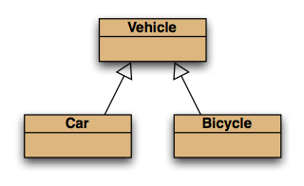
Subtyping and assignment
subclass objects may be assigned to superclass variables
Vehicle v1 = new Vehicle();
Vehicle v2 = new Car();
Vehicle v3 = new Bicycle();

Slide 29
Subtyping
First, we had:
public void addMessagePost(
MessagePost message)
public void addPhotoPost( PhotoPost photo)
Now, we have:
public void addPost(Post post)
We call this method with:
PhotoPost myPhoto = new PhotoPost(...);
feed.addPost(myPhoto);

Slide 30
Subtyping and parameter passing
public class NewsFeed
{
public void addPost(Post post)
{
...
}
}
PhotoPost photo = new PhotoPost(...);
MessagePost message = new MessagePost(...);
feed.addPost(photo);
feed.addPost(message);
subclass objects may be used as actual parameters for the superclass
PhotoPost & MessagePost are both subtypes of Post

Slide 31
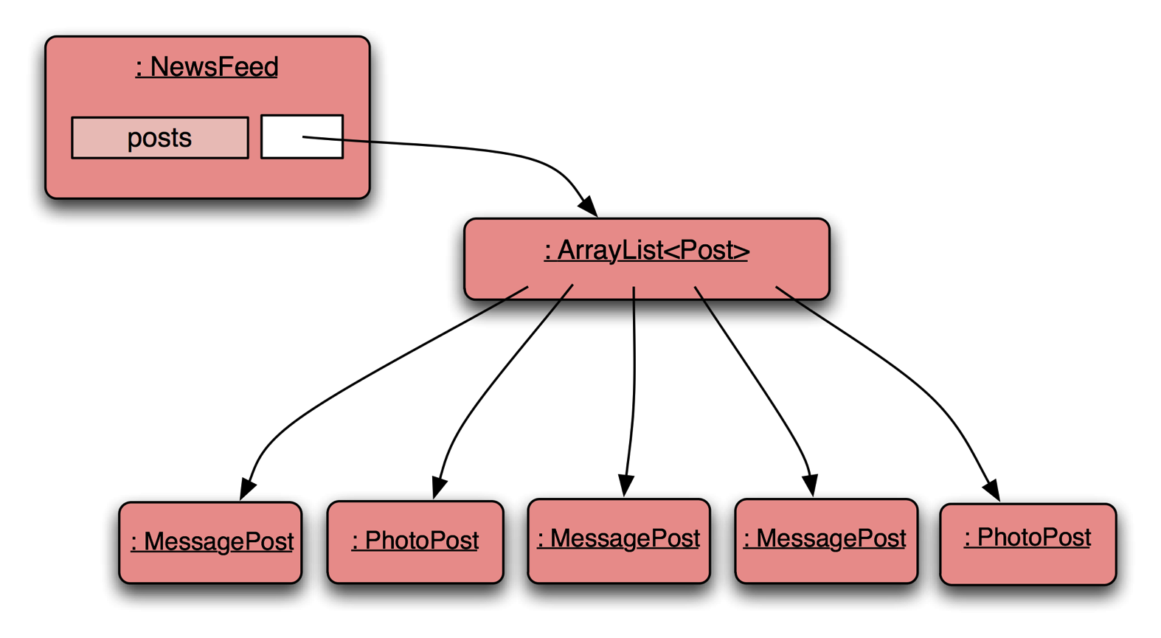
Object diagram
NewsFeed object can hold a single or mixed collection of supertype Post and subtypes PhotoPost/MessagePost
Notes:
NewsFeed object will hold a single, mixed collection

Slide 32
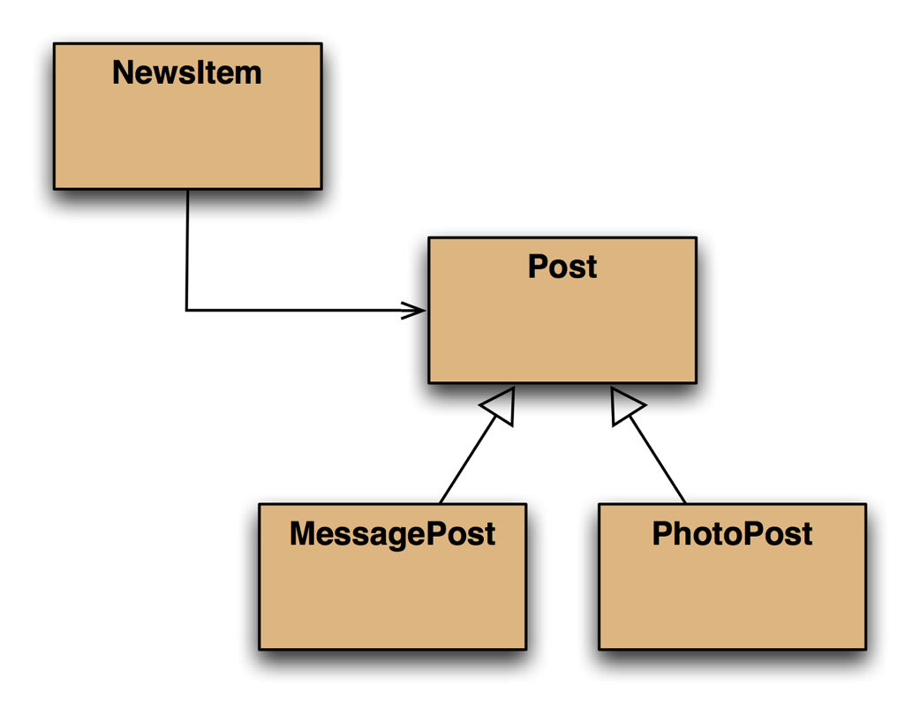
Class diagram
NewsItem now only knows about Post
rather than the subclasses
Notes:
Newsitem now only knows about Post rather than the subclasses.

Slide 33
Polymorphic variables
Object variables in Java are polymorphic (many shapes)
Can hold objects of more than one type
Can hold objects of the declared type, or of subtypes of the declared type
for(Post post : posts)
{
post.display();
System.out.println();
}
Variables of supertype Post may hold objects of subtypes PhotoPost/MessagePost

Slide 34
Casting
We can assign subtype to supertype …
… but we cannot assign supertype to subtype! Vehicle v; Car c = new Car(); v = c; // correct c = v; // compile-time error!
Casting fixes this: c = (Car) v; (only ok if the vehicle really is a Car!)

Slide 35
Casting
An object type in parentheses
Used to overcome 'type loss'
The object is not changed in any way
A runtime check is made to ensure the object really is of that type:
ClassCastException if it isn't!
Use it sparingly

Slide 36
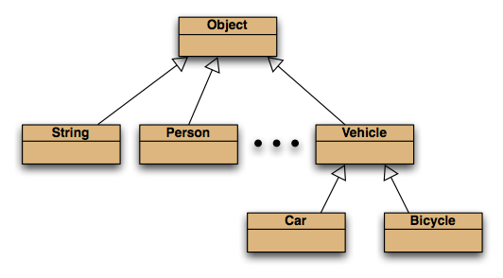
The Object class
All classes inherit from Object
Object class from Java standard library

Slide 37
Polymorphic collections
All collections are polymorphic
The elements could simply be of type Object public void add(Object element) public Object get(int index)
Usually avoided by using a type parameter with the collection

Slide 38
Polymorphic collections
A type parameter limits the degree of polymorphism:
ArrayList<Post>
Collection methods are then typed
Without a type parameter, ArrayList<Object> is implied
Likely to get an “unchecked or unsafe operations” warning
More likely to have to use casts

Slide 39
Review
Inheritance allows the definition of classes as extensions of other classes
Inheritance
avoids code duplication
allows code reuse
simplifies the code
simplifies maintenance and extending
Variables can hold subtype objects
Subtypes can be used wherever supertype objects are expected (substitution)

