Slide 1
OOPDA
Intro
5.0
Notes:
Objects First with Java
© David J. Barnes and Michael Kölling

Slide 2
Topics
Website and Syllabus
Rowan VPN and H:drive
BlueJ application and projects
Programming Style (Appendix J)
Javadoc (Appendix I)
Debugger (Appendix F)
Unit Testing (Appendix G)

Slide 3
Code completion
The BlueJ editor supports lookup of methods
Use Ctrl-space after a method-call dot to bring up a list of available methods
Use Return to select a highlighted method
Objects First with Java - A Practical Introduction using BlueJ, © David J. Barnes, Michael Kölling

Slide 4
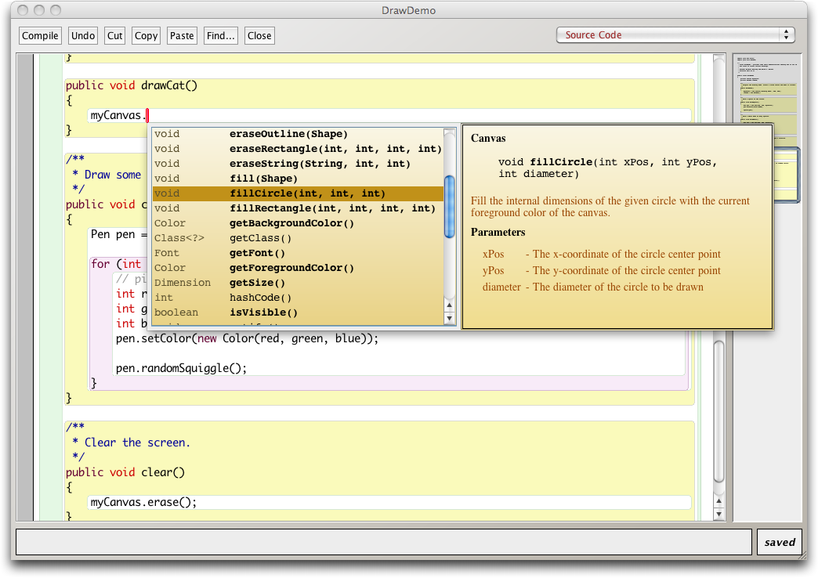
Code completion in BlueJ
Objects First with Java - A Practical Introduction using BlueJ, © David J. Barnes, Michael Kölling

Slide 5
Prevention vs Detection
(Developer vs Maintainer)
We can lessen the likelihood of errors
  Use software engineering techniques, like encapsulation
  Pay attention to cohesion and coupling
We can improve the chances of detection
  Use software engineering practices, like modularization and good documentation
We can develop detection skills
Objects First with Java - A Practical Introduction using BlueJ, © David J. Barnes, Michael Kölling

Slide 6
Modularization and interfaces
Applications often consist of different modules
  e.g. so different teams can work on them
The interface between modules must be clearly specified
  Supports independent concurrent development
  Increases the likelihood of successful integration
Objects First with Java - A Practical Introduction using BlueJ, © David J. Barnes, Michael Kölling
Notes:
Objects First with Java
© David J. Barnes and Michael Kölling

Slide 7
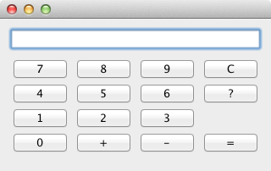
Method headers as a (class) interface
// Return the value to be displayed.
public int getDisplayValue();
// Call when a digit button is pressed.
public void numberPressed(int number);
// Plus operator is pressed.
public void plus();
// Minus operator is pressed.
public void minus();
// Call to complete a calculation.
public void equals();
// Call to reset the calculator.
public void clear();
* Interface is shown in the javadoc documentation!!
Notes:
Objects First with Java
© David J. Barnes and Michael Kölling

Slide 8
Writing class documentation
User classes should be documented the same way library classes are
Others should be able to use your class without reading the implementation
Make your class a potential library class
Objects First with Java - A Practical Introduction using BlueJ, © David J. Barnes, Michael Kölling
Notes:
Objects First with Java
© David J. Barnes and Michael Kölling

Slide 9
Elements of documentation
Documentation for a class should include:
the class name
a comment describing the overall purpose and characteristics of the class
a version number (@version)
the authors’ names (@author)
documentation for each constructor and each method
Objects First with Java - A Practical Introduction using BlueJ, © David J. Barnes, Michael Kölling
Notes:
Objects First with Java
© David J. Barnes and Michael Kölling

Slide 10
Elements of documentation
The documentation for each constructor and method should include:
the name of the method
the return type (@return)
the parameter names and types (@param)
a description of the purpose and function of the method
a description of each parameter
a description of the value returned
Objects First with Java - A Practical Introduction using BlueJ, © David J. Barnes, Michael Kölling
Notes:
Objects First with Java
© David J. Barnes and Michael Kölling

Slide 11
javadoc
Class comment:
/**
* The Responder class represents a response
* generator object. It is used to generate an
* automatic response.
*
* @author Michael Kölling and David J. Barnes
* @version 1.0 (2011.07.31)
*/
Objects First with Java - A Practical Introduction using BlueJ, © David J. Barnes, Michael Kölling
Notes:
Objects First with Java
© David J. Barnes and Michael Kölling

Slide 12
javadoc
Method comment:
/**
* Read a line of text from standard input (the text
* terminal), and return it as a set of words.
*
* @param prompt A prompt to print to screen.
* @return A set of Strings, where each String is
* of the words typed by the user
*/
public HashSet<String> getInput(String prompt)
{
...
}
Objects First with Java - A Practical Introduction using BlueJ, © David J. Barnes, Michael Kölling
Notes:
Objects First with Java
© David J. Barnes and Michael Kölling

Slide 13
Javadoc
Appendix I
DEMO
README.txt
Objects First with Java - A Practical Introduction using BlueJ, © David J. Barnes, Michael Kölling

Slide 14
We have to deal with errors
Early errors are usually syntax errors
  The compiler will spot these
Later errors are usually logic errors
  The compiler cannot help with these
  Also known as bugs
Some logical errors have no immediately obvious manifestation
  Commercial software is rarely error free
Objects First with Java - A Practical Introduction using BlueJ, © David J. Barnes, Michael Kölling
Notes:
Objects First with Java
© David J. Barnes and Michael Kölling

Slide 15
Errors
Syntax
* Errors in the code text itself
* Found when compiling with unrecognizable text
* Fix by editing code
Logic
* Errors in the behavior of the program
* Found when running with unexpected results
* Fix by debugging and observing states
Runtime
* Errors which prohibit program from running
* Found when executing the program
* Fix by editing code and debugging

Slide 16
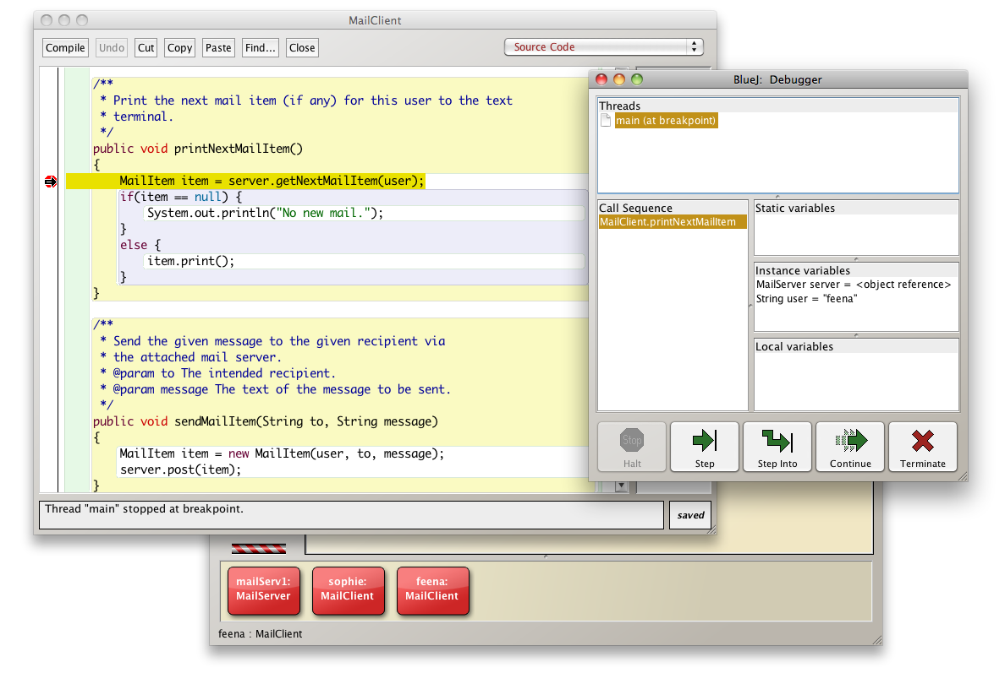
BlueJ debugger

Slide 17
BlueJ debugger
Debuggers are both language-specific and environment-specific
  BlueJ has an integrated debugger
Set breakpoints to halt program
Step and Step-into controlled execution through code
Call sequence (stack)
Examine variables and object states

Slide 18
BlueJ debugger
Appendix F
DEMO
Objects First with Java - A Practical Introduction using BlueJ, © David J. Barnes, Michael Kölling

Slide 19
Debugging
It is very important to develop code reading and tracing skills
  Debugging will often be performed on others’ code
Various techniques and tools exist to support the debugging process
Objects First with Java - A Practical Introduction using BlueJ, © David J. Barnes, Michael Kölling
Notes:
Objects First with Java
© David J. Barnes and Michael Kölling

Slide 20
Manual walkthroughs
Review of printed (hard) copies
Relatively under-used
  A low-tech approach
  More powerful than appreciated
Get away from the computer!
Run a program by hand
High-level (Step) or low-level (Step into) views
Objects First with Java - A Practical Introduction using BlueJ, © David J. Barnes, Michael Kölling
Notes:
Objects First with Java
© David J. Barnes and Michael Kölling

Slide 21
Tracing object state
An object’s behavior is largely determined by its state …
… so incorrect behavior is often the result of incorrect state
Tabulate the values of key fields
Document state changes after each method call
Tracing of object state changes
Objects First with Java - A Practical Introduction using BlueJ, © David J. Barnes, Michael Kölling
Notes:
Objects First with Java
© David J. Barnes and Michael Kölling

Slide 22
Verbal walkthroughs
Explain to someone else what the code is doing
  They might spot the error
  The process of explaining might help you to spot it for yourself
Group-based processes exist for conducting formal walkthroughs or inspections
Objects First with Java - A Practical Introduction using BlueJ, © David J. Barnes, Michael Kölling
Notes:
Objects First with Java
© David J. Barnes and Michael Kölling

Slide 23
Print statements
The most popular technique
No special tools required
All programming languages support them
Only effective if the right methods are documented
Output may be voluminous!
Turning off and on requires forethought
Objects First with Java - A Practical Introduction using BlueJ, © David J. Barnes, Michael Kölling
Notes:
Objects First with Java
© David J. Barnes and Michael Kölling

Slide 24
Choosing a test strategy
Be aware of the available strategies
Choose strategies appropriate to the point of development
Automate whenever possible
  Reduces tedium
  Reduces human error
  Makes (re)testing more likely
Objects First with Java - A Practical Introduction using BlueJ, © David J. Barnes, Michael Kölling
Notes:
Objects First with Java
© David J. Barnes and Michael Kölling

Slide 25
Review
Errors are a fact of life in programs
Good software development techniques can reduce their occurrence
Testing and debugging skills are essential
Practice a range of debugging skills
Make testing a habit
Automate testing where possible
Continually repeat tests
Regression test and use unit testing
Objects First with Java - A Practical Introduction using BlueJ, © David J. Barnes, Michael Kölling
Notes:
Objects First with Java
© David J. Barnes and Michael Kölling

Slide 26
Unit testing
Application testing can only be done after entire application is completed
Unit testing of any single unit can be done once written and compiled
Each unit of an application may be tested
  Method, class, module (package in Java)
Can (should) be done during development
  Finding and fixing early lowers development costs (e.g. programmer time)
  A test suite is built up
Notes:
Objects First with Java
© David J. Barnes and Michael Kölling

Slide 27
Testing fundamentals
Understand what the unit should do – its contract (requirements)
  You will be looking for violations
  Use positive tests and negative tests (include null and empty conditions)
Test boundaries
  Zero, One, Full
    Search an empty collection
    Add to a full collection
Objects First with Java - A Practical Introduction using BlueJ, © David J. Barnes, Michael Kölling
Notes:
Objects First with Java
© David J. Barnes and Michael Kölling

Slide 28
Test automation
Good testing is a creative process, but ...
... thorough testing is time consuming and repetitive
Regression testing involves re-running tests that have previously passed
Use of a test rig or test harness can relieve some of the burden
  Program to automate testing conditions
Objects First with Java - A Practical Introduction using BlueJ, © David J. Barnes, Michael Kölling
Notes:
Objects First with Java
© David J. Barnes and Michael Kölling

Slide 29
Test harness
Additional test classes are written to automate the testing
Objects of the harness classes replace human interactivity
Creativity and imagination required to create these test classes
Test classes must be kept up to date as functionality is added
Objects First with Java - A Practical Introduction using BlueJ, © David J. Barnes, Michael Kölling

Slide 30
JUnit
Appendix G
DEMO
Objects First with Java - A Practical Introduction using BlueJ, © David J. Barnes, Michael Kölling

Slide 31
online-shop-junit project
Show unit testing tools in BlueJ
  Tools -> Preferences -> Interface
Create test class and methods
  Create Test Class for a class
  Create Test Method for the test class
    Naming begins with test (e.g. testTwoComments)
    Record test of SalesItem object & 2 comments
    Ensure assertions are the expected results
    End button to stop recording of test
Run Tests, Test All or each method indiv.
Create initial objects with setup method
  Use Object Bench to Test Fixture

Slide 32
JUnit
JUnit is a Java test framework
Test cases are methods that contain tests
Test classes contain test methods
Assertions are used to assert expected method results
Fixtures are used to support multiple tests
Objects First with Java - A Practical Introduction using BlueJ, © David J. Barnes, Michael Kölling

