Slide 1
RockawayX vaults under attack
riskdep on a mainnet fork, step by step · alerts on Telegram
Notes:
Demo: scripts/demo-rock/demo-rock.sh (README next to it). Vaults and dependencies: docs/analysis/ROCK-VAULT.md. Run of scripts/demo-rock/demo-rock.sh on a fork at block 26,165,572, 2026-10-11; alerts from out/demo-rock/watch-*.jsonl.

Slide 2
The question we answer
One deposit hides a chain of other contracts and people
If one link breaks: how much do I lose, and how fast?
Leaving costs something for sure; staying may cost more
riskdep finds the chain, watches it, and says stay or exit
Notes:
The challenge brief (Belem Capital): identify a position's dependencies, estimate the impact when one fails, and help decide stay or exit despite execution costs.

Slide 3
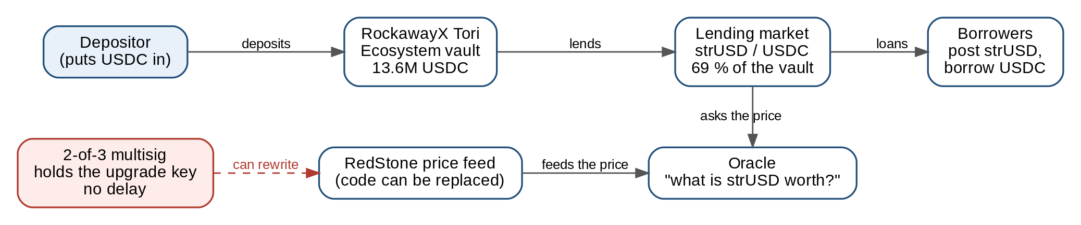
What a deposit really depends on
• Your USDC goes into the vault, which lends it to borrowers who post strUSD
• Those loans are safe only while the oracle prices strUSD correctly
• The oracle reads a RedStone feed whose code can be replaced
• Two signatures out of three are enough to do it, with no delay
Notes:
Tori Ecosystem: 13.6M USDC, 69 % of it lent against strUSD (ROCK-VAULT.md, demo prediction). The 2-of-3 Safe owns RedStone's ProxyAdmin (scripts/fork/addresses.env, alt-redstone.sh).

Slide 4
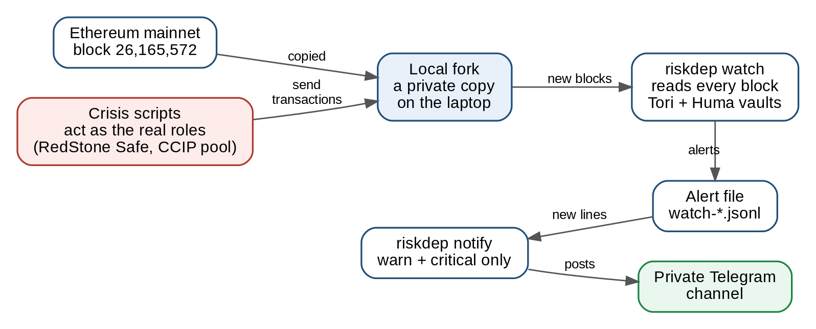
How the demo works
• A fork is a private copy of Ethereum on the laptop
• Scripts act as the real key holders: nothing real is touched
• riskdep reads every new block, as it would on mainnet
• Only real risks (warn and critical) reach Telegram
Notes:
Fork at block 26,165,572 (anvil). Two watches: RockawayX Tori Ecosystem and Huma USDC Main. notify posts alerts at warn and above; start-up findings stay in the terminal.

Slide 5
The words, in plain language
Word | What it means
Vault | A pool of deposits lent out by a curator
Oracle | The contract that tells the market what collateral is worth
Bad debt | A loan worth more than what backs it: someone loses
Multisig | A wallet that needs several signatures (here 2 of 3)
Fork | A private copy of the blockchain, for rehearsing a crisis
warn / critical | Something changed / money is being lost now
Notes:
Levels: docs/alert-runbook.md (critical: money is being lost now, or can be lost in the next block; warn: the risk changed, a decision may be needed).

Slide 6
Act 1 · A forecast before the event
What we ask
What if strUSD lost 32 % of its value?
Computed from recorded vaults, offline
Before anything happens on the fork
What riskdep answers
The book of 7 vaults loses 2.80M USD (2.8 %)
Tori: 1.83M (13.5 %) · USDC Yield: 0.97M (5.3 %)
Act first on Tori: leaving pays if the risk is above 4.9 % over 30 days
Notes:
Command: analyze --book examples/rockawayx-ethereum.json --shock token=strUSD:0.32. Same −32 % as act 2 causes, so the forecast comes before the event.

Slide 7
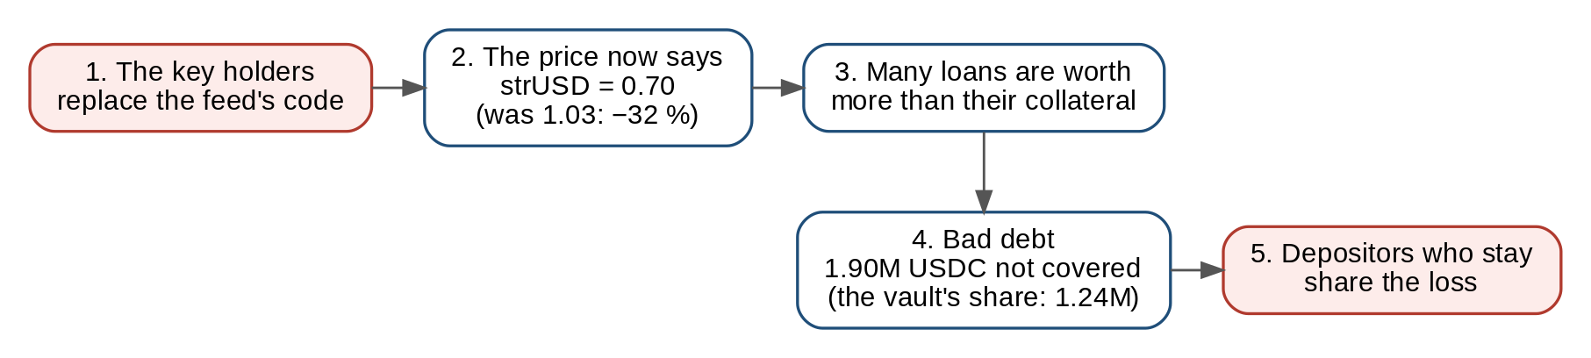
Act 2 · The price feed is rewritten
• RedStone's multisig swaps the code of the strUSD price feed
• The new code says strUSD is worth 0.70 instead of 1.03
• Loans become bigger than their collateral: 1.90M USDC of bad debt
• Until it is written off, whoever stays in the vault carries it
Notes:
alt-redstone.sh: oracle 1.0300 → 0.7001. UnrealisedBadDebt: 1,902,392 USDC, the vault's share 1,236,933 (9.09 % of the vault).

Slide 8
Act 2 · What riskdep said
Alert | Level | In plain words
Admin.Upgraded | critical | The code behind the price changed
Oracle moved −32 % | warn | The collateral lost a third of its value
UnrealisedBadDebt | critical | 1.90M USDC of loans no longer covered
ExitQueue | critical | In a rush to the exit, this depositor gets stuck
OracleDivergence | warn | The oracle is 32 % below the market price
OracleImpact | critical | The loss, and the decision: EXIT
Notes:
All six at block 26,165,574, the block after the upgrade. On Telegram: one summary (bad debt, exit queue, oracle move), the upgrade, and a second summary (divergence, impact).

Slide 9
Act 2 · Stay or exit?
Stay
Loses 454,103 USDC: its share of the bad debt
Waits for the debt to be written off
Exit now: riskdep's verdict
2,374,262 USDC can leave at full value
The loss falls to 293,378 USDC
2,620,422 USDC cannot leave yet
Notes:
Depositor followed: the vault's largest, 0xddcd…cdd1, 4,994,682 USDC (36.7 %). Figures from the OracleImpact alert. Leaving first moves part of the loss onto those who stay: that is why speed matters.

Slide 10
Is this a hack?
Who sends the upgrade | What it is | Effect
Someone with 2 stolen keys | A hack | Price set by the attacker
The real signers, by mistake | A bad upgrade | Same damage
The real signers, announced | Maintenance | Nothing bad
Notes:
In the demo nothing is hacked: the fork is local. On-chain the three cases look identical; riskdep flags any upgrade, and the runbook says to check whether the new code is verified and announced, and to de-lever or exit until it is explained.

Slide 11
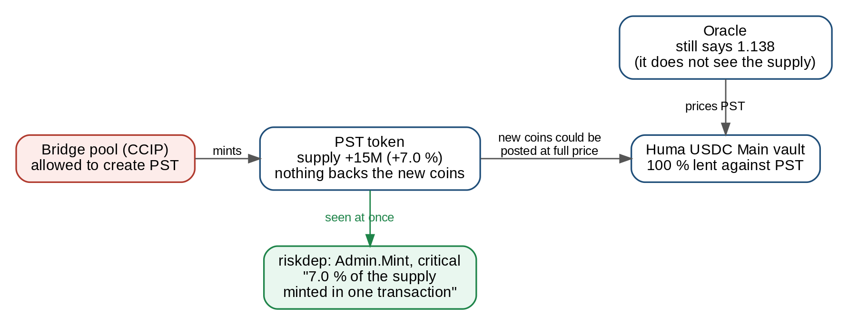
Act 3 · Coins from nowhere
• The bridge pool creates 15M PST, +7 % of the supply
• Nothing backs these new coins
• The oracle reads a rate, not the supply: it still says 1.138
• riskdep flags the mint itself, in the same block
Notes:
alt-pst-mint.sh 15000000: supply 213.9M → 228.9M PST. Admin.Mint is critical above 5 % of the supply in one transaction (watch.mint_share_critical); 10M (4.7 %) would stay silent.

Slide 12
Reading a Telegram alert
Red (critical) rings the phone; orange (warn) arrives silently
First line: the level and the vault
Then what happened, the amounts, the block and a runbook link
Alerts of one block can arrive as one short summary
On the fork, the Etherscan link finds nothing: the transaction is local
Notes:
riskdep notify: only alerts at warn and above, no heartbeat; standing findings once per 1800 blocks; criticals with sound.

Slide 13
What to remember
A position depends on people and code you never see
riskdep names them, watches them and prices the damage
Each alert says what happened, what it costs and what to do
It cannot tell a hack from an upgrade: it flags both
Limits: a simulated crisis, prices read block by block
Notes:
Run it: scripts/demo-rock/demo-rock.sh --manual (or PAUSE=10 for a slower pace; --no-telegram to rehearse).

