Slide 1
INFOSYS SPRINGBOARD AirFly Insights
Data Visualization & Analysis of Airline Operations
Mentor : Rahul Yadav
Submitted By : Banuka Pravalika

Slide 2
Project Objective
Analyze large-scale airline flight data
Identify delay and cancellation patterns
Apply multiple data visualization techniques
Extract actionable insights for operations improvement

Slide 3
Dataset Overview
Source: US DOT Airline Flight Dataset (Kaggle)
Millions of flight records
Attributes: airline, airports, delays, cancellations, time, distance

Slide 4
Data Preprocessing
Before analysis, the raw dataset was preprocessed.
We removed irrelevant columns, handled missing values, optimized memory usage, and converted columns to appropriate data types.
This step is important to ensure accurate analysis.

Slide 5
Feature Engineering
We created new features such as month, day, departure hour, and route by combining origin and destination airports.
These engineered features help analyze time-based and route-based delay patterns more effectively

Slide 6
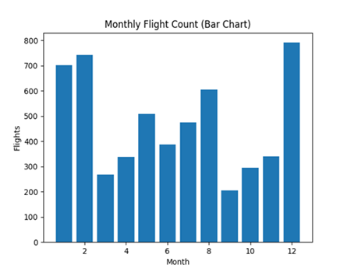
Bar Chart – Monthly Flights
Represents number of flights operated in each month.
Helps identify peak and off-peak travel seasons.
Airlines can plan manpower and aircraft availability.
Useful for seasonal demand analysis.

Slide 7
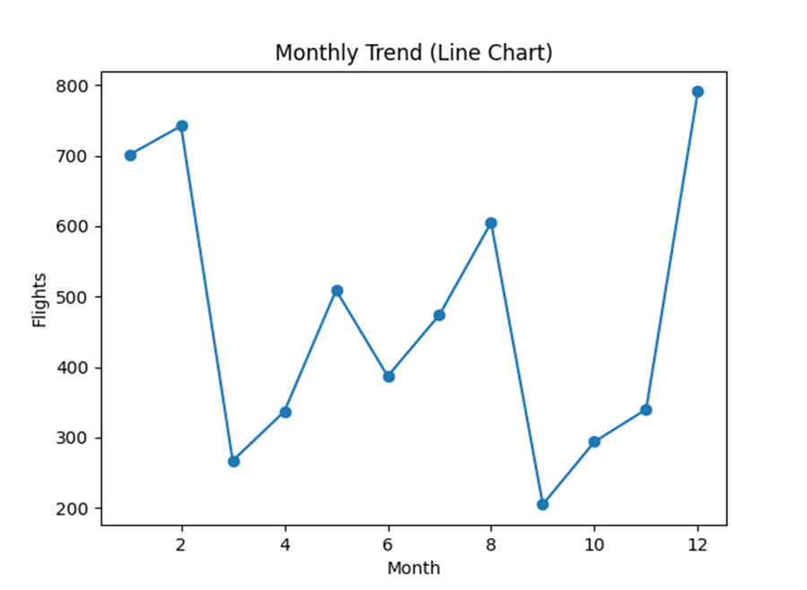
Line Chart – Flight Trend Over Time
Shows changes in flight operations over time.
Identifies increasing or decreasing traffic trends.
Supports long-term planning and forecasting.
Useful for understanding industry growth patterns.

Slide 8
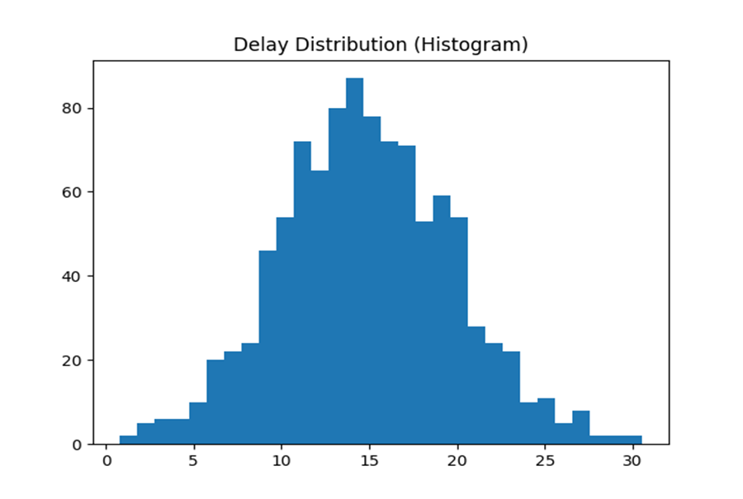
Histogram – Delay Distribution
Displays frequency of different delay durations.
Most flights experience short delays.
Highlights extreme delay cases.
Helps evaluate service reliability.

Slide 9
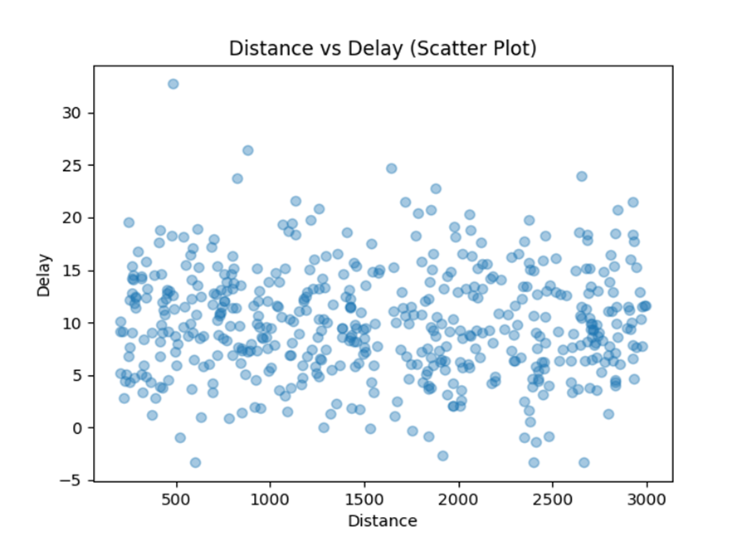
Scatter Plot – Distance vs Delay
Analyzes relationship between flight distance and delay.
Shows whether longer flights experience more delays.
Helps evaluate route efficiency.
Useful for route optimization decisions.

Slide 10
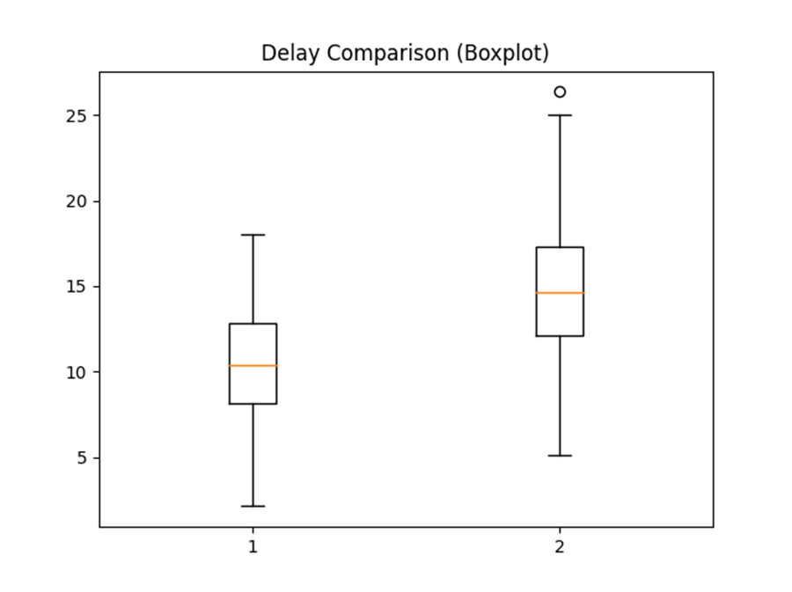
Box Plot – Airline Delay Comparison
Compares delay patterns across airlines.
Identifies airlines with higher variability in delays.
Shows median and extreme delay values.
Supports competitive performance benchmarking.

Slide 11
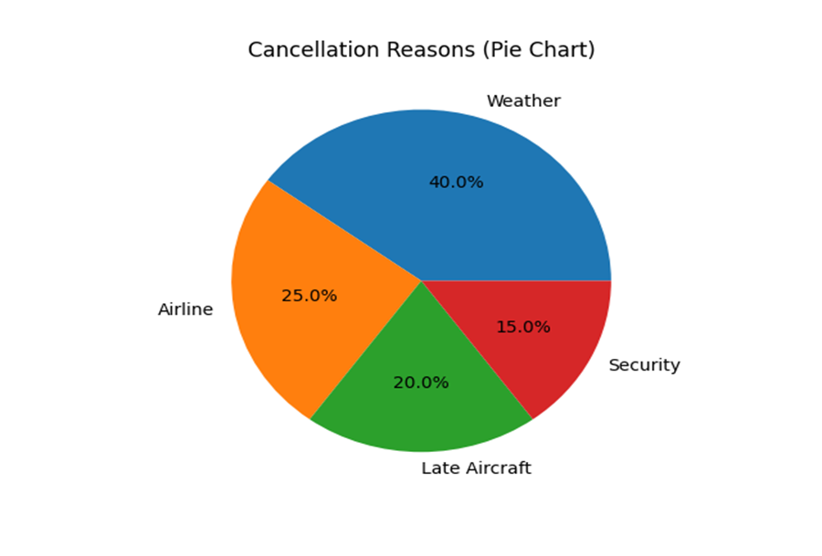
Pie Chart – Cancellation Reasons
Displays proportion of cancellation causes.
Major causes include weather and operational issues.
Helps identify high-impact risk factors.
Supports preventive strategy planning.

Slide 12
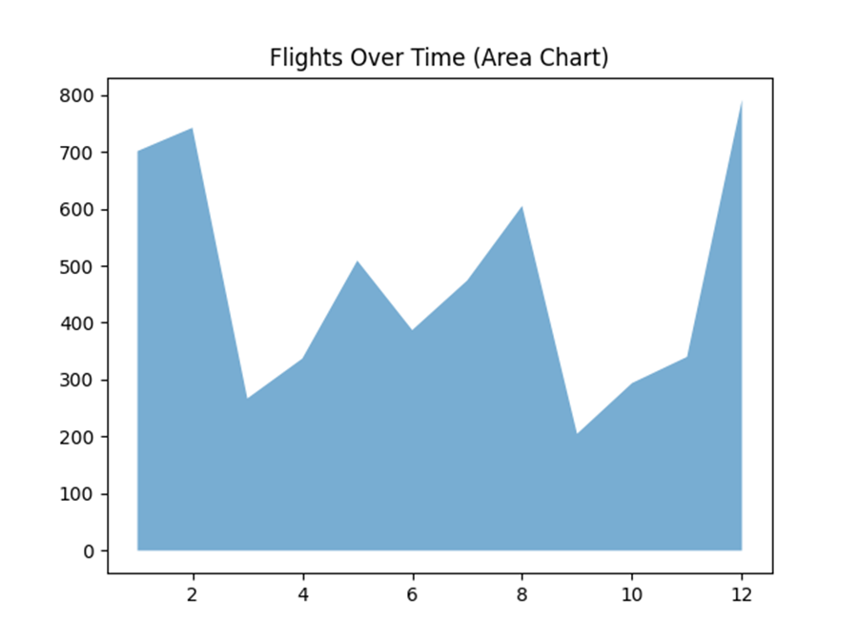
Area Chart – Flights Over Time
Shows cumulative flight volume over time.
Highlights seasonal traffic growth clearly.
Useful for capacity and infrastructure planning.
Supports long-term operational strategy.

Slide 13
Core Findings
Flight delays vary significantly by season and airline
Late aircraft and weather are major delay contributors
Peak-hour flights experience higher congestion delays
Certain routes show consistently high traffic volumes
Visualization helps quickly identify operational bottlenecks

Slide 14
Strategic Recommendations
Optimize flight schedules during peak seasons.
Use predictive analytics to reduce delays.
Improve turnaround time at busy airports.
Enhance customer communication during disruptions.

Slide 15
Conclusion
Multiple visualization techniques improve understanding
Insights support better scheduling and planning
Project demonstrates effective data-driven decision making

Slide 16
THANK YOU

