Slide 1
GUI-1 Basic Version
The GUI consists of left and a right column described below.
Left Column:
Purpose: Inputs the model to be simulated
Inputs multiple text boxes and radio buttons. The exact size of boxes and their locations do not matter.
2 buttons to run the simulation and open&load the results are required. Each button needs to be connected to a callback to execute an external code (e.g. MATLAB or another python code) if selected.
Right Column
Purpose: plots 3 graphs as a result of the inputs on the left column
The arrangement of the 3 plots do not matter as long as the GUI is readable and user-friendly. In the bext slide, I arranged a 1x2 and 1x1 style.

Slide 2
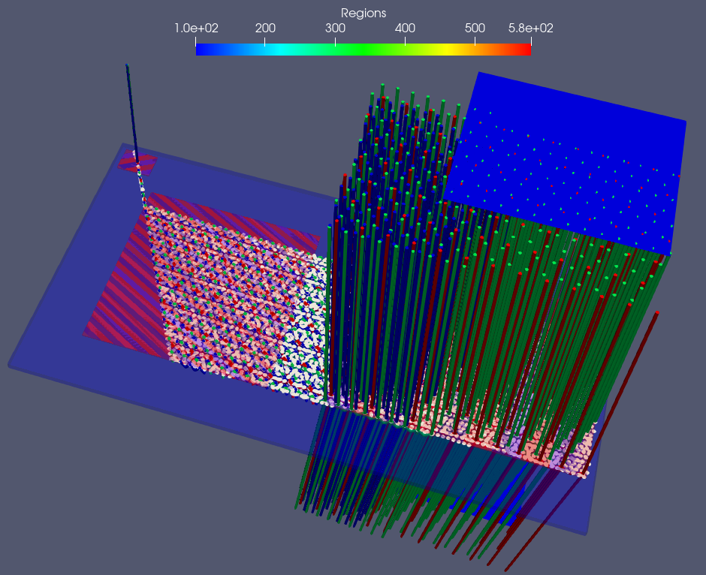


Left Column
Right Column
Variable-1
0, 1000, 2000, ….
Figure-1
Figure-2
Variable-2
0, 1000, 2000, ….
I’ll create a Plotly figure here
V3
C
P
Var4
3
V5
0, 1000, 2000, ….
V6
0, 1000, 2000, ….
V7
U
W
Run Simulation
Load Simulation Results/Open Data
1
Trame options to turn on/off view for geometry1.vtu
Dropdown Choose color preset:
Greens, Blues, Purples, Blue to Red Rainbow,
X-Ray, …
Slider: Opacity (default = 0.2)
Figure-3
2
Trame options to turn on/off view for geometry2.vtu
Slider: Opacity (default = 0.4)
3
Trame options to turn on/off view for geometry3.vtu
4
Trame options to turn on/off view for geometry4.vtu
5
Trame options to turn on/off view for geometry5.vtu
6
Trame options to turn on/off view for geometry6.vtu
7
Trame options to turn on/off view for geometry7.vtk
Tube filter options: default radius to 100
8
Trame options to turn on/off view for geometry6.vtu

Slide 3
Figure-2
Features
Based on the inputs on the left column, a 2D grid may be created. Figure-2 shows a default grid based on the inputs (xmin, xmax, x-increment; ymin, ymax, y-increment)
The grid shows circles around each point in grey color.
If the user selects each point, it turns into red. If the user clicks the point again, it turns grey again (de-select).
Multiple points can be selected.
The python code obtains the points which the user selected through callbacks.
Question:
Is there a good way to do this? It seems Plotly has an interactive plot about this (https://dash.plotly.com/interactive-graphing)

Slide 4
Figure-3
Features
All geometry plots are XML-based except for geometry7 that is an ASCI PloyData set.
There is one geometry1, one geometry2, one geometry3, one geometry4 data file.
There are multiple geometry5, multiple geometry6, multiple geometry7, multiple geometry8 data files.
All the data in geometry1,…,geometry8 show only one variable. Therefore, there is no need to have a dropdown to show the field plot variable. The range of this variable is [100,600].
Only one colormap for the whole data is required.
Question:
Shall I convert geometry7 to XML format as well to be consistent in developing the python code? If it makes things easier, I do not mind what the data format is. I do not know how to convert geometry7 to XML format.

Slide 5
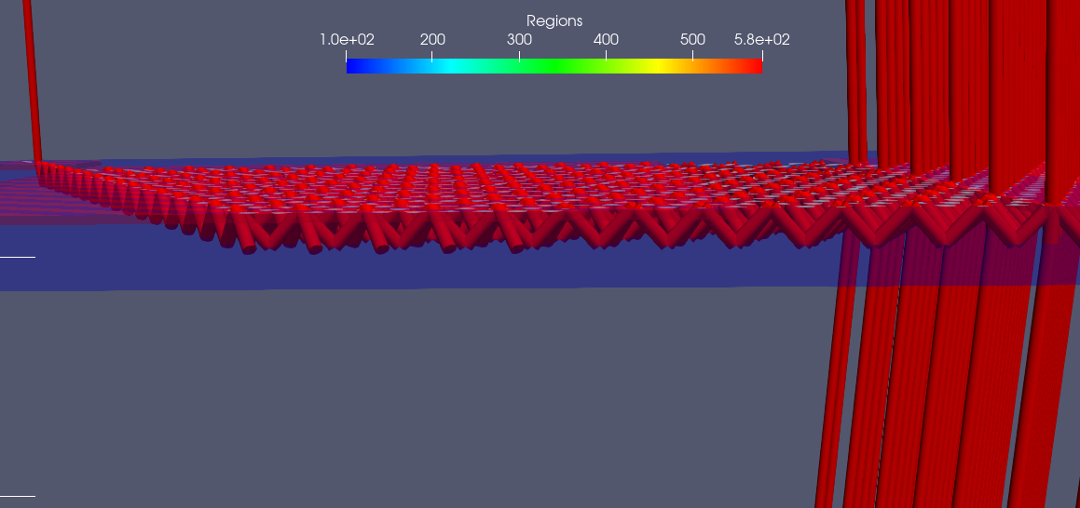
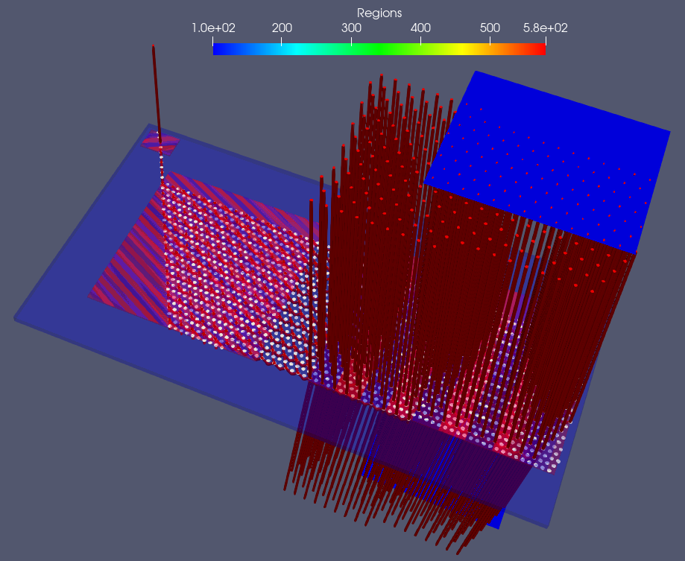
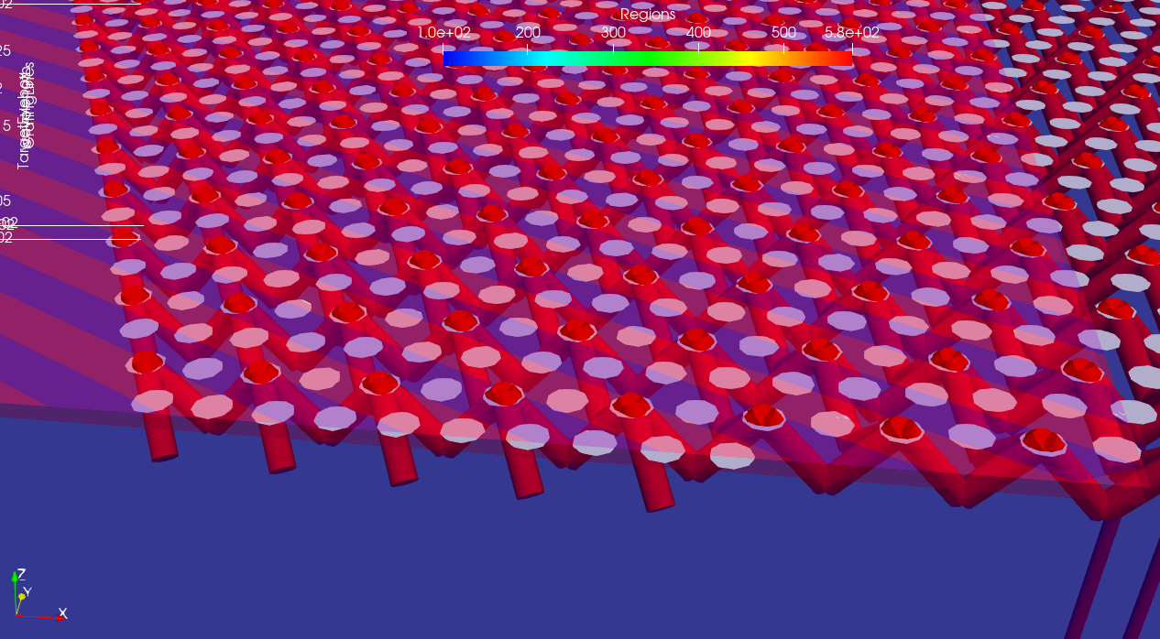
Figure-3 Left-Column Figure Numbers
7
5
3
1
1
7
2
8
8
6
4

