Slide 1
Bioinformatics page 12, 529-530 + 659-660 +part of ch. 21
Cell and Mol Biol Lab

Slide 2
Tremendous amounts of sequence data; the gene is made up of sequence of A, T, G and Cs
Small change in one of these “nucleotide bases” can make a major change in the gene
3.2 billion bases in the human genome
New field emerged: Bioinfomatics that
Combines biology, math and computer science
Our campus has a program in this field…
Study the genome and the proteome (the ~35,000 proteins that result from genes; 3-D structure as we studied in the earlier lab)

Slide 3
For the sequences…the Genome
Where are the genes (only 1-2% of DNA is for genes, a bit is involved in regulation, the majority is “junk” DNA)?
How do the genes differ?
When is the gene on?
In what tissues is the gene on?
What kind of protein does the gene code for?
How do the proteins function? The PROTEOME

Slide 4
VOCABULARY:
THE CELL
CENTRAL DOGMA (THE CODE…)
DNA STRUCTURE
mRNA: TRANSCRIPTION, TRANSCRIPTION FACTORS
GENE ACTIVITY: NORTHERN BLOT AND HIGH THROUGHPUT ARRAY ANALYSIS
PROTEIN: TRANSLATION, STRUCTURE, 2-D GELS AND REGULATION BY PHOSPHORYLATION
BIOCHEMICAL PATHWAYS

Slide 5
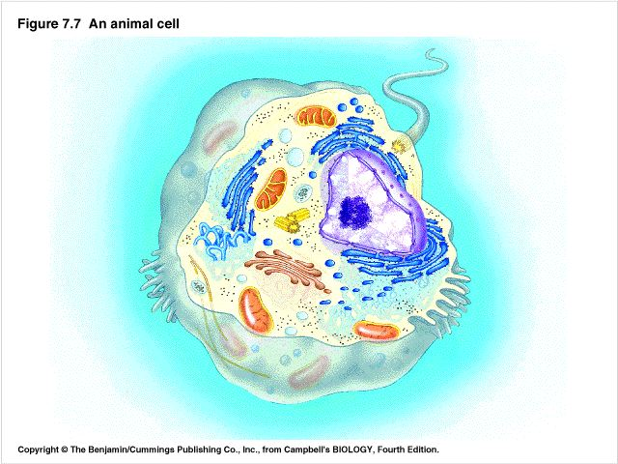
Fig. 4-5
NUCLEUS
(DNA HERE)
CYTOPLASM
(PROTEINS MADE HERE)
PROTEINS CARRY OUT FUNCTIONS OF CELL

Slide 6
CENTRAL DOGMA
FLOW OF INFORMATION FROM DNA TO mRNA TO PROTEIN. PROTEIN THEN MAKES RED HAIR.
INFORMATION: CODE FOR RED HAIR, BODY SHAPE, DISEASE, ETC.

Slide 7
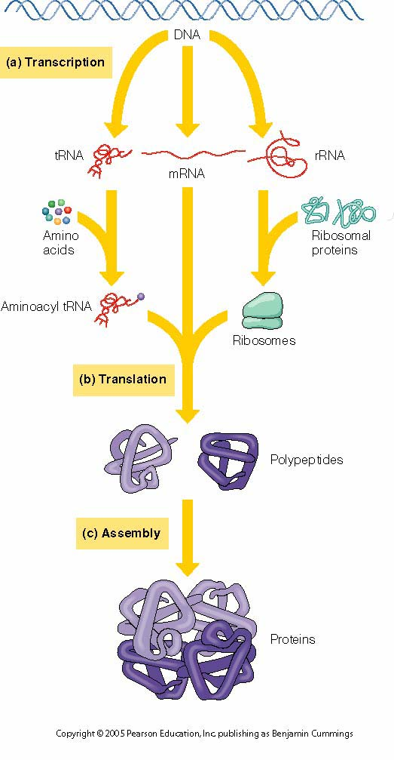
Fig. 21-1; Know vocab list

Slide 8
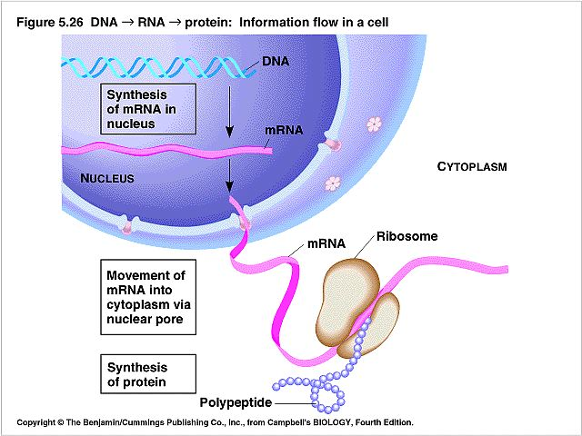
STORE INFO IN
NUCLEUS IN DNA
TRANSFER INFO
TO CYTOPLASM
MAKE PROTEIN IN CYTOPLASM

Slide 9
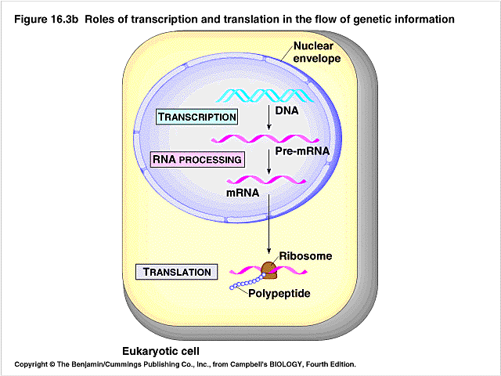
TRANSCRIPTION AND TRANSLATION

Slide 10
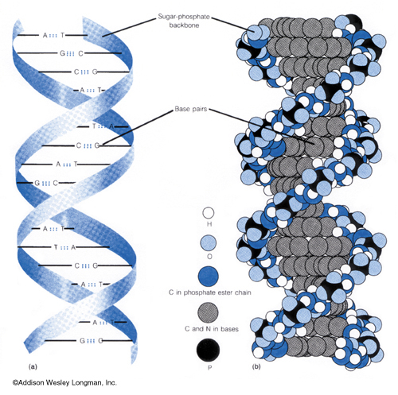
DNA STRUCTURE
CODE OR INFO
IS IN SEQUENCE
OF G, C, T, OR A

Slide 11
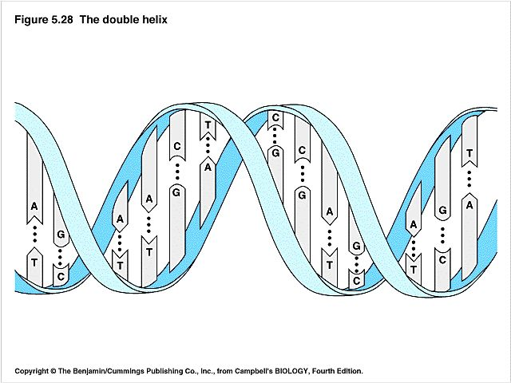
CODE IS IN SEQUENCE
OF NUCLEOTIDE BASES (ATGC)
IN THE DNA (OR DOUBLE HELIX)

Slide 12
HERE IS PART OF 1 GENE:
ATTGCTAGGAAATTCGCCAT ATTGCTAGGAAATTCGCCAT
ATTGCTAGGAAATTCGCCAT ATTGCTAGGAAATTCGCCAT
ATTGCTAGGAAATTCGCCAT ATTGCTAGGAAATTCGCCAT
ATTGCTAGGAAATTCGCCAT ATTGCTAGGAAATTCGCCAT
ATTGCTAGGAAATTCGCCAT ATTGCTAGGAAATTCGCCAT
ATTGCTAGGAAATTCGCCAT ATTGCTAGGAAATTCGCCAT
ATTGCTAGGAAATTCGCCAT ATTGCTAGGAAATTCGCCAT
ATTGCTAGGAAATTCGCCAT ATTGCTAGGAAATTCGCCAT
ATTGCTAGGAAATTCGCCAT ATTGCTAGGAAATTCGCCAT
ATTGCTAGGAAATTCGCCAT ATTGCTAGGAAATTCGCCAT
ATTGCTAGGAAATTCGCCAT ATTGCTAGGAAATTCGCCAT
ATTGCTAGGAAATTCGCCAT ATTGCTAGGAAATTCGCCAT
ATTGCTAGGAAATTCGCCAT ATTGCTAGGAAATTCGCCAT
ATTGCTAGGAAATTCGCCAT ATTGCTAGGAAATTCGCCAT
ATTGCTAGGAAATTCGCCAT ATTGCTAGGAAATTCGCCAT
ATTGCTAGGAAATTCGCCAT ATTGCTAGGAAATTCGCCAT
ATTGCTAGGAAATTCGCCAT ATTGCTAGGAAATTCGCCAT
ATTGCTAGGAAATTCGCCAT ATTGCTAGGAAATTCGCCAT
ATTGCTAGGAAATTCGCCAT ATTGCTAGGAAATTCGCCAT
ATTGCTAGGAAATTCGCCAT ATTGCTAGGAAATTCGCCAT

Slide 13
Our genome is unique…
We are all unique: 0.3% of the base sequence in you is different from others,
This is amounts to 0.3%=0.003 x 3.2 billion = 10 million changes in the nucleotide base sequence
Each change is known as a “single nucleotide polymorphism” (poly is many, morphism is form) or snp’s --pronounced “snips”
In the future, Physicians will find your snp’s, and base their treatment (dose, type of medicine) on your snp’s
Snp’s might lead to certain diseases

Slide 14
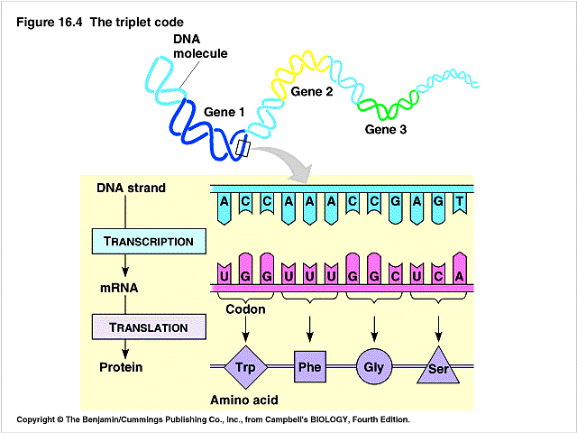

Slide 15
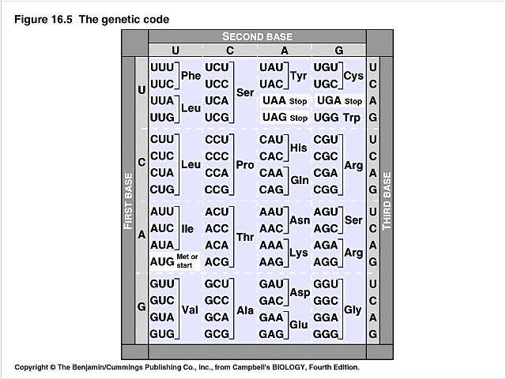
Fig. 21-8
3 BASES ON DNA/mRNA
MAKE UP ONE UNIT
AND CORRESPOND
TO ONE AMINO ACID
IN THE PROTEIN

Slide 16
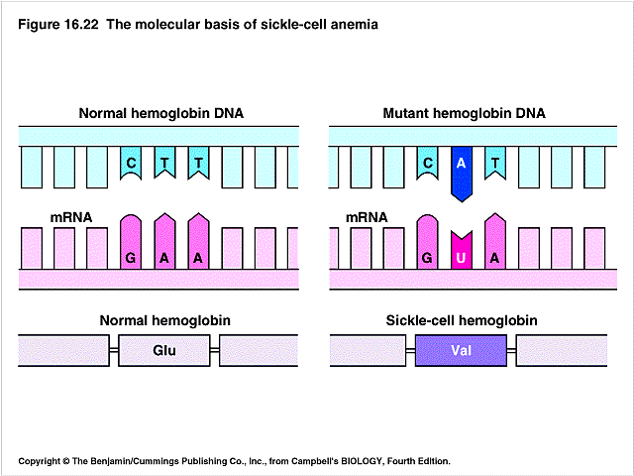
ONE WRONG
AMINO ACID

Slide 17
Transcription –making mRNA- video & vocab:
Gene runs from promoter to the terminator (think of AHHNOLD)
RNA polymerase makes mRNA
Off of one strand of DNA called template strand
Note matching up of code on DNA as mRNA is made- this carries the protein info
D:\cell mol lab\bioinform lab protein struc\17-06-Transcription.mov

Slide 18
Translation; making the protein from mRNA
Note how 3 nucleotides (codon) pair up with the transfer RNA that brings in a certain amino acid
So correct amino acids are added
Protein has correct amino acid sequence
D:\cell biol 3611\protein synth sorting\TRANSLATION.MOV

Slide 19
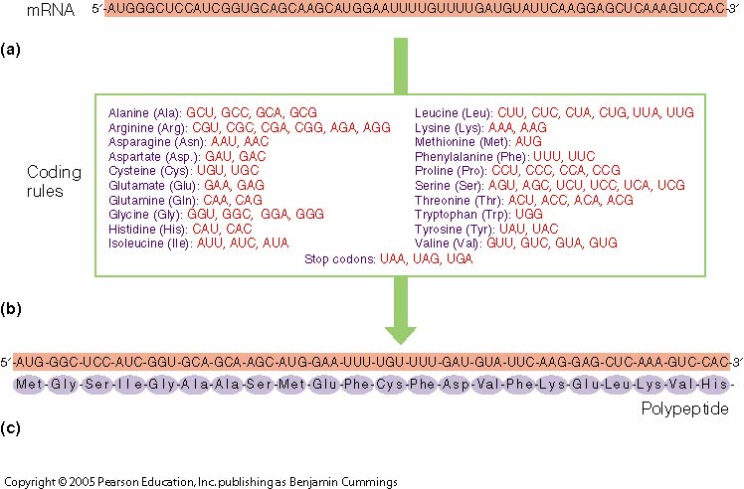
Fig. 21-2

Slide 20
Problem….
So, the various exons in the DNA are used for making a protein
The introns are not; they can have other regulatory functions (e.g., site of transcription factor binding)
The introns are spliced out of the Pre- mRNA (in a process called Processing)
Problem for scientists: exons can become introns (and vice versa), pre RNA processing cuts out differing sections
So, one gene, many proteins possible

Slide 21
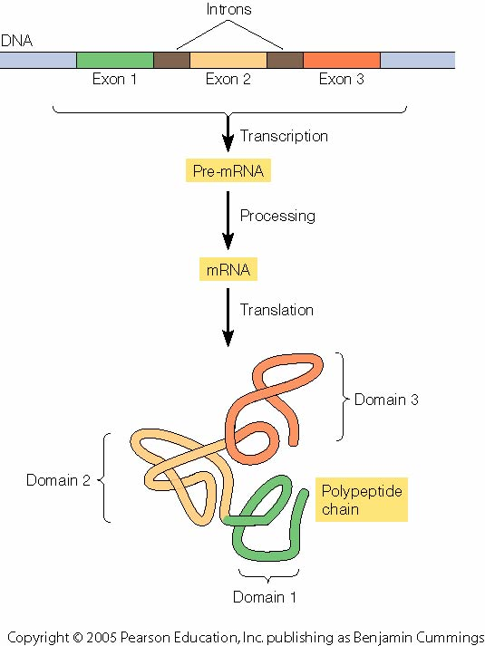
Fig. 21-26 Note that what is an exon can change from one time to the next. Also, processing of the Pre-mRNA can change, both producing different proteins. Note relationship between exons and domains

Slide 22
GENE ACTIVITY:
IS THE GENE “ON” OR “OFF”?
If GENE is “ON”, it is
MAKING mRNA
This is transcription (transcribing
the code from DNA to mRNA).
Regulation of transcription OR
Gene Activity is by
“TRANSCRIPTION FACTORS”

Slide 23
OLD METHOD:
NORTHERN BLOT FOR ONE GENE
IF GENE X IS ON, mRNA FROM THIS
GENE WILL BE PRODUCED.
ADD INSULIN TO CELL, GENE X
IS TURNED ON
NO INSULIN,
GENE X OFF
DETECT mRNA
FROM GENE X

Slide 24
Newer Method: RT-PCR
Isolate RNA from a cell
Only the genes that are on will be making mRNA
Add Reverse Transcriptase (RT) to make cDNA from mRNA
Clone (make many copies) of one particular cDNA with use of primers and PCR

Slide 25
NEW METHOD: HIGH THROUGHPUT “ARRAY ANALYSIS”
ANALYZE 10,000 OR MORE GENES
ALL AT ONCE.
WHAT GENES ACT IN CONCERT
WHEN YOU ADD INSULIN TO A CELL?
WHAT GENES TURN ON IN A
CANCER CELL?

Slide 26
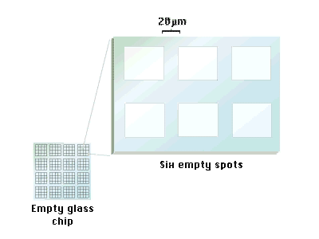
(mouse click to play)

Slide 27
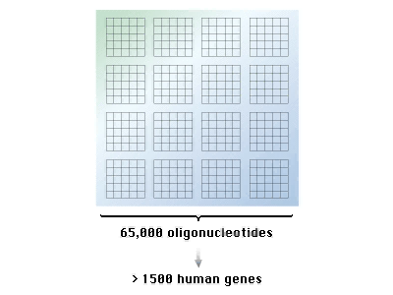

Slide 28
One Problem: if there are about 25,000 genes, why are there about 200,000 to 1 million different proteins?
Answer 1: different sections of one gene can be used to produce different proteins (e.g., exons can become introns, and vice versa)
Answer 2: one Pre- mRNA is cut up differently (or processed differently, called “alternative splicing of the RNA”), producing different proteins from one original Pre- mRNA.

Slide 29
USING COMPUTAIONAL TECHNIQUES to handle the large amount of data, study the Proteome:
Mass Spec
3-D PROTEIN STRUCTURE
GEL ELECTROPHORESIS TO IDENTIFY WHAT PROTEINS ARE PRESENT
HIGH-THROUGHPUT: 2-D GEL ELECTROPHORESIS
PROTEIN ARRAYS (place protein on glass slide, not nucleic acid, see what binds to the protein)

Slide 30
Study the Proteome- Mass Spec
Use electrophoresis to separate the various size proteins (separate based on size)
Purified Protein is cut up into different size fragments by a protease
The exact size of each peptide determined by Mass Spectrometry
From the DNA sequence, predict the pattern of peptide fragments – find that your protein comes from a new gene

Slide 31
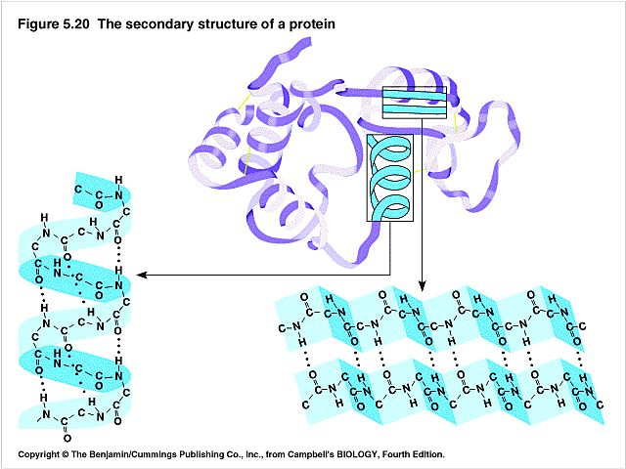
Study the Proteome: 3-D PROTEIN STRUCTURE

Slide 32
What Proteins are Made?
(I.E., ~What genes are active)
SEPARATE AND IDENTIFY PROTEINS USING GEL ELECTROPHORESIS:
OBTAIN A MIXTURE OF PROTEINS FROM A LIVER CELL
USE 1-D GEL ELECTROPHORESIS TO CRUDELY FIND OUT WHAT PROTEINS ARE PRESENT

Slide 33
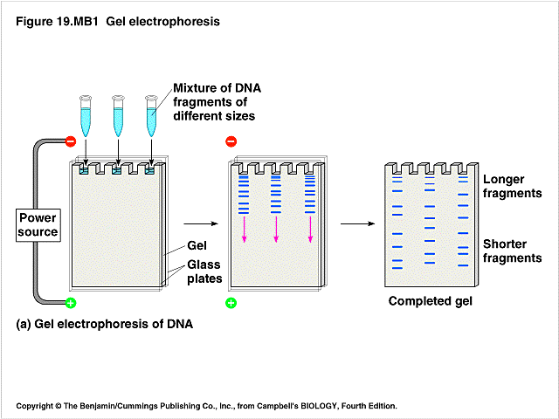
1-D ELECTROPHOESIS
(SEPARATES BY SIZE)
IS INSULIN MADE IN THIS CELL?
IS INSULIN MADE
IN THIS CELL?
MIXTURE OF PROTEINS FROM ONE CELL
(WESTERN BLOTTING USED HERE)

Slide 34
2-D GEL ELECTROPHORESIS
HIGH THROUGHPUT; ANALYZE THOUSANDS OF PROTEINS
PROBLEM: THERE ARE
THOUSANDS OF SPOTS;
EACH 2-D GEL
RUNS A LITTLE
DIFFERENTLY,
SO IT CAN BE DIFFICULT
TO ID EACH SPOT
ANALYZE DISTANCE
BETWEEN SPOTS
(PATTERN ANLYSIS)
TO IDENTIFY SPOTS

Slide 35
POST-TRANSLATIONAL MODIFICATION
ONCE MADE (POST-TRANSLATION),
THE PROTEIN CAN BE MODIFIED.
ONE MODIFICATION IS THE
ADDITION OF PHOSPHATE
TO A PROTEIN
ADDITION OF PHOSPHATE MAY
TURN ON (OR OFF) A PROTEIN
DETECT ADDITION OF PHOSPHATE
BY “MASS SPEC”

Slide 36
Web sites for Bioinfomatics
NCBI http://www.ncbi.nlm.nih.gov/
PubMed (National Library of Medicine, 2004) http://www.ncbi.nlm.nih.gov/entrez/query.fcgi
LocusLink (Pruitt and Maglott, 2001) http://www.ncbi.nlm.nih.gov/LocusLink/
OMIM (NCBI, 2000) http://www.ncbi.nlm.nih.gov/entrez/query.fcgi?db¼OMIM
Psi-Phi BLAST (Altschul et al., 1997) http://www.ncbi.nlm.nih.gov/BLAST/
ClustalW (Thompson et al., 1994) http://www.ebi.ac.uk/clustalw/index.html
KEGG (Kanehisa, 1997; Kanehisa and Goto, 2000) http://www.genome.ad.jp/kegg/
ExPASy http://us.expasy.org/
DeepView (Guex and Peitsch, 1997) http://us.expasy.org/spdbv/
SwissProt (Boeckmann et al., 2003) http://us.expasy.org/sprot/
Protein Data Bank (Berman et al., 2000) http://www.rcsb.org/pdb/
Sequence Manipulation Suite (Stothard, 2000) http://bioinformatics.org/sms/
PSIPRED (McGuffin et al., 2000), MEMSTAT (Jones, 1999) http://bioinf.cs.ucl.ac.uk/psipred/

Slide 37
VOCABULARY:
THE CELL
CENTRAL DOGMA
DNA STRUCTURE
mRNA: TRANSCRIPTION, TRANSCRIPTION FACTORS
GENE ACTIVITY: NORTHERN BLOT AND HIGH THROUGHPUT ARRAY ANALYSIS
PROTEIN: TRANSLATION, STRUCTURE, 2-D GELS AND REGULATION BY PHOSPHORYLATION
BIOCHEMICAL PATHWAYS

