Slide 1
Mutations of triangular mesh for 3d shape analysis
KYOTO UNIVERSITY INFORMATICS SEMINAR
2019/10/17
Ryo Yamada
Statistical Genetics, Kyoto Univ.

Slide 2
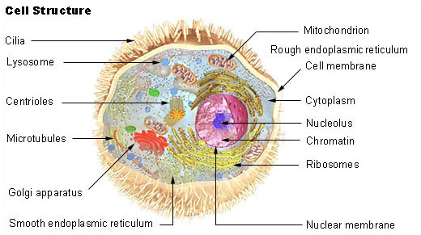
Cell
https://en.wikipedia.org/wiki/Cell_biology

Slide 3
3D movie
https://science.sciencemag.org/content/360/6386/eaaq1392#media-9
Movie 9
Science 20 Apr 2018: Vol. 360, Issue 6386, eaaq1392 DOI: 10.1126/science.aaq1392

Slide 4
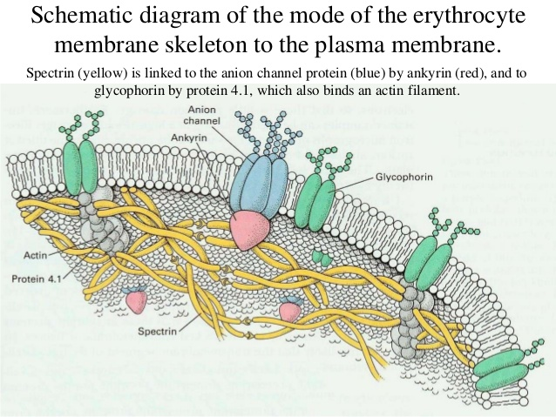
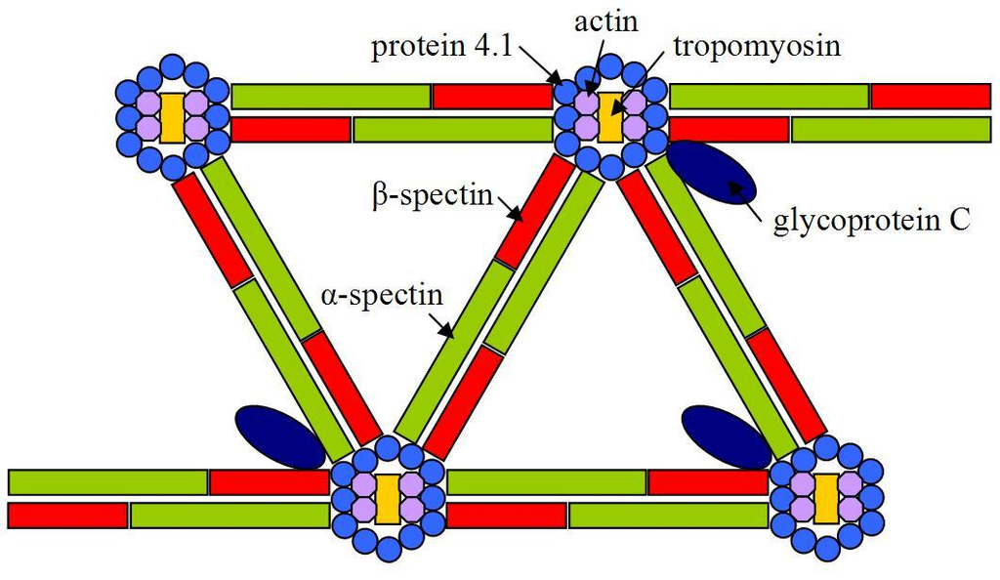
Cytoskeleton
https://www.slideshare.net/E_neutron/biological-membranes-transport-related-questions
https://en.wikipedia.org/wiki/Spectrin

Slide 5
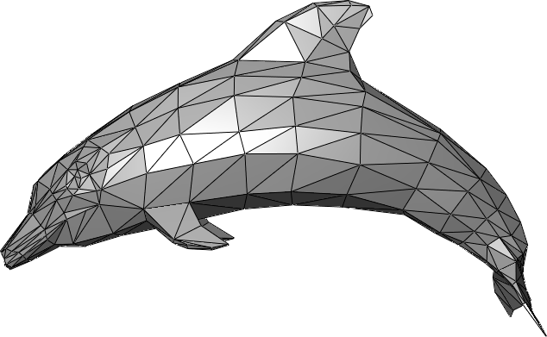
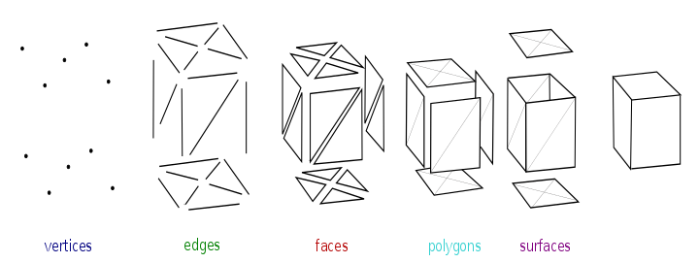
Triangular mesh
The study of polygon meshes is a large sub-field of computer raphics(specifically 3D computer graphics).
https://en.wikipedia.org/wiki/Polygon_mesh

Slide 6
Contents
Triangular mesh and its dual
Curvature and its discrete expression
Stochastic representations of shapes
Quiver and cluster algebra
Stochastic change of triangular mesh as mutation of quiver
3-regular graph and edge connection matrix
“Straight line” of 3-regular graph
Straight lines are a permutation

Slide 7
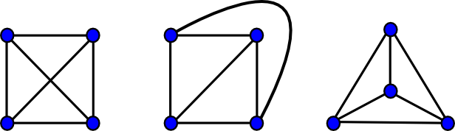
Planar graph and Euler’s formula
|V| - |E| + |F| = 2
https://www.boost.org/doc/libs/1_49_0/libs/graph/doc/planar_graphs.html

Slide 8
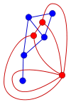
Dual Graph
Triangular mesh
Polygon
https://en.wikipedia.org/wiki/Planar_graph

Slide 9
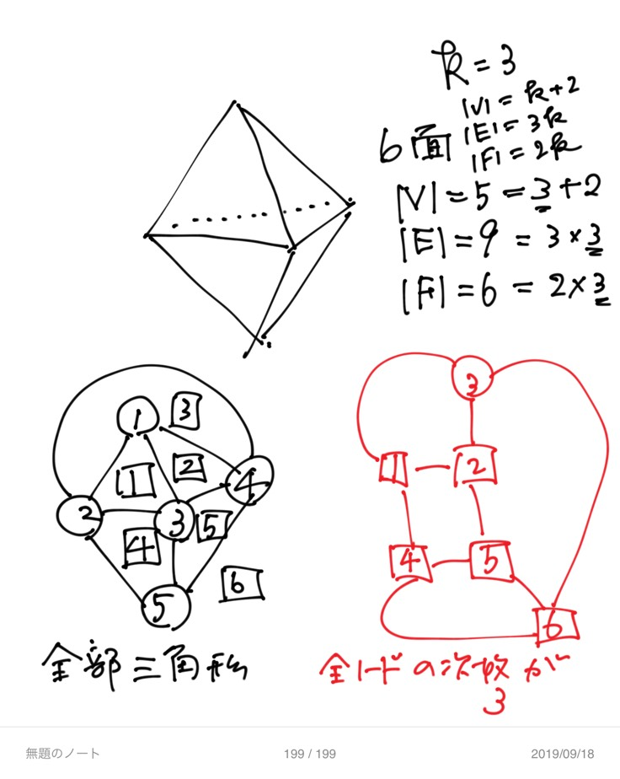
Dual graph of triangular mesh is 3-regular
Triangular mesh
All faces are triangles
Dual
Degree of all vertices are 3.
3-regular

Slide 10
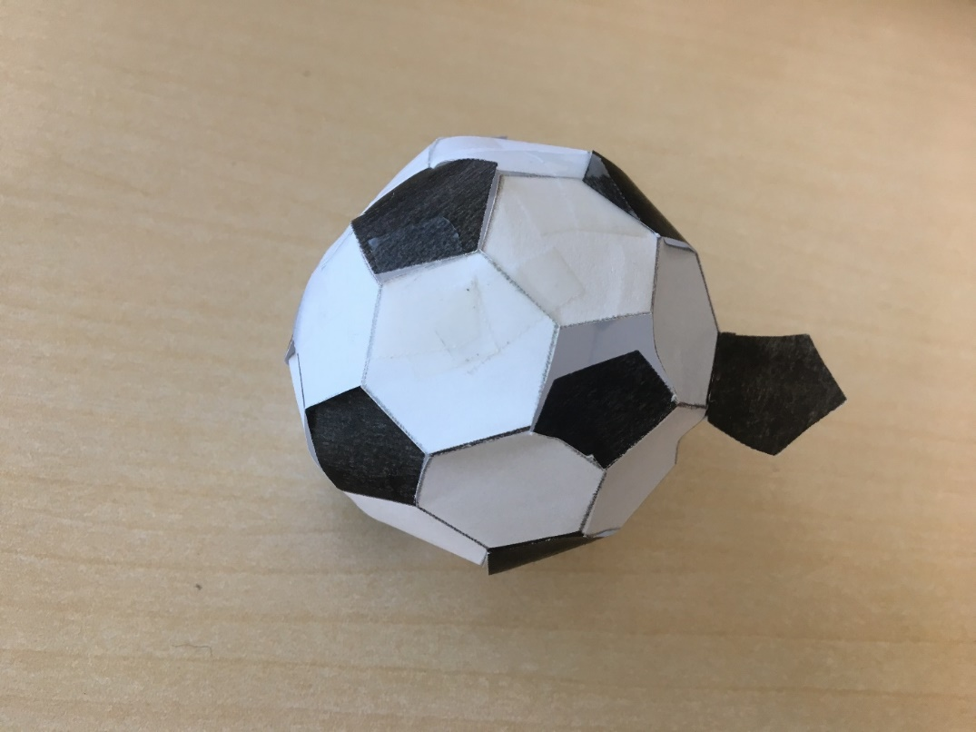
Curvature and Polygon
6 equilateral triangles make a flat plane.
< 6 equilateral triangles make concave/convex part.
> 6 equilateral triangles make redundancy of area … hyperbolic.

Slide 11

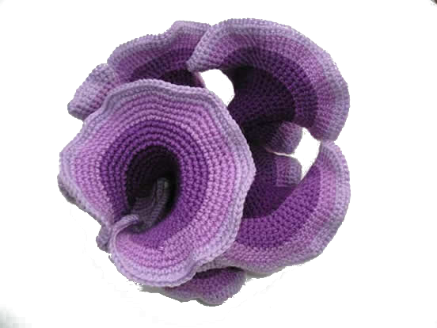
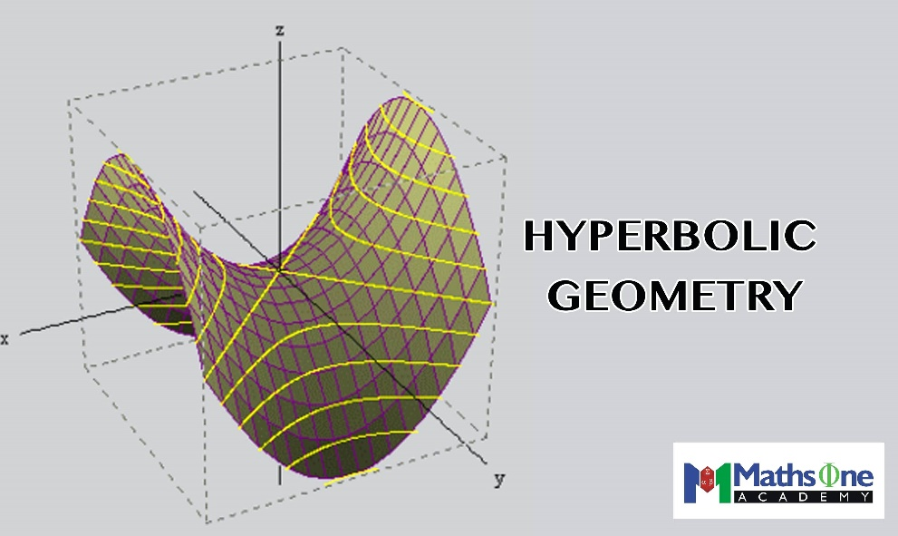
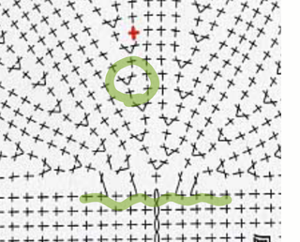
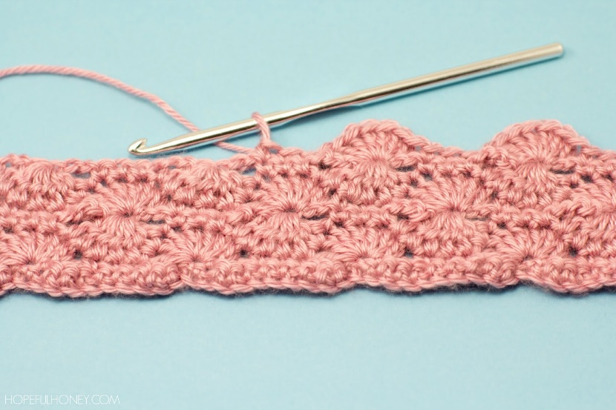
Hyperbolic geometry & Croche Knitting Digital/discrete representation of curved surface
http://lugezi.com/imgs/
https://crochetcoralreef.org/contributors/daina_taimina.php

Slide 12
Stochastic representation of S2-isomorphic shapes

Slide 13
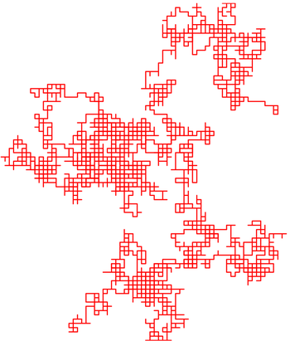
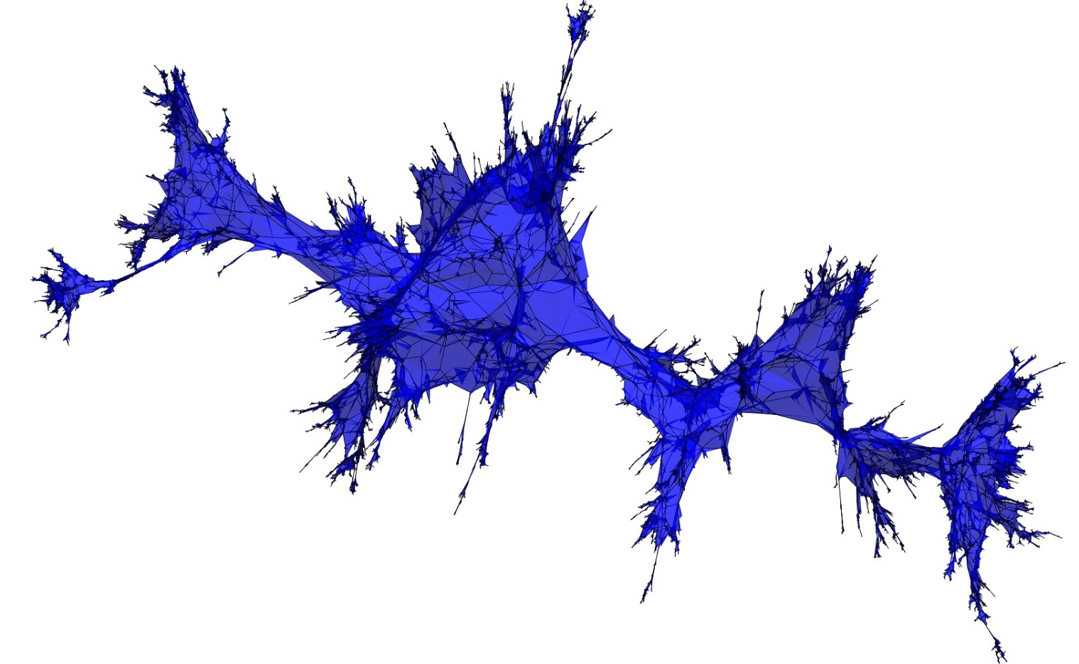
Brownian map
https://en.wikipedia.org/wiki/Random_walk
http://bettinel.perso.math.cnrs.fr/

Slide 14
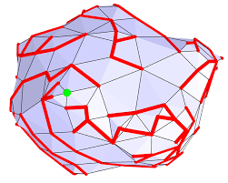
Cori–Vauquelin– Schaeffer bijection

Slide 15
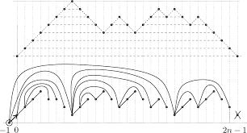
Brownian excursion

Slide 16
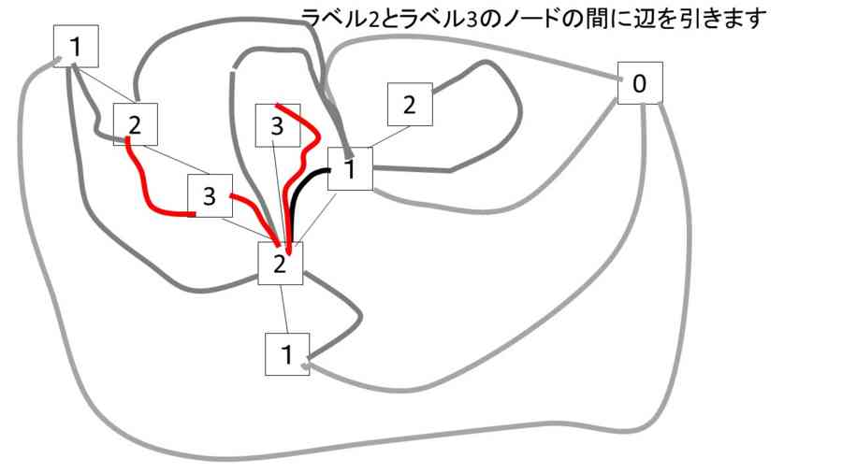
Brownian motion on Tree

Slide 17
Random planar curves and Schramm-Loewner evolutions
https://www.youtube.com/watch?v=NkdlqW1hmlY
Driven by one-dimensional random walk

Slide 18
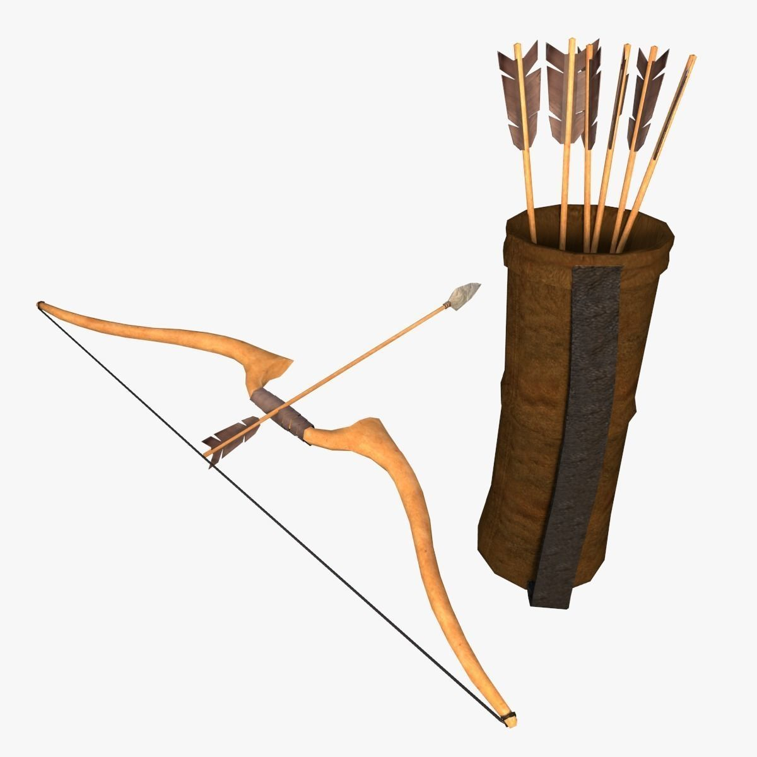
Stochastic representation of triangular meshes
A quiver is a directed graph, used in representation theory.
A quiver transforms to another quiver; mutation of quiver.
The mutations of quivers are accompanied by algebraic expressions, “cluster algebra”.
This feature of quivers supports mathematically sound generation of variation of quivers.
If triangular meshes have their quiver expression, stochastic changes of triangular meshes can be expressed as mutations of quivers.
https://www.cgtrader.com/3d-models/military/other/low-poly-arrow-quiver-and-bow

Slide 19
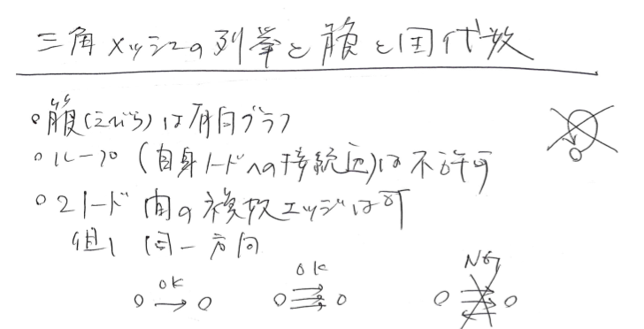
Quiver
A directed graph
No loop
Multiple edges are allowed
Edges in opposite directions should be cancelled.

Slide 20
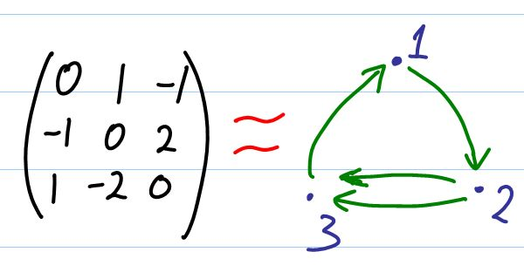
Quiver
Matrix representation
Skew-symmetric matrix (A^T = -A)

Slide 21
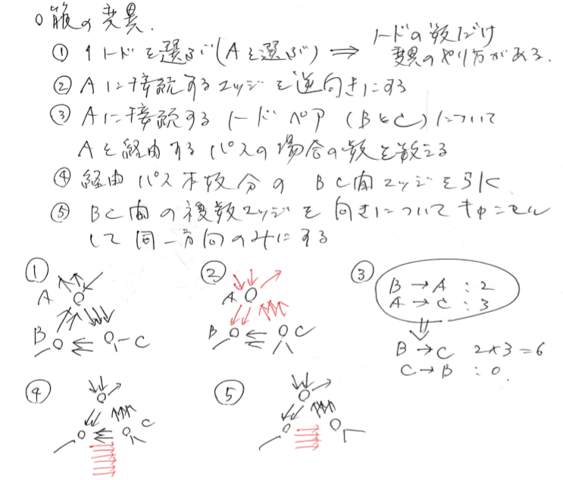
Mutations of Quivers
Select one of Vs, A.
Reverse direction of edges connecting to A.
If B and C are adjacent to A, count the number, N, of the ways to go from B to C (or C to B) via A. Add N edges between B and C.
Cancel the edges in opposite directions.

Slide 22
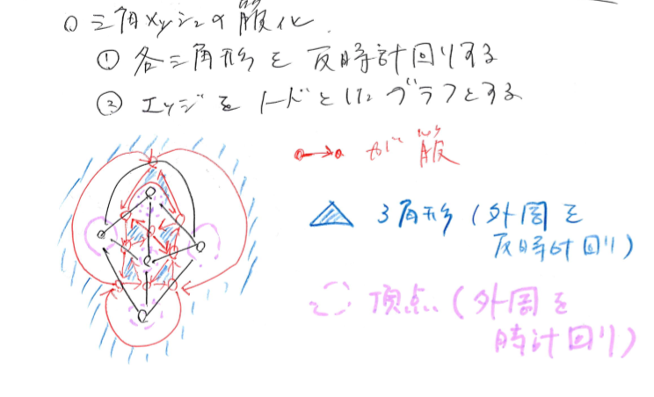
Quiver representation of polygon/dual polygon

Slide 23
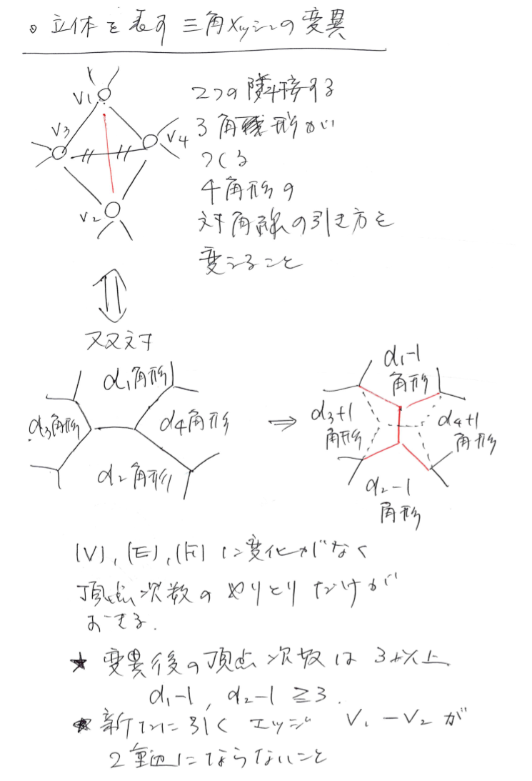

Slide 24
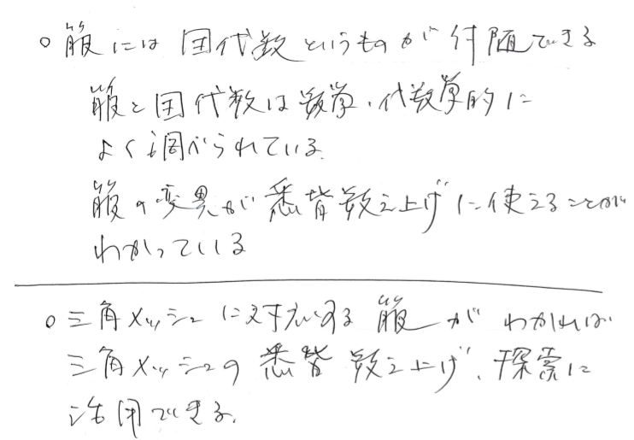
Cluster algebra
Quiver has cluster algebra.
Each vertex of quiver corresponds to one of the elements of the algebra.
The elements are rational polynomials.
Mutations of quiver changes the elements to another set of elements.
The whole rational polynomial elements and their quiver-mutational changes define an algebraic structure.
Cluster algebra has been applied to: Various algebraic studies, geometry, knot theory, mathematical physics …

Slide 25
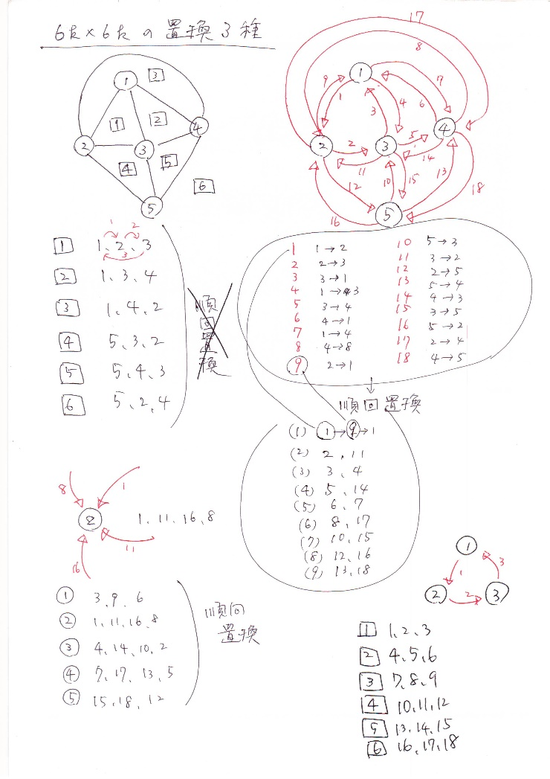

Slide 28
Mutation of polygon/dual polygon

Slide 29
Enumeration of triangular mesh

Slide 31

Number of cycles and Ihara’s zeta function
Backtrack-less cycles of graph
Ihara’s zeta function is a moment-generating function of bachtrack-less cycles.
W is a edge connection matrix a graph.
Explanation of W follows.

Slide 32
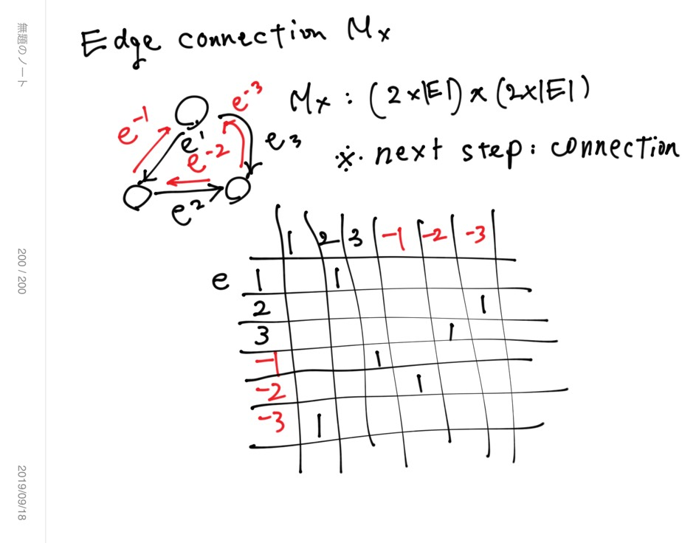

Slide 33
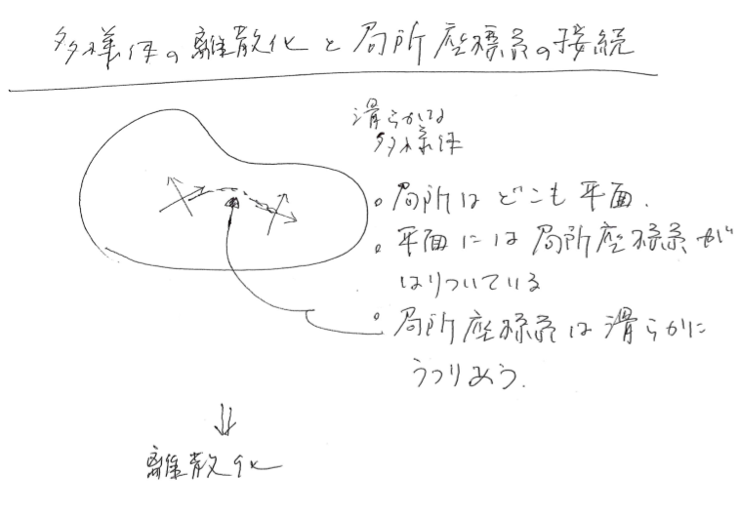

Slide 34
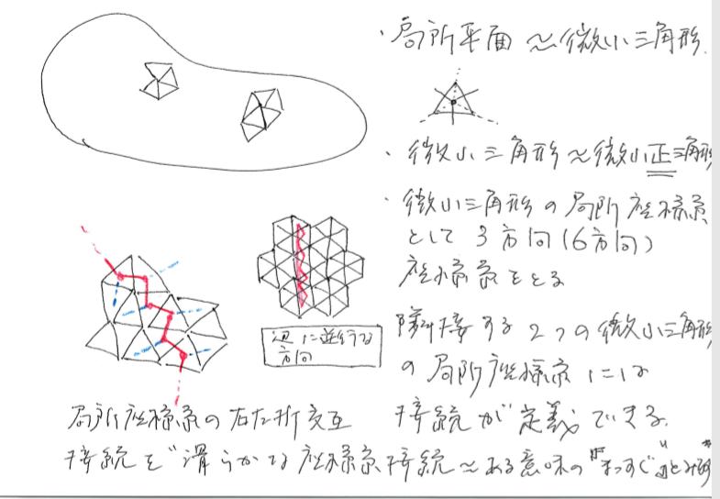

Slide 35
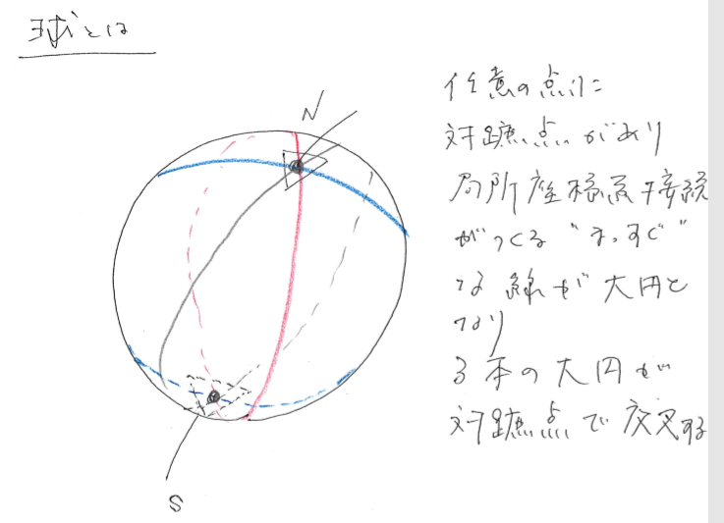

Slide 36
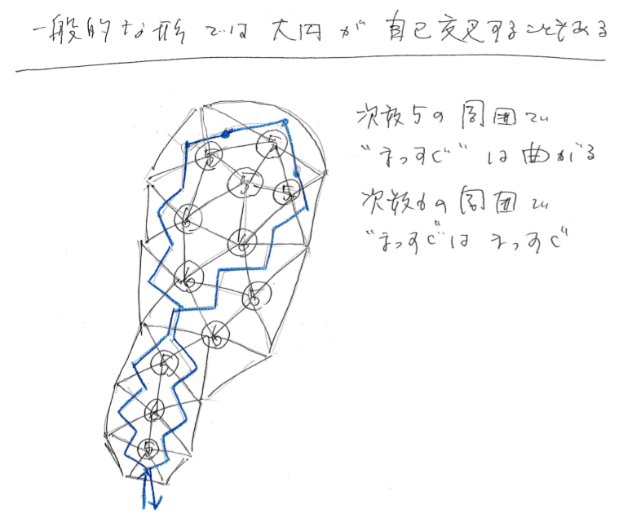

Slide 37
Edge-connection matrix

Slide 38
Regular graph

Slide 39
3-regular graph

Slide 40
Edge connection matrix of 3-regular graph
Sum of two permutation matrices

Slide 41
“Straight path” of 3-regular graph

Slide 42
“Straight paths” of 3-regular graph
Cycles

Slide 43
A set of cycles

Slide 45
Shape(凹凸), Curved surface(凹凸ナシ、伸び縮みのみ)

