Slide 1
Mutations of triangular mesh for 3d shape analysis
KYOTO UNIVERSITY INFORMATICS SEMINAR
2019/10/17
Ryo Yamada
Statistical Genetics, Kyoto Univ.

Slide 2
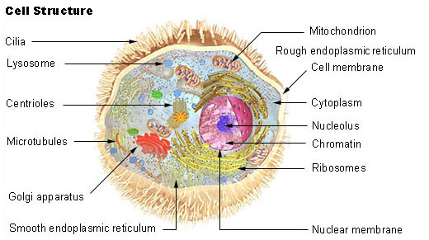
Cell
https://en.wikipedia.org/wiki/Cell_biology

Slide 3
3D movie
https://science.sciencemag.org/content/360/6386/eaaq1392#media-9
Movie 9
Science 20 Apr 2018: Vol. 360, Issue 6386, eaaq1392 DOI: 10.1126/science.aaq1392

Slide 4
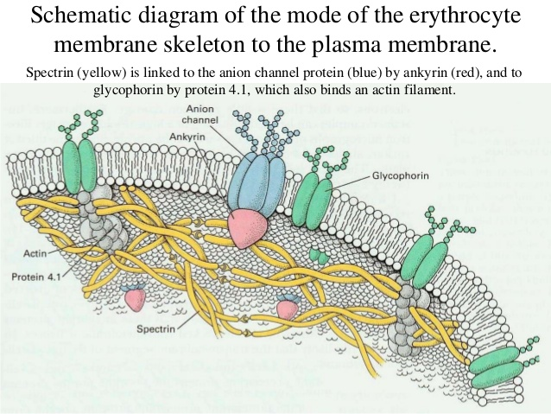
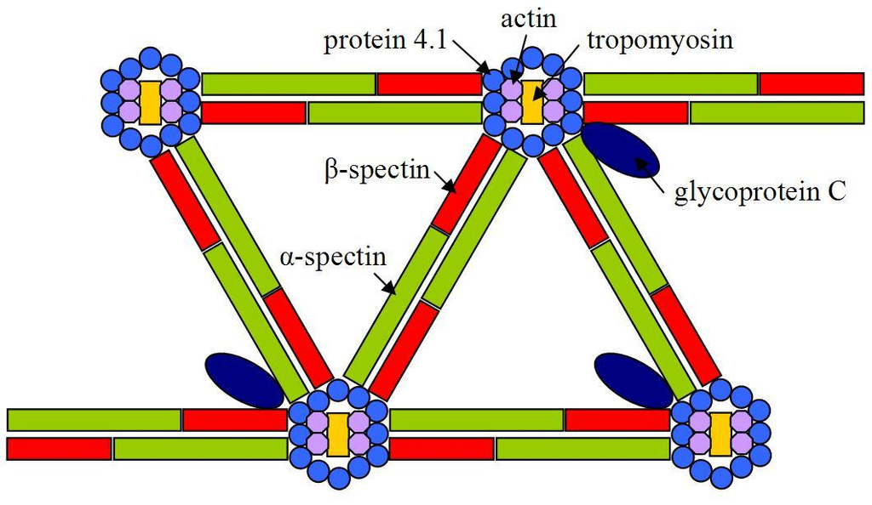
Cytoskeleton
https://www.slideshare.net/E_neutron/biological-membranes-transport-related-questions
https://en.wikipedia.org/wiki/Spectrin

Slide 5
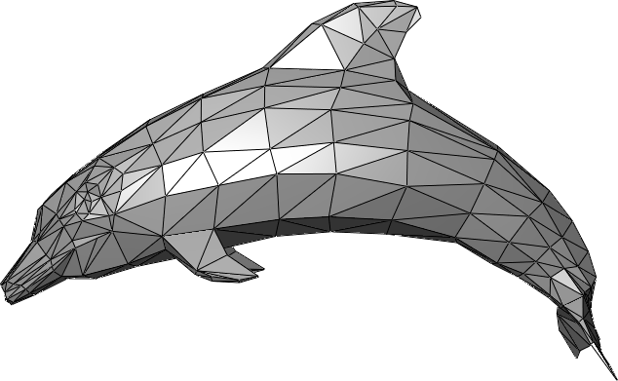
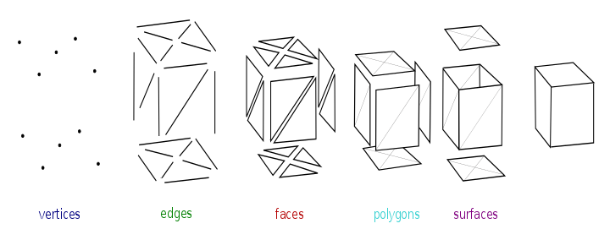
Triangular mesh
The study of polygon meshes is a large sub-field of computer raphics(specifically 3D computer graphics).
https://en.wikipedia.org/wiki/Polygon_mesh

Slide 6
Contents
Triangular mesh and its dual
Curvature and its discrete expression
Stochastic representations of shapes
Quiver and cluster algebra
Stochastic change of triangular mesh as mutation of quiver
3-regular graph and edge connection matrix
“Straight line” of 3-regular graph
Straight lines are a permutation

Slide 7
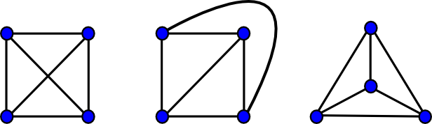
Planar graph and Euler’s formula
|V| - |E| + |F| = 2
https://www.boost.org/doc/libs/1_49_0/libs/graph/doc/planar_graphs.html

Slide 8
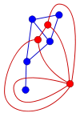
Dual Graph
Triangular mesh
Polygon
https://en.wikipedia.org/wiki/Planar_graph

Slide 9
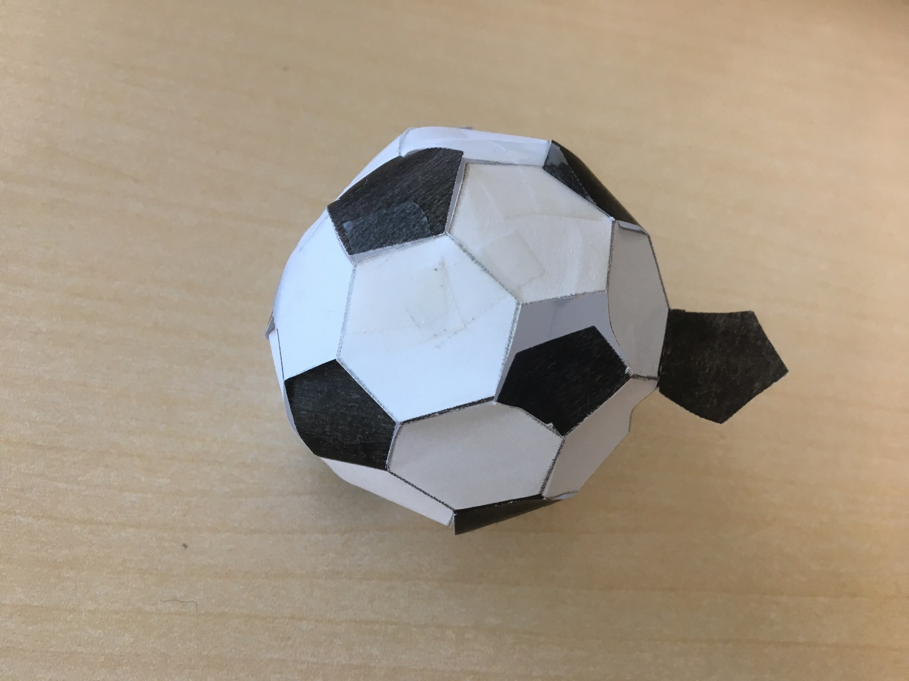
Curvature and Polygon

Slide 10

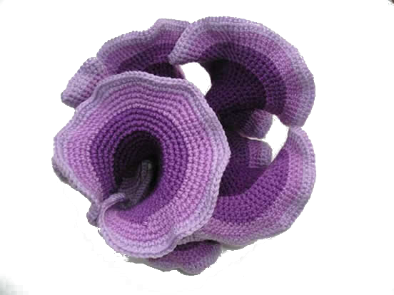
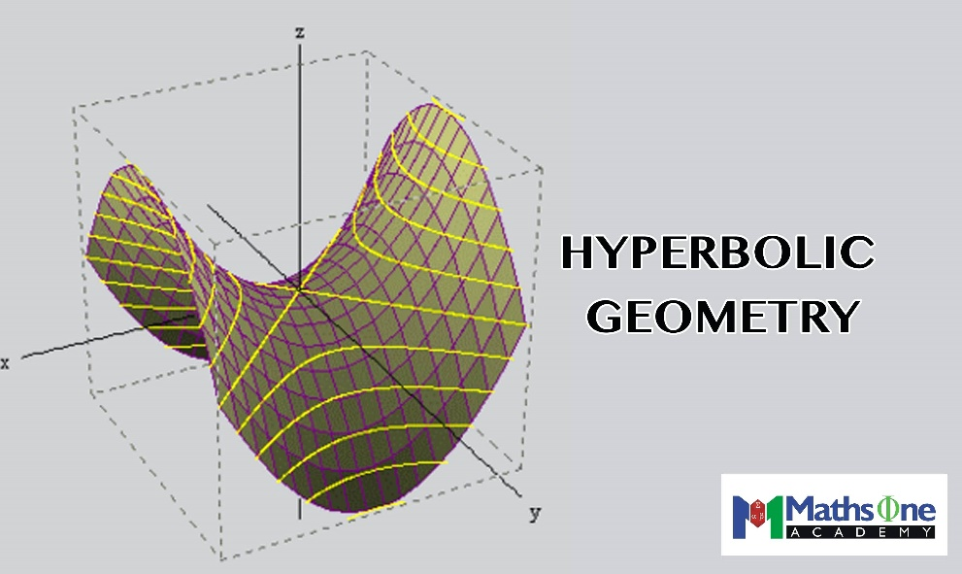
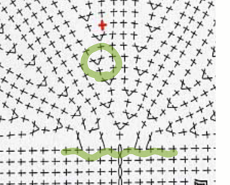
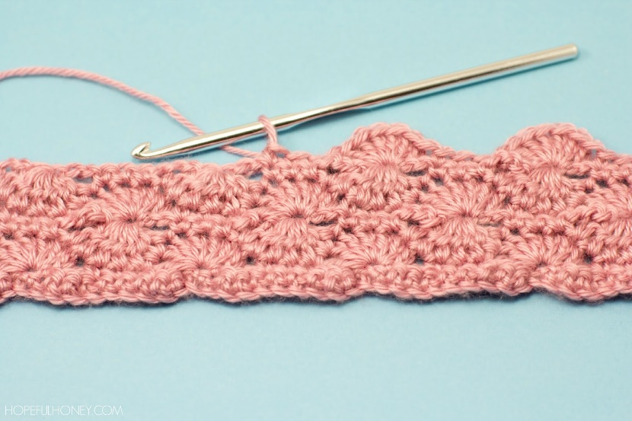
Hyperbolic geometry & Croche Knitting
http://lugezi.com/imgs/
https://crochetcoralreef.org/contributors/daina_taimina.php

Slide 11
Stochastic representation of S2-isomorphic shapes

Slide 12
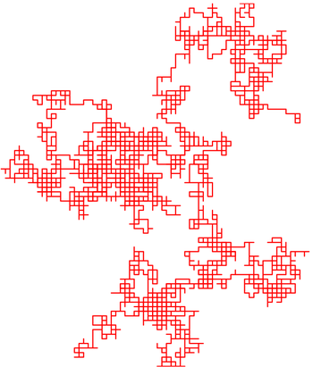
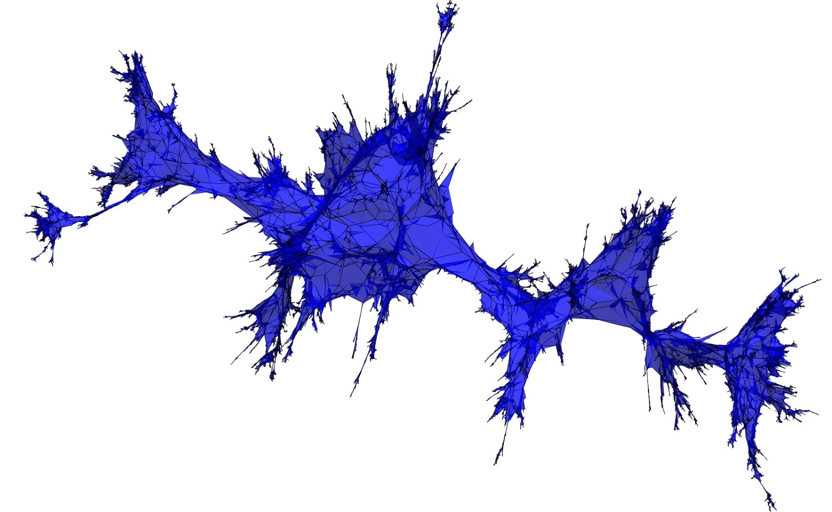
Brownian map
https://en.wikipedia.org/wiki/Random_walk
http://bettinel.perso.math.cnrs.fr/

Slide 13
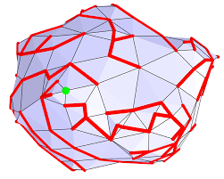
Cori–Vauquelin– Schaeffer bijection

Slide 14
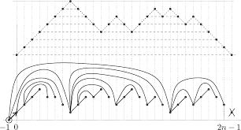
Brownian excursion

Slide 15
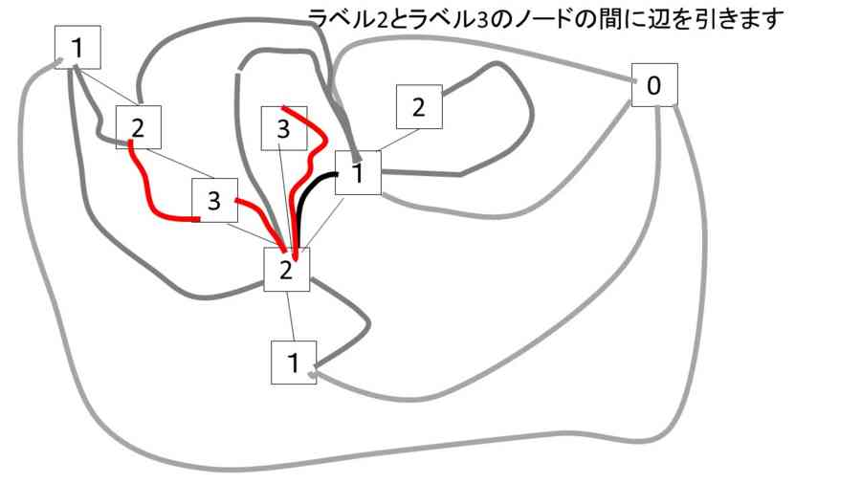
Brownian motion on Tree

Slide 16
Random planar curves and Schramm-Loewner evolutions
https://www.youtube.com/watch?v=NkdlqW1hmlY
Driven by one-dimensional random walk

Slide 17
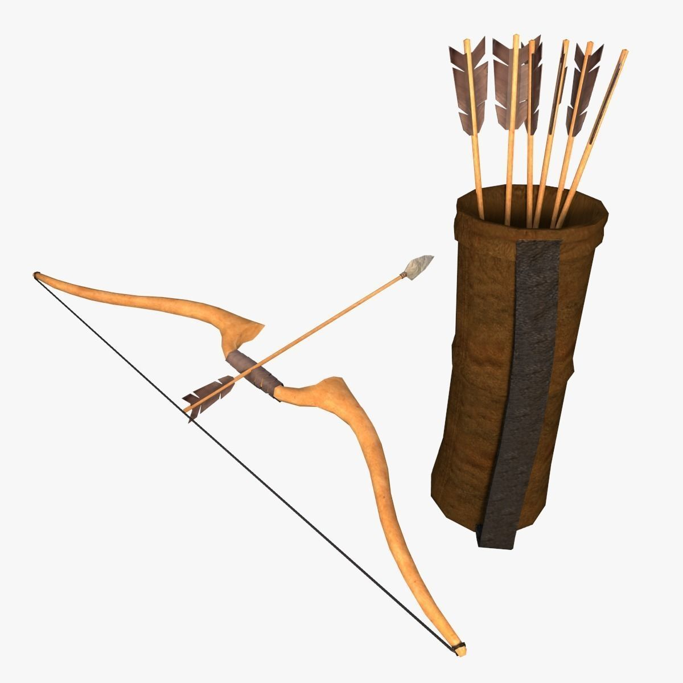
Stochastic representation of triangular meshes
A quiver is a directed graph, used in representation theory.
A quiver transforms to another quiver; mutation of quiver.
The mutations of quivers are accompanied by algebraic expressions, “cluster algebra”.
This feature of quivers supports mathematically sound generation of variation of quivers.
If triangular meshes have their quiver expression, stochastic changes of triangular meshes can be expressed as mutations of quivers.
https://www.cgtrader.com/3d-models/military/other/low-poly-arrow-quiver-and-bow

Slide 18
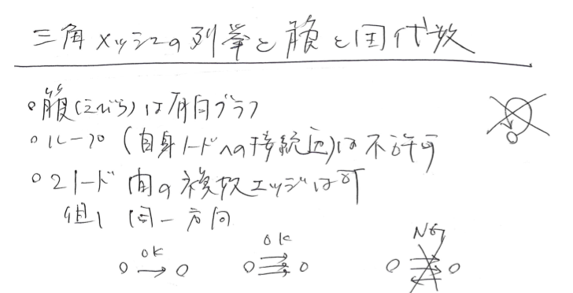
Quiver
A directed graph
No loop
Multiple edges are allowed
Edges in opposite directions should be cancelled.

Slide 19
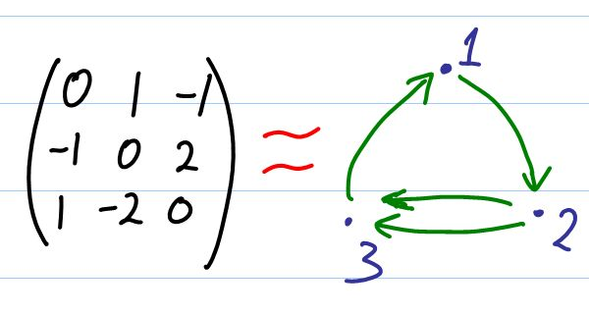
Quiver
Matrix representation
Skew-symmetric matrix (A^T = -A)

Slide 20
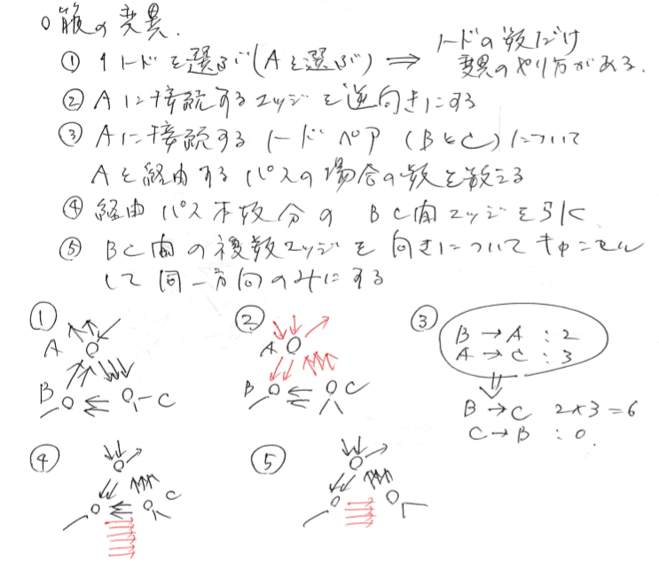
Mutations of Quivers
Select one of Vs, A.
Reverse direction of edges connecting to A.
If B and C are adjacent to A, count the number, N, of the ways to go from B to C (or C to B) via A. Add N edges between B and C.
Cancel the edges in opposite directions.

Slide 21
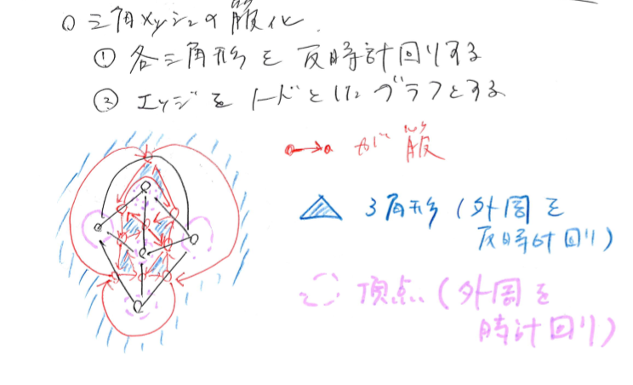
Quiver representation of polygon/dual polygon

Slide 22
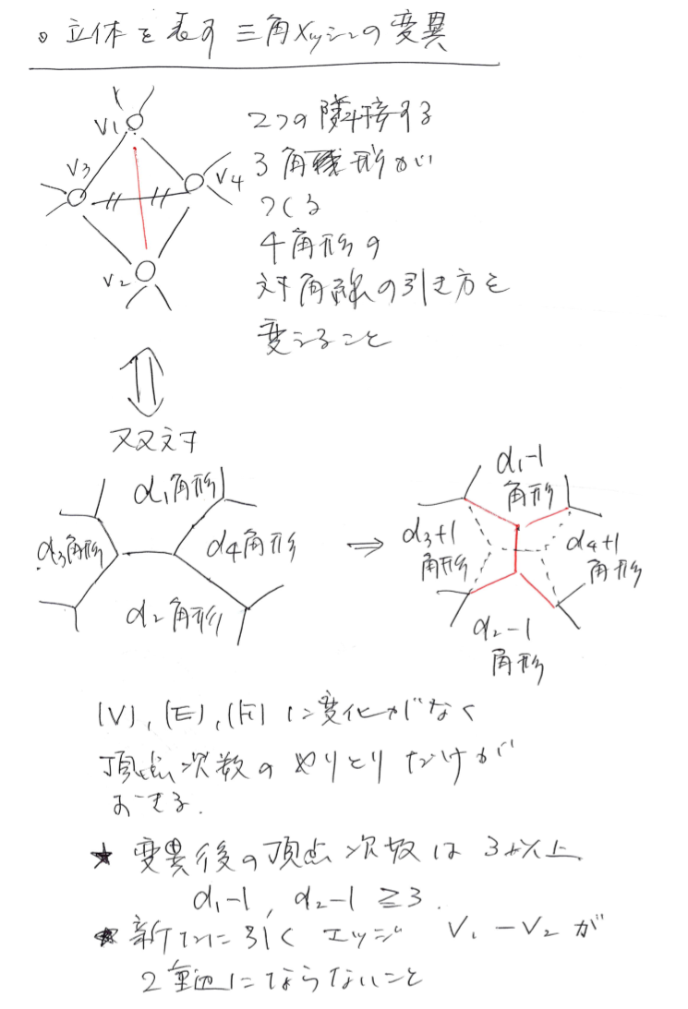

Slide 23
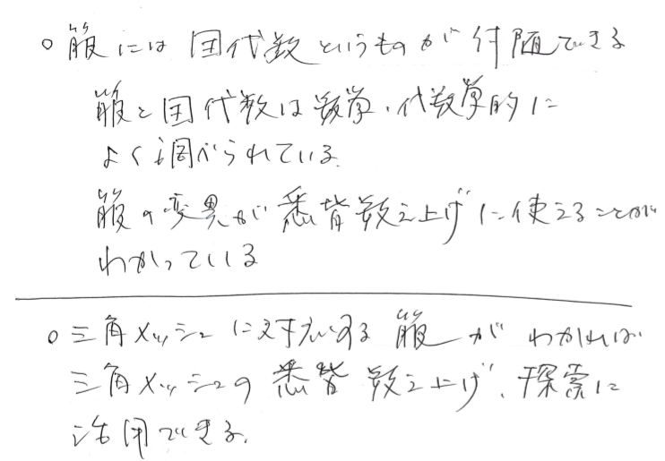
Cluster algebra
Quiver has cluster algebra.
Each vertex of quiver corresponds to one of the elements of the algebra.
The elements are rational polynomials.
Mutations of quiver changes the elements to another set of elements.
The whole rational polynomial elements and their quiver-mutational changes define an algebraic structure.
Cluster algebra has been applied to: Various algebraic studies, geometry, knot theory, mathematical physics …

Slide 24
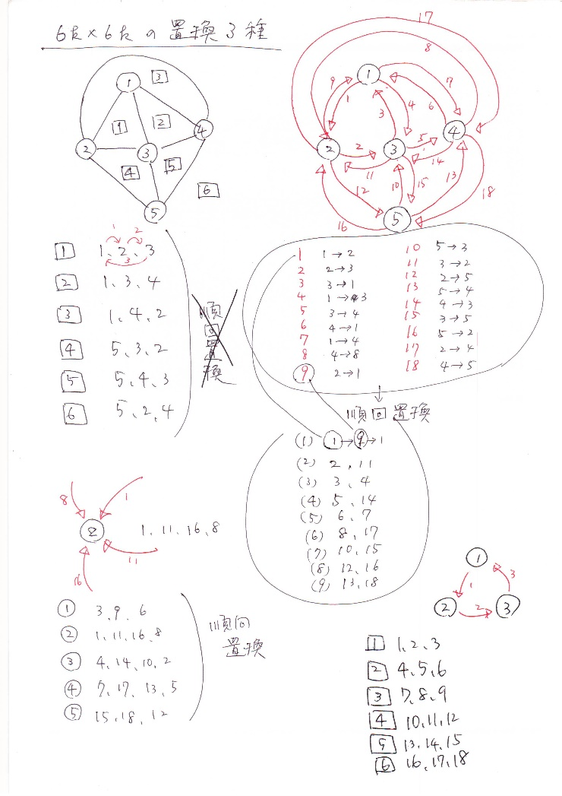

Slide 27
Mutation of polygon/dual polygon

Slide 28
Enumeration of triangular mesh

Slide 30
Cycles and Ihara’s zeta function

Slide 31
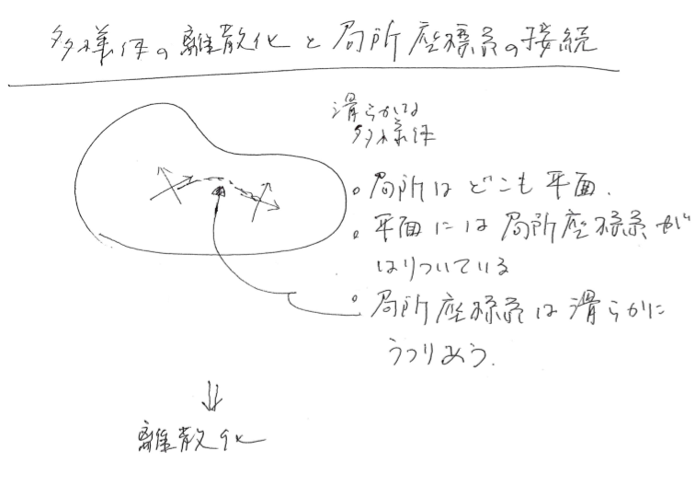

Slide 32
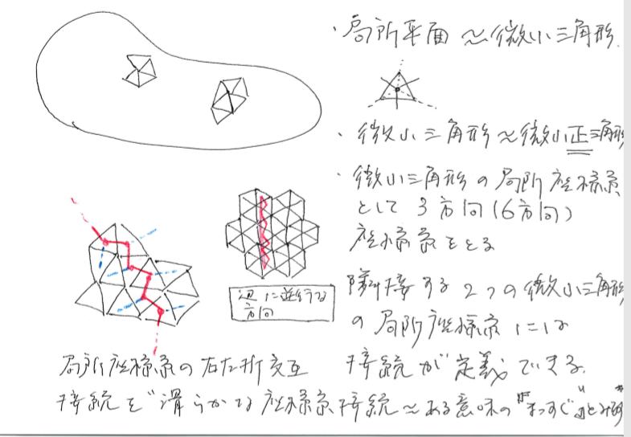

Slide 33
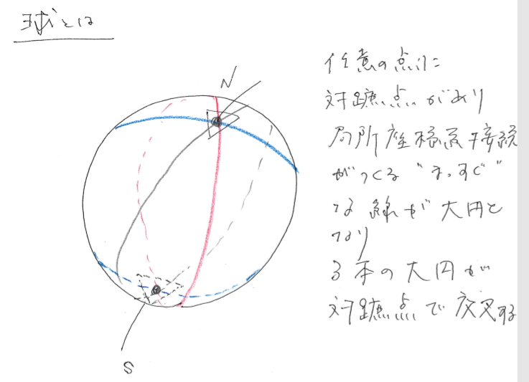

Slide 34
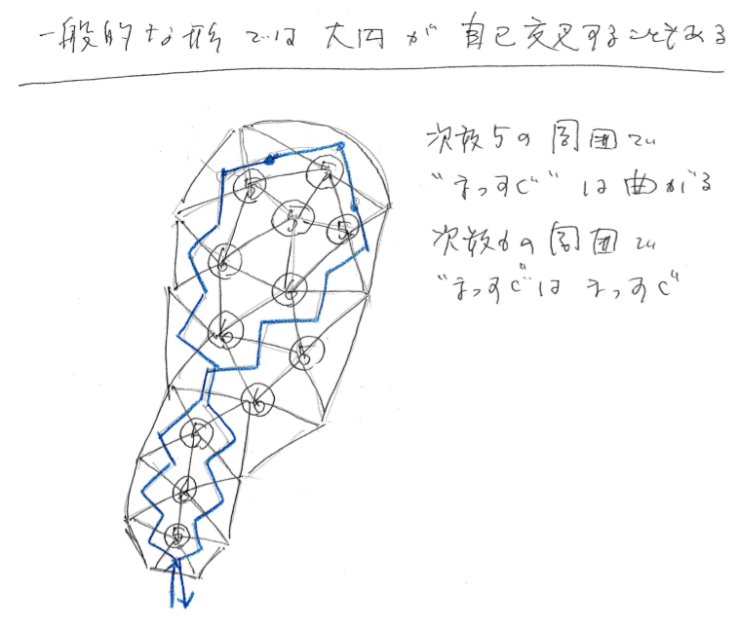

Slide 35
Edge-connection matrix

Slide 36
Regular graph

Slide 37
3-regular graph

Slide 38
Edge connection matrix of 3-regular graph
Sum of two permutation matrices

Slide 39
“Straight path” of 3-regular graph

Slide 40
“Straight paths” of 3-regular graph
Cycles

Slide 41
A set of cycles

Slide 43
Shape(凹凸), Curved surface(凹凸ナシ、伸び縮みのみ)

