Slide 1
Genetic Statistics
Lectures
（５）
Multiple testing correction and population structure correction

Slide 2
Independence of tests
When all tests are mutually independent,
  probability to observe P<=0.01, is 0.01
  probability to observe P<=0.05, is 0.05
  probability to observe P<=0.5, is 0.5
  probability to observe P<=0.05 and probability to observe 0.05<P<=0.1 are the same and 0.05

Slide 3
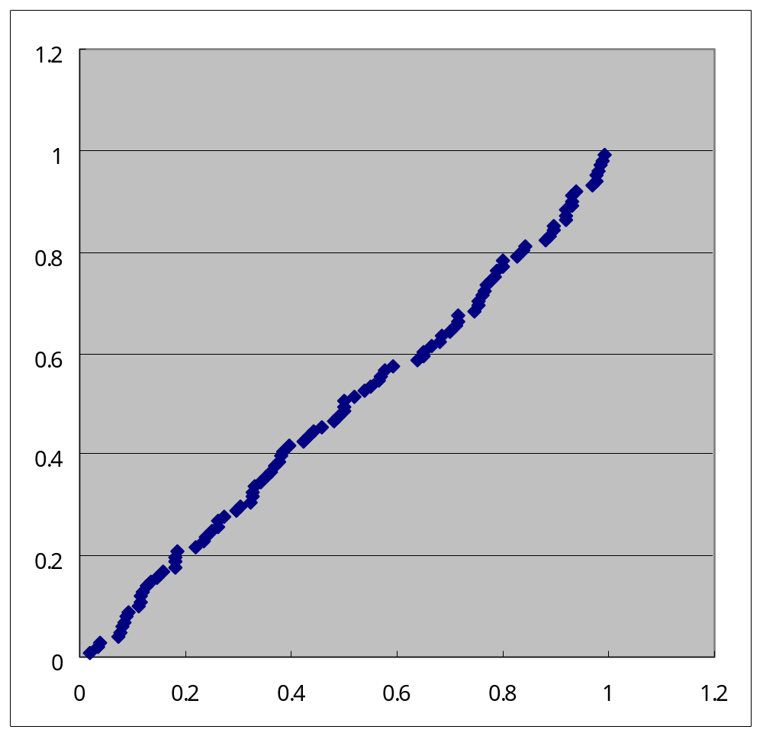
When 100 independent tests are performed....
Q-Q plot of p value
Observed p values were sorted.
The i-th minimum p value is expected as i/(100+1).
Expected p
Observed p

Slide 4
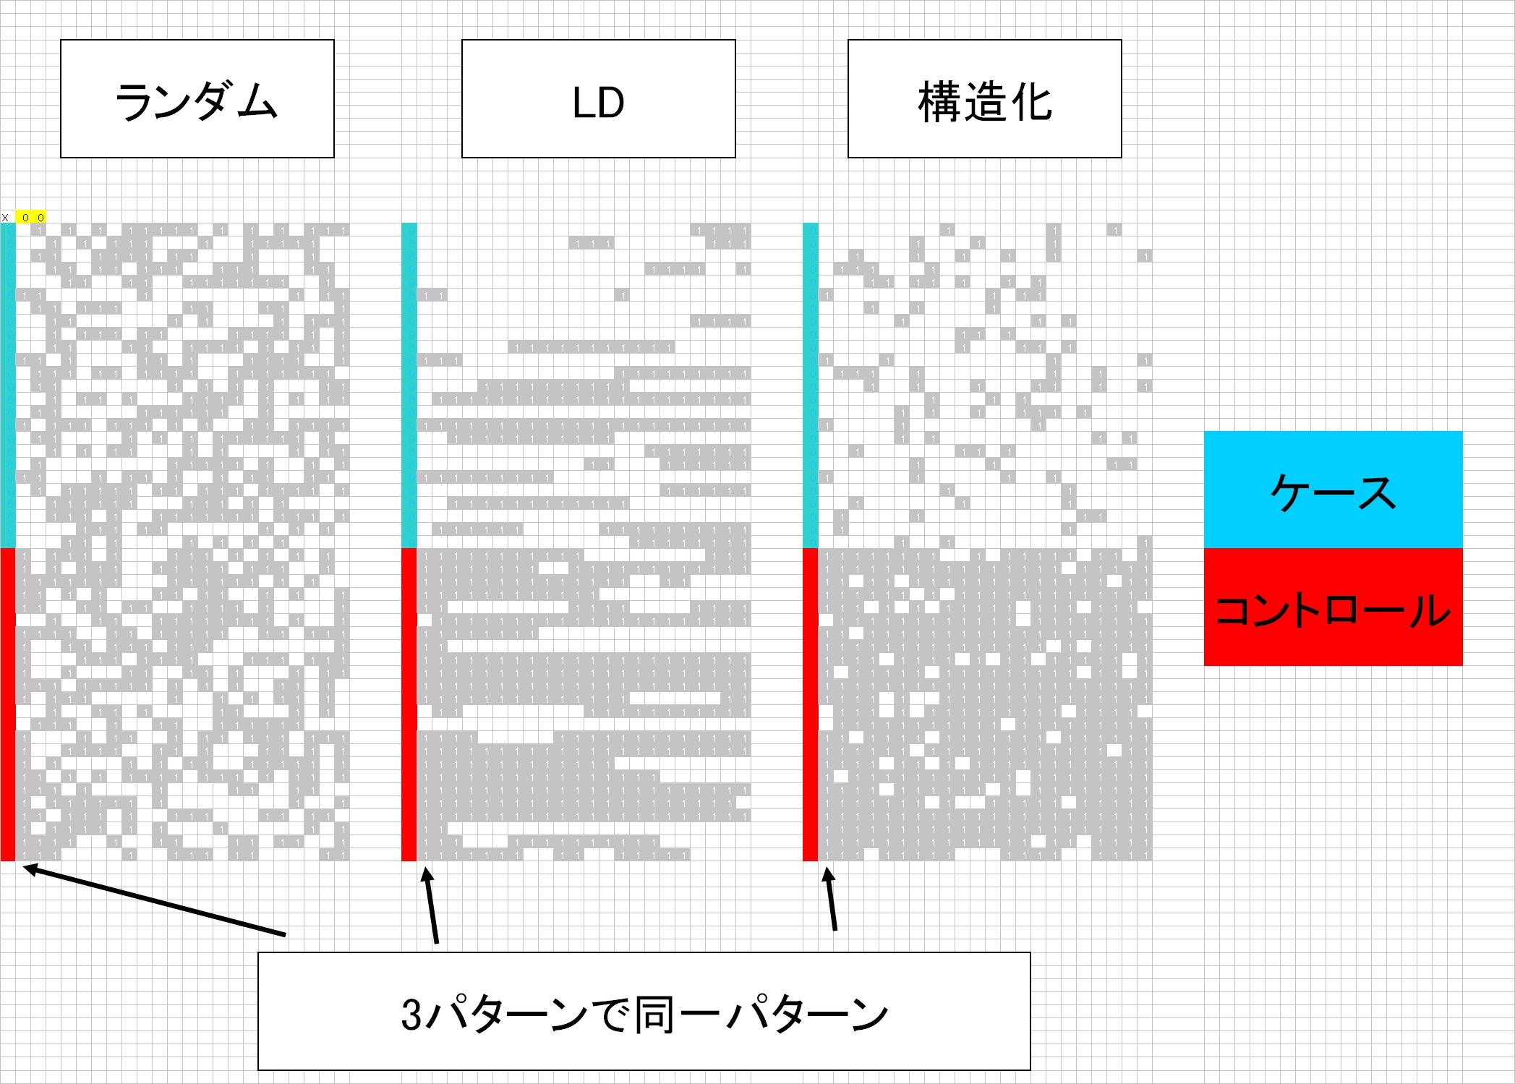
Phenotype
One marker, one test
marker genotype
cases
controls
strong association between phenotype and genotype

Slide 6
phenotype
Multiple markers, multiple tests
Two markers
Phenotype is associated with the first marker

Slide 7
phenotype
markers
Do you believe the association between phenotype and the first marker?

Slide 8
phenotype
markers
Do you beilive the association still???

Slide 9
Multiple testing correction
Bonferroni’s correction
  When k independent hypotheses are tested,
    pc=pn x k
      pc: corrected p
      pn: nominal p (p before correction)
Family-wise error rate
  When k independent hypotheses are tested, the probability to observe q as the minimal p value among k values is;
    1-(1-q)^{k} ～ q x k

Slide 10
FWER for two tests
0.05 －D=0.0475
1-B-C-D
= 0.95 x 0.95
= 1-0.0975
= 0.9025
B
A
Hypothesis ２
P<=0.05 for either H1 or H2 or both is B+C+D=1-0.9025
０．０５
D
C
0.05x0.05=0.0025
０．０５
Hypothesis １
0.05 －D=0.0475

Slide 12
←Same→

Slide 15
The association is likely to be true.
The association is present between phenotype and all the markers.
Markers are dependent each other.
When markers are in LD, this happens.
Markers are mutually independen.

Slide 16
When multiple hypotheses are dependent,
Bonferroni’s correction and Family-wise error rate correction are too conservative .
Different methods are necessary.

Slide 17
FWER for two tests
When tests are dependent, FWER can not be applied.
0.05 －D=0.0475
1-B-C-D
= 0.95 x 0.95
= 1-0.0975
= 0.9025
B
A
Hypothesis ２
P<=0.05 for either H1 or H2 or both is B+C+D=1-0.9025
０．０５
D
C
0.05x0.05=0.0025
０．０５
Hypothesis １
0.05 －D=0.0475

Slide 18
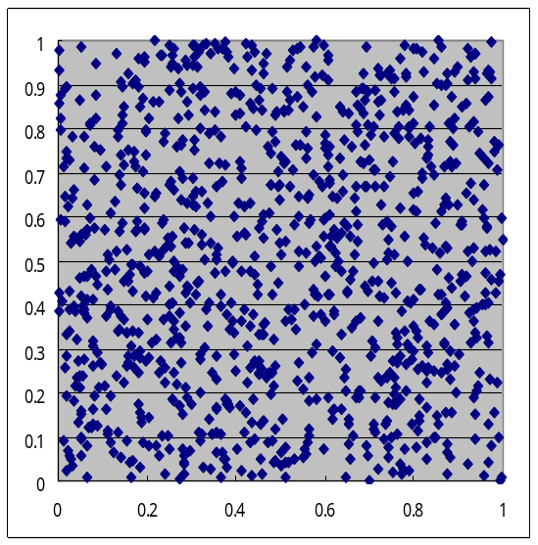
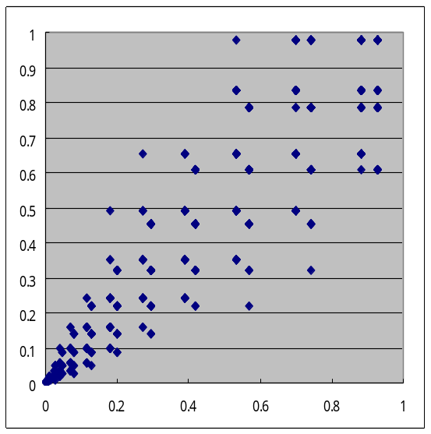
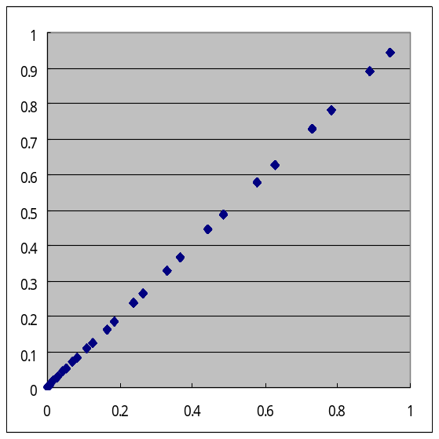
Multiple testing correction for dependent tests.
Fraction(P1<0.1 or P2<0.1)
P2
P2
P1
P1
P1
190/1000
137/1000
78/1000

Slide 19
Examples of dependent tests
Multiple tests (2x3 and dominant and recessive and trend) for one SNP are not mutually independent.
Tests for markers in LD are not independent.
A test for a SNP and a test for a haplotype containing the SNP are not mutually dependent.
When multiple phenotypes that are mutually dependent are tested, they are dependent.
。。。。

Slide 20
When multiple hypotheses are dependent,
Bonferroni’s correction and Family-wise error rate correction are too conservative .
Different methods are necessary.
  Permutation test
    Under the assumption of no association between phenotype and markers, you can exchange phenotype label of samples.
    Let’s exchange phenotype labels and tests all the markers for the shuffled phenotype information.
    Compare the original test result and the results from shuffled labels.
    If the original test result is considered rare among the results from shuffled labels, then you can believe the original test result is rare under the assumption of no association.

Slide 21
Ways to perform permutation tests.
Permutations for “123”:
  “123”,”132”,”213”,”231”,”312”,”321”
When sample size is small, you can try all permutations of phenotype label shuffling.
When sample size is not small enough, you should try samples of permutations at random. (Monte carlo permutation)

Slide 22
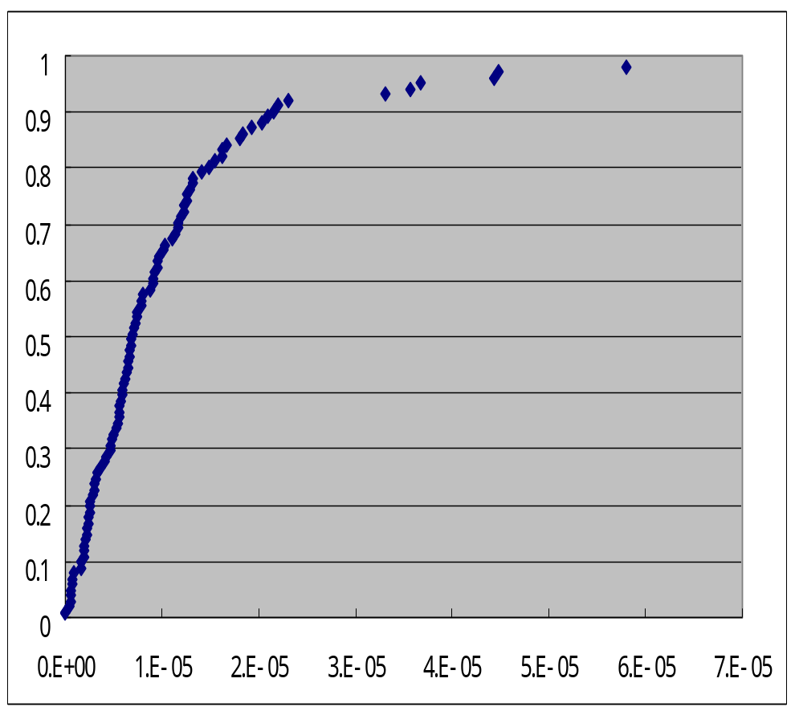
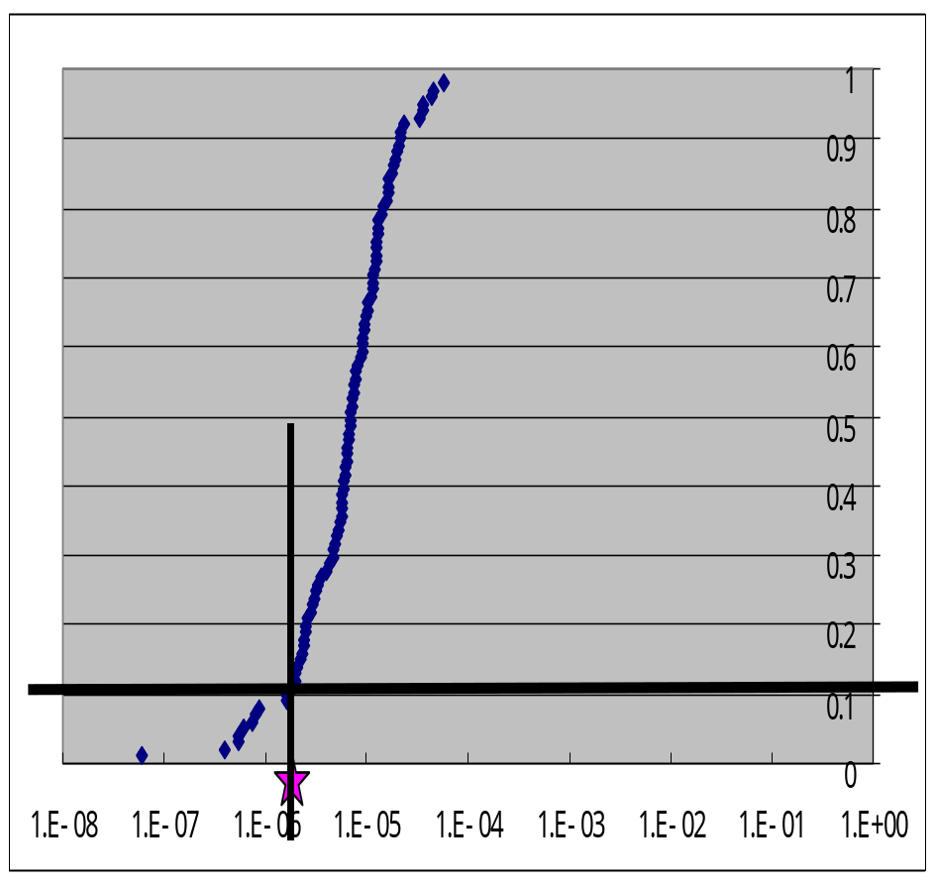
Example
Cumulative probability of minimal p value from Monte-Carlo permutation attempts.
Log

Slide 23
Population structure
Population from where you sample can not be homogeneous and randmly maiting. They are consisted of multiple small sub-populations which might be in HWE.
In this case, the population is “structured”.
When sampling population is structured, case-control association tests tend to give small p values-> false positives increase.

Slide 24
Smapling from structured population
Cases and controls are evenly sampled...Luck!
Cases and controls are sampled with biase.

Slide 25
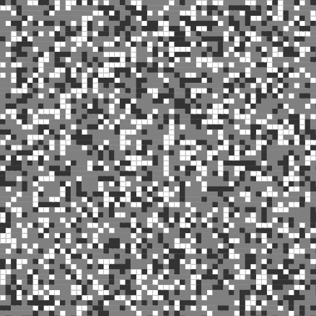
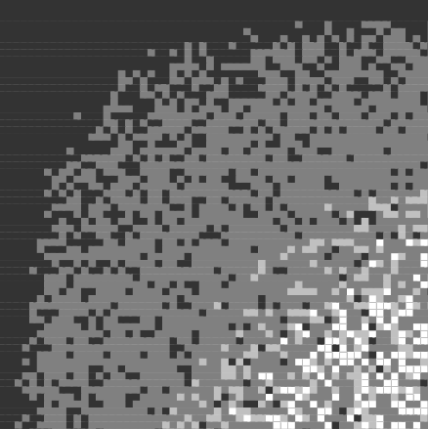
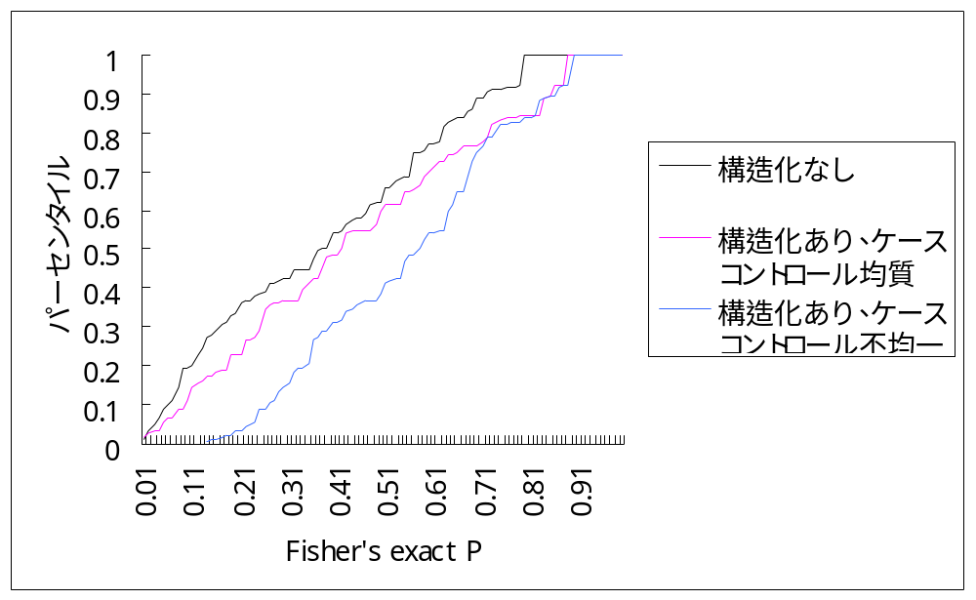
P値
P-value
Biased samples give many mall p values.
Markers
P値昇順プロット

Slide 26
←Same→

Slide 29
Markers and phenotype are associated.
Markers are dependent each other.
Genotypes of each individual are not associated.
→Population structure.
Markers are dependent each other.
Genotypes of each individual are associated each other.
→LD

Slide 30
Random
LD
Structure
Same

Slide 31
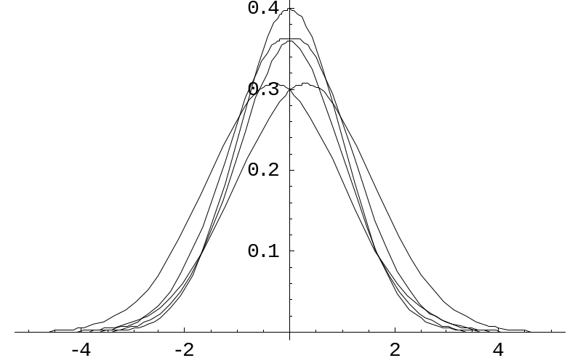
Genomic control method
When structured, Variance inflates.

Slide 32
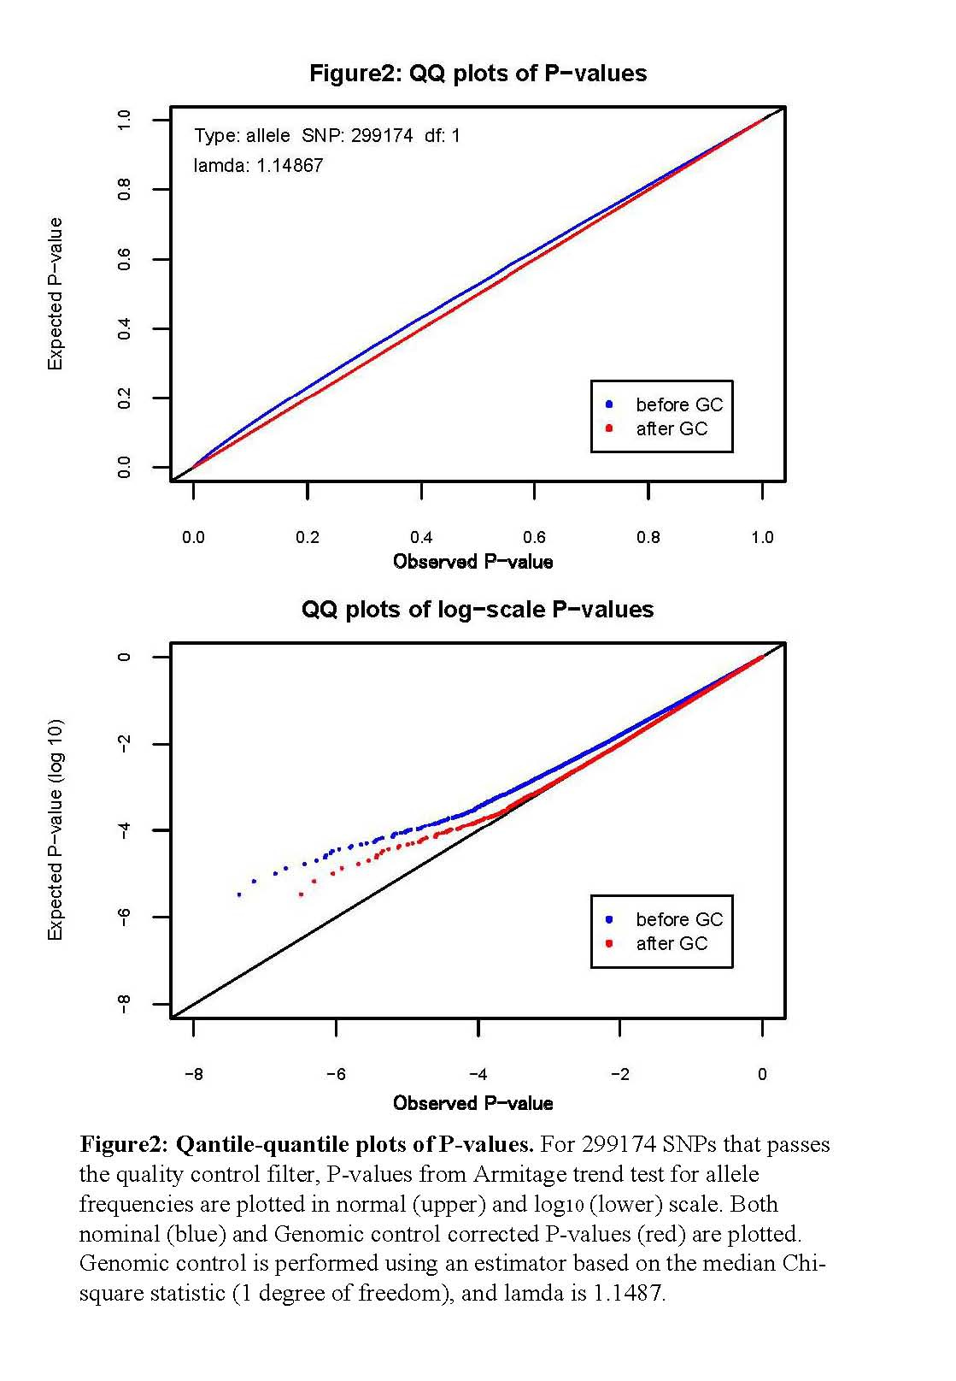
When structured, i-th minimum p value is smaller than i/(N+1).

Slide 33
Genomic control method
lambda = Median(chi-square values of observation)/chi-square value that gives p of 0.5
corrected chi-square = observed chi-square/lambda

Slide 34
GC-method corrects the plot to fit y=x.

Slide 35
Genomic control method
All the p values become bigger with GC-correction.... Conservative.

Slide 36
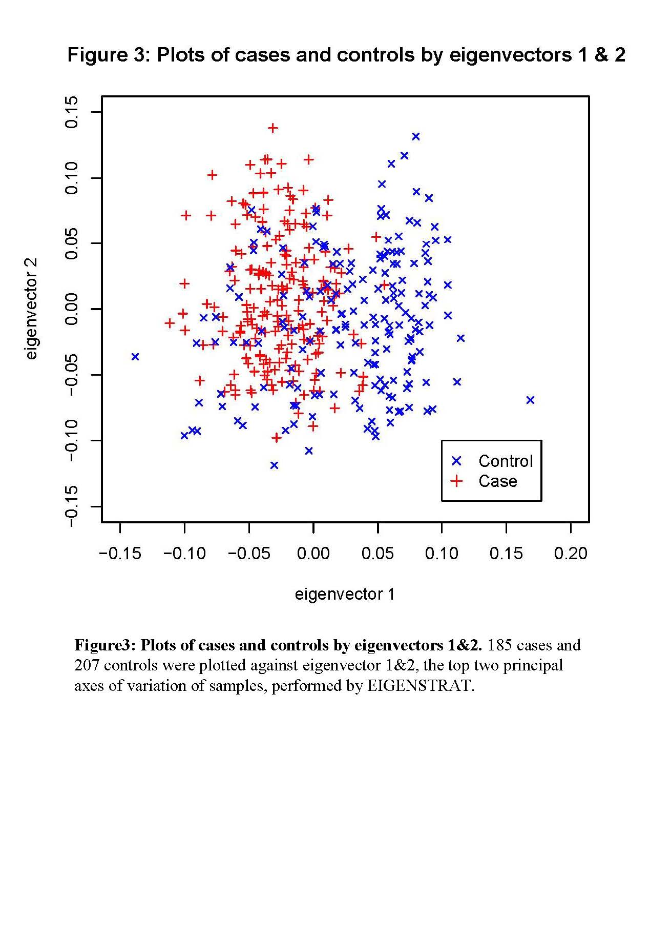
Eigenstrat
Principal component-based method.
Identify vectors to describe population structure.
Assess each SNP with the vectors and recalculate p value for case-control association.

Slide 37
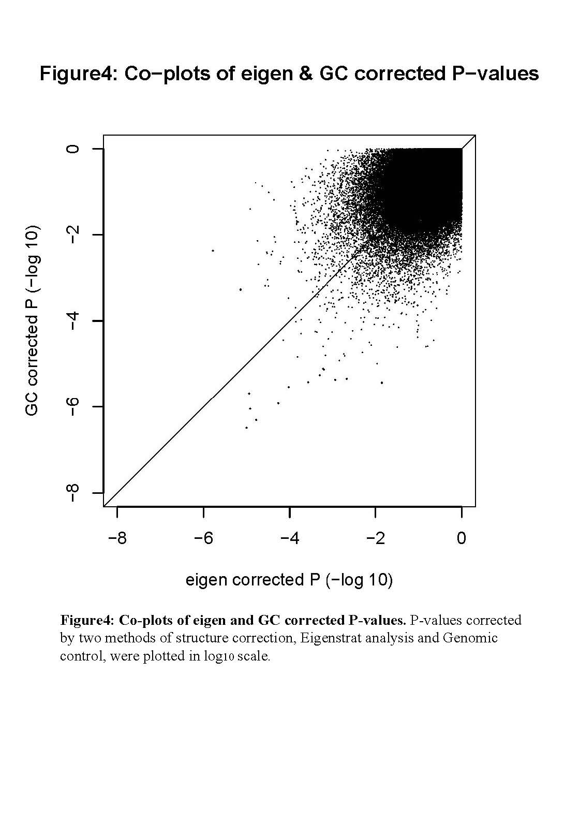
Eigenstrat makes some nominal p values bigger and some nominal p values smaller.

Slide 38
Examples of dependent tests
Multiple tests (2x3 and dominant and recessive and trend) for one SNP are not mutually independent.
Tests for markers in LD are not independent.
A test for a SNP and a test for a haplotype containing the SNP are not mutually dependent.
Markers far-away each other can be dependent when sample population are structured.
When multiple phenotypes that are mutually dependent are tested, they are dependent.
。。。。

