Slide 1
Genetic Statistics
Lectures
（２）
Linkage disequilibrium(LD)
LD mapping

Slide 2
Human genome
1
10
10²
10³
10⁴
10⁵
10⁶
10⁷
10⁸
10⁹
10¹⁰
Sub-microscopic variants
Microscopic variants
Structural variants
SNP
substitutions
♂♀
insertions / deletions
CNV
repeat-number variations
inversions
variation of location

Slide 3
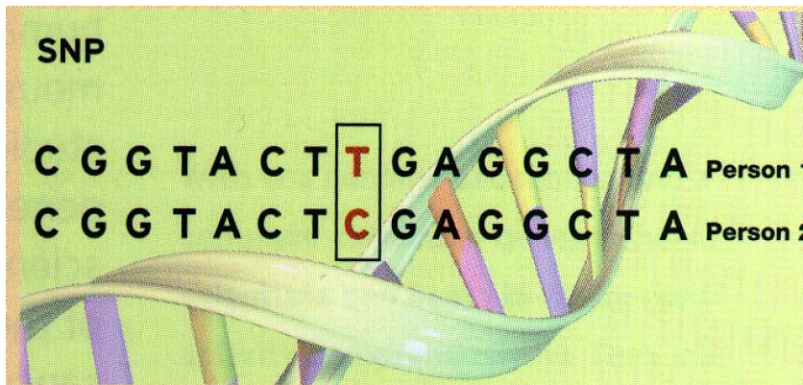

Slide 4
Status IV
４haplotypes
D’<1,r^2<1
Recombination
Drift
Nh : Number of haplotype alleles
Ns : Number of polymorphic sites
Monophyletic mutation
Status III
３haplotypes
D’=1,r^2<1
Birth of SNP pairs
Status II-A
1 SNP
Nh=2,Ns=1
Status II-B
2 haplotypes
D’=1,r^2=1
Status I
No SNP
Nh=1,Ns=0
Death of SNP pairs
Notes:
Figure 1
Five statuses of nucleotide pairs. Statuses II-B, III and IV are circled by solid line and colored, indicating that they are observed as polymorphic pairs. Statuses I and II are circled by dashed line, indicating that they are not counted by conventional SNP assays. Four types of arrows represent genetic events that changes status of nucleotide pairs. Nh and Ns represnt number of haplotypes and number of SNPs, respectively.

Slide 5
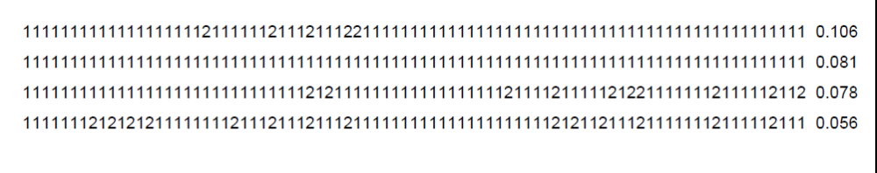

Slide 6
SNP
Single Nucleotide Polymorphism
Most densely distributed among polymorphisms
  1/100-1000bp throughout the genome
Genotyping is easy
  Best for high-throughput genotyping

Slide 7
Human genetic heterogeneity
Chromosome from mother
0 | 0 | 0 | 0 | 0 | 0 | 0 | 0 | 0 | 0 | 0 | 0 | 0 | 0 | 0 | 0 | 0 | 0 | 0 | 0 | 0 | 0 | 0 | 0 | 0 | 0 | 0 | 0 | 0 | 0 | 0 | 0 | 0 | 0 | 1 | 0
0 | 0 | 0 | 0 | 0 | 0 | 0 | 0 | 0 | 0 | 0 | 0 | 0 | 0 | 0 | 0 | 0 | 0 | 1 | 0 | 0 | 1 | 0 | 1 | 0 | 0 | 1 | 0 | 0 | 1 | 0 | 0 | 0 | 0 | 0 | 0
Chromosome from father
DNA sequence of two chromosomed differ 1/100-1000 in average.
In genome, ～3,000,000 sites are different between two chromosome sets.

Slide 8
0 | 0 | 0 | 0 | 0 | 0 | 0 | 0 | 0 | 0 | 0 | 0 | 0 | 0 | 0 | 0 | 0 | 0 | 0 | 0 | 0 | 0 | 0 | 0 | 0 | 0 | 0 | 0 | 0 | 0 | 0 | 0 | 0 | 0 | 1 | 0
0 | 0 | 0 | 0 | 0 | 0 | 0 | 0 | 0 | 0 | 0 | 0 | 0 | 0 | 0 | 0 | 0 | 0 | 1 | 0 | 0 | 1 | 0 | 1 | 0 | 0 | 1 | 0 | 0 | 1 | 0 | 0 | 0 | 0 | 0 | 0
When multiple chromoses are pooled, No. polymorphic sites increases.
0 | 0 | 0 | 0 | 0 | 0 | 0 | 0 | 0 | 0 | 1 | 0 | 0 | 0 | 0 | 0 | 0 | 0 | 1 | 0 | 0 | 0 | 0 | 0 | 0 | 0 | 1 | 0 | 0 | 0 | 0 | 0 | 0 | 0 | 1 | 0
0 | 0 | 0 | 0 | 0 | 0 | 0 | 0 | 0 | 0 | 1 | 0 | 0 | 0 | 0 | 0 | 0 | 0 | 0 | 0 | 0 | 0 | 0 | 0 | 0 | 0 | 0 | 0 | 0 | 1 | 0 | 0 | 0 | 0 | 0 | 0
0 | 0 | 0 | 0 | 0 | 0 | 0 | 0 | 0 | 0 | 0 | 0 | 0 | 0 | 0 | 0 | 0 | 0 | 0 | 0 | 0 | 0 | 0 | 1 | 0 | 0 | 1 | 0 | 0 | 0 | 0 | 0 | 0 | 0 | 0 | 0
0 | 0 | 0 | 0 | 0 | 0 | 0 | 0 | 0 | 0 | 0 | 0 | 0 | 0 | 0 | 0 | 0 | 0 | 0 | 0 | 0 | 0 | 0 | 0 | 0 | 0 | 0 | 0 | 0 | 0 | 0 | 0 | 0 | 0 | 0 | 1
0 | 0 | 0 | 0 | 0 | 0 | 0 | 0 | 0 | 0 | 0 | 0 | 0 | 0 | 0 | 0 | 1 | 0 | 0 | 0 | 0 | 0 | 0 | 0 | 0 | 0 | 0 | 0 | 0 | 0 | 0 | 0 | 0 | 0 | 0 | 1
0 | 0 | 0 | 0 | 0 | 0 | 0 | 0 | 0 | 0 | 0 | 1 | 0 | 0 | 0 | 0 | 1 | 0 | 0 | 0 | 1 | 1 | 0 | 0 | 0 | 0 | 0 | 0 | 0 | 0 | 0 | 0 | 0 | 0 | 0 | 0
0 | 0 | 0 | 0 | 0 | 0 | 1 | 0 | 0 | 0 | 0 | 1 | 0 | 0 | 0 | 0 | 0 | 0 | 0 | 0 | 0 | 0 | 0 | 0 | 0 | 0 | 1 | 0 | 0 | 0 | 0 | 0 | 0 | 0 | 0 | 1
0 | 0 | 0 | 0 | 0 | 0 | 0 | 0 | 0 | 0 | 0 | 0 | 0 | 0 | 0 | 0 | 0 | 0 | 0 | 0 | 0 | 0 | 0 | 0 | 0 | 0 | 0 | 0 | 0 | 0 | 0 | 0 | 0 | 0 | 0 | 1
0 | 0 | 0 | 0 | 0 | 0 | 0 | 0 | 0 | 0 | 0 | 0 | 0 | 0 | 0 | 0 | 0 | 0 | 0 | 0 | 0 | 0 | 0 | 0 | 0 | 0 | 1 | 0 | 0 | 0 | 0 | 0 | 0 | 0 | 0 | 0
0 | 0 | 0 | 0 | 0 | 0 | 0 | 0 | 0 | 0 | 0 | 0 | 0 | 0 | 0 | 0 | 0 | 0 | 0 | 0 | 0 | 0 | 0 | 0 | 0 | 0 | 1 | 0 | 0 | 0 | 0 | 0 | 0 | 0 | 0 | 0
0 | 0 | 0 | 0 | 0 | 0 | 0 | 0 | 0 | 0 | 1 | 0 | 0 | 0 | 0 | 0 | 0 | 0 | 0 | 0 | 1 | 0 | 0 | 0 | 0 | 0 | 1 | 0 | 0 | 1 | 0 | 0 | 0 | 0 | 0 | 1
0 | 0 | 0 | 0 | 0 | 0 | 0 | 0 | 0 | 0 | 1 | 0 | 0 | 0 | 0 | 0 | 0 | 0 | 0 | 0 | 0 | 0 | 0 | 0 | 0 | 0 | 0 | 0 | 0 | 0 | 0 | 0 | 0 | 0 | 1 | 0
0 | 0 | 0 | 0 | 0 | 0 | 0 | 0 | 0 | 0 | 0 | 0 | 0 | 0 | 0 | 0 | 0 | 0 | 0 | 0 | 0 | 0 | 0 | 0 | 0 | 0 | 0 | 0 | 0 | 0 | 0 | 0 | 0 | 0 | 0 | 0
0 | 0 | 0 | 0 | 0 | 0 | 0 | 0 | 0 | 0 | 0 | 0 | 0 | 0 | 0 | 0 | 0 | 0 | 0 | 0 | 0 | 0 | 0 | 0 | 0 | 0 | 0 | 0 | 0 | 0 | 0 | 0 | 0 | 0 | 1 | 0
0 | 0 | 0 | 0 | 0 | 0 | 0 | 0 | 0 | 0 | 0 | 0 | 0 | 0 | 0 | 0 | 0 | 0 | 1 | 0 | 0 | 1 | 0 | 1 | 0 | 0 | 1 | 0 | 0 | 1 | 0 | 0 | 0 | 0 | 0 | 0

Slide 9
0 | 0 | 0 | 0 | 0 | 0 | 0 | 0 | 0 | 0 | 1 | 0 | 0 | 0 | 0 | 0 | 1 | 0 | 0 | 0 | 0 | 0 | 0 | 0 | 0 | 0 | 0 | 0 | 0 | 1 | 0 | 0 | 0 | 0 | 0 | 0
0 | 0 | 0 | 0 | 0 | 0 | 0 | 0 | 0 | 0 | 1 | 0 | 0 | 0 | 0 | 0 | 0 | 0 | 0 | 0 | 0 | 0 | 0 | 0 | 0 | 0 | 0 | 0 | 0 | 0 | 0 | 0 | 0 | 0 | 0 | 0
0 | 0 | 0 | 0 | 0 | 0 | 0 | 0 | 0 | 0 | 1 | 0 | 0 | 0 | 0 | 0 | 0 | 0 | 0 | 0 | 1 | 0 | 0 | 0 | 0 | 0 | 1 | 0 | 0 | 0 | 0 | 0 | 0 | 0 | 0 | 0
0 | 0 | 0 | 0 | 0 | 0 | 0 | 0 | 0 | 0 | 1 | 1 | 0 | 0 | 0 | 0 | 1 | 0 | 0 | 0 | 1 | 0 | 0 | 0 | 0 | 0 | 1 | 0 | 0 | 0 | 0 | 0 | 0 | 0 | 0 | 1
0 | 0 | 0 | 0 | 0 | 0 | 0 | 0 | 0 | 0 | 1 | 0 | 0 | 0 | 0 | 0 | 0 | 0 | 1 | 0 | 0 | 0 | 0 | 0 | 0 | 0 | 1 | 0 | 0 | 0 | 0 | 0 | 0 | 0 | 1 | 0
0 | 0 | 0 | 0 | 0 | 0 | 0 | 0 | 0 | 0 | 1 | 0 | 0 | 0 | 0 | 0 | 0 | 0 | 0 | 0 | 0 | 0 | 0 | 0 | 0 | 0 | 0 | 0 | 0 | 1 | 0 | 0 | 0 | 0 | 0 | 0
0 | 0 | 0 | 0 | 0 | 0 | 0 | 0 | 0 | 0 | 0 | 0 | 0 | 0 | 0 | 0 | 0 | 0 | 0 | 0 | 0 | 0 | 0 | 1 | 0 | 0 | 1 | 0 | 0 | 0 | 0 | 0 | 0 | 0 | 0 | 0
0 | 0 | 0 | 0 | 0 | 0 | 0 | 0 | 0 | 0 | 0 | 0 | 0 | 0 | 0 | 0 | 0 | 0 | 0 | 0 | 0 | 0 | 0 | 0 | 0 | 0 | 0 | 0 | 0 | 0 | 0 | 0 | 0 | 0 | 0 | 1
0 | 0 | 0 | 0 | 0 | 0 | 0 | 0 | 0 | 0 | 0 | 0 | 0 | 0 | 0 | 0 | 1 | 0 | 0 | 0 | 0 | 0 | 0 | 0 | 0 | 0 | 0 | 0 | 0 | 0 | 0 | 0 | 0 | 0 | 0 | 1
0 | 0 | 0 | 0 | 0 | 0 | 0 | 0 | 0 | 0 | 0 | 1 | 0 | 0 | 0 | 0 | 1 | 0 | 0 | 0 | 1 | 1 | 0 | 0 | 0 | 0 | 0 | 0 | 0 | 0 | 0 | 0 | 0 | 0 | 0 | 0
0 | 0 | 0 | 0 | 0 | 0 | 1 | 0 | 0 | 0 | 0 | 1 | 0 | 0 | 0 | 0 | 0 | 0 | 0 | 0 | 0 | 0 | 0 | 0 | 0 | 0 | 1 | 0 | 0 | 0 | 0 | 0 | 0 | 0 | 0 | 1
0 | 0 | 0 | 0 | 0 | 0 | 0 | 0 | 0 | 0 | 0 | 0 | 0 | 0 | 0 | 0 | 0 | 0 | 0 | 0 | 0 | 0 | 0 | 0 | 0 | 0 | 0 | 0 | 0 | 0 | 0 | 0 | 0 | 0 | 0 | 1
0 | 0 | 0 | 0 | 0 | 0 | 0 | 0 | 0 | 0 | 0 | 0 | 0 | 0 | 0 | 0 | 0 | 0 | 0 | 0 | 0 | 0 | 0 | 0 | 0 | 0 | 1 | 0 | 0 | 0 | 0 | 0 | 0 | 0 | 0 | 0
When multi-ethnic populations are pooled, No. polymorphic cites gets much increased.
0 | 0 | 0 | 0 | 0 | 1 | 1 | 0 | 1 | 0 | 0 | 0 | 0 | 0 | 0 | 0 | 0 | 0 | 0 | 0 | 0 | 0 | 0 | 1 | 0 | 0 | 0 | 0 | 0 | 1 | 0 | 0 | 0 | 0 | 1 | 0
0 | 0 | 0 | 0 | 0 | 1 | 0 | 0 | 0 | 0 | 0 | 0 | 0 | 0 | 0 | 0 | 0 | 0 | 0 | 0 | 1 | 1 | 0 | 1 | 1 | 0 | 0 | 0 | 0 | 1 | 0 | 0 | 0 | 0 | 0 | 0
1 | 0 | 1 | 0 | 0 | 1 | 0 | 0 | 1 | 0 | 0 | 0 | 0 | 0 | 0 | 1 | 0 | 0 | 0 | 1 | 0 | 0 | 1 | 1 | 0 | 1 | 0 | 0 | 0 | 1 | 0 | 0 | 0 | 0 | 0 | 0
0 | 0 | 0 | 0 | 0 | 1 | 0 | 0 | 1 | 0 | 0 | 0 | 0 | 0 | 0 | 0 | 0 | 0 | 0 | 0 | 1 | 0 | 0 | 0 | 1 | 1 | 0 | 0 | 0 | 1 | 0 | 0 | 0 | 0 | 0 | 0
0 | 0 | 1 | 0 | 0 | 0 | 0 | 0 | 0 | 0 | 0 | 0 | 0 | 0 | 0 | 0 | 0 | 0 | 0 | 0 | 0 | 1 | 0 | 0 | 1 | 1 | 0 | 0 | 0 | 1 | 0 | 0 | 0 | 0 | 0 | 0
1 | 0 | 0 | 0 | 0 | 0 | 1 | 0 | 0 | 0 | 0 | 1 | 0 | 0 | 0 | 0 | 0 | 0 | 0 | 0 | 0 | 0 | 0 | 1 | 1 | 1 | 0 | 0 | 0 | 1 | 0 | 0 | 0 | 0 | 0 | 0
0 | 0 | 1 | 0 | 0 | 1 | 0 | 0 | 1 | 0 | 0 | 1 | 0 | 0 | 0 | 0 | 0 | 0 | 0 | 1 | 1 | 0 | 0 | 0 | 1 | 1 | 0 | 0 | 0 | 1 | 0 | 0 | 0 | 0 | 1 | 1
1 | 0 | 0 | 0 | 0 | 0 | 1 | 0 | 0 | 0 | 0 | 1 | 0 | 0 | 0 | 1 | 0 | 0 | 0 | 0 | 0 | 0 | 1 | 1 | 0 | 1 | 0 | 0 | 0 | 1 | 0 | 0 | 0 | 0 | 0 | 1
0 | 0 | 0 | 0 | 0 | 1 | 0 | 0 | 1 | 0 | 0 | 1 | 0 | 0 | 0 | 0 | 0 | 0 | 0 | 0 | 1 | 1 | 0 | 0 | 1 | 1 | 0 | 0 | 0 | 0 | 0 | 0 | 0 | 0 | 1 | 1
1 | 0 | 0 | 0 | 0 | 1 | 0 | 0 | 0 | 0 | 0 | 0 | 0 | 0 | 0 | 0 | 0 | 0 | 0 | 0 | 1 | 1 | 0 | 1 | 1 | 1 | 0 | 0 | 0 | 0 | 0 | 0 | 0 | 0 | 1 | 0
0 | 0 | 0 | 0 | 0 | 1 | 0 | 0 | 0 | 0 | 0 | 0 | 0 | 0 | 0 | 1 | 0 | 0 | 0 | 0 | 0 | 1 | 1 | 1 | 0 | 1 | 0 | 0 | 0 | 0 | 0 | 0 | 0 | 0 | 0 | 0

Slide 10
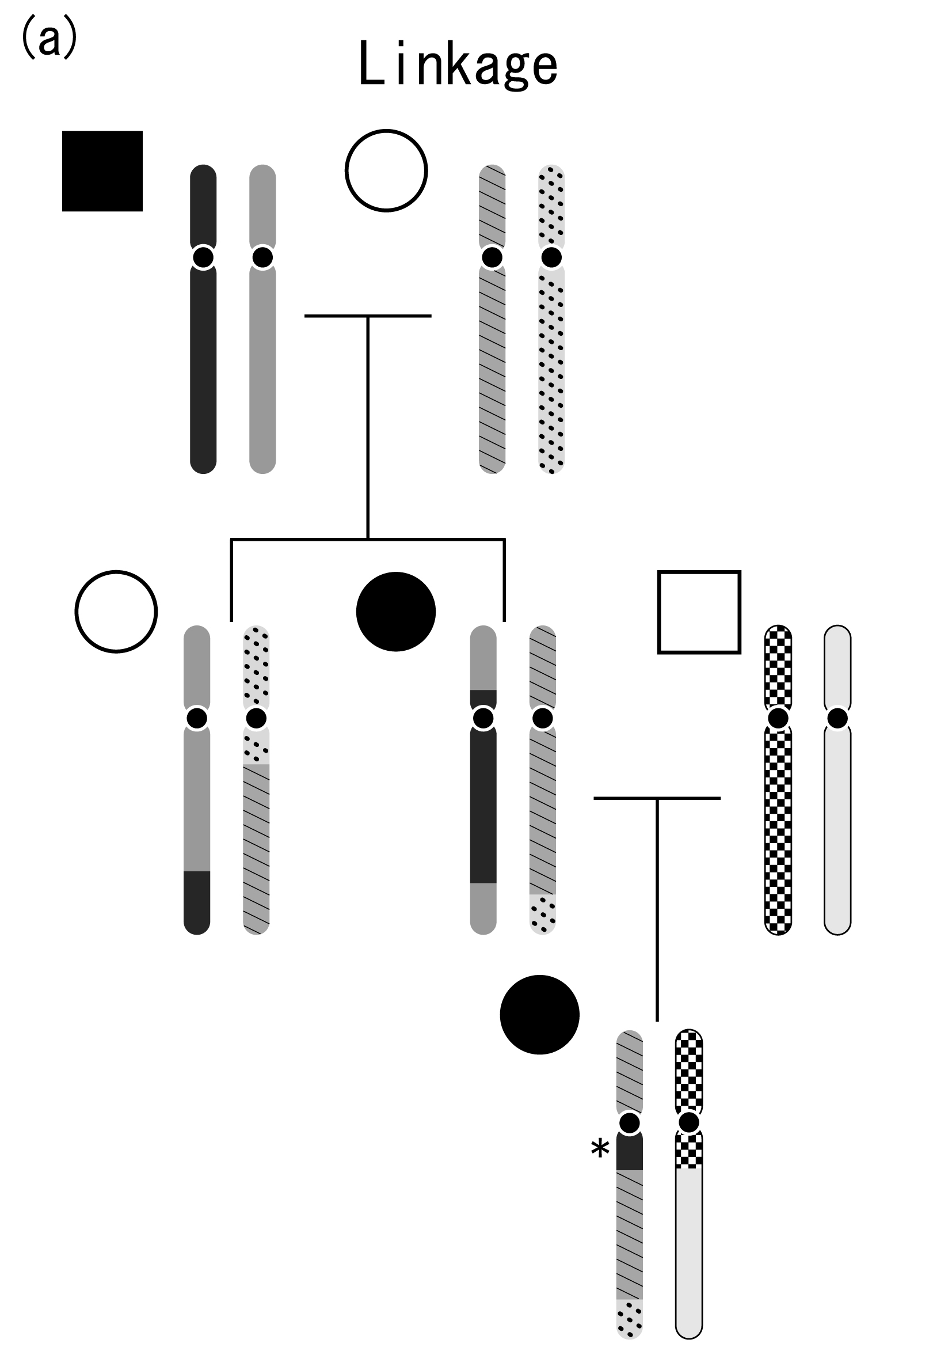

Slide 11
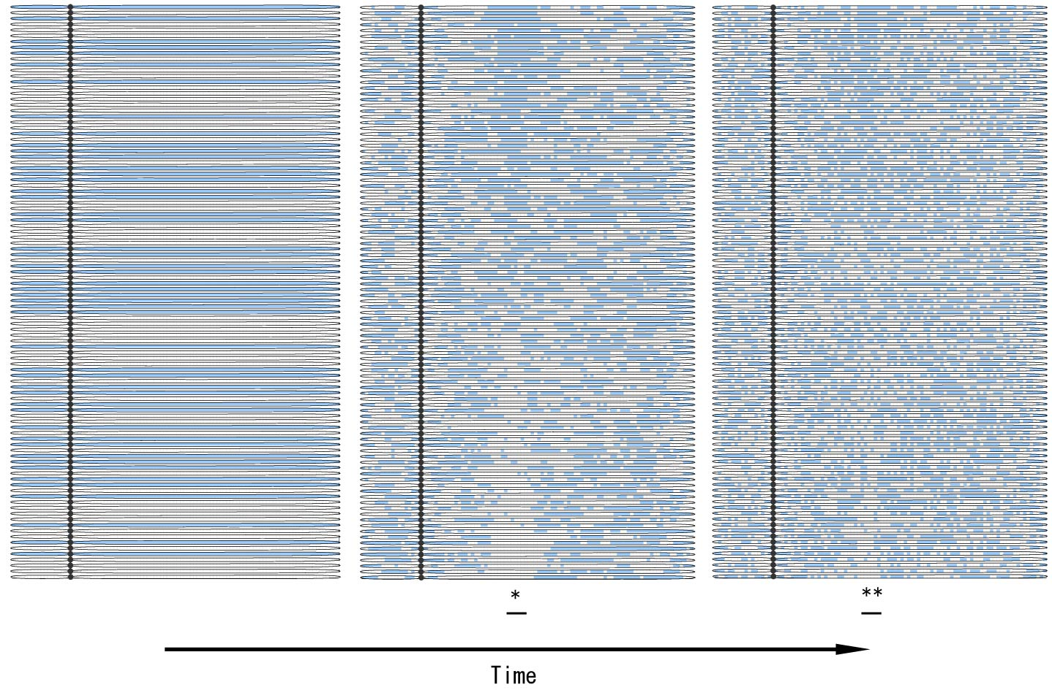

Slide 12
Linkage equilibrium
Allele frequency of haplotypes are product of allele frequency of consisting SNP alleles.
  Allele freq. of SNPA:pA, pa (pA+pa=1)
  Allele freq. of SNPB:qB, qb (qB+qb=1)
  Allele freq of halotype AB：pA x pB
  Allele freq of halotype Ab : pA x pb
  Allele freq of halotype aB : pa x pB
  Allele freq of halotype ab : pa x pb

Slide 13
Linkage disequilibrium
“Linkage” does not meet “equilibrium”
Linkage disequilibrium is distroyed by crossovers and it reaches “linkage equilibrium”.
Indices of LD(0:equilibrium,１:max disequilibrium)
D’
r^2

Slide 14
 | Haplotype AB | Haplotype Ab | Haplotype aB | Haplotype ab
LE | P(A)xP(B) | P(A)x(1-P(B)) | (1-P(A))xP(B) | (1-P(A)x(1-P(B))
Absolute disequilibrium | P(A) | 0 | 0 | 1-P(A)
Complete disequilibrium | P(A) | 0 | P(B)-P(A) | 1-P(B)

Slide 15
 | D’ | Δ²
LE | 0 | 0
Absolute disequilibrium | 1 | 1
Complete disequilibrium | 1 | 0より大、1未満

Slide 16
Status IV
４haplotype
D’<1,r^2<1
Recombination
Drift
Nh : Number of haplotype alleles
Ns : Number of polymorphic sites
Monophyletic mutation
Status III
３haplotype
D’=1,r^2<1
Birth of SNP pairs
More distant between markers, more recombinations.
Older the SNP pairs, more recombinations.
Status II-B
２haplotype
D’=1,r^2=1
Status II-A
SNP１個
Nh=2,Ns=1
Status I
No SNP
Nh=1,Ns=0
Death of SNP pairs
Notes:
Figure 1
Five statuses of nucleotide pairs. Statuses II-B, III and IV are circled by solid line and colored, indicating that they are observed as polymorphic pairs. Statuses I and II are circled by dashed line, indicating that they are not counted by conventional SNP assays. Four types of arrows represent genetic events that changes status of nucleotide pairs. Nh and Ns represnt number of haplotypes and number of SNPs, respectively.

Slide 17
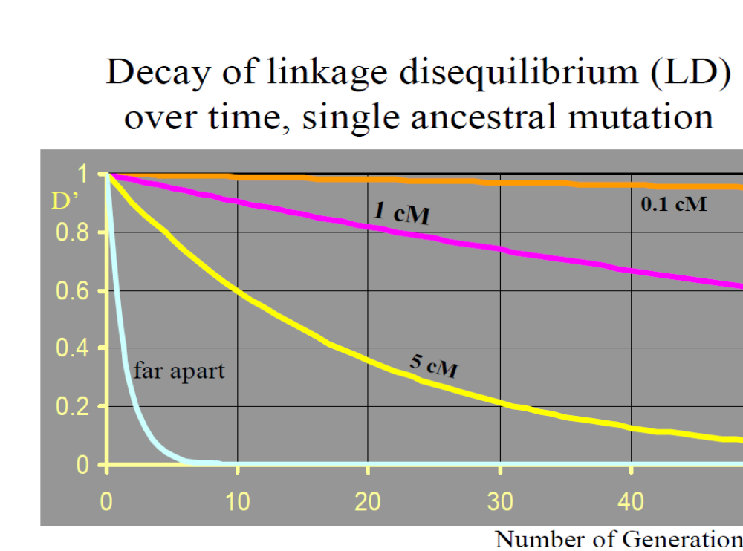
LD インデックスの共通点と差異
Distance
Time

Slide 18
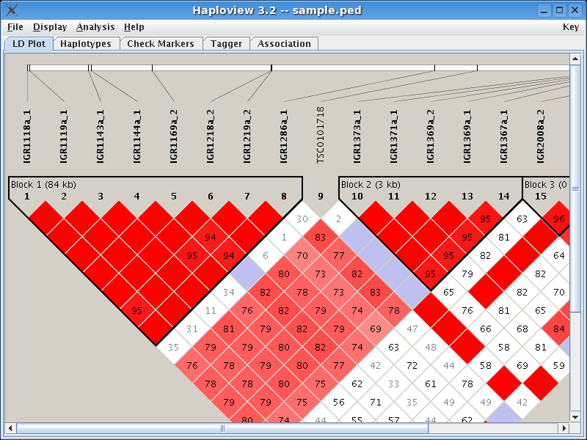
LD between SNPs in short distance is strong.
Some exceptions exist.

Slide 19
Past
Present
LD block gets shorter along time.
More markers are necessary to investigate the same length.
Identified block is shorter, so indicated locus is more specific.

Slide 20
Basics of LD mapping
Genotypes of SNPs in LD are alike each other.
SNPs in LD can substitute each other because association statistics for them are alike.

Slide 21

Basics of LD mapping
Location of many recombinations
snp
snp
snp
snp
snp
snp
Segment that each SNP can cover is almost nothing
When all the markers in LE, SNPs can not substitute any polymorphisms near-by.
snp
snp
snp
snp
snp
snp
In case recombination evenly happend, each SNP covers a segmet with same length each other.
snp
snp
snp
snp
snp
snp
In reality, recombination happened unevenly, so each SNP cover a segment with various length.
Disease locus
Notes:
LDマッピングとは、
ゲノム上にある、SNPをマーカーとして、RA関連多型を検出すること
SNPマーカーが真の関連多型を検出することができるのは、連鎖不平衡と呼ばれる関係がSNPマーカーと真の関連多型との間に存在するからである。
その関係があるのは、日本人の歴史において、蓄積された組み換えの数がある程度限定されていて、粗密があるから。
たとえば：
上段は、組み換えが非常に沢山おきてしまっていたら、LDはまったくなく、SNPをマーカーにして検出不能
中断は、ある程度少ない数の組み換えが、均等におきた場合→検出可能。
だけど、これは、真実ではない。
真実は下段。
限定された数の組み換えが、あるところでは密にあるところでは疎におきたのが真実で、それにより、LDの広がりはゲノム上の場所によりまちまちであり、したがって、真の関連多型を検出することのできるSNPの持つ役割もゲノムの位置によりまちまちである。
このLDの広がりが、LDブロックといわれるもので、LDブロックの中にある関連多型は、同じブロック上のSNPを調べることで検出可能である、
これがLDマッピング。

Slide 22
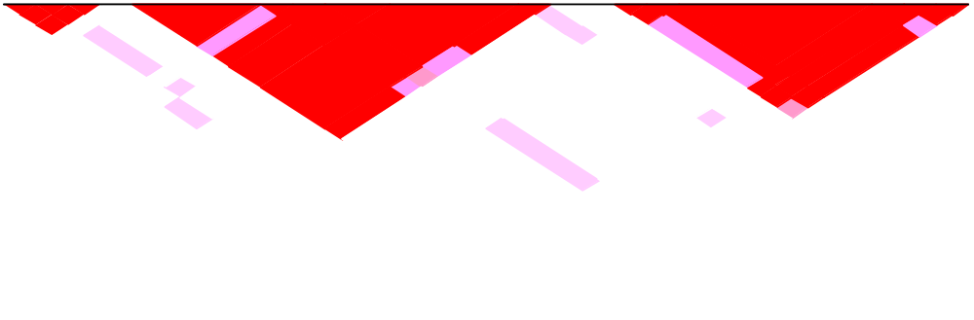
Processes of LD mapping
SNP
gene
LD block
A C G T
G G G T
A C C G T T C C T G G C C
G G G T C G C G A C T A G
A G C T C G C G A C G C G
A C G G C G G G T G T A C
A C G T T C C A A C A
G G T C G C G T C G A
A C T C G C G T A C C
haplotype and tagging SNP

Slide 23
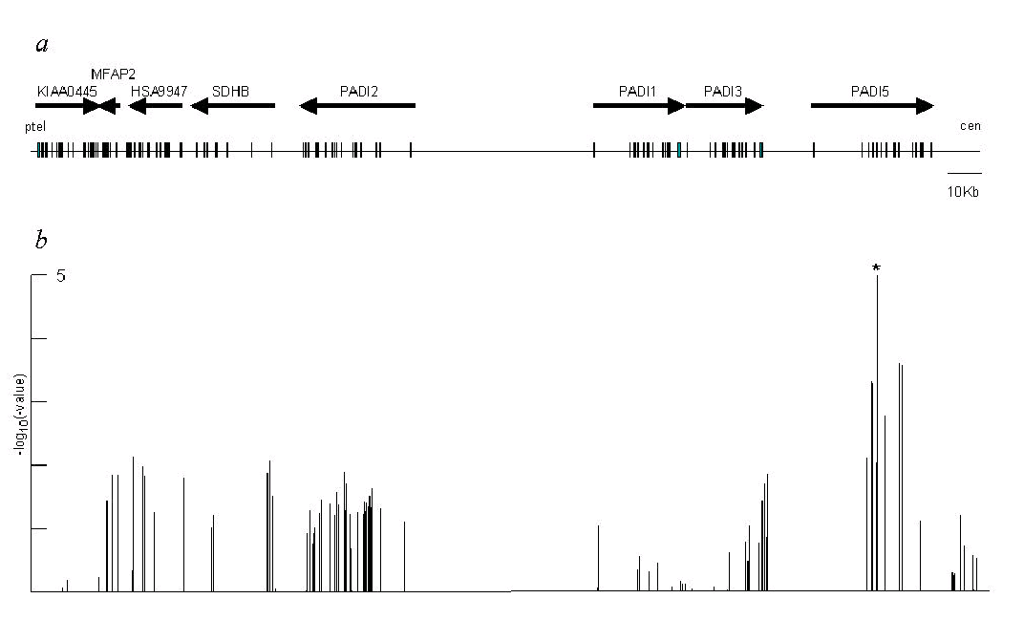
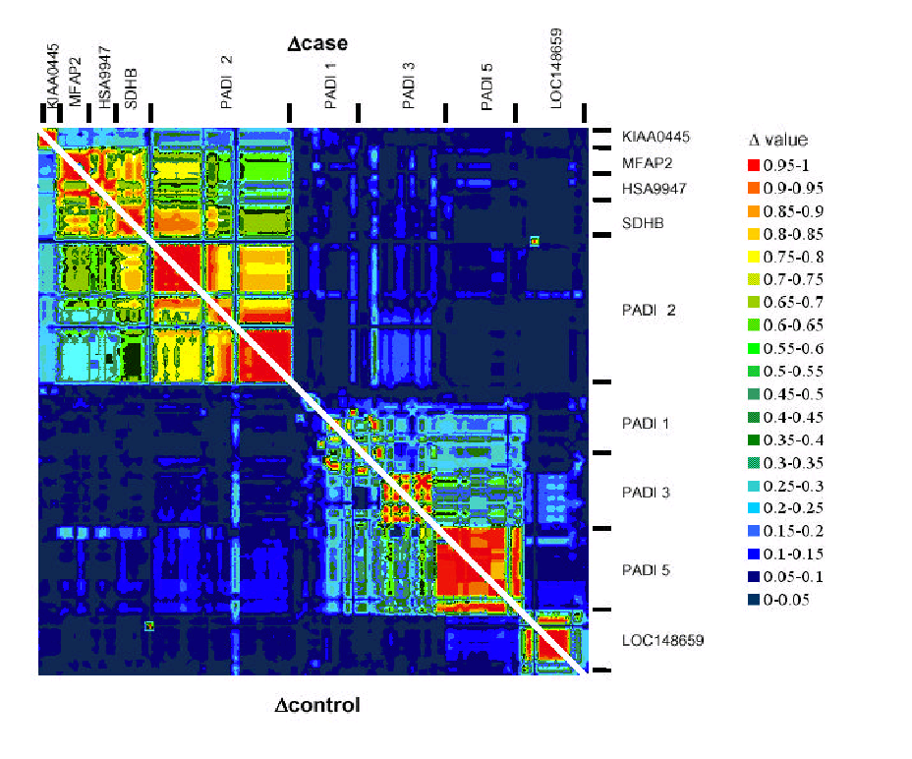
サンプリングバイアス
観測した関連が及ぶ範囲はどこまでか？
観測した関連は最強か？

Slide 24
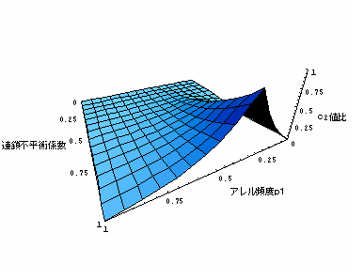
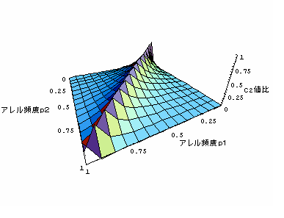
Allele frequency of one SNP is fixed.
D’
allele freq of the other SNP
ratio of chi-sq value
allele freq of the other SNP
D’ is fixed
allele freq of one SNP

Slide 25
２SNP
９genotypes case/control
“ LD-StatisticsAssoc.xls ”
Create simulation data.
Single SNP test
Inference of haplotype frequency
Calculation of LD indices

