Slide 1

Large-scale Linkage Disequilibrium Mapping of
Rheumatoid Arthritis-associated Genes in Japan
～Results and Perspectives～
December 9, 2005
Human Genome Variation and Their Association to Complex Diseases
Seoul, Korea
Ryo Yamada
Unit of Human Disease Genomics, CGM, Kyoto University, Kyoto Japan
Lab. For Rheumatic Diseases, SRC, RIKEN, Yokohama, Japan

Slide 2
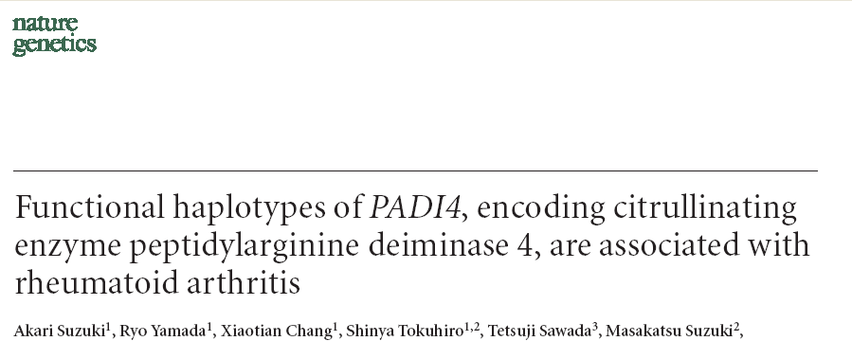
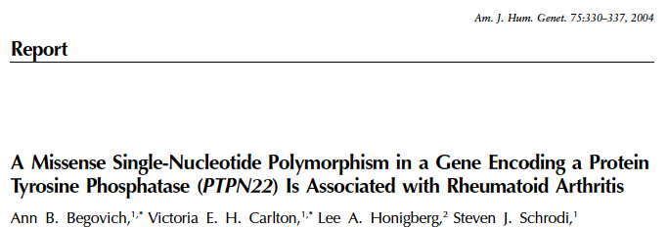
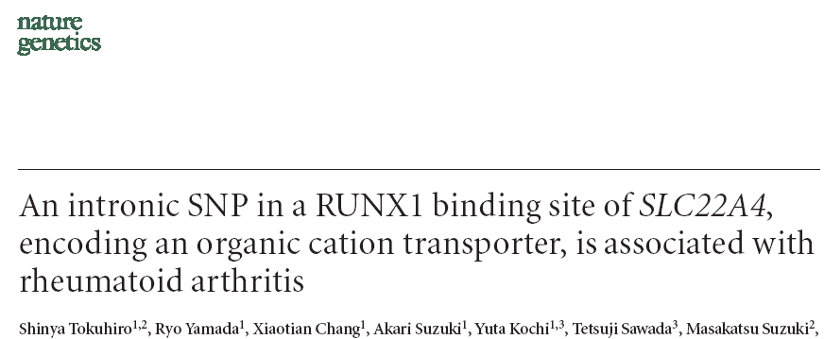
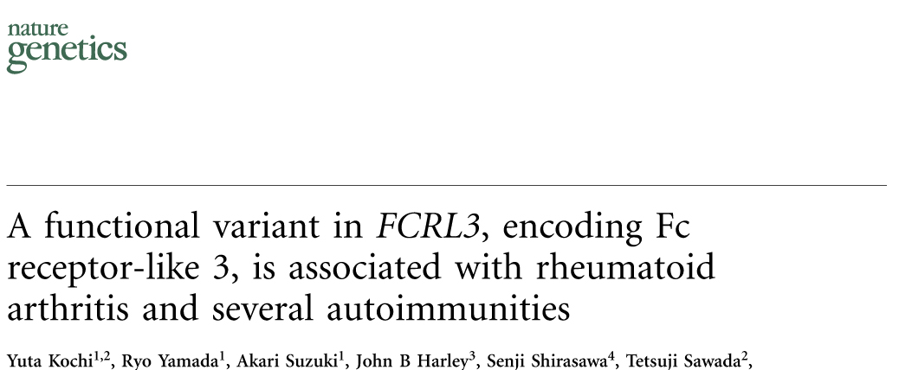

Slide 3
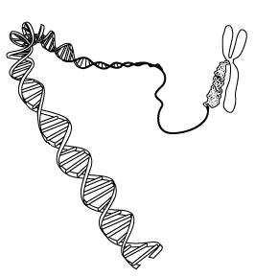
DNA-variations and their Effects on Transcripts, Peptides, Molecules … Phenotypes
http://www.microbe.org/espanol/news/human_genome.asp

Slide 4
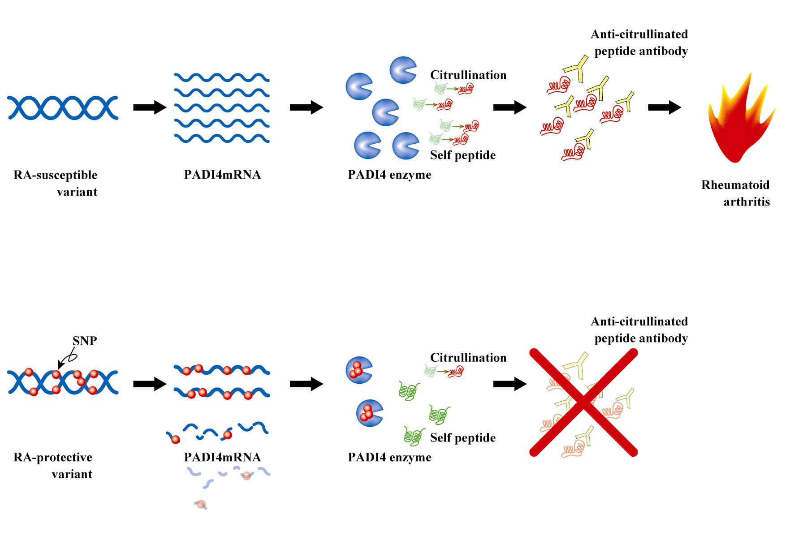
Missense SNPs in PADI4 gene
RA-susceptible haplotype and non-susceptible haplotype with three missense SNPs and one silent SNP in coding region
Allele specific mRNA stability and enzymatic activity and risk to RA
Allele-specific molecular difference
No allele-specific difference in molecular structure

Slide 5
Central Dogma & DNA Variations
ＤＮＡ
Variations
Transcription initiation point
Variations
Transcription
Transcription termination point
Variations
Splicing and mRNA maturation
mRNA
Variations
Translation initiation point
Translation
Codon triplets
Variations
Translation termination point
Peptide
Post-translational peptide modifications
Molecules

Slide 6
Not one way, but Multiple Bifurcations & Quantitative Variations
ＤＮＡ
Transcript variations
ｍＲＮＡ１
ｍＲＮＡ２
Peptide variations
Ｐｅｐｔｉｄｅ１
Ｐｅｐｔｉｄｅ３
Ｐｅｐｔｉｄｅ２
Molecular variations
Ｍｏｌｅｃｕｌｅ１
Ｍｏｌｅｃｕｌｅ２
Ｍｏｌｅｃｕｌｅ３
Ｍｏｌｅｃｕｌｅ４

Slide 7
ＤＮＡ
ｍＲＮＡ１
ｍＲＮＡ２
Ｐｅｐｔｉｄｅ１
Ｐｅｐｔｉｄｅ３
Ｐｅｐｔｉｄｅ２
Ｍｏｌｅｃｕｌｅ１
Ｍｏｌｅｃｕｌｅ２
Ｍｏｌｅｃｕｌｅ３
Ｍｏｌｅｃｕｌｅ４
Phenotype1
Phenotype2
Phenotype3
Phenotype4

Slide 8
ＤＮＡ
ｍＲＮＡ１
ｍＲＮＡ２
Ｐｅｐｔｉｄｅ１
Ｐｅｐｔｉｄｅ２
Ｐｅｐｔｉｄｅ３
Ｍｏｌｅｃｕｌｅ３
Ｍｏｌｅｃｕｌｅ４
Ｍｏｌｅｃｕｌｅ１
Ｍｏｌｅｃｕｌｅ２
Phenotype3
Phenotype2
Phenotype4
Phenotype1

Slide 9
Monogenic determination
～Recessive trait～
Disease mutation and mal-functional molecule
ＤＮＡ
ｍＲＮＡ１
Ｐｅｐｔｉｄｅ１
Ｍｏｌｅｃｕｌｅ１
Disease phenotype
Non-disease phenotype

Slide 10
Monogenic Trait
Complex Trait
Non-coding
Silent
Missense
Missense mutation and significant change of molecular function
Depth of transmission of allele-specific molecular difference depends on type of polymorphism

Slide 11
Association study of Complex Traits with DNA-markers
Susceptible
Non-susceptible
DNA
RNA
Peptides

Slide 12
Association study with DNA-markers
Susceptible
Non-susceptible
Simplified Architecture Bypasses Elements between DNA and Phenotypes … Pros and Cons

Slide 13
More dynamic and more direct information from Non-DNA analyses; Amount of Information is more but might be difficult to define their representatives among them.
DNA-analyses Data is Simple and Fixed throughout the Life.
DNA
RNA, proteins and others
DNA
RNA, proteins and others
Time course
Time course
Birt
Birth
Clinical F/U
Triggering Event
Disease Manifestations
Diagnosis
No observation In pre-clinical phase
Notes:
実際に観測する時点

Slide 14
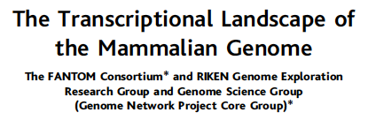

Another big world of RNA genes
Non-coding RNA x 23,000 in mammals

Slide 15
Non-coding-gene World and Variations
DNA
Effects on transcription
Coding DNA
Functional RNA
Coding mRNA
Effects on translation
?? Effects on phenotypes??
Coding-gene World and Variations

Slide 16
Large-scale LD mapping and Identification of RA-Susceptible PADI4 Polymorphisms and Follow-up Replication Studies

Slide 17
Genetics and Genetic Analysis of Rheumatoid Arthritis
Twin and family studies
  Relative risk to monozygotic twin ( λ_{MZ} )
    12~62
  Relative risk to siblings (λ_{sib})
    2~17
  HLA locus explains 1/3-1/2 of total genetic components.
  There are multiple non-HLA genes.
Multiple linkage studies
Many candidate-approach studies
Notes:
関節リウマチの遺伝性

Slide 18
Two Ways of Whole Genome LD Mapping
Map-based Approach
6
7
2
8
1
3
4
5
9
Gene D
Gene A
Gene B
Gene C
Coding Gene-based Approach
8
9
2
3
1
4
7
6
5
Gene D
Gene A
Gene B
Gene C

Slide 19

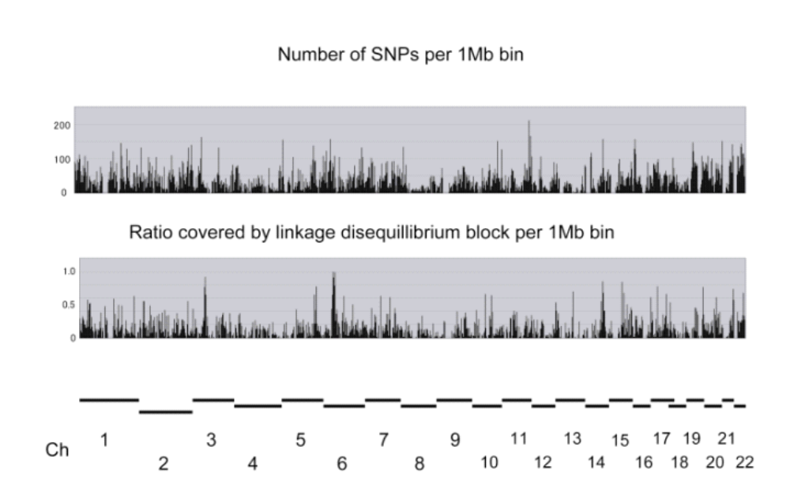
SNP distribution of RIKEN study

Slide 20
836 vs. 658 two-stage joint screening
Michael Boehnke : Design Considerations in Large Scale Genetic Association Studies
HapMap Tutorials
One-Stage Design
SNPs
Samples
Two-Stage Design
Replication-based analysis
Joint analysis
SNPs
SNPs
Samples
Samples
Stage 1
Stage 1
Stage 2
Stage 2
Notes:
Testing for an association in a one-stage design is straightforward
Two-stage samples can be analyzed either using either a replication based analysis or joint analysis
<CLICK>
In both cases the SNPs are genotyped on a subset of cases and controls and those SNPs exceeding a liberal significance level are then genotyped in the remaining cases and controls.
<CLICK>
In replication-based analysis, the genotype data collected in stage 2 is analyzed independently of the stage 1 data, allowing any significant stage 2 result to be deemed a replication.
<CLICK>
In joint analysis, the test statistics for stage 1 and 2 are combined

Slide 21
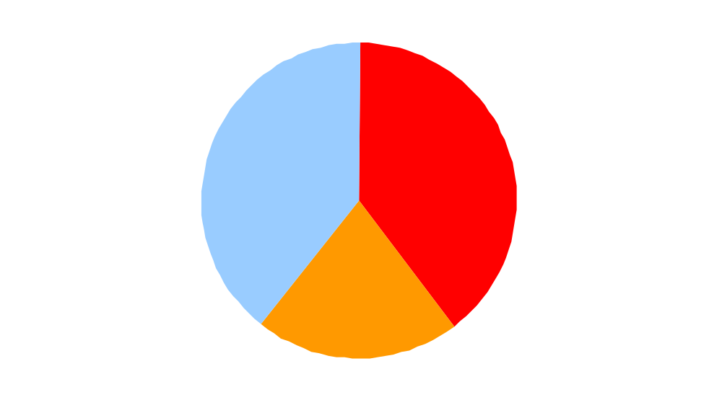
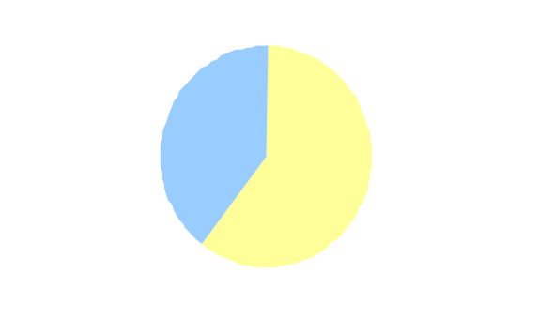
12,890 / 21,153 genes
12,890 （60.9%） genes were evaluated with block/SNPs
No. SNPs per gene and density of SNPs
5.0±6.4 /gene
0.2±0.3 /kb
No. coding genes in autosomal chromosomes ：21,153
Not covered
8,263
8,381
12,890
Covered with block
4,509
RIEN project started
Covered with SNPs not in block
2000
2001
2002
2003
2004
2005
50k
27,283Genes
40k
Gene
30k
20k
10k

Slide 22
Major findings from SNP-based studies
Japanese study (RIKEN)
  PADI4 : RA
    Post-translational enzyme to produce targets of the most RA-specific autoantibodies.
  SLC22A4 /A5 : RA & Crohn
    Ergothioneine or carnitine transporter expressed in hematologic lineages.
  FCRL3 : RA, SLR & AITD
    Fc receptor homolog on B-cell membrane
US study (A.Begovich et al.)
  PTPN22 : T1DM, SLE, RA & AITD
    Lymphoid-specific intracellular phophatase

Slide 23
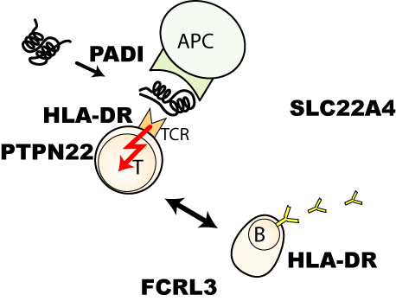
MΦ
Anti-oxydant transporter

Slide 24
PADI4
SLC22A4
Missense SNPs
Intronic SNPs
Transcriptional regulation
Stability of transcript
RR～２
RR～２
FCRL3
PTPN22
Promoter SNP
Transcriptional regulation
Missense SNP
Molecular function?
RR～２
RR～２

Slide 25
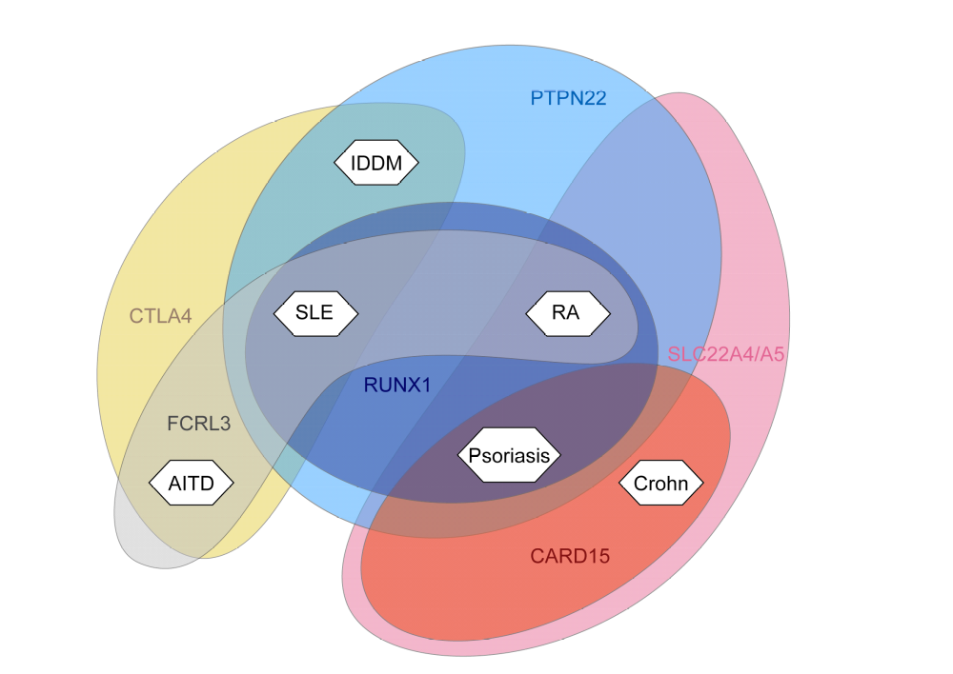
Multiple Genes and Multiple Diseases
Notes:
根拠のはっきりした感受性遺伝子のみによる検討これらの相互関係を検討するところから

Slide 26
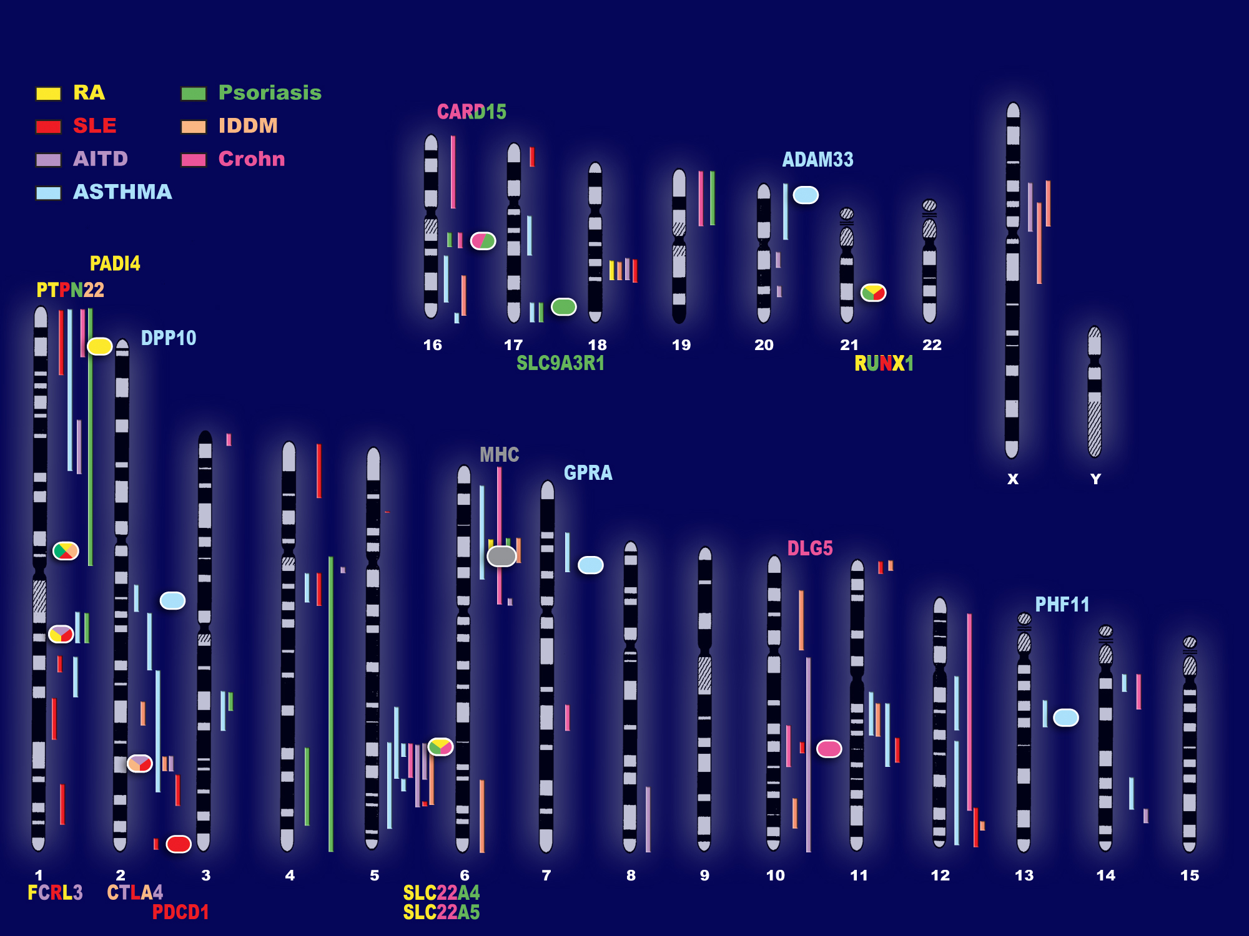

Slide 27
Rheumatoid Arthritis and PADI4
Citrulline and a-CCP Antibody
Very many and heterogeneous autoantibodies are detectable in RA sera.
Sensitivity and specificity vary.
Antiperinuclear
Anti-Sa
Anti-keratin
Some of RA-autoantibodies are extremely specific but their relatively low sensitivity limited their clinical utility.
Their epitope target turned out to be common and citrulline residue in the molecules.
Anti-CCP antibody has established as a reliable clinical marker of RA and they could predict development of RA several years before clinical onset.
Citrulline is a non-coding native amino-acid and they are in proteins only after enzymatic conversion from arginine by PADI.

Slide 28
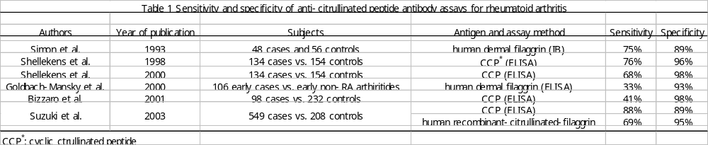
Anti-citrullinated peptide anyibody
~Most reliable autoantibody for RA

Slide 29
ＰＡＤＩ４
Ca²⁺-dependent post-translational modification
Arginine
Citrulline
NH₂
NH₂
C=NH₂ +
C=O
NH
NH
CH₂
CH₂
CH₂
CH₂
Loss of ionic NH2+ of Arg residue
CH₂
PADIs
CH₂
HCNH₃⁺
HCNH₃⁺
COO⁻
COO⁻
Effects on intra- and inter- molecular interactions

Slide 30
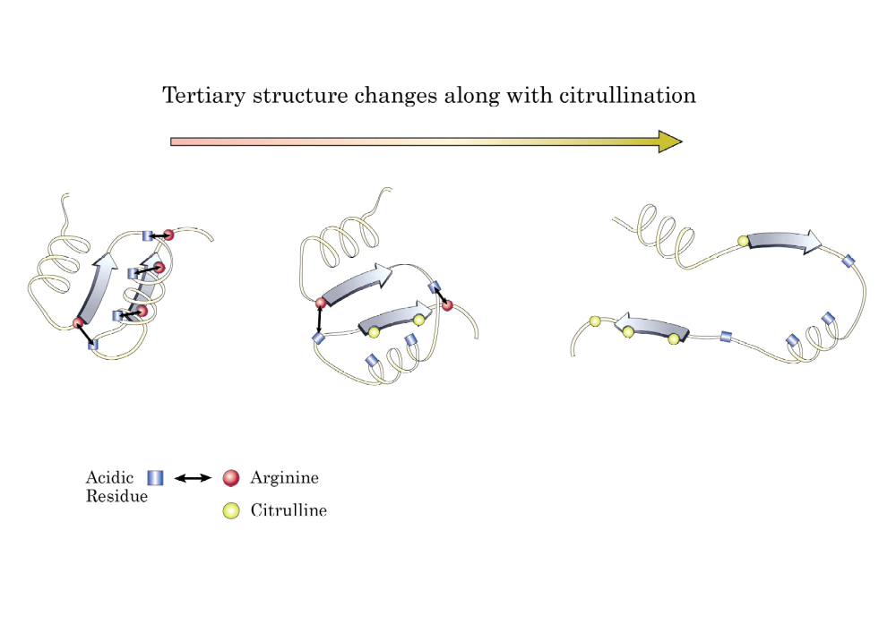

Slide 31
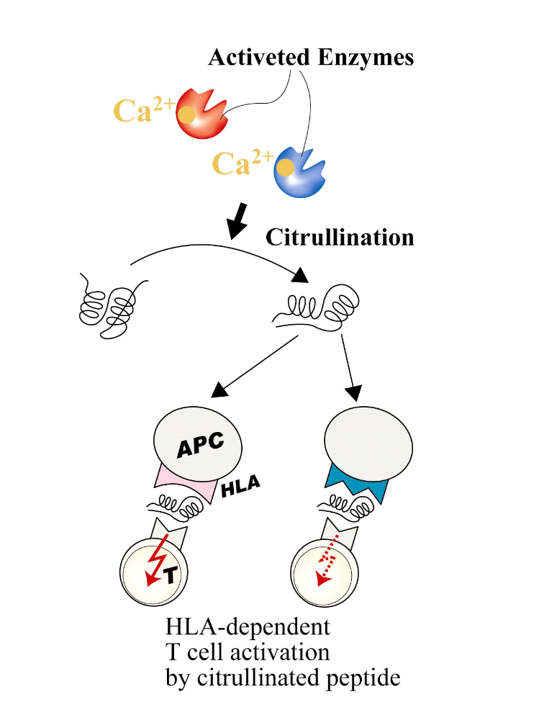
PADI4
Citrullination
Antigenicity
この部分だけ！

Slide 32
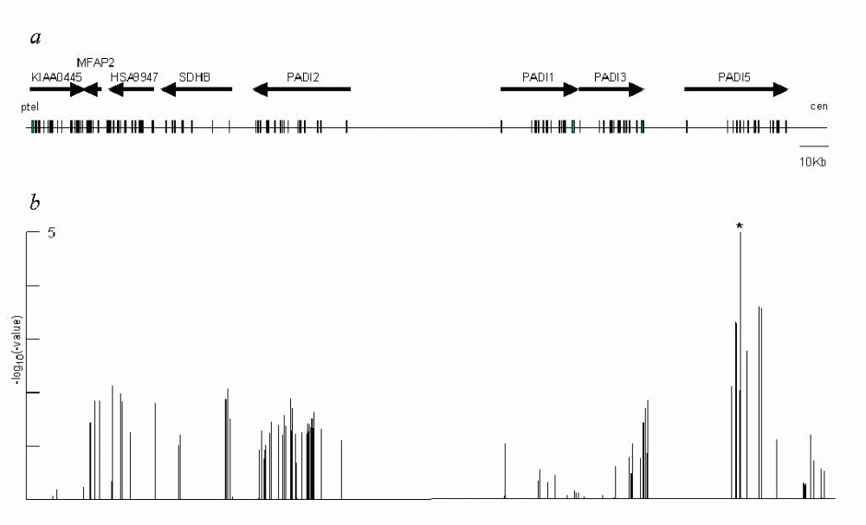
Association Plots in the PADI Cluster
PADI4
-log₁₀(P)＝５

Slide 33
Enzyme substrate
Missenes SNPs, but no allelic difference in enzyme activity.

Slide 34
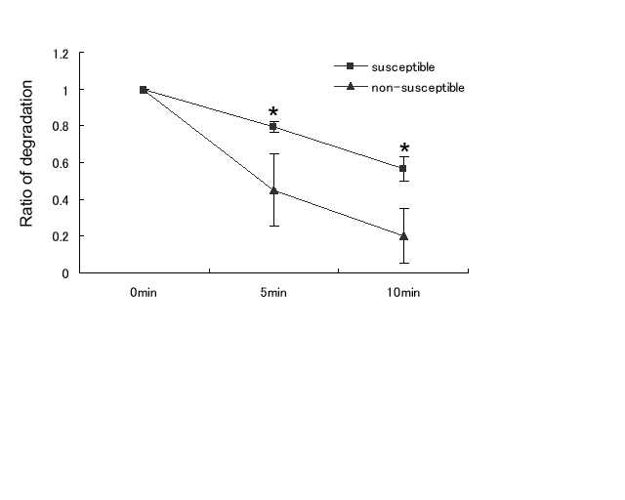
RA-susceptible variant transcript is more stable.

Slide 35
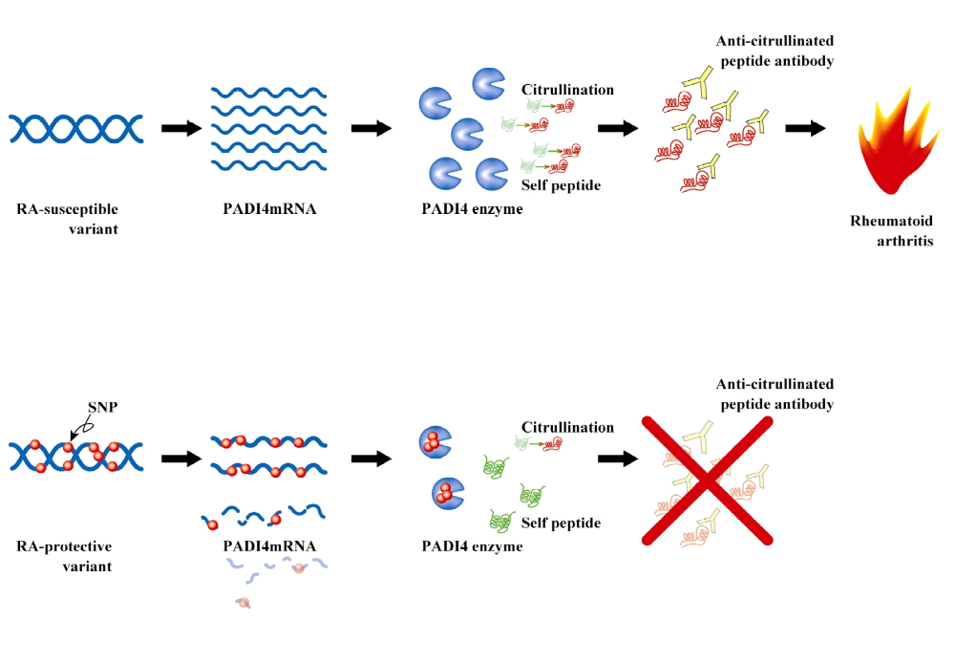
Hypothetical mechanism of RA-susceptible variant

Slide 36
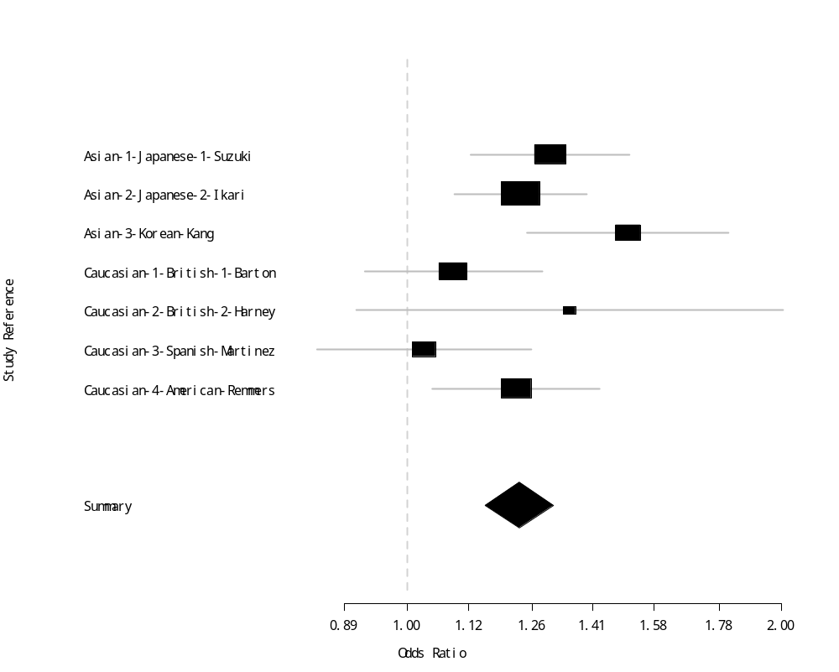
Multiple studies on PADI4 padi_92 or padi_94
Asian
Caucasian
3 “Positive” reports
&
3 “Negative” reports
Notes:
> outPlusKorea
Fixed effects ( Mantel-Haenszel ) Meta-Analysis
Call: meta.MH(ntrt = n.case, nctrl = n.ctrl, ptrt = sus.case, pctrl = sus.ctrl,
names = study, data = outobj)
Mantel-Haenszel OR =1.23 95% CI ( 1.15, 1.31 )
Test for heterogeneity: X^2( 6 ) = 10.41 ( p-value 0.1085 )

Slide 37
Perspectives
Genetic determinants of prognosis and clinical responsiveness
Coding genes and non-coding genes
Ethnic diversity and genetic factors
Combination of multiple genetic factors with or without environment factors

Slide 38
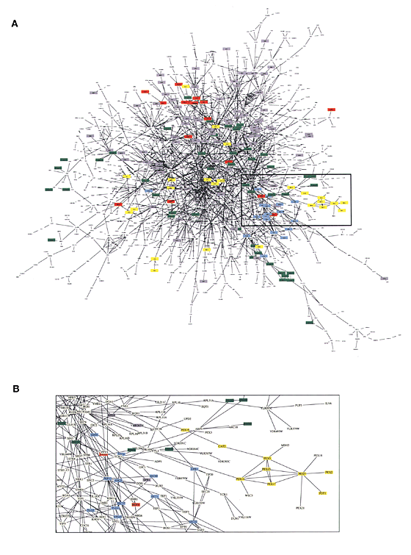
Network of genes with susceptible polymorphisms and genes without susceptible variations but functionally important
A network of protein–protein interactions in yeast
by Benno Schwikowski, Peter Uetz3 & Stanley
Nature Biotechnology 18 :1257 - 1261 (2000)

Slide 39
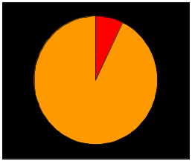
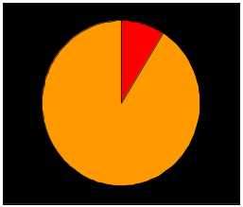
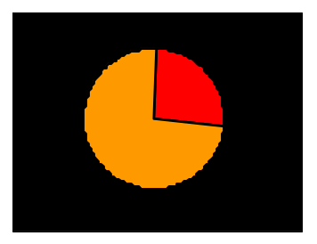
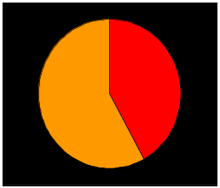
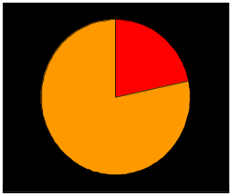
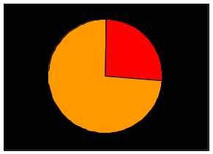
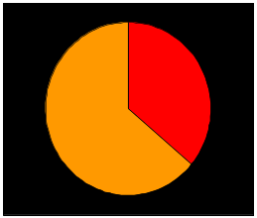

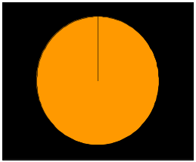
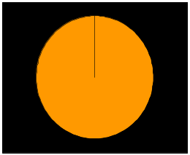

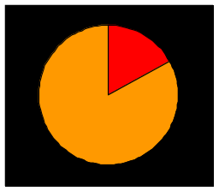
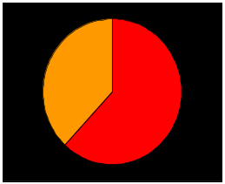
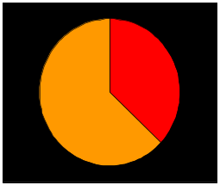
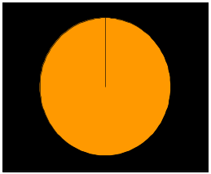
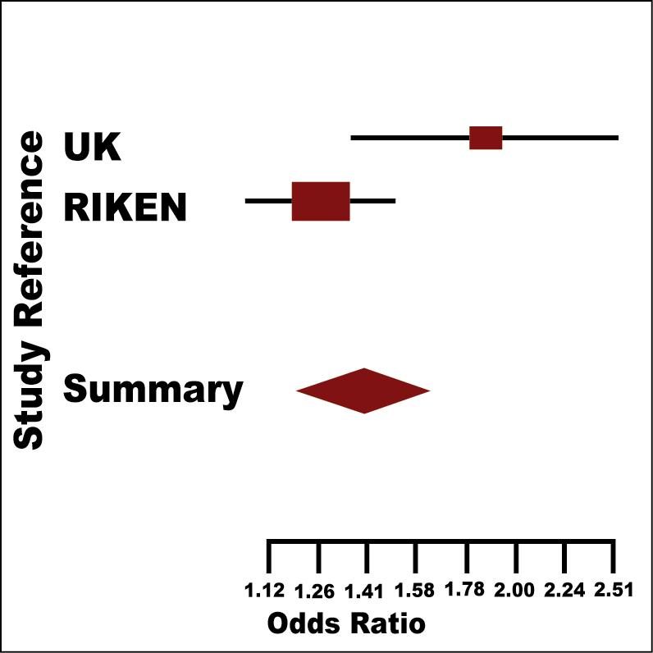
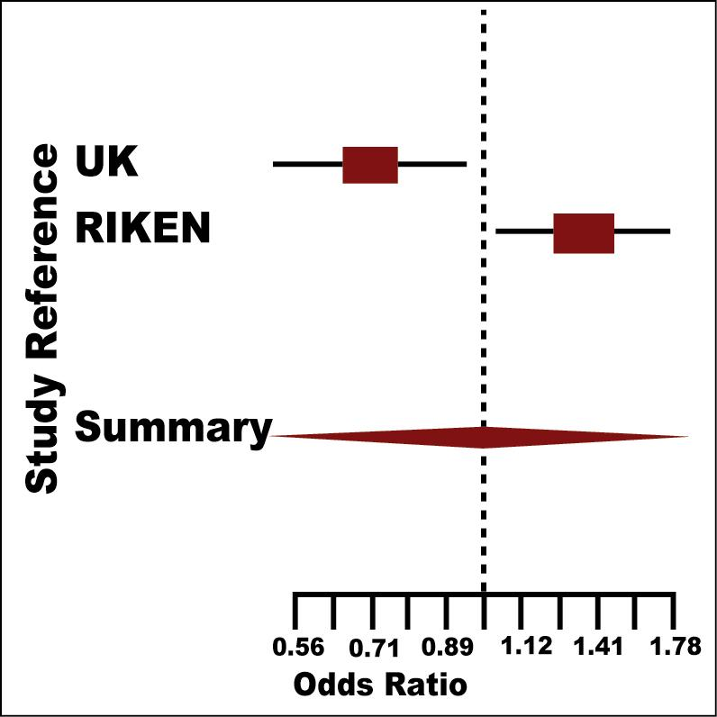
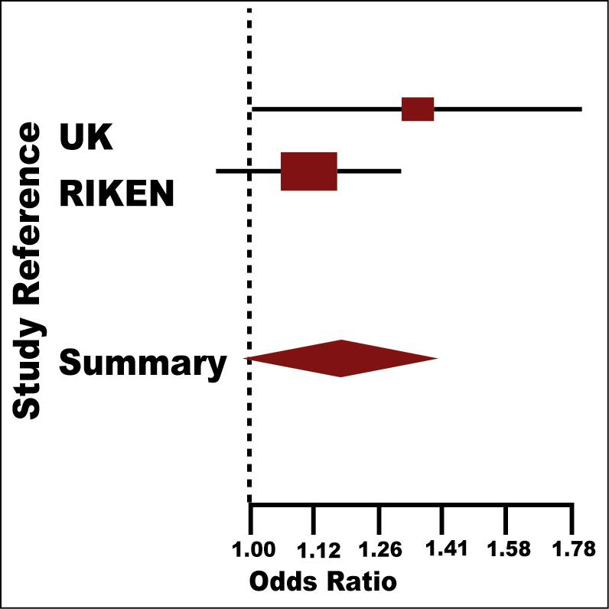
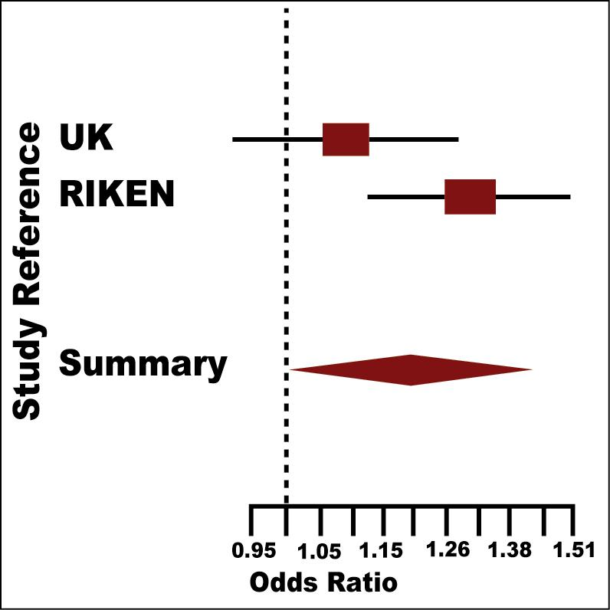
Caucasians
PDCD1
MIF1
CTLA4
SLC22A4/A5
PTPN22
TNFRSF1
PADI4
Preliminary calculation with random-effect model
Susceptible allele
Japanese

Slide 40
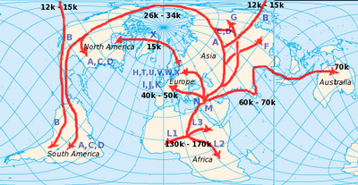

Ethnic variations

Slide 41
SNP Research Center, RIKEN, Yokohama, Japan
  Lab. for Rheumatic DIseases
    Kazuhiko Yamamoto
    Akari Suzuki
    Yuta Kochi
    Mikako Mori
  Akihiro Sekine
  Tatsuhiko Tsunoda
  Yusuke Nakamura
Clinical Institutes of Collaboration
  University of Tokyo Hospitals
    Tetsuji Sawada
  National Sagamihara Hospital
    Shigeto Tohma
    Toshihiro Matsui
Center for Genomic Medicine, Kyoto University, Kyoto, Japan
  Fumihiko Matsuda
  Shohei Chida
  Alexandre Vasilescu
  Hitomi Hiratani
  Victor Renault
  Masao Yamaguchi
  Katsura Hirosawa
  Kenei Ohigashi

