Slide 1
Ryo Yamada ¹ Hiroto Kawakami ² Masao Yamaguchi ³
Eri Tatsu ¹ Akihiro Sekine ⁴ Kazuhiko Yamamoto ¹
Yusuke Nakamura ⁴ Tatsuhiko Tsunoda ³
¹ Laboratory for Rheumatic Diseases, SNP Research Center, RIKEN, Tokyo, JAPAN
² Laboratory of Molecular Medicine, Human Genome Center, Institute of Medical Science, University of Tokyo, Tokyo, JAPAN
³ Laboratory for Medical Informatics, SNP Research Center, RIKEN, Tokyo, JAPAN
⁴ Laboratory for Genotyping, SNP Research Center, RIKEN, Tokyo, JAPAN
Correspondence to Ryo Yamada, ryamada-tky@umin.ac.jp
Acknowlegments
We Thank Hisanori Haga ² for discussing on presentation materials in detail.

Slide 2
Key Words
Population Structure
Multiple Genetic Markers
SNP
Spurious Association
Genomewide Association Study
Markov Chain Monte Carlo Simulation
Japanese

Slide 3
Abstract
Linkage disequilibrium (LD) mapping, using a dense map of single nucleotide polymorphisms (SNPs), has been advocated as the method of choice to locate loci of complex genetic diseases. However it has also been suggested that genetic population structure could lead to many spurious associations between genetic markers and a disease phenotype when LD mapping was performed, especially in case of studies using samples from ethnically structured populations.
Japanese population has been considered to be less structured, and, therefore, more appropriate for LD mapping than many other populations in the world, because of its ethnic isolation from both historical and geographical standpoints. However no analysis on their genetic homogeneity based on assayed genotype data has been reported. We evaluated homogeneity of two sub-populations, each of which were from one of the two largest Japanese metropolises by analyzing genotype data of 188 individuals for 303 unlinked SNPs on autosomal chromosomes. We adopted two analytical methods to evaluate structure. One method was to assess existence of difference in population structure between two sub-populations, by analyzing chi square statistics computed for multiple contingency tables constructed for allele distribution of each SNP between sampling sub-populations. The other was to infer population structure by model-based clustering method using Markov Chain Monte Carlo algorithm. We found that, if any, only subtle difference in population structure between two sub-populations existed. The possible allele difference between two sub-populations seemed small enough not to severely interfere case-control association studies for complex genetic traits.

Slide 4
Organization of This Presentation
Six sets of simulated genotype data of two sub-populations with various degree of difference in allele frequencies of SNPs were analyzed with two methods for genetic structure.
Real genotype data of two sub-populations in Japan were analyzed in the same way.
The results of real data were compared with the results of simulated data.

Slide 5
Methods
Construction of genotype data for the structural analysis of simulated data
Suppositions:
  Two sub-populations were supposed, each of which had randomly mated and were homogeneous.
  180 SNPs were supposed, all of which were:
    Biallelic.
    In Hardy-Weinberg equilibrium.
    Unlinked each other.
  Genotypes of individuals, consisting of genotype data sets, were assigned as if individuals were randomly sampled from each sub-population.
  Fifty individuals were sampled for each sub-population.
Six data sets were constructed with variations in allele frequencies of a part of SNPs between two sub-populations.

Slide 6
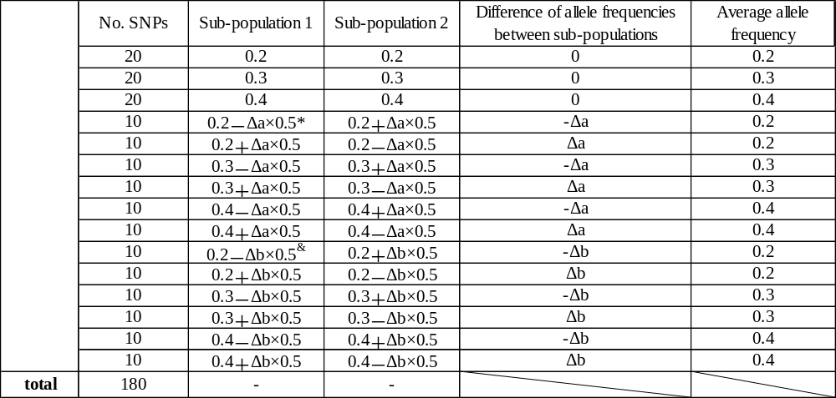
Methods
Allele frequencies of SNPs in two sub-populations for 6 sets of simulated data (1)
Table 1 Number of SNPs and their allele frequencies in 2 sub-populations.
Δa* and Δb & are parameters to make difference of allele frequency between sub-populations 1 and 2. Δa and Δb are specified for each set of simulation on Table2

Slide 7
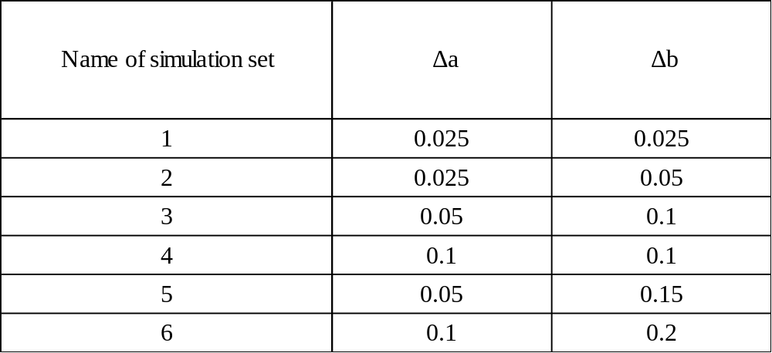
Methods
Allele frequencies of SNPs in two sub-populations for 6 sets of simulated data (2)
Table 2 Parameters to give allele frequency difference between sub-populations 1 and 2

Slide 8
Methods
Analytical Methods of Structure (1)
Analytical Method 1
  Evaluation of sum of multiple chi statistics calculated for individual SNP¹
Analytical Method 2
  Inference of structure by Markov Chain Monte Carlo simulation method²
  1 Jonathan K. Prichard and Noah A. Rosenberg. Use of unlinked genetic markers to detect population stratification in association studies. Am J Hum Genet. 65: 220-228,1999
  2 Jonathan K. Prichard, Matthew Stephens and Peter Donnelly. Inference of population structure using multilocus genotype data. Genetics. 155: 945-959, 2000

Slide 9

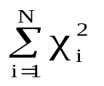
Methods
Analytical Method 1
・ Principles of sum of multiple chi statistics calculated for individual SNP
  Null hypothesis and alternative hypothesis
    ・Null Hypothesis: All the samples are from an identical population.
    ・Alternative hypothesis: Samples are from two distinct sub-populations.
  Chi square value for each SNP genotype data
    ・ (i=1,2,…N; N:Number of SNPs analysed) represents chi square value calculated for 2×2 contingency table of the observed number of alleles from two sub-populations.
  Sum of multiple chi square value(S) and degree of freedom(df)
    ・S =
    ・df = N
    ・S is statistically evaluated as chi square value with degree of freedom being df.

Slide 10
Methods
Analytical Method 2
Inference of structure by Markov Chain Monte Carlo (MCMC) simulation method*
  Parameter matrices were set as below:
    X: Genotypes of the sampled individuals
    Z: Belonging sub-populations of the individuals
      Number of sub-populations : Two
    P: Allele frequencies of SNPs in all sub-populations
  Belonging sub-population was assigned to each individual at random at the beginning.
  MCMC algorithm was applied and converged result was obtained.
    Sample P^{(m)} from Pr(P|X,Z^{(m-1)})#.
      Beta distribution was used for allele frequency distribution of biallelic markers.
      Gibbs sampler with adaptive rejection sampling was adopted.
    Sample Z^{(m)} from Pr(Z|X,P^{(m)}).
  Results of multiple runs were summed, considering phenomenon to converge into symmetrical modes.
      * Program source will be available in near future on request by the author.
      # m denotes number of iterations and Pr(Y|W) denotes conditional probability distribution of Y when W.

Slide 11
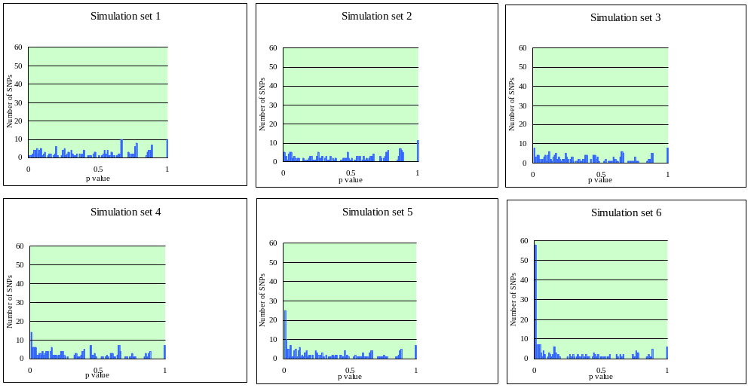
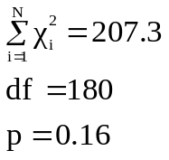
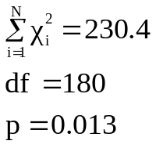
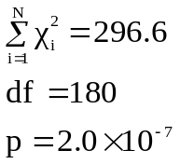
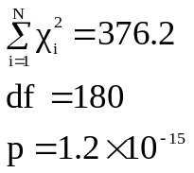
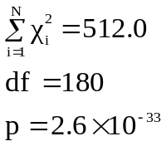
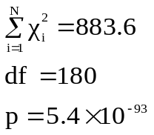
Results
Results of analysis 1(Sum of Chi Square Statistics) of simulated data
Fig1 p value distribution of individual SNPs and sum of chi square values and their corresponding p value
6 histograms represents result of 6 simulated data,respectively.
Null hypothesis in set 1 was not rejected. For sets 3, 4, 5 and 6 null hypothesis was strongly rejected.

Slide 12
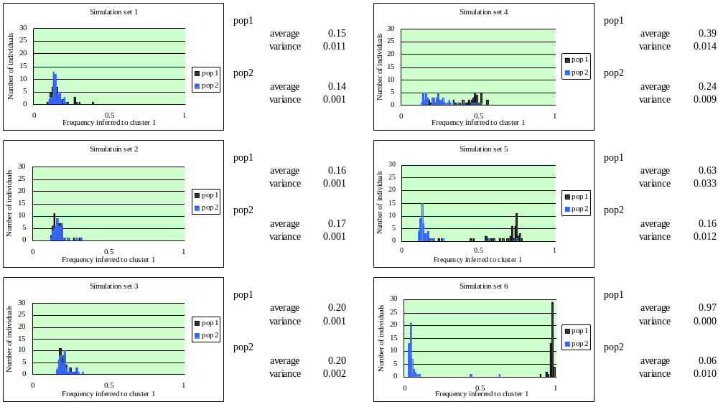
Results
Results of analysis 2 (MCMC) of simulated data
Fig2 Histograms showing how often each individual was inferred to cluster 1
Distributions of sub-populations 1 and 2 of simulation sets 1, 2 and 3 appeared to be similar. Simulation sets 4, 5 and 6 segregated two sub-populations with appropriate progression of clarity of discrimination.

Slide 13
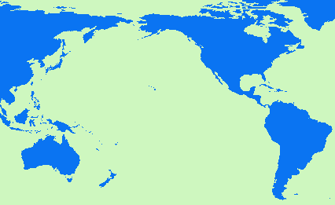
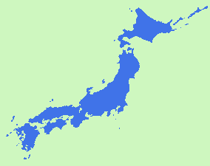
Methods
Samples(1)
Construction of genotype data for the structural analysis of real data
Tokyo: Sampling Metropolis 1
Osaka: Sampling Metropolis 2
Fig3 Location of Tokyo and Osaka
Tokyo
Osaka

Slide 14
Methods
Samples(2)
Construction of genotype data for the structural analysis of real data
・Historical, geographical and ethnical information of sampling sub-populations
  The land of Japan consists of 4 major islands and many small islands, locating at the rim of northwestern Pacific ocean.
  Japanese ancestry is considered to be formed by migration of at least a few ethnic groups from the Eurasian continent before the end of the last glacial epoch, admixed by the Pacific islanders.
  No major migration or admixture happened for the last few thousands years, forming a strongly culturally distinct population with a limited degree of ethnic diversity.
  Tokyo and Osaka metropolitan areas are characterized by high-degree of influxes of people from diverse areas of Japan, followed by random mating, which is believed to have canceled genetic structure present in the past.
    Major differences between Tokyo and Osaka areas:
      Population of Tokyo area has been formed by influx of people from almost all the areas of Japan for the last 4 hundreds years without a core ancestral population.
      Population of Osaka area has been formed by admixture of many people from many areas of Japan, especially of south-western area, to the core ancestral population, which had been formed before early middle ages.

Slide 15
Methods
SNPs(1)
Construction of genotype data for the structural analysis of real data
Source of SNPs:
  SNPs on autosomal chromosomes from IMS-JST SNPs database, discovered by direct-sequencing method of multiple Japanese individuals’genomic DNAs targeting mainly on and around known and expected genes throughout the human genome. (http://snp.ims.u-tokyo.ac.jp/)
Number of SNPs:
  4373 SNPs were genotyped initially.
  303 of 4373 SNPs were adopted for structure analyses by criteria described on the following sheet of paper.

Slide 16
Methods
SNPs(2)
Construction of genotype data for the structural analysis of real data
  SNPs were selected for analyses of population structure by the criteria as below:
    Each SNP should:
      Be assayed with appropriate call for more than 170 individuals.
      Be biallelic.
      Have minor allele frequency more than 0.1.
      Be unlinked each other:
        Two SNPs on an identical chromosome were considered to be unlinked each other when
        linkage disequilibrium (LD) index D’* were less than 0.3
        *D’: Index of LD was calculated as below:
        1. Haplotype frequencies were estimated by EM-algorithm
        2. D’＝|(P_{AB}**×P_{ab}－P_{ab}×P_{aB} )|/Minimum((P_{AB}＋P_{aB})×(P_{aB}＋P_{ab}),((P_{AB}＋P_{Ab})×(P_{Ab}＋P_{ab})) ,
        AB, Ab, aB, and ab represent 4 haplotypes created by 2 SNPs.
        ** P_{cd} represents frequency of haplotype.
      Be successfully assayed. Our internal criteria # was adopted for judgment of success of assays:
        # It based on the data in SRC, RIKEN, TOKYO, JAPAN (unpublished):
        Intensity of fluorescence signals should be more than a threshold.
        More than 90 % of samples should be called.
        Chi square statistic for Hardy-Weinberg Equilibrium should give p-value of larger than 1.0×10⁻³.

Slide 17
Methods
Genotyping Assay
Construction of genotype data for the structural analysis of real data
  Invader assay with multiplex polymerase chain reaction (PCR),
  characterized as below:
    Multiplex PCR was performed against 100 genomic regions simultaneously
    in a single reaction tube.
    Each amplified fragment contained at least one SNP.
    A specialized 384-well card system was adopted for the ultra high-throughput genotyping system.
    Very small amount of genomic DNA was required for genotyping:
      40 ng of genomic DNA was used as a template for each multiplex PCR,
      meaning only 0.4 ng of genomic DNA per genotyping of one SNP.
    A high-throughput SNP typing system for genome-wide association studies.
    J Hum Genet. 2001;46(8):471-7.
    Ohnishi Y, Tanaka T, Ozaki K, Yamada R, Suzuki H, Nakamura Y.

Slide 18
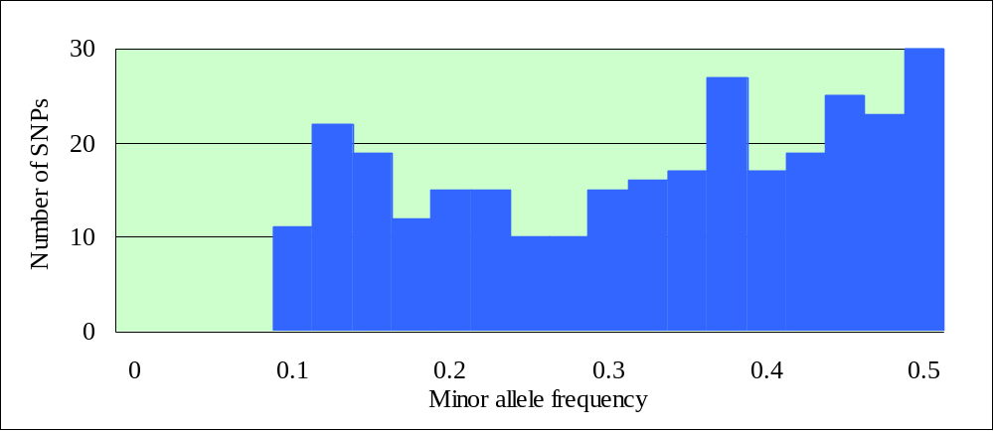
Results
Characterization of selected SNPs of real data
Characterization of SNPs included for analyses of population structure
  303 SNPs out of 4373 were selected.
  Average rate of successful call of genotyping of 303 SNPs was 0.99
  Minor allele frequency of each SNP was distributed as below:
Fig4 Distribution of minor allele frequency of 303 SNPs
SNPs with higher minor allele frequency seemed to be included more frequently than the distribution in reality.

Slide 19
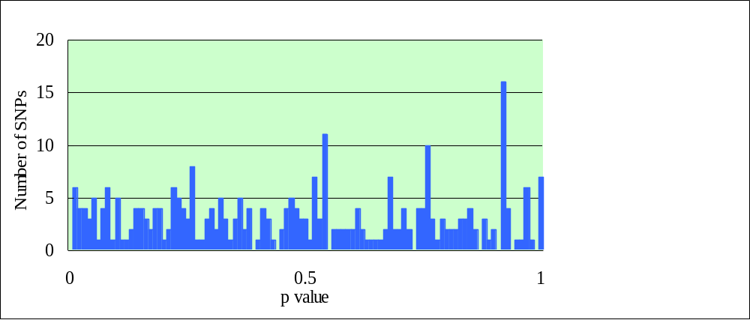
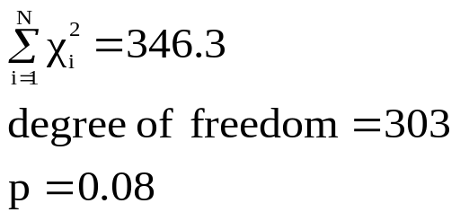
Results
Result of analysis 1(Sum of Chi Square Statistics) of real data
Fig5 p value distribution of 303 chi square tests and sum of chi square values and its corresponding p value with degree of freedom of 303
Null hypothesis that Tokyo and Osaka sub-populations were identical was not rejected with cut off p-value of 0.05.

Slide 20
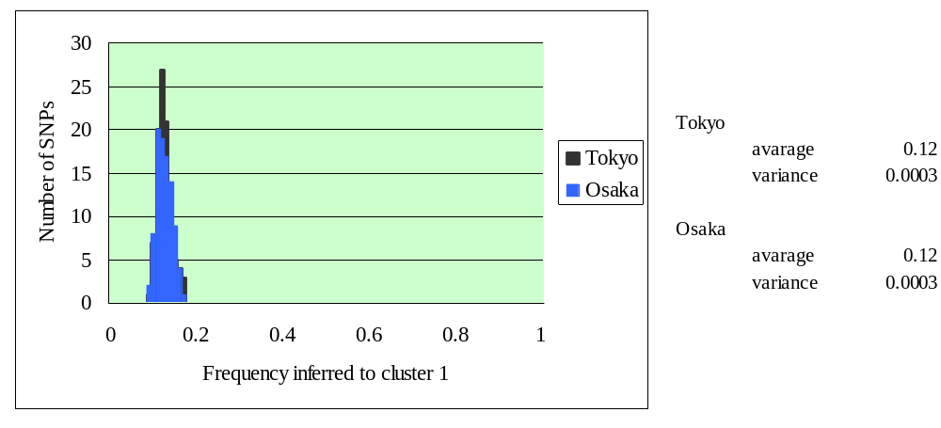
Results
Result of analysis 2(MCMC) of real data
Fig6 Histogram of frequency that each individual was inferred to cluster 1
Almost identical distributions were obtained for 2 sampling areas.
These distributions were similar to one of simulation sets 1, 2 and 3.
It suggested the difference between Tokyo and Osaka was as small as difference between two sub-populations in simulation sets 1, 2 or 3.

Slide 21
Discussion
The two analytical methods were applied to simulated genotype data and real data, both of which represented subtly heterogeneous two sub-populations. Result of analyses of simulated data revealed both analytical methods could dissect two populations when SNPs with allele frequency difference between populations more than 0.1 existed. Analysis 1 (sum-of-chi square values) showed statistical significance, even when SNPs with allele frequency difference of 0.05 dominated, if such SNPs existed frequently, although analysis 2 (MCMC) did not show visible discrimination in the distributions. In a situation, where population-based sampling association studies were carried out, difference of allele frequencies among subtly stratified populations would be negligible, as far as the difference between ethnic sub-populations was smaller than the difference between phenotypic sub-groups. The comparison between results of simulated data and real data gave an idea that the genetic structure between Tokyo and Osaka was somewhere between a simulated data with maximum allele frequency difference of 0.025 and another set with maximum allele frequency difference of 0.05. When complex genetic traits are analyzed with LD mapping, allele frequency difference between phenotypically distinct groups distributes most likely more than 0.05. From this standpoint, samples from Japanese metropolises should be treated as homogeneous.

