Slide 1

SPONSORSAVVY
By Praveen

Slide 2
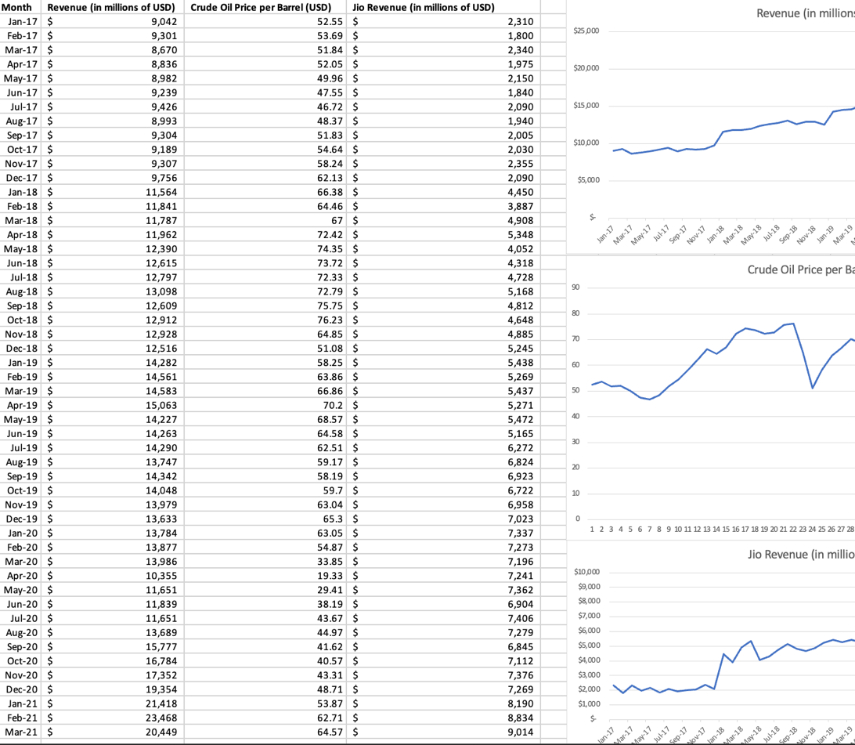
DATA CLEANING BY EXCEL
From the data we can see there’s a slight relation between company’s revenue and Crude oil and Company’s revenue and Jio Revenue

Slide 3
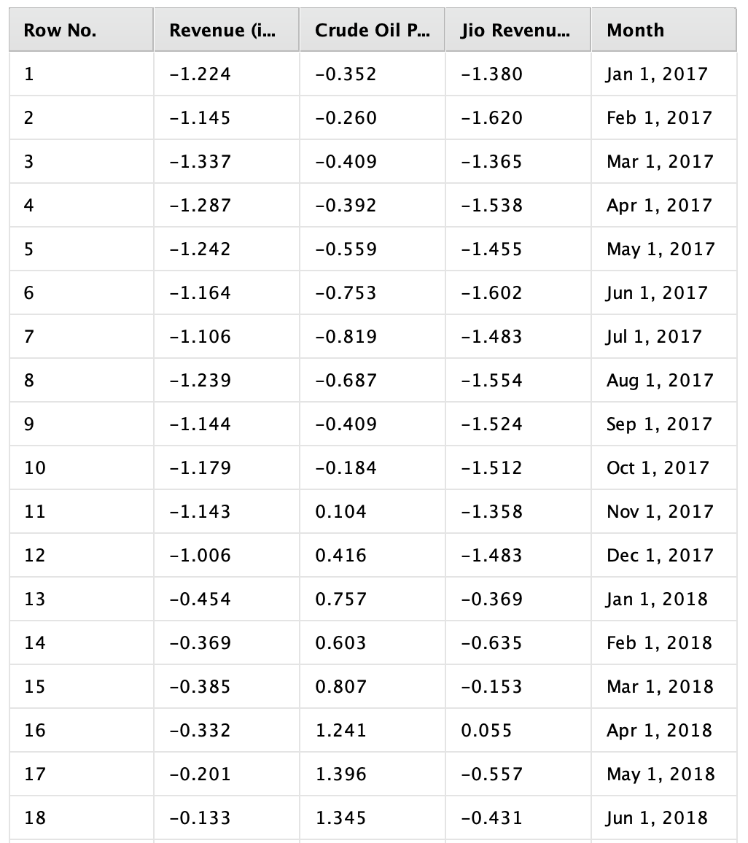
Normalizing The Data
Normalization involves scaling your input features to have a mean of 0 and a standard deviation of 1 to improve the result efficiency.
Since the variables are
Normalized data result:

Slide 4
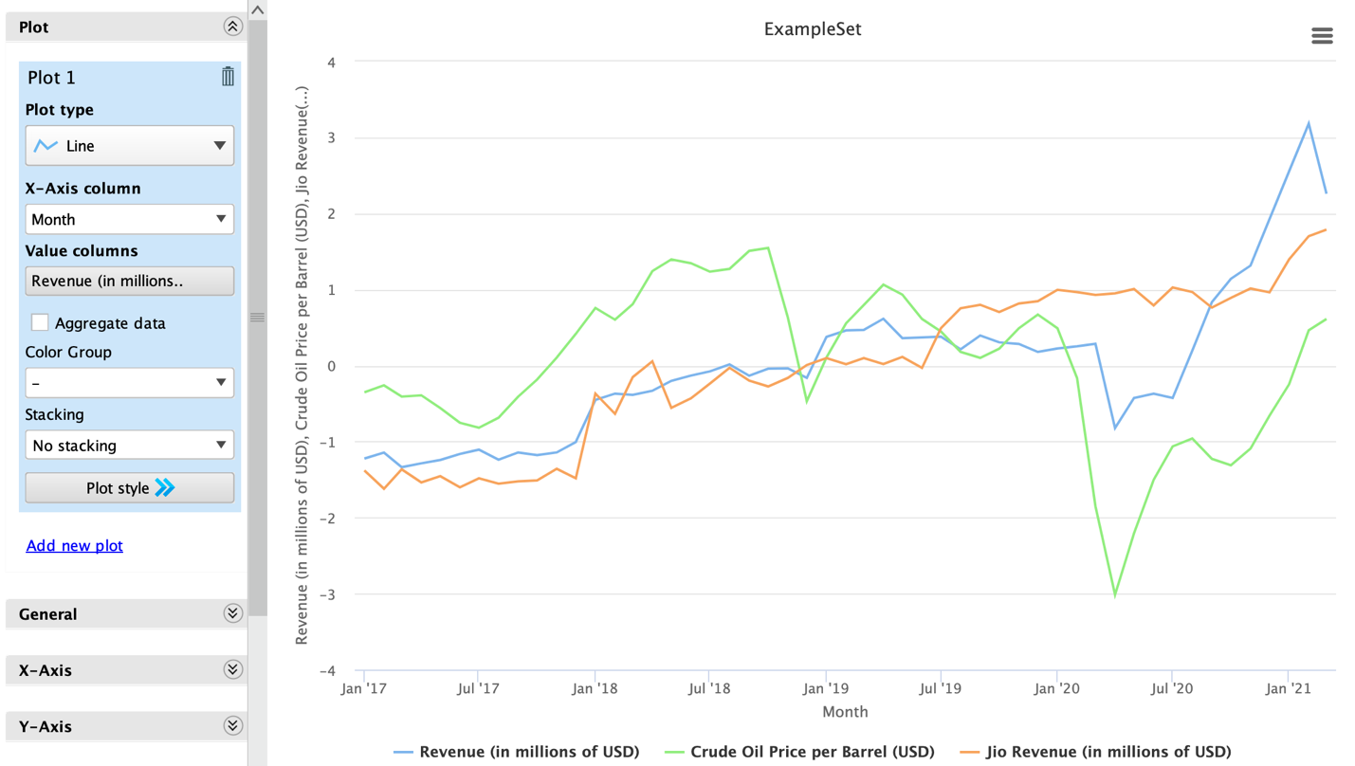

Slide 5
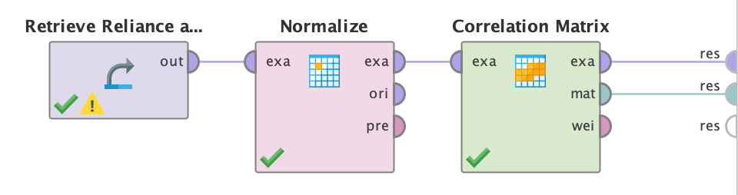
Correlation Matrix

Slide 6
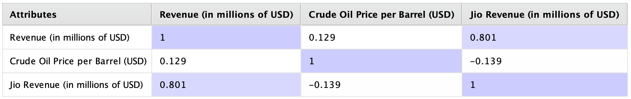
Correlation Table
The correlation coefficient between "Revenue (in millions of USD)" and "Crude Oil Price per Barrel (USD)" is 0.129, indicating a weak positive correlation between the two variables.
The correlation coefficient between "Revenue (in millions of USD)" and "Jio Revenue (in millions of USD)" is 0.801, indicating a strong positive correlation between the two variables.
The correlation coefficient between "Crude Oil Price per Barrel (USD)" and "Jio Revenue (in millions of USD)" is -0.139, indicating a weak negative correlation between the two variables.
Overall, these results suggest that there is a weak relationship between "Revenue (in millions of USD)" and "Crude Oil Price per Barrel (USD)", and strong relationship between "Revenue (in millions of USD)" and "Jio Revenue (in millions of USD)".

Slide 7
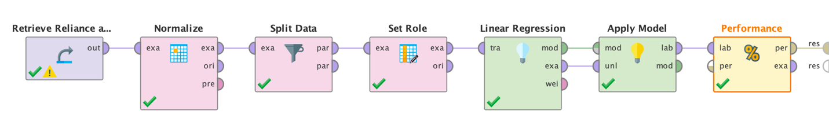
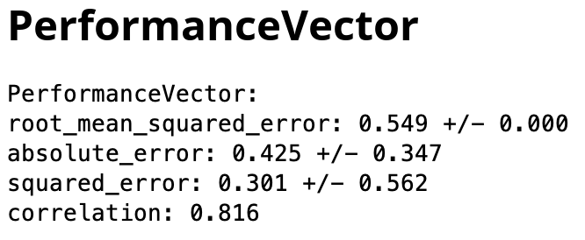
Regression Analysis
The root mean squared error is 0.549, indicating that the average prediction error is around 0.549 million USD. The absolute error is 0.425, meaning that the average absolute difference between the predicted revenue and the actual revenue is around 0.425 million USD. The squared error is 0.301, indicating that the average squared difference between the predicted revenue and the actual revenue is around 0.301 million USD. Finally, the correlation between the predicted and actual revenue is 0.816, indicating a strong positive linear relationship between the two variables.

Slide 8
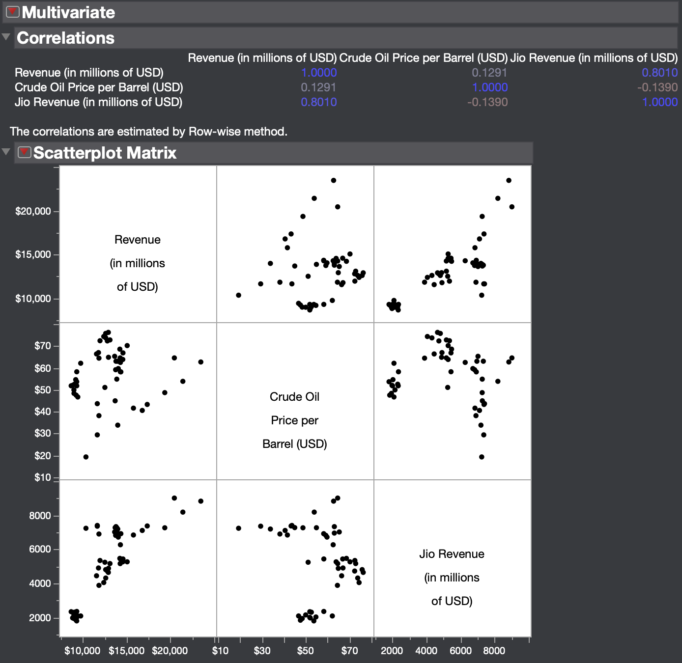
Correlation Using JMP

Slide 9
I Really Appreciate for Your Patience. Thank You

