Slide 1


Korte introductie & hands-on lab

Slide 2
What is ansible
Assignment
Ansible ad hoc, modules, tasks and documentation
Inventories
Plays
Roles
Templating
Handlers

Slide 3
What is ansible
Automation platform/engine
(Tries to be mostly) idempotent
Configuration management
Agentless
GitOps/IAC

Slide 4
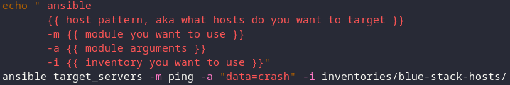
Adhoc, modules, tasks and documentation
Ansible vs ansible-playbook
Ansible documentation -> https://docs.ansible.com/ansible/latest/

Slide 5
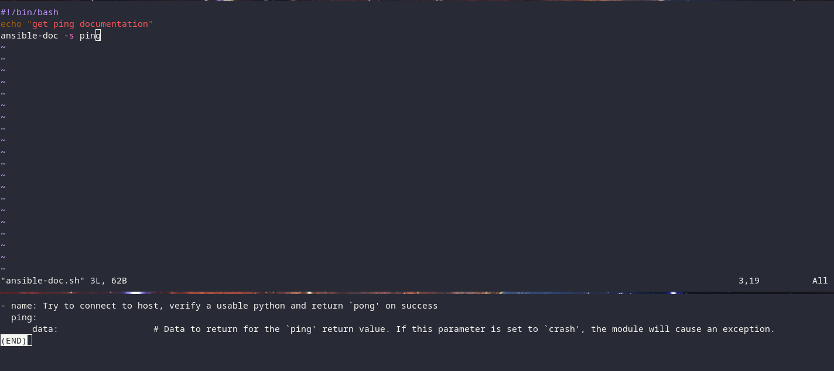
Ansible doc

Slide 6
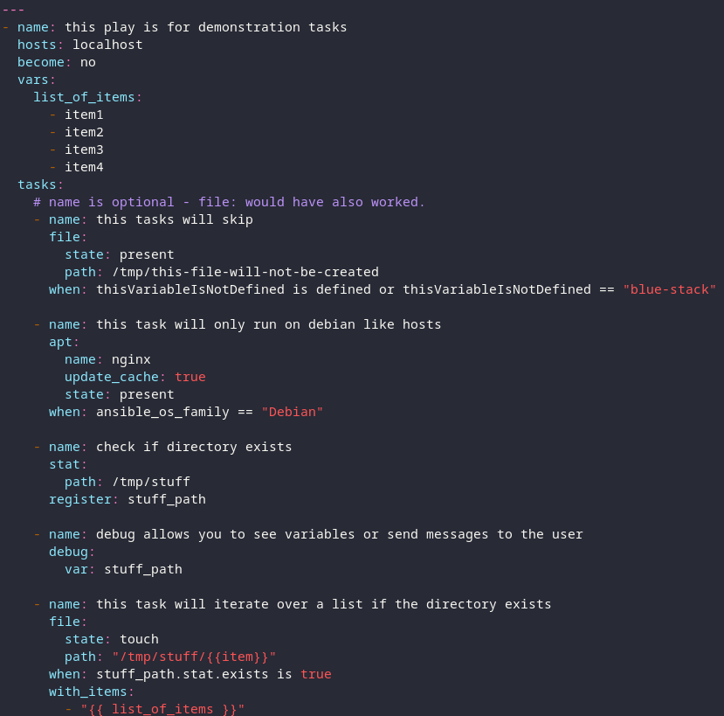
Ansible tasks and control
A task uses a module
Tasks can be controlled by when
Debug module
Loop or with_items or with_dict

Slide 7
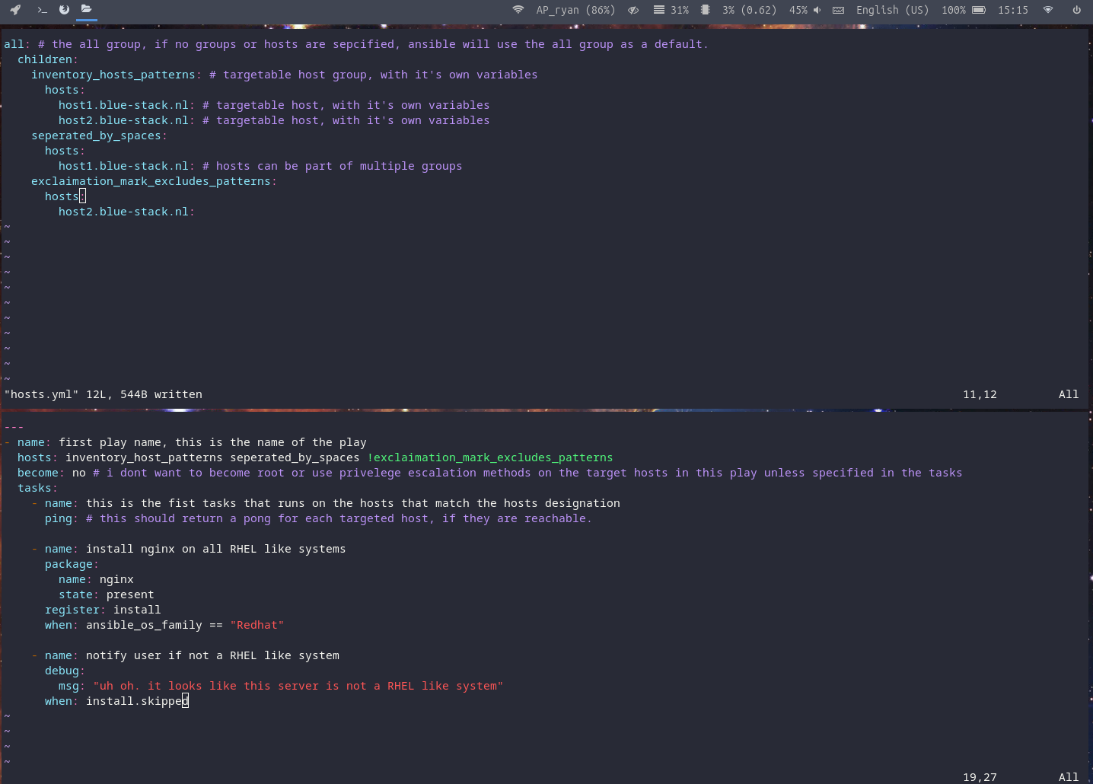
inventories
YAML or ini format
Multi or single
Groups and hosts vars
Variable precedence

Slide 8
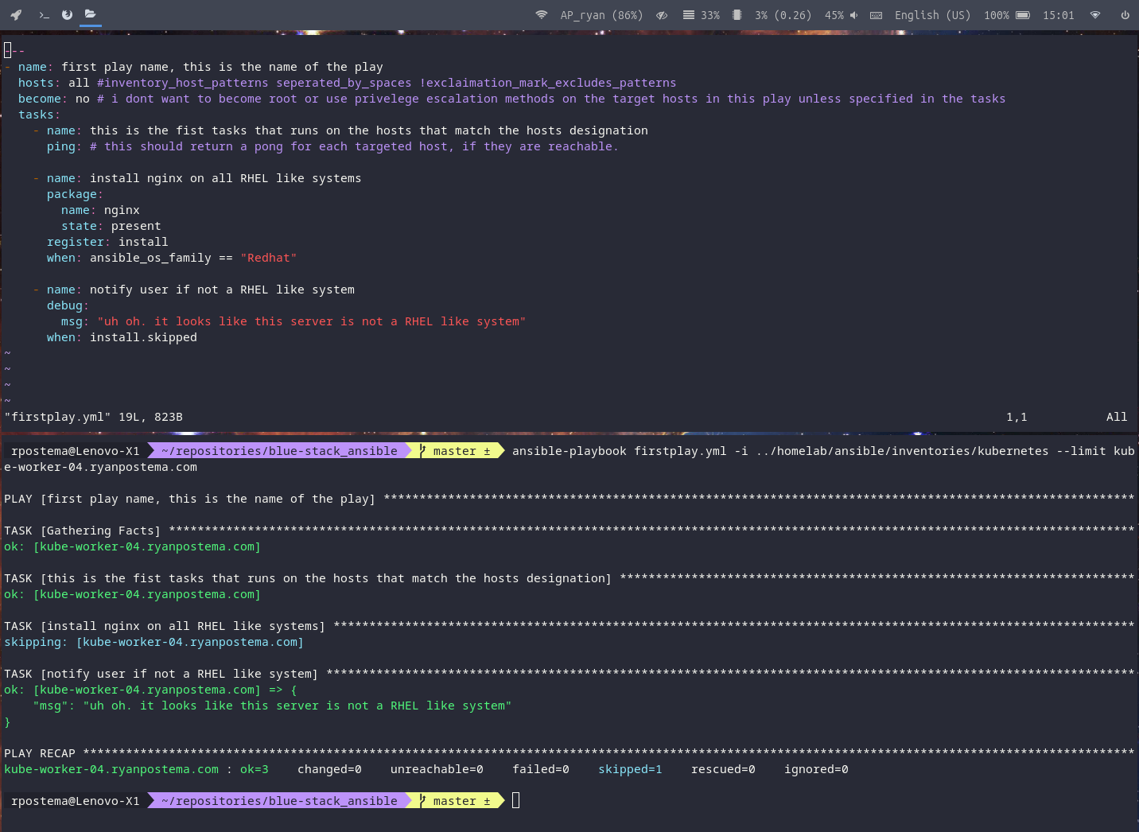
Plays
YAML
Playbook can
have more than
one play

Slide 9
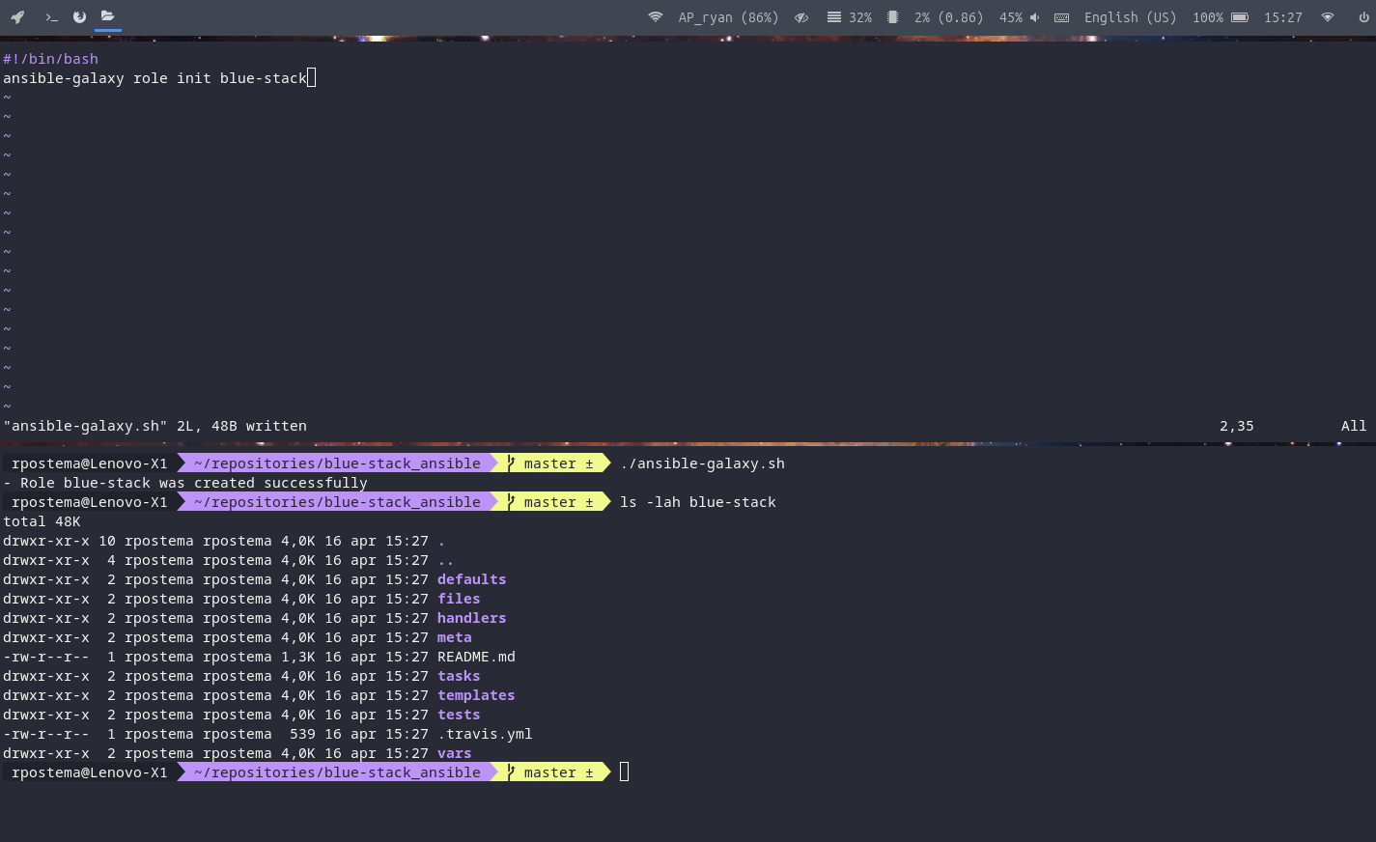
roles
Reusable
Sharable
Ansible galaxy

Slide 10
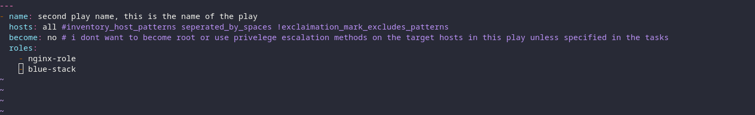
Play with roles

Slide 11
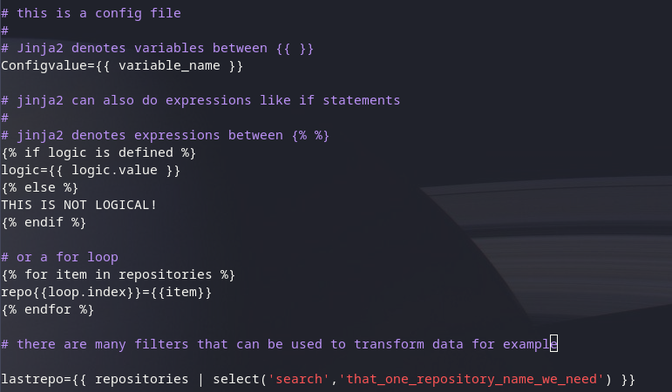
Jinja templating
Documentation:
https://jinja.palletsprojects.com/en/3.1.x/templates/

Slide 12
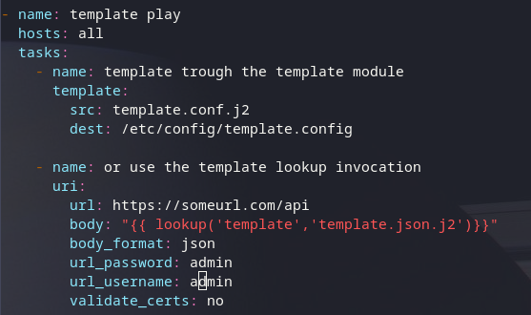
Jinja templating in ansible playbook
Template module
Template Lookup invocation

Slide 13
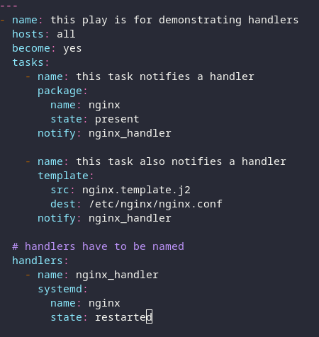
handlers
Handlers run at the end of a play
Handlers only run once even when called more than once

Slide 14

FIN

