Slide 1

D424 Software Engineering Capstone (Hourmap)
HOURMAP – DEPLOYMENT
Deployment
Ryan Snyder
011535988

Slide 2
HOURMAP – DEPLOY LOCAL DEMO
Table of Contents
1. DEVELOPMENT ENVIRONMENT …3
2. PRODUCTION ENVIRONMENT …8
3. SUMMARY …15
4. REFERENCES …16

Slide 3
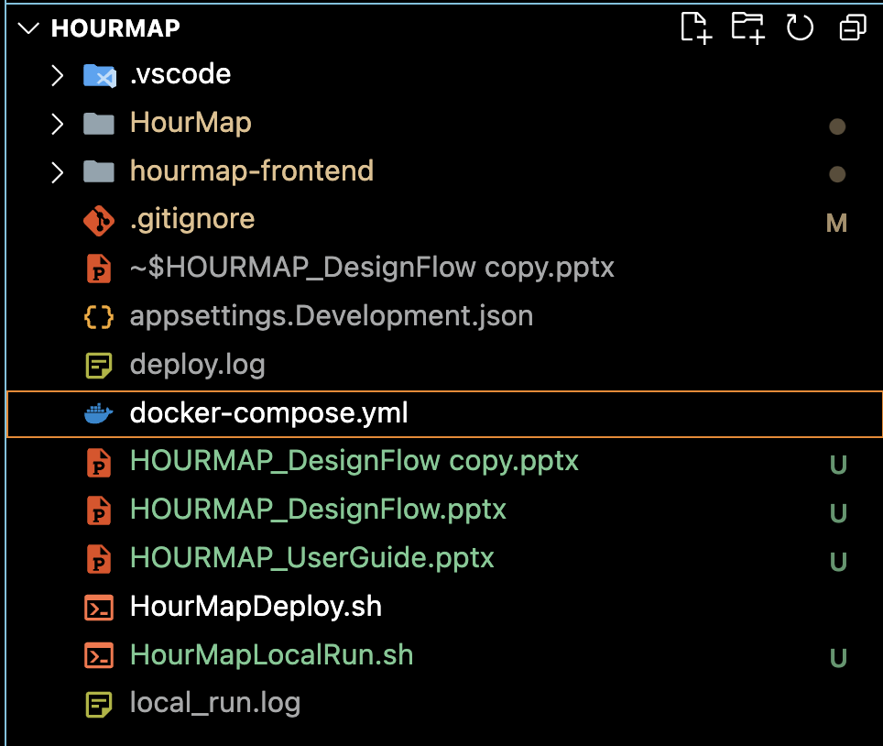
01 – DEVELOPMENT ENVIRONMENT
HOURMAP – DEPLOYMENT
HourMap relies on SQL server to store and retrieve data about an organization. Due to SQL server not being compatible with all operating systems, we install Docker Desktop by following this guide https://docs.docker.com/desktop. We built a docker compose file to spin up our DB as needed.
This project includes a docker-compose file for spinning up the database when we need it.

Slide 4
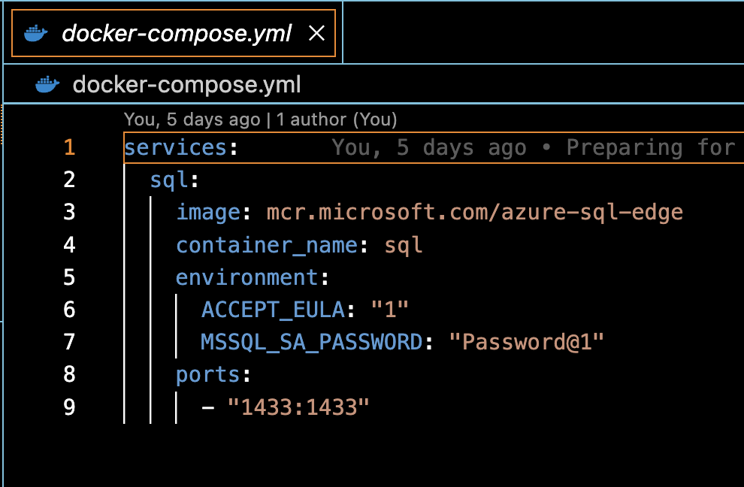
HOURMAP – DEPLOYMENT
Development Environment
The docker compose file is very simple. We use an ‘AZURE-SQL-EDGE’ image due to its small size and similarity to Azure SQL server (our production DB).
We set up the password for the demo DB and the port we want to publish it on.
You can test your settings by using docker-compose up in the same directory via terminal.
Note : Production environments should keep these secret by storing them
In a secret server or within environment variables.

Slide 5
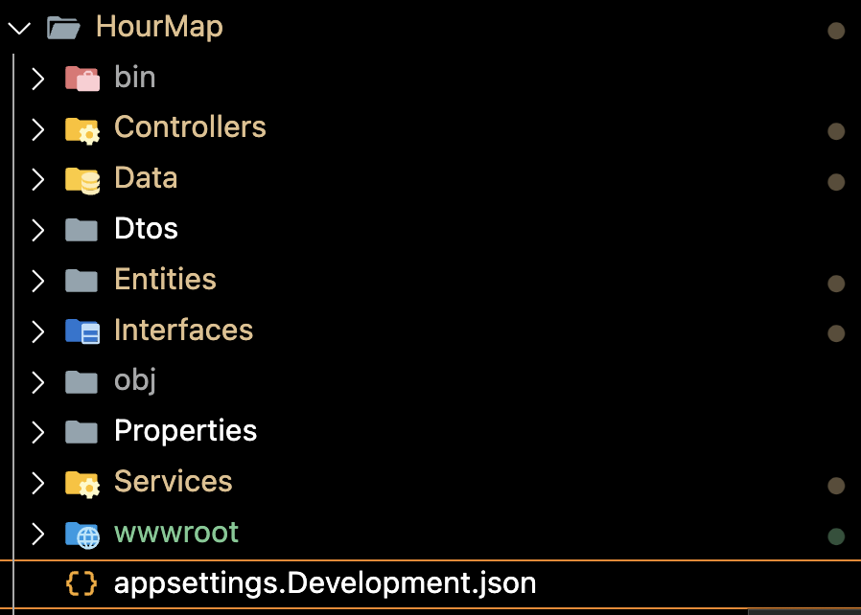
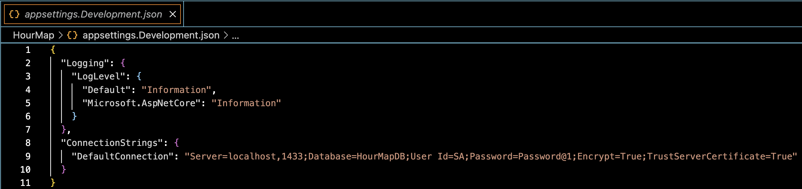
HOURMAP – DEPLOYMENT
Development Environment
Within the backend ‘HourMap’ folder, we have an ‘appsettings.Development.json’ file. This file stores important information like our DB connection string and JWT generation key!
The DB connection string tells our application which database to connect to while in development mode.

Slide 6
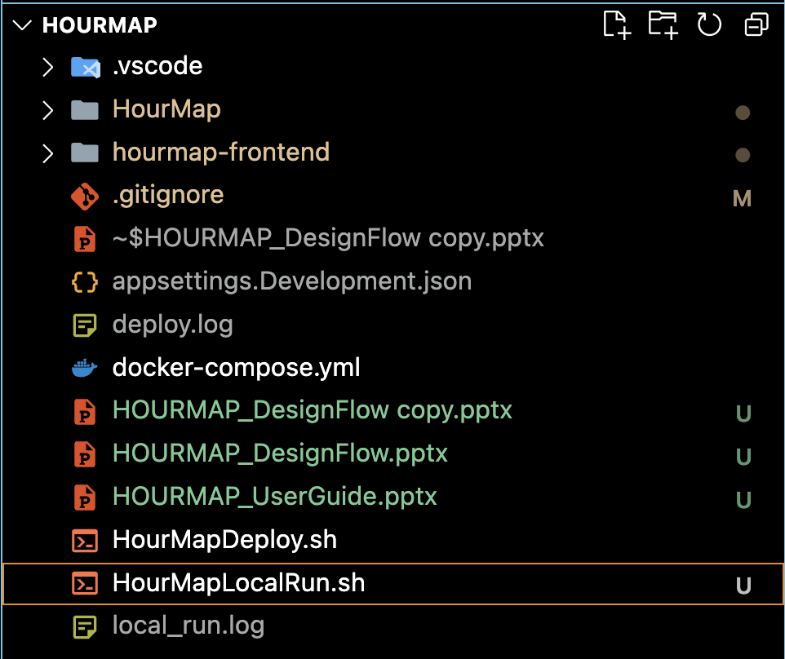
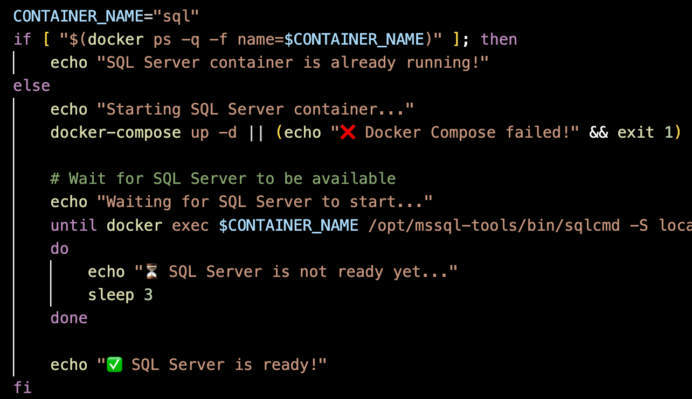
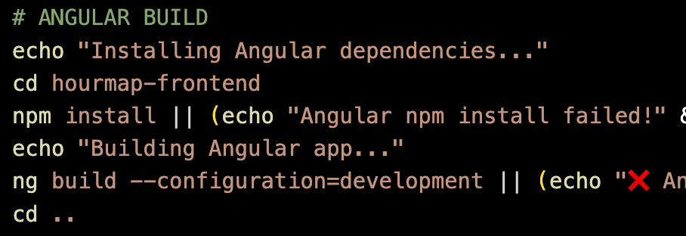
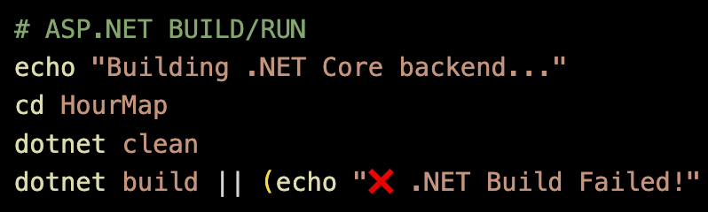
HOURMAP – DEPLOYMENT
Development Environment
1. Makes sure the docker DB is running.
2. Builds our Angular frontend into the www-root folder.
We also have a bash script called ‘HourMapLocalRun.sh’. This script is also simple and focuses on three things!
3. Builds ASP.NET with the www-root and runs the application!

Slide 7
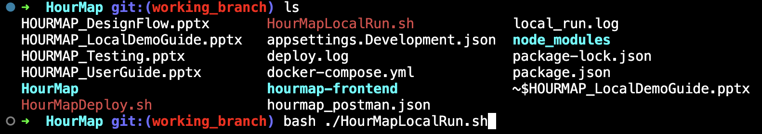
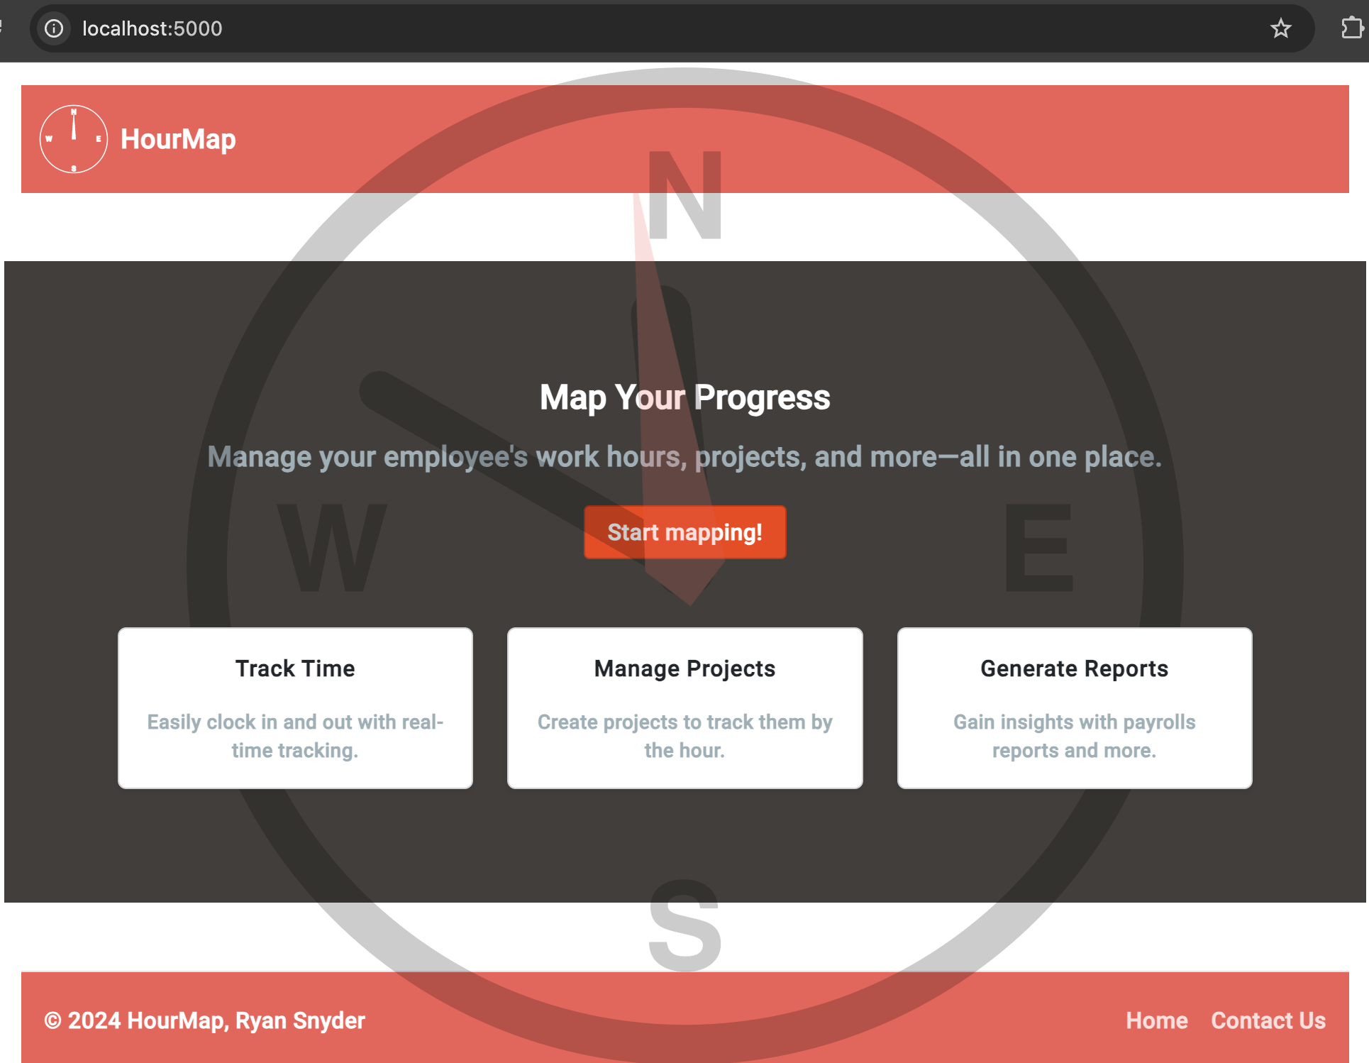
HOURMAP – DEPLOYMENT
Development Environment
Deployed locally and ready to test!

Slide 8

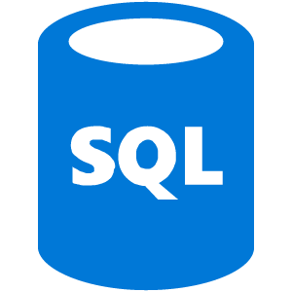
02 – PRODUCTION ENVIRONMENT
HOURMAP – DEPLOYMENT
There are two primary components to the HourMap production environment:
Azure App Services
“…an HTTP-based service for hosting web applications, REST APIs, and mobile back ends.”
Azure SQL Database
“…platform as a service (PaaS) database engine that handles most of the database management functions”
Microsoft Learn - Azure App Services
Microsoft Learn - Azure SQL Database
Where we deploy our compiled code.
Where we host our database.

Slide 9
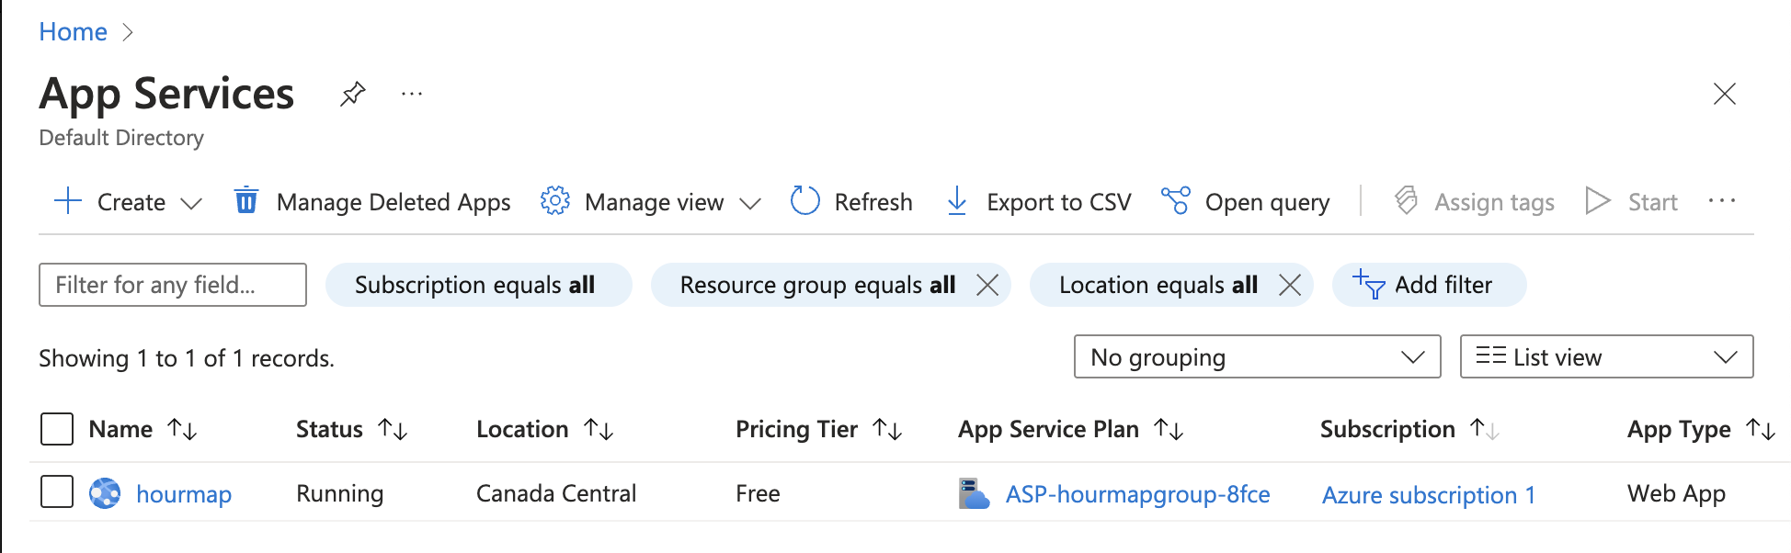
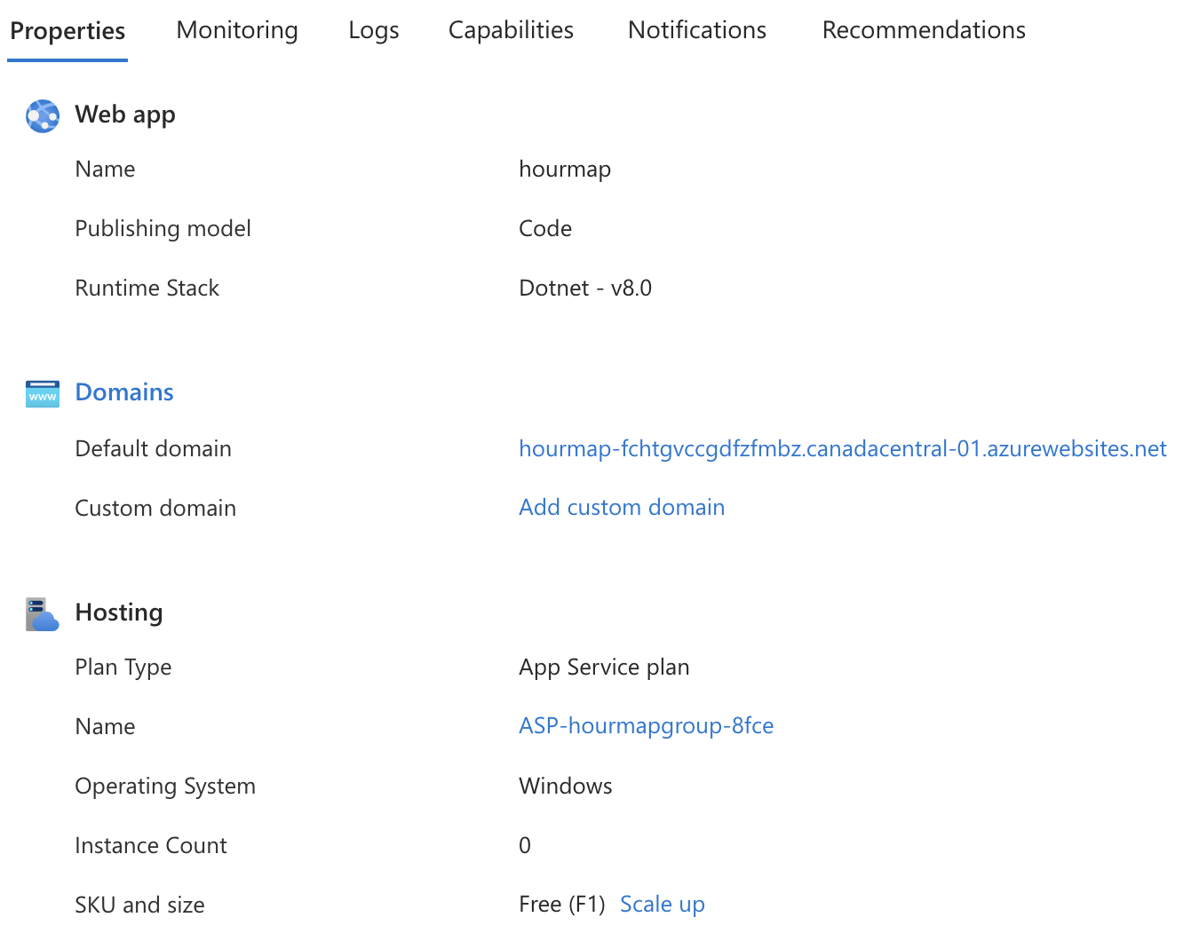
HOURMAP – DEPLOYMENT
Production Environment
App Services allow us to centrally manage our web app’s production environment without setting up the networking, patching servers, or worrying about backups. Since this is a student project, and not expecting a thousand visitors a day, the free tier of this services was a great choice.

Slide 10
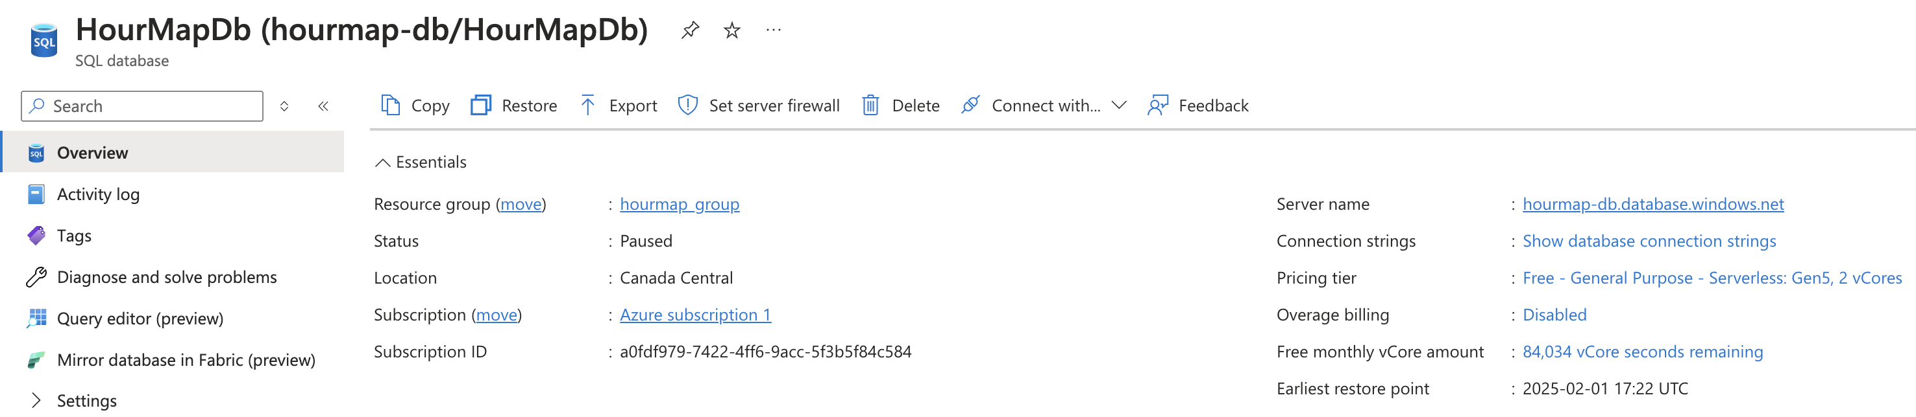
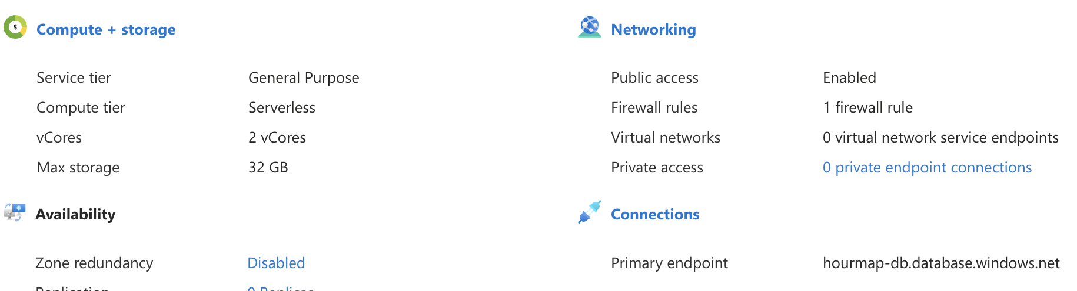
HOURMAP – DEPLOYMENT
Production Environment
Azure SQL Server is the same premise. We can create databases instantly, no need to spin up a VM or worry about patching. There’s free time available, and an auto-pause feature if you don’t want to incur costs after it runs out.

Slide 11

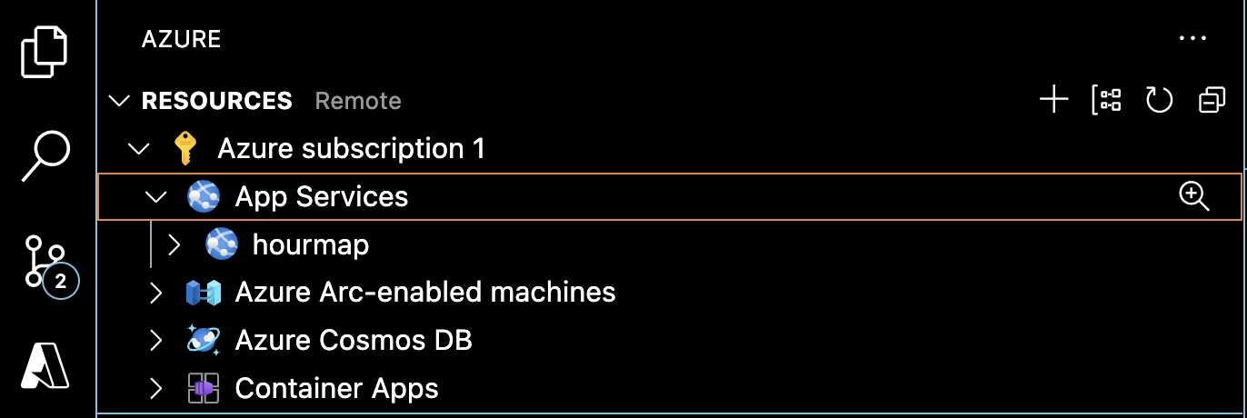
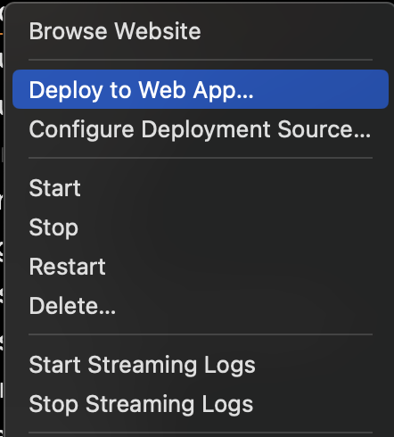
HOURMAP – DEPLOYMENT
Production Environment
There’s also an extension for VS Code where you can deploy your app directly to Azure App Service via your development environment or terminal.
Once the resource is created, managing it via VS Code is simple as right clicking and choosing what you want to do. For automation we use the CLI interface to the API instead.

Slide 12
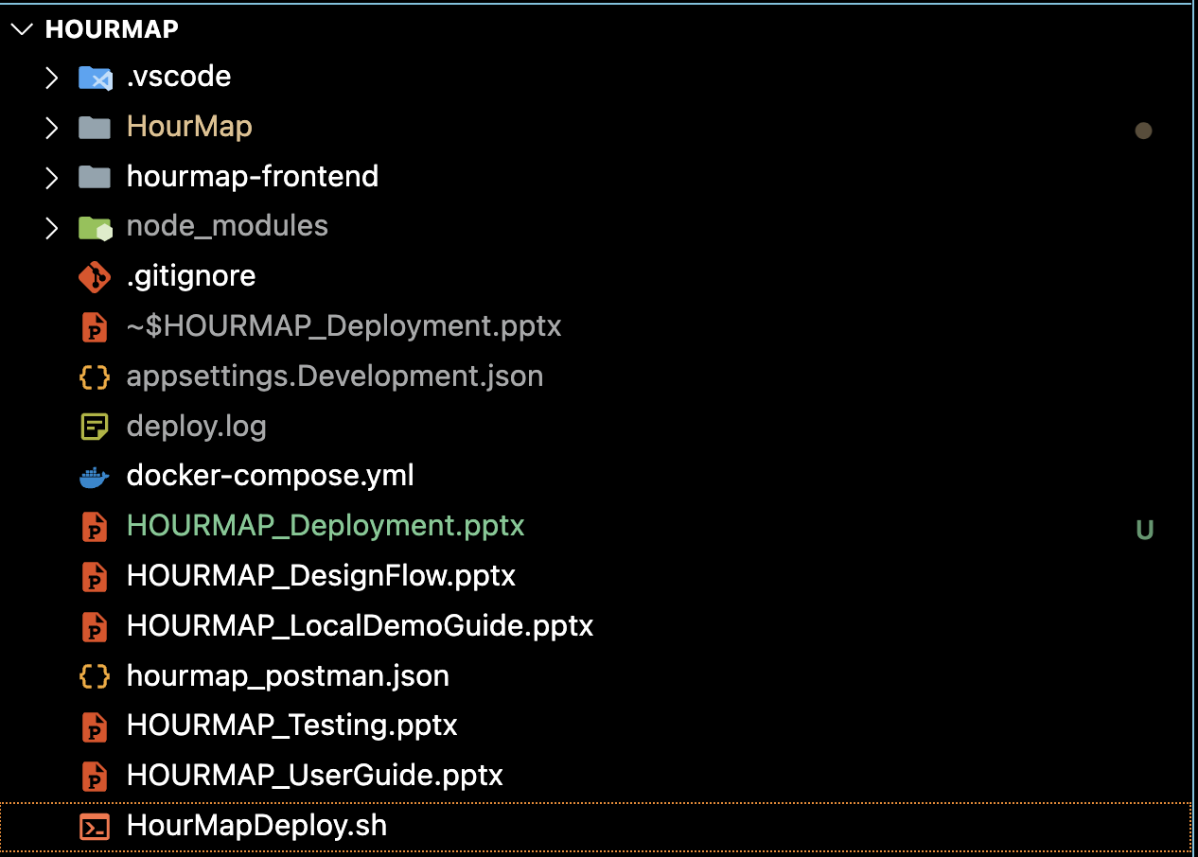
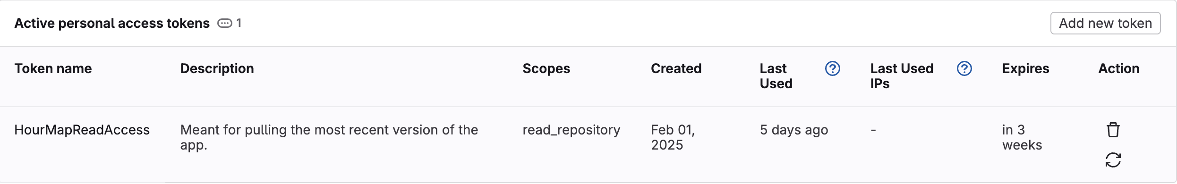
HOURMAP – DEPLOYMENT
Production Environment
Automating our deployment is done via a bash script like our local deployment, but with more setup required.
Special environment variables are created and stored within our shell that need to be exported for the script to work correctly. As well as a personal access token on GitLab.

Slide 13
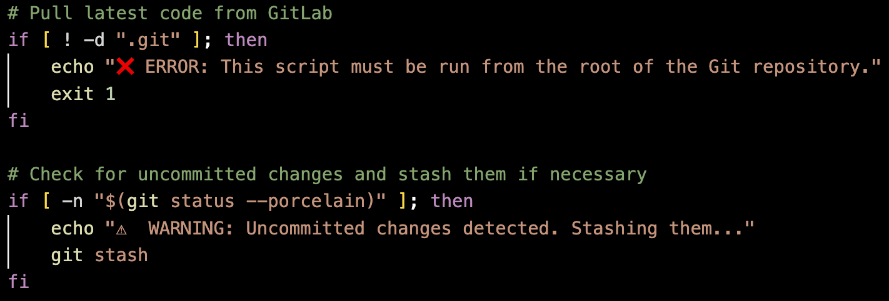
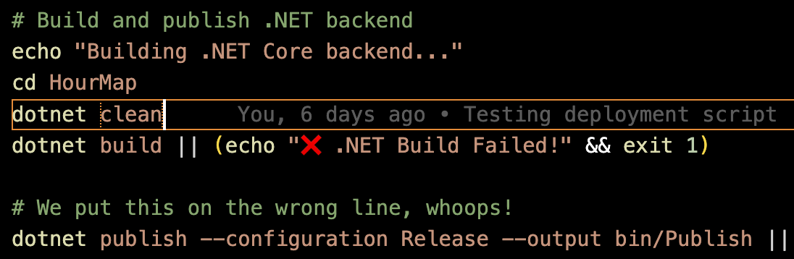
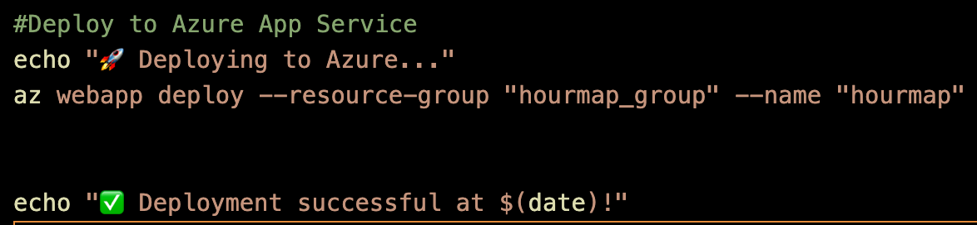
HOURMAP – DEPLOYMENT
Production Environment
The deployment script does several things…
1. Pulls the latest code from GitLab, stashing any changes that haven’t been committed yet.
This script should only be run after testing in the development environment using the docker SQL server!
2. Builds the ASP.NET backend and then publishes it to the Publish folder for deployment.
3. Deploys the built web app to Azure Web Service for hosting!

Slide 14
HOURMAP – DEPLOYMENT
Production Environment
The deployment script does several things…
1. Pulls the latest code from GitLab, stashing any changes that haven’t been committed yet.
This script should only be run after testing in the development environment using the docker SQL server!
2. Builds the ASP.NET backend and then publishes it to the Publish folder for deployment.
3. Deploys the built web app to Azure Web Service for hosting!

Slide 15
03 – SUMMARY
HOURMAP – DEPLOYMENT
Azure App Services is used because of its ease of deployment, management, and affordability. If the need ever arises to scale this app up, creating new instances would be a button push and a few dollars away.
Azure SQL Database is used for similar reasons, as well as the ability to automatically pause a database when it reaches max allowances to prevent a crazy PaaS bill from showing up. Docker allows us to simulate this environment easily on our local machine.
BASH scripts allow seamless local test deployments and production deployments once ready utilizing environment variables and Azure’s App Service API and VS Code toolbox.
All these technologies are free, have a free tier, or allow us to stay within a free usage with little setup. Making them a perfect choice for web app with a light user base or a portfolio project.

Slide 16
04 – REFERENCES
HOURMAP – DEPLOYMENT
Microsoft. (2024, 09 12). What Is Azure SQL Database? Retrieved from Microsoft Learn: https://learn.microsoft.com/en-us/azure/azure-sql/database/sql-database-paas-overview?view=azuresql
Microsoft. (2025, 01 24). App Service Overview. Retrieved from Microsoft Learn: https://learn.microsoft.com/en-us/azure/app-service/overview

Slide 17
THANK YOU
HOURMAP – DEPLOYMENT
resnyd81@wgu.edu
Ryan Snyder
011535988

