Slide 1

D424 Software Engineering Capstone (Hourmap)
HOURMAP
Testing Using Postman
Ryan Snyder
011535988

Slide 2
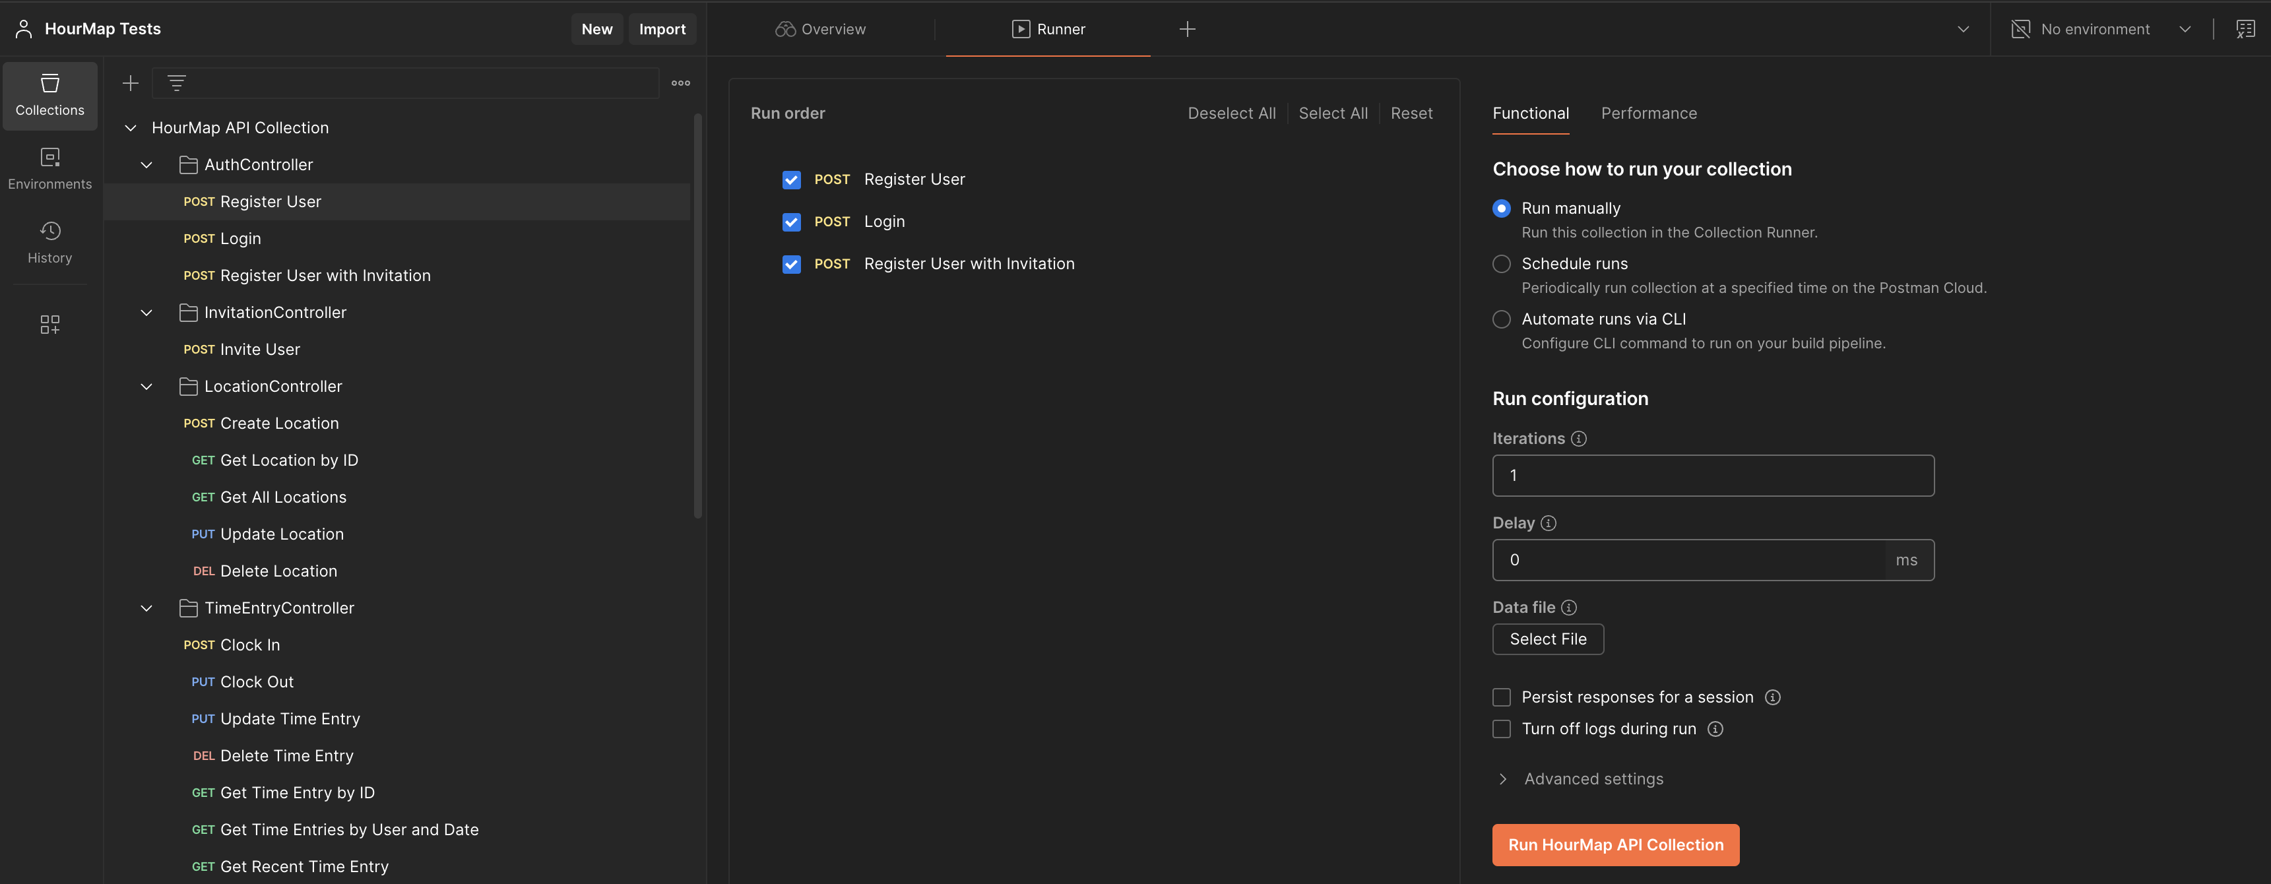
HOURMAP
Testing Using Postman
All testing of the API was conducted utilizing Postman, an application made for the testing, diagraming, and building of APIs. See: Postman

Slide 3
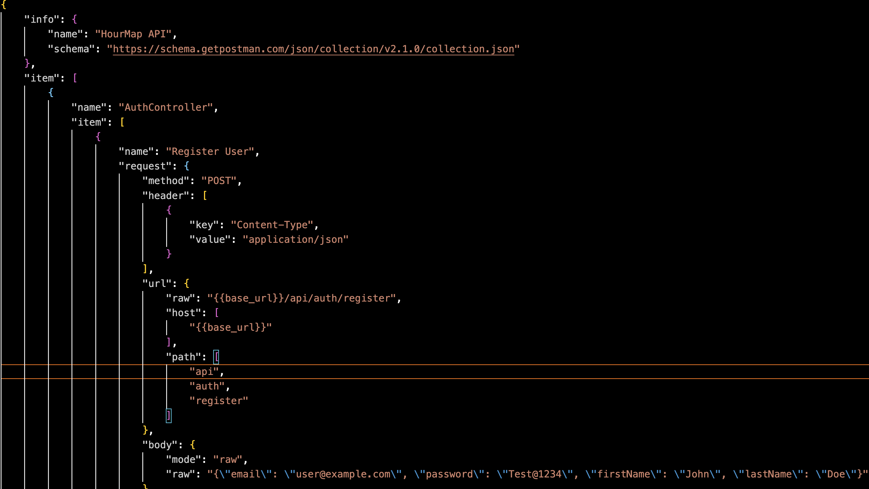
HOURMAP
Testing Using Postman
We define the controllers within a JSON document, along with the body to send, and expected results.

Slide 4
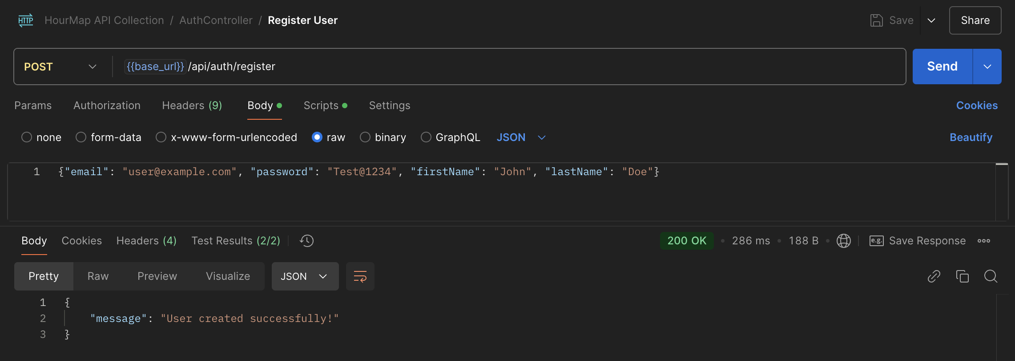
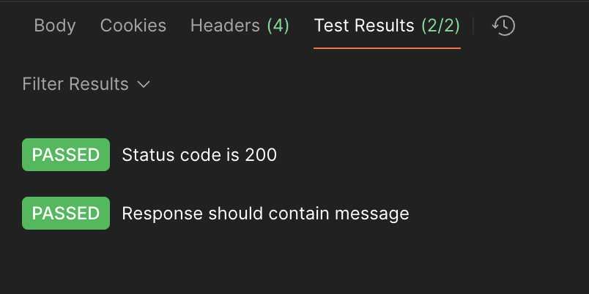
HOURMAP
Testing Using Postman
Once, imported, you can specify environment variables such as the base URL, and set up “runs” for testing individual controllers. Here is “register” passing both of our predefined checks.

Slide 5
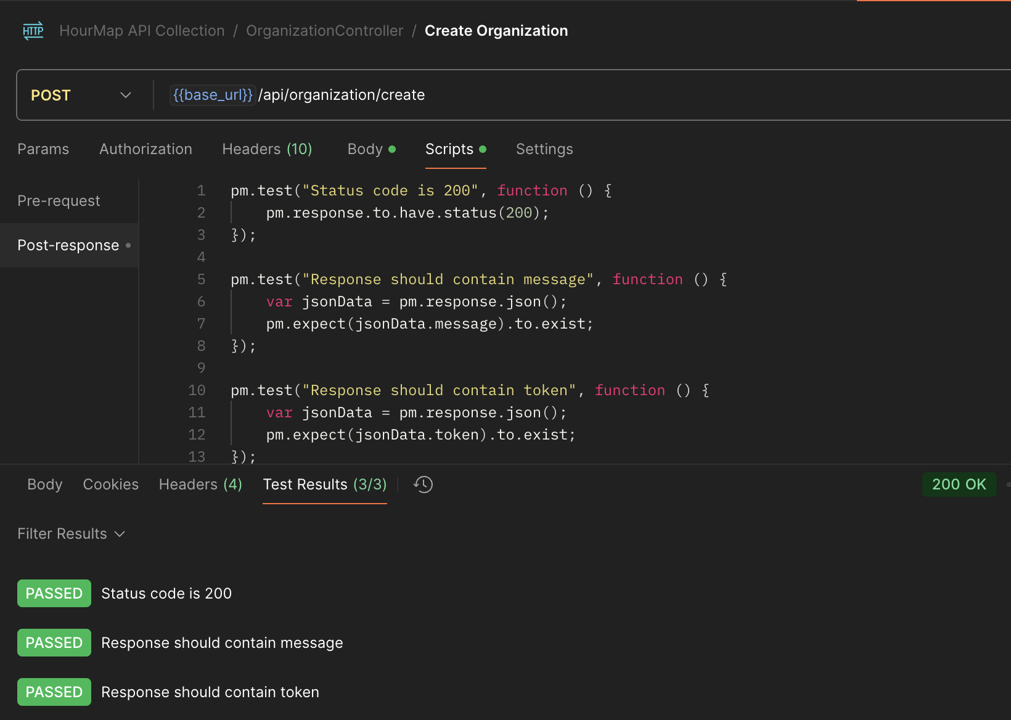
HOURMAP
Testing Using Postman
Another test, for the Organization Controller. The response should be OK 200, contain a success message, and a token for session refresh.

Slide 6
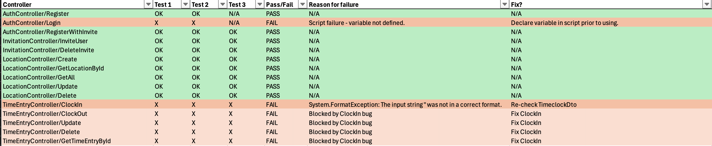
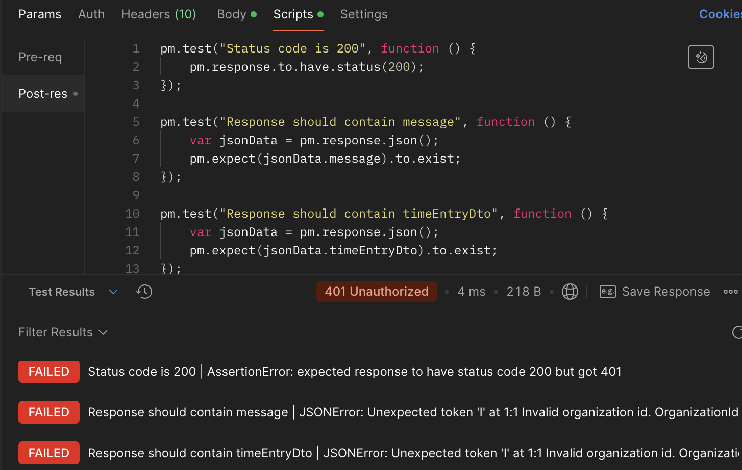
HOURMAP
Testing Using Postman
We track each test according to pass rate for each test. A single failure means the API endpoint needs to be looked at again and investigated. Tracking down the time entry clock in bug, we can see that the token claims didn’t include an organization ID like it was supposed to.

Slide 7
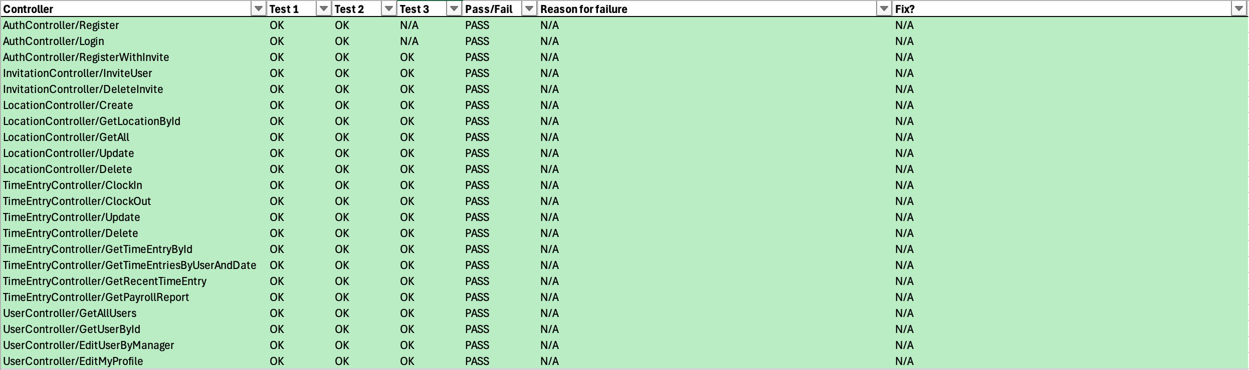

HOURMAP
Testing Using Postman
Once bugs are tracked down and fixed, we can enjoy the nice shade of green success!
Testing with Postman helps catch errors early and encourages taking time to develop each API endpoint correctly! This gives us a better product overall.

Slide 8
THANK YOU
HOURMAP
resnyd81@wgu.edu
Ryan Snyder
011535988

