Slide 1

D424 Software Engineering Capstone (Hourmap)
HOURMAP
UML and Example Flow Diagrams
Ryan Snyder
011535988

Slide 2
HOURMAP
Table of Contents
1. ASP.NET ENTITIES AND CLASSES …3
2. ANGULAR COMPONENTS AND MODELS …7
3. EXAMPLE FLOW DIAGRAMS …12

Slide 3
01 - ASP.NET Entities and Classes
HOURMAP
HourMap’s backend was built using ASP.NET for the API and Identity management, and Entity Framework for database connections and management.
Controllers
Entities
Helpers
Handle HTTP requests and the resulting data.
The structure of the data being handled by the controllers.
Handle token generation and build out database.

Slide 4
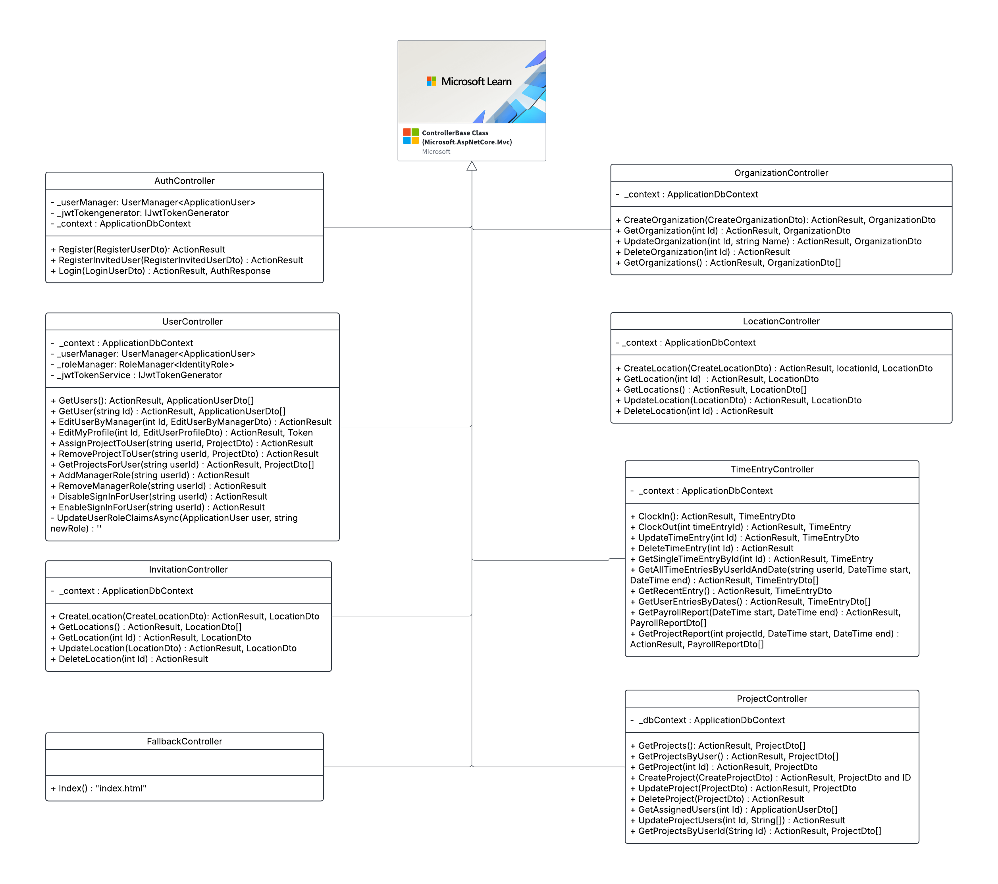
HOURMAP
Controllers
ASP.NET MVC ControllerBase

Slide 5
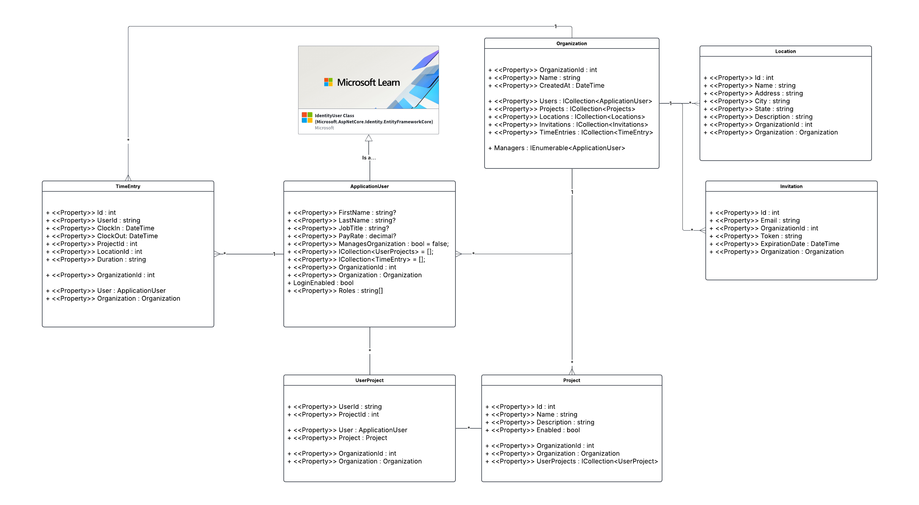
HOURMAP
Entities
ASP.NET IdentityUser

Slide 6
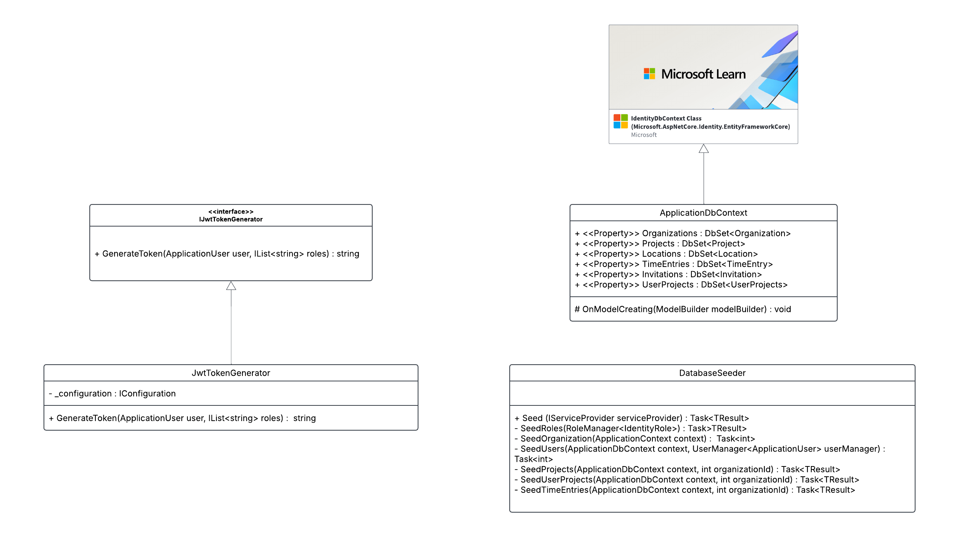
HOURMAP
Helpers
ASP.NET IdentityDbContext

Slide 7
02 - Angular Components and Models
HOURMAP
HourMap’s frontend was built using Angular and TypeScript. It includes models, services, components, interceptors, and guards.
Models
Services
Components
Interceptors
Guards
The structure of the data being handled by the services and components
Handle communication with backend controllers.
“Pages” of the Angular webapp, all have different logic for handling data delivered from Angular services.
Intercept service traffic to inject objects (like an auth token) or catch responses (like a 401 error).
Block access depending on set parameters, in our case Roles. EX: Logged out users can’t access clock in component.

Slide 8
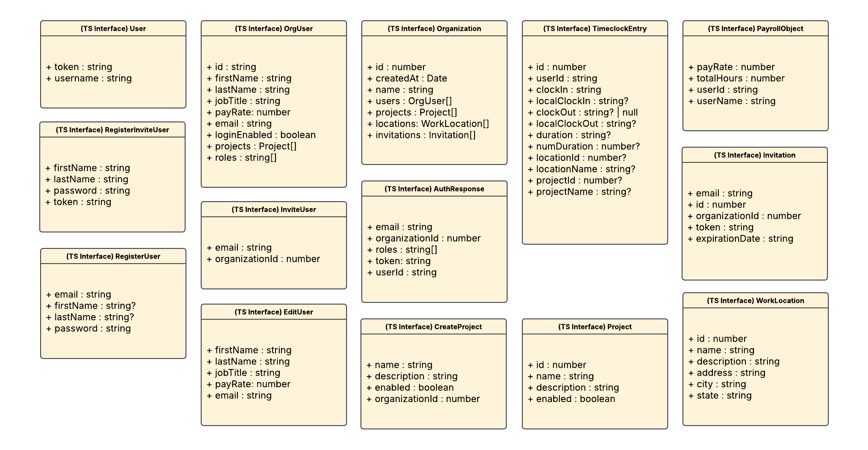
HOURMAP
Models

Slide 9
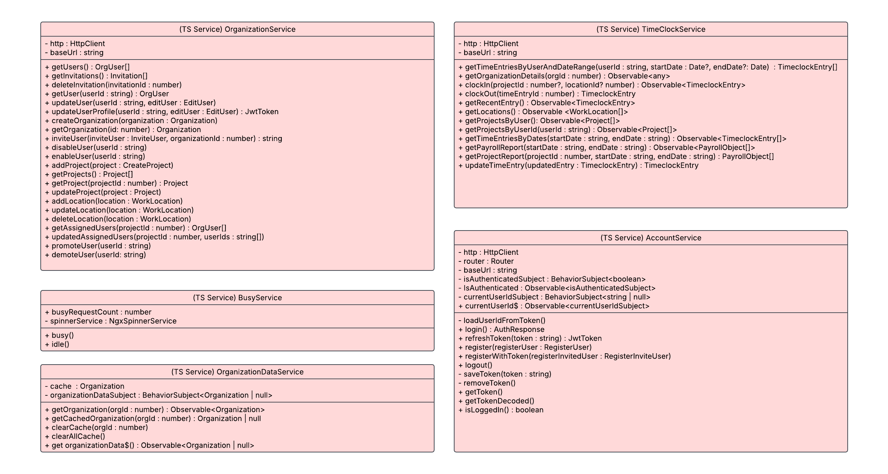
HOURMAP
Services

Slide 10
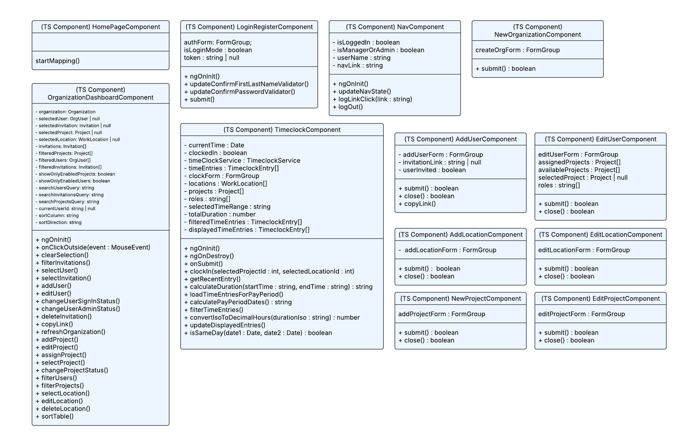
HOURMAP
Components Pt. 1

Slide 11
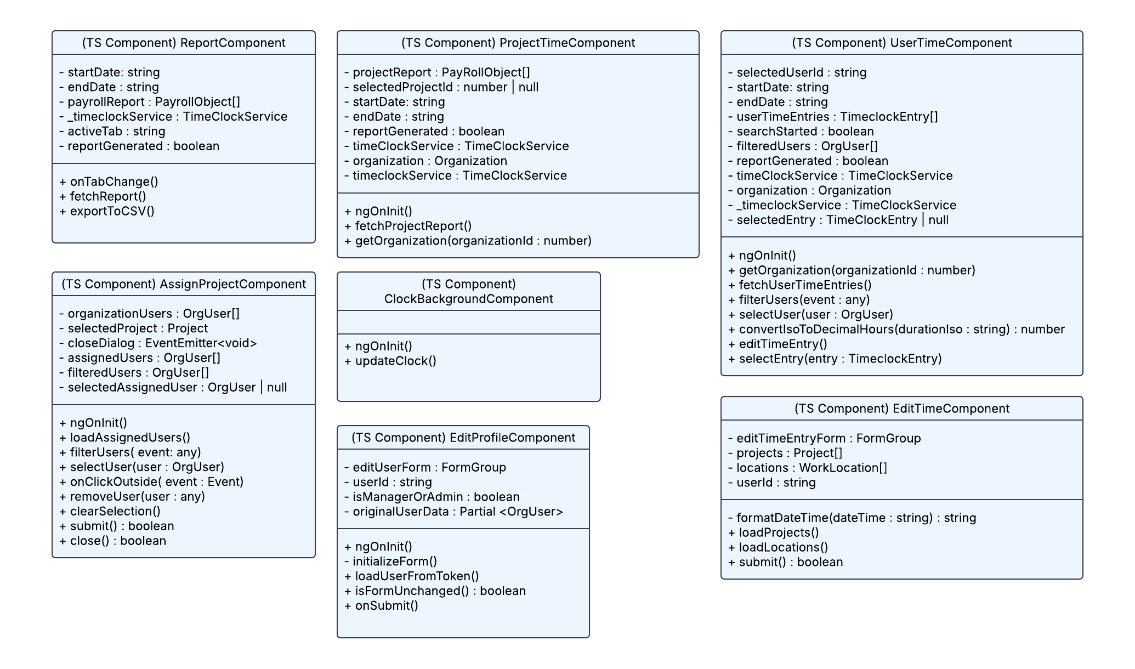
HOURMAP
Components Pt. 2

Slide 12
03 - EXAMPLE FLOW DIAGRAMS
HOURMAP
Components from Angular utilize TypeScript services to communicate with our ASP.NET backend and SQL database.
Angular Component
Services
Controllers
The Database
The user interacts with this component directly, like a view.
The connection from our frontend to the backend.
The backend API! Always listening.
Where we store everything that needs to be utilized.

Slide 13
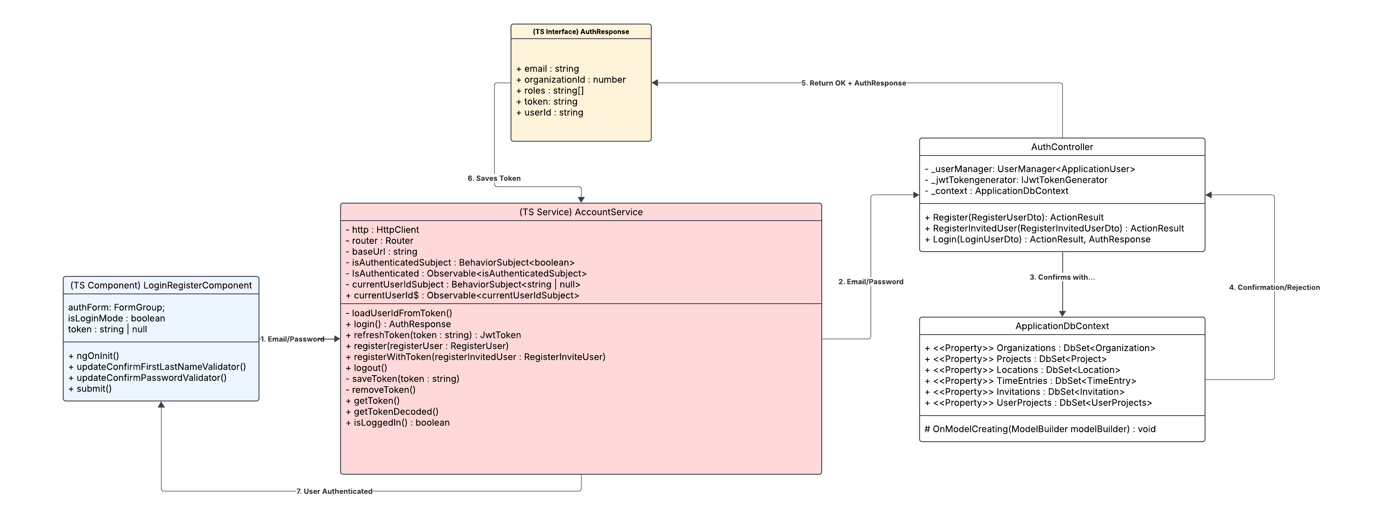
HOURMAP
Example Flow – User login

Slide 14
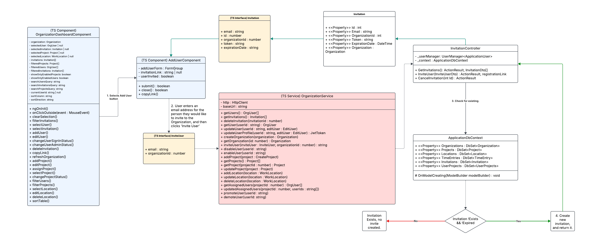
HOURMAP
Example Flow – Invite new user

Slide 15
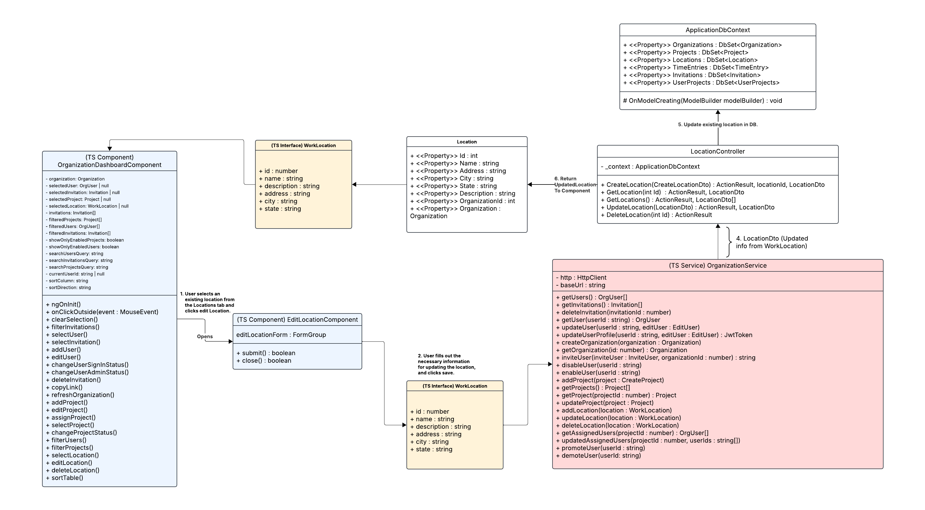
HOURMAP
Example Flow – Edit existing location

Slide 16
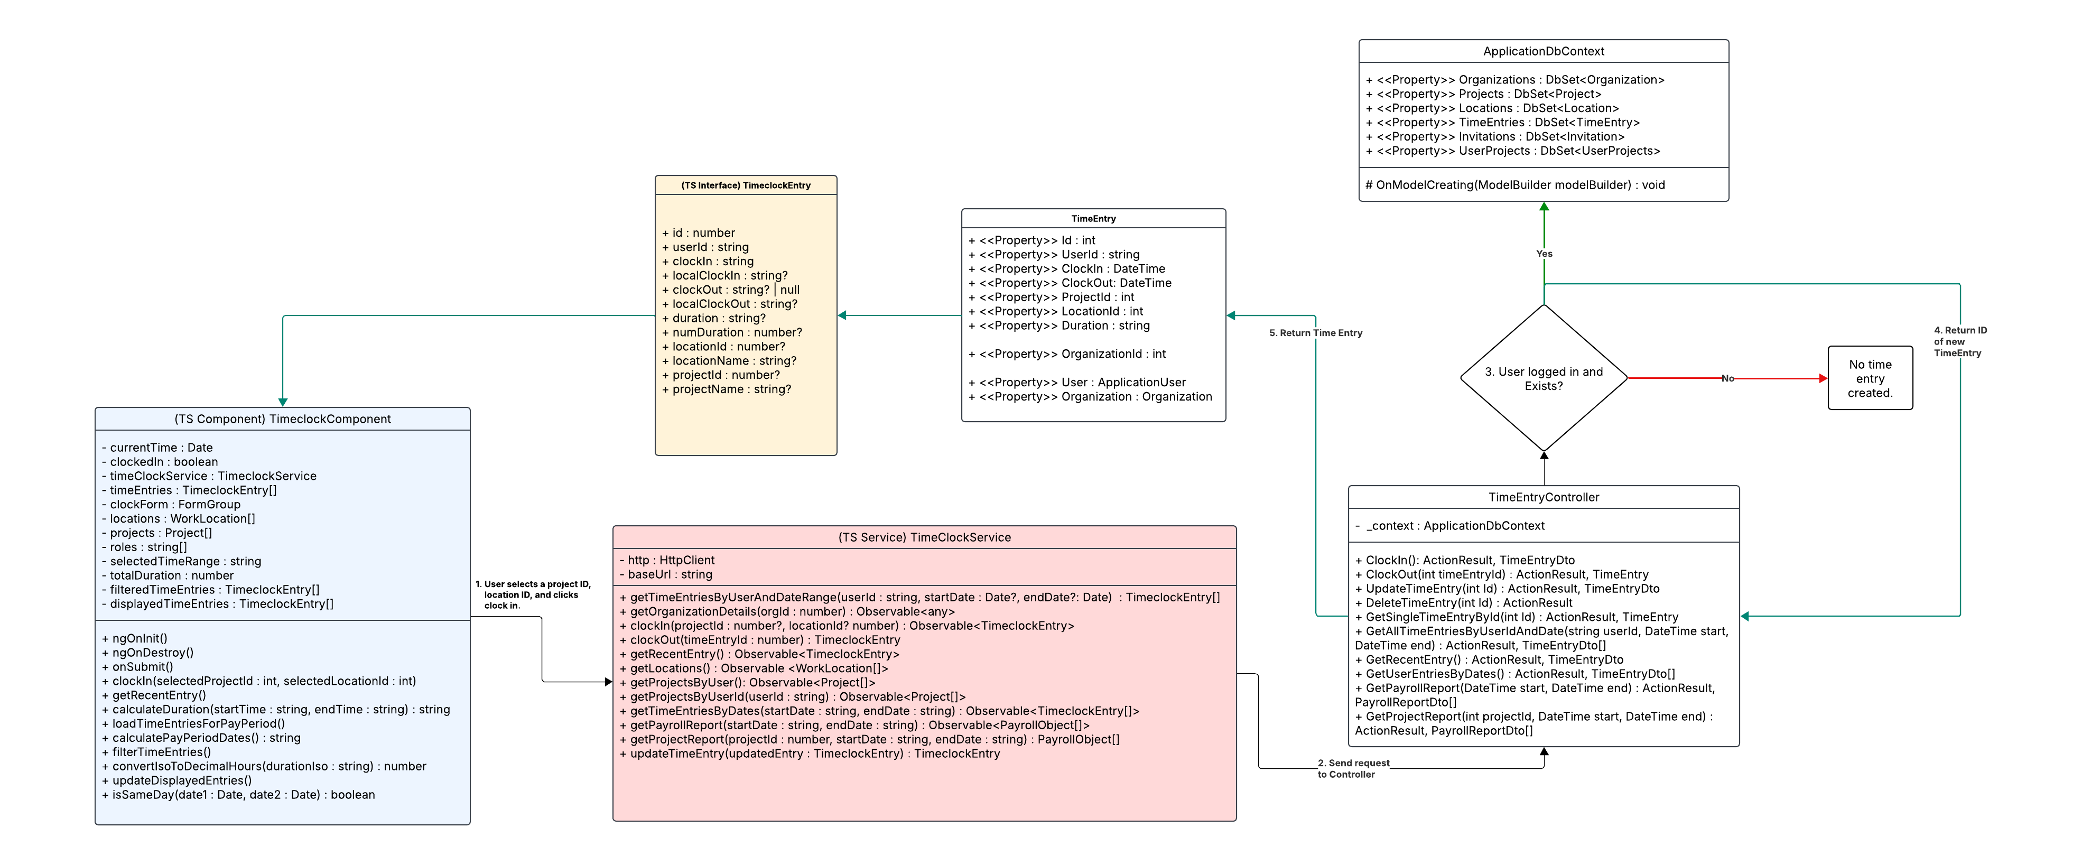
HOURMAP
Example Flow – User clock in

Slide 17
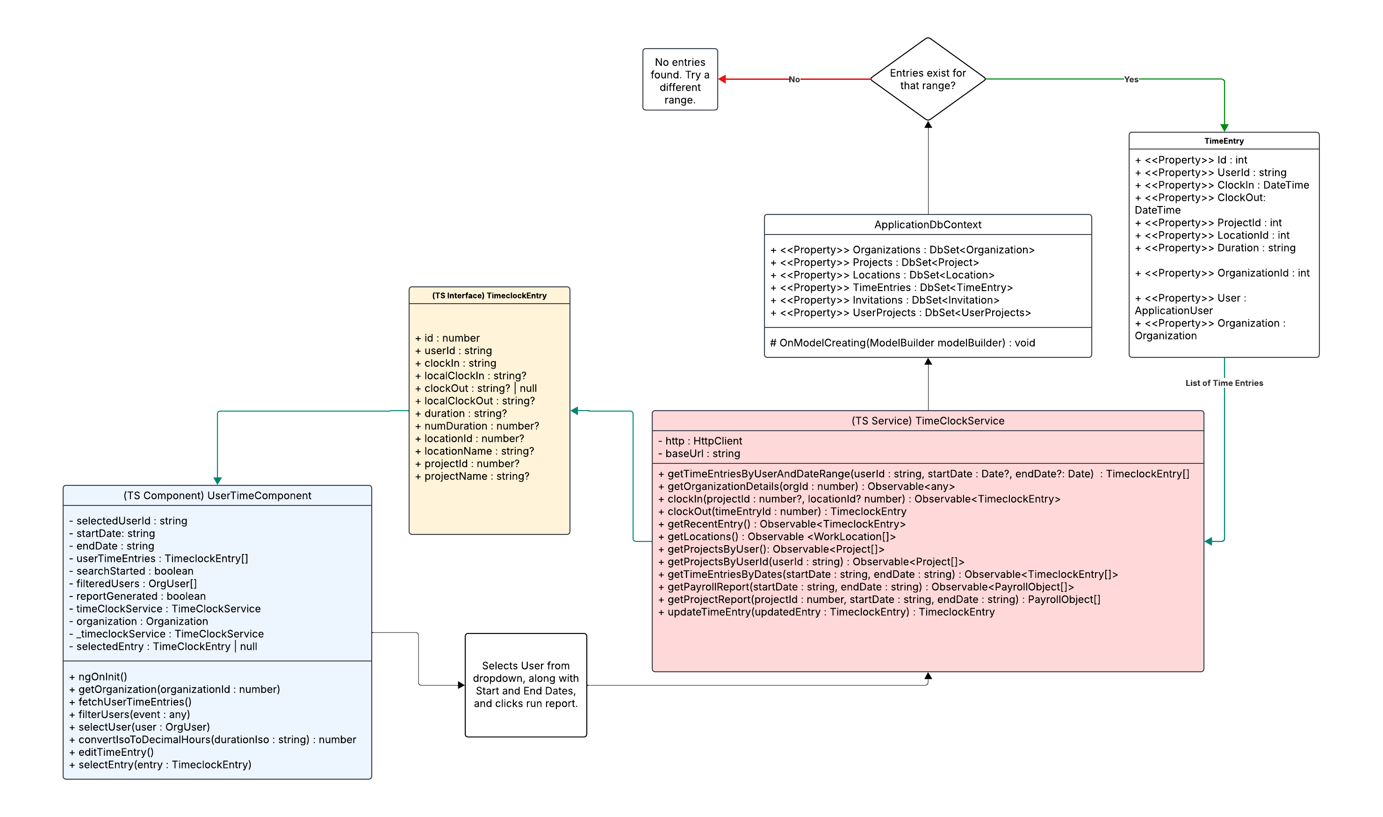
HOURMAP
Example Flow – Pull user time entries

Slide 18
THANK YOU
HOURMAP
resnyd81@wgu.edu
Ryan Snyder
011535988

