Slide 1

D424 Software Engineering Capstone (Hourmap)
HOURMAP – DEPLOY LOCAL DEMO
Local Demo Guide
Note : This guide assumes the latest build has been pulled from GitLab here.
Ryan Snyder
011535988

Slide 2
HOURMAP – DEPLOY LOCAL DEMO
Table of Contents
1. MODIFYING DOCKER COMPOSE (SQL) …3
2. SETTING CONNECTION STRINGS …5
4. THE LOCAL DEPLOY SCRIPT …12
5. LOGGING IN WITH DEMO ACCOUNT …15

Slide 3
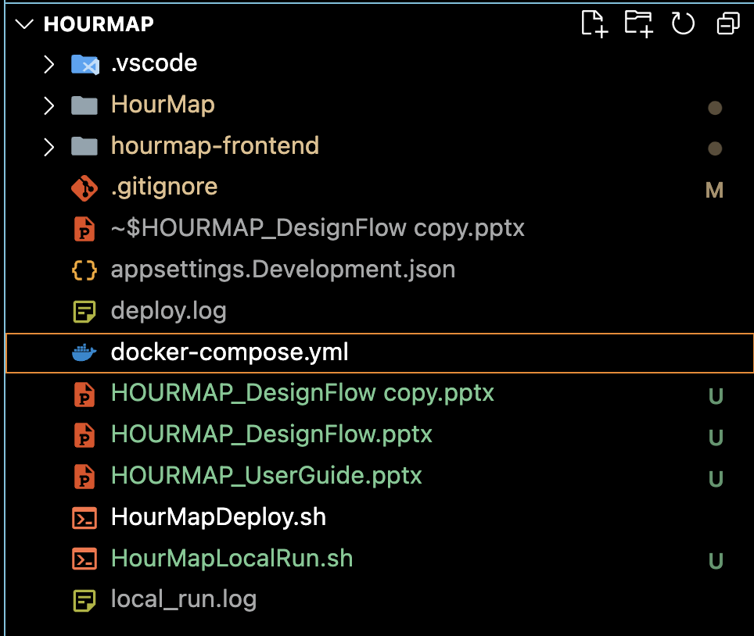
01 – MODIFYING DOCKER COMPOSE (SQL)
HOURMAP – DEPLOY LOCAL DEMO
HourMap relies on SQL server to store and retrieve data about an organization. SQL server is not compatible with all operating systems. Please install Docker Desktop by following this guide https://docs.docker.com/desktop/ to ensure system compatibility.
This project includes a docker-compose file to edit for your environment. Please use it!

Slide 4
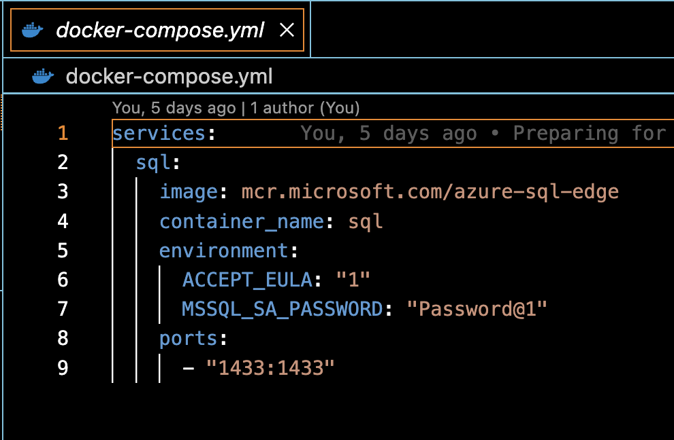
HOURMAP – DEPLOY LOCAL DEMO
Modify Docker Compose
Update the password and ports field to your preference and save the file.
PW: The preferred password for your SQL server.
Port: The external port to connect to the SQL server by.
Note : Production environments should keep these secret by storing them
In a secret server or within environment variables.

Slide 5
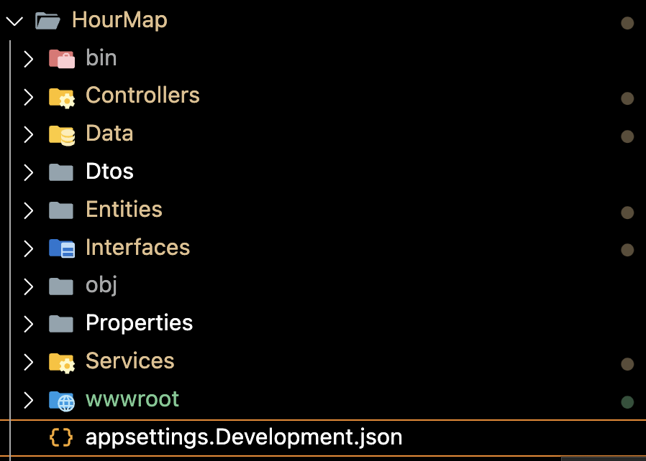
02 – SETTING CONNECTION STRINGS
HOURMAP – DEPLOY LOCAL DEMO
Within the backend ‘HourMap’ folder, create an ‘appsettings.Development.json’ file if it does not already exist.
This file will be used to store DB connection settings and log levels!

Slide 6
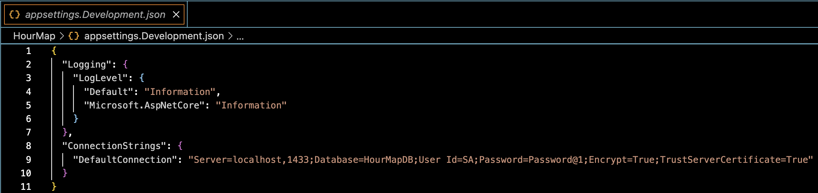
HOURMAP – DEPLOY LOCAL DEMO
Setting Connection Strings
Your file should look like above! Modify the connection string to include the password set in the last step. Save it!
Connection String
"Server=localhost,1433;Database=HourMapDB;User Id=SA;Password={YOURPASSWORD};Encrypt=True;TrustServerCertificate=True"

Slide 7
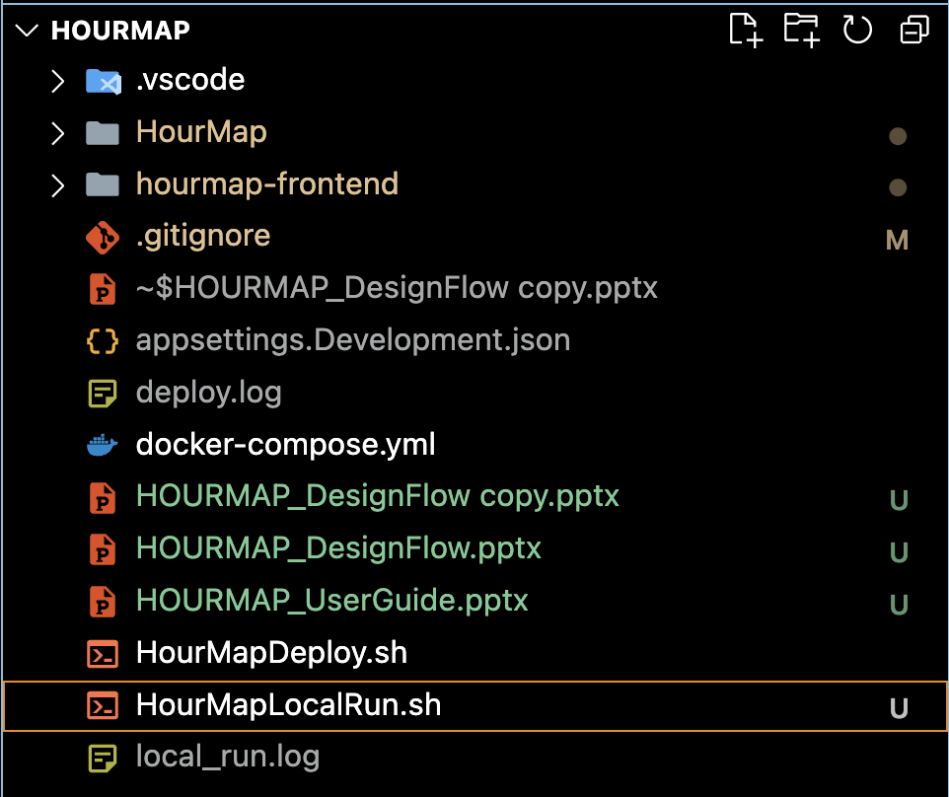
03 – THE LOCAL DEPLOY SCRIPT
HOURMAP – DEPLOY LOCAL DEMO
Within the project folder, in the same directory as your docker-compose file, there is an HourMapLocalRun.sh file. This is our local script!
Bash script for deploying our DB and web app locally.

Slide 8
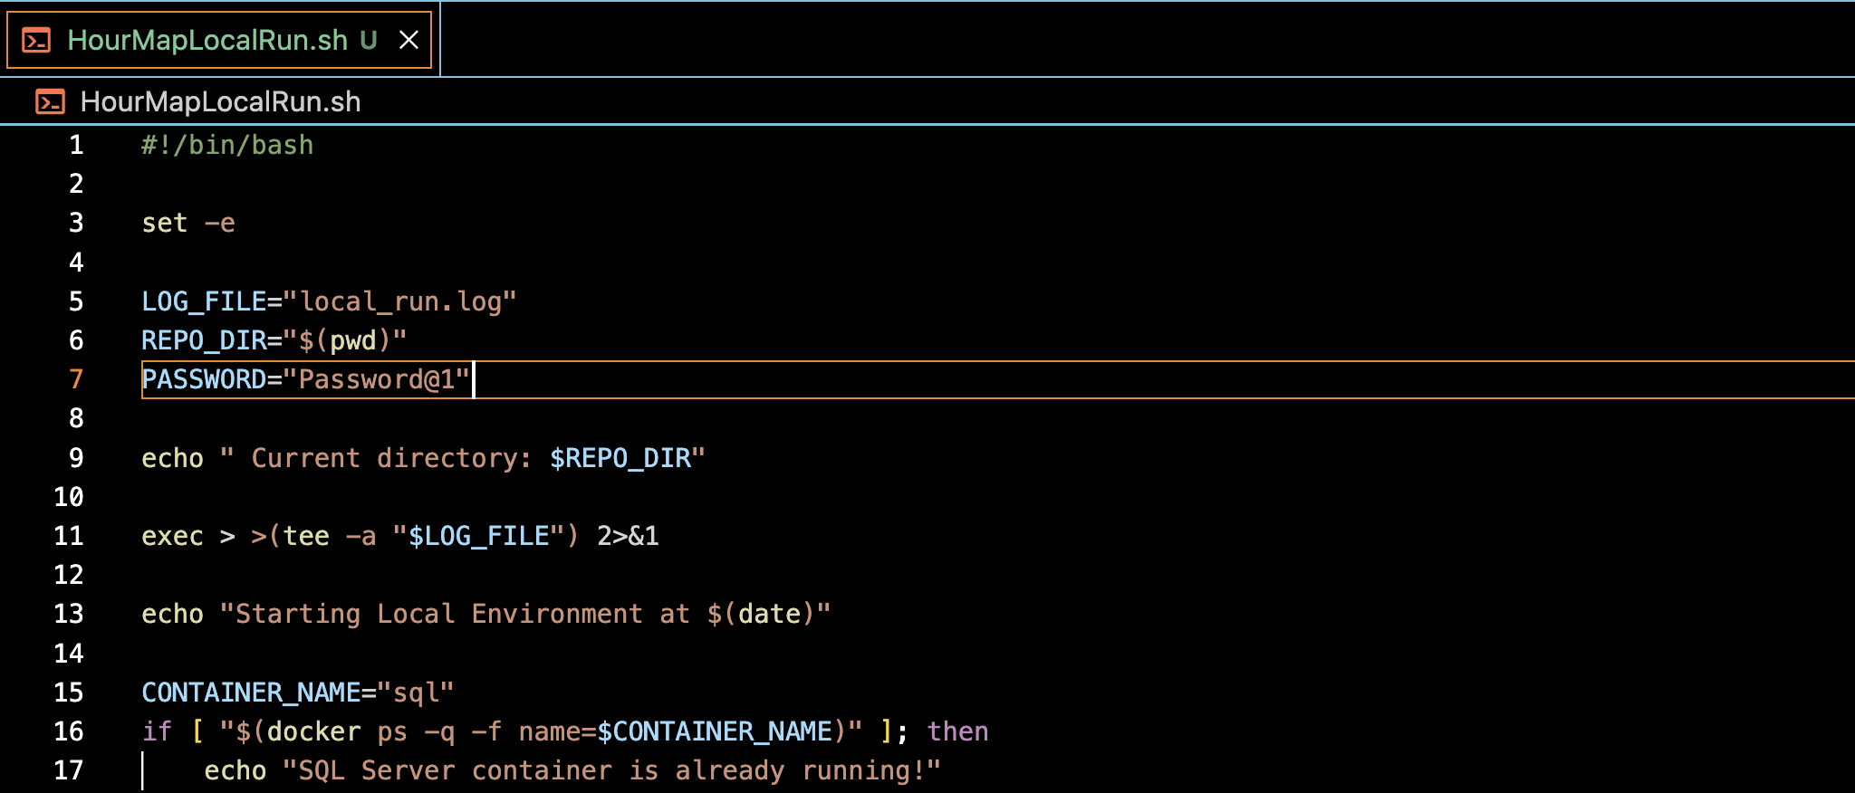
HOURMAP – DEPLOY LOCAL DEMO
The Local Deploy Script
Your file should look like above! Modify the PASSWORD field to include the DB password (or set it as an ENV).
Save the file
Set the file permissions to be executable.
Run it!

Slide 9
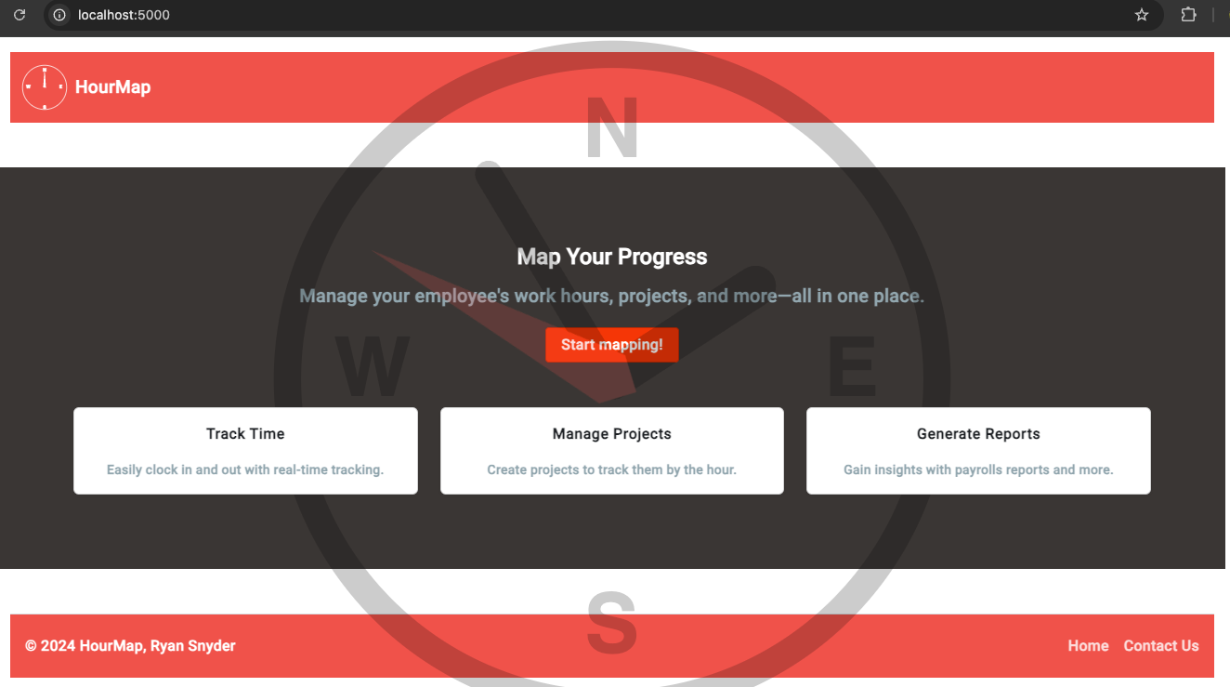
03 – LOGGING IN WITH DEMO ACCOUNT
HOURMAP – DEPLOY LOCAL DEMO
Look for the deploy localhost port at the bottom of the deploy logs to find out where to go!
Navigate there and click on START MAPPING!

Slide 10
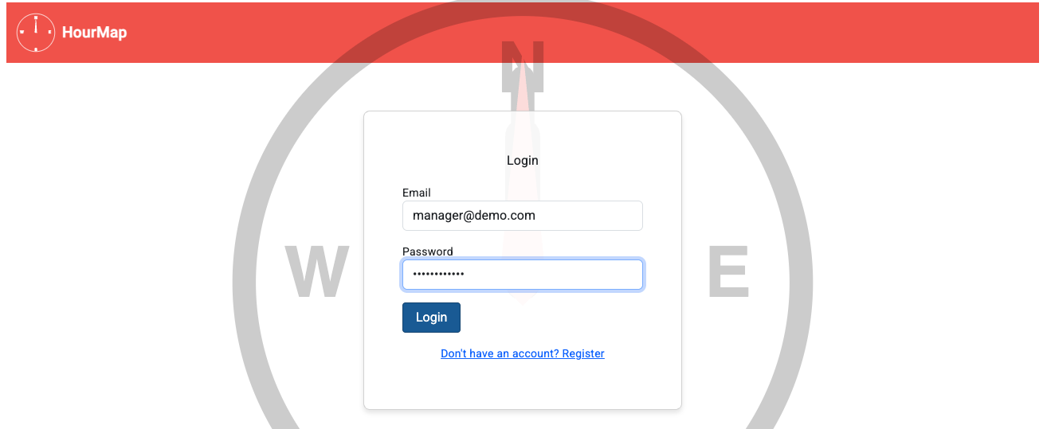
HOURMAP – DEPLOY LOCAL DEMO
Logging In With Demo Account
Demo credentials: Email: manager@demo.com
Password: DemoPass@123

Slide 11
THANK YOU
HOURMAP – DEPLOY LOCAL DEMO
resnyd81@wgu.edu
Ryan Snyder
011535988

