Slide 1

D424 Software Engineering Capstone (Hourmap)
HOURMAP – USER GUIDE
HourMap User Guide
Ryan Snyder
011535988

Slide 2
HOURMAP – USER GUIDE
Table of Contents
1. REGISTERING FOR AN ACCOUNT (NEW ORG) …3
2. ADD A NEW USER TO YOUR ORGANIZATION …8
3. REGISTERING FOR AN ACCOUNT (INVITATION) …12
4. EDIT YOUR PROFILE …15
5. CLOCKING IN/OUT …18
6. MANAGING USER ACCOUNTS …23
7. MANAGING PROJECTS …28
8. MANAGING LOCATIONS …35
9. RUNNING REPORTS …41

Slide 3
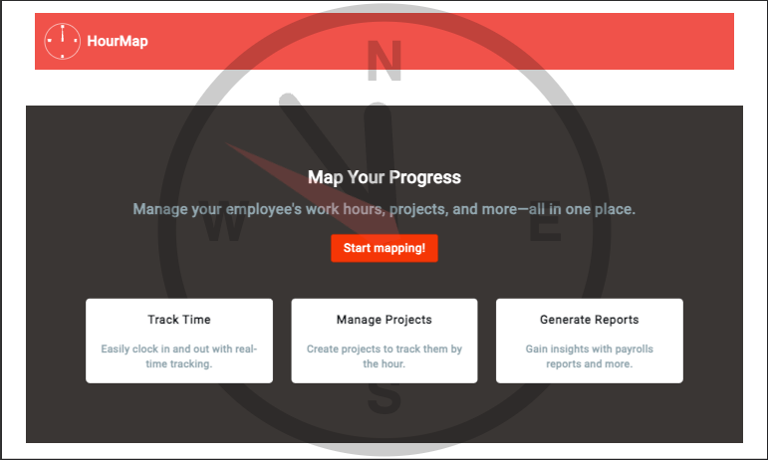
01 – Registering for an account (New org)
HOURMAP – USER GUIDE
One the home page, ’Start Mapping’ will take you to the Login/Register screen if logged out.

Slide 4
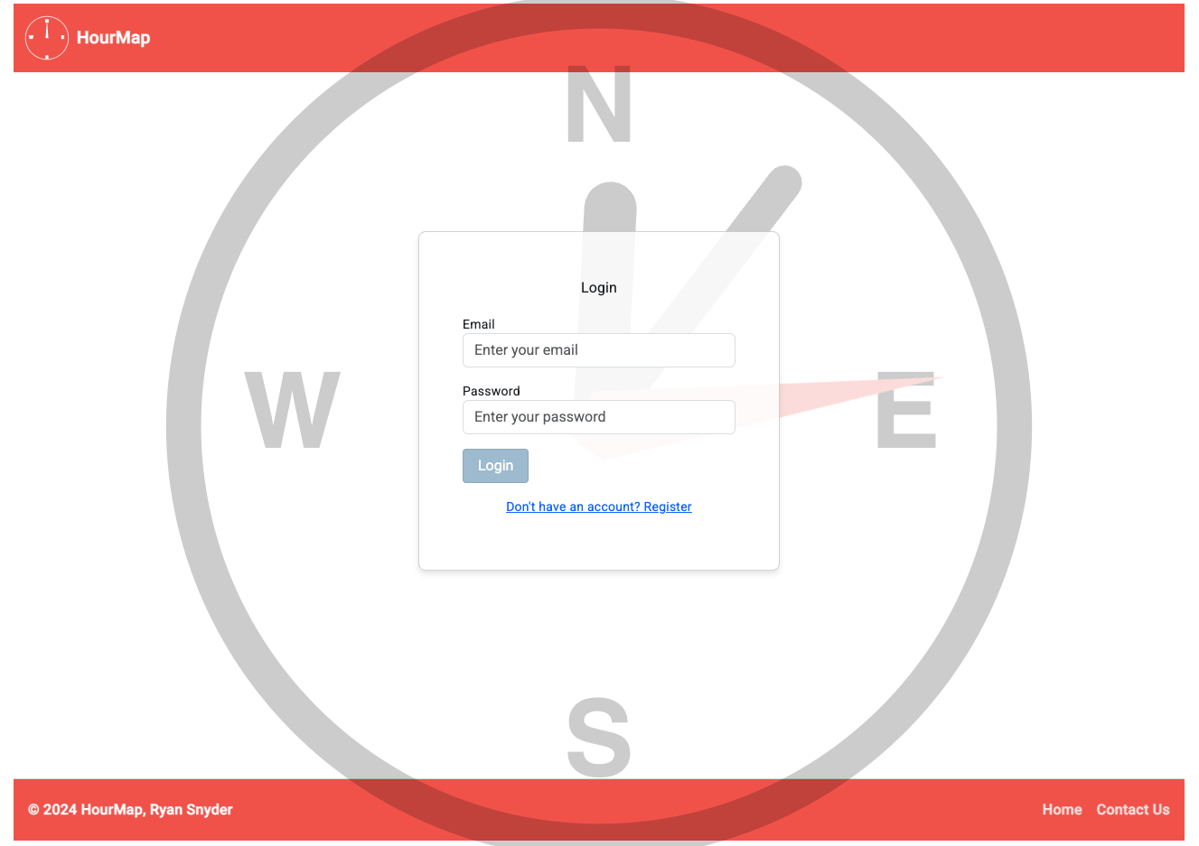
HOURMAP – USER GUIDE
Registering For An Account
Click here to switch to register mode!

Slide 5
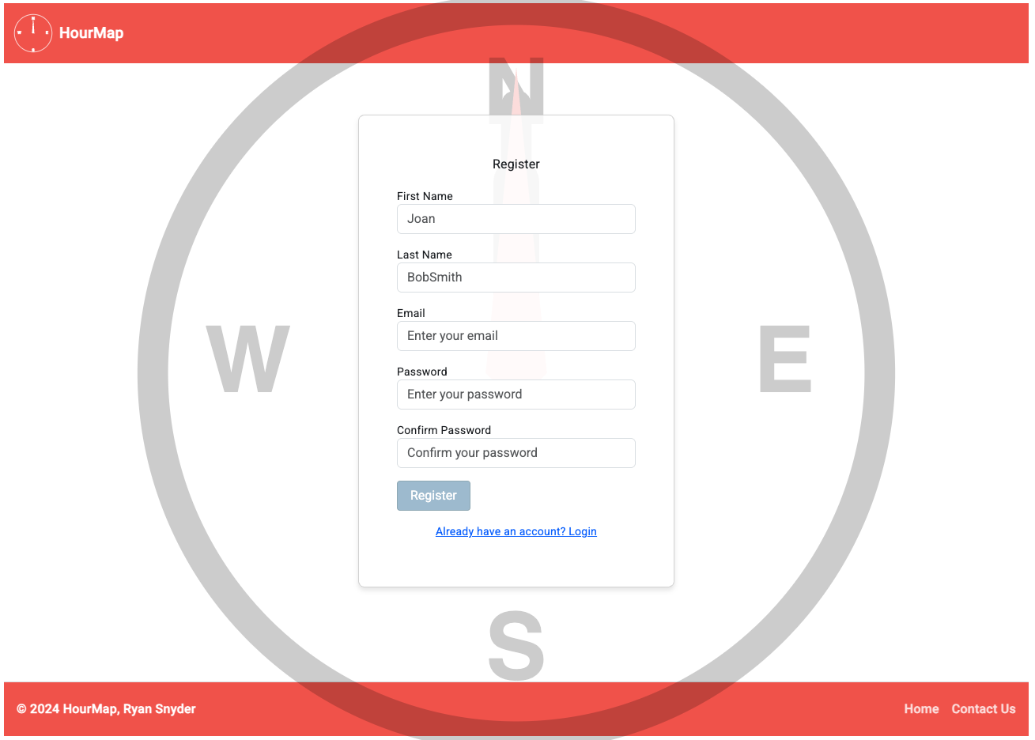
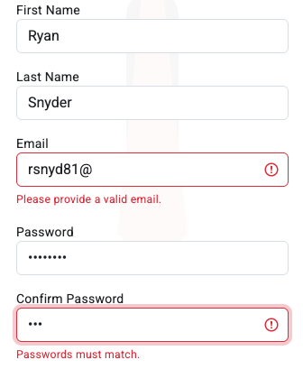
HOURMAP – USER GUIDE
Registering For An Account
Fill out each field according to their label! These are all required, and feedback will be provided if something is missed.

Slide 6
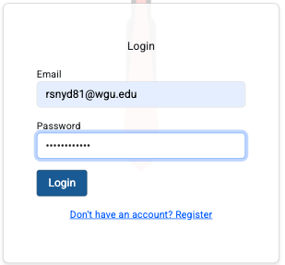
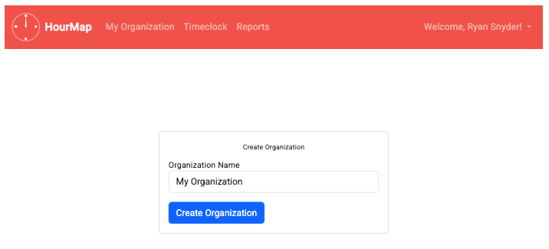
HOURMAP – USER GUIDE
Registering For An Account
Afterward, you’ll be prompted to create your Org!
You’ll be navigated back to the Login fields.

Slide 7
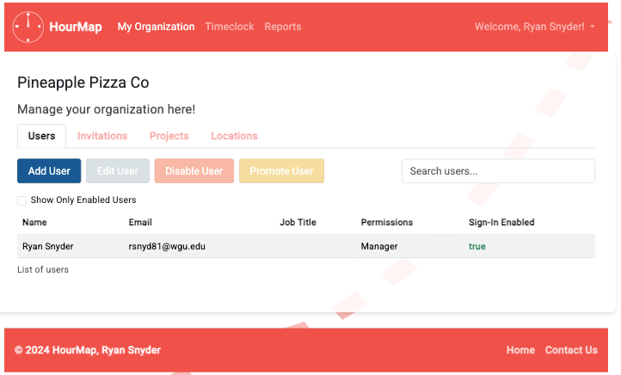
HOURMAP – USER GUIDE
Registering For An Account
Welcome to your new dashboard!

Slide 8
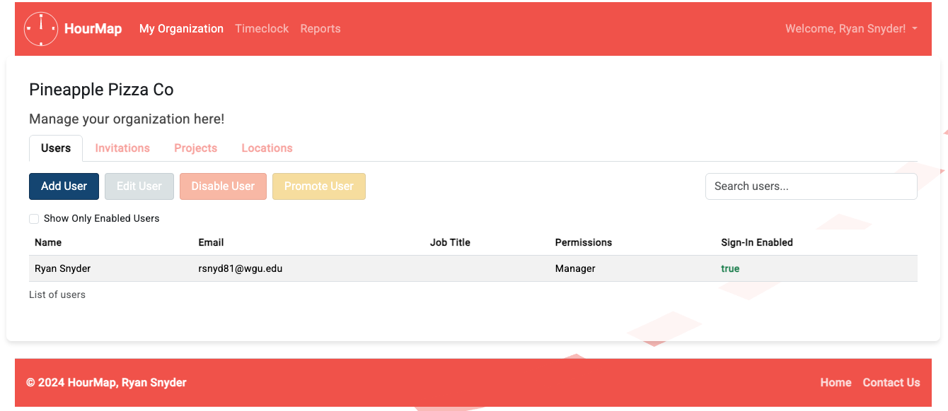
02 – ADDING A NEW USER TO YOUR ORG
HOURMAP – USER GUIDE
Let’s add a new user by clicking ‘Add User’ on the Users tab in your Organization Dashboard.

Slide 9
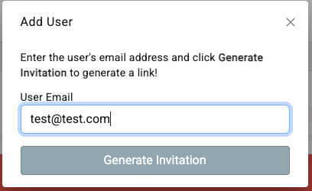
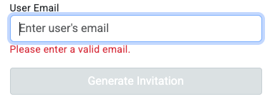
HOURMAP – USER GUIDE
Adding A New User
Enter the email of the user you’d like to invite, and click ‘Generate Invitation’

Slide 10
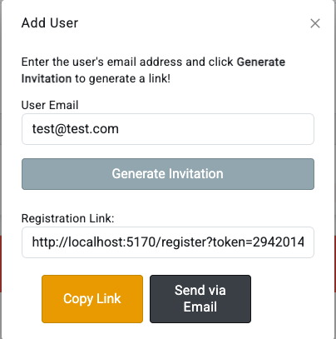
HOURMAP – USER GUIDE
Adding A New User
A registration link will be generated for you to send to the user. Either copy the link or click ‘Send via Email’ to use your local email application!

Slide 11
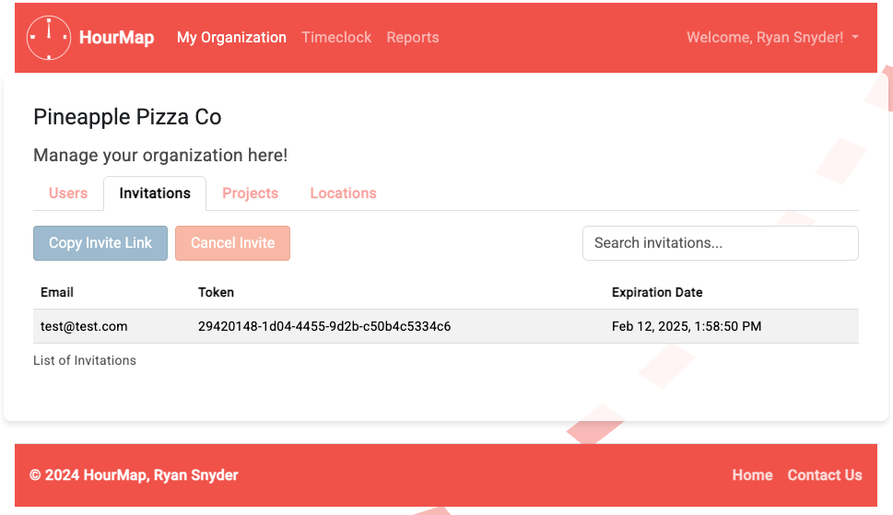
HOURMAP – USER GUIDE
Adding A New User
You can view your created invitations on the ‘Invitations’ tab and can copy the invite link or cancel the invitation here at any time.
Invitations expire after a week of not being accepted!

Slide 12
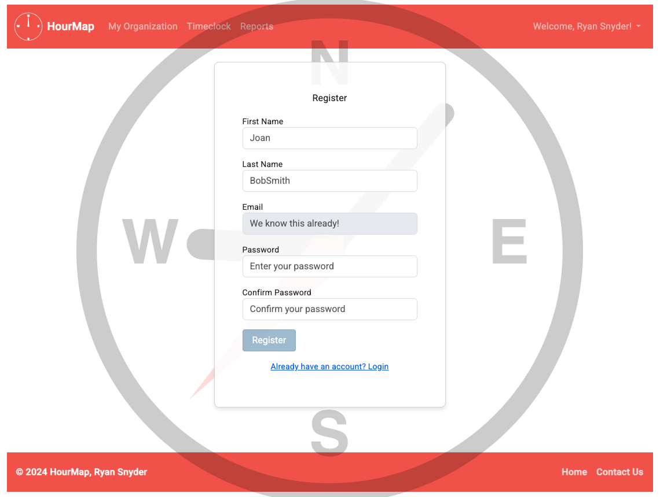
03 – Registering for an account (INVITED)
HOURMAP – USER GUIDE
Navigate to the URL provided by the Organization you’ve been invited to, and you’ll be greeted by a special registration form!

Slide 13
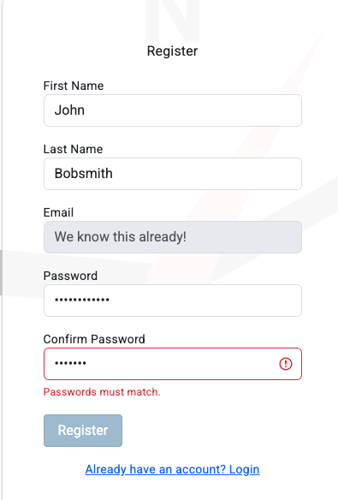
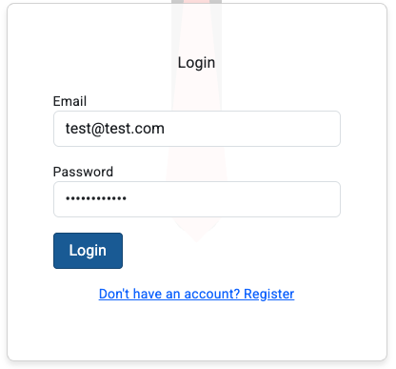
HOURMAP – USER GUIDE
Registering For An Account (Invited)
Make sure your passwords match and your name is properly entered, or you won’t be able to continue. Afterwards you’ll be prompted to login.

Slide 14
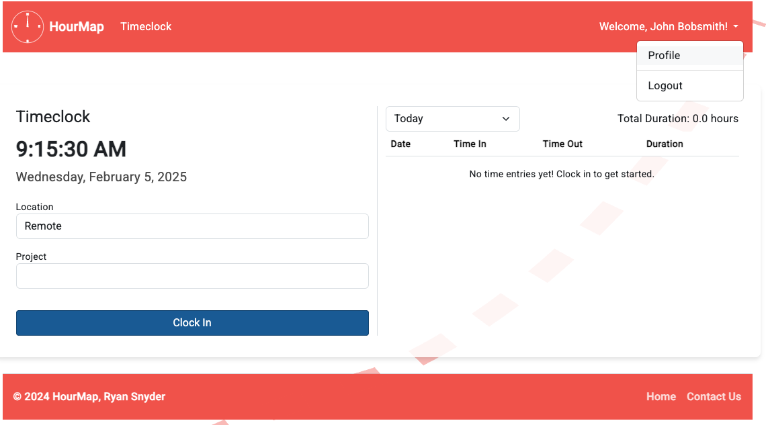
HOURMAP – USER GUIDE
Registering For An Account (Invited)
Welcome to the Organization! As a user, there’s not a lot to do. You can clock in, edit your profile, or sign out.

Slide 15
04 – EDIT YOUR PROFILE
HOURMAP – USER GUIDE
Select Profile to edit your user profile!

Slide 16
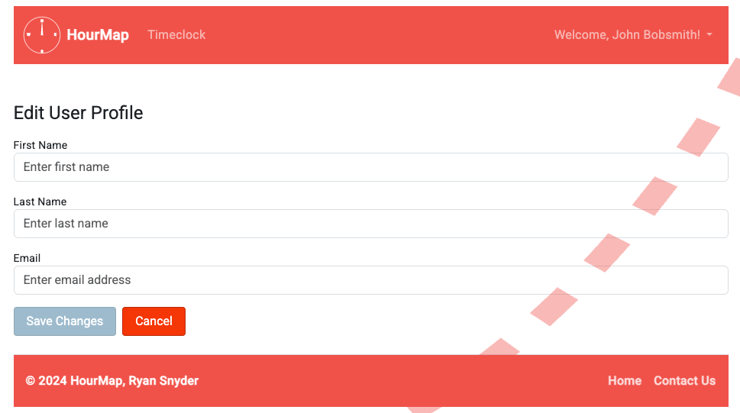
HOURMAP – USER GUIDE
Edit Your Profile
Enter your preferred name, and email address and save changes to update your profile.

Slide 17

HOURMAP – USER GUIDE
Edit Your Profile
Nice, it updated!

Slide 18
05 – CLOCKING IN / OUT
HOURMAP – USER GUIDE
Clocking in and out is easy! Let’s dive into it.

Slide 19
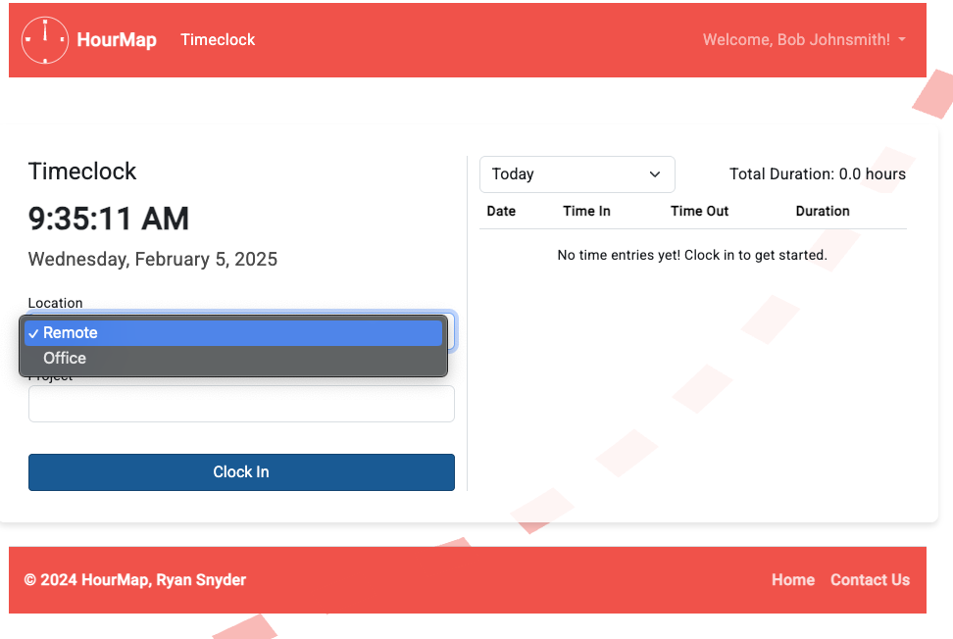
HOURMAP – USER GUIDE
Clocking In/Out
Select a working location, and a project, then click ‘Clock In’.

Slide 20
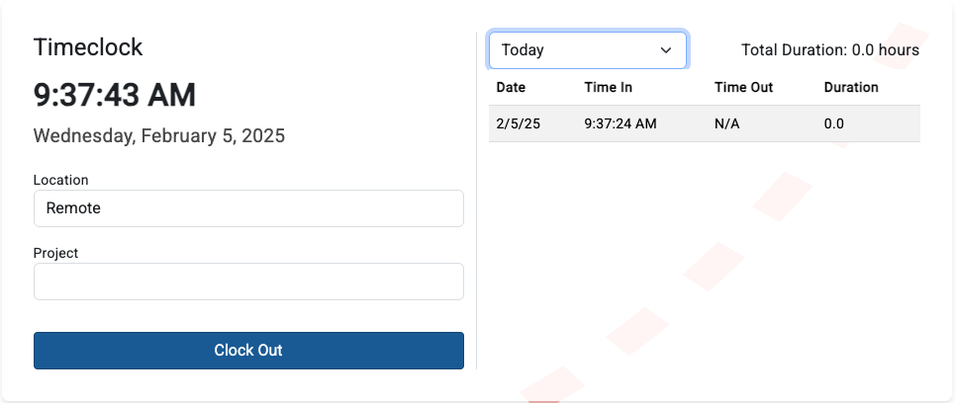

HOURMAP – USER GUIDE
Clocking In/Out
Hey look, it popped up! We can also choose to see time entries for the pay period.
Well, that’s enough work for the day, let’s clock out.

Slide 21
HOURMAP – USER GUIDE
Clocking In/Out
Hey look, it popped up! We can also choose to see time entries for the pay period.
Well, that’s enough work for the day, let’s clock out.

Slide 22

HOURMAP – USER GUIDE
Clocking In/Out
Nice. It shows the total duration as well.
Good job making your first time entry!

Slide 23
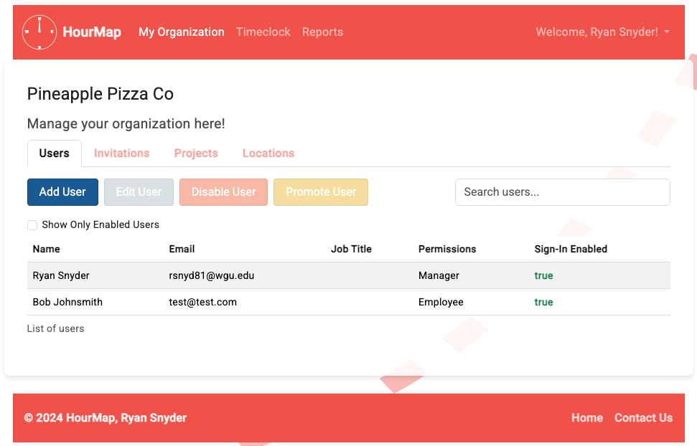
06 – Managing USER ACCOUNTS
HOURMAP – USER GUIDE
Your organization dashboard is the key to managing all aspects of your org, including user accounts.
We’ve already added a new user, let’s manage that user account.

Slide 24
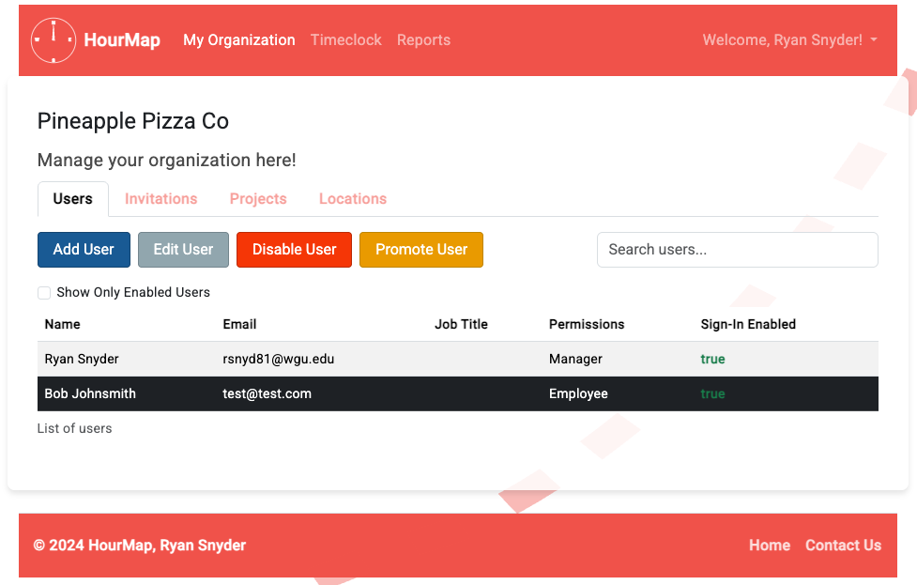
HOURMAP – USER GUIDE
Managing User Accounts
Let’s look at the options that become available when a user is selected.

Slide 25
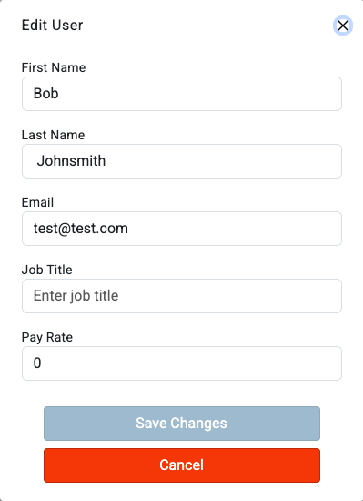
HOURMAP – USER GUIDE
Managing User Accounts
EDIT USER
Edit user allows you to update a user’s account with information such as name, job title, email, and pay rate.

Slide 26
HOURMAP – USER GUIDE
Managing User Accounts
DISABLE USER
Disable user will prevent the user from signing in, locking them out of their account.

Slide 27
HOURMAP – USER GUIDE
Managing User Accounts
PROMOTE USER
Need another manager user? Promote lets the selected user access the same organization dashboards you do.

Slide 28
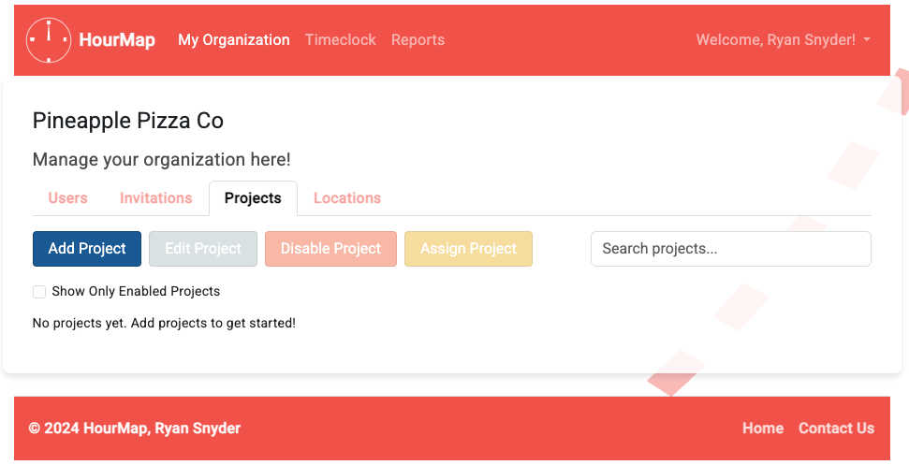
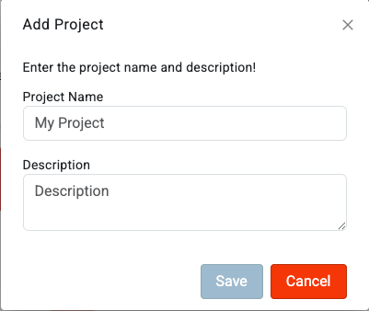
07 – Managing PROJECTS
HOURMAP – USER GUIDE
The projects tab is for managing any projects for your organization. I don’t see any yet, let’s add one! Enter the project info and save!

Slide 29
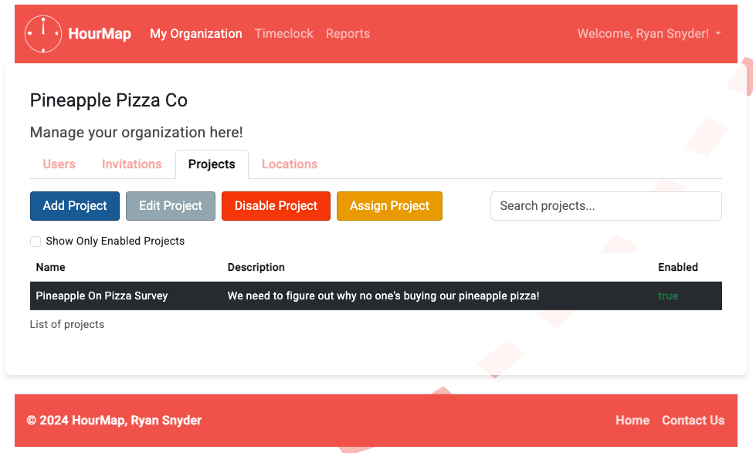
HOURMAP – USER GUIDE
Managing Projects
That’s better, let’s check out our options here. You can see the name, description, and enabled status in the table below.

Slide 30
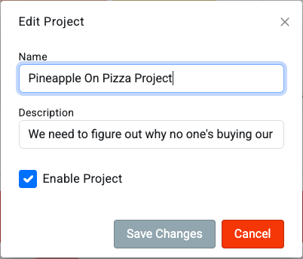
HOURMAP – USER GUIDE
Managing Projects
Edit project lets us update the name or description of the project and has a check box for enabling it/disabling it!

Slide 31

HOURMAP – USER GUIDE
Managing Projects
Disable project sets the enabled status to ‘false’. Projects that are disabled don’t show up when clocking in for users, even when it’s assigned to them.

Slide 32
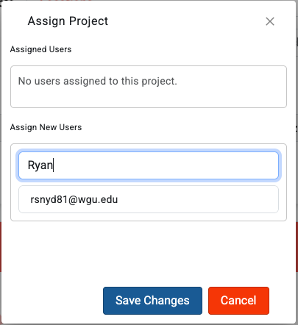
HOURMAP – USER GUIDE
Managing Projects
Assigning a project to a user lets them clock into it. Let’s assign it to ourselves by search for our name in the box and selecting our email.

Slide 33
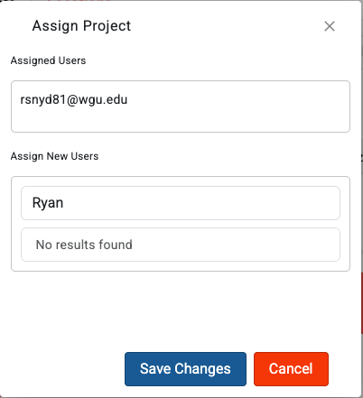
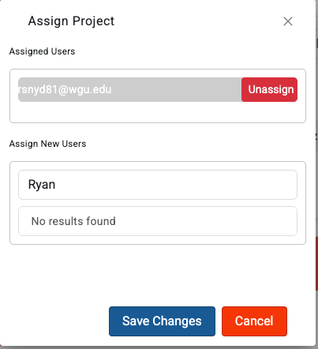
HOURMAP – USER GUIDE
Managing Projects
Nice, we’re in the assigned box, Changes won’t be saved until we click ‘Save’ though.
We can remove users from this list by selecting them in the assigned table, but let’s leave us for now.
Saving will only assign users in the ‘Assigned Users’ box, so double check your assignments!

Slide 34
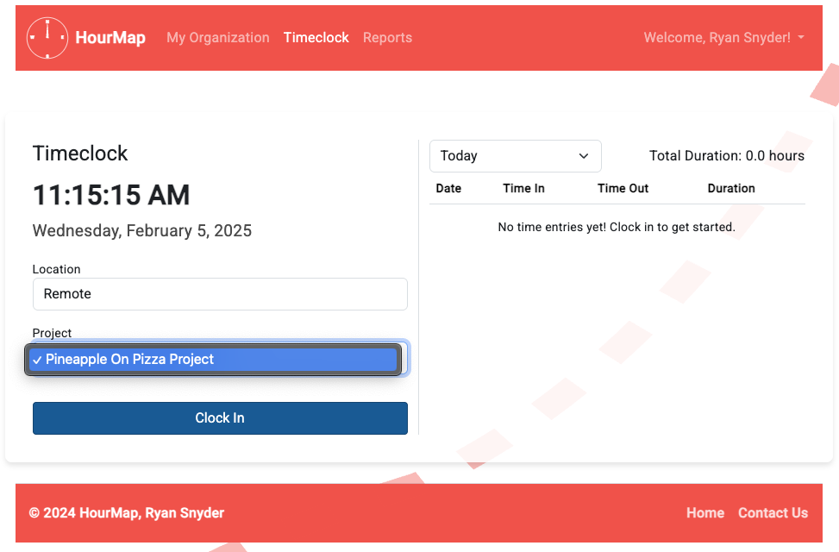
HOURMAP – USER GUIDE
Managing Projects
Now that it’s assigned, we can clock into it. Nice work!

Slide 35
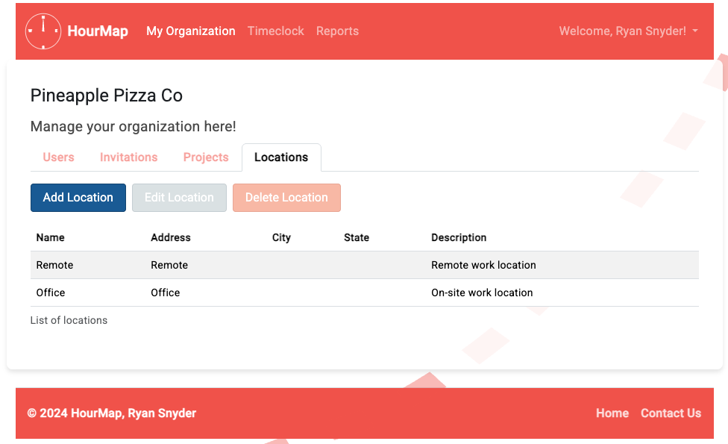
08 – Managing LOCATIONS
HOURMAP – USER GUIDE
Every organization starts with two default locations, Office and Remote.
Let’s edit our Office location to include our business address!

Slide 36
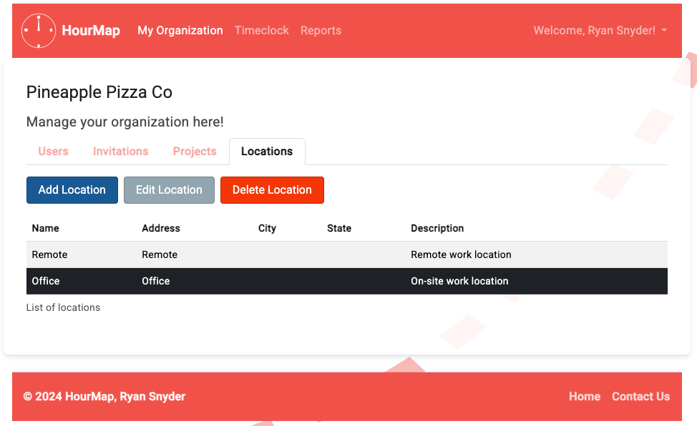
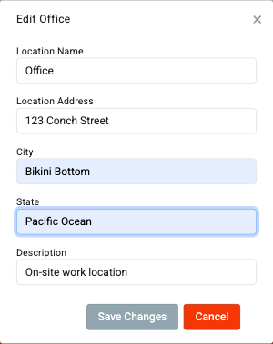
HOURMAP – USER GUIDE
Managing Locations
Select ‘Office’ in the table below, and then click ‘Edit Location’ to edit! Fill out the form then save.

Slide 37
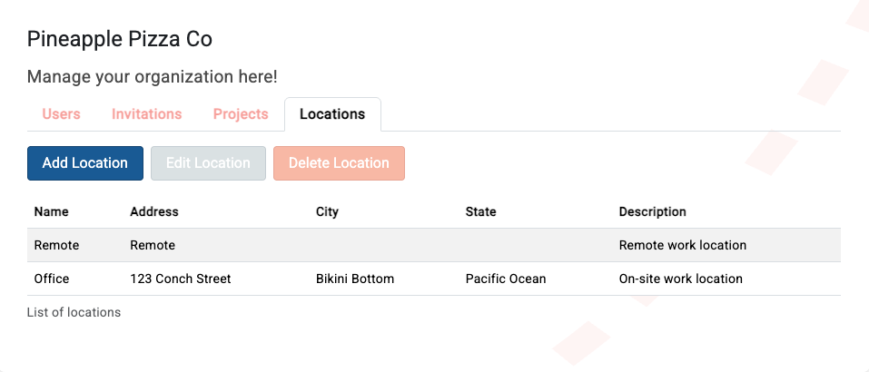
HOURMAP – USER GUIDE
Managing Locations
Looking good!
Let’s make a new location next.

Slide 38
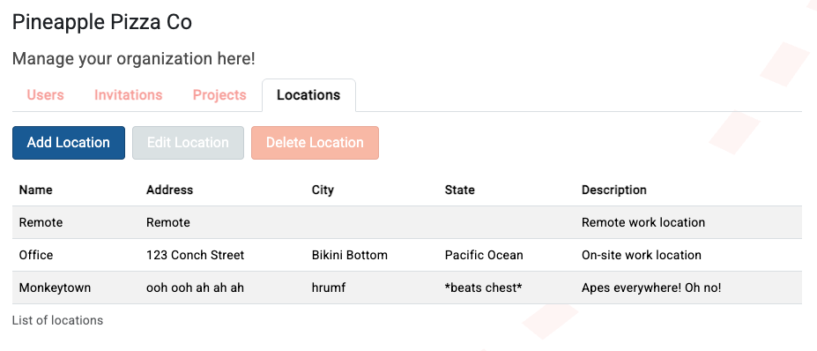
HOURMAP – USER GUIDE
Managing Locations
Nice. Users can clock in from Monkeytown! Hmmm.. Not sure they want to though, it sounds scary.
On second thought, some places are better left a secret. Let’s delete it next.

Slide 39
HOURMAP – USER GUIDE
Managing Locations
Nice. Users can clock in from Monkeytown! Hmmm.. Not sure they want to though, it sounds scary.
On second thought, some places are better left a secret. Let’s delete it next.

Slide 40
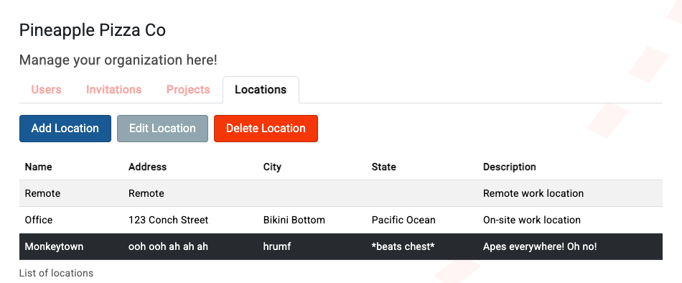
HOURMAP – USER GUIDE
Managing Locations
Select ‘Monkeytown’ and click delete! Bye Monkeytown, see you later when I’m braver.
Good job managing locations!

Slide 41
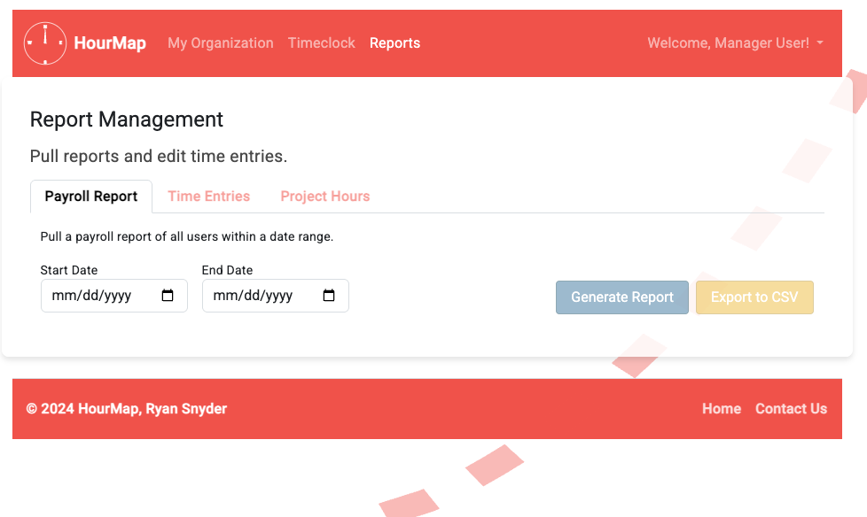
09 – RUNNING REPORTS
HOURMAP – USER GUIDE
The reports page is for managing our time entries and getting data out of them.
We’ll be using a demo account, so we’ll have something to work with.

Slide 42
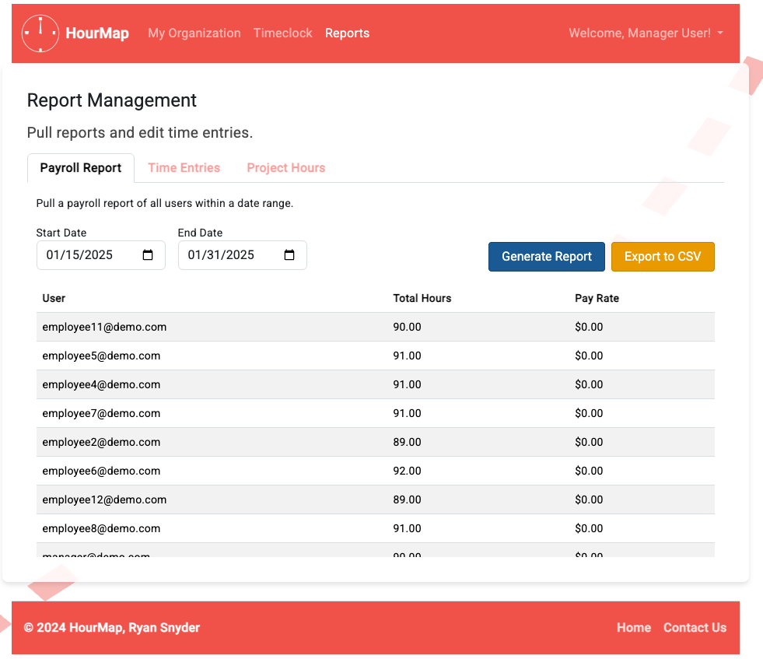
HOURMAP – USER GUIDE
Running Reports
PAYROLL Select a start and end date, run the report, and get every employee’s hours who worked in that period, along with their payrate.

Slide 43
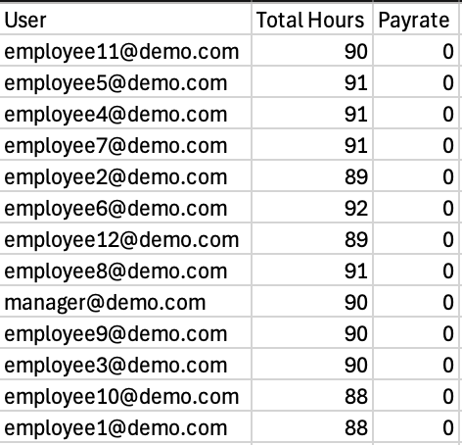
HOURMAP – USER GUIDE
Running Reports
Export it to a CSV file so you can load it into another program!

Slide 44
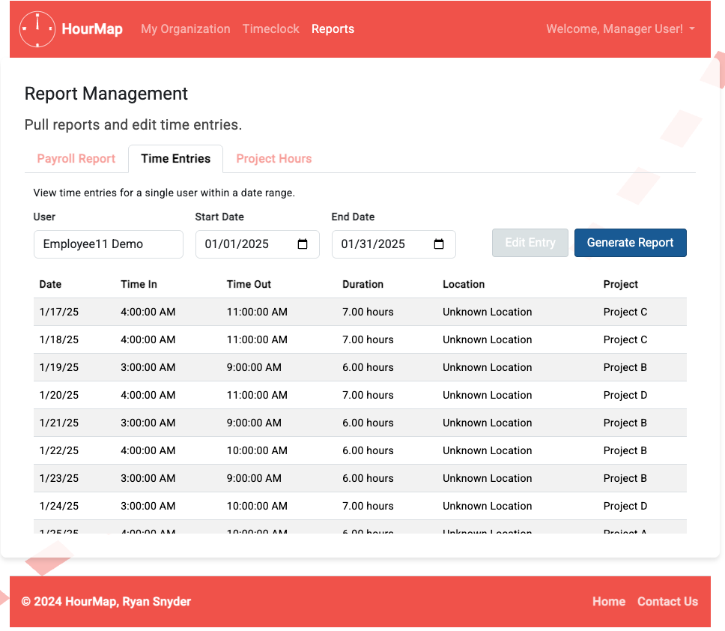
HOURMAP – USER GUIDE
Running Reports
TIME ENTRIES If a user made a mistake on a time entry, search for it here. You can pull time entries for any user by searching for them and setting the time range.

Slide 45
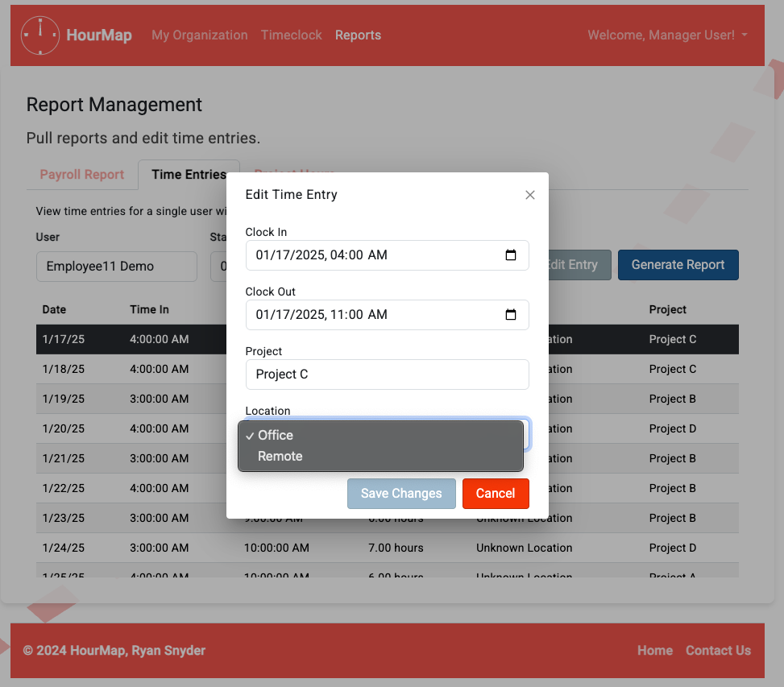
HOURMAP – USER GUIDE
Running Reports
Selecting any time entry and selecting ‘Edit Entry’ allows you to update it and fix any issues (like a missing location).

Slide 46
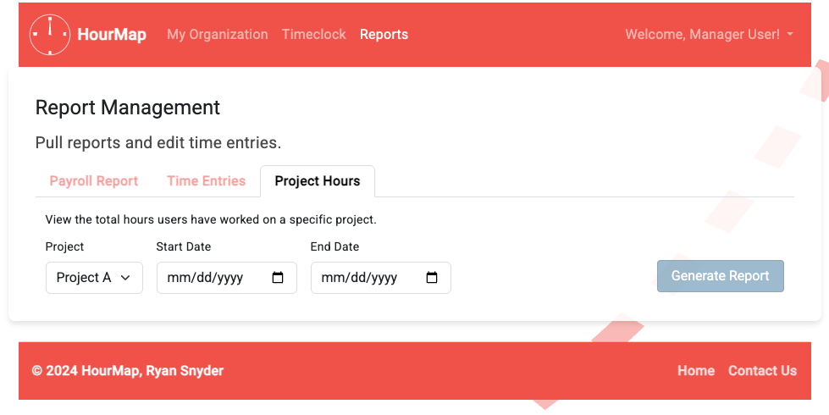
HOURMAP – USER GUIDE
Running Reports
PROJECT HOURS
A report for pulling project hours based on the project. Like a payroll report, but better for estimating effort towards a specific project.

Slide 47
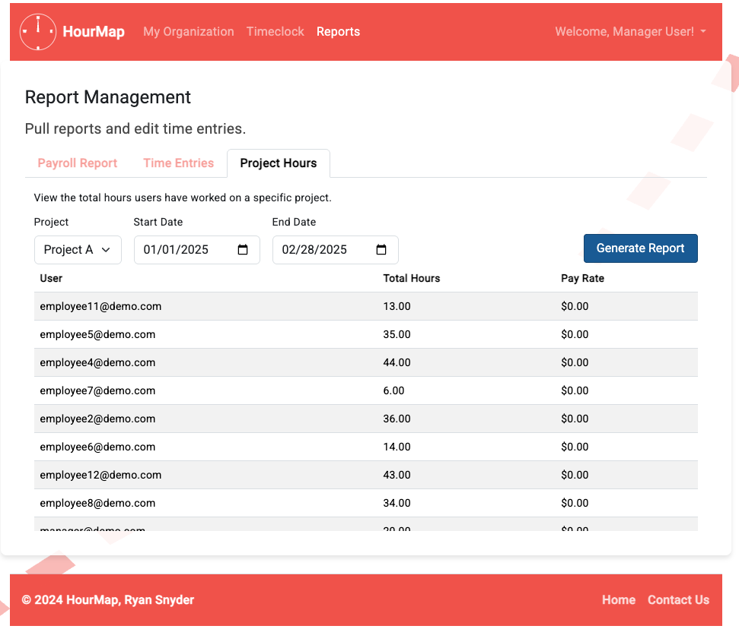
HOURMAP – USER GUIDE
Running Reports
Select a project from the dropdown, a start and end date, and click ‘Generate Report’ to get those project estimations!

Slide 48
THANK YOU
HOURMAP – USER GUIDE
resnyd81@wgu.edu
HOPEFULLY, YOU’VE GOT THE HANG OF IT!
Ryan Snyder
011535988

