Slide 1
Group C Design Pitch

Slide 2
Roles
Point-of-Contact: Charles Voege
Database Architect: Duncan Hill
Web Architect: Ryan Endacott
--Web UI Lead: Charles Voege
--Web UI B/U: Hang Cui
--Web Serv. Lead: Ryan Endacott
--Web Serv. B/U: Duncan Hill
--Submission Prg. Lead: Avery Wells
Submission Prg. B/U: Bowei Xu
Collection Prc. Lead: Hang Cui
Collection Prc. B/U: Bowei Xu

Slide 3
Responsibilities - Ryan Endacott
Web Architect
Create and design architecture for entire web portion of the system
Oversee three main components:
Database (models)
Services (controllers)
User Interface (views)
Create project scaffolds that tie separate components together
Facilitate implementation to ensure smooth integration between components
Ensure the web portion as a whole interacts with other system components, like the command line submission program
Web Services Lead
Design and implement all of the various web services needed in the system
Implement the controllers in the web application
Ensure the components interact well with other portions of the web system, like the database and user interface
Provide an easy-to-use API for the other main system components, like the command line submission program

Slide 4
Responsibilities - Duncan Hill
Database Architect
Design the database architecture for the application.
Implement the database for usage.
Providing consultation for team members utilizing the database systems.
Managing any mid-project database changes and migrations of data.
Web Service B/U
Assist Ryan Endacott in the development process and creation of the web service section of the system.
Create the controllers and integrate the models of the system for usage with the views.
Provide connection pathways for the various components, acting as a middleman of sorts.

Slide 5
Responsibilities - Hang Cui
Web UI B/U
Cooperate with Charles Voege design the web UI
Create different functionalities for different user group: TAs/Instructors
Collection Prc. Lead
Cooperate with Bowei Xu
Design a collection system allow TAs/Instructors to collect all of a specific assignment
Create a automatic collection system
The collection system should be easy to use
Connect the collection system to the WEB SERVER

Slide 6
Responsibilities - Bowei Xu
Submission Prg. B/U
Cooperate with Avery Wells working on the submission program.
Build a system which allows students to submit their program work with command line(multiple files allowed)
The files should be stored under the directory of their section (error check for invalid directory)
Ensure that the implement is easy for users to follow
Collection Prc. B/U
Cooperate with Hang Cui working on the submission program.
Build a system which allows instructors and TAs to collect student’s assignment work
The authority of this system belongs to TAs and instructor (only accessible to instructor and TAs)
Every TA and instructor has their own directory (display only files in their section)
Ensure that the implement is easy for users to follow

Slide 7
Responsibilities - Avery Wells
Submission Program Lead
Design and implement command line submission program
Ensure that students can successfully submit assignment with command line and web tool
Send assignments to database in such a way that the other services can access them
Ensure each submission is logged with its errors/receipts

Slide 8
Responsibilities - Charles Voege
Point - of - Contact
Come into contact with:
Instructors
Teaching Assistants
All group members
Ensure communication between all members.
Web UI Lead
Create the web user interface with the help of Hang.
Ensure that the user interface is:
User friendly
Follows Ryan’s architecture
Is maintained efficiently

Slide 9
Use Cases

Slide 10
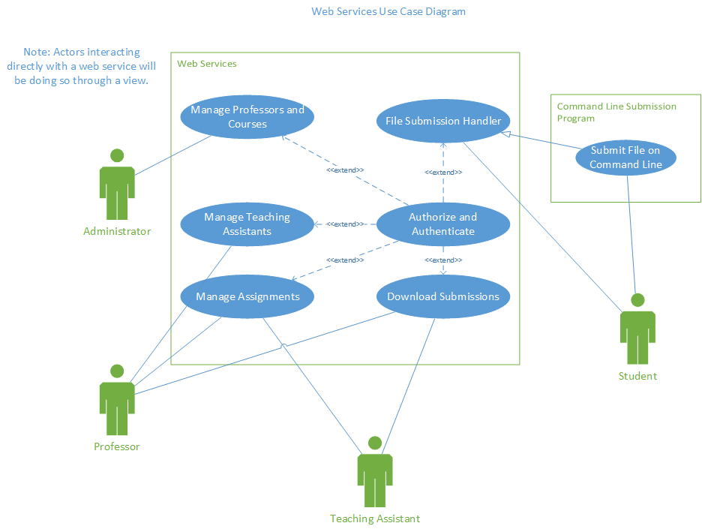

Slide 11
High-Level Architecture

Slide 12
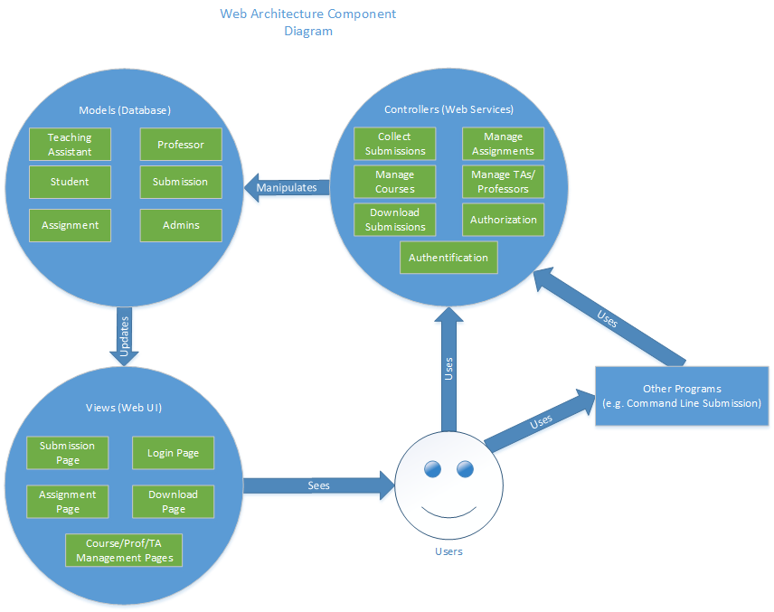

Slide 13
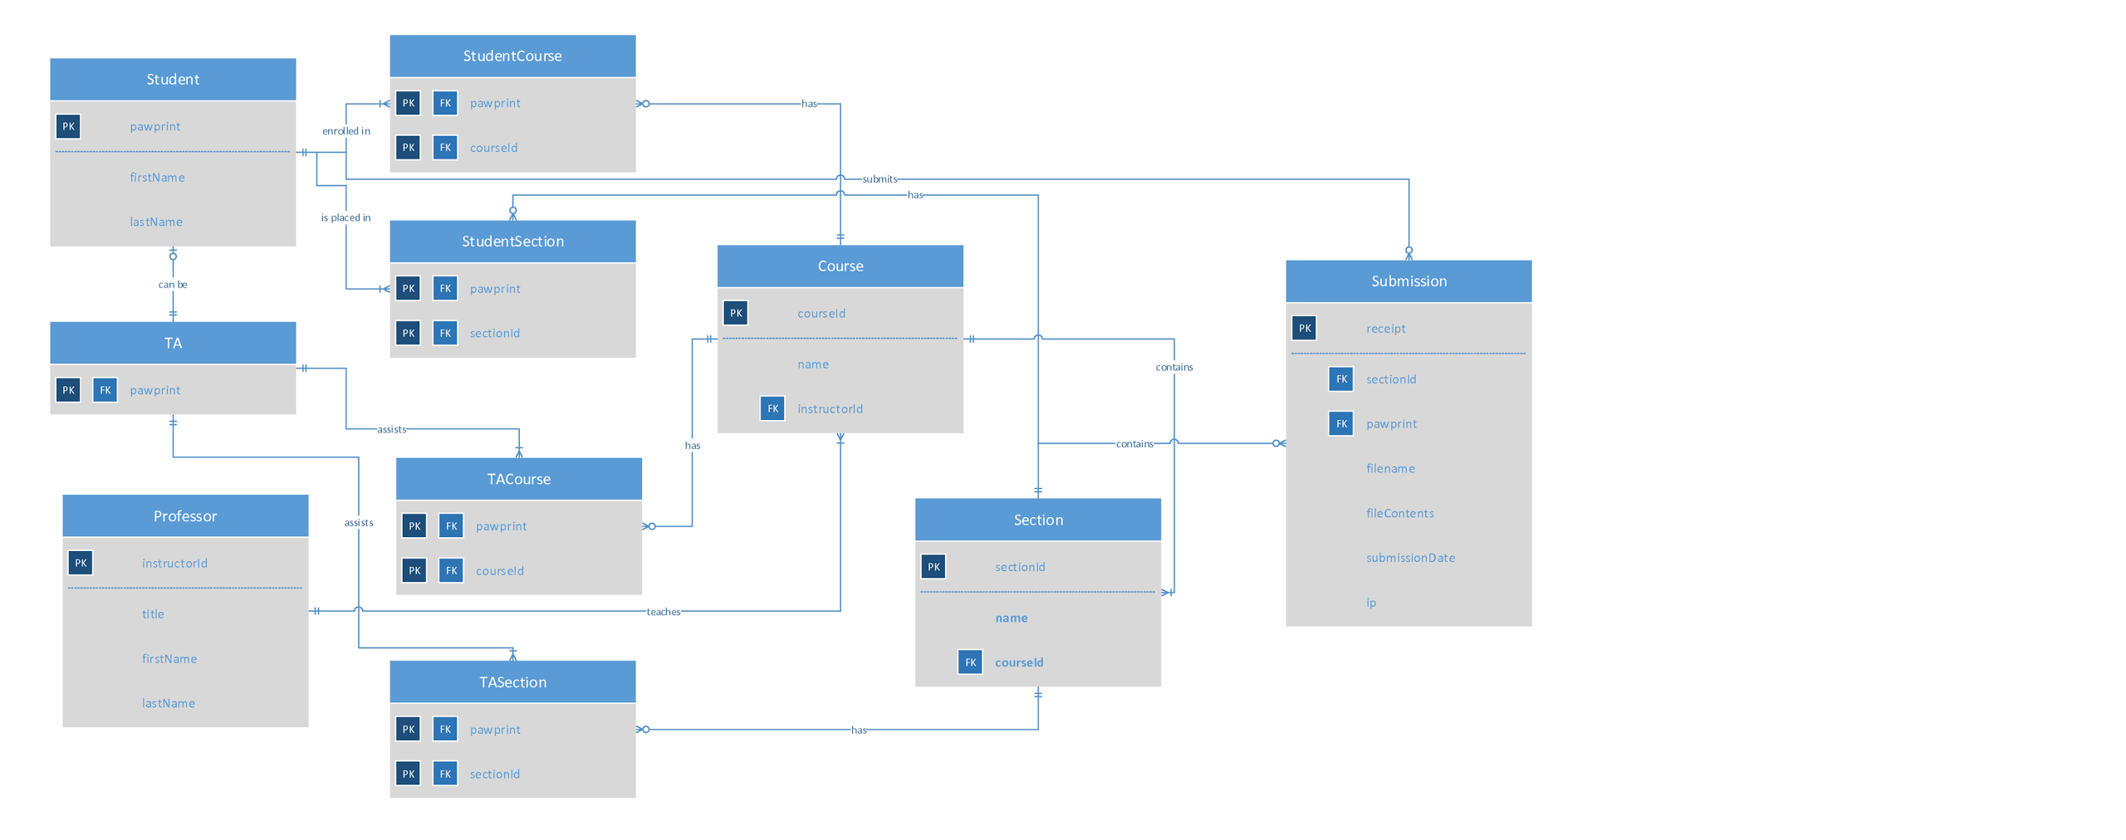
Database

Slide 14
Submission Program
Students will be able to submit assignment through command line or web based tool
Command line form: <program> <course_section> <assignment> <filename>
Use system utilities and OS authentication so pawprint and password do not have to be entered
Submitting multiple files will be supported
Log information about each submission
IP address
File size and location
Timestamp
Separate log for errors and verification receipts
Receipts will be unique hashcodes

Slide 15
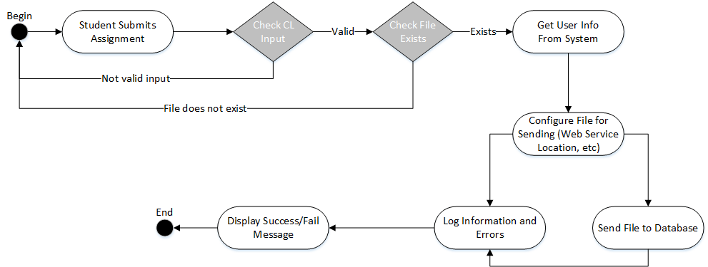

Slide 16
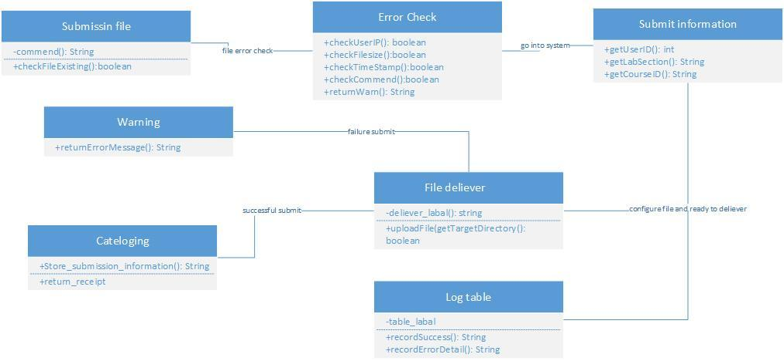

Slide 17
File Acceptor Web Service

Slide 18
Collection Process
Collection allows TA or Instructor to collect all labs/assignments from a specific labs or assignment.
1. In the TA web UI, TA has the authority to collect labs/assignments. This could be a "bottom" or "submit"
2. After click this button, the web server will run the collection command
3. Collection is specified by course->section->student_lastname_initial
3.1 All files have been already cataloged be submission, which means all files are in the folder where they suppose to be
4. All files that matched will be collected to TAs' local or their babbage

Slide 19
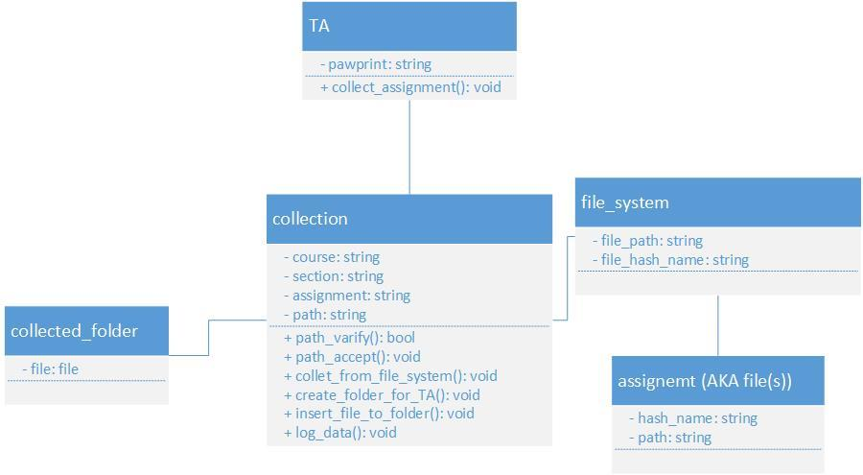

Slide 20
Other Web Services

Slide 21
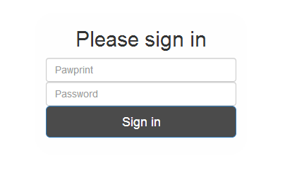
Web User Interface
The web user interface will include:
Login page
File submit page
Receipt received page
Submissions Summary page

Slide 22
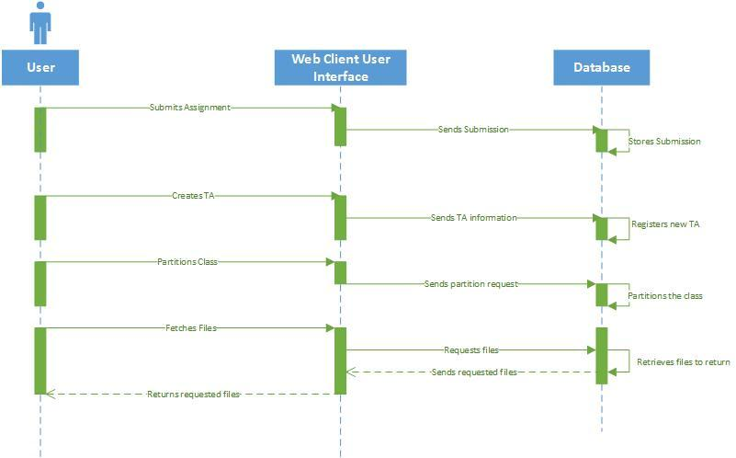

Slide 23
Thanks for listening!
Questions?
Comments?

