Slide 1
Probability
Basics | types | Distributions | Bayes’ theorem

Slide 2
Have you heard this?
Doctor saying that a patient has a 50-50 chance of surviving a certain operation
There is a 70% chance that it will rain today
I can make it before the light goes red
Can you give some more examples?

Slide 3
What is Probability?
Probability is the chance that some event will happen
It is the ratio of the number of ways a certain event can occur to the number of possible outcomes

Slide 4
What is Probability?
number of favorable outcomes
P(event) =
number of possible outcomes
Examples that use Probability:
Dice, Spinners, Coins, Deck of Cards, Evens/Odds etc.

Slide 5
What is Probability?
0% 25% 50% 75% 100%
0 ¼ or .25 ½ 0r .5 ¾ or .75 1
Impossible Not Very Equally Likely Somewhat Certain
Likely Likely

Slide 6

Probability of Simple Event
Example 1: Roll a dice.
What is the probability of rolling a 4?
# favorable outcomes
# possible outcomes
1
6
The probability of rolling a 4 is 1 out of 6
P(event) =
P(rolling a 4) =

Slide 7
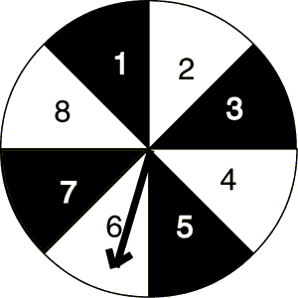
Can you calculate the probability?
1) P(black) =
2) P(1) =
3) P(odd) =
4) P(prime) =
4/8
1/8
1/2
1/2

Slide 8
Summary
Probability is the chance that some event will happen
It is the ratio of the number of ways a certain even can occur to the total number of possible outcomes

Slide 9
Business Use Case
A computer company manufactures 2,500 computers each day. An average of 100 of these computers are returned with defects. What is the probability that the computer you purchased is not defective?
# not defective 2,400 24
total # manufactured 2,500 25
P(not defective) = = =

Slide 10
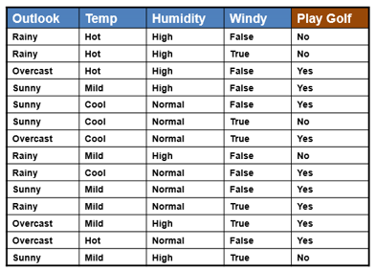
Probability from Data

Slide 11
Conditional Probability
Conditional probability is the probability of one event occurring with some relationship to one or more other events
Example: The probability of raining given that there are clouds in the sky

Slide 12
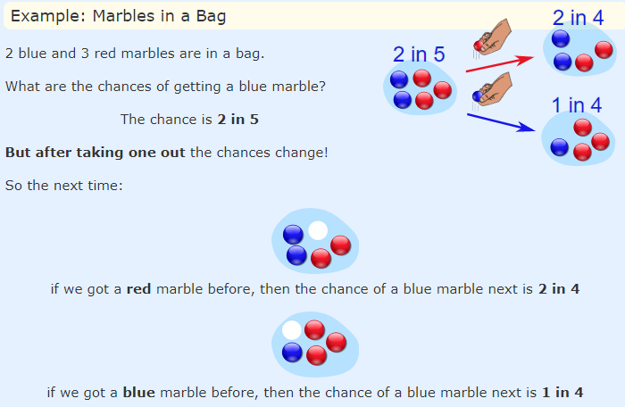
What?
Tossing a coin is an independent event
Events can also be "dependent" ... which means they can be affected by previous events …

Slide 13
Joint Probability
A joint probability, in probability theory, refers to the probability that two events will both occur. In other words, joint probability is the likelihood of two events occurring together.
What is the joint probability of rolling the number five twice in a fair six-sided dice?
Event “A” = The probability of rolling a 5 in the first roll is 1/6 = 0.1666.
Event “B” = The probability of rolling a 5 in the second roll is 1/6 = 0.1666.
Therefore, the joint probability of event “A” and “B” is P(1/6) x P(1/6) = 0.02777 = 2.8%.

Slide 14
Joint Probability
What is the joint probability of getting a head followed by a tail in a coin toss?
Event “A” = The probability of getting a head in the first coin toss is 1/2 = 0.5.
Event “B” = The probability of getting a tail in the second coin toss is 1/2 = 0.5.
Therefore, the joint probability of event “A” and “B” is P(1/2) x P(1/2) = 0.25 = 25%.

Slide 15
Joint Probability
What is the joint probability of drawing a number ten card that is black?
Event “A” = The probability of drawing a 10 = 4/52 = 0.0769
Event “B” = The probability of drawing a black card = 26/52 = 0.50
Therefore, the joint probability of event “A” and “B” is P(4/52) x P(26/52) = 0.0385 = 3.9%.

Slide 16
Why learn probability?
Sales of Pepsi = Income + Weather + Discount + SKU + Price
Customer 1 = Carrots + Milk + Bread + Eggs + Butter
In an uncertain world, it can be of immense help to know and understand chances of various events. You can plan things accordingly. If it’s likely to rain, I would carry my umbrella. If I am likely to have diabetes on the basis of my food habits, I would get myself tested. If my customer is unlikely to pay me a renewal premium without a reminder, I would remind him about it.
So knowing the likelihood might be very beneficial.

Slide 17
Distributions
The distribution of a statistical data set (or a population) is a listing or function showing all the possible values (or intervals) of the data and how often they occur.
When a distribution of categorical data is organized, you see the number or percentage of individuals in each group.
When a distribution of numerical data is organized, they’re often ordered from smallest to largest, broken into reasonably sized groups (if appropriate), and then put into graphs and charts to examine the shape, center, and amount of variability in the data.

Slide 18
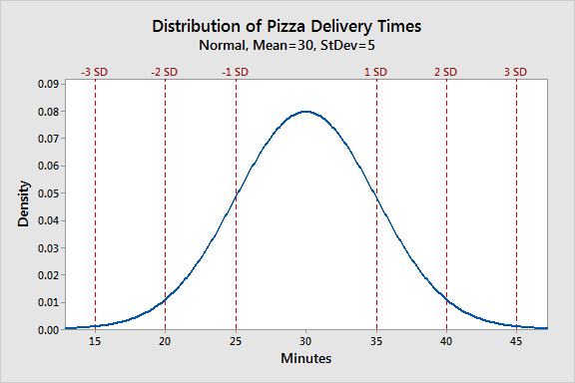
Normal Distribution
Normal distribution describes continuous data which have a symmetric distribution, with a characteristic 'bell' shape.

Slide 19
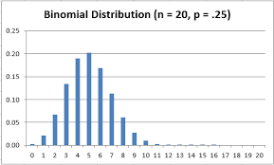
Binomial Distribution
Binomial distribution describes the distribution of binary data from a finite sample. Thus it gives the probability of getting r events out of n trials.

Slide 20
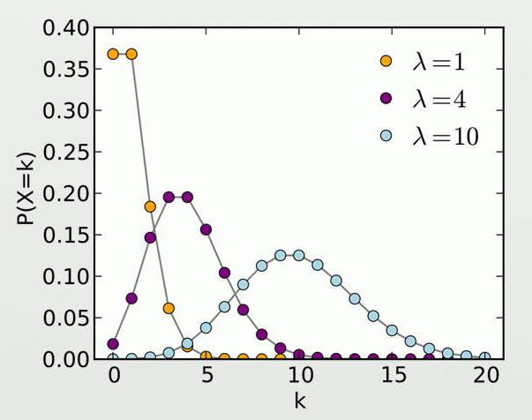
Poisson Distribution
Poisson distribution describes the distribution of binary data from an infinite sample. Thus it gives the probability of getting r events in a population.

Slide 21
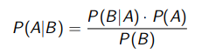
Bayes’ Theorem
Also called Bayes’ rule or Bayes’ Formula
Allows you to find P(A|B) from P(B|A), i.e. to ‘invert’ conditional probabilities.

Slide 22
Two schools of thought – Frequentist Approach
The populist view of probability is the so-called frequentist approach:
whereby the probability P of an uncertain event A, P(A), is defined by the frequency of that event based on previous observations.
For example, in the UK 50.9% of all babies born are girls; suppose then that we are interested in the event A: 'a randomly selected baby is a girl'.
According to the frequentist approach P(A)=0.509.

Slide 23
Two schools of thought – Bayesian Approach
Say there are two beliefs for Covid19
A – Covid19 is going to strike back this winter
B – Covid19 is going to vanish this winter
For example, Henry may have a strong belief in the statement a based on his knowledge of the current events and past events like black death / Spanish flu.
Marcel, on the other hand, may have a much weaker belief in the statement based on some inside knowledge about the status of Covid19 researches
Thus, in general, a person's subjective belief in a statement a will depend on some body of knowledge K. We write this as P(a|K). Henry's belief in a is different from Marcel's because they are using different K's. However, even if they were using the same K they might still have different beliefs in a.
The expression P(a|K) thus represents a belief measure. Sometimes, for simplicity, when K remains constant we just write P(a), but you must be aware that this is a simplification.

Slide 24

The Bayes’ Rule
True Bayesians actually consider conditional probabilities as more basic than joint probabilities . It is easy to define P(A|B) without reference to the joint probability P(A,B). To see this note that we can rearrange the conditional probability formula to get:
P(A|B) P(B) = P(A,B)
by symmetry:
P(B|A) P(A) = P(A,B)
This is so-called Bayes Rule.

Slide 25
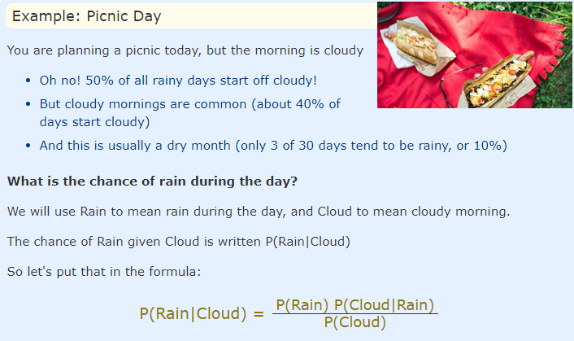
Example

Slide 26

Example

Slide 27
Questions?
Thank you!

