Slide 1
Statistics
Relevance to data science | descriptive statistics | Correlation | Hypothesis tests

Slide 2
Why learn statistics?
It is important to understand the ideas behind the various techniques, in order to know how and when to use them.
One has to understand the simpler methods first, in order to grasp the more sophisticated ones.
It is important to accurately assess the performance of a method, to know how well or how badly it is working.
Additionally, this is an exciting research area, having important applications in science, industry, and finance.
Ultimately, statistical learning is a fundamental ingredient in the training of a modern data scientist. Examples of Statistical Learning problems include:

Slide 3
Why learn statistics?
Identify the risk factors for prostate cancer.
Classify a recorded phoneme based on a log-periodogram.
Predict whether someone will have a heart attack on the basis of demographic, diet and clinical measurements.
Customize an email spam detection system.
Identify the numbers in a handwritten zip code.
Classify a tissue sample into one of several cancer classes.
Establish the relationship between salary and demographic variables in population survey data.

Slide 4
What can you do?
Sales Forecasting
Predicting customer demand
Predicting customer share of wallet
Predicting fraud
Identifying email is spam or not
Predicting what house will a person buy
Predicting which employee is most likely to resign

Slide 5
Descriptive Statistics
Descriptive statistics, in short, help describe and understand the features of a specific data set by giving short summaries about the sample and measures of the data.
The most recognized types of descriptive statistics are measures of center: the mean, median, and mode, which are used at almost all levels of math and statistics.
Descriptive statistics summarizes or describes characteristics of a data set.
Descriptive statistics consists of two basic categories of measures: measures of central tendency and measures of variability or spread.
Measures of central tendency describe the center of a data set.
Measures of variability or spread describe the dispersion of data within the set.

Slide 6
Sample vs. Population
Population
Sample

Slide 7
Descriptive Statistics
An Illustration:
Which Group is Smarter?
Class A--IQs of 13 Students
102 115
128 109
131 89
98 106
140 119
93 97
110
Class B--IQs of 13 Students
127 162
131 103
96 111
80 109
93 87
120 105
109

Slide 8
Descriptive Statistics
Which group is smarter now?
Class A--Average IQ Class B--Average IQ
110.54 110.23
They’re roughly the same!
With a summary descriptive statistic, it is much easier to answer our question.

Slide 9
Descriptive Statistics
Types of descriptive statistics:
Organize Data
Tables
Graphs
Summarize Data
Central Tendency
Variation

Slide 10
Histogram

Slide 11
Bar Graph

Slide 12
Measures of Central Tendency - Mean
Measuring weight of 5 people in a class
68, 70, 75, 80, 72
Mean = (68+70+75+80+72) / 5 = 73

Slide 13
Mean
Means can be badly affected by outliers (data points with extreme values unlike the rest)
Outliers can make the mean a bad measure of central tendency or common experience
Income in the U.S.
Bill Gates
All of Us
Mean
Outlier

Slide 14
Outliers affect Mean
Measuring weight of 5 people in a class
68, 70, 75, 80, 150
Mean = (68+70+75+80+150) / 5 = 88.6

Slide 15
Measures of Central Tendency - Median
The median is the middle number in a sorted, ascending or descending, list of numbers and can be more descriptive of that data set than the average.
Measuring weight of 5 people in a class
68, 70, 75, 80, 150
Median = 75

Slide 16
Measures of Central Tendency - Mode
The most common data point is called the mode.
The combined IQ scores for Classes A & B:
80 87 89 93 93 96 97 98 102 103 105 106 109 109 109 110 111 115 119 120 127 128 131 131 140 162
BTW, It is possible to have more than one mode!
A la mode!!

Slide 17
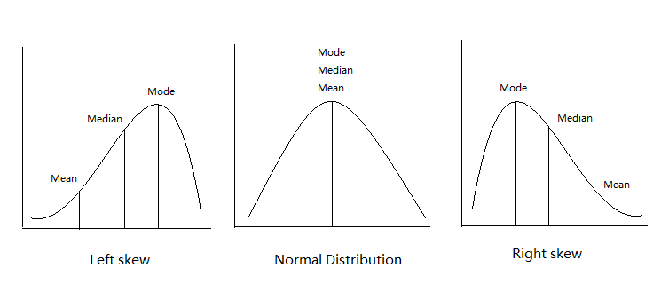

Slide 18
Range
The spread, or the distance, between the lowest and highest values of a variable.
To get the range for a variable, you subtract its lowest value from its highest value.
Class A--IQs of 13 Students
102 115
128 109
131 89
98 106
140 119
93 97
110
Class A Range = 140 - 89 = 51
Class B--IQs of 13 Students
127 162
131 103
96 111
80 109
93 87
120 105
109
Class B Range = 162 - 80 = 82

Slide 19
Interquartile Range
A quartile is the value that marks one of the divisions that breaks a series of values into four equal parts.
The median is a quartile and divides the cases in half.
25th percentile is a quartile that divides the first ¼ of cases from the latter ¾.
75th percentile is a quartile that divides the first ¾ of cases from the latter ¼.
The interquartile range is the distance or range between the 25th percentile and the 75th percentile. Below, what is the interquartile range?
25%
25%
25% of cases
25% of cases
0 250 500 750 1000

Slide 20
Variance
A measure of the spread of the recorded values on a variable. A measure of dispersion.
The larger the variance, the further the individual cases are from the mean.
The smaller the variance, the closer the individual scores are to the mean.
Mean
Mean

Slide 21
Standard Deviation
To convert variance into something of meaning, let’s create standard deviation.
The square root of the variance reveals the average deviation of the observations from the mean.
s.d. = Σ(Yi – Y-bar)²
n - 1

Slide 22
Standard Deviation
For Class A, the standard deviation is:
235.45 = 15.34
The average of persons’ deviation from the mean IQ of 110.54 is 15.34 IQ points.

Slide 23
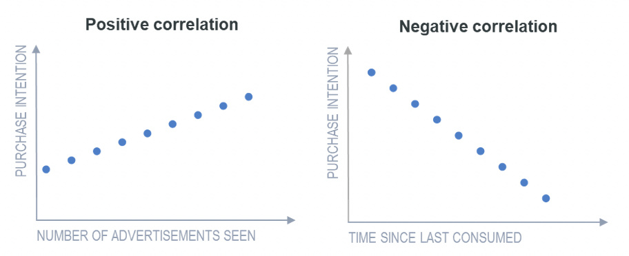
Correlation
Dependence or association is any statistical relationship, whether causal or not, between two random variables or bivariate data.
Can be negative or positive.

Slide 24
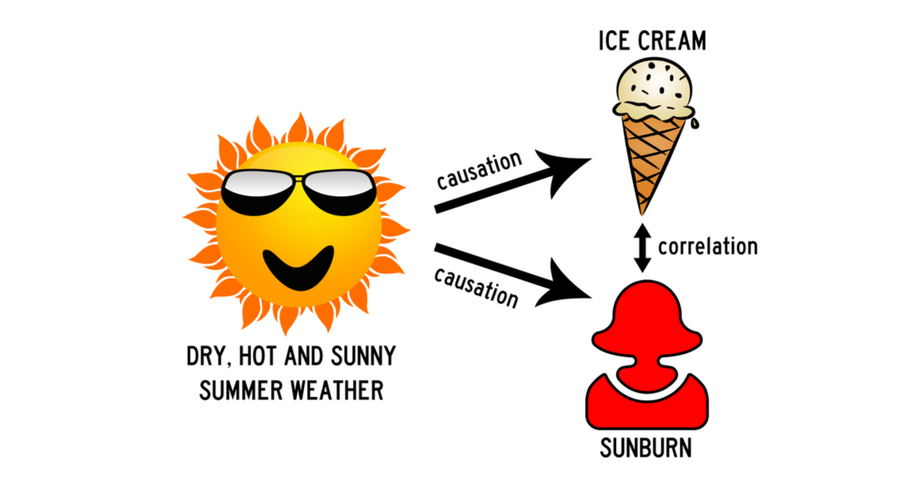
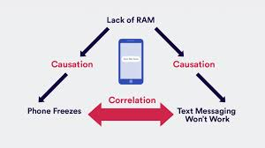
Causation

Slide 25


Spurious Correlation
Donald sneezes and there is a tsunami in Japan

Slide 26
Hypothesis Testing
For example, suppose you’re comparing two teaching methods and want to determine whether one method produces higher mean test scores.
In your sample data, you see that the mean for Method A is greater than Method B. However, random samples contain random error, which makes your sample means very unlikely to equal the population means precisely.
Unfortunately, the difference between the sample means of two teaching methods can represent either an effect that exists in the population or random error in your sample.

Slide 27
Hypothesis Testing
This is where you make use of Hypothesis testing to get statistical proof of coming to a conclusion.
This is where you run tests to get p-values. Typically, you want p-values that are less than your significance levels (e.g., 0.05) because it indicates your sample evidence is strong enough to conclude that Method A is better than Method B for the entire population. Teaching method appears to have a real effect.

Slide 28
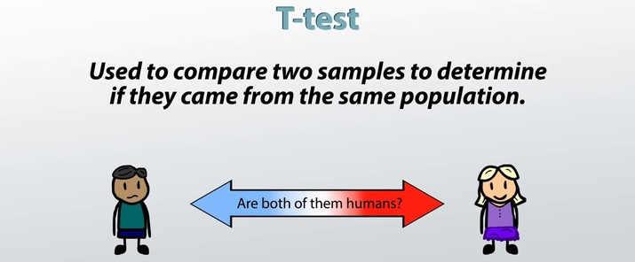
t - Test
The t test (also called Student’s T Test) compares two averages (means) and tells you if they are different from each other.
The t test also tells you how significant the differences are; In other words it lets you know if those differences could have happened by chance.

Slide 29
t - Test
Simple Example
Let’s say you have a cold and you try a homoeopathic medicine. Your cold lasts a couple of days. The next time you have a cold, you buy an over-the-counter pharmaceutical and the cold lasts a week.
You survey your friends and they all tell you that their colds were of a shorter duration (an average of 3 days) when they took the homeopathic medicine.
What you really want to know is, are these results repeatable? A t-test can tell you by comparing the means of the two groups and letting you know the probability of those results happening by chance.

Slide 30
t - Test
A large t-score tells you that the groups are different.
A small t-score tells you that the groups are similar.
Large Score means p-value < 0.05
Small Score means p-value > 0.05

Slide 31
Questions?
Thank you!

