Slide 1
Abalone Classification
Ryan Heslin, Chenxi Liao, Sebastian Zovko

Slide 2
Introduction
The goal of this analysis is to create an inferential model of the sex of abalone, a type of saltwater mollusk. This is a classification problem with three classes: infant, (adult) male, and (adult) female. Avaliable features include:

Slide 3
More on the Problem
Wild abalone populations have collapsed from overharvesting, but they are farmed commercially for their meat and pearls. Predicting sex is of interest because the eggs of adult female abalone are useful to breeders and scientists (Bradley, 2010).

Slide 4
Available Predictors

Slide 5
Abalone Weight by Sex
Infant abalone weigh substantially less than adults, but male and female adult abalone weigh about the same. This illustrates the main challenge of this classification task: infant abalone are easy to distinguish from adults, but male and female adults are hard to distinguish from each other.

Slide 6
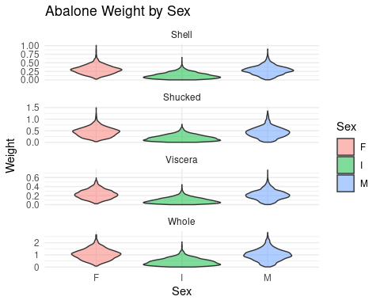
Abalone Weight by Sex Visualized

Slide 7
The Data in Detail
The full data have 4177 observations. The dataset (Kaggle, 2020) is standard in machine learning research. It may be obtained here. The three separate weight variables don’t quite sum to total weight, suggesting measurement error. Still, including all three would be a bad idea because it would make the model matrix nearly singular. We will select one to use. This table summariezes the difference of whole weight and the sum of the other weight variables
Min. 1st Qu. Median Mean 3rd Qu. Max. 1 -0.447 0.018 0.037 0.05 0.068 0.608

Slide 8
General Approach
We fit an initial $J−1$ (here $J=3$) logits baseline model using sex, dimensions, and whole weight as predictors. This model is appropriate for nominal outcomes, which abalone sex is because it has no logical ordering. This model consists of $J−1$ logit models, each predicting the log odds of a given class versus a baseline class. There are $\left({J \atop 2}\right)$ possible comparisons, but all can be derived algebraically from just $J−1$ logits. We choose infants as the reference class because they differ in the same way from each adult class (i.e., are younger).

Slide 9
Initial Model Fitting and Data Partitioning
# A tibble: 12 × 5 y.level term estimate statistic p.value <chr> <chr> <dbl> <dbl> <dbl> 1 F (Intercept) -2.95 -5.36 8.25e- 8 2 F Whole.weig… 5.39 10.7 6.80e-27 3 F Length -16.6 -5.28 1.30e- 7 4 F Diameter 11.0 2.84 4.57e- 3 5 F Height 8.40 2.26 2.39e- 2 6 F Rings 0.228 8.50 1.87e-17 7 M (Intercept) -0.238 -0.559 5.76e- 1 8 M Whole.weig… 6.31 13.4 3.14e-41 9 M Length -17.9 -5.96 2.49e- 9 10 M Diameter 6.36 1.70 8.86e- 2 11 M Height 5.23 1.44 1.49e- 1 12 M Rings 0.212 8.09 6.06e-16

Slide 10
Overall Likelihood Ratio Test of Initial Model
The overall likelihood ratio test of the initial model is highly significant, so we reject the null hypothesis of no linear relationship
Model Resid. df Resid. Dev Test Df 1 Null 6680 7325 NA 2 Full 6670 5764 1 vs 2 10 LR stat. Pr(Chi) 1 NA NA 2 1561 0

Slide 11
Wald Tests of Coefficients
Most of the estimated coefficients are significant under Wald tests, even after applying the Bonferroni correction to $p$-values.
# A tibble: 6 × 5 y.level term estimate statistic p.value <chr> <chr> <dbl> <dbl> <dbl> 1 F (Intercept) -2.95 -5.36 9.90e- 7 2 F Whole.weight 5.39 10.7 8.16e-26 3 F Length -16.6 -5.28 1.56e- 6 4 F Diameter 11.0 2.84 5.48e- 2 5 F Height 8.40 2.26 2.87e- 1 6 F Rings 0.228 8.50 2.24e-16

Slide 12
Choosing a Model by Stepwise Selection
Stepwise selection by AIC chooses a model with a few interactions. The upper scope includes all pairwise interactions and quadratic variable terms.
The Stepwise-Selected Model
# A tibble: 6 × 5 y.level term estimate statistic p.value <chr> <chr> <dbl> <dbl> <dbl> 1 F (Intercept) -5.74 -6.03 1.60e- 9 2 F Whole.weight 8.33 4.54 5.71e- 6 3 F Length -20.8 -6.06 1.40e- 9 4 F Diameter 3.75 0.898 3.69e- 1 5 F Height 38.6 3.56 3.70e- 4 6 F Rings 0.951 9.04 1.54e-19

Slide 13
Residuals by Class
Average standardized residuals are notably lower for infants than for adults, consistent with infants being easier to classify.

Slide 14
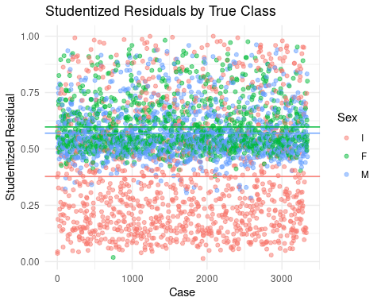

Slide 15
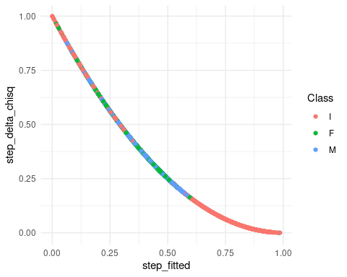
Delta Chi-Square vs. Predicted Probability

Slide 16
Model Testing
A likelihood-ratio test of the step-selected model over the initial model is highly significant. A goodness-of-fit test for the step-selected model has a p-value that is computationally 1, providing no evidence against the null of a good fit
Statistic: 112 Degrees of freedom: 6 Threshhold: 12.6 p = 6.87e-22

Slide 17
Type II ANOVA
A type II ANOVA test shows that all predictors aside from diameter significantly improve the fit when included. Whole.weight is by far the most important, followed by Rings and the interactions.
LR Chisq Df Pr(>Chisq) Whole.weight 288.53 2 2.22e-63 Length 52.76 2 3.49e-12 Diameter 4.48 2 1.06e-01 Height 5.60 2 6.07e-02 Rings 80.74 2 2.93e-18 Whole.weight:Rings 16.05 2 3.27e-04 Height:Rings 12.57 2 1.87e-03 Whole.weight:Diameter 4.61 2 9.98e-02

Slide 18
Comparing Different Weight Variables
Next we try refitting the model with each of all four available weight variables (including replacing the interaction) and comparing AIC. (AIC has no inherent interpretation, but is useful when comparing variants of the same model). It turns out whole weight has the lowest, but the differences are minor.

Slide 19
Class Separation by Height and Width
Plotting predicted class by height and width shows again that infants are well separated from adults. # Predicted Class by Height and Width

Slide 20
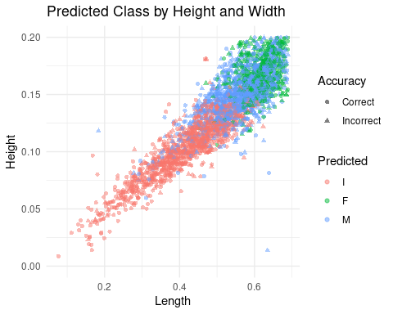

Slide 21
Comparison with Binary Classification
It is obvious that distinguising infants from adults is much easier than male from female adults. For comparison, we combine the male and female classes into “adult” and fit a binomial model.
# A tibble: 9 × 4 term estimate std.error p.value <chr> <dbl> <dbl> <dbl> 1 (Intercept) -2.79 0.713 9.38e- 5 2 Whole.weight 9.05 1.73 1.79e- 7 3 Length -22.0 3.18 4.83e-12 4 Diameter 1.01 3.83 7.92e- 1 5 Height 32.8 9.57 6.21e- 4 6 Rings 0.889 0.0918 3.64e-22 7 Whole.weight:Rings -0.409 0.0874 2.95e- 6 8 Height:Rings -2.91 0.890 1.08e- 3 9 Whole.weight:Diamet… 6.55 2.91 2.42e- 2

Slide 22
Deviance Comparison
While a direct likelihood ratio test is inappropriate because these models use different versions of the response, it is worth noting this binary model has less than half the deviance of the step-selected model.
Binary Deviance Three-Class Deviance 1 2560 5652

Slide 23
Model Validation
On both training and testing sets, sensitivity, specificity, and precision are much higher for the infant than the adult classes. However, test error was only a little higher than train error. Still, overall test accuracy is above 50%, much better than the 36% (the highest class proportion) achieved by the naive classifier.
I F M
I 859 48 162 F 154 330 566 M 240 288 694 Overall accuracy: 0.564

Slide 24
Class-Specific Statistics for Training Set
I F M sensitivity 0.804 0.314 0.568 specificity 0.830 0.683 0.692 precision 0.686 0.495 0.488

Slide 25
Test Set Results
Results on the test set are very similar, suggesting minimal generalization error. Overall test accuracy is 0.568.
I F M I 223 14 36 F 36 82 139 M 67 69 170
I F M sensitivity 0.817 0.319 0.556 specificity 0.834 0.692 0.692 precision 0.684 0.497 0.493

Slide 26
Test-Train Comparison and Overall Accuracy
The difference of the two confusion matrices shows that test and train performance are similar.
I F M sensitivity -0.01330 -0.00478 0.012366 specificity -0.00462 -0.00866 0.000877 precision 0.00151 -0.00147 -0.004709

Slide 27
Conclusion
Male and female adult abalone are difficult to distinguish using predictors avaliable in this dataset. Using a $J−1$ logits baseline model with interaction terms, approximately 50% classification accuracy was achieved. However, infant abalone are smaller than adults of either sex, making them significantly easier to classify accurately. Future research should focus on finding easily measured predictors for which the adult sexes are easily distinguished. Published research tends to focus on classifying abalone age in years (e.g, Abdelbar [1998]). For the reason noted above, this in some ways an easier problem than classifying sex.

Slide 28
References
Abalone Dataset. (n.d.). [2022]. Kaggle. Retrieved April 15, 2022, from https://www.kaggle.com/rodolfomendes/abalone-dataset
Abdelbar, A. M. (1998). Achieving superior generalisation with a high order neural network. Neural Computing and Applications, 7, 141–147.
Bradley, R. (2010, March 9). How to Sex an Abalone: A Sea Snail’s Story. The Atlantic. https://www.theatlantic.com/health/archive/2010/03/how-to-sex-an-abalone-a-sea-snails-story/37198/

