Slide 1


Decentralized Finance
Sentiment Analysis
By Saud Ishaq
September / 16 / 2020

Slide 2
Agenda
Objective
Approach
Exploration
Introduction
Visualization
Codes

Slide 3
What is defi?
Decentralized finance generally refers to the digital assets and financial smart contracts, protocols, and decentralized applications (DApps) built on Ethereum.
Source: https://defipulse.com/blog/what-is-defi/
Cost
Reach
Speed
Openness

Slide 4

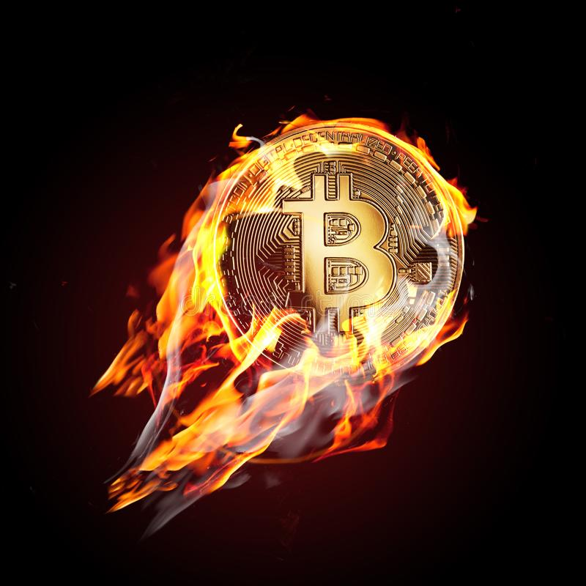

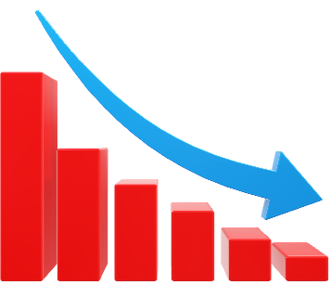

Slide 5

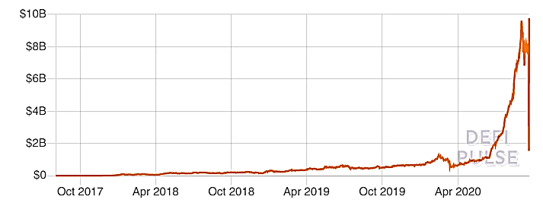
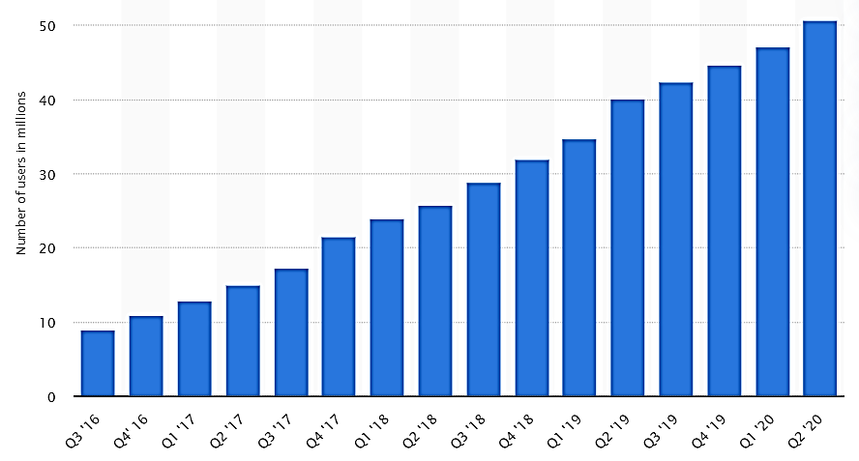
Number of Blockchain wallet users worldwide
Source: www.statista.com/statistics/647374/worldwide-blockchain-wallet-users
Total Value Locked in Defi (USD)
Source: https://defipulse.com/

Slide 6

Major advancements
A crypto exchange become a bank (Kraken)
Traditional finance adapting (Crypto friendly banks)
Corporations invest in crypto (Microstrategy)

Slide 7
Sentiment analysis Model Objectives
Positive sentiment?
Major influencers?
Location of tweets?

Slide 8






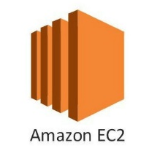




Approach
Please view in slideshow mode for better process flow
Defined a schema for the dataframe and connected it to QuickSight to visualize it
Used GitBash to control EC2 instance
Boto3, Twitter API and Python3
Created a dataframe
Performed data cleansing and feature engineering
Predicted sentiment using ML
Pyspark, Python, and SQL codes
Kinesis Firehose
Streamed and fetched live data on the background
Saved it on the cloud (S3 Bucket)
Json format

Slide 9
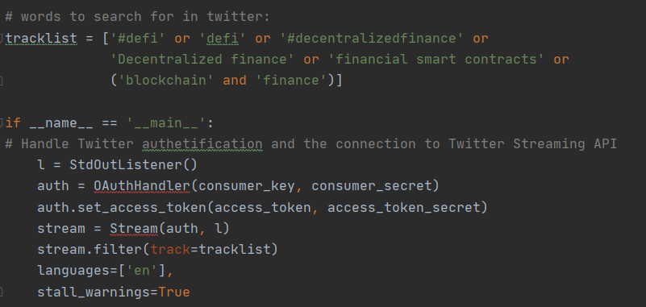
Fetching Tweets

Slide 10
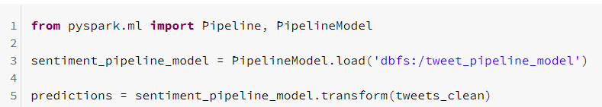
Databricks
Existing sentiment analysis trained model

Slide 11
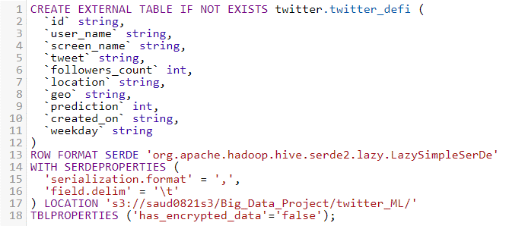
Connecting to Quicksight

Slide 12
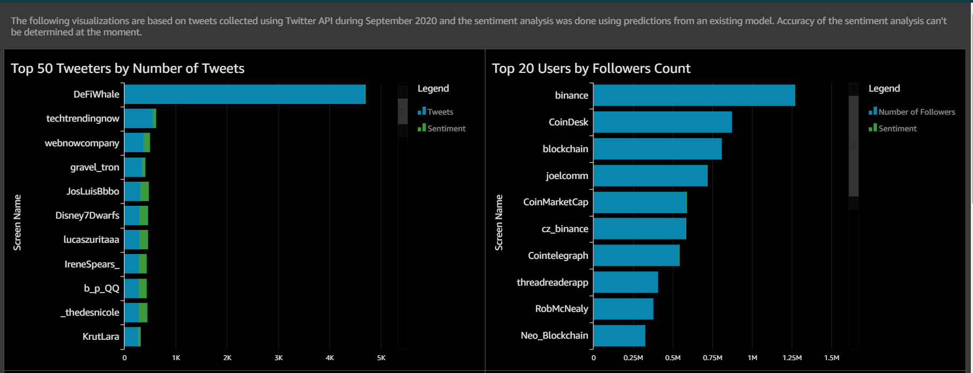
Visualization

Slide 13
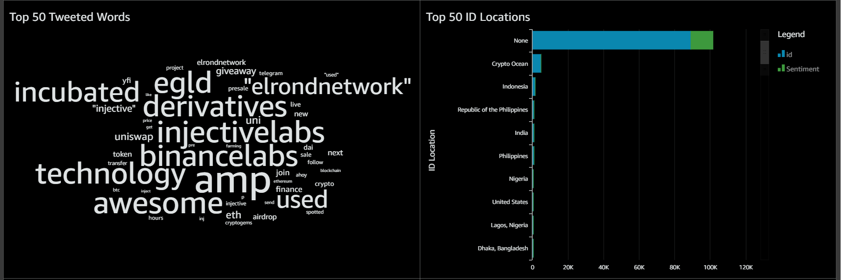
Visualization

Slide 14
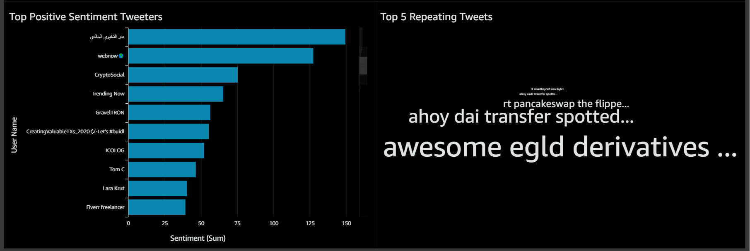
Visualization

Slide 15
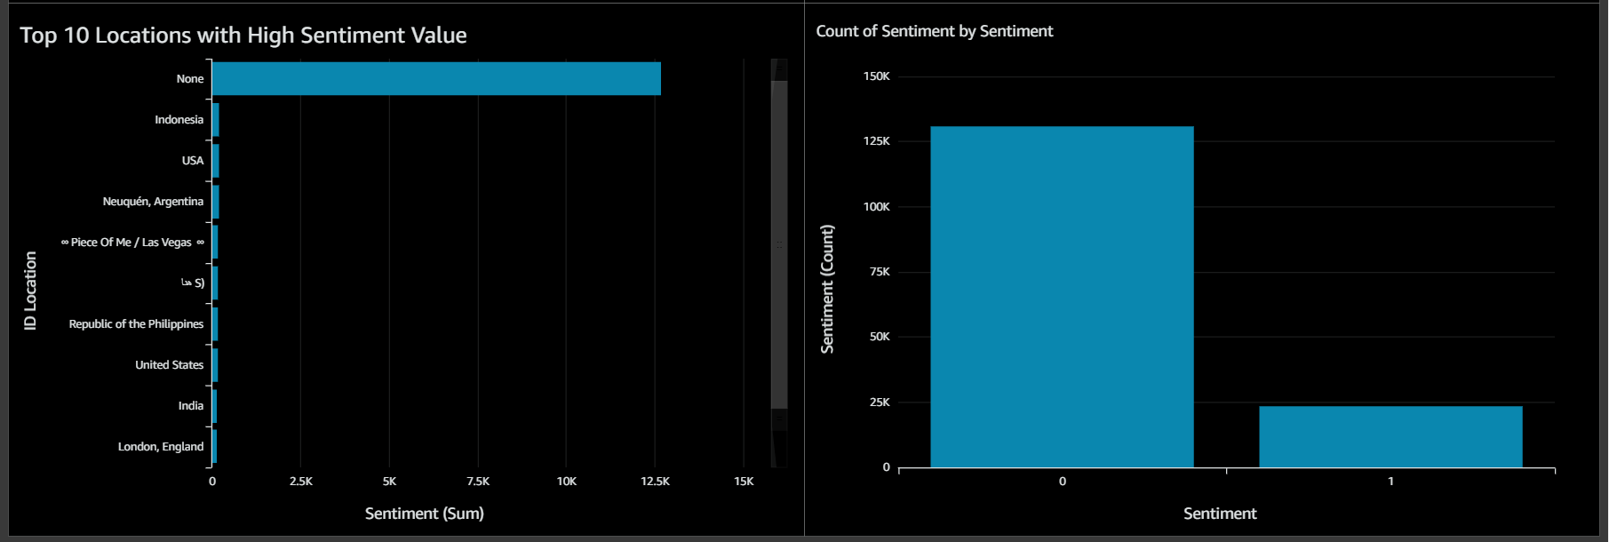
Visualization

Slide 16
Conclusion
Positive sentiment:
  Low 15%
Major Influencers:
  DefiWhale (Number of Tweets)
  Binance (Number of Followers)
Top Locations:
  “None”
  Crypto Ocean
  Indonesia

Slide 17

Further Exploration
Enhanced Sentiment Analysis Model
Collect tweets over a longer period
Collect tweets in better market conditions
WCD - Sep 2020
17

Slide 18

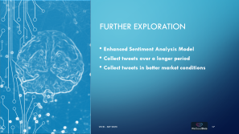

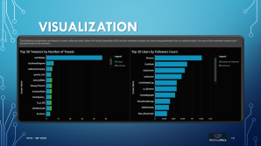
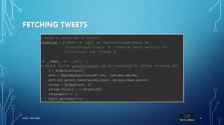
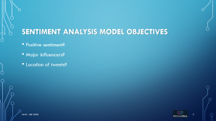
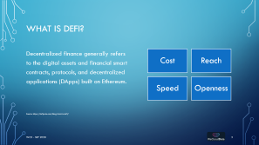
Questions
Saud Ishaq

