Slide 1


Data Visualization
By
Taz Khan
Saud Ishaq
August / 07 / 2020

Slide 2
Agenda
Overview
Objective
Data
Visualization
Opportunities

Slide 3



Introduction

Slide 4

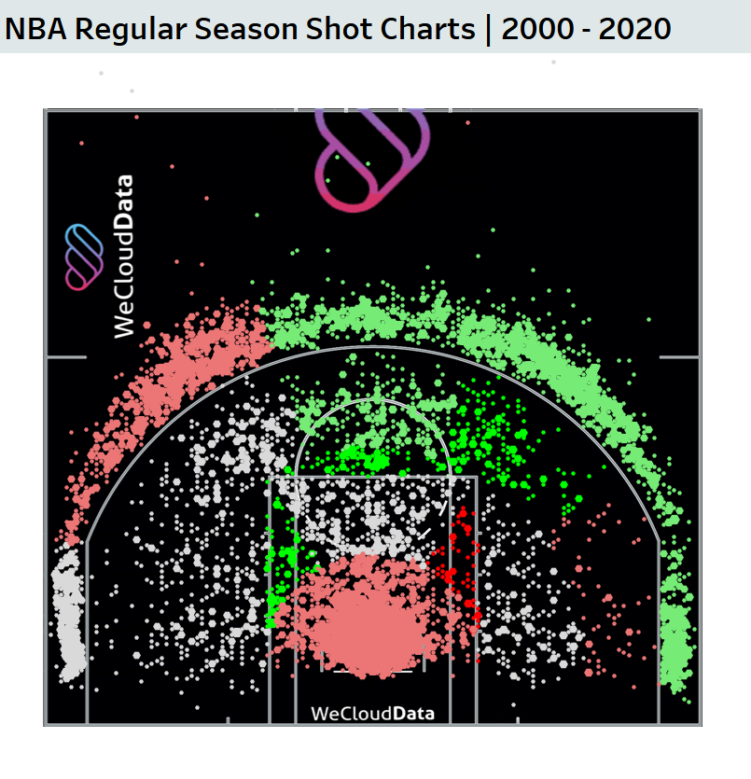
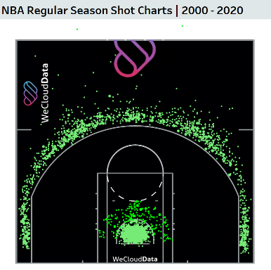

Objective
Easily interpreted
Players affect (defending and scoring)
Interactive court graph
Comparative dashboard
Trends (shooting behaviour)

Slide 5
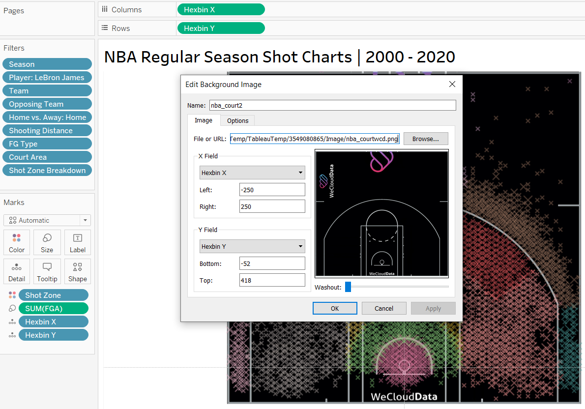
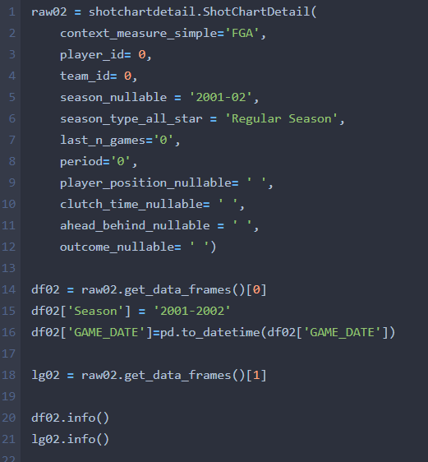
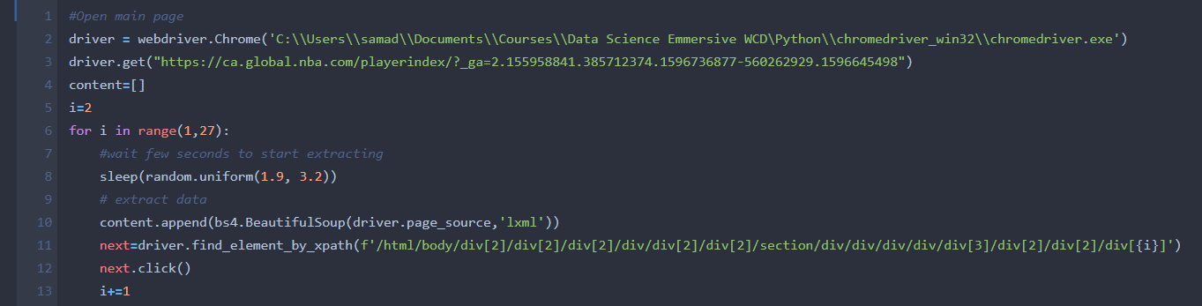
Data
API
Selenium
Tableau

Slide 6
Data
20
Seasons
3,955,504
Rows
31
Features
30
Teams
4,501
Players
122,620,624

Slide 7





Dashboard Demo

Slide 8
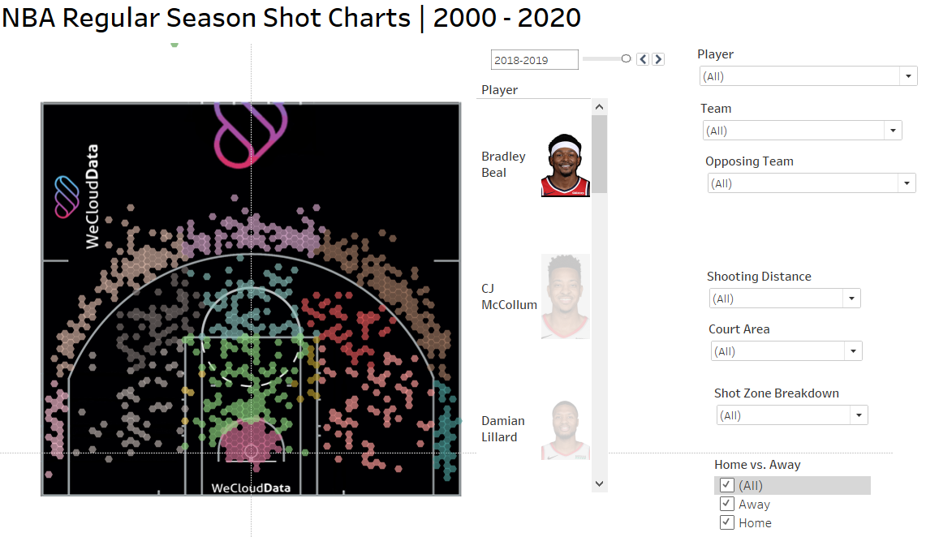
Future Exploration
Nearest defender impact on shot
Better interface
Conditional filters
Image integration

Slide 9


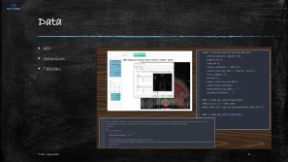
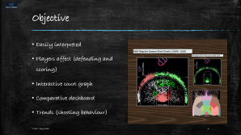


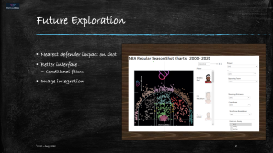
Questions
Taz Khan
Saud Alkoheji

