Slide 1

ECS 351L and 851L : Geospatial Data Science
Lecture 6: Machine learning applications
Email: jonathan.ryan@duke.edu
Office: 3101 Grainger Hall
Office hours: Mondays and Wednesdays 15:00-16:00

Slide 2
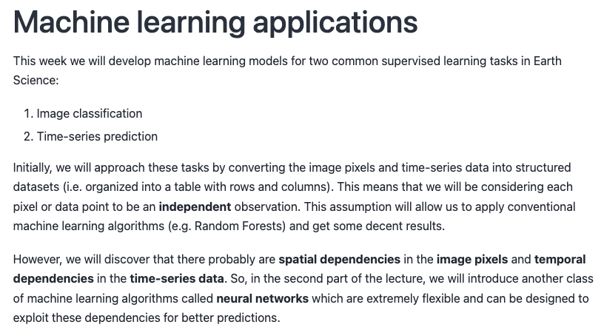

Slide 5
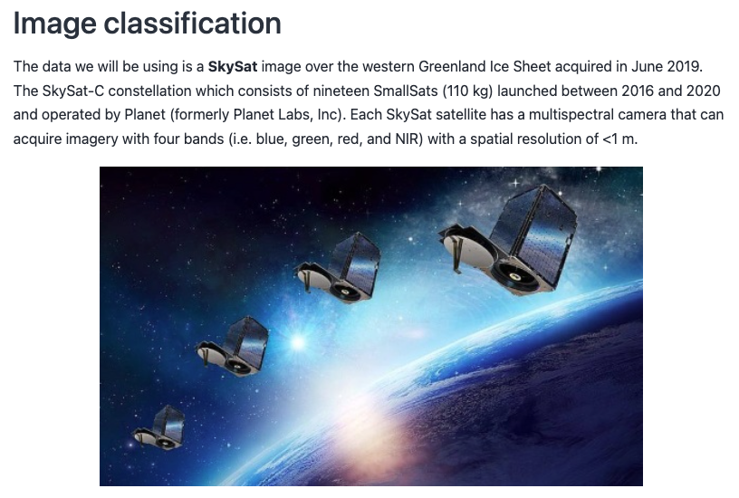

Slide 6
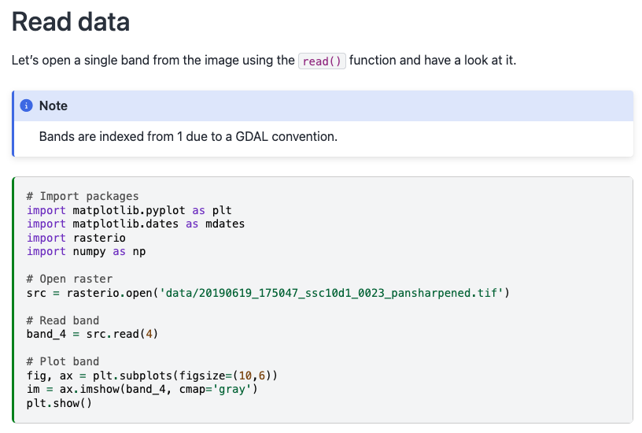

Slide 7
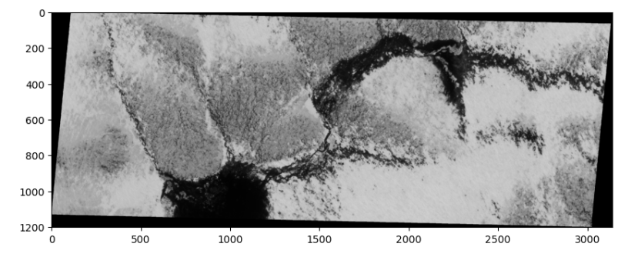

Slide 8
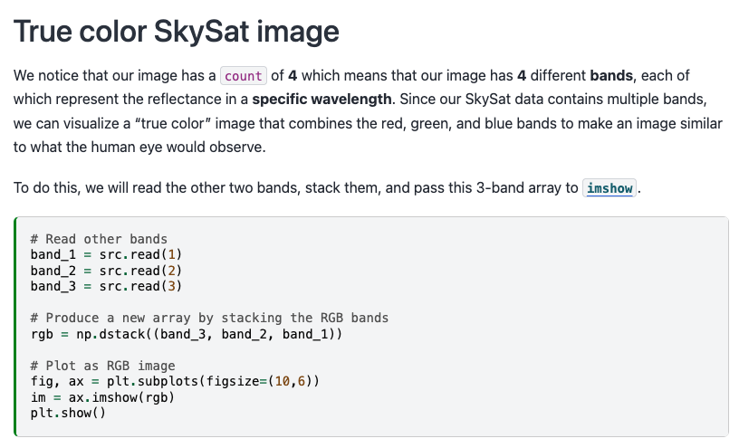

Slide 9
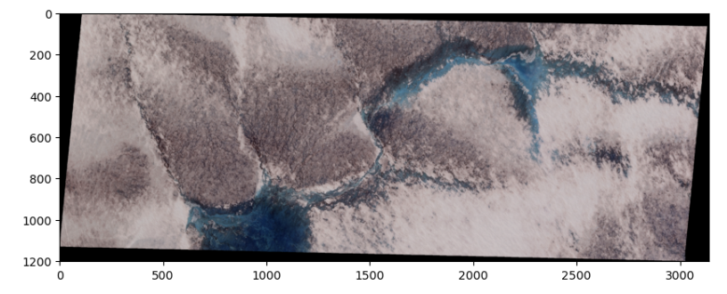

Slide 10
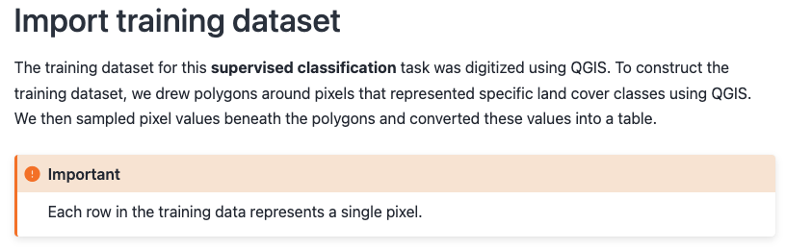

Slide 11
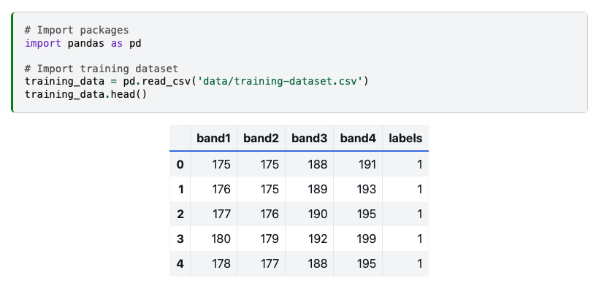

Slide 12
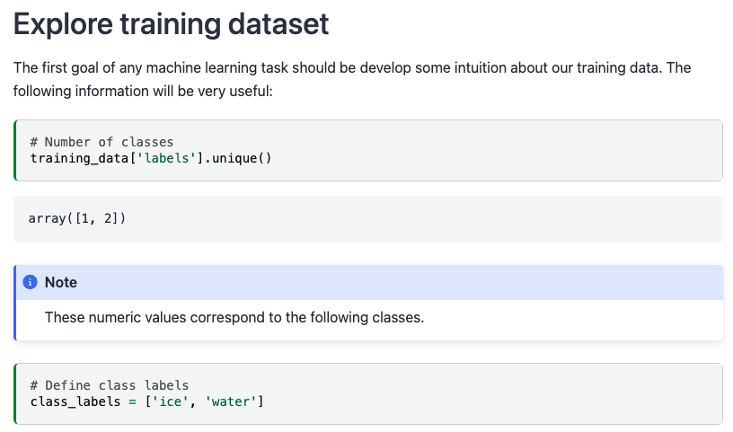

Slide 13
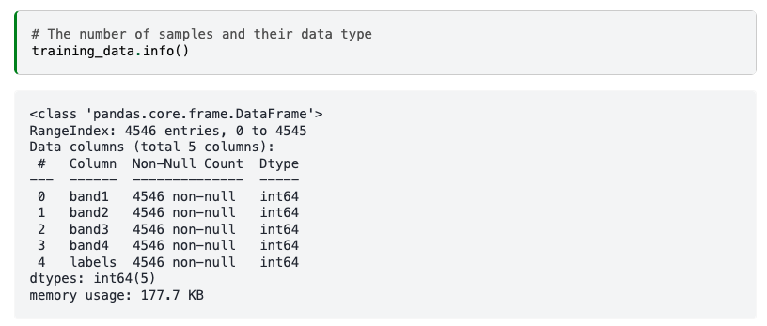

Slide 14
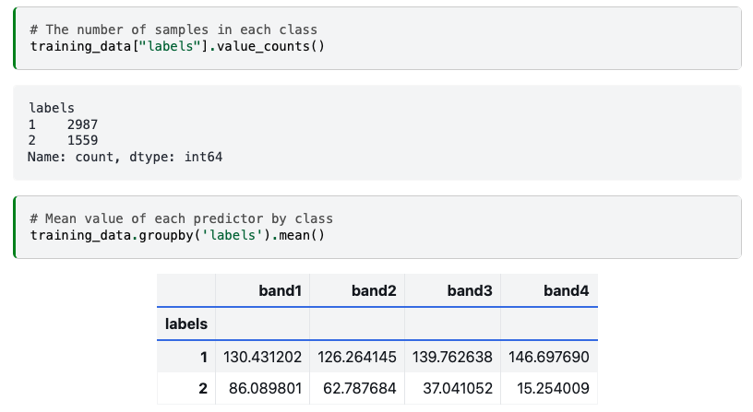

Slide 16
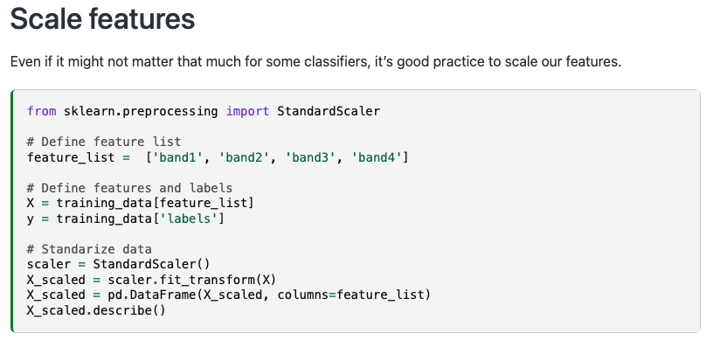

Slide 17
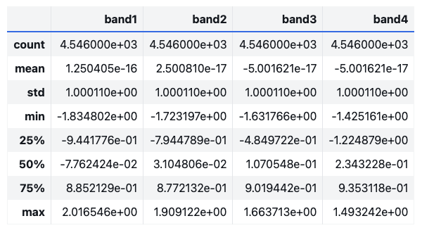

Slide 18
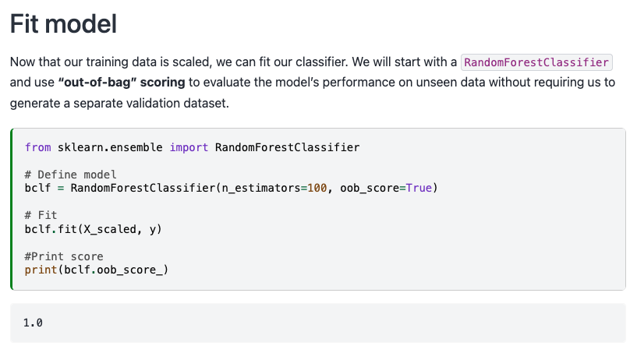

Slide 21
Next time: Specialized neural networks
Email: jonathan.ryan@duke.edu
Office: 3101 Grainger Hall
Office hours: Mondays and Wednesdays 15:00-16:00

