Slide 1

ECS 351L and 851L : Geospatial Data Science
Bonus lecture: Previous class projects
Email: jonathan.ryan@duke.edu
Office: 3101 Grainger Hall
Office hours: Mondays and Wednesdays 15:00-16:00

Slide 2
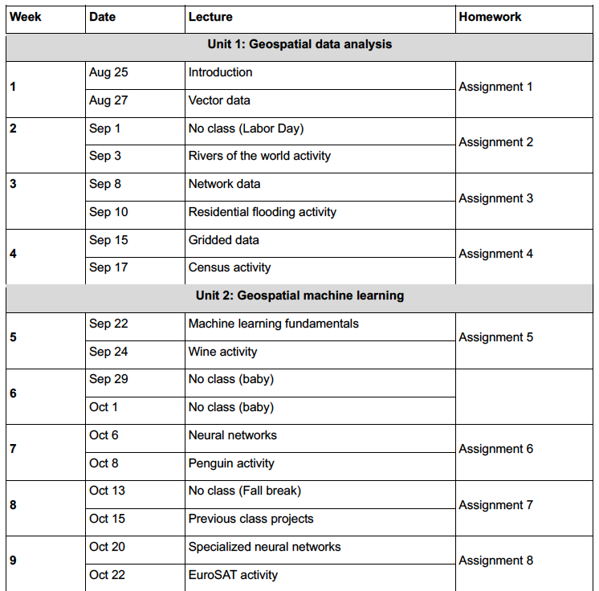

Slide 3
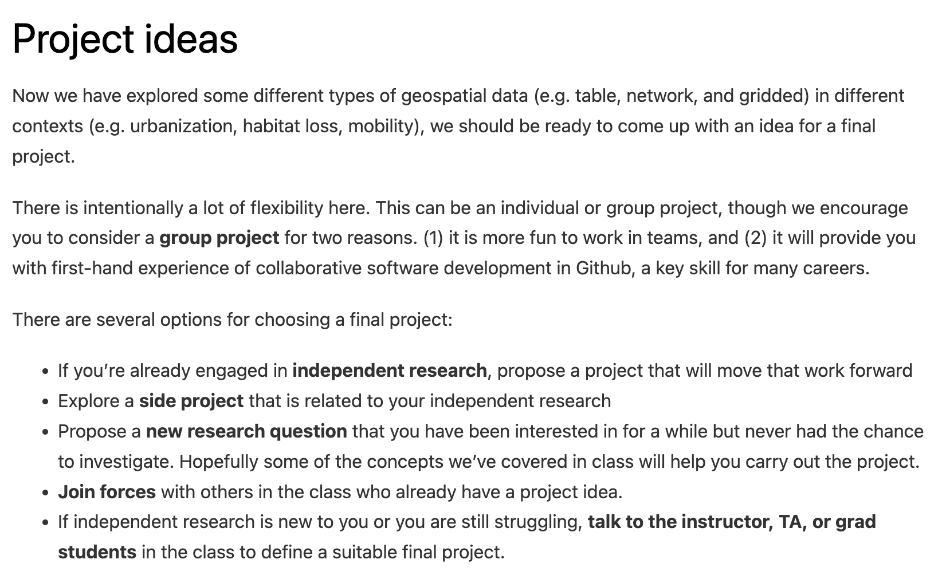
Assignment 7 (due Oct 22)

Slide 4
Assignment 7 (due Oct 22)

Slide 5
Assignment 7 (due Oct 22)

Slide 6
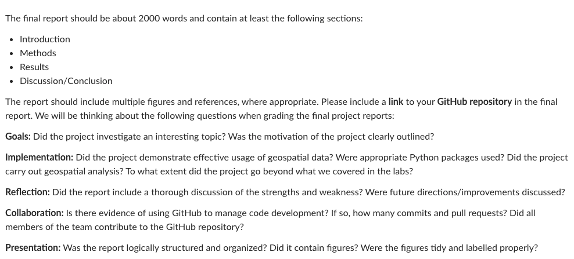
Final project report (due Dec 5)

Slide 7
Final project report (due Dec 5)

Slide 8
Final project report (due Dec 5)

Slide 9
Final project presentations (week starting Dec 1)
10-minute presentation with 2 minutes for questions
10 slides, one minute per slide
Similar structure to final project reports

Slide 10
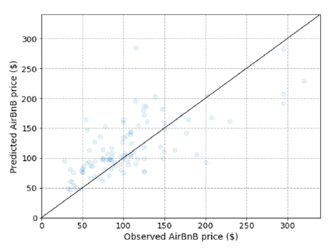
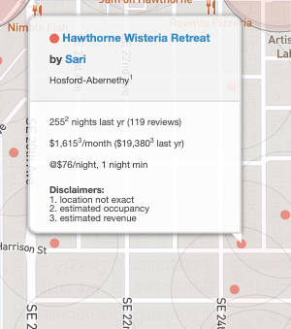
Machine learning AirBnB rates in Portland
https://insideairbnb.com/

Slide 11
Post-fire vegetation recovery for the Holiday Farm Fire, Oregon
Notes:
Four Landsat images

Slide 12
Post-fire Vegetation Recovery for the Douglas Fire Complex, Oregon
Notes:
92 Landsat images in Google colab

Slide 13
Parking lot surface area coverage in U.S. Cities
OSMnx to download geospatial data from OpenStreetMap that contained the tag “parking”

Slide 14
Spatial distributions of COVID-19 vaccine availability according to race
OSMnx to download street network data from OpenStreetMap to compute walking and driving distances to nearest vaccination clinic.
census package to download population and race/ethnicity data for Detroit, Michigan
Won the Trussell Family Scholarship ($2000)
Notes:
Detroit

Slide 15
Machine learning the discharge of the Nisqually River
Notes:
Detroit

Slide 16
Tsunami evacuation times
Notes:
Seaside Oregon

Slide 17
Lamprey habitat suitability modeling
Notes:
Seaside Oregon

Slide 18
Next time: Specialized neural networks
Email: jonathan.ryan@duke.edu
Office: 3101 Grainger Hall
Office hours: Mondays and Wednesdays 15:00-16:00

