Slide 1
GEOG 4/590: Geospatial Data Science
Lecture 4.5: Previous class projects
Email: jryan4@uoregon.edu
Office: 163A Condon Hall
Office hours: Monday 14:00-16:00

Slide 2
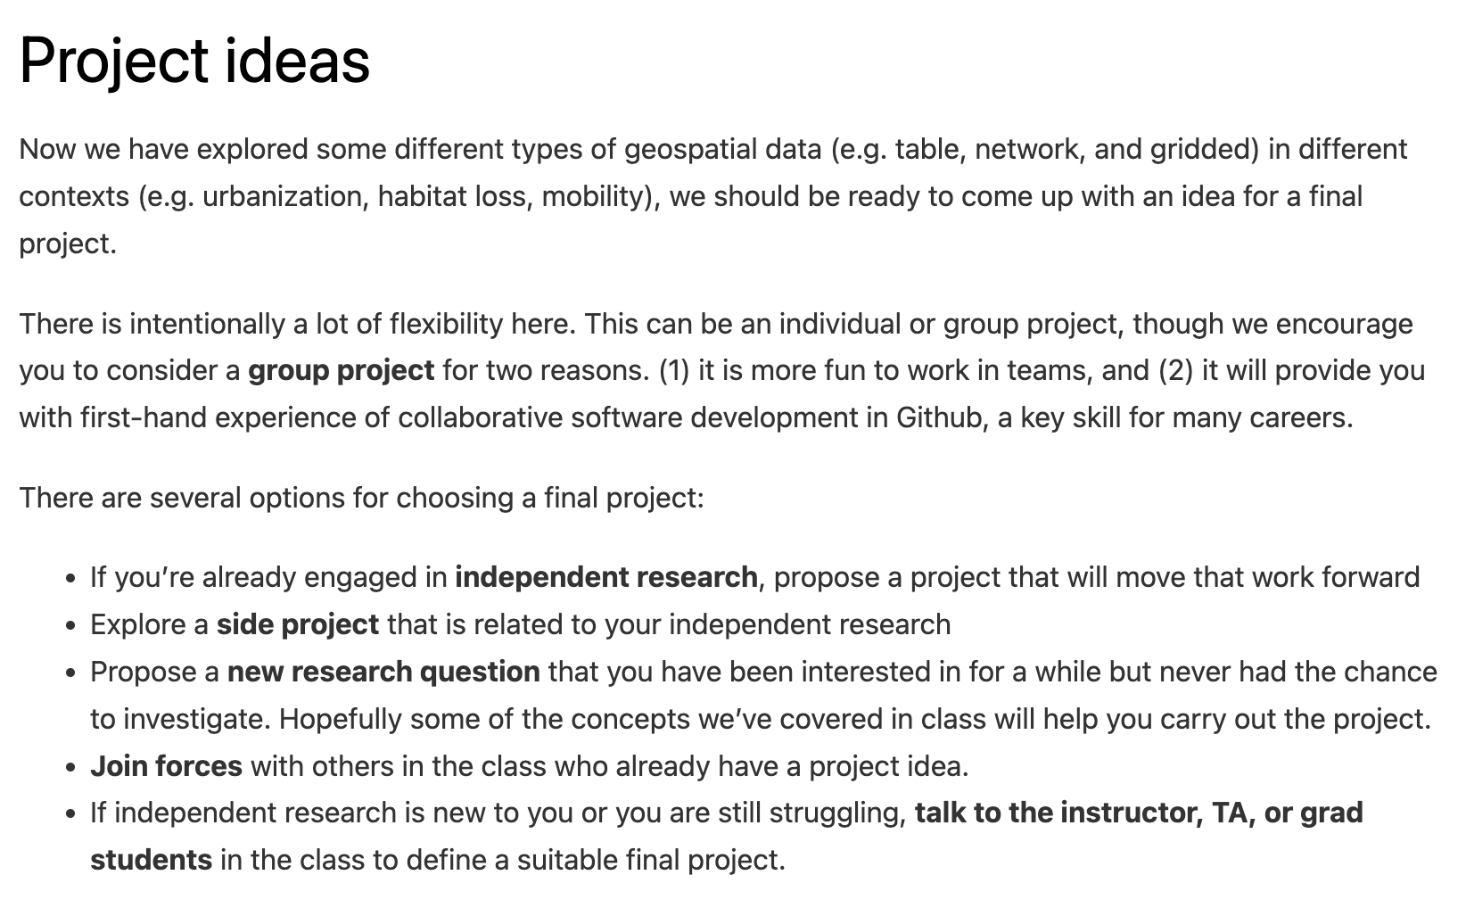
Final projects

Slide 3
Final projects

Slide 4
Final projects

Slide 5
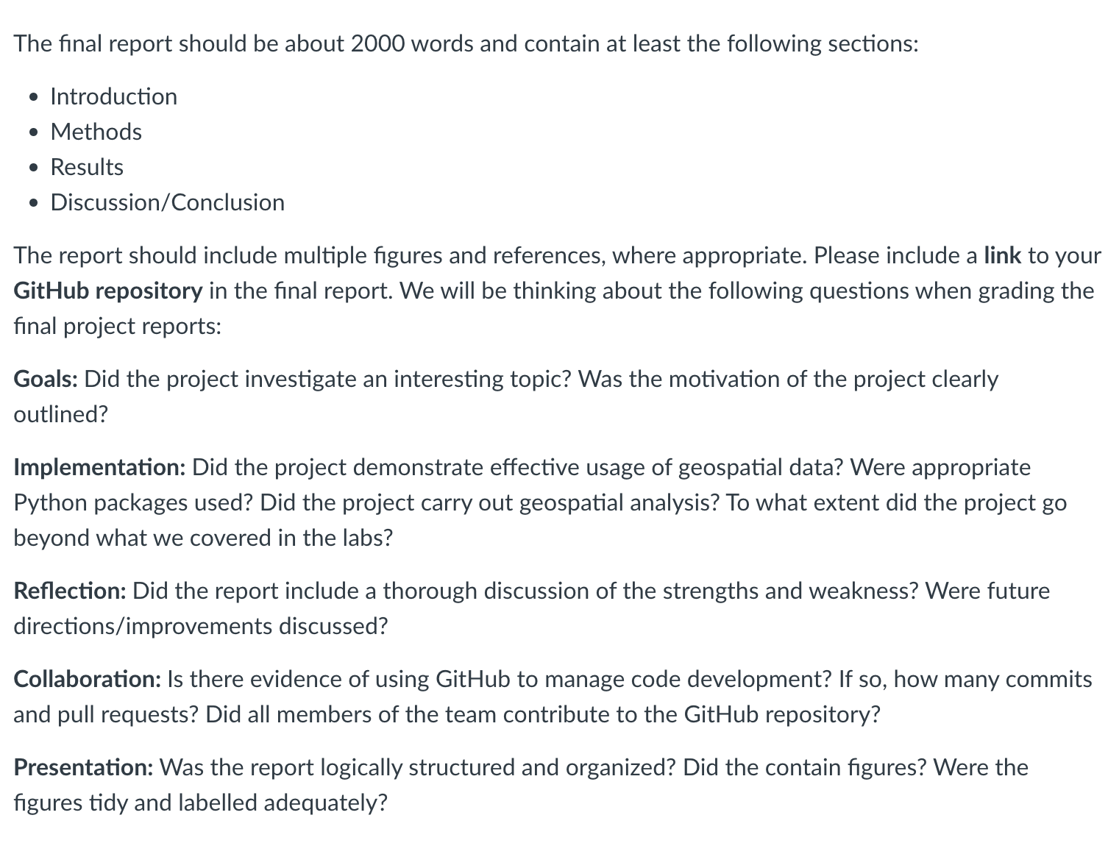
Final projects

Slide 6
Final projects

Slide 7
Final projects

Slide 8
Machine learning AirBnB rates in Portland
https://insideairbnb.com/

Slide 9
Post-fire vegetation recovery for the Holiday Farm Fire, Oregon
Notes:
Four Landsat images

Slide 10
Post-fire Vegetation Recovery for the Douglas Fire Complex, Oregon
Notes:
92 Landsat images in Google colab

Slide 11
Parking lot surface area coverage in U.S. Cities
OSMnx to download geospatial data from OpenStreetMap that contained the tag “parking”

Slide 12
Spatial distributions of COVID-19 vaccine availability according to race
OSMnx to download street network data from OpenStreetMap to compute walking and driving distances to nearest vaccination clinic.
census package to download population and race/ethnicity data for Detroit, Michigan
Won the Trussell Family Scholarship ($2000)
Notes:
Detroit

Slide 13
Machine learning the discharge of the Nisqually River
Notes:
Detroit

Slide 14
Tsunami evacuation times
Notes:
Seaside Oregon

Slide 15
Lamprey habitat suitability modeling
Notes:
Seaside Oregon

Slide 16


