Slide 1
Electron momentum distributions in metals using the Angular Correlation of positron Annihilation Radiation
(ACAR)
24th May, 2010
Supervisors:
Prof. C. D. Beling Prof. S. Fung
Department of Physics, HKU Department of Physics, HKU
Presenter:
Leung Wai Yan
2007132498

Slide 2
Positrons - Antimatter of electrons
Mass: 0.511MeV
Charge: +1
Spin: ½
Antimatter of electrons
Theorized by Paul. A.M. Dirac
Discovered by Carl D. Anderson
24th May, 2010
[ <number> ]

Slide 3
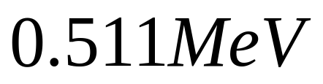
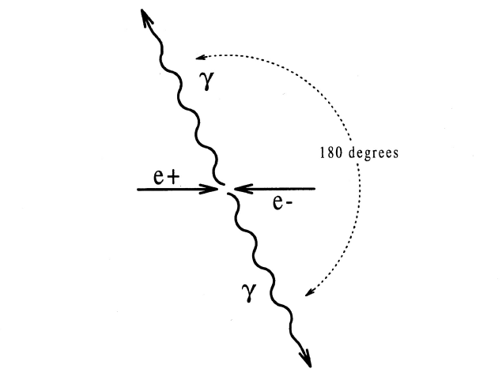
Electron–positron annihilation
24th May, 2010
[ <number> ]

Slide 4
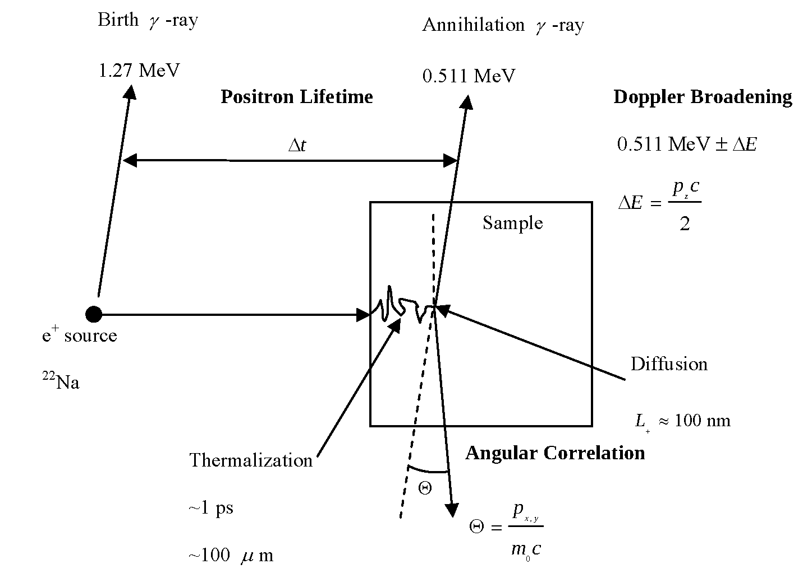
Early positron research
(Sources: 2)
24th May, 2010
[ <number> ]

Slide 5
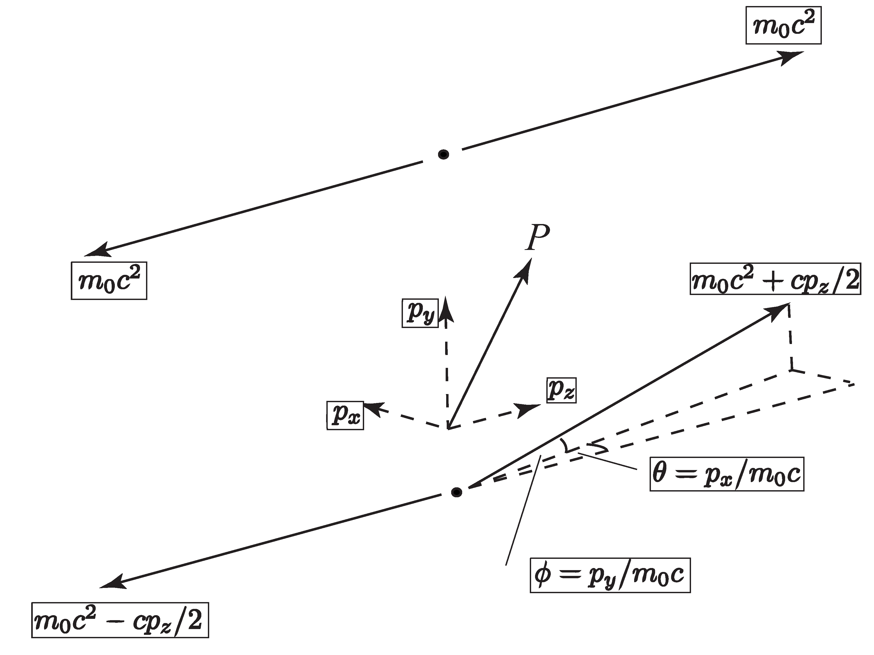
Angular Correlation of Annihilation Radiation
24th May, 2010
[ <number> ]

Slide 6
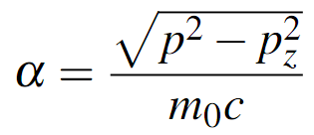
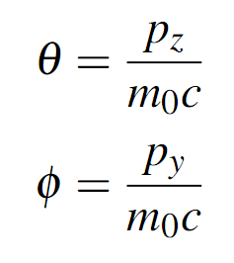
Angular Correlation of Annihilation Radiation
(2.7)
For small angles,
(2.8)
(2.9)
24th May, 2010
[ <number> ]

Slide 7

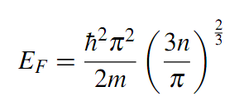




Fermi Gas Model
Energy level of a fermi gas
Fermi-energy and Fermi-momentum
Distribution in the magnitude of momentum
Distribution in the x component of momentum
24th May, 2010
[ <number> ]

Slide 8
ACAR EXPERIMENT
Chapeter 2
24th May, 2010
[ <number> ]

Slide 9
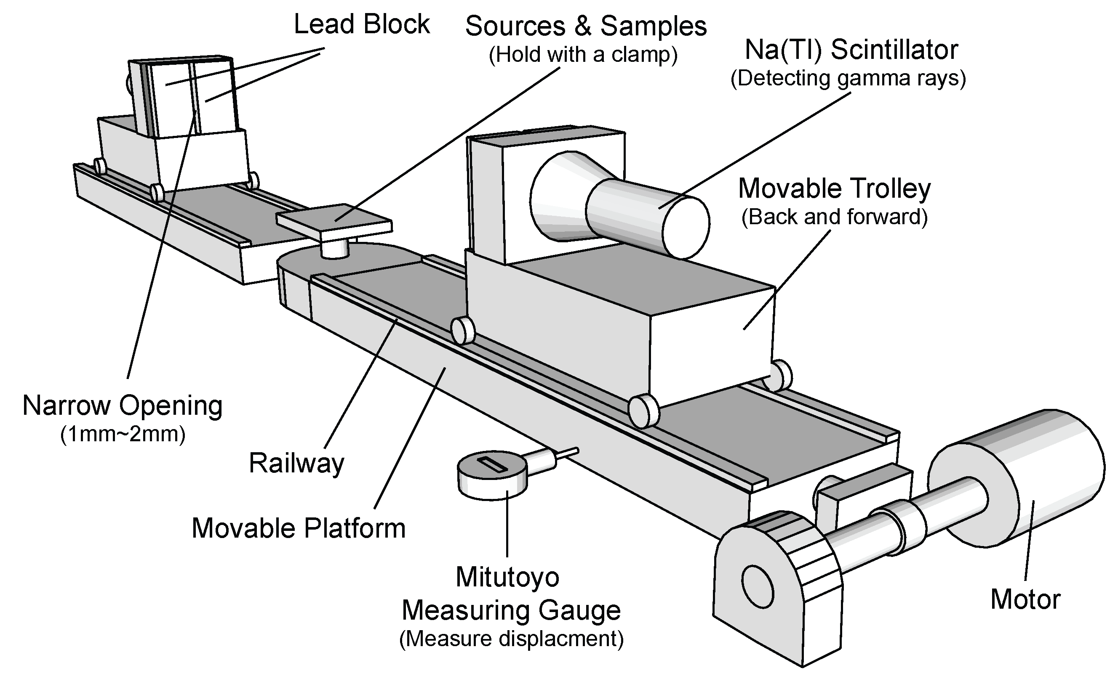
1D ACAR Spectrometer
24th May, 2010
[ <number> ]

Slide 10
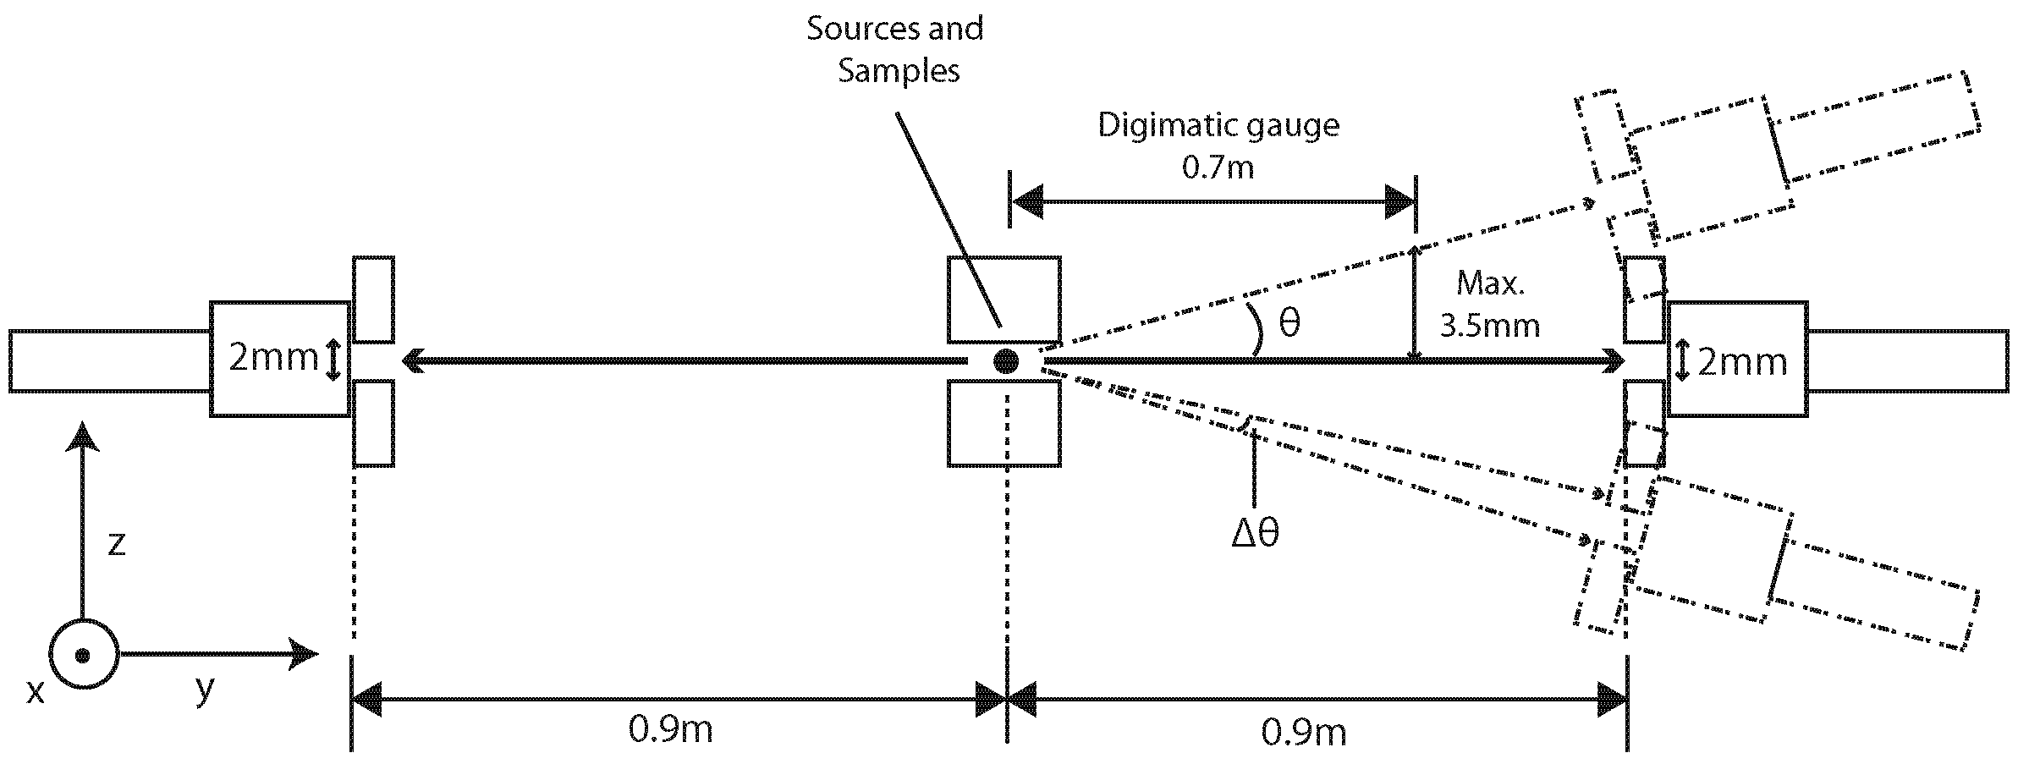
Schematic Diagram
x
y
z
24th May, 2010
[ <number> ]

Slide 11

Positron Sources
Germanium - 68
Half life: 275 days
All decay into Gallium - 68 first
Decay into.. By… | Stable Zinc-68 | Excited Zinc-68
Positron emission | 84% | 3.5%
Electron capture | 9.8% | 3.9%
24th May, 2010
[ <number> ]

Slide 12
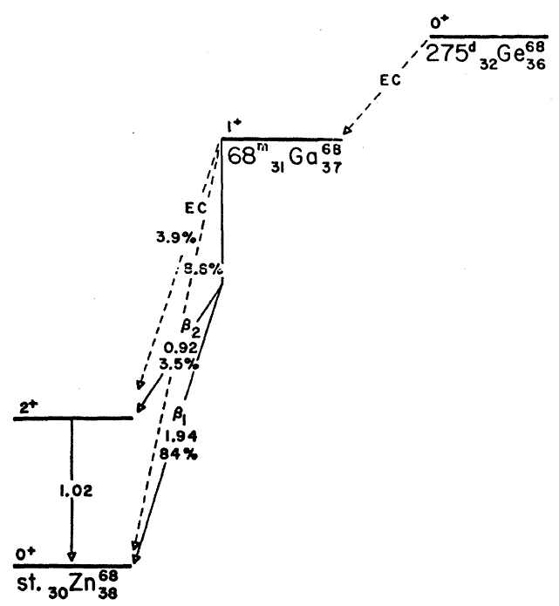
Germanium Decay Diagram
24th May, 2010
[ <number> ]

Slide 13
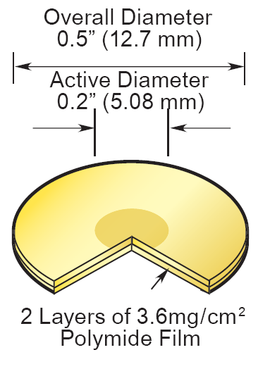
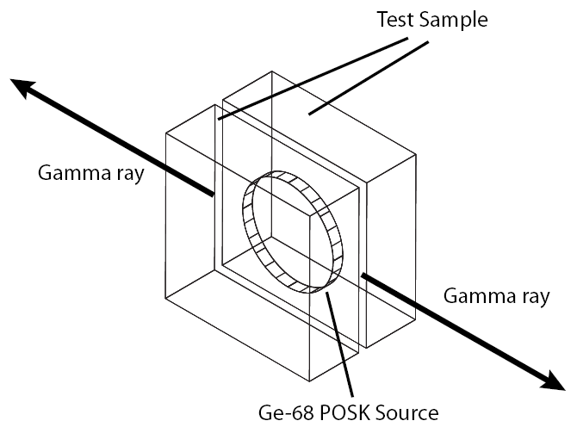
Germanium-68 Source
24th May, 2010
[ <number> ]

Slide 14
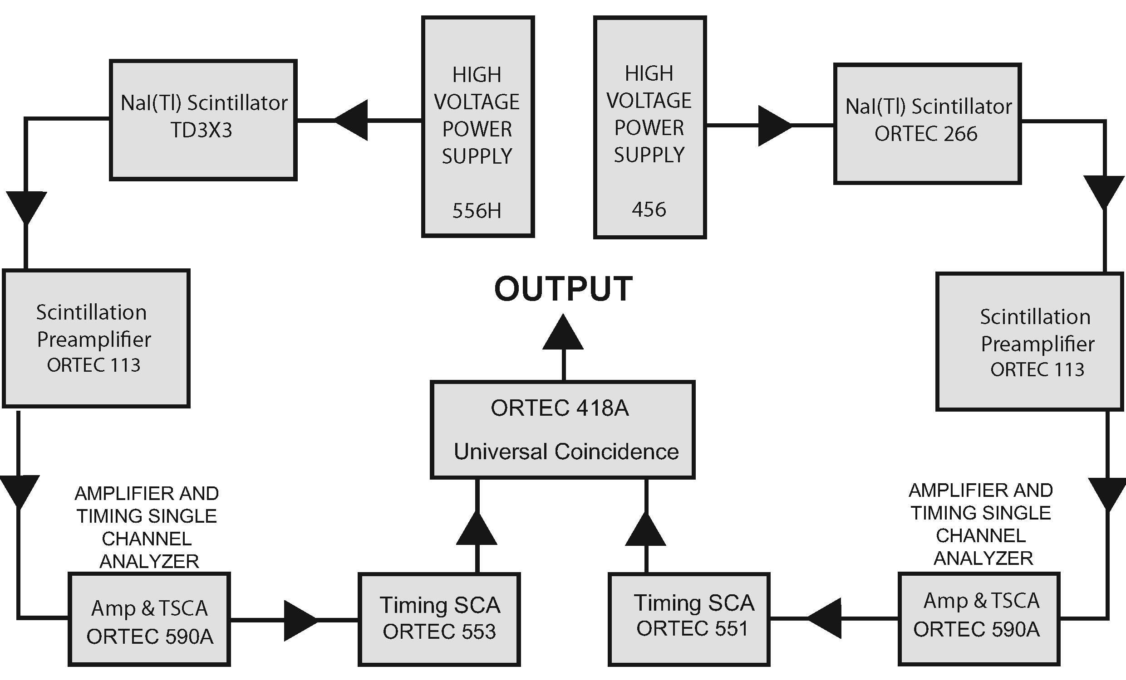
Gamma-Gamma coincidence electronic setup
24th May, 2010
[ <number> ]

Slide 15
High-Voltage power supply
Provide enough power for the operation of the photomultiplier tube in the NaI Scintillation detectors
Left Detector Model : Ortec 556H (0.6V)
Right Detector Model : Ortec 456 (0.6V)
24th May, 2010
[ <number> ]

Slide 16
NaI(TI) Scintillation Detector
The Scintillation Detector detects the gamma ray and releases photo electrons to a photomultiplier tube.
The photomultiplier tube increases the number of photoelectrons to make a current pulse.
24th May, 2010
[ <number> ]

Slide 17
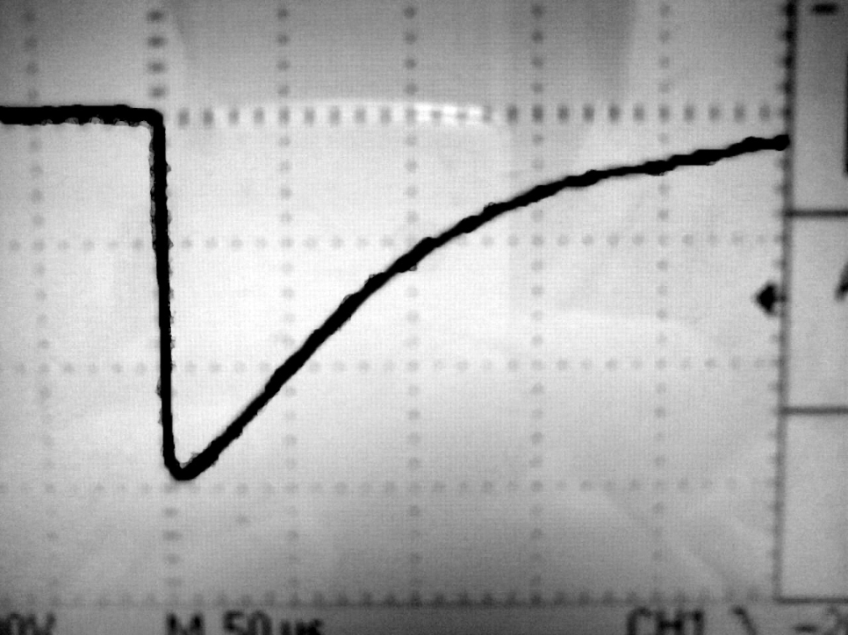
Scintillation Preamplifier
Model: Ortec 113
Extract the signal from the scintillation detectors
Change the charges from the PM Tube to produce a voltage pulse
Signal Shape
24th May, 2010
[ <number> ]

Slide 18
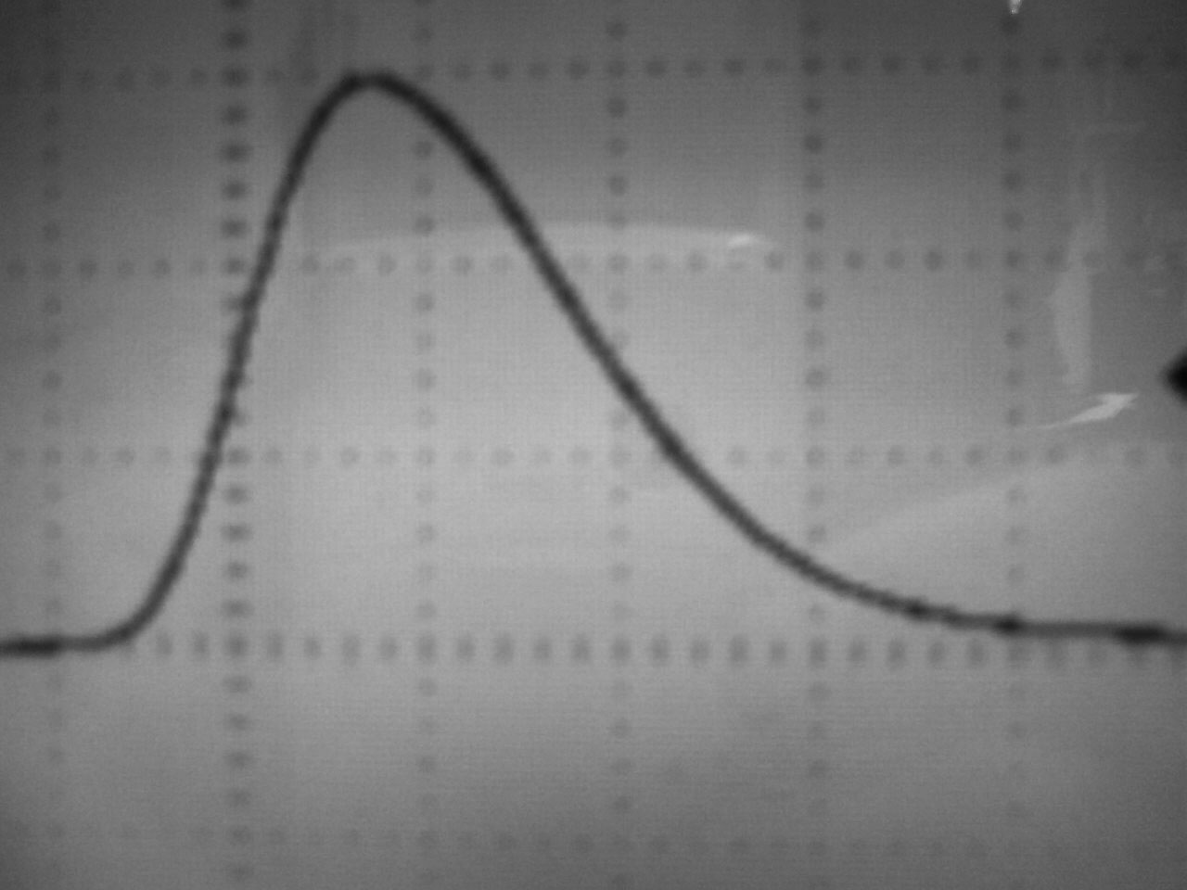
Amplifier
Model: Ortec 590A
Low-noise shaping amplifier (active-filter shaping on the incoming signal)
Unipolar semi-Gaussian pulse shape
24th May, 2010
[ <number> ]

Slide 19
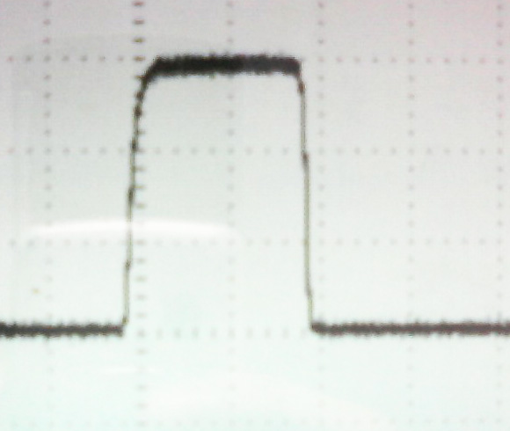
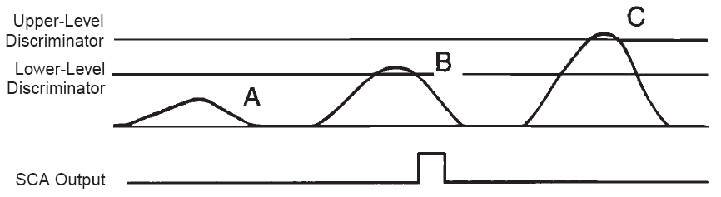
Timing Single-Channel Analyzer
Model: Ortec 551
Select specific range of pulses
Logic pulses will be generated only if the peak of the input signals falls within the range
24th May, 2010
[ <number> ]

Slide 20
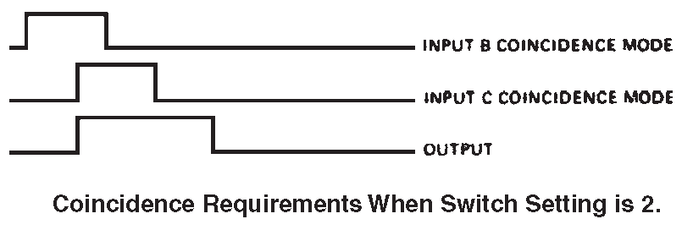
Universal Coincidence
Model: Ortec 418A
Generate a logic pulse if a signal from one of the inputs arrived within the resolving time of a pulse from another input.
24th May, 2010
[ <number> ]

Slide 21
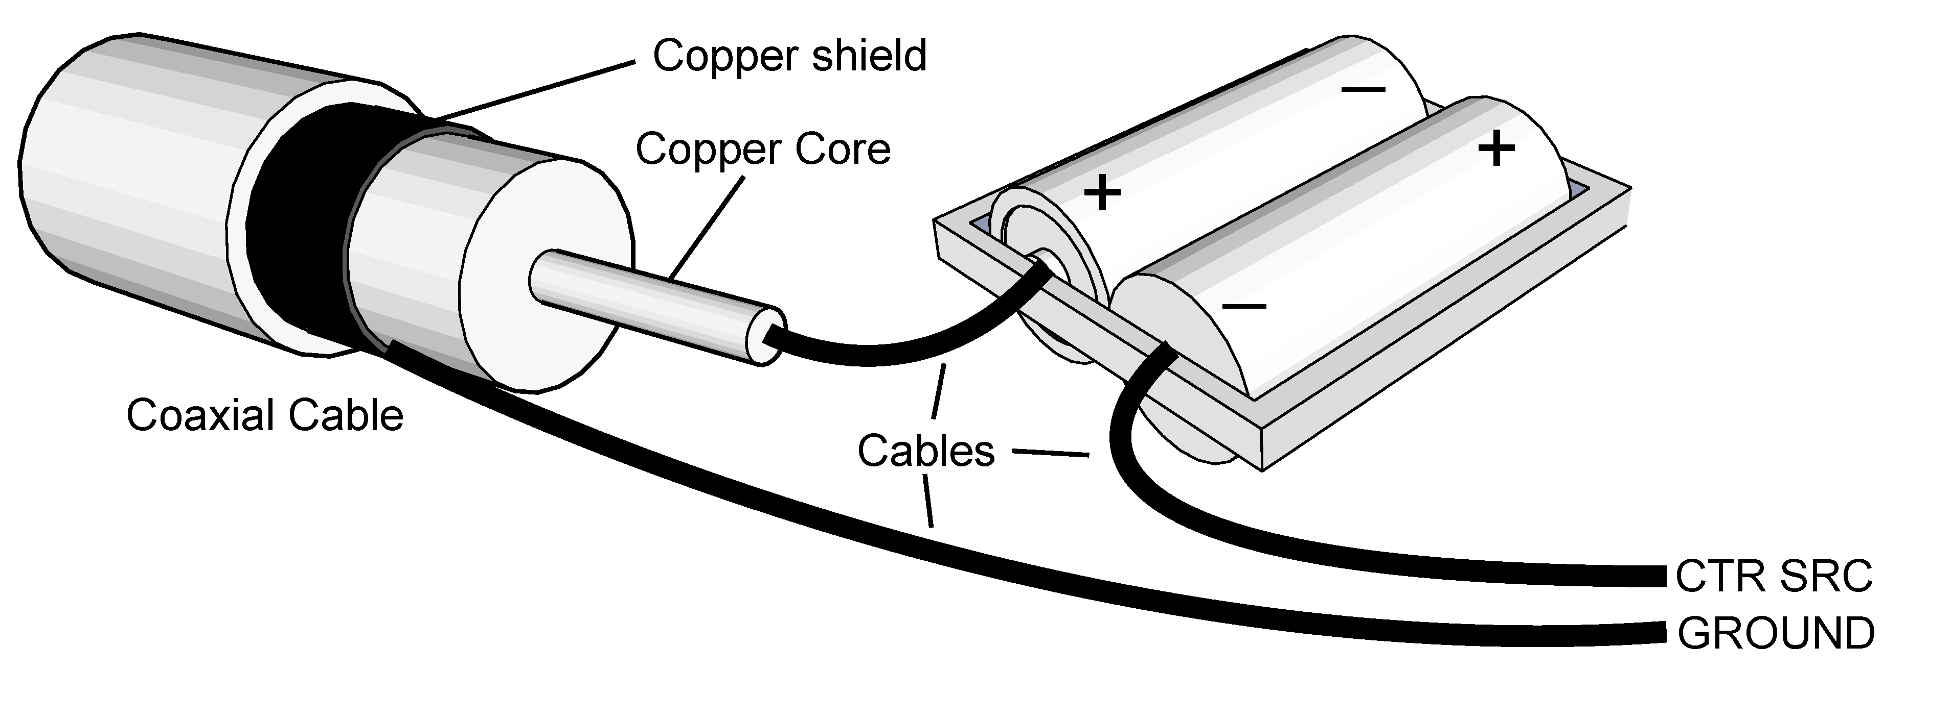
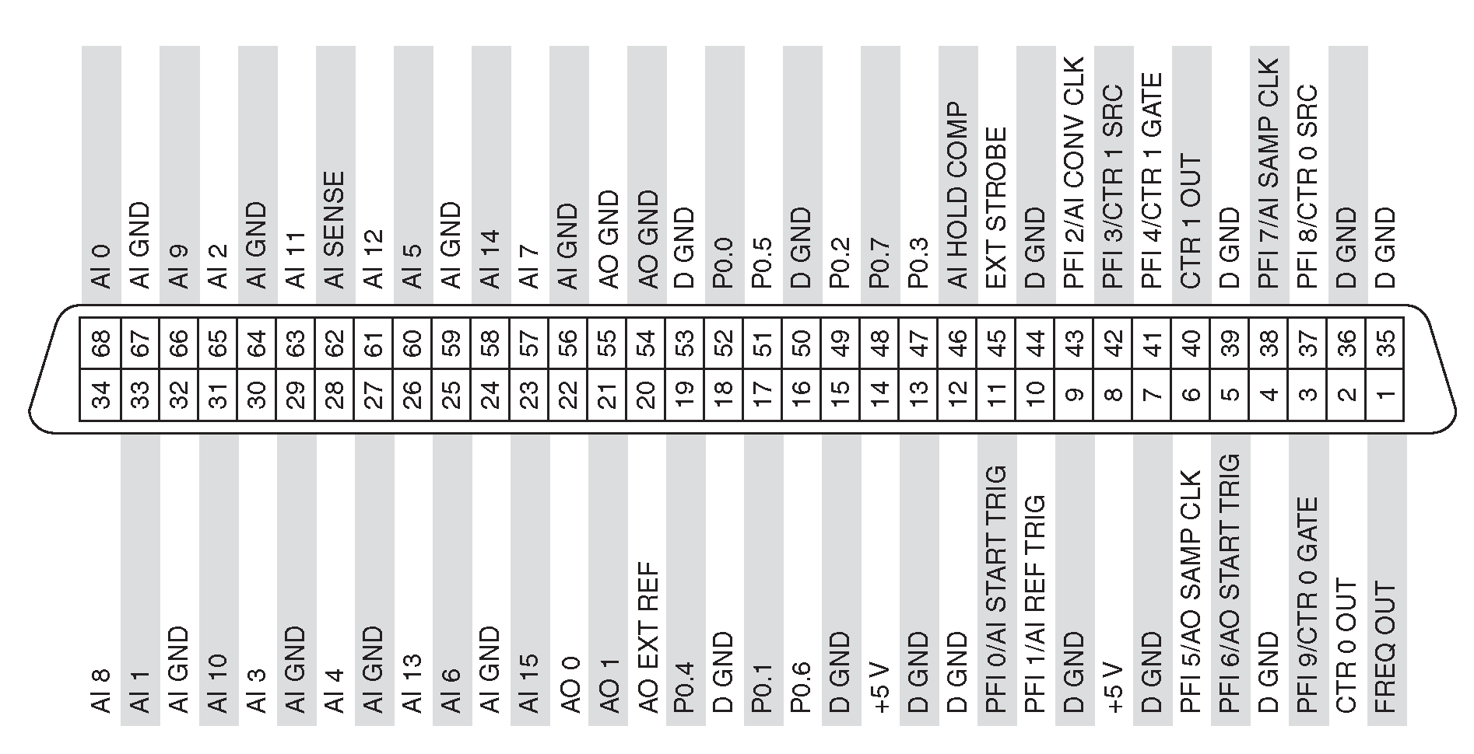
Multifunction Data Acquisition (DAQ) Card
24th May, 2010
[ <number> ]

Slide 22
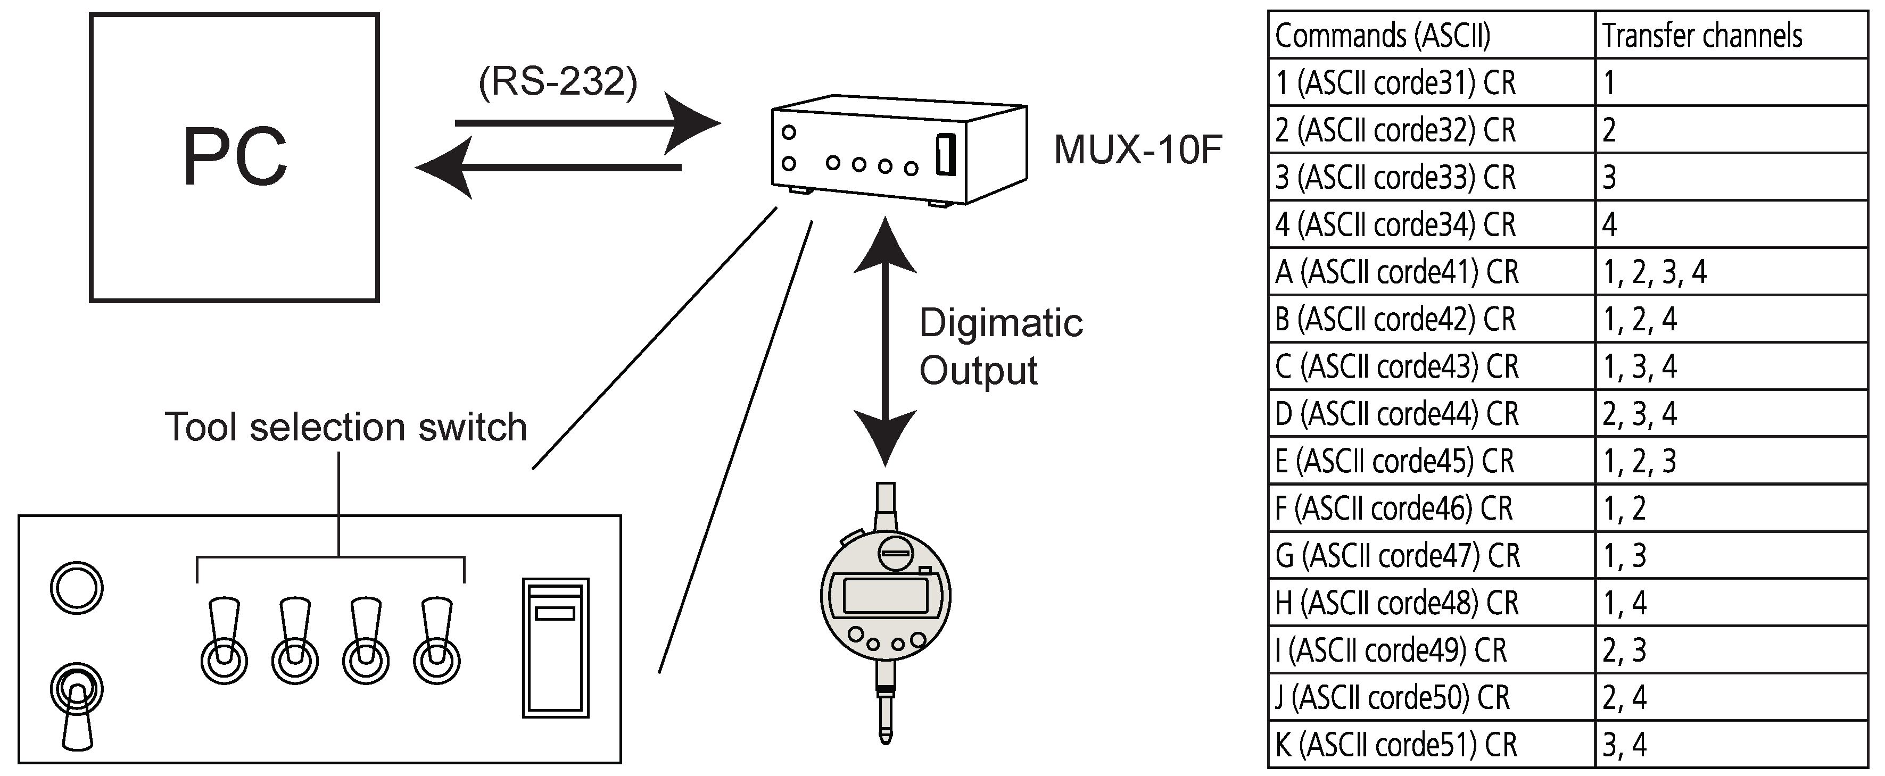
Digimatic measuring gauge
24th May, 2010
[ <number> ]

Slide 23
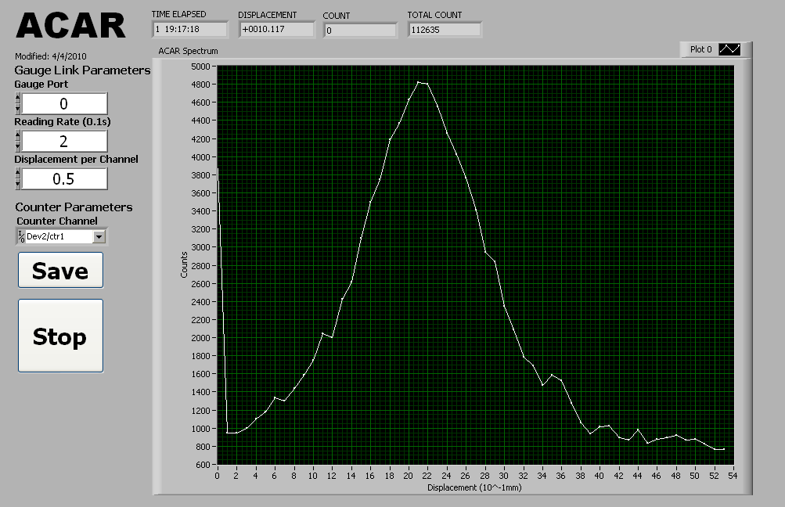
LabVIEW Program
Front Panel
24th May, 2010
[ <number> ]

Slide 24
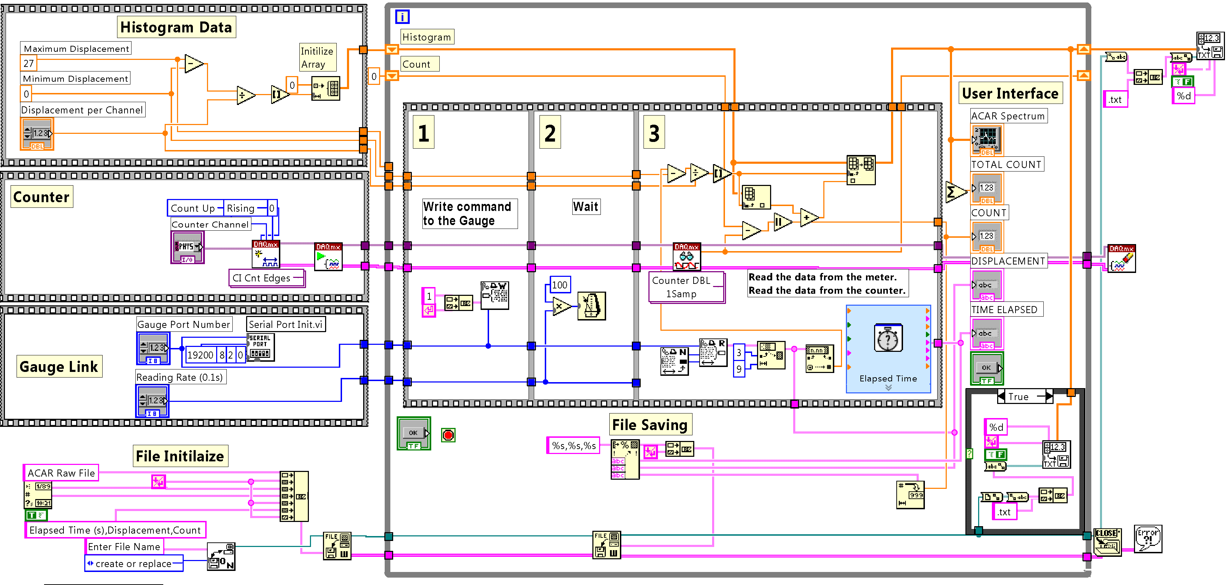
LabVIEW Program
Block Diagram
24th May, 2010
[ <number> ]

Slide 25
Other software
GNU plot
  For plotting the graph
C++ language
  -For customized programming
24th May, 2010
[ <number> ]

Slide 26
RESULT AND DATA ANALYSIS
Chapeter 3
24th May, 2010
[ <number> ]

Slide 27
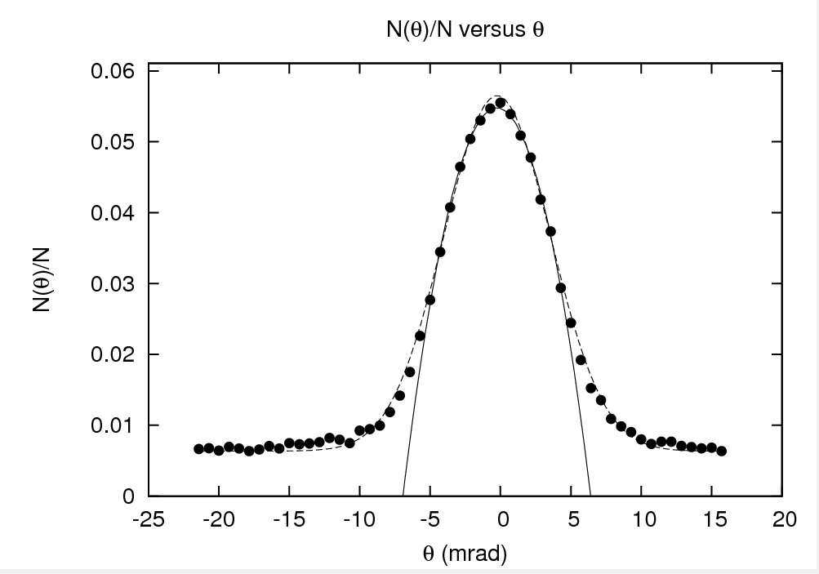

Aluminium
24th May, 2010
[ <number> ]

Slide 28
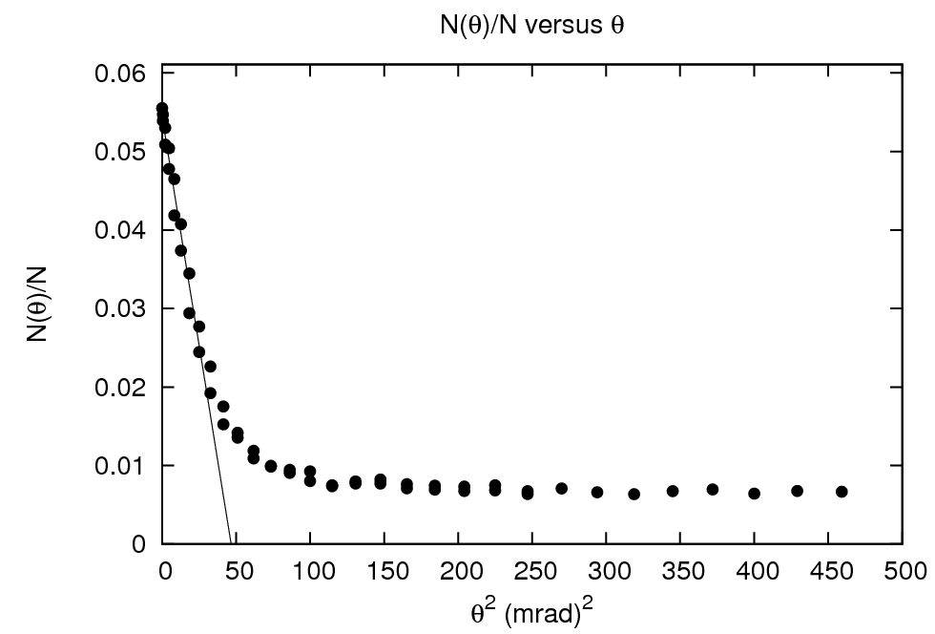
Aluminium
24th May, 2010
[ <number> ]

Slide 29
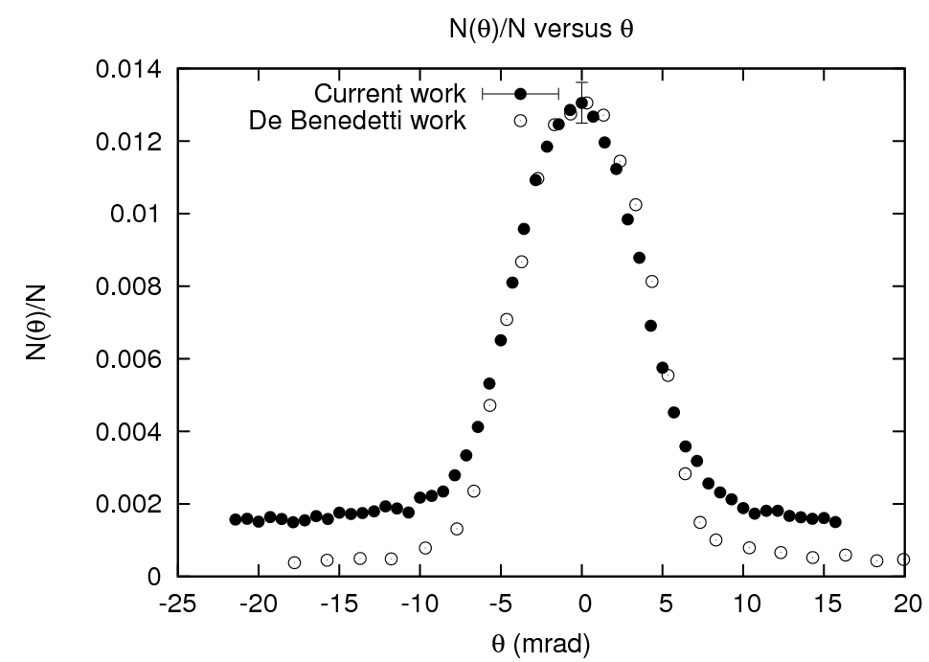
Aluminium
24th May, 2010
[ <number> ]

Slide 30
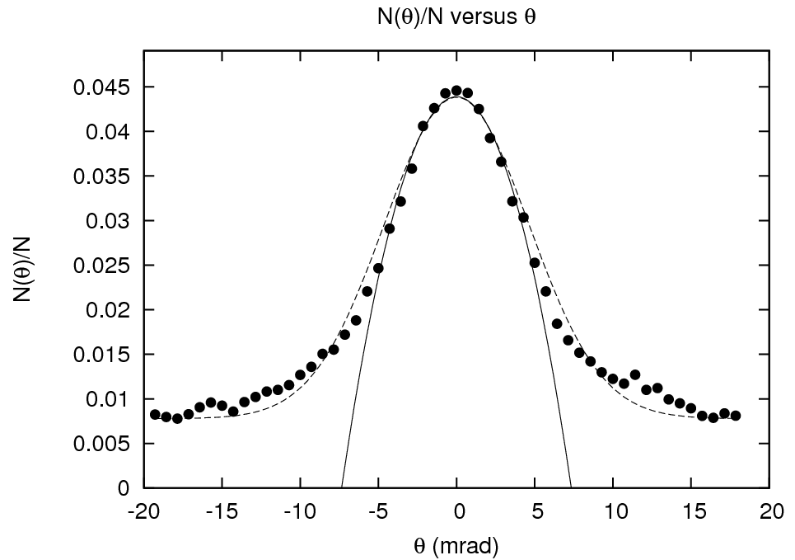

Copper
24th May, 2010
[ <number> ]

Slide 31
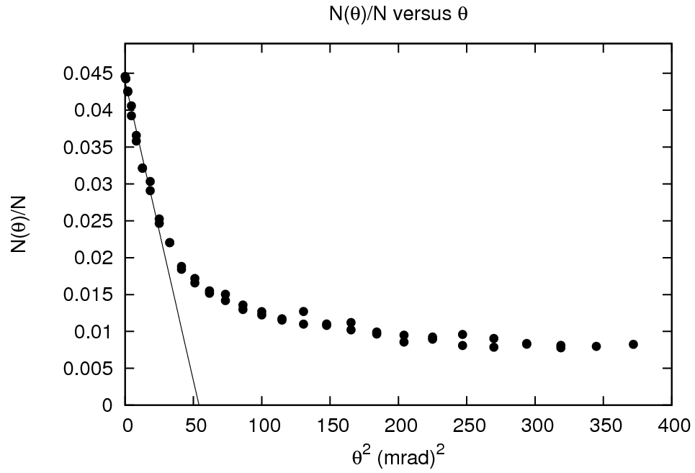
Copper
24th May, 2010
[ <number> ]

Slide 32
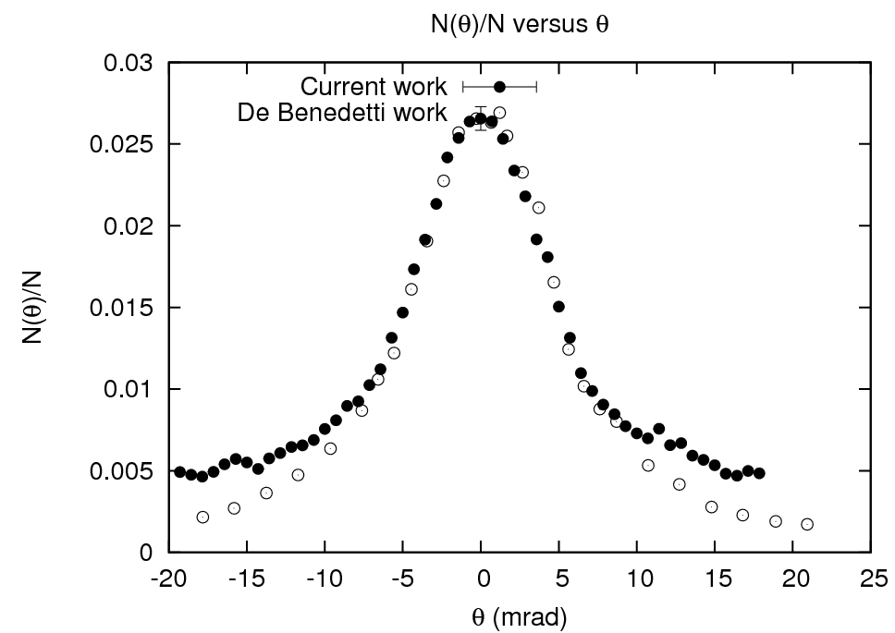
Copper
24th May, 2010
[ <number> ]

Slide 33
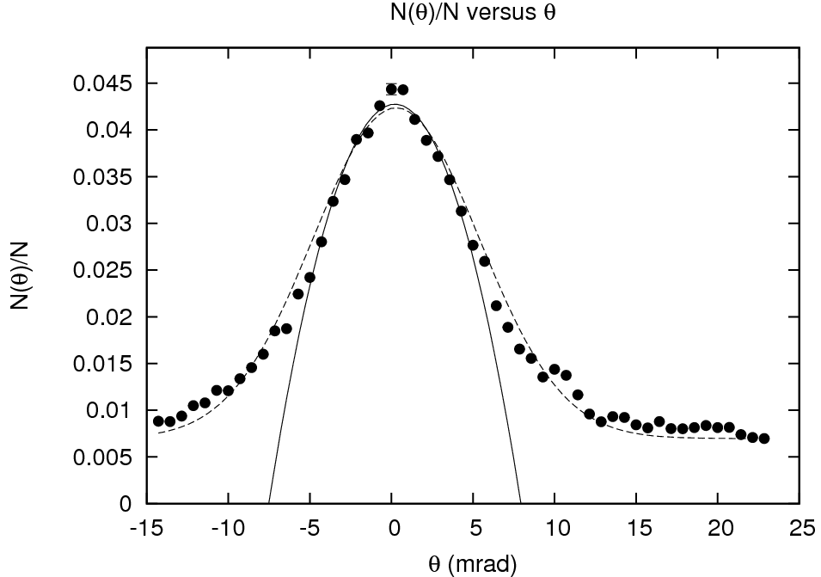

Stainless steel
24th May, 2010
[ <number> ]

Slide 34
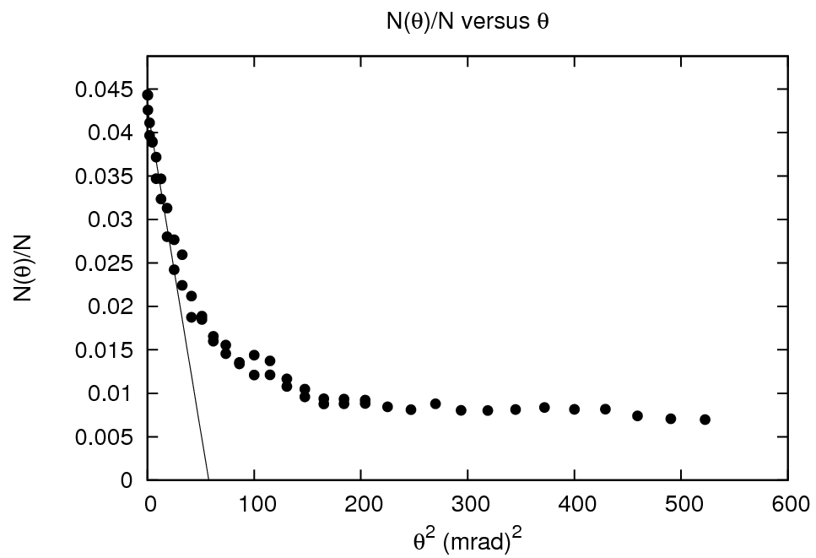
Stainless steel
24th May, 2010
[ <number> ]

Slide 35
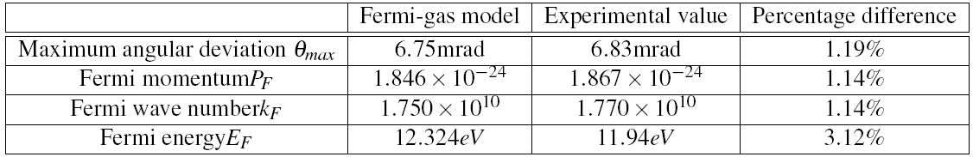
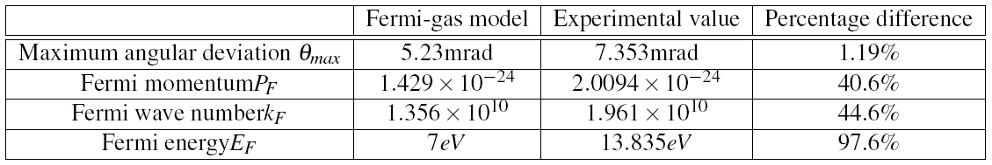

Comparison with Fermi gas model
Aluminium
Copper
Stainless steel
24th May, 2010
[ <number> ]

Slide 36
Comparison with Fermi gas model
DeBenedetti suggested that there are three types of metals that can be classified according to the ACAR results
Group A: Li, Na, Be, Mg, Al. Ge, Sn, and Bi
  Distributions that ended at a sharp break
  the distribution curve have an inverted parabola at the center
  Have a long flat tail to large angle
24th May, 2010
[ <number> ]

Slide 37
Comparison with Fermi gas model
Group B: Ca, Ba, Zn, Cd, and Pb
  Also have a central parabola but the tail is comparatively larger than group A
Group C: Cu, Ag, Au, Fe, Co,Ni, Rh, Pd, Pt and W
  Do not follow this distribution and show a “bell-shaped angular distribution”
24th May, 2010
[ <number> ]

Slide 38
DISCUSSION
Chapeter 4
24th May, 2010
[ <number> ]

Slide 39
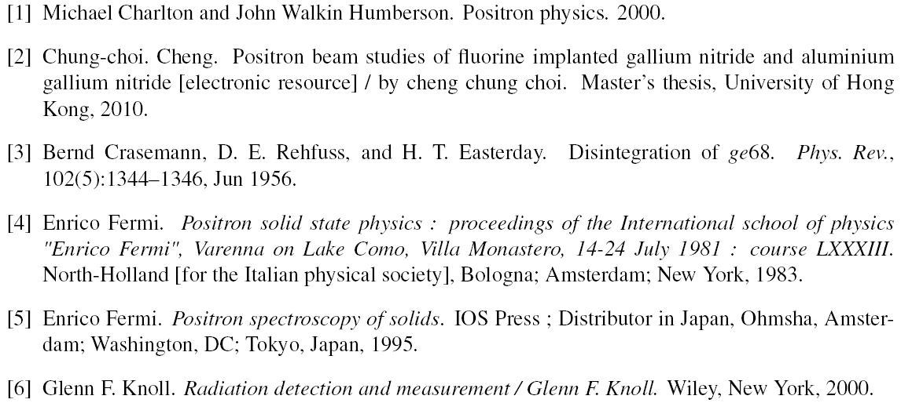
Bibliography
24th May, 2010
[ <number> ]

Slide 40
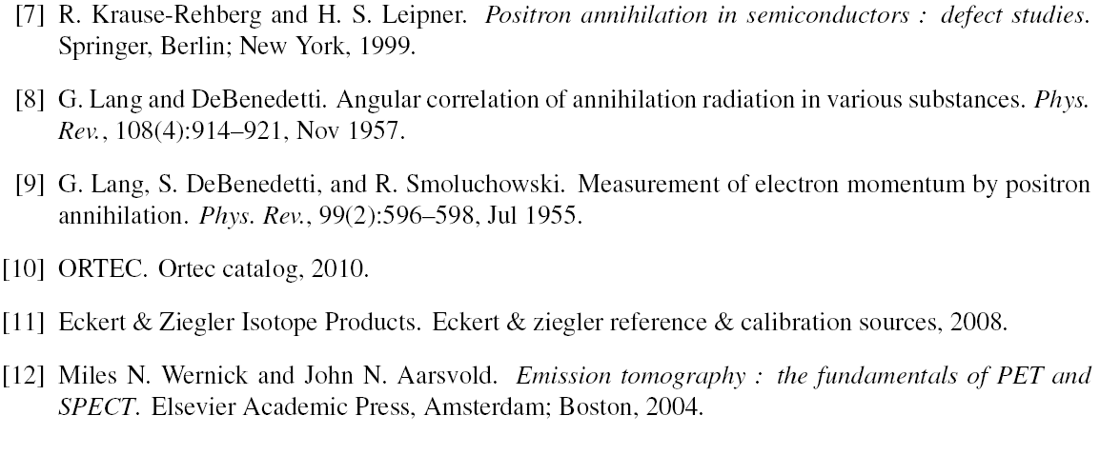
Bibliography
24th May, 2010
[ <number> ]

Slide 41
END
24th May, 2010
[ <number> ]

