Slide 1
Scrum-Agile Project Management
An analysis of the scrum-agile project management workflow

Slide 2
The Team
Product Owner
Responsible for representing the client’s voice, prioritizing features, and acts as a bridge between stakeholders and development team (Cobb, 35).
Tester
Assists with planning the development process, creates user stories with clear acceptance criteria and constraints, and ensures developed items meet quality standard (Cobb, 80-81).
Scrum Master
Acts as leader for development team, fosters a collaborative environment where agile principles are adhered to, and ensures all parties involved understand scrum (Cobb, 36).
Developer
Responsible for incremental development of product, creating a plan for Sprints, and aid in management of Product Backlog (Cobb, 38).

Slide 3
SDLC Phases and The Agile Approach
The Software Development Lifecycle (SDLC) provides a systematic framework for developers to follow when developing, distributing, and managing software projects. The Agile Approach adapts these phases to support iterative and incremental development.

Slide 4
This is the conception phase involving creating user stories, prioritizing features, and estimating effort (Cobb, 68).
The iterative phase, where the Scrum Master hosts a daily meeting for the development team to discuss progress, obstacles, and to check in.
The review stage, in which the team delivers and demonstrates the progress and finished product at the end of each sprint for reviewing (Cobb, 43).
Backlog Refinement
Sprint Planning
Daily Standup
Development and Testing
Sprint Review
Retrospective
The inception phase, where the team decides what user stories to work on and to further define what tasks must be accomplished to satisfy the user stories (Cobb, 41).
An extension of the iterative phase into the testing phase, involving iterative development, client feedback, and continuous testing (Cobb, 73).
The phase involving project closure, in which the team reflects on the sprint to determine what worked well and what could be improved (Cobb, 73).

Slide 5
The Waterfall Approach
The Waterfall Approach is a more traditional form of planning a project. A comparison between the Waterfall and Agile approach can be used to understand how the project would have been handled differently.

Slide 6
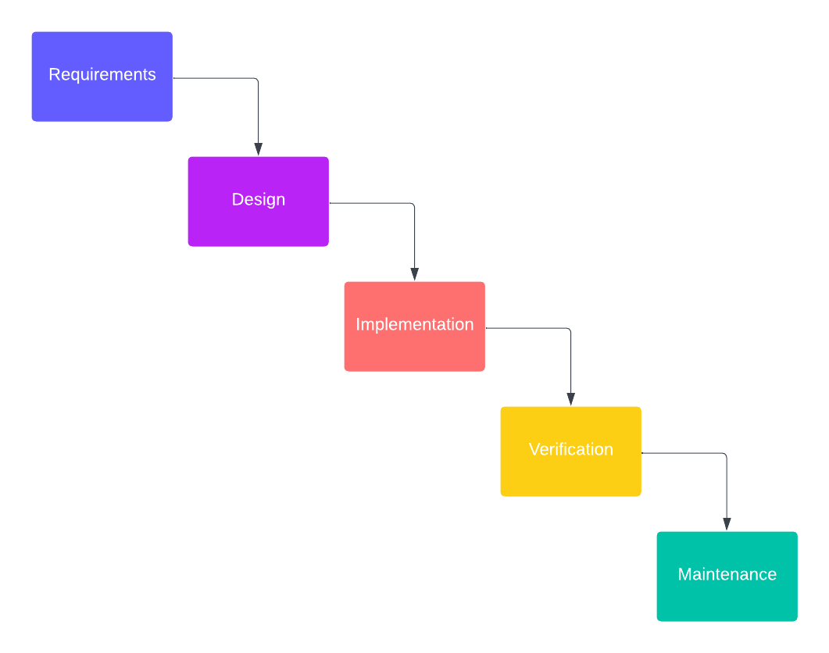
The Waterfall Process
In the Waterfall Approach, a plan is created for the entire project in the beginning stage (Cobb, 263).
Image created in LucidChart.

Slide 7
The Waterfall Approach
What is it?
Predictability
Potential Issues
The Waterfall Method is a plan-driven approach to projects that is completed in sequential order, requiring the previous step to be completed prior to starting on the next (Cobb, 4).
This method favors consistency and predictability and the ability to control various components in the project (Cobb, 6).
Due to the rigid and structured nature of the waterfall method, several issues arise that have the potential to create major obstacles throughout the software development lifecycle.

Slide 8
The Problems
Not Iterative
Late Feedback
Long Development
Linear Development
Each phase must be completed prior to moving onto the next, leading to a rigid framework that does not respond well to changes in any requirements (Cobb, 264).
High Risk
Due to its linear nature, the waterfall method does not give the opportunity for client feedback until late in the development cycle (Cobb, 264).
Rigid framework
Projects using the Waterfall method are typically much longer than Agile, making it much less adaptable with changing conditions (Cobb, 6).

Slide 9
The Difference In Handling Change
Waterfall
Project requirements are established and locked down at the beginning of the project.
Process:
Necessary to review and approve the requested changes.
Need to revisit design, development, and testing phases, leading to potential delays.
Feedback is gathered until the end of the development cycle.
Agile
Changes in project requirements are expected and can be accommodated.
Process:
Product backlog is reviewed and adjusted to prioritize user stories.
Iterative development allows for changes to be implemented in sprints.
The team collaborates to discuss changes and get feedback much more quickly.
(Cobb, 5, 264)

Slide 10
Waterfall or Agile?
As beneficial as an Agile approach can be, it is not a one-size-fits-all method. Deciding on which approach best fits with a company depends on several considerations.
Choosing the right approach

Slide 11
Factors to Consider
Business Environment
Scope / Requirements
Client Involvement
Some environments are more compatible with an Agile approach, such as product-oriented businesses. Others, such as hybrid or Project environments, may not be as compatible with the approach (Cobb, 213).
Is the scope well-known or uncertain? If the requirements are clearly defined and not likely to change, the waterfall method may be best. Otherwise, if these are understood to be prone to change, an Agile approach is best (Cobb, 5).
Some projects may not require as much feedback or may not need it as often as others. These are best suited for the Waterfall method, as change is less likely. Other projects may require constant feedback, making Agile a better choice (Shahriari, 2022).

Slide 12
References
Cobb, C. G. (2015). The Project Manager’s Guide to Mastering Agile: Principles and practices for an adaptive approach (1st ed.). Wiley.
Shahriari, D. (2022, August 20). Agile vs. waterfall: How to choose the right approach for your project. Tactical Project Manager. https://www.tacticalprojectmanager.com/agile-vs-waterfall/

