Slide 1

Green Pace
Security Policy Presentation
Developer: Ryan Hoskins

Slide 2

OVERVIEW: DEFENSE IN DEPTH

Slide 3
THREATS MATRIX
Likely EXP-001-CPP STR-001-CPP IDS-001-CPP MEM-001-CPP CTR-001-CPP | Priority P12 P18 P18 P18 P9
Low priority P3 P1 P3 P6 | Unlikely DCL-001-CPP DCL-002-CPP DCL-003-CPP EXP-002-CPP

Slide 4
10 PRINCIPLES
Validate Input Data - String Correctness - Container Indices
Heed Compiler Warnings - Data Value
Architect and Design for Security Policies - Data Type - Exceptions
Keep It Simple - Data Type - Data Value
Default Deny - Object’s Memory Lifetime

Slide 5
10 PRINCIPLES
Adhere to the Principle of Least Privilege - Object Memory Lifetime
Sanitize Data Sent to Other Systems - Data Value - SQL Injection
Practice Defense in Depth - String Correctness - Memory Protection
Use Effective Quality Assurance Techniques - Memory Protection - Assertions - Exceptions - Reserved Identifiers
Adopt a Secure Coding Standard - Data type - Data value - String Correctness - Memory Protection

Slide 6
CODING STANDARDS
SQL Injection: Prevent SQL Injection by using prepared statement and parameterization when handling any user input for interacting with a database.
String Correctness: Guarantee that storage for strings has sufficient space for character data and the null terminator. This emphasizes the importance of allocating enough memory for a string to ensure a buffer overflow does not occur.
Memory Protection: Properly deallocate dynamically allocated resources. When attempting to free dynamically allocated memory using ‘delete’, ‘delete[]()’, etc., make sure to use the appropriate option depending on what allocation method was used.
Data Value: Do not read uninitialized memory. Any local variables that are read prior to being initialized will use an indeterminate value that may result in unexpected behavior.
Container Indices: Guarantee that container indices and iterators are within the valid range

Slide 7
CODING STANDARDS
Object’s Memory Lifetime: Do not access an object outside of its lifetime.
Exceptions: Handle all exceptions. Anytime an exception is thrown, a matching handler needs to exist to facilitate the handling of the try block in which the exception occurred.
Data Type: Obey the “One-Definition” rule. Any non-inline types, entities, or functions declared across files or translational units must abide by one definition.
Reserved Identifiers: Do not declare or define a reserved identifier. There are several reserved names with specific rules that need to be abided by.
Assertions: Use a static assertion to test the value of a constant expression. If conditions that can be evaluated at compile time, it’s better to use static assertions to improve code quality and performance.

Slide 8
ENCRYPTION POLICIES
Encryption at Rest: Any data not being transmitted or used and is instead being stored shall abide by encryption practices such as AES-256. Access to decryption keys will be strictly monitored and restricted to any users not explicitly authorized with a default of denying access. Any data considered to be valuable should be mapped and classified as such to support this policy.
Encryption in Transit: Any data sent over a network or any specific location shall follow encryption policies. Any data in flight will adhere to encryption protocols such as HTTPS, Transport Layer Security (TLS), and employ data integrity checks such as SHA-256. Data should adhere to the mapping and classification process to ensure that any potentially sensitive data will be properly secured. Members of the organization will not use public networks when transferring any sort of potentially sensitive data.
Encryption in Use: Any data that is being processes, prepared, or used by a system will be secured using accepted encryption policies. These practices include implementing application-level encryption or homomorphic encryption algorithms. Additional considerations for Secure Multi-Party Computations should be implemented wherever possible.

Slide 9
TRIPLE-A POLICIES
Authentication: Verify the identity of users and systems, Use industry-standard authentication protocols such as OAuth 2.0, and implement multi-factor authentication for potentially sensitive systems and data.
Authorization: Determine and map out the level of access for any users and systems, follow a Role-Based Access Control protocol, and abide by the principle of least privilege access for potentially sensitive data or systems.
Accounting: Carefully track and monitor any user and system activity through tools such as Kibana or Grafana, schedule routine log and record audits that will be adhered to in a timely manner, follow any compliance or regulatory requirements regarding data collection and storing.

Slide 10
Unit Testing
The coding vulnerabilities demonstrated in the following unit tests include Memory Deallocation and Using Quality Assurance Techniques,

Slide 11
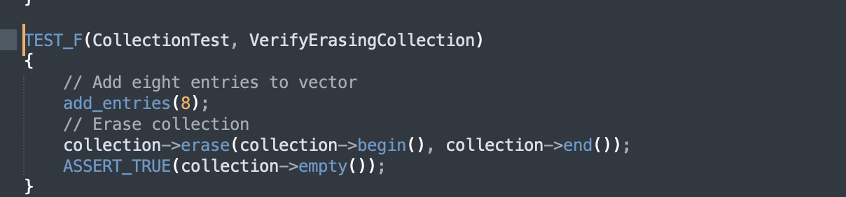
VerifyErasingCollection
Unit test verifying the erasure of a collection. This uses the ASSERT_TRUE assertion to confirm the collection is properly emptied after using the erase method. This demonstrate Properly Deallocating Memory.

Slide 12
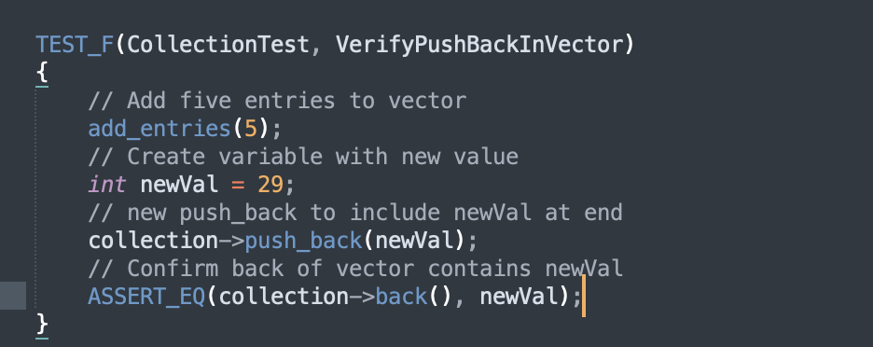
VerifyPushBackInVector
Unit test verifying that the push_back method actually moves the newly added value to the end of the vector object. This demonstrate data type, data value, and quality assurance.

Slide 13
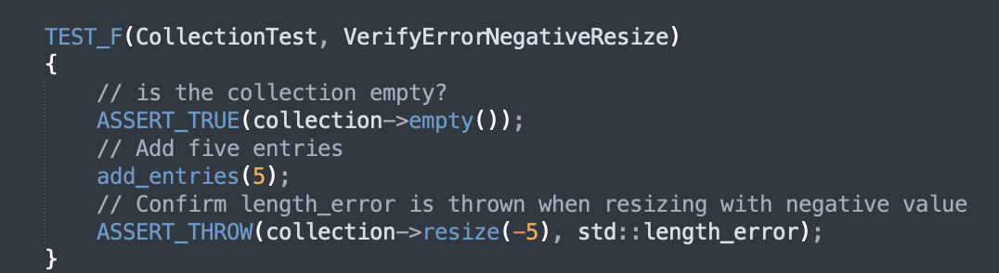
VerifyErrorNegativeResize
Unit Test verifying that an error is thrown when attempting to resize a vector to a negative value. This falls under the security vulnerability for string correctness and data value.

Slide 14
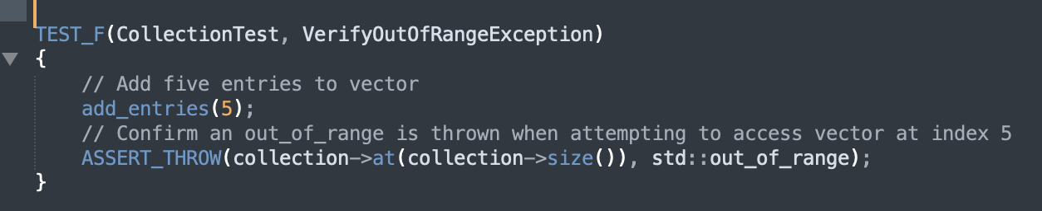
VerifyOutOfRangeException
Negative Unit Test verifying an exception is thrown when attempting to access a vector at an index outside of what actually exists. This falls under memory proper use of assertions and checking for String Correctness.

Slide 15

AUTOMATION SUMMARY

Slide 16
AUTOMATION SUMMARY
The DevSecOps Pipeline is used to illustrate the key stages of the Software Development Lifecycle that security can be incorporated into. This approach incorporates security through the Continuous Improvement Continuous Delivery Pipeline. The key stages include:
Assess and Plan
Design
Build
Verify and Test
Transition and Health Check
Monitor and Detect
Respond
Maintain and Stabalize

Slide 17
TOOLS
Security Tools can be implemented in essentially any stage shown in the diagram. To demonstrate, here are a few examples:
Planning and Design: Threat modeling tools such as Threat Dragon from OWASP.
Build: Automated IDE plug-ins and compiler warnings.
Verify and Test: Static Testing tools such as OWASP ZAP, Parasoft, or JBroFuzz
Transition: Tripwire, Chaos Monkey tool, Principle of Least Privilege, and configuration management tools such as Puppet and Docker.
Monitor and Detect: Runtime application self-protection (RASP)

Slide 18
RISKS AND BENEFITS
Problems: Security Vulnerabilities in the code and system, failure to implement effective automation in security testing, lack of appropriate policies and procedures to react to security incidents.
Risks: Increased likelihood of security breaches and damage to reputation, financial loss as a result of failing to comply with regulatory standards, and data leaks.
Solutions: Implement security coding standards and abide by policy, incorporate security into the DevOps and CI/CD pipeline process, implement automation into the DevSecOps pipeline.
Benefits: Decreased chance of security breaches and damage to reputation, cost effective remedies for security vulnerabilities caught earlier, and strong reputation.
Notes:
Notes: ”Regarding the risks and benefits, problems and solutions of deciding to wait or act now, our security strategy is designed to address the problems of security vulnerabilities in code and systems, lack of automation in security testing and deployment, and insufficient training and resources for secure coding practices. Risks and Problems of waiting include damage to reputation and trust, failure to comply with regulatory standards. Solutions and benefits of the policy include implementing security into the DevOps and CI/CD pipstandardeline, implementing automation, and strong education of the security

Slide 19
RECOMMENDATIONS
Gap Analysis: The security policy as a whole lacks substance, cohesiveness, clear guidelines, and training details to aide implementation and adoption. The Code Standards are too vague, the Code Principles are vague as well without any direct correlation to the company’s specific and unique needs, and little to no information has been provided as to what the client needs, currently has, and general context. There is no Incident Response Plan or specific and clear guidelines that extend beyond standard coding practices.
Notes:
Notes: “The gap analysis also reveals potential gaps and improvements, a severe lack of relevant context that is crucial to developing a comprehensive plan.”

Slide 20
RECOMMENDATIONS
Thoroughly review the specific needs of the company. This includes a thorough review of current systems, processes used, and map potentially sensitive data.
Initiate Threat Modeling to identify areas of priority.
Develop and implement clear guidelines relevant to the client regarding an Incident Response plan.
Utilize training sessions for employees.
Adopt security frameworks and protocols such as OWASP and NIST frameworks.
Notes:
Notes: “To address the severe lack of relevant and and specific coding standards, security frameworks that are use widely and are trusted should be implemented and followed, such as OWASP or NIST frameworks”.

Slide 21
CONCLUSIONS
NIST and OWASP frameworks should be adopted and implemented to make up for the lack of comprehensive and relevant security and coding standards unique and specific needs.
Develop an Incident Response plan.
Develop and implement training schedules and methods to monitor adoption of security policies across teams.
Decide on specific tools that will be used throughout the DevSecOps pipeline and CI/CD process.
Notes:
Notes: “It’s crucial for NIST and OWASP frameworks to be implemented throughout the security policies at some point to ensure any future gaps are promptly addressed. It’s also recommended that an Incident Response Plan be developed.

Slide 22
REFERENCES
Atlassian. (n.d.). DevSecOps Tools | Atlassian. https://www.atlassian.com/devops/devops-tools/devsecops-tools
Ertl, B., & Ertl, B. (2024, May 30). Essential data encryption best practices. Kiteworks | Your Private Content Network. https://www.kiteworks.com/secure-file-sharing/secure-file-sharing-essential-data-encryption-best-practices/

