Slide 1
Presentation

Slide 2
Motivation

Slide 3
Primary Goal
Watching tennis casually makes it hard to pick a player to root for
Big stars are easy to recognize, but most players are unfamiliar
Choosing an underdog is appealing, but risky without context
How can you identify a “safe” underdog worth rooting for, especially as a casual watcher?

Slide 4
Background/Introduction
Designed for casual viewers, not experts
Ignores complex factors (play style, endurance, etc.)
Uses only what you can easily see or look up:
Players
Court surface
ATP ranking
Goal: Find a simple, data-informed way to pick an unknown player who is reasonably likely to win

Slide 5
Research gap
Many tennis prediction models exist, but:
Require detailed data not available to casual fans
Perform best for well-known, frequently studied players
Simpler models proposed are regression, ELO points based logistic model, and previous head-to-head match-ups
They are accessible, but:
Are often too limited or use the aforementioned detailed data
Can perform poorly for less-studied players
Key gap: No simple, accessible model designed specifically for players with limited data

Slide 6
Model

Slide 7
Our Approach
Designed specifically for lesser-known / low-data players
Uses only information visible to casual viewers:
Rankings, Court Surface, and Player names
Combines regression + point-based ideas
Bayesian framework allows us to borrow strength from well-studied players to produce more stable predictions with limited data

Slide 8
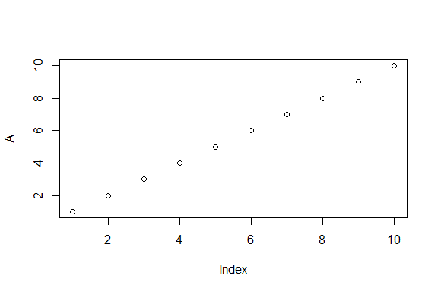
Test double
Words

Slide 9
Only plot

Slide 10
Script
Script:
Imagine you turn on the TV and a game of tennis is playing. You don’t necessarily follow tennis very closely, but you like watching the games and you want to know who you should root for. This is really easy for the big names like Nadal, Federer, Djokovic, Alcaraz, but what about the smaller names? What if you want to root for the underdog, but don’t want to risk getting your hopes up for nothing?
My partner and I both casually enjoy tennis, and we thought this would be a fun algorithm to use next time we tune in to a match. We found this amazing repository from gitHub that has records of professional matches from 1968-2024. We have chose to hone in on data from the years 2019-2023 for completeness and recency.
Now there are a number of factors determining who will win a match of tennis. Handed-ness, endurance, play style, but remember, we are causal fans, we don’t know any of this, nor do we know the intricate rock-paper-scissors mechanics of these factors. We are assuming that you can only see what is on TV and only have the motivation to google who the underdog is in a given scenario. So, we know the player, the court surface, and the men’s professional tennis (ATP) ranking. What now?

