Slide 1
Picking the Safe Underdog
A Bayesian Mixed-Effects Approach to ATP Tennis Prediction Ryan Mersereau and Naomi Novick

Slide 2
Motivation
When you watch sports, it is more fun to pick someone to root for (we don’t condone gambling)
Casual tennis viewers struggle to pick a player to root for
Big stars are recognizable, but most players are unfamiliar
Choosing an underdog is appealing, but risky without context of data
Goal: Build a simple, data-informed model for picking a “safe” underdog, designed for casual viewers

Slide 3
Background
Want a model designed for casual viewers, not experts
Should ignore complex factors (play style, endurance, etc.)
Uses only what you can easily see or look up:
Players
Court surface
ATP ranking

Slide 4
Research Gap
Many tennis models require detailed data unavailable to casual fans
Simpler alternatives (regression, ELO, head-to-head) lack coverage for low-data players
None are designed specifically for players with limited match history
We can fill this gap with a Bayesian hierarchical model, borrowing strength across players

Slide 5
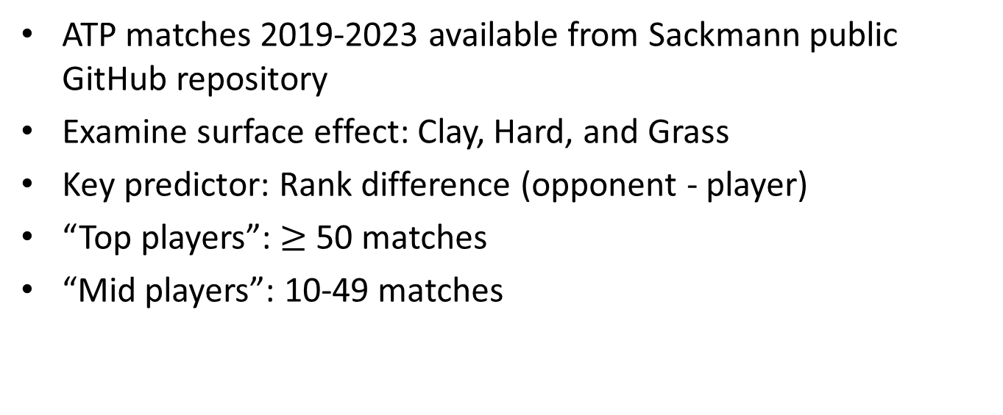
Data
ATP matches 2019-2023 available from Sackmann public GitHub repository
Examine surface effect: Clay, Hard, and Grass
Key predictor: Rank difference (opponent - player)
“Top players”: $≥$ 50 matches
“Mid players”: 10-49 matches

Slide 6
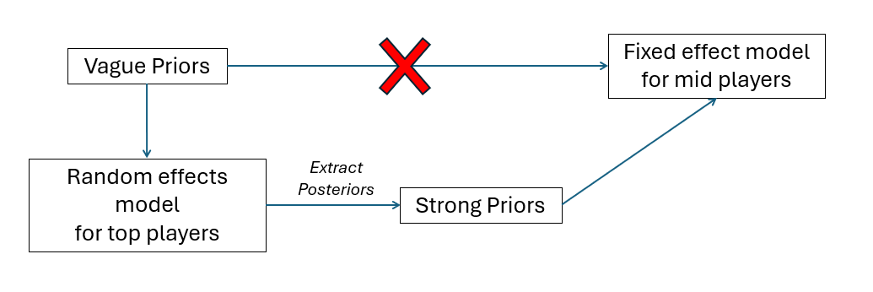
Model (check this notation)

Slide 7
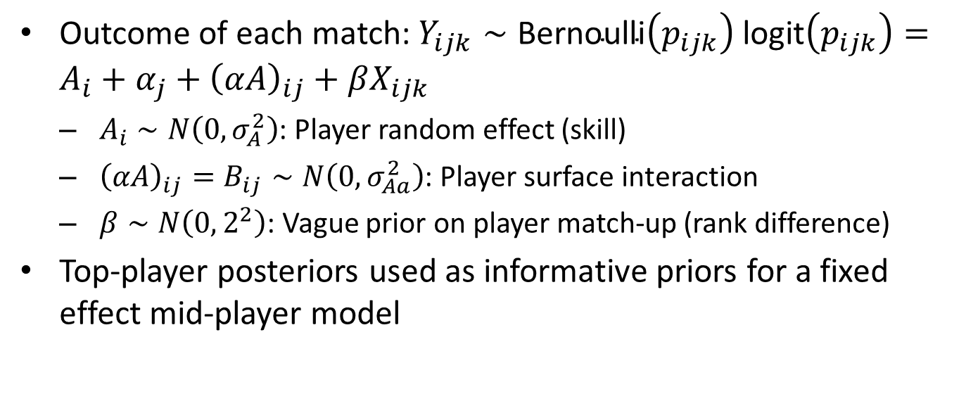
Model Specifics
Outcome of each match: $Y_{ijk}∼\text{Bernoulli}\left(p_{ijk}\right)$ $\text{logit}\left(p_{ijk}\right)=A_{i}+α_{j}+{\left(αA\right)}_{ij}+βX_{ijk}$
$A_{i}∼N\left(0,σ_{A}^{2}\right)$: Player random effect (skill)
${\left(αA\right)}_{ij}=B_{ij}∼N\left(0,σ_{Aa}^{2}\right)$: Player surface interaction
$β∼N\left(0,2^{2}\right)$: Vague prior on player match-up (rank difference)
Top-player posteriors used as informative priors for a fixed effect mid-player model

Slide 8
Model Assumptions
Top players are representative of the population
Mid and top players come from the same population
Players are mutually independent

Slide 9
Supplimentary Results: Surface & Rank Effects
SSVS determined
surface effect is significant
Rank difference is a significant positive predictor of winning probability
DIC comparison between models to determine interaction is significant

Slide 10
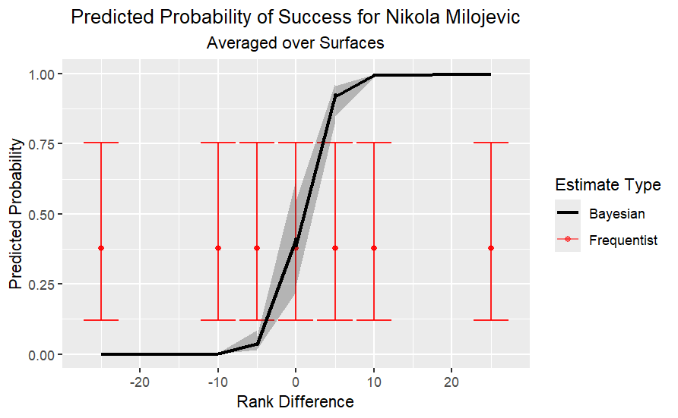
Results: Posterior Predictions for Single player
Bayesian credible intervals are wider for mid-players than top players
Less data = More uncertainty
Frequentist GLM estimates lack shrinkage and are more extreme at tails
Plot shows frequentist vs Bayesian estimate for a single mid-player
Notice that freqentist estimate is the same throughout all rank differences, whereas Bayesain estimate is more certain

Slide 11
Posterior Predictions for Future data
Data from the next year (2024) and selected the players we just modeled
We used our model to predict the outcome of these matches
Our model had accuracy of 61.2% and specificity of 54.4%
This is ok, but much better than a model that does not pool strength from the top players
This model had accuracy of 55.9% but specificity of only 18.4%!!

Slide 12
Summary (another plot?)

Slide 13
Strengths & Limitations
Shrinkage improves stability for low-data players
Credible intervals communicate prediction uncertainty honestly
Rank difference along is a noisy signal, ignores form, injuries, head-to-head
Could expand time frame to capture larger player pool, track players along time, or have an internal database of more complex predictors per player

Slide 14
Gory Details {visibility “uncounted”}
SSVS: delta ~ dcat([1/3, 1/3, 1/3]); P(M1)=0.49, P(M2)=0.51, P(M3)≈0
Priors on σ: Half-T(0,1,4) truncated at 0; tau = 1/σ² ~ Gamma(a,b) for mid model
Gamma hyperparameters fit via MLE on top-player posteriors: optim(BFGS)
4 chains, 10k burn-in, 20k samples; Gelman-Rubin R-hat < 1.05
Surface encoding: 1=Clay, 2=Grass, 3=Hard (alphabetical factor levels in R)

Slide 15
Script
Script:
Imagine you turn on the TV and a game of tennis is playing. You don’t necessarily follow tennis very closely, but you like watching the games and you want to know who you should root for. This is really easy for the big names like Nadal, Federer, Djokovic, Alcaraz, but what about the smaller names? What if you want to root for the underdog, but don’t want to risk getting your hopes up for nothing?
My partner and I both casually enjoy tennis, and we thought this would be a fun algorithm to use next time we tune in to a match. We found this amazing repository from gitHub that has records of professional matches from 1968-2024. We have chose to hone in on data from the years 2019-2023 for completeness and recency.
Now there are a number of factors determining who will win a match of tennis. Handed-ness, endurance, play style, but remember, we are causal fans, we don’t know any of this, nor do we know the intricate rock-paper-scissors mechanics of these factors. We are assuming that you can only see what is on TV and only have the motivation to google who the underdog is in a given scenario. So, we know the player, the court surface, and the men’s professional tennis (ATP) ranking. What now?

