Slide 1
Picking the Safe Underdog
A Bayesian Mixed-Effects Approach to ATP Tennis Prediction Ryan Mersereau and Naomi Novick

Slide 2
Motivation
When you watch sports, it is more fun to pick someone to root for (we don’t condone gambling)
Casual tennis viewers struggle to pick a player to root for
Big stars are recognizable, but most players are unfamiliar
Choosing an underdog is appealing, but risky without context of data
Goal: Build a simple, data-informed model for picking a “safe” underdog, designed for casual viewers

Slide 3
Background
Want a model designed for casual viewers, not experts
Should ignore complex factors (play style, endurance, etc.)
Uses only what you can easily see or look up:
Players
Court surface
ATP ranking

Slide 4
Research Gap
Many tennis models require detailed data unavailable to casual fans
Simpler alternatives (regression, ELO, head-to-head) lack coverage for low-data players
None are designed specifically for players with limited match history
We can fill this gap with a Bayesian hierarchical model, borrowing strength across players

Slide 5
Data
ATP matches 2019-2023 available from Sackmann public GitHub repository
Examine surface effect: Clay, Hard, and Grass
Key predictor: Rank difference (opponent - player)
“Top players”: $≥$ 50 matches
“Mid players”: 10-49 matches

Slide 6
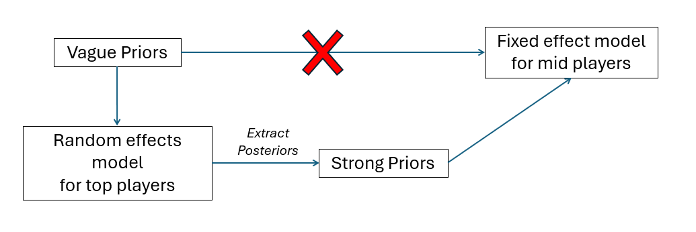
Model (check this notation)

Slide 7
Model Specifics
Outcome of each match: $Y_{ijk}∼\text{Bernoulli}\left(p_{ijk}\right)$ $\text{logit}\left(p_{ijk}\right)=A_{i}+α_{j}+{\left(αA\right)}_{ij}+βX_{ijk}$
$A_{i}∼N\left(0,σ_{A}^{2}\right)$: Player random effect (skill)
${\left(αA\right)}_{ij}=B_{ij}∼N\left(0,σ_{Aa}^{2}\right)$: Player surface interaction
$β,α_{i}∼N\left(0,2^{2}\right)$: Vague priors on player match-up (rank difference) and surface effect
$σ_{A}^{2},σ_{B}^{2}∼$ Half Cauchy
Top-player posteriors used as informative priors for a fixed effect mid-player model

Slide 8
Model Assumptions
Top players are representative of the population
Mid and top players come from the same population
Players are mutually independent

Slide 9
Supplimentary Results: Surface & Rank Effects
SSVS determined that surface effect is significant
Rank difference is a significant positive predictor of winning probability
Prob$\left(β>0\right)=1$
DIC comparison between models to determine interaction is significant

Slide 10
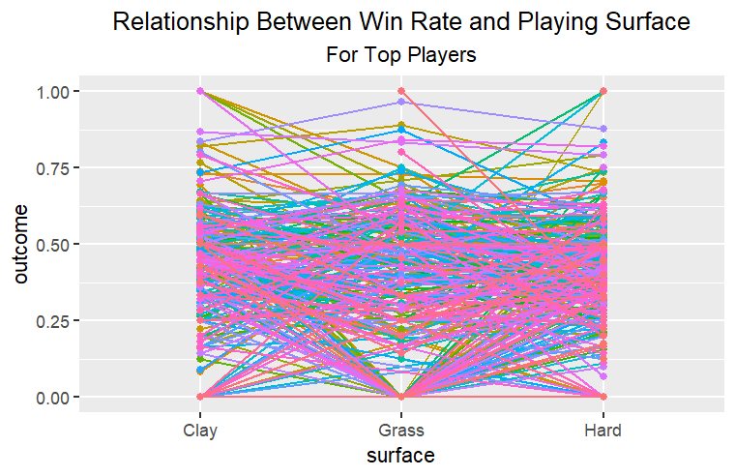
Data Interaction

Slide 11
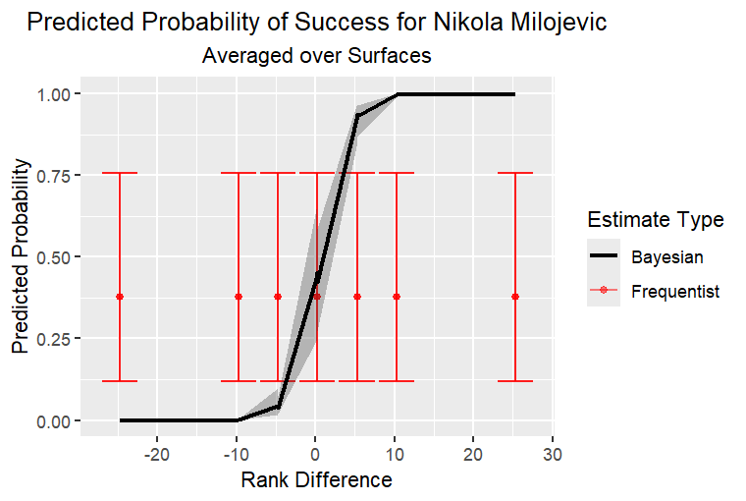
Results: Posterior Predictions for Single player
Bayesian credible intervals are wider for mid-players than top players
Less data = More uncertainty
Frequentist GLM estimates gives same result as conjugate vauge priors for Bayes
lacks shrinkage and are more extreme at tails
Plot shows frequentist (Vague Prior) vs Bayesian (Strong Prior) estimate for a single mid-player

Slide 12
Posterior Predictions for Future data
Data from the next year (2024) and selected the players we just modeled
We used our model to predict the outcome of these matches
Our model had accuracy of 61.2% and sensitivity (true positive) of 54.4%
This is ok, but much better than a model that does not pool strength from the top players
Vague model had accuracy of 55.9% but sensitivity of only 18.4%!!

Slide 13
Who Should you Root for? (Summary of Fixed Effects)

Slide 14
Strengths & Limitations
Shrinkage improves stability for low-data players
Credible intervals communicate prediction uncertainty honestly
Rank difference along is a noisy signal, ignores form, injuries, head-to-head
Could expand time frame to capture larger player pool, track players along time, or have an internal database of more complex predictors per player

Slide 15
Programming Details (Extra information Slides)

Slide 16
Random effects Model
SSVS: delta ~ dcat([1/3, 1/3, 1/3])
Interaction: P(M1)=0.49, Additive: P(M2)=0.51, No fixed surface effect: P(M3)≈0
Priors on σ: Half-T(0,1,4) truncated at 0
Samples confirmed to converge via Gelman-Rubin R-hat < 1.05
DIC: Interaction model 27820, Additive model 27927

Slide 17
Extracting parameters
Variance hyperparameters fit via finding MLE of Gamma distribution likelihood built on top-player posteriors: Using method optim(BFGS)
Normal hyperparameters extracted from summary statistics exactly, use mean and SD from summary of MCMC.list$statistics
Rank difference slightly lower/wider for mid players than top players
Restricted fixed effect model to only the observations with rank_diff within the center 95% of top_player rank_diff quantile(.025, .975)
Player “Martin Cuevas” had no data within this limit

Slide 18
Fixed effect model
4 chains, 10k burn-in, 20k samples;
Samples confirmed to converge via Gelman-Rubin R-hat < 1.05
Surface encoding: 1=Clay, 2=Grass, 3=Hard (alphabetical factor levels in R)
For future predictions, we plugged the new values into the prediction formula rather than re-running JAGS (code on next slide) ## > d.grid = data.frame(mid_df_future |> select(-outcome), Est=NA, Lower=NA, Upper=NA) for ( i in 1:nrow(d.grid) ){ surf = d.grid$surface\left[i\right]player=d.grid$player[i] mu = rez[,paste0(“alpha[”, surf, ”]”)] + rez[,“beta”]*d.grid$rank_diff[i] + rez[,paste0("A[", player, "]")] + rez[,paste0("B[", player, ",", surf, "]")] pr = 1/(1+exp(-mu)) d.grid[i,c("Est", "Lower", "Upper")] = round(quantile(pr, p=c(0.5, 0.025, 0.975)), 3) } Results = data.frame(mid_df_future$outcome, d.grid)

