Slide 1
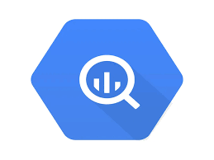

























Data Warehouse
BI Tools
ML/Analytics
Ops Systems
Cyber Tools
NewCo Solution
HR
Finance
Sales
Security
Marketing

Slide 2






Data Warehouse
BI Tools
ML/Analytics
Ops Systems
Cyber Tools
NewCo Solution
CICD Tooling
HR
Finance
Sales
Security
Marketing
aws-account
aws-account

Slide 3

Data Warehouse
BI Tools
ML/Analytics
Ops Systems
Cyber Tools
NewCo Solution
HR
Finance
Sales
Security
Comms/Marketing

Slide 4
Customer Stories:
We have XYZ and are trying to do ABC, but can’t figure it out.
NewCo Discriminators
We do this securely.
NewCo Roles
Ryan: Cloud Engineer
Gabriel: Data Engineer
Sheen: Network/Security Engineer

Slide 5
Can Kestra store secure credentials? How would our solution store these types of secrets?
New airflow architecture: Worker separated from meta node – allowing more secure deployment.
https://airflow.apache.org/docs/apache-airflow/stable/core-concepts/overview.html#airflow-components
Questions:
1. Would our offering be something that could be ‘sold’ on the AWS (or other CSP) marketplace?

