Slide 1
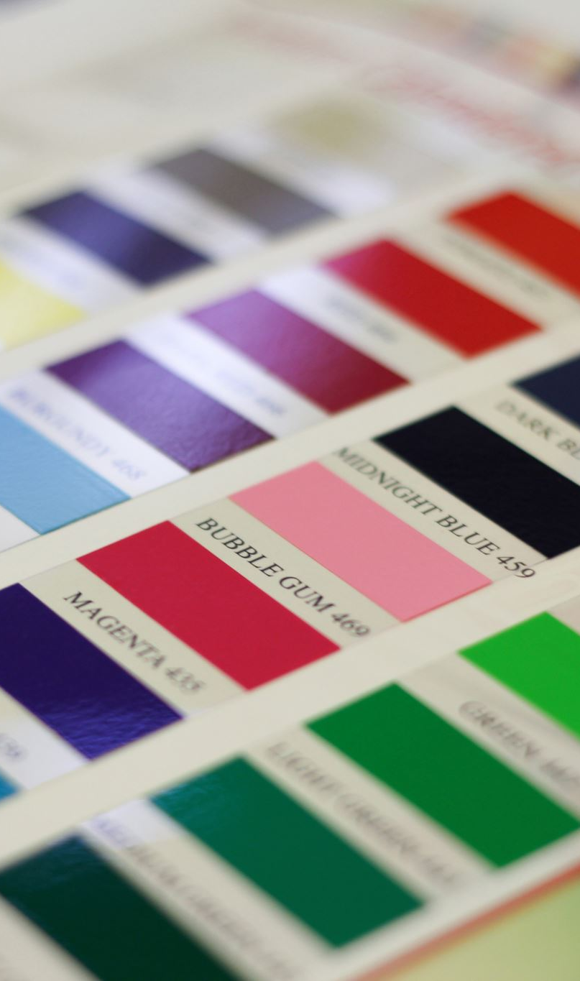
Do Multimodal Models Show Evidence of Semantic Color Discriminability?
Ryan Moreno & Laura Roettges

Slide 2



Background
Humans associate meanings with colors based on their sensory experiences, leading to color-concept associations.
Notes:
This is often easier to think of when you think about objects in the real world that are historically deemed ‘color-able’ for example when you think of a banana what color do you first think of?

Slide 3
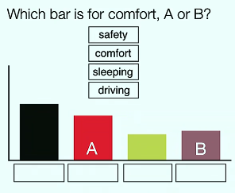
We infer semantic meaning from color choices.
We can leverage color for visual communication
Misleading color encodings impede effective communication

Slide 4
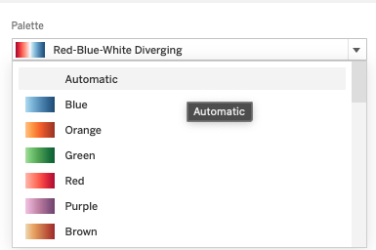
Motivation: Automatic Color Palette Generation
Notes:
Ultimately there is a need for automating palette generation particularly for data visualizations (think of the default colors provided in Tableau or your python visualization libraries you may use) , with the goal of suggesting semantically interpretable colors particularly when encoding categorical values with color.
_______
Gathering color-concept association scores from human trials is costly, especially when scaling to the many concepts that require categorical color encodings for effective data visualizations

Slide 5
Previous Literature

Slide 6
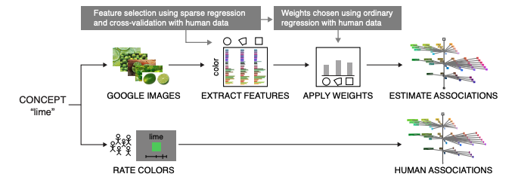
Estimating Color-Concept Associations from Image Statistics
Ragini Rathore, Zachary Leggon, Laurent Lessard, and Karen B. Schlos
Notes:
Figure 3. Illustration of our pipeline for automatically extracting color distributions from images. The bottom flow (concepts to color ratings to human associations) describes the slow yet reliable direct approach using human experiments to determine ground truth associations. The top flow involves querying Google Images, extracting colors using a variety of different methods (features), then weighting those features appropriately to obtain estimated associations. Deciding which features to use and how to weight them is learned from human association data using sparse regression and cross-validation. Once the model is trained, color-concept associations can be quickly estimated for new concepts without additional human data.

Slide 7
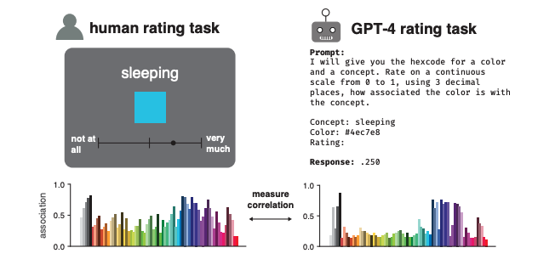
Large Language Models Estimate Fine-Grained Human Color-Concept Associations
Kushin Mukherjee, Timothy T. Rogers, Karen B. Schloss
Notes:
Figure 2: Example trial from the human color-concept association rating task (left) and GPT-4 rating task for the same color-concept pair (right). Bar graphs correspond to average human and GPT-4 color concept association ratings for the concept “bird” over the entire UW-71 color library.

Slide 8
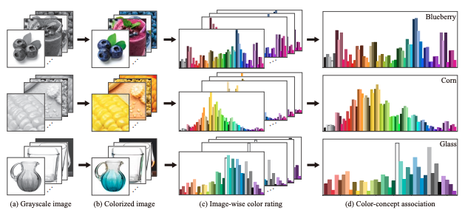
Self-Supervised Color Concept Association via Image Colorization
Ruizhen Hu, Ziqi Ye, Bin Chen, Oliver van Kaick, and Hui Huang
Notes:
Fig 1: We introduce a method for automatically extracting color-concept associations from natural images. We apply a colorization neural network to predict color distributions for the input images. The distributions are transformed into ratings for a color library, which are then aggregated across multiple images of a concept to provide the color-concept associations.

Slide 9
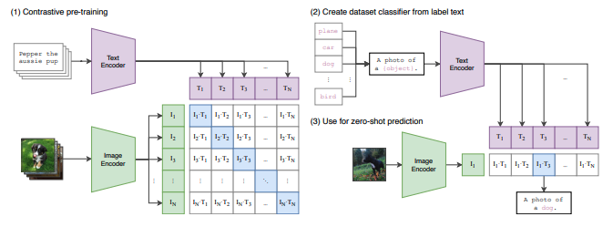
Our Approach: Zero-Shot transfer for Multimodal Models (CLIP)
How well do pretrained multimodal models perform at understanding color concept associations?
Figure from A. Radford, et al. Learning transferable visual models from natural language supervision. ICML 2021
Notes:
Figure 1. Summary of our approach. While standard image models jointly train an image feature extractor and a linear classifier to predict some label, CLIP jointly trains an image encoder and a atext encoder to predict the correct pairings of a batch of (image, text) training examples. At test time the learned text encoder synthesizes a zero-shot linear classifier by embedding the names or descriptions of the target dataset’s classes.

Slide 10
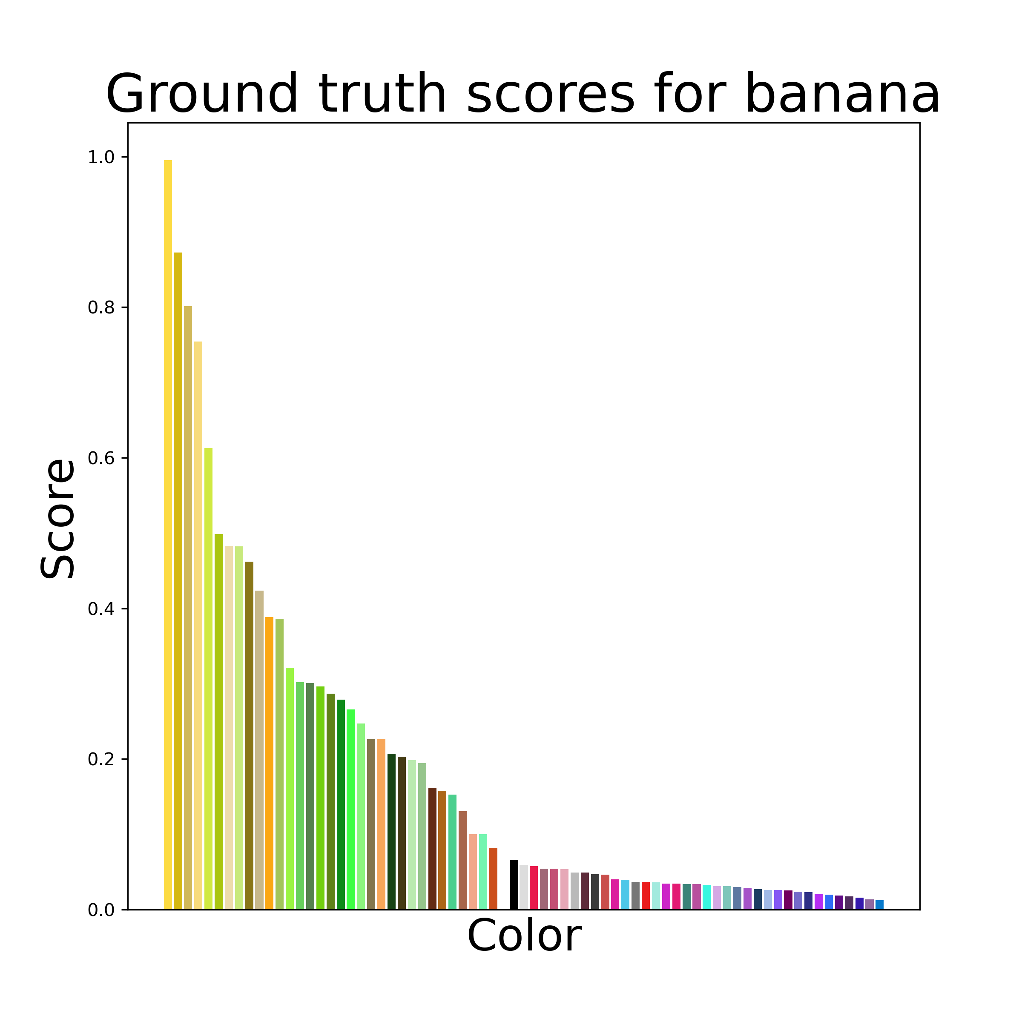
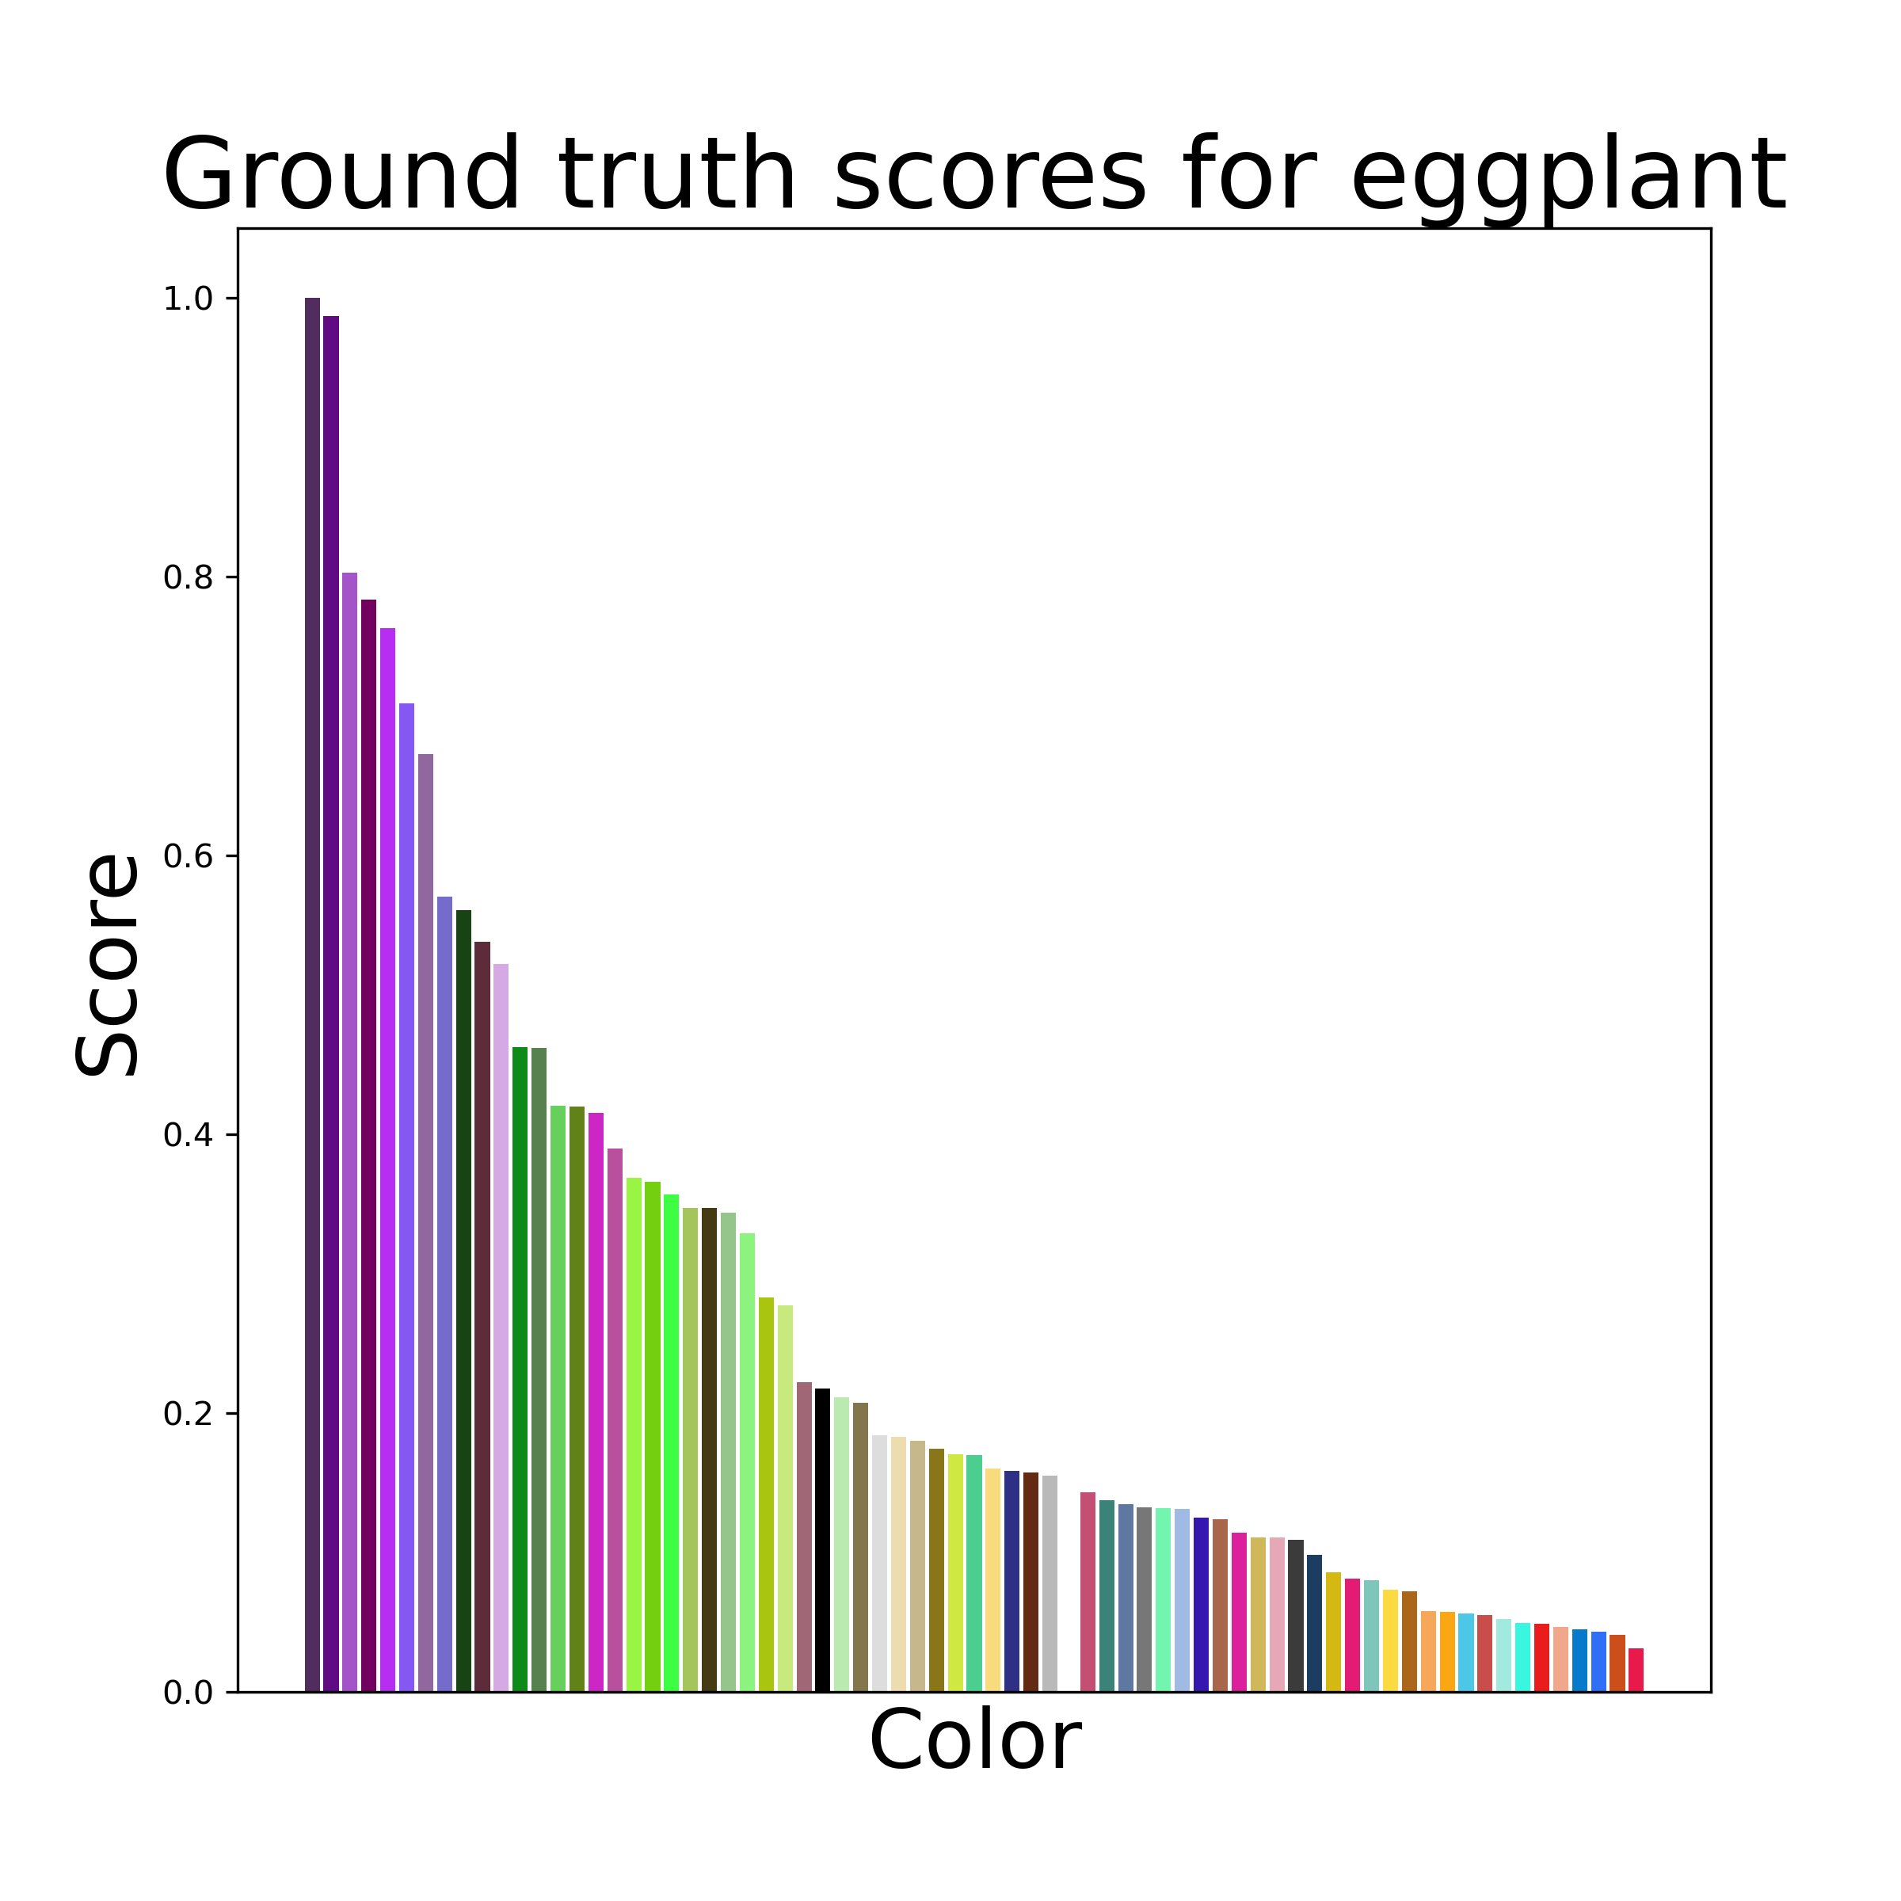
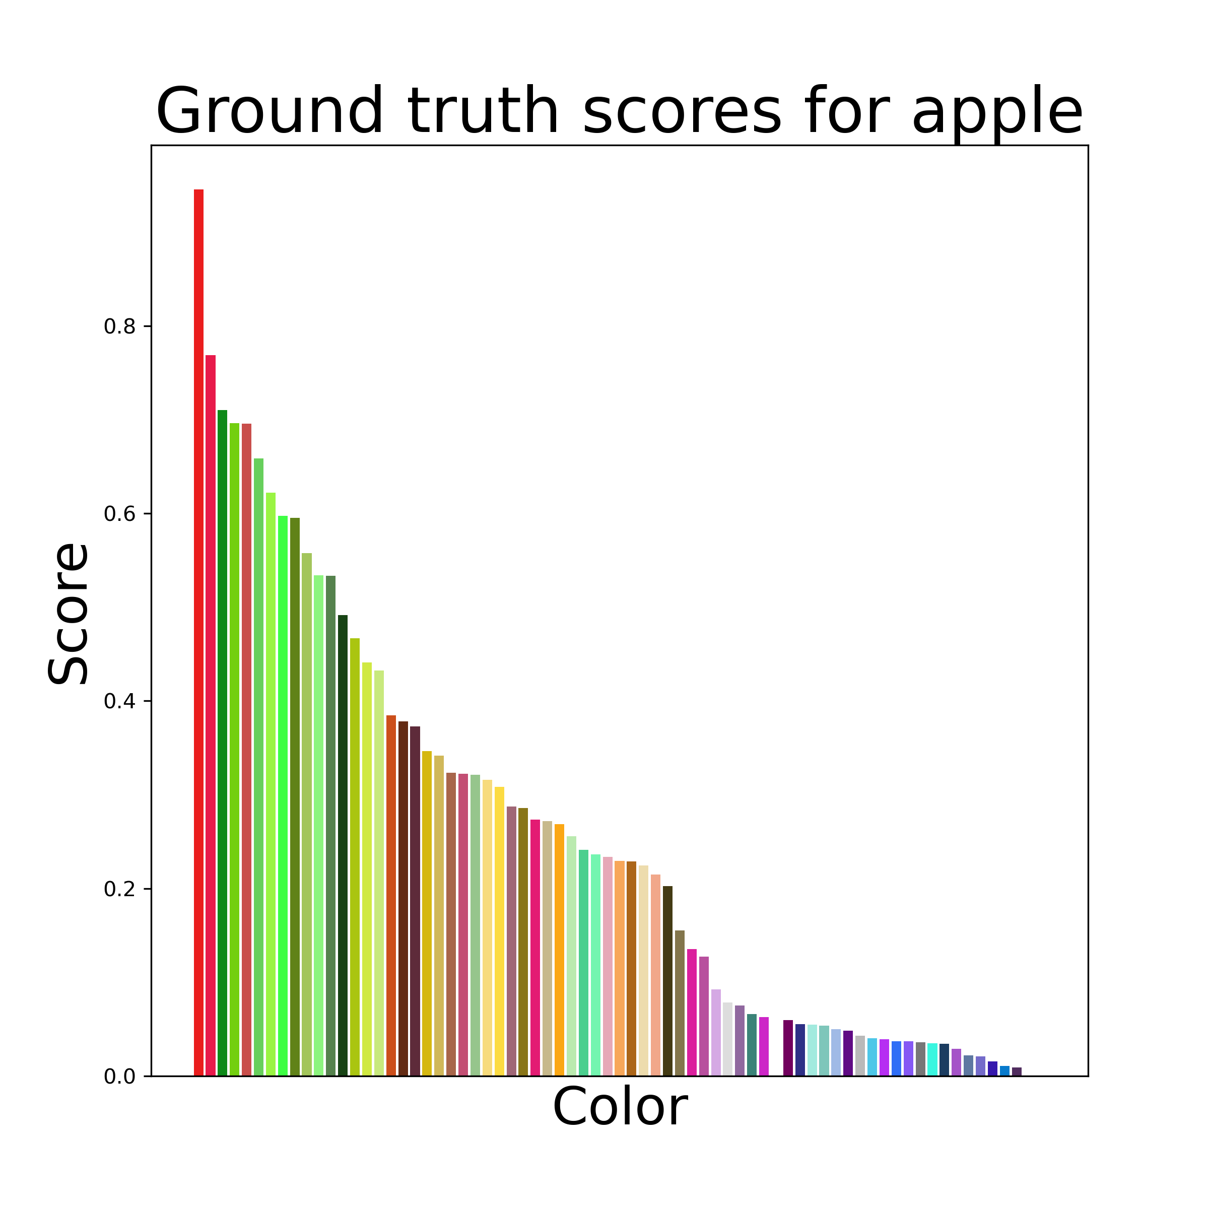
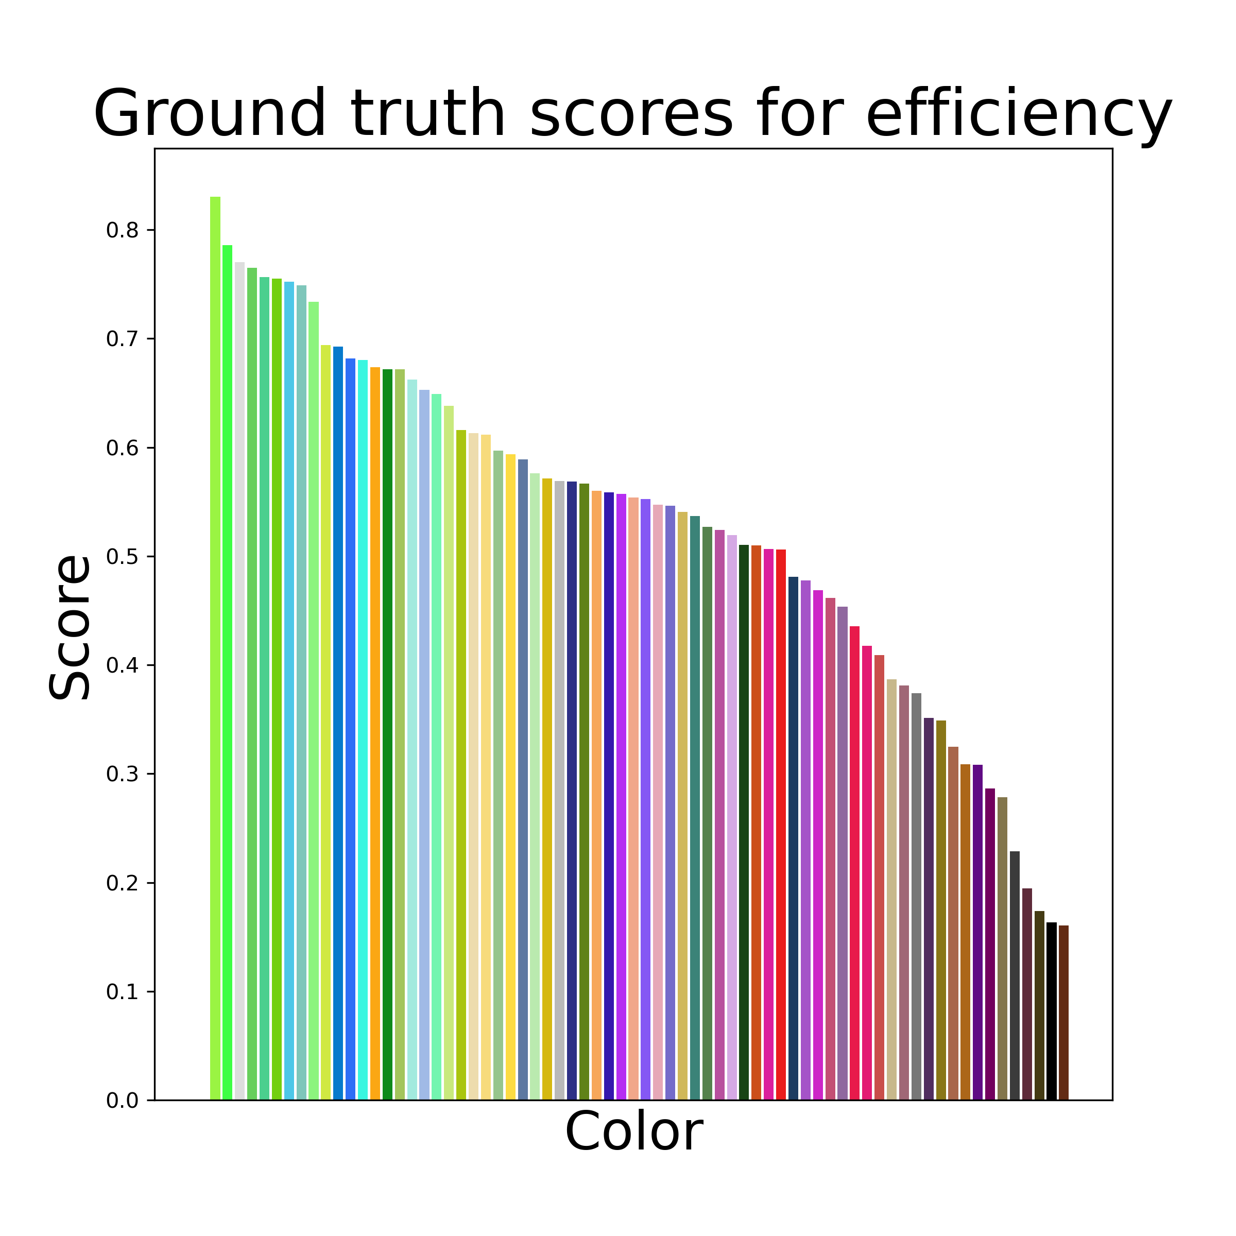
Data
Human trial color concept associations
20 concepts
71 colors
Courtesy of Schloss Visual Reasoning Lab
Notes:
The data we are using was share by the Schloss Visual reasoning lab, we had 20 concepts and 71 colors which are defined in CIELAB space, these serve as the ground truth data for our experiment. These were also used in the Large Language Models paper though the other studies used a set of 51 color from the same space and a separate set of concepts.
https://schlosslab.discovery.wisc.edu/

Slide 11

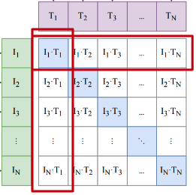








The color of the image represents the word apple.
The color of the image represents the word banana.
The color of the image represents the word carrot.
The color of the image represents the word celery.
The color of the image represents the word cherry.
The color of the image represents the word comfort.
The color of the image represents the word corn.
The color of the image represents the word driving.
The color of the image represents the word eating.
The color of the image represents the word efficiency.
The color of the image represents the word eggplant.
The color of the image represents the word grape.
The color of the image represents the word leisure.
The color of the image represents the word mushroom.
The color of the image represents the word peach.
The color of the image represents the word reliability.
The color of the image represents the word safety.
The color of the image represents the word sleeping.
The color of the image represents the word speed.
The color of the image represents the word working.
Color-concept association score:
Text Encoder
Experiment 1: Bidirectional Transformer using Byte-Pair Encoding (BPE) for tokenization
Experiment 2: LLM enhanced transformer leveraging Llama3-8B-CC
x3 prompt formats
Image Encoder
Experiment 1: ViT B 32
Experiment 2: ViT B 16
RGB images based on UW 71 CIELAB colors
Notes:
TODO: write up a script for this slide to explain the Contrastive Finetuning and differences in the text encoders across the 2 experiments
____________________________________________

Slide 12
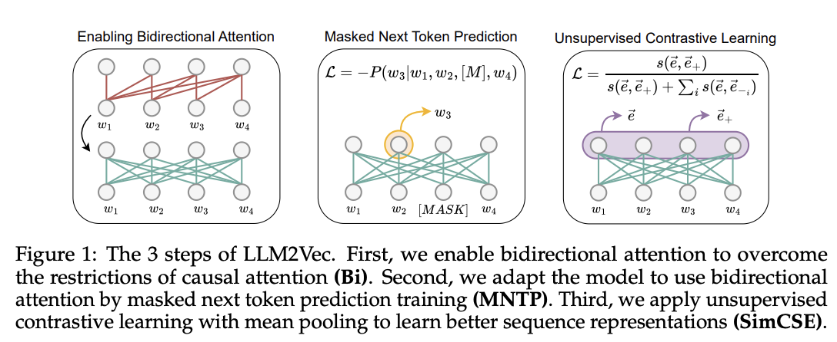
https://arxiv.org/pdf/2404.05961
Notes:
https://arxiv.org/pdf/2404.05961

Slide 13
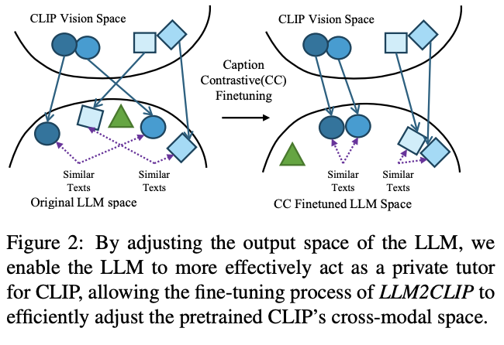
https://arxiv.org/pdf/2411.04997
Notes:
https://arxiv.org/pdf/2411.04997

Slide 14
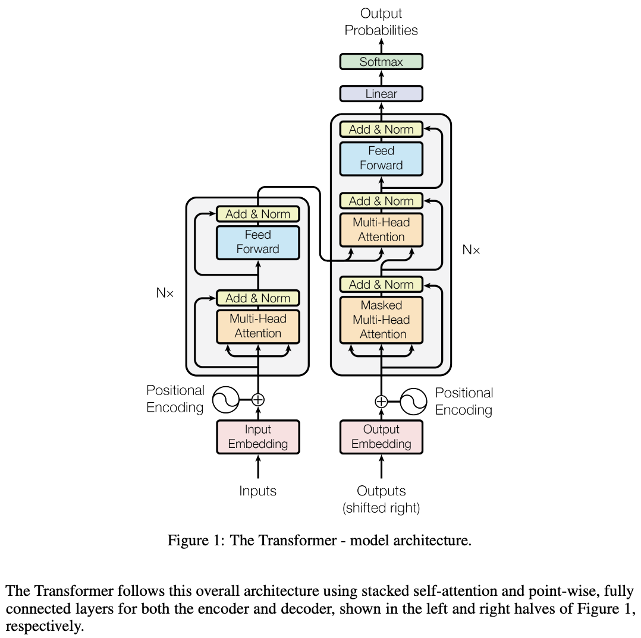
Feature | Attention Is All You Need | Language Models are Unsupervised Multitask Learners | CLIP
Architecture | Encoder-Decoder | Decoder-Only | Dual-Stream (Separate Image and Text Encoders)
Attention | Bidirectional (in encoder) | Unidirectional (causal masking) | Bidirectional (text encoder) + Global attention for image encoder
Training Approach | Supervised (e.g., translation) | Unsupervised (next-token prediction) | Contrastive learning for image-text alignment
Task-Specificity | Designed for specific tasks (e.g., translation) | General-purpose multitask learning | General-purpose multimodal learning
Positional Encodings | Static sinusoidal | Static sinusoidal (retained) | Static sinusoidal (text) + learned 2D embeddings (image)
Scaling | Small-scale models | Large-scale models with more parameters | Massive dataset (400M image-text pairs); scaled models
Tokenization | Language-specific | Byte-Pair Encoding (BPE) | BPE for text; images tokenized into patches (ViT)
Optimization | Standard Adam, fixed LR schedule | Advanced techniques (layer norm, gradient clipping) | AdamW optimizer, weight decay, and learning rate warmup
Zero-Shot Learning | Not addressed | Emergent behavior through unsupervised pretraining | Emergent behavior through multimodal pretraining
Objective Function | Cross-Entropy for token prediction | Cross-Entropy for next-token prediction | Contrastive loss for aligning image-text embeddings
Attention Is All You Need Framework
Notes:
https://arxiv.org/pdf/1706.03762
OpenAI modified the attention mechanism to be unidirectional (causal) for the decoder-only architecture. Each token can only attend to itself and tokens before it. This ensures that predictions depend only on prior context, making it suitable for language modeling, where future tokens are not available during training.
Focus shifted to unsupervised pretraining on large, diverse text corpora (e.g., books, articles, and web data). The model learns general-purpose language representations by predicting the next token across a vast range of natural text.
In LMUML: Improvements included:Layer normalization adjustments: Normalization was applied differently to stabilize training in large models.
Gradient clipping: Used to prevent exploding gradients.
Learning rate schedules: Adjustments to learning rates for better convergence during pretraining on large datasets.
In LMUML: OpenAI used Byte-Pair Encoding (BPE) for tokenization to process diverse text inputs efficiently while ensuring compatibility with the unsupervised training pipeline.
In "Attention Is All You Need": The Transformer consists of both an encoder and a decoder:The encoder processes input sequences.
The decoder generates output sequences, attending to both its own generated tokens and the encoder's representations.
In LMUML: The model uses only the decoder stack of the Transformer, with no encoder. This simplifies the architecture and is optimized for autoregressive generation (predicting the next token in a sequence).
In "Attention Is All You Need": Positional encodings were static, sinusoidal vectors added to input embeddings to help the model recognize token order.
In LMUML: OpenAI retained sinusoidal positional encodings without major modifications, though subsequent work like GPT-2 and GPT-3 explored trainable positional encodings.

Slide 15
diff betw ViT B 32 & Microsoft version
CLIP ViT B 32 | Microsoft LLM2CLIP
Vision Transformer, text encoder is a transformer as well Image patch size 32x32 pixels Text encoder limited to 77 tokens | Builds on CLIP’s ViT B 16 model for the image encoder LLM enhanced transformer for text encoding - leverages Llama3 as the text encoder Image patch size 16x16 pixels (Argues it is better suited for tasks requiring detailed image analysis or understanding complex textual semantics.)
Notes:
LLM2CLIP is a fine-tuning strategy for CLIP, consisting of two stages. The first stage aims to improve the separability of the LLM’s output space, and the second stage involves fine-tuning by replacing CLIP’s text model with the LLM.
CLIP text encoder paragraph from paper: The text encoder is a Transformer (Vaswani et al., 2017) with the architecture modifications described in Radford et al. (2019). As a base size we use a 63M-parameter 12- layer 512-wide model with 8 attention heads. The transformer operates on a lower-cased byte pair encoding (BPE) representation of the text with a 49,152 vocab size (Sennrich et al., 2015). For computational efficiency, the max sequence length was capped at 76. The text sequence is bracketed with [SOS] and [EOS] tokens and the activations of the highest layer of the transformer at the [EOS] token are treated as the feature representation of the text which is layer normalized and then linearly projected into the multi-modal embedding space. Masked self-attention was used in the text encoder to preserve the ability to initialize with a pre-trained language model or add language modeling as an auxiliary objective, though exploration of this is left as future work.

Slide 16
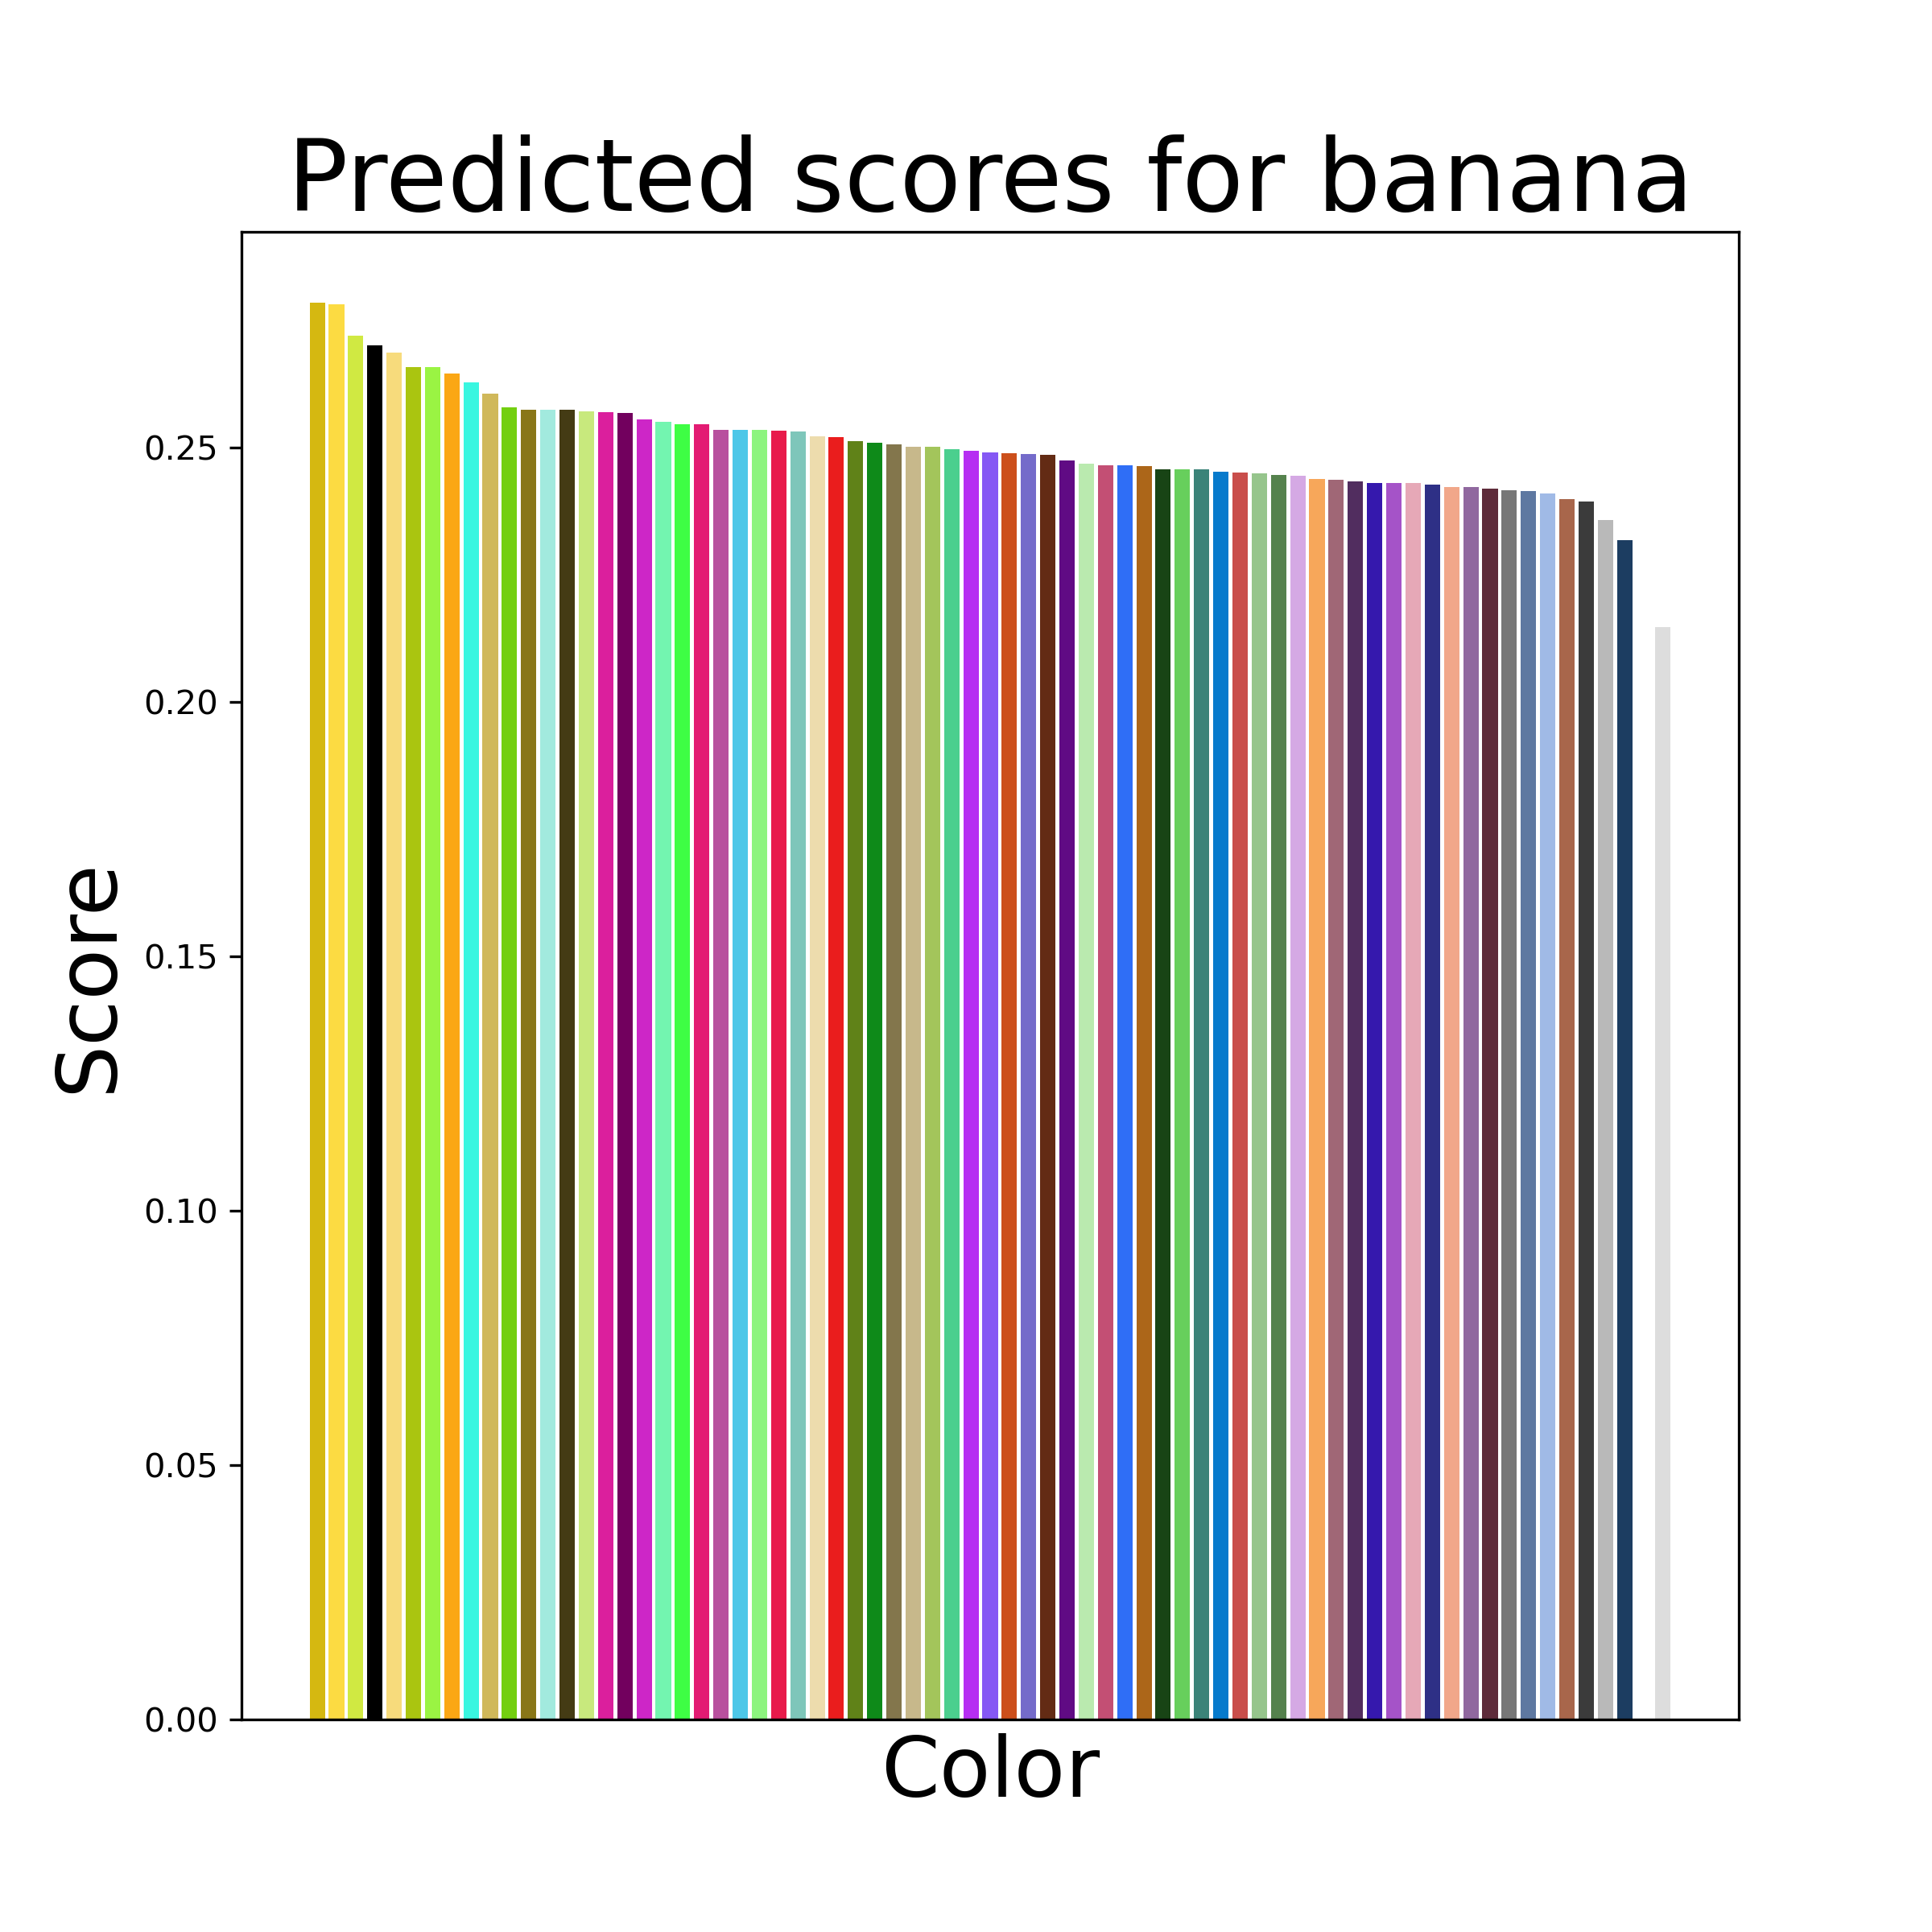

Results
Notes:
This smaller range makes sense given the scale of images and text prompts in the trained data and how much variation there can be
We used the cosine similarity scores to determine our association score. Note that there is a much smaller range for our predictions than ground truth, but the difference are overall still meaningful.
The max range of values across cosine similarity scores assigned by the ViT B-32 model was 0.1003.
Throughout the rest of the results, we’ll be grouping the set of association scores across all colors for a single concept. We will compare the concept’s predicted color association scores to the ground truth scores using the Pearson Correlation Coefficient as our metric.

Slide 17


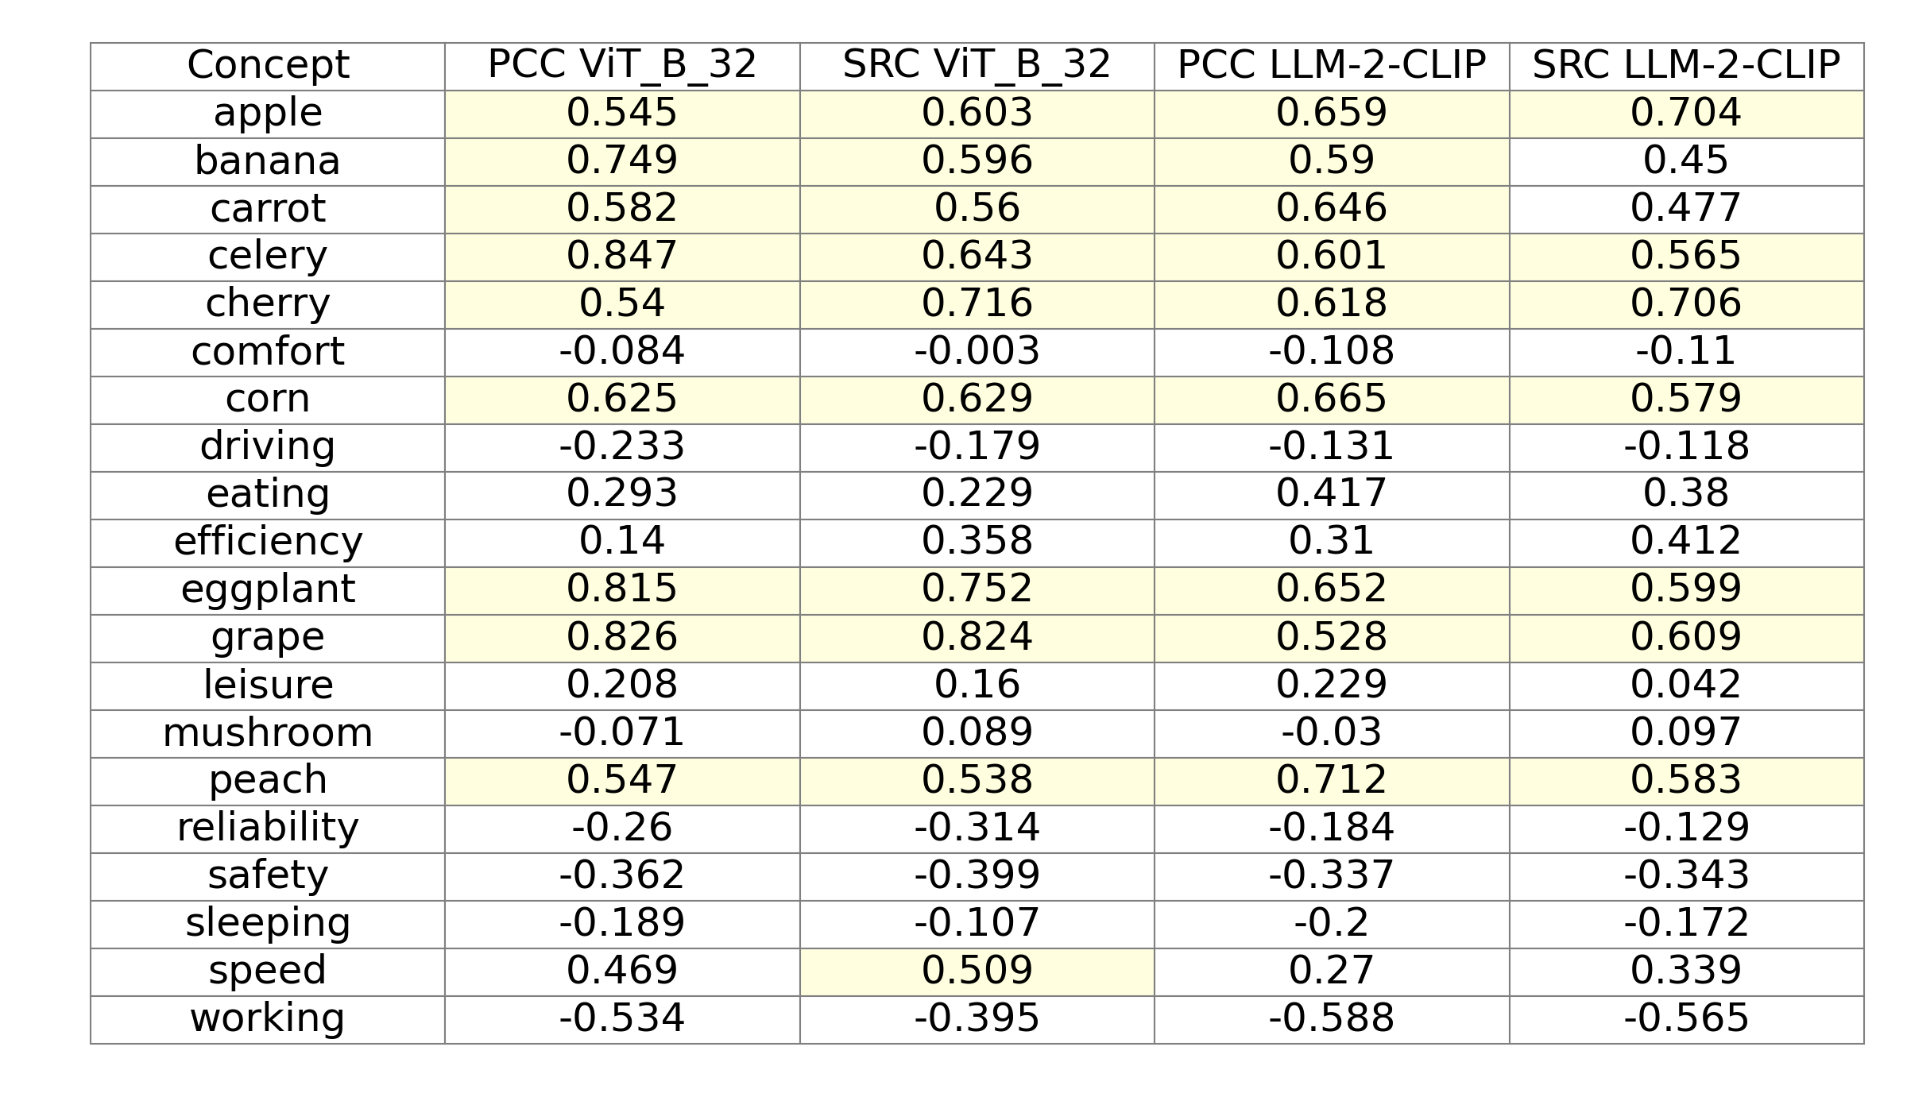
Exp 1 & 2:
Comparison of predicted and ground truth association scores
Pearson Correlation Coefficient (PCC)
Spearman Rank Correlation (SRC)
Notes:
Used many metrics but primarily Pearson Correlation Coefficient (PCC) and Spearman Rank Correlation (SRC). Many results show strong positive correlation, highlighted are values over .5)
PCC measures the linear relationship between two variables. It assumes the relationship can be described with a straight line.
SRC measures the monotonic relationship between two variables. It assesses how well the relationship can be described by a consistently increasing or decreasing function, even if the relationship is not linear.

Slide 18
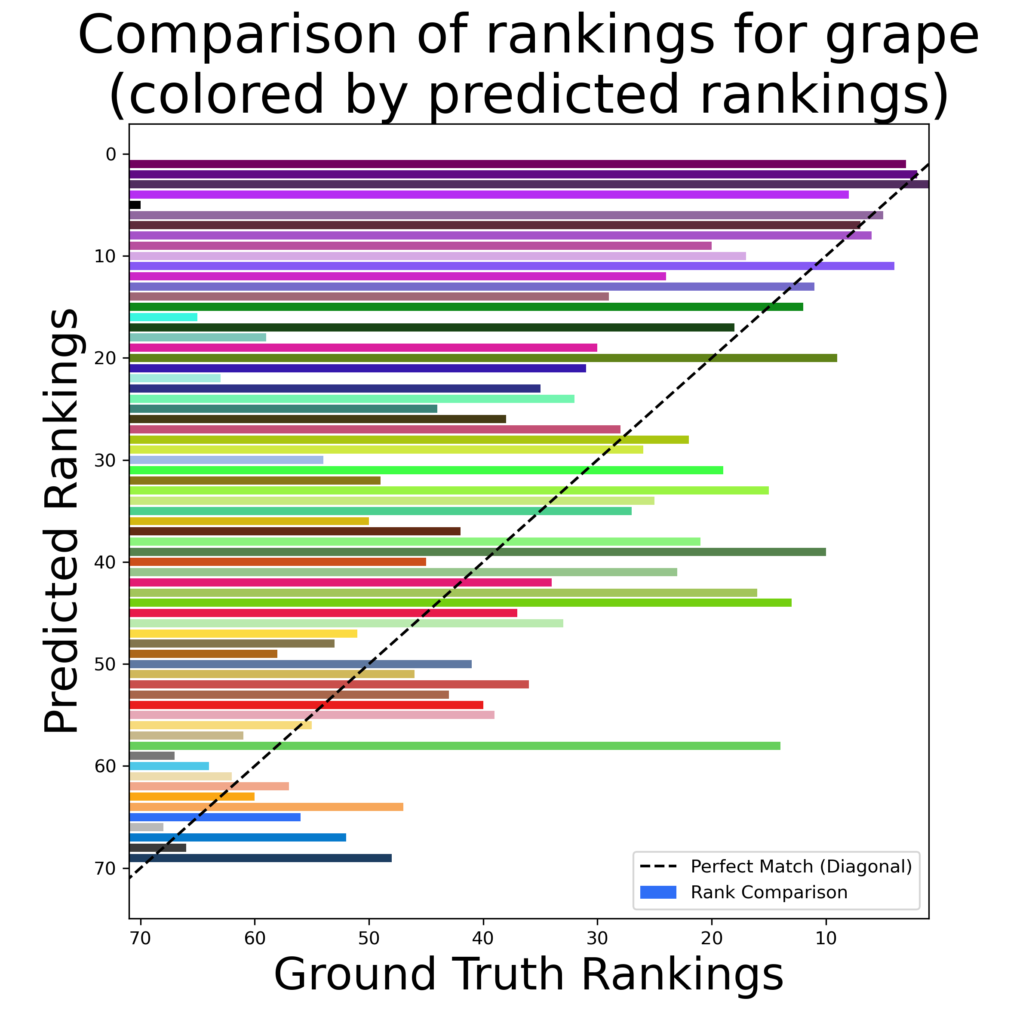
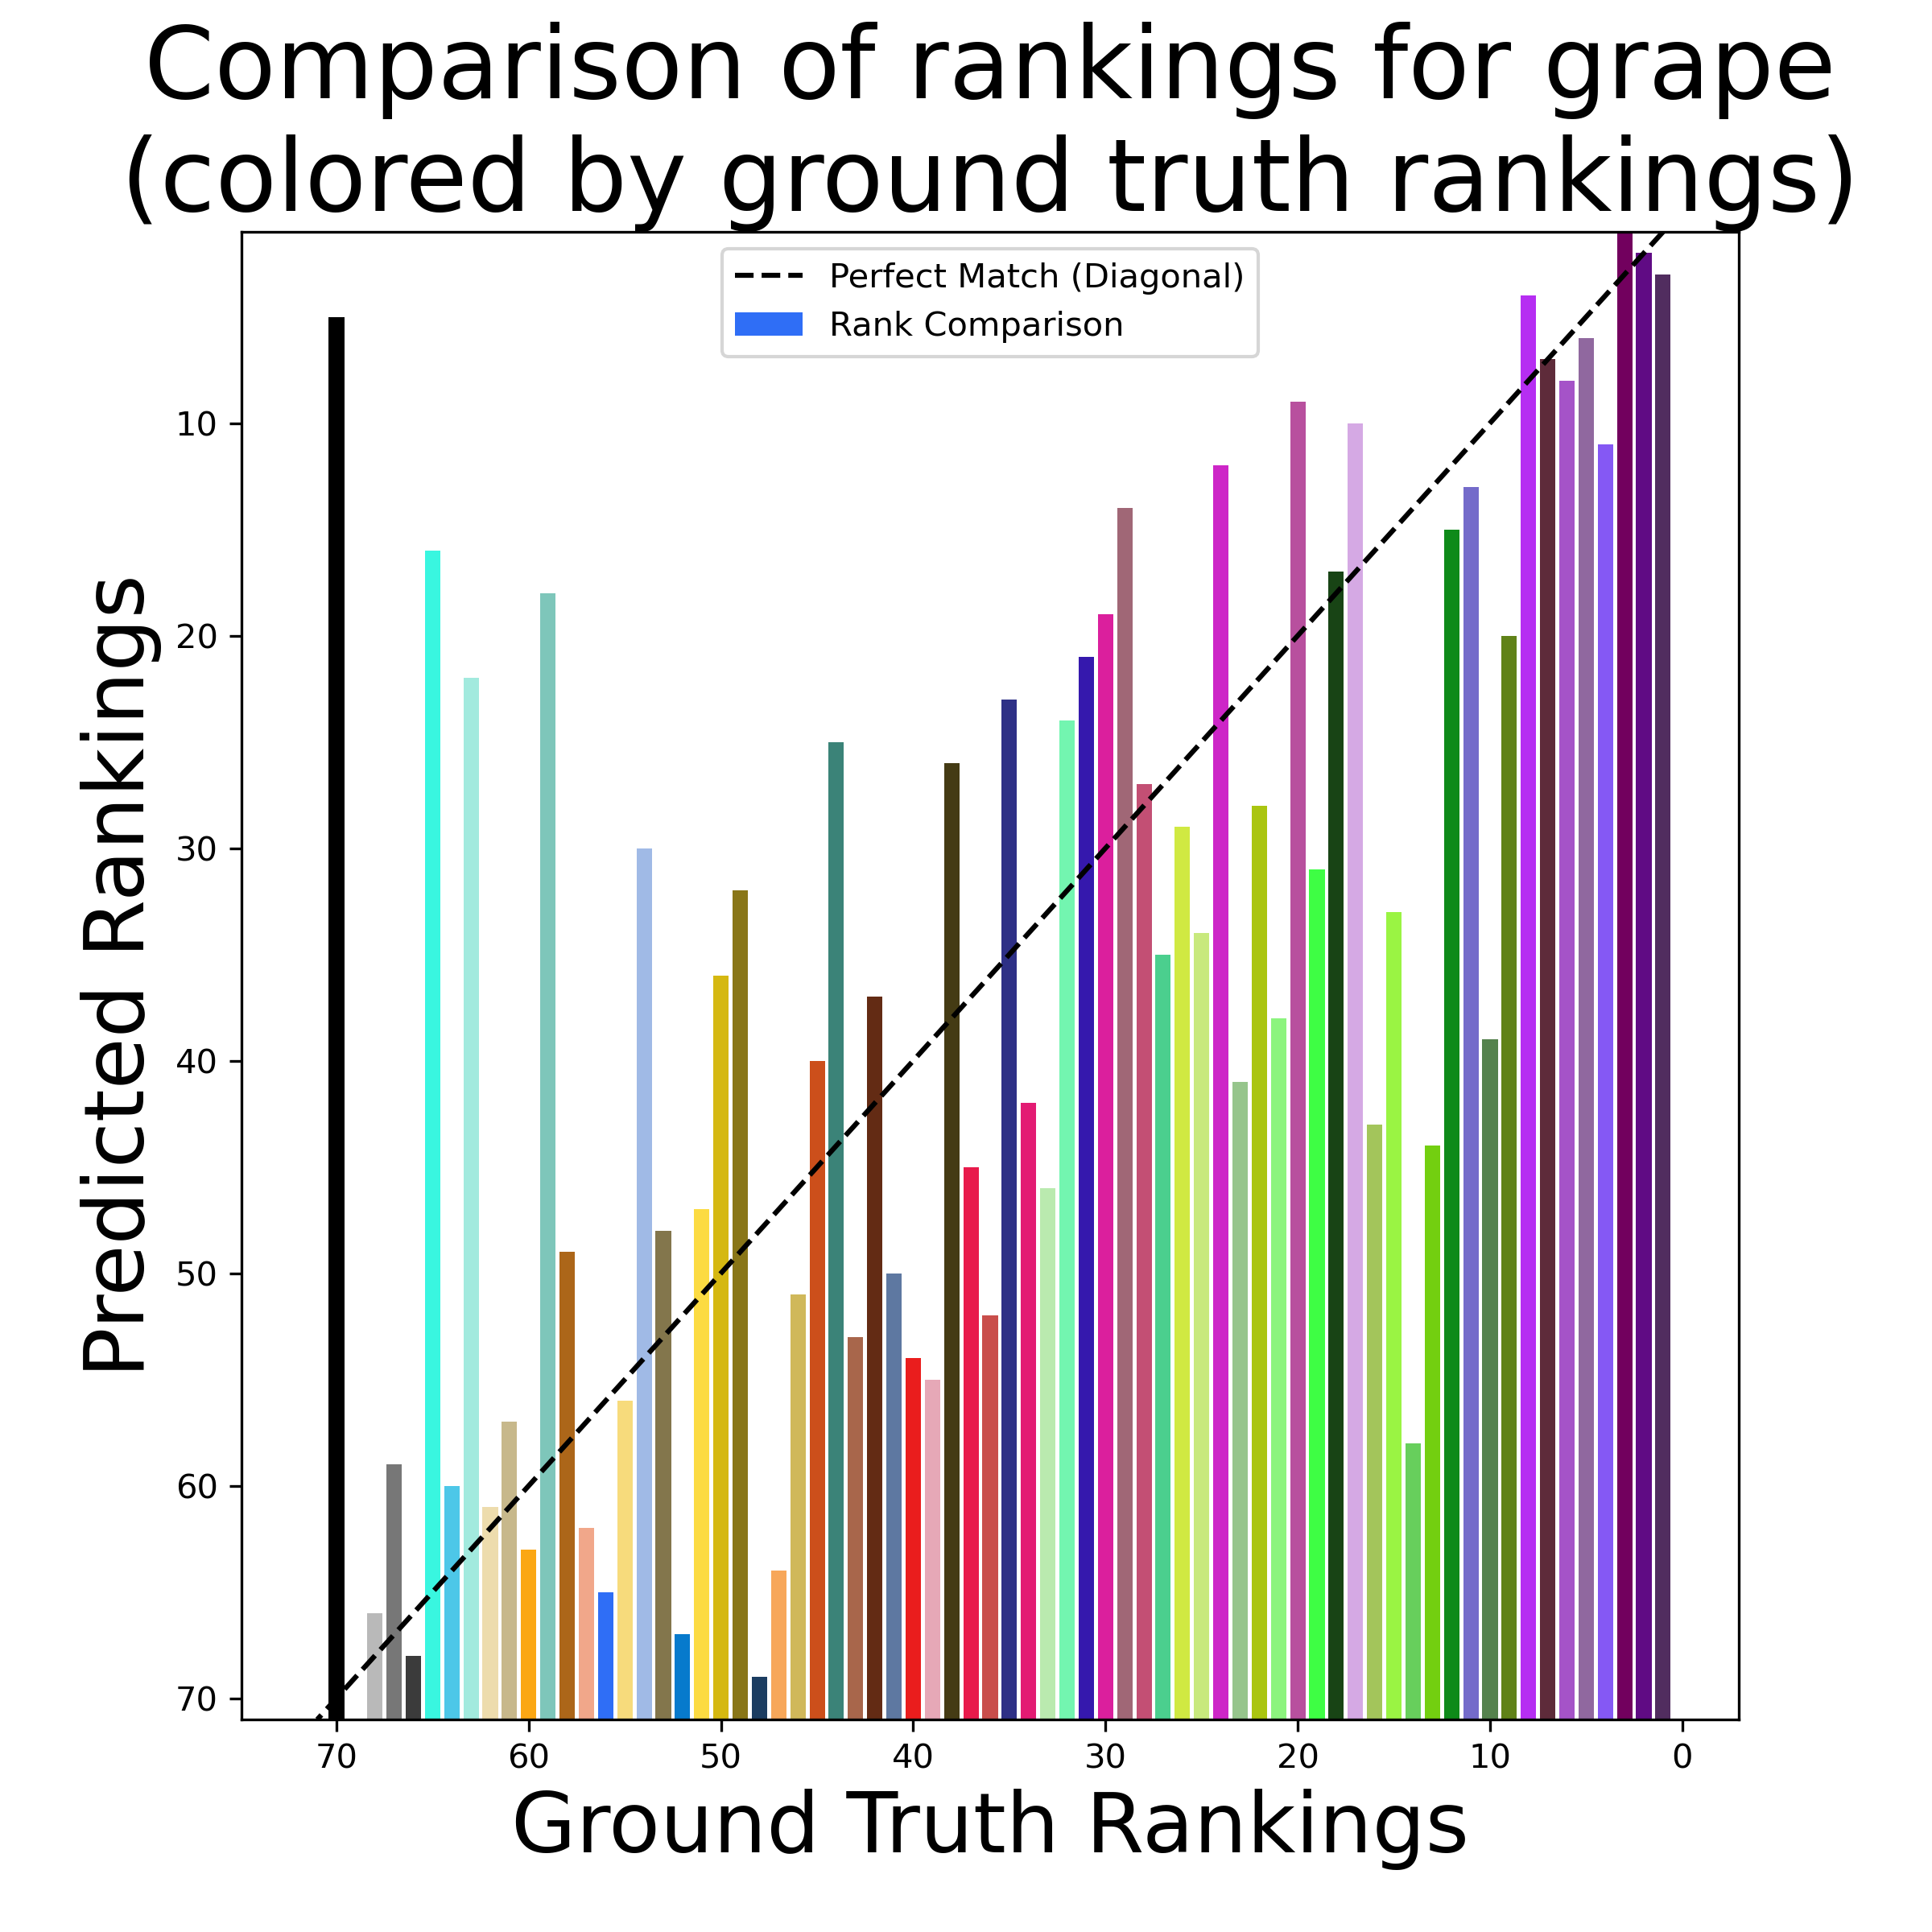
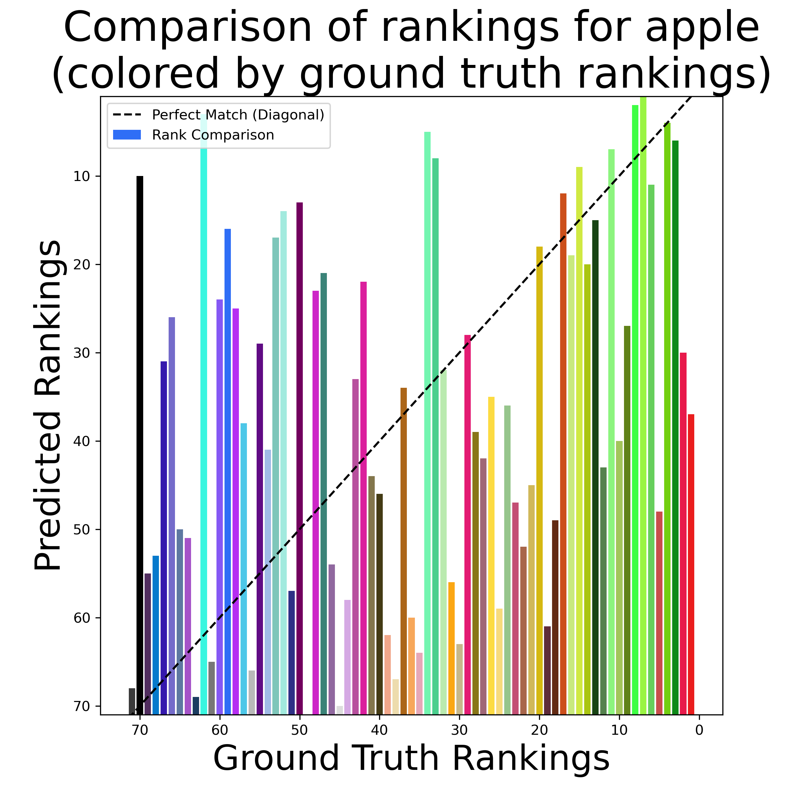
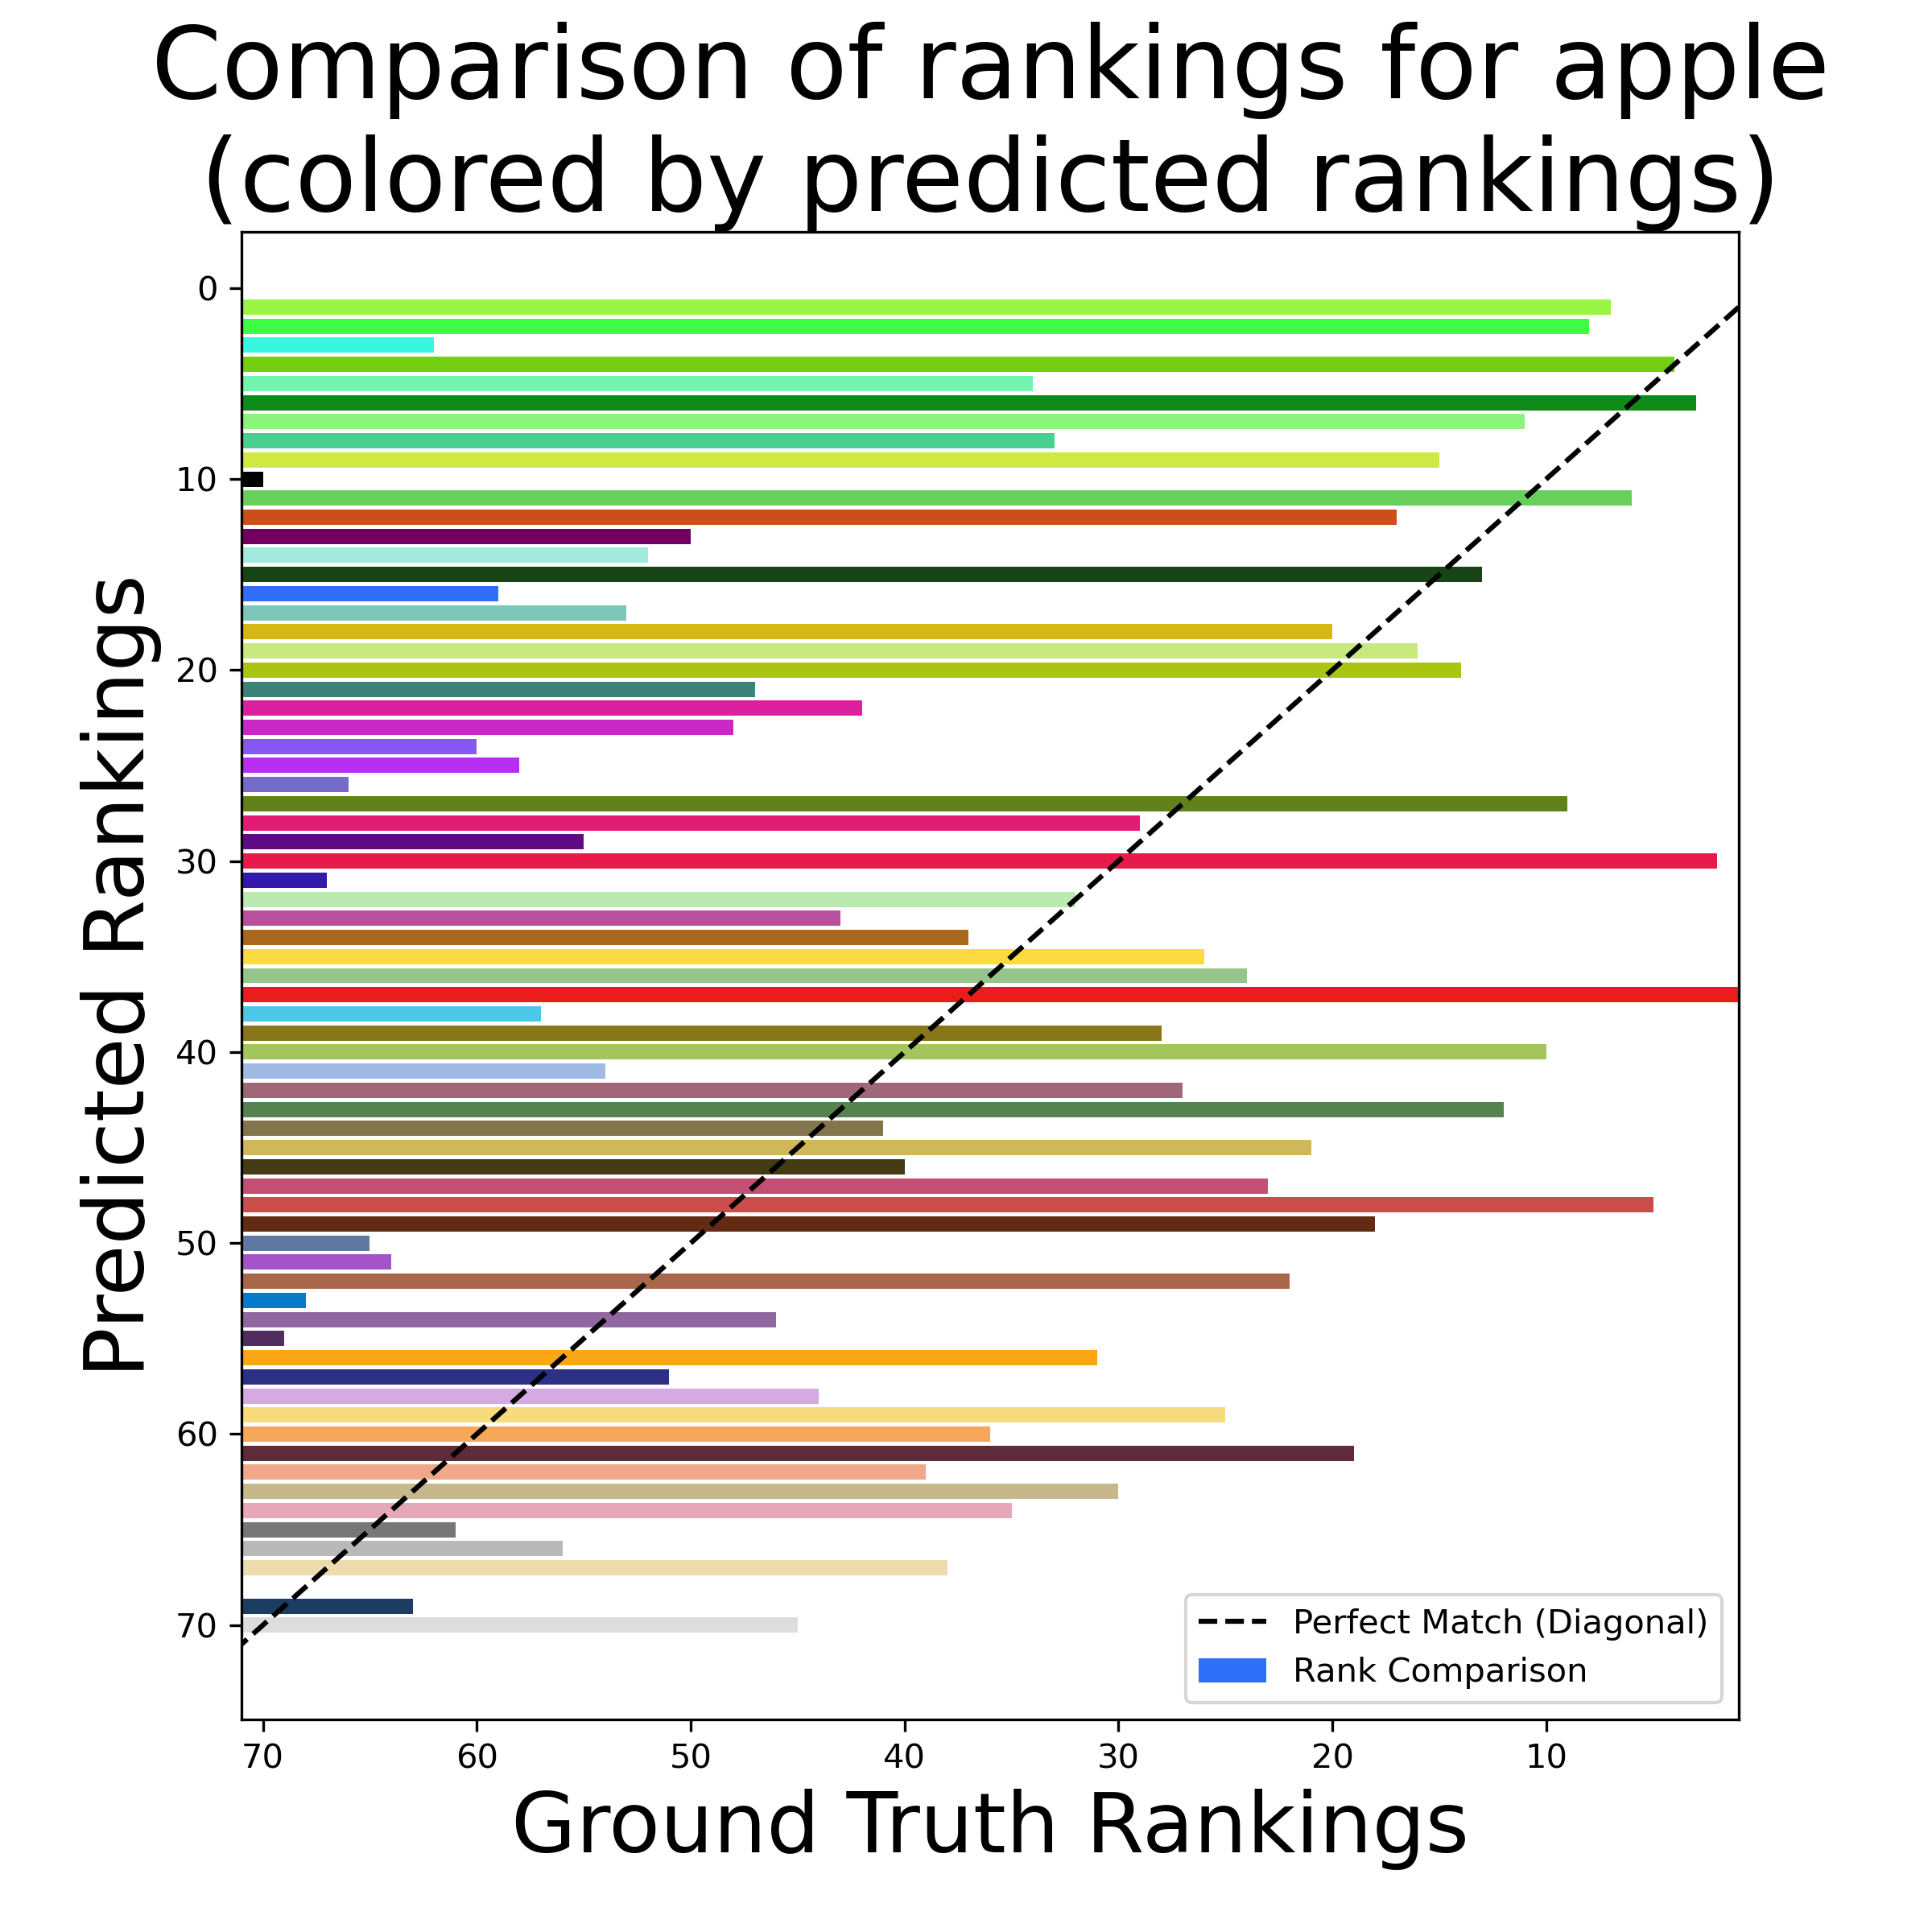
Predicted vs Ground Truth Rankings

Slide 19
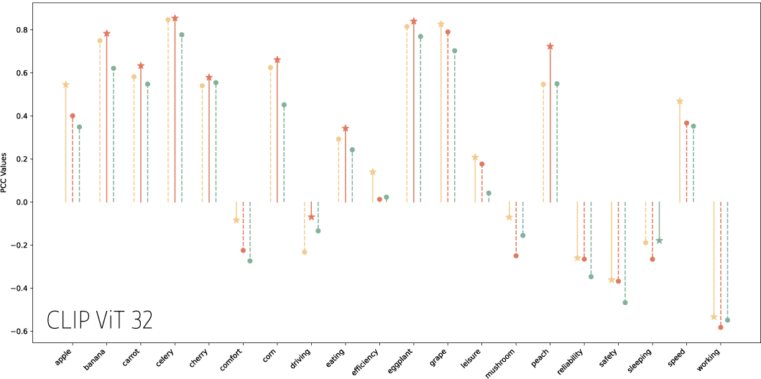
Performance across concepts
Prompt 1: The color of the image represents the word <concept>
Prompt 2: The concept <concept> is well represented by the color of the image.
Prompt 3: The color of the image is associated with the concept <concept>
Notes:
Both models perform worse generally on less traditionally ‘colorable’ concepts like comfort, driving, and working. Though also perform worse on ‘mushroom’ which appears to show some high variability based on prompt style.
Prompt 1 had the highest PCC on average for both models.
0.273 for CLIP ViT 32
0.266 for Microsoft LL2CLIP
CLIP ViT 32: Average PCC value for Prompt 1: 0.27258423586643066
Average PCC value for Prompt 2: 0.2566663151859727
Average PCC value for Prompt 3: 0.1936421946162165
Average Entropy value for Prompt 1: 5.640564503380831
Average Entropy value for Prompt 2: 5.095873925545051
Average Entropy value for Prompt 3: 5.208688027913963
Microsoft LLM2CLIP
Average PCC value for Prompt 1: 0.26595157050807783 Average PCC value for Prompt 2: 0.23862363369400685 Average PCC value for Prompt 3: 0.22436450519776324 Average Entropy value for Prompt 1: 3.8341082836301323 Average Entropy value for Prompt 2: 3.712015518417715 Average Entropy value for Prompt 3: 3.857930148527781

Slide 20
Why else may we be underperforming for concepts like: working, sleeping, mushroom, driving, and comfort
Underperforming for white and greys TODO laura to make visual and show common theme among things we did bad with are related to under-associating greys & white

Slide 21
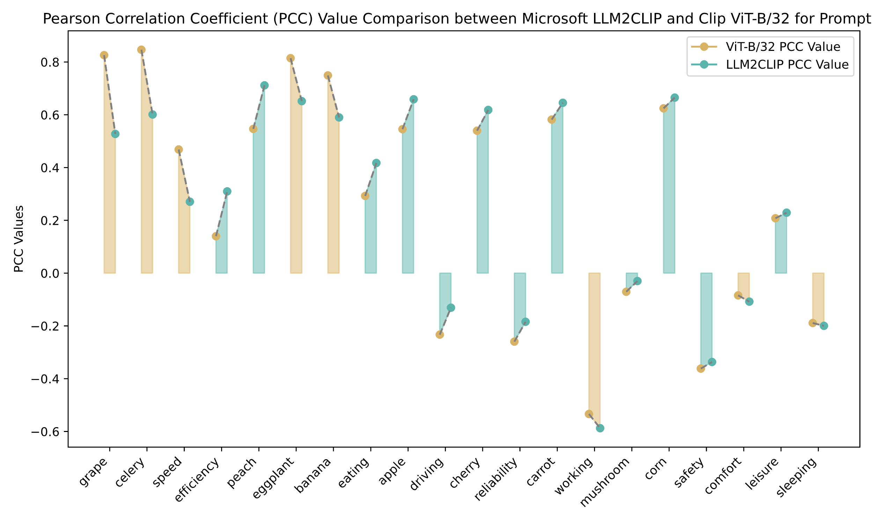
Model Comparison
Notes:
Microsoft’s LLM2CLIP model outperformed the ViT B 32 Model on 12 out of the 20 concepts based on PCC
Left to right is larger gaps to smaller gaps. Models perform similarly

Slide 22
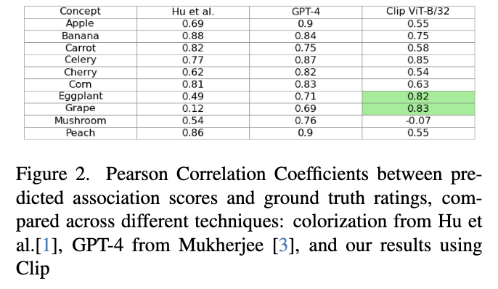
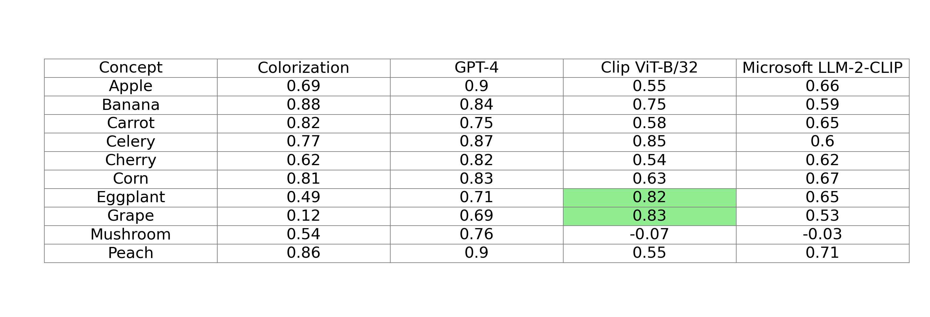
Comparison with previous methods

Slide 23
Next steps
Exp 3: Text to image generation
using a weighted scoring system based of distances in CIE Color Lab space to determine if text to image approach could also be feasible

Slide 24

Questions?

Slide 25
References
To do

