Slide 1

Web Development & Databases – Coursework Project
Travel Booking System
Easy Travel Group - Ryan Morgan

Slide 2
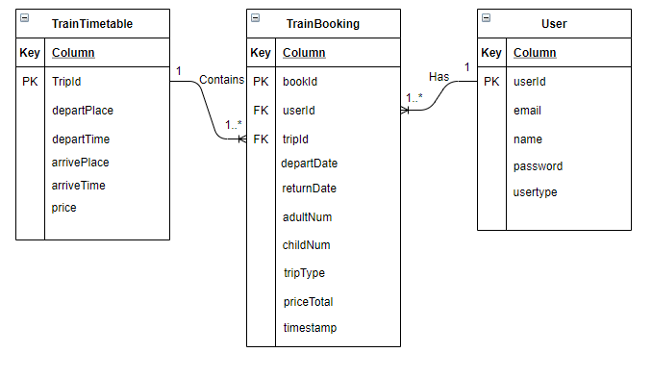
Database Design

Slide 3
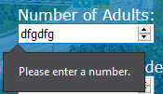
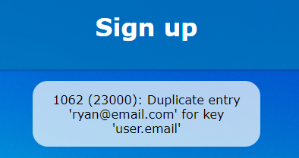
Database Design
1st Normal Form – Values and columns are atomic and are single valued. All of the data in each column are about the same thing. All rows are unique. Tables have no repeating columns.
2nd normal form – Database, tables and data are in 1st normal form. All non-key columns and the primary key are about the same thing in all tables. Each table is only about one thing and are not about multiple things.
3rd normal form – Database, tables and data are in 2nd normal form. All relationships in all tables have no transitive functional dependencies which are on the primary key. If any piece of data in a column that’s not the primary key were changed, then nothing else would have to be changed.
There is not a lot information collected about the user. Essential data was collected and stored such as name, email, hashed password with salt, and what type of user they are (customer/admin).
There is client side and server side validation. For example, not duplicate emails for users, only numbers are valid when selecting the number of people for booking, website doesn’t book trips which take place on Saturday’s and more.

Slide 4

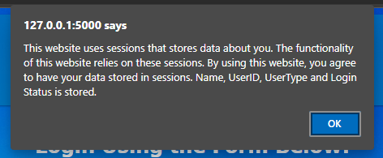

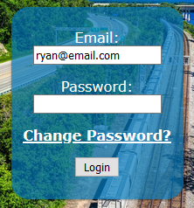
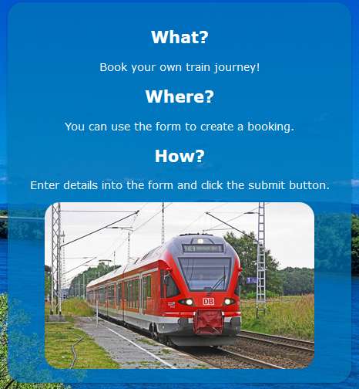
LESP
Ethical data collection – The user is alerted when logging in that their information would be stored using sessions. Shows the user transparency and data consent. Data has to be used in sessions to function. The website does not use cookies. Sessions don’t track like cookies do.
Trademark concerns – Pictures are from ‘Pexels’. Pexel claims: photos on there are free to use for non-commercial and commercial use, I can edit and change photos as I please, and do not have to credit anyone for the use of the photo. Source: https://www.pexels.com/license/
Passwords are hashed with password salts and then stored to keep them completely private and safe. PayPal/credit card details are not stored in the database. This ensures that they cannot be stolen from there.
The main elements of the all web pages are black text on white background. I made it this way in case a user is colour blind and would mean they could still easily see the main elements of a web page. The other elements such as the navigation menu and the aside element have white text so that it is still visible to colour blind people.
My website interface is understandable. My page layout is consistent for all pages. This means the interface is predictable and can be easily used by many types of users. Most if not all of my pages have help boxes which guide the user by telling them what the page is for and what they need to do to navigate it.
There is no SQL injection in my code. This makes it so my database cannot be attacked and have data stolen.

Slide 5

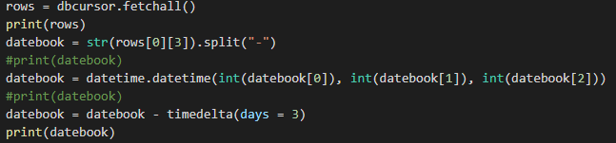

Evaluation (Testing)
I think my website meets all the requirements from the specification. Everything works as required. Look up and booking process are completely separate and can be more elegant. It can be more elegant by being able to take data from the look up process and create a booking from that.
I done lots of testing to my website. I used black-box testing to test my website. I did this by putting data into the forms and using the browser. I tested things such as if the flask app routes load the correct web page, if functions output data correctly, date validation and more.
I also used white-box testing. I used lots of print statements to show data and output in the IDE terminal. If data is not outputted correctly then I could refer to my print statements to identify the issue and where it went wrong.
#Test | Testing | Test Description | Input Data | Expected Outcome | Actual Outcome
1 | Reject on Day of the Week. | Reject user’s train booking if departure date is on a Saturday. | 22/05/2021 in departure date. | Stay on booking page and do nothing, as well as displaying a message which says the train doesn’t run on Saturdays. | Stays on booking page and does nothing. Displays message correctly.
2 | Seat Availability. | Show seats available for a journey to the user. | Newcastle, Bristol, 17/05/2021, oneway. | Correctly show the number of seats available to the user for that specific journey and date. Number should be between 0 and 200. | Seats availability is displayed correctly. Shows as 200 which is correct.

Slide 6

Group Aspect 1
How:
Use Github for version control and code sharing, allowing everyone to make changes.
Use blueprints to link everyone’s pages and routes.
Conflict - Democracy
Aesthetic Design
Database Design
Module Compatibility
Roles
Front-end (2x)
Back-end functionality (2x)
Styling Responsibility (1x)
Roles

Slide 7
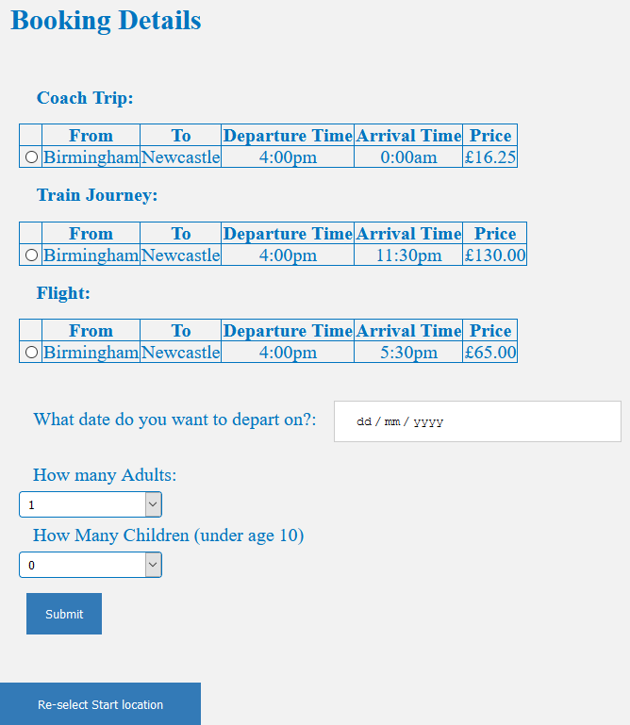
Group Aspect 2
GR1 (Front-End)
Main website flow
Select Start location
Load destinations based on the travel options (from relevant databases)
Select Destination
Choose transport option
Select one-way or return
Takes you to a page where you can select from available trips
Make booking / payment
Commits booking to database(s)
Completion message
Accessibility
Responsive web design for a range of screen sizes
Mobile first approach
Colour blind friendly colour schemes
Good font styles and sizes
GR2 (Back-End)
Have a main database which connects all individual travel types together
Consistent formatting between databases which allows the same queries to work for all travel types.
Functionality to select which dates / travel routes which have 10% discount
Flask .py file containing all functions / routes for accessing data
Server-side data validation
Error handling for invalid user data

